Slide 1
IGTF RATCC Communications Challenge 2019 EUGridPMA47, Karlsruhe David Groep

Slide 2
IGTF’s Risk Assessment Team
“responsible for assessing risk and setting time and deadlines for response and action for concerns and vulnerabilities”
IGTF-wide distributed team across multiple time zones
has not had much to do post-SHA1 migration
number of volunteers adequate but getting smaller
Tasks
respond to technological risks and developments (like the digest issue, or QC)
assess immediate threats to the trust fabric (incidents, compromises)
maintain response capability through communications (“RAT CC”)

Slide 3
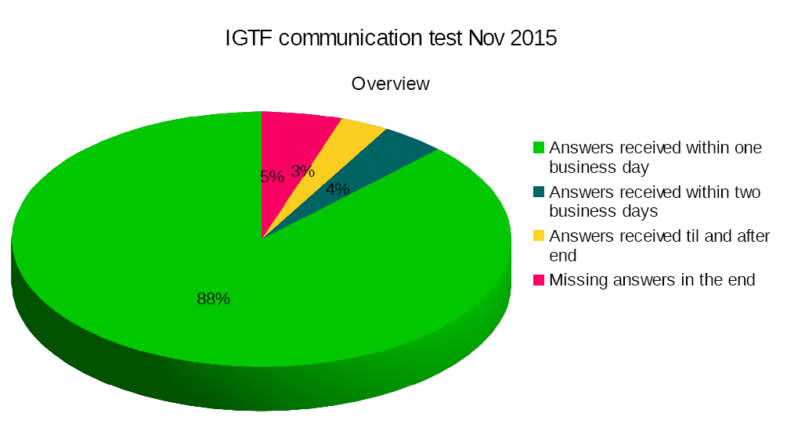
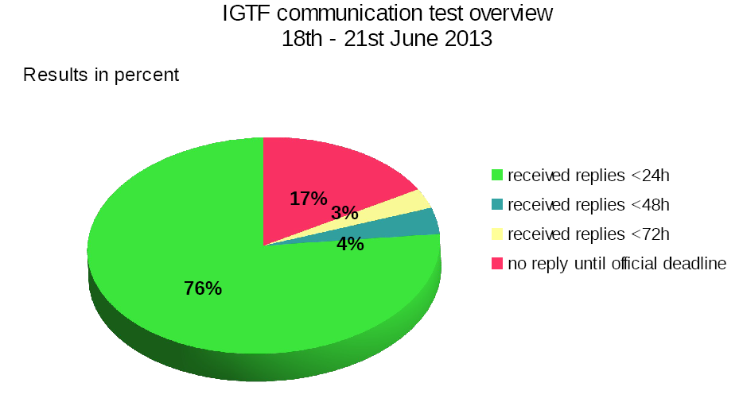
RAT CC: Communications Challenges
Periodic test of responsiveness of registered ‘emergency contact’ addresses
Addresses are in themselves public (and part of the trust anchor meta-data)
As use of these is intermittent, accuracy suffers over time
Coordinated challenges run periodically (intent was every 2 years)
2009: 71% responded within one day, 94% within one month, 100% eventually
2013: 76% within one day, ~95% within one week
2015: 88% within one day, 95% within 3 days
2019?

Slide 4
Different challenges of varying complexity
Can challenges be classified by ‘depth’?
ability to receive – mail does not bounce or phone rings
automated answering – ticket system receipt or answering machine
human responding – a human (helpdesk operative) answers trivially (e.g. name)
human familiar with subject-matter responding – responsible person responds
For
2009: automated answer was sufficient
2013: subject-matter response was requested (IPv6 compliance)
2015: subject-matter response: SHA-2 status and last SHA-1 based EEC

Slide 5
2019 challenge
91 trust anchors (including both ICAs and HLCAs)
60 organisations – but contact addresses may be different for each trust anchor
To be discussed:
aim ‘human response’?
scope all of the IGTF authorities (authN sources)
instructions should we add to the mail ‘1-working-day response required’
timeframe in October 2019?
should we also challenge the RP members?

Slide 6
Challenge email draft
Subject: IGTF RATCC Communications Challenge for %ALIAS%
Dear trust anchor operator of %ALIAS%:
This is a communications challenge conducted by the IGTF Risk Assessment Team,
and is used to evaluate the responsiveness of our accredited authorities to
incidents and extraordinary events.
On receipt of this mail:
- please hit "Reply"
- include your own name in the reply
- keep the subject line intact (it contains your trust anchor name)
- and send this mail back to <ratcc-responses@igtf.net> (you will not receive a response)
You may receive multiple messages, one for each of your accredited or
trusted authorities. For technical reasons, you are kindly requested to
reply to each one of these.
Responses will be aggregated, and per-authority data only released to
IGTF members. Aggregated results may be shared with peer infrastructures or publicly for higher-level summary data.
If this message reaches you at an unexpected address, please contact your
PMA chair or trusted introducer to update the emergency contact address of
your authority in the IGTF distribution. Your address %EMAIL%
has been taken from there.
Kind regards,
Name of RATCC
for the IGTF Risk Assessment Team.

Slide 7
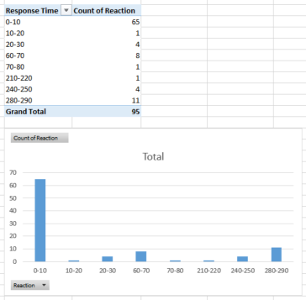
Example evaluation

Slide 8
Time line
Do we need a heads-up message 1-2 weeks before, e.g. Oct 1st?
1 working day (local) is the intent
allow for n-day running period – maybe 8 days max

Slide 9
Beyond the RATCC – ‘SCCC-JWG’
Trusted Introducer and TF-CSIRT
2-3 Reaction Tests per year
supported by web click infrastructure, but requires (team) authentication
SURFcert challenges
annual response challenges, just reply to email to a (traceable) ticket
IGTF RAT Communications Challenges
every 1-2 years
in parallel with continuous operational monitoring
yet we already listed 14 entities that have a real interest in running tests, 5000+ entities can claim the same

Slide 10
Challenge elements – what is valued or expected might differ …
timeliness
investigative capability
confidentiality
ability to take action
….
but a single test can answer the questions of many
if the challenge measures responsiveness and the data are available, each infrastructure can set its own level of expectancy
but other elements require different probes (and may be complex or intensive to conduct)
responsiveness vs. ability to take action or forensics/traceability capacity

Slide 11
Proposal for the SCCC Working Group
Coordination of ‘CCs recipient groups’ among participating infrastructures
ensure targets are not overloaded by coinciding or overlapping challenges
Transitivity of trust in CC results between infrastructures
what should be the level of disclosure detail for CCs between trusted infrastructures?
how can requests for CCs between infrastructures be handled, e.g. in response to changing needs or a changed risk assessments; or as remediation after an incident in which communications did not meet expectation.
Definition of CC models and classification
‘depth’ of the CC testing is a balance between the level of trust gained and expediency
Frequency of CCs
simple communications challenges are often performed one or several times per year (e.g. for TF-CSIRT, by SURFcert for the SURFconext federation, EGI Operations on their sites).
complex challenges less frequent (e.g. ‘black-box traceability’ trials in EGI once every 1-2 years).
following a CC model classification, propose an appropriate frequency for each class.

Slide 12
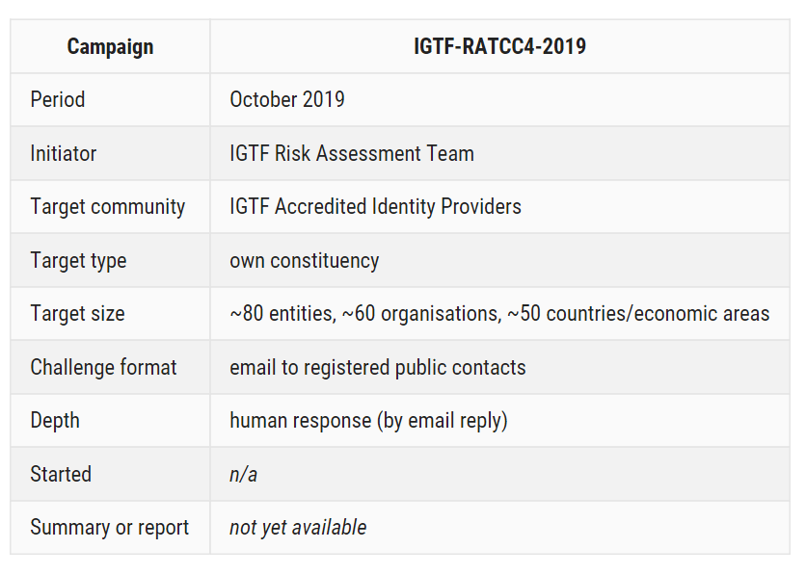
Sharing planning – in how much detail?

Slide 13
Making progress by example?
We have a Wiki: https://wiki.geant.org/display/WISE/SCCC-JWG
agreement in SIGISM and WISE that it’s a good idea and should start
on the wiki start creating the lists and some detail of past and future challenges?
has not yet started, but can be done fairly soon …

