Slide 1
IGTF EUGridPMA 47 in collaboration with GN4-3 EnCo, EOSCH-ISM, and AARC-Community September 23-25 KIT, Karlsruhe, DE

Slide 2
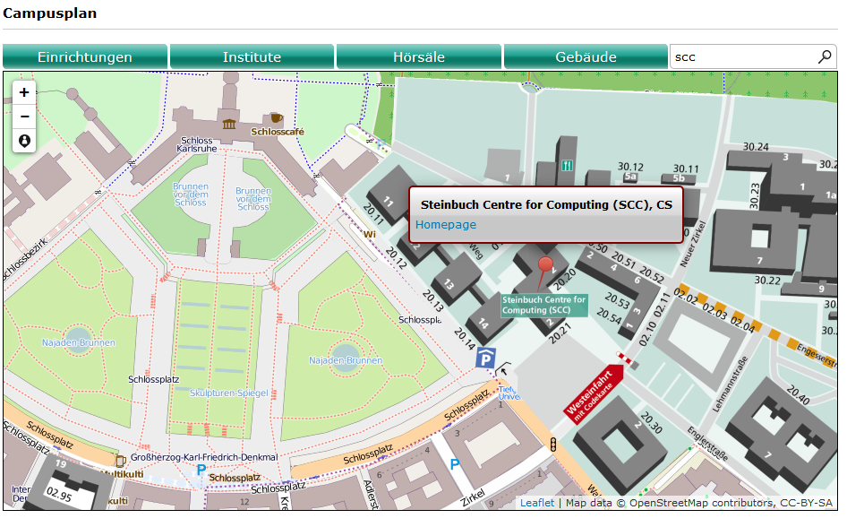
You made it …

Slide 3
Some logistical information
On-line agenda and materials at https://www.eugridpma.org/agenda/47
Please upload presentations – use the ‘usual’ password if required
Videoconference and presentation sharing https://www.nikhef.nl/pdp/video/?m=eugridpma

Slide 4
Introductions
For minutes of last meeting see https://www.eugridpma.org/meetings/2019-05/
Note takers, anyone?
Agenda planning

Slide 6
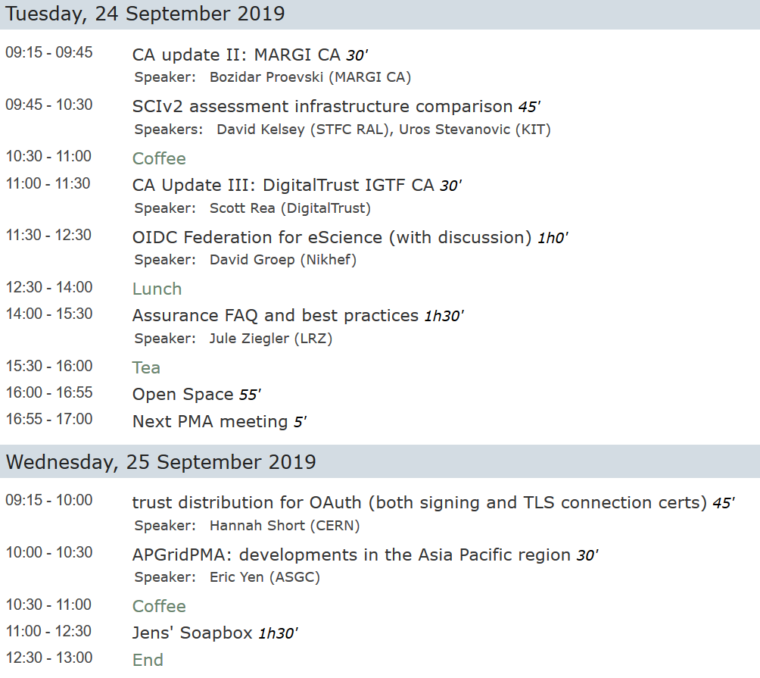

Slide 7
Next meetings
I2 TechEx New Orleans, Lois., US December joint with FIM4R and REFEDS
EUGridPMA 48 January 2020
APGridPMA 2020 Taipei, TW March 9, 2020 (tbc)
EUGridPMA 49 May 2020
IGTF All Hands (& EUGridPMA50?) Pittsburg, PA, USA September 2020

