Slide 1

IGTF Federation in OIDC technology – the next step
The road towards a working OIDCfed prototype for e-Research
David Groep
AEGIS policy area
Nikhef, Physics Data Processing group
EUGridPMA 47, Karlsruhe
September 2019

Slide 2
OIDC Federation use cases for communities
Why did we embark on OIDC Fed for global e-Science?
EOSC-HUB registration of clients
goal for EGI and EUDAT is a scalable and trusted form of OIDC usage.
Today < O(50) clients; next year maybe O(100-1000)?
cloud-based services (containers, microservices) could push that to millions
CILogon (and XSEDE) use cases see need for a set of policies and practices
that support a 'trust anchor distribution'-like service targeting OIDC OPs and RPs
and where RPs that are ‘in the community’ can be identified as such
ELIXIR (and the Life Sciences) AAI expect growth in # OIDC RPs as AAI extends beyond just ELIXIR and into other biomedical RIs – potentially dynamically created
All of these need a policy framework, on both the (infrastructure) OPs and on the RPs
This is the community that traditionally also relied on the IGTF trust anchor distribution

Slide 3
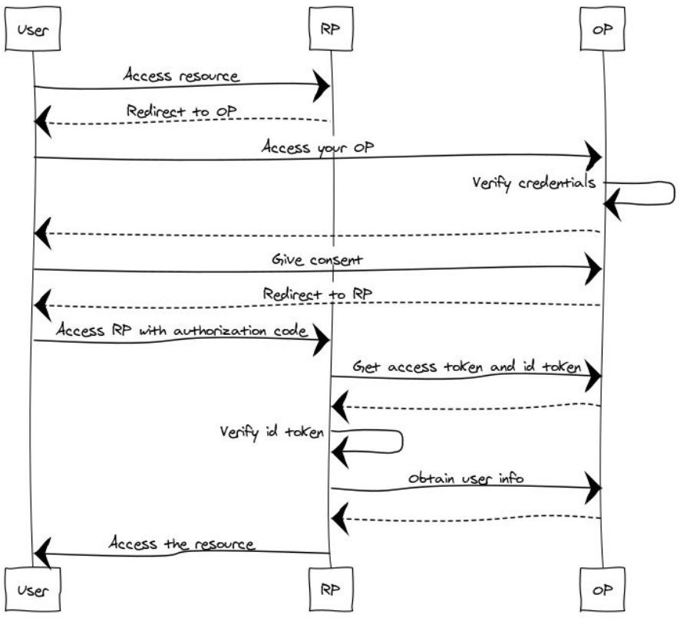
OIDC: OP and RP needs to know about each other
RP redirect the user to the OP’s
authorization_endpoint
OP redirect the user to the RP’s redirect_uri
RP exchange the code for an access_token at the token_endpoint (and authenticate…)
RP requests user claims at the OP’s
userinfo_endpoint
slide content thanks to Davide Vaghetti, GARR, for GN4-2-JRA3-T3.1.A

Slide 4
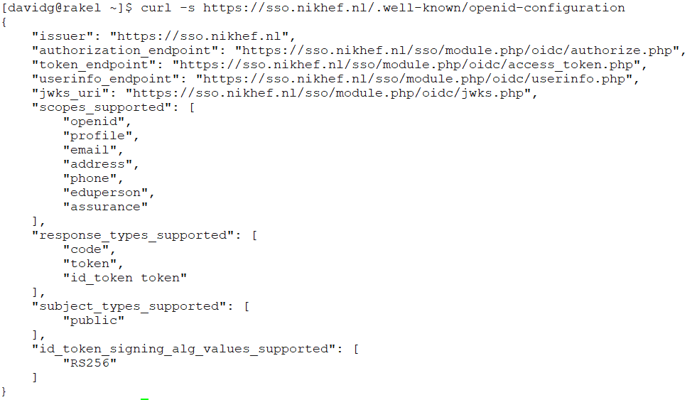
Relying on a URL and self-registration of clients is not trusted

Slide 5
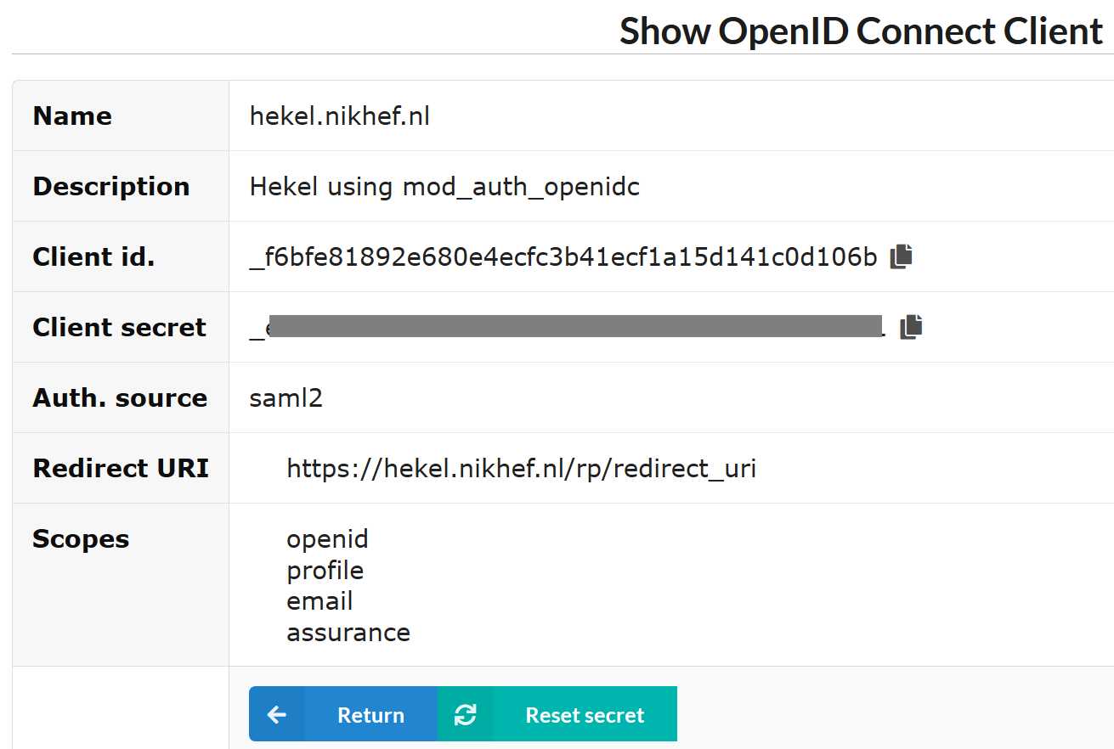
And registering clients does not scale…
configuration of a (test) client on the Nikhef institutional OP sso.nikhef.nl

Slide 6
OIDC Fed ‘policy’
IGTF “RP oriented” OIDC Fed can leverage existing framework
connect RPs from infrastructures that are IGTF members
(EGI, HPCI, OSG, WLCG, GEANT, PRAGMA, PRACE, XSEDE, …)
and new IGTF RP members can join of course!
Accreditation process and membership guidelines in place
OPs in the federation (RI/EI IdP-SP-Proxies) use IGTF APs
and Snctfi framework where needed
RPs in the federation become the responsibility of their member representatives
regional (‘national’) RP groups via their existing authority member
for RP trust (more than today) re-use Sirtfi, WISE, and trust groups

Slide 7
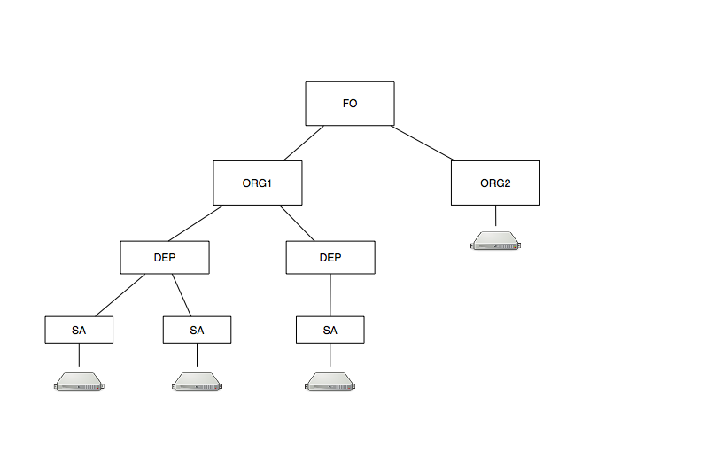
OIDC federation organisation
One option: everything ‘centralised’ at the national level (the FO keeps all the entities)
Second option: permit hierarchies – the OIDCfed spec nicely allows that
  great for e.g. cloud-based services that are provisioned on-demand

Slide 8
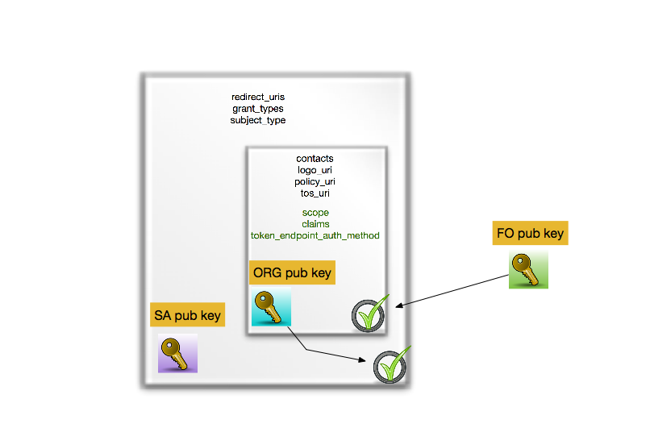
OIDCfed is basically signing a tree of entities with extensions
we kind-of know building trees and meshed of signed entities work – is this ‘just recast it JSON’ ?

Slide 9
Or can we do without a single one to rule them all?
today the RIs and EIs trust the IGTF trust anchors and
may (but do rarely) add their own
Can the ‘federation’ be the community and import a commonly trusted set?
Can the IGTF allow devolved registration provided that the trusted organisations implement the same policy controls Snctfi and the proper Assurance Profiles?

Slide 10
But: these were also the use cases in 2018 – why aren’t we there yet?

Slide 11
OIDC fed spec changes

Slide 12
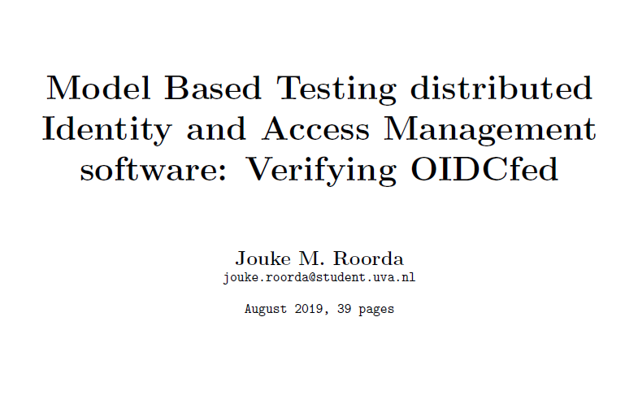
We’re getting there …

Slide 13
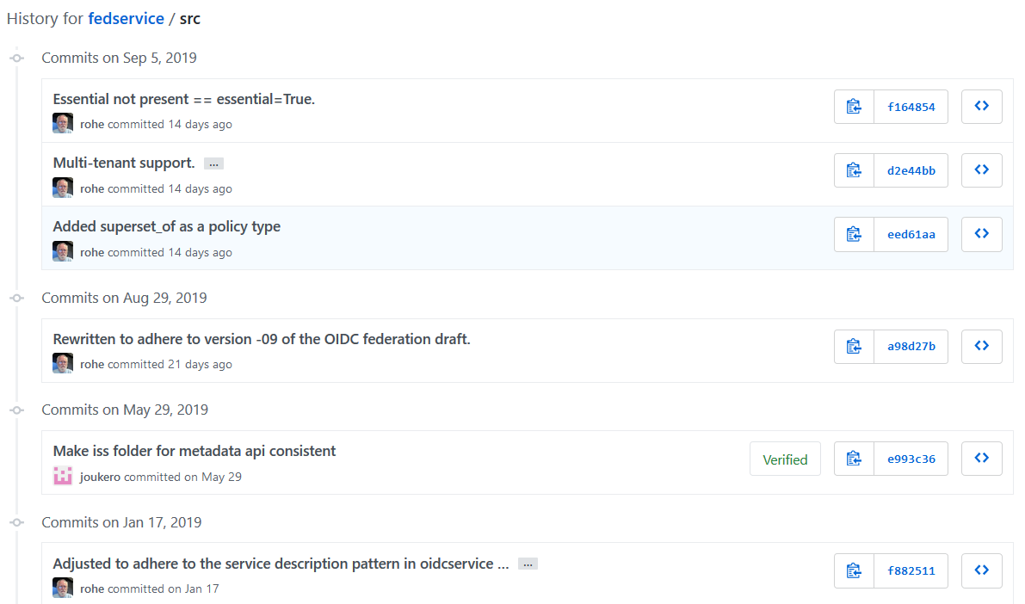
OIDC MDSS service – getting it matching the spec: Rapid evolution!

Slide 14
Developing and deploying an MDSS service
Version based on latest git instance, some patches, built with ./gradlew bootRun
running on an internal test server for now: uvm-56-143
but it can support both file-based and (Aladdin eToken) HSM-based keys now
Evolve into a ‘real’ end-point for the IGTF federation
  will we need multiple ones? one per profile?
  or shall we use the policy attributes in the OIDCfed meta-data for that?
  or …

Slide 15
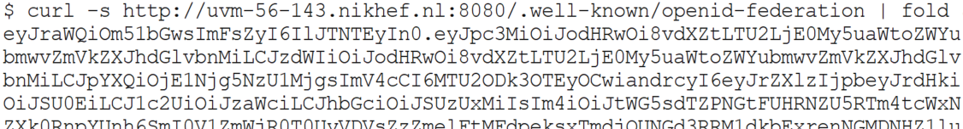
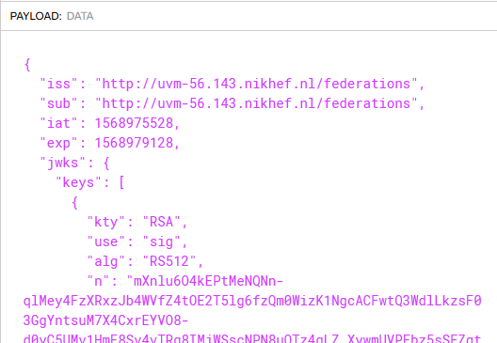
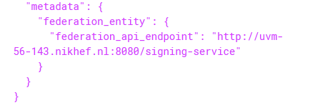
and this (kind-of) works
translating with jwt.io into

Slide 16
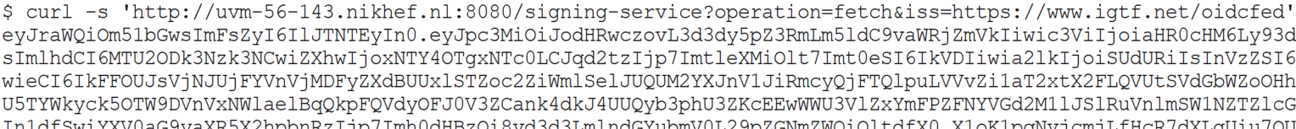
And getting a list of trusted signed entities
And
http://uvm-56-143.nikhef.nl:8080/signing-service?operation=fetch&...
… sub=https://www.igtf.net/oidcfed&iss=https://www.igtf.net/oidcfed
then should give a signed statement back

Slide 17
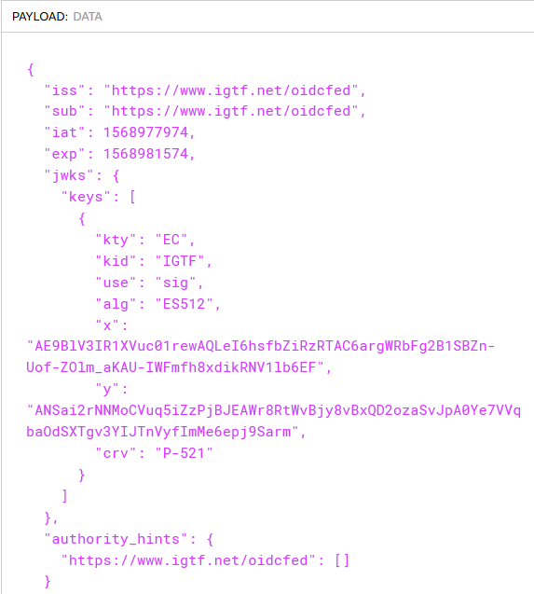
signing-service?operation=fetch

Slide 18
Next steps
Commission an IGTF MDSS service and some entities
Add a few entities (an OP that is actually compliant, some RPs)
Add the organisation-layer (to validate the hierarchy)
Requested from ‘the community’
one actual RPs
a few OPs (can be IdP-SP-proxies)
more use cases ☺

Slide 19

davidg@nikhef.nl
This work is part of a project that has received funding from the European Union’s Horizon 2020 research and innovation programme under Grant Agreement No. 856726 (GN4-3).

