Slide 1


The RHIC transverse spin physics program
A crucial STEP to EIC
E.C. Aschenauer
arXiv:1602.03922
arXiv: 1212.1701

Slide 2
Overarching Goals
Obtain a data set, if combined with future EIC data the validity and limits of factorization and universality can be rigorously tested
Challenge theory predictions on evolution for Twist-3 and TMD PDFs and FFs
  Complete the measurements only doable at a polarized pp collider
To separate interaction dependent phenomena from intrinsic properties
UNIVERSALITY
different complementary probes are needed
RHIC-pp & pA <-> EIC
WHAT information can RHIC pp provide:
observables sensitive to quarks and gluons over a wide range in p_{t}
data purely sensitive to observables in the TWIST-3 formalism
  different √s → evolution
observables purely sensitive to observables in the TMD formalism
  different √s → different p_{t} at the same x_{t} → evolution
observables as transversity can be accessed also in collinear observables
  should help to test factorization breaking

Slide 3
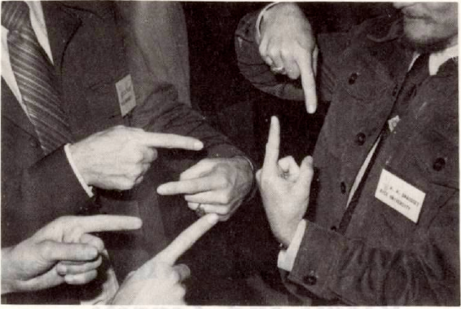
What can polarized pp tell us
Focus on physics with transversely polarized beams

Slide 4
A_{N}: How to get to THE underlying Physics
measure less inclusive → not only A_{N} for hadrons
Initial State
Final State
SIVERS/Twist-3
Collins Mechanism
A_{N} for jets, direct photons
A_{N} for heavy flavour → gluon
A_{N} for W^{+/-}, Z⁰, DY
asymmetry in jet fragmentation
  π^{+/-}π⁰ azimuthal distribution in jets
  Interference fragmentation function
A_{N} for pions
→ Novel Twist-3 FF Mechanisms
related through
S_{P}
S_{P}
k_{T,q}
p
S_{q}
k_{T,π}
p
p
p
Sensitive to correlations
proton spin –
parton transverse motion
not universal between SIDIS & pp
Sensitive to
transversity x spin-dependent FF
universal between SIDIS & pp & e+e-

Slide 5
Rhic has unique kinematics
Till today TMDs come only from fixed target low scale, high x
measurements should establish concept at high √s and different x
→ polarised pp at RHIC

Slide 6
Results at mid rapidity

Slide 7
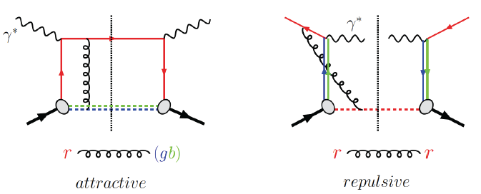
Visualize Color interactions in QCD.
Measure non-universality of sivers-function
DIS:
γq-scattering
attractive FSI
pp:
qqbar-anhilation
repulsive ISI
QCD:
Sivers_{DIS} = - (Sivers_{DY} or Sivers_{W} or Sivers_{Z0})
A_{N}(direct photon) measures the sign change in the Twist-3 formalism
All three observables can be approached
at 500 GeV at STAR
only way to access HP13

Slide 8
First Results: A_{N}^{W}
Results based on 2011 25 pb⁻¹ transversely polarised 500 GeV data
→ published in PRL arXiv:1511.06003
y and p_{t} for fully reconstructed Ws → recoil combined with MC
→ method used at Fermi-Lab and LHC
Asymmetry favors Sivers fct. sign change and small evolution

Slide 9
What can we DO in RUN-17
Assumptions:
integrated delivered luminosity of 400 pb⁻¹
13 weeks transversely polarized p+p at 510 GeV
only STAR operational & dynamic β* through out the fill
  smoothed lumi-decay during fills
  reduced pileup effects in TPC → high W reconstruction efficiency
Will provide data to constrain TMD evolution
sea-quark Sivers fct
test sign-change if TMD evolution ÷ ~5 or less

Slide 10
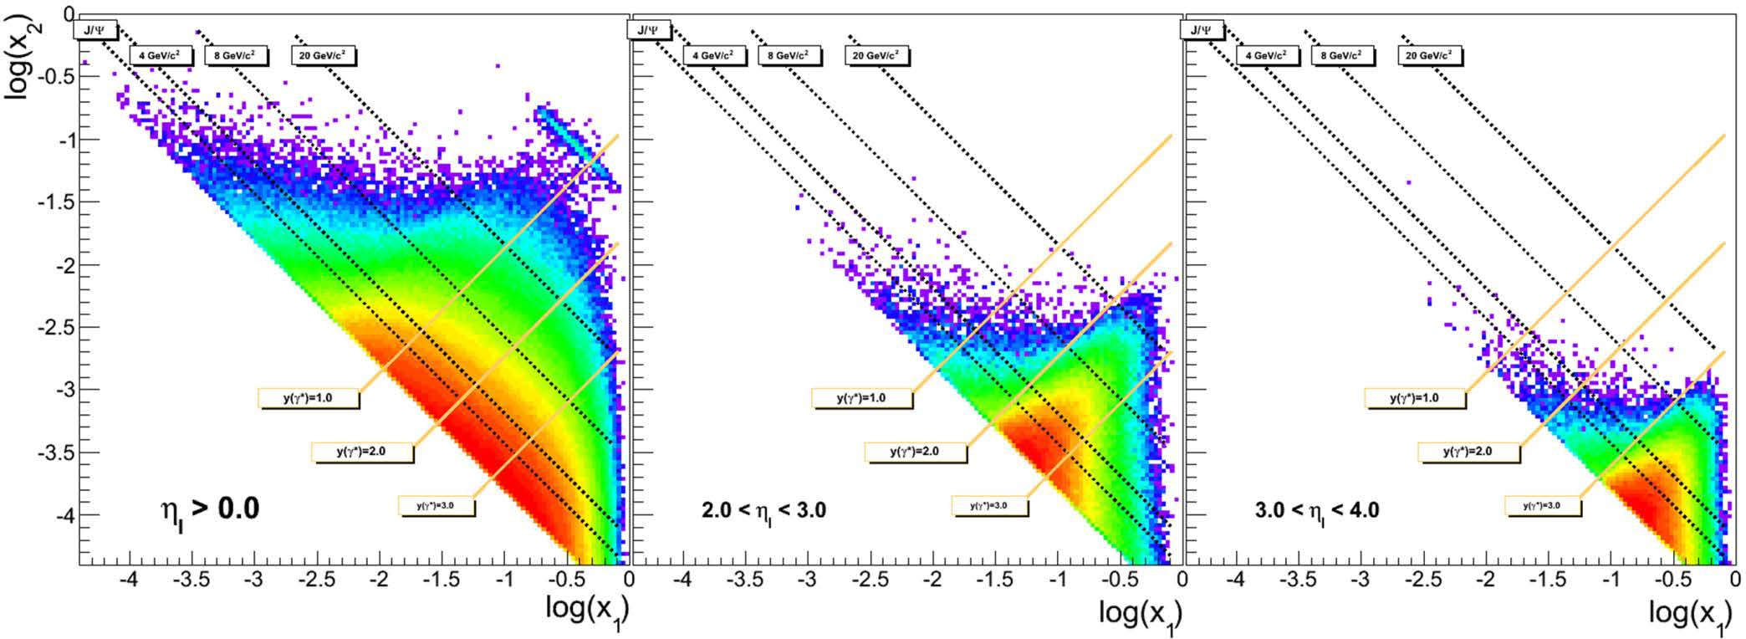
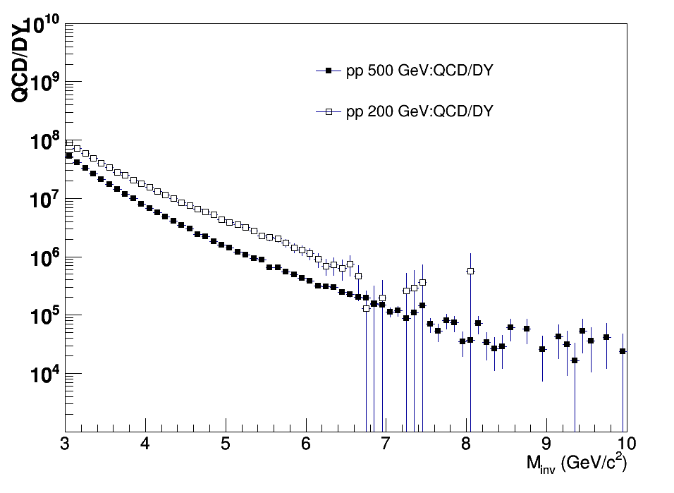
DY@STAR For 500 GeV
Kinematics:
DY e+e- in 2.5 < η < 4.0 4.0 GeV < M_{e+e-} < 9.0 GeV
Add a postshower and preshower
to the FMS
will be able to measure A_{N} DY
2.5 < η < 4.0

Slide 11
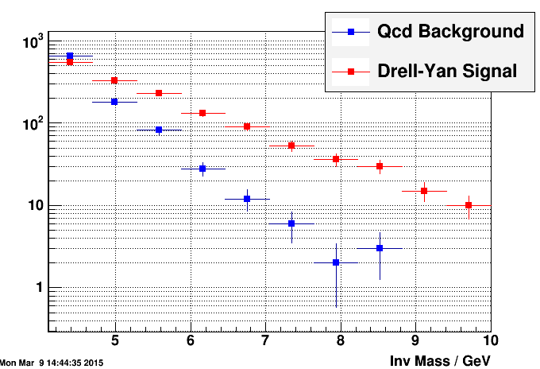
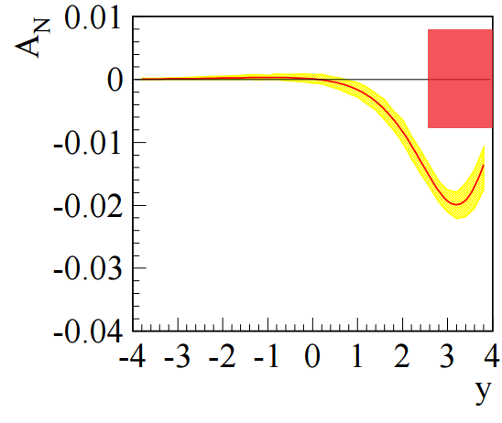
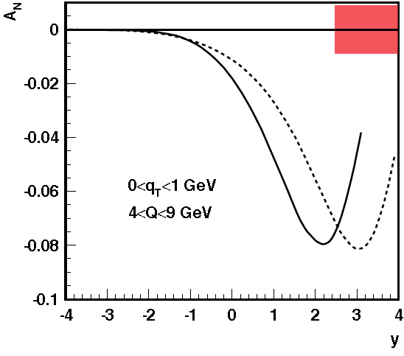
Background Suppression
After analysis 2.5 < η < 4.0
:
With TMD Evolution
No TMD Evolution
Can measure A_{N} for DY to +/- 0.008
in run-17 for ∫L_{del}=400 pb⁻¹

Slide 12
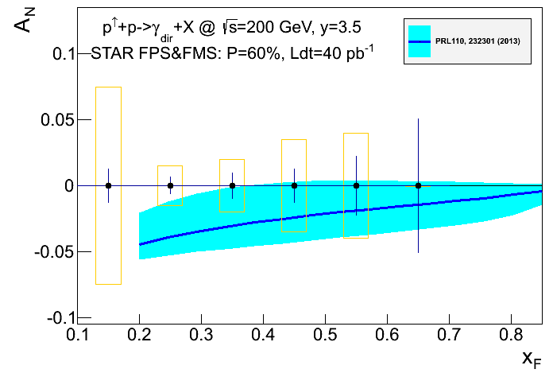
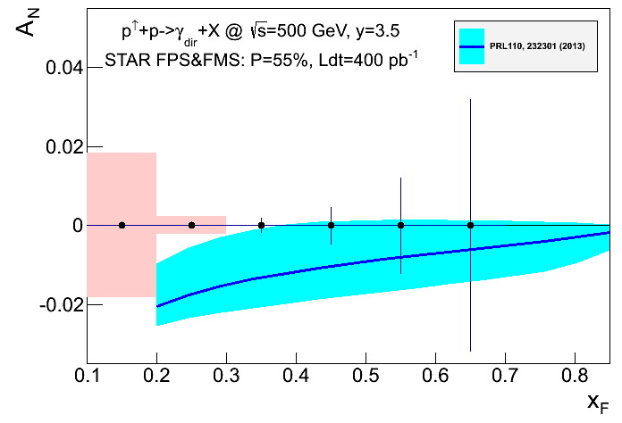
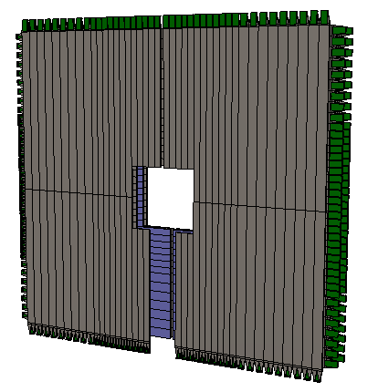
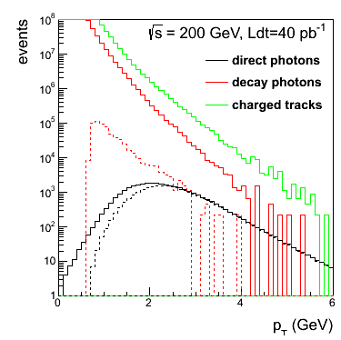
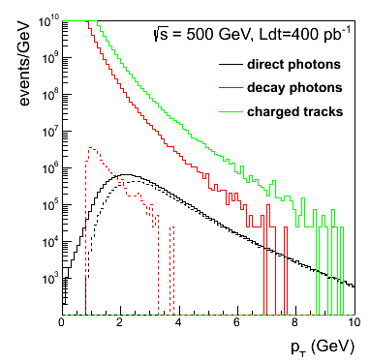
Complementary Channel
STAR FMS-PreShower:
3 layer preshower in front of the FMS,
distinguish photons, electrons/positrons
and charged hadrons → installed for RUN-15
2015
2017
2023:
reduction of uncertainties by ~3
critical to pin down Twist-3 evolution
A_{N} for direct photon production:
sensitive to sign change, but in TWIST-3 formalism
not sensitive to TMD evolution
no sensitivity to sea-quarks; mainly u_{v} and d_{v} at high x
collinear objects but more complicated evolutions than DGLAP
indirect constraint on Sivers fct.
Not a replacement for A_{N}(W^{+/-}, Z⁰, DY) measurement
but an important complementary piece in the puzzle

Slide 13
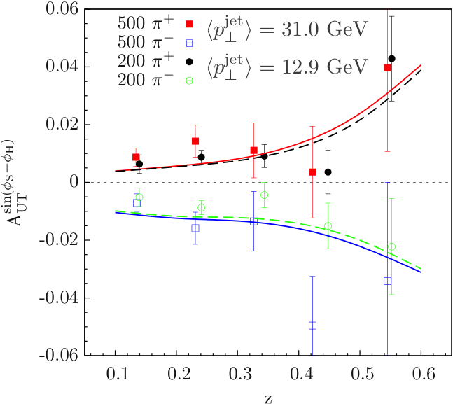

Jets to access Transversity x Collins
Data jets MC jets
Detector
j_{T}
GEANT
π⁺
e⁺
π⁰
π⁻
Particle
e⁻
Κ⁰
PYTHIA
Parton
200 vs. 500 GeV Comparison:
These measurements coupled with the interference fragmentation function (IFF) measurements at both 200 and 500 GeV will provide insight into the evolution and universality of TMD functions.
These results could lend sensitivity to the size of potential factorization-breaking in Collins in p+p.
dependence of the Collins FF on pion transverse momentum (j_{T})

Slide 14
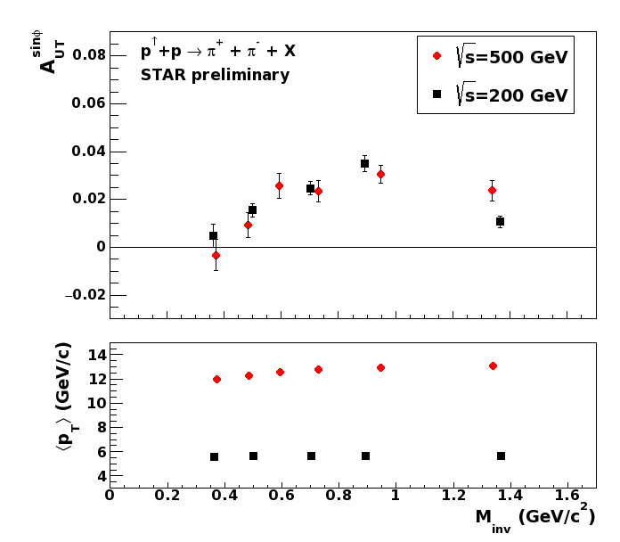
Interference Fragmentation Function (IFF)
p↑+p → π⁺π⁻+X → transversity x IFF
survives in collinear framework
Significant di-hadron asymmetries both at √s=200GeV and √s=500GeV
Increasing with p_{T}
Enhancement to asymmetry is seen around ρ mass

Slide 15

Collins like AsymmetrY
Maximized contribution
for √s = 500 GeV
D’Alesio et al.
Model predictions shown for “maximized” effect,
saturated to positivity bound
Until now, Collins-like asymmetries completely unconstrained
→ Sensitive to linearly polarized gluons

Slide 16
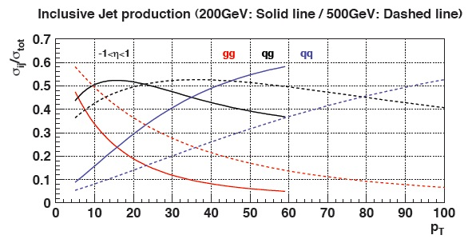
“Twist-3 Sivers” Through Jets
Asymmetries shown as function of particle-jet p_{T}
Corresponding parton-jet p_{T} lower by 0.6-1.4 GeV
Horizontal errors include uncertainties from statistics, calorimeter gains, efficiencies, track momentum, and tracking efficiency
No sign of sizable azimuthal asymmetry in jet production at √s = 500 GeV
Consistent with expectation from inclusive jets, di-jets, and neutral pions at √s = 200 GeV
p_{T} [GeV/c]
Notes:
----- Meeting Notes (9/26/13 11:10) -----
specify p_T range on left-hand plot
specify eta range

Slide 17
Mid-rapidIty observables
At 200 GeV in 2015&2023 and 500 GeV in 2017 / 202X:
Transversity x Collins
Sivers function through TWIST-3:
more 500 GeV in 202X:
reduction of uncertainties by ~2
linearly polarised gluons
could be a explanation for
the ridge seen in pp and pA
To have high precision data at
different √s
→ constrain TMD evolution
→ fixed x and Q² → p_{T} different

Slide 18
Results at forward rapidities
η ≳ 2.5

Slide 19
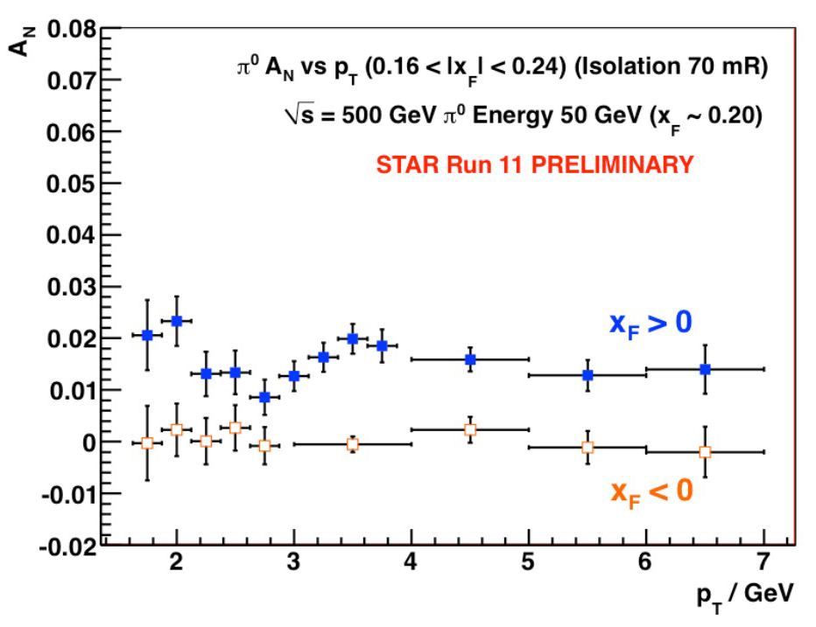
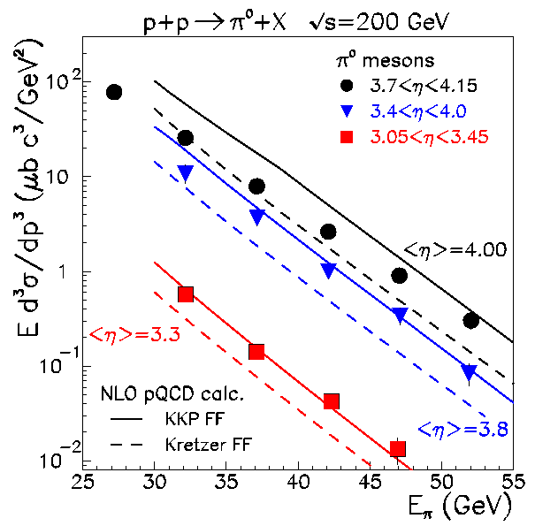

World Data for Inclusive A_{N}
left
right
Single-spin transverse asym.
1
N↑/L↑ − N↓/L↓
A_{N} ≡
P₁
N↑/L↑ + N↓/L↓
where ↑ (↓) are defined with
respect to reaction plane
Stat. Unc. ~ 1/(P₁ √N )
Underlying subprocess responsible for the
large asymmetries till today not clear
Most popular explanation a TMD
PRL 97, 152302
strong rise with
A_{N} pretty much independent of √s
A_{N}(π⁰) ≠ (A_{N}(π⁺) + A_{N}(π⁻))/2
p_{t} dependence flat for p_{t} > 3.5 GeV
cross section can be described by collinear calculation

Slide 20
Surprises at forward rapidities
1-photon events, which include a large π⁰ contribution in this analysis, are similar to 2-photon events
Three-photon jet-like events have a clear non-zero asymmetry, but substantially smaller than that for isolated π⁰’s
A_{N} decreases as the event complexity increases (i.e.,the "jettiness”
A_{N} for #photons >5 is similar to that for #photons = 5
RUN-15
The STAR RP phase-II* will be the key detector component to investigate
A_{N} for π⁰ is dominated by hard diffraction
p↑+p → π⁰+ p’+X
new surprise in spin physics
asymmetry moderated through 2g (pomeron) or 3g exchange
theory assumption: pomeron no spin effects
Jettier events
Several other Asymmetries for jettier events are also very small

Slide 21
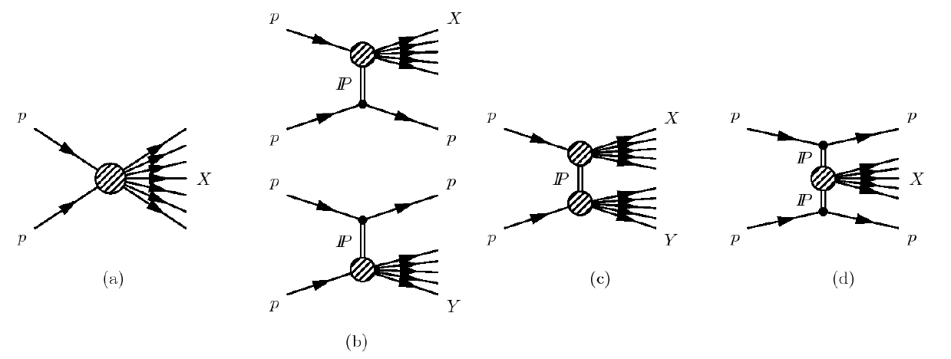
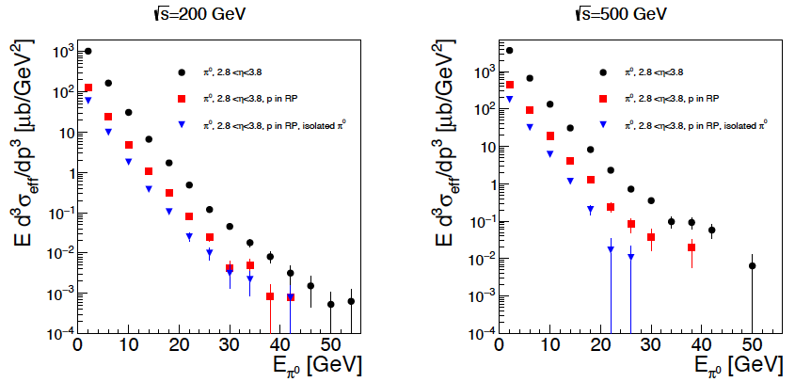
Diffraction: A neglected child at RHIC
Processes:
STAR RP the optimal tool to tag
diffractive processes
inclusive cross section
Pythia-8
~20% at least
diffractive
Many more interesting physics opportunities with diffraction
SSA for UPC J/Ψ production → GPDs
R_{pA} for diffractive events → saturation

Slide 22
Collins asymmetries for π⁰ relative to jet axis
Calculated A_{N} for jet-isolated π⁰, background subtracted A_{N} for inclusive π⁰ and π⁰ in EM-jet
Isolation defined by anti-k_{T} jet algorithm with
R = 0.7
Longitudinal momentum fraction z of π⁰ is calculated w.r.t the EM-jet as Z_{EM}
Asymmetries of less exclusively produced π⁰ (Z_{EM} < 0.9) is smaller than isolated π⁰
Total of Sivers and Collins asymmetries of EMjet and π⁰ relative to jet axis are found to be insufficient to account for the observed inclusive π⁰ single spin asymmetries.

Slide 23
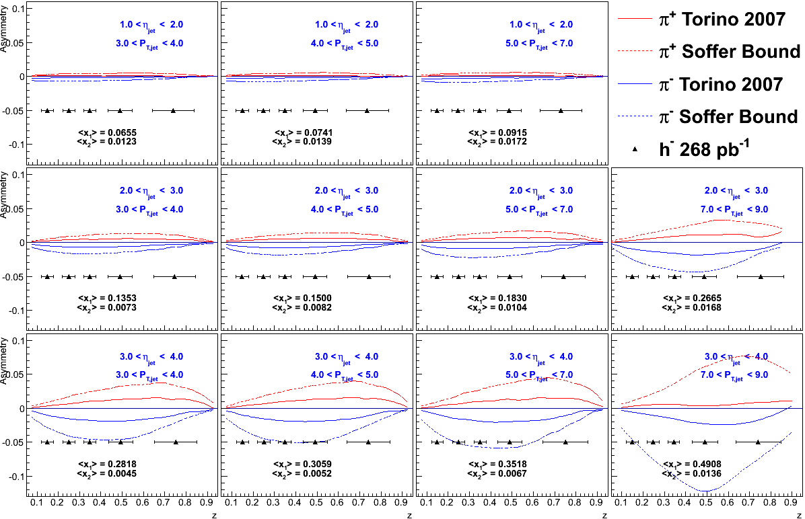
Forward rapidities
At 200 GeV in 2023 and 500 GeV in 202X → 2021:
500 GeV: access high x and jets at forward rapidities
Transversity x Collins FF
At 200 GeV: A_{N} for charged hadrons → rigid test on Twist-3 FF

Slide 24
Findings from forward rapidity
A_{N} decreases as the event complexity increases(i.e., the "jettiness”)
Isolated π⁰ asymmetries are smaller when there is a correlated EM-jet at mid-rapidity.
A_{N} of forward jets are small
→ cancellation of u and d Sivers TMD
Total of Sivers and Collins asymmetries of EMjet and π⁰ relative to jet
axis are found to be insufficient to account for the observed inclusive
π⁰ single spin asymmetries.
These dependences raise serious question about how much of the
large forward π⁰ A_{N} have 2 → 2 parton scattering as underlying
process (diffractive events?).

Slide 25
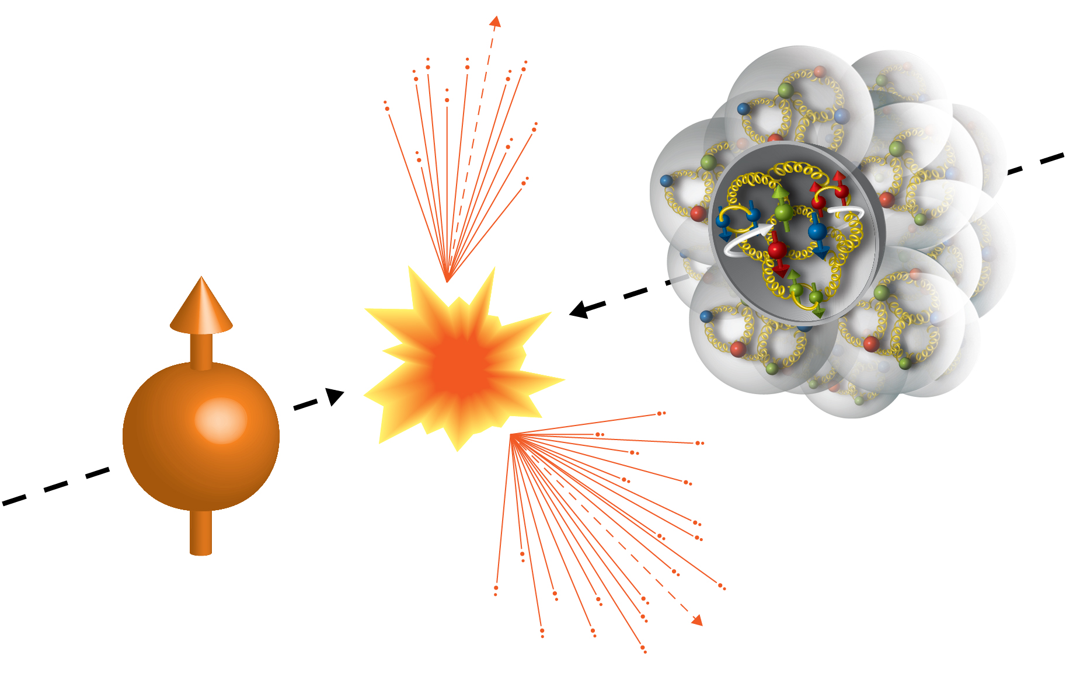
TMDs in pA @ RHIC
RHIC’s unique opportunities
polarised p↑(d,He) A (Au, C, Cu, …)
A-scan unique to RHIC
Energy scan to separate different underlying mechanisms

Slide 26
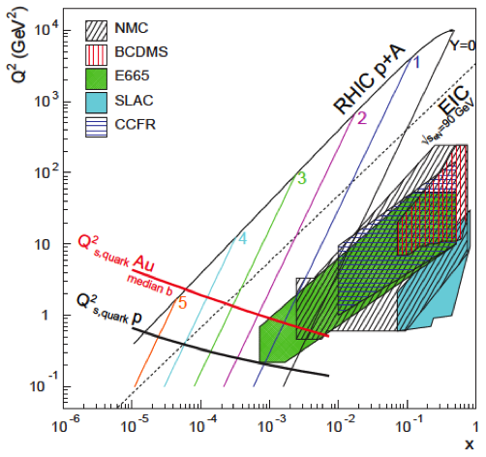
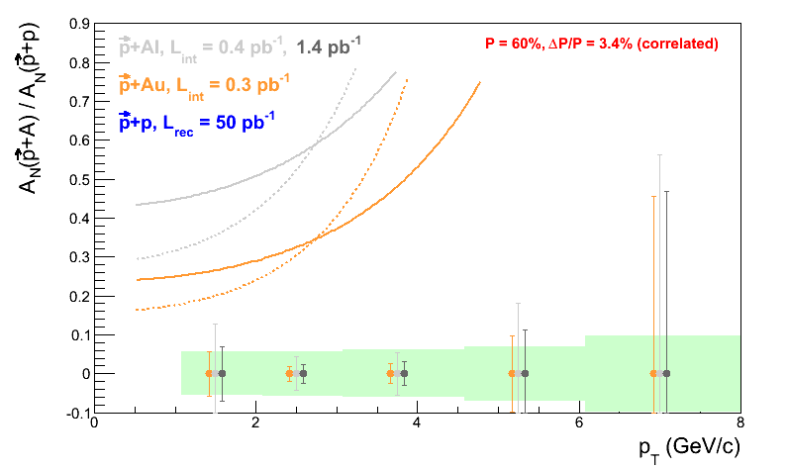
Studying Saturation Through Spin
Very unique RHIC possibility p↑A
Gluon saturation signature in transverse
single spin asymmetries A_{N}
Suppression is enhanced in nuclei
Suppression of A_{N} in p↑A provides
sensitivity to Q_{s}.
arXiv:1106.1375 & arXiv:1201.5890
strong suppression of odderon STSA in nuclei.
Q_{s}^{p}=1.0 GeV
r=1fm
Q_{s}^{p}=0.8 GeV
p+p
r=1.4fm
p+Al
r=2fm
p+Au

Slide 27
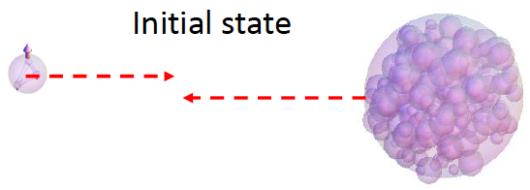
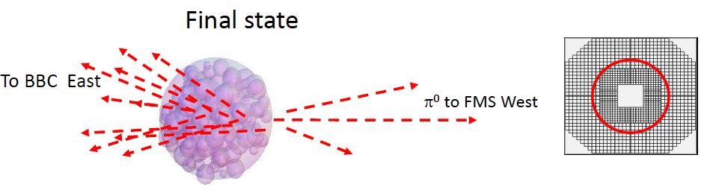
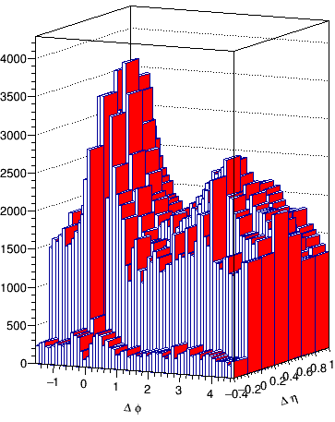
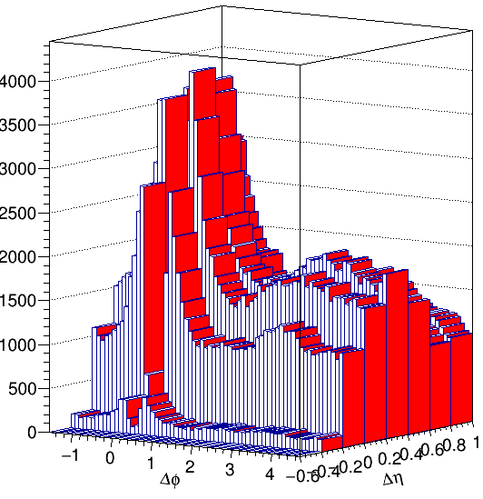
First results from p↑A
STAR Run-15:
A_{N} data for p↑p, p↑Au and p↑Al at 2.8 < η < 4.0
π⁰ to
forward meson
spectrometer
2 cluster distribution
pp
pAu
π⁰:
0.25 < x_{F}(π⁰) < 0.35
3.55 < p_{T}(π⁰) < 4.05 GeV

Slide 28
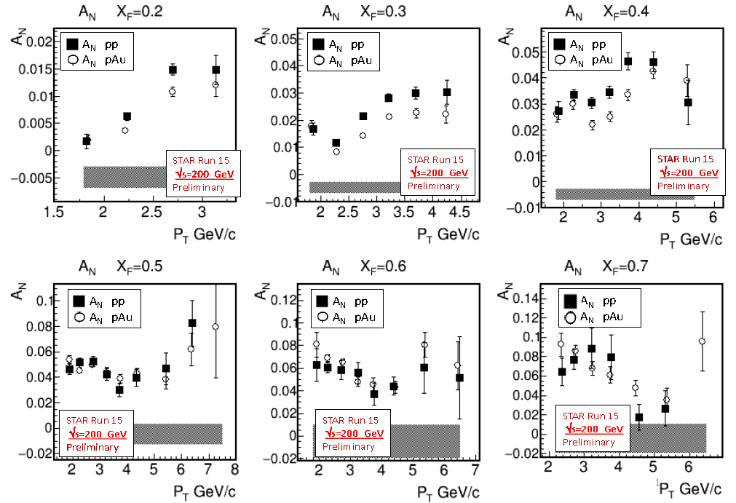
First results from p↑A
suppression only expected
if main underlying process of A_{N} is of 2→2 nature
remember A_{N} pp
only minimal suppression
Shaded bands represent systematic uncertainty, dominated by dependence of A_{N} on observed BBC multiplicity → central vs. peripheral collisions

Slide 29
nuclear modification of TMDs
Collins FF in pAu
First study of a nuclear modification of a spin observable ever

Slide 30
What is coming and needed
Running to have really high statistics data sets:
  2017: 12 weeks (400 pb⁻¹) transverse polarized p+p @ √s= 500 GeV
  2023: 8 weeks (300 pb⁻¹) transverse polarized p+p @ √s= 200 GeV
  8 weeks transverse polarized p+Au and p+Al each
  @ √s= 200 GeV (1.8 pb⁻¹ / 12.6 pb⁻¹)
  202X: transverse and longitudinal polarized p+p @ √s= 500 GeV
  10 weeks each (2x 1.1 fb⁻¹)
Hardware:
  wide acceptance mid-rapidity detector with good PID → STAR
  forward rapidities (4.5 > η > 1) Ecal + HCal + charge identification
  both STAR and sPHENIX have dedicated upgrades
  For details see:
  RHIC Cold QCD Plan
  https://drupal.star.bnl.gov/STAR/system/files/FCS_FTS-proposal_20160119_final_0.pdf

Slide 31
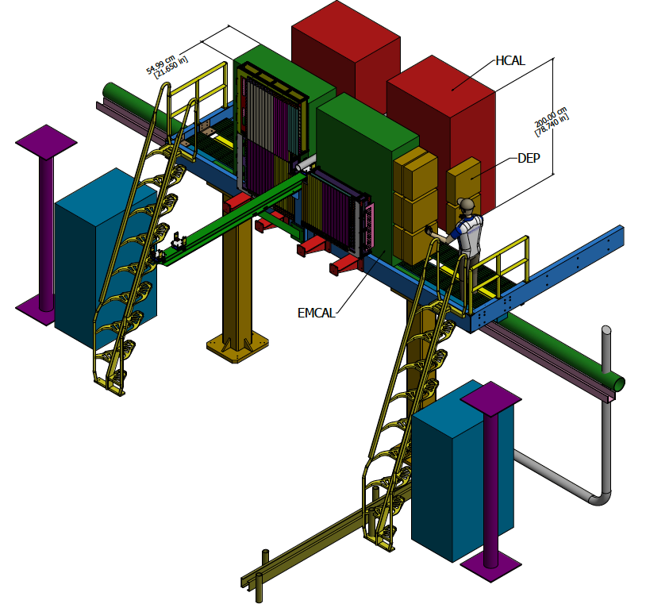
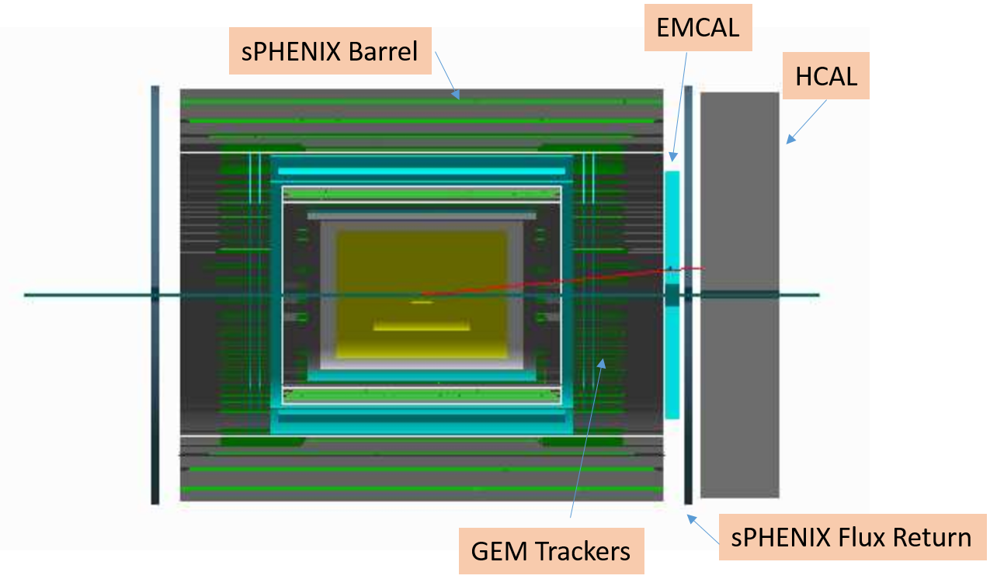
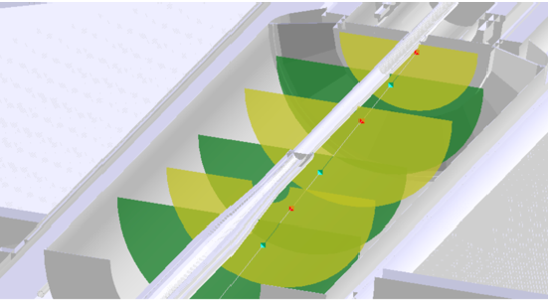
Rhic Forward upgrade plans
Add to existing STAR at rapidity
2.5 < η < 4.5
In addition to the central detector
upgrade, sPHENIX has a plan for a
forward arm 1 < η < 4.5
Ecal:
reuse PHENIX Ecal
Hcal:
design ala
STAR fHCal and EIC fHCal
Tracking:
4-6 Si strip-disks
Ecal:
reuse PHENIX Ecal
Hcal:
follow design ideas from
STAR fHCal and EIC fHCal
Tracking:
3 stations of GEM Trackers

Slide 32

Outlook
EIC

Slide 33
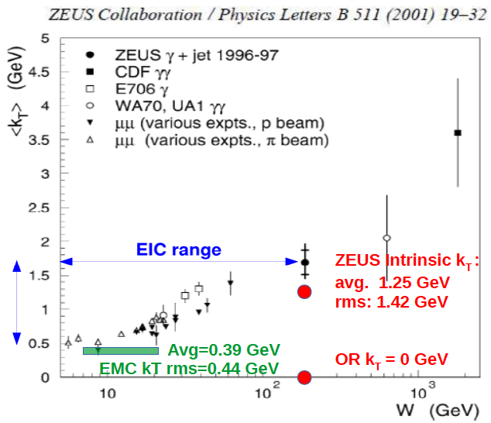
Can we measure k_{t}
4 different contributions to the p_{t} of a hadron
k_{t}: non-pertubative; very often called “intrinsic”
k_{t}^{PS}: from parton showers → connection to softfactors in TMDs
p_{t}^{frag}: p_{t} contribution from the fragmentation
p_{t}^{hard} : from hard QCD scattering (QCDC, PGF, …)
Running of effective k_{T}:
In order to relate k_{T} to fundamentals like Q_{S}, we must actually measure k_{T}

Slide 34
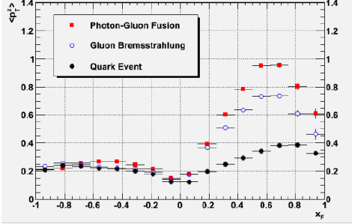
Possible Solution: <p_{t}²> vs. x_{f}
x_{F}>0: “struck” parton hemisphere
x_{F}<0 “target remnant” hemisphere
sensitive to intrinsic k_{t}s (initial + fragmentation)
Detector Requirements @ EIC:
Measure p (or E) & charge to η of 5
+ Roman Pots for very forward protons

Slide 35
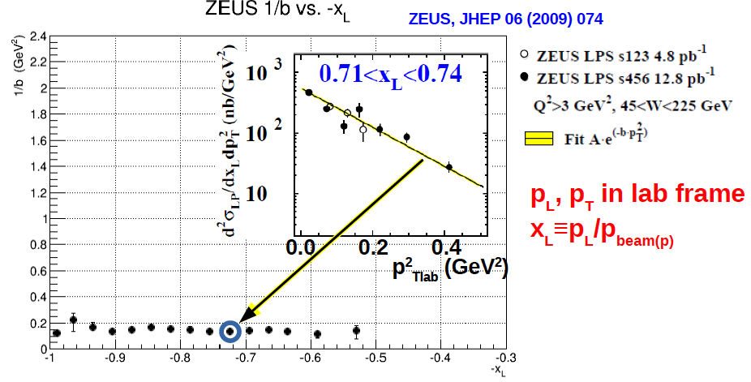
What do we know Now
We do have high precision data from Zeus at x_{F} < -0.2
<p_{T}> = 1/b from fit
x_{L}=p_{z}/p_{zbeam} ~ -x_{F}

Slide 36
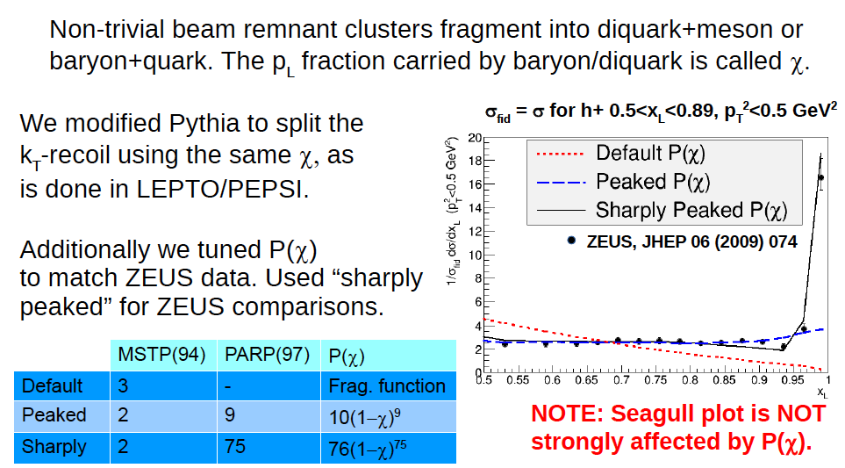
Can we model this in pythia?

Slide 37
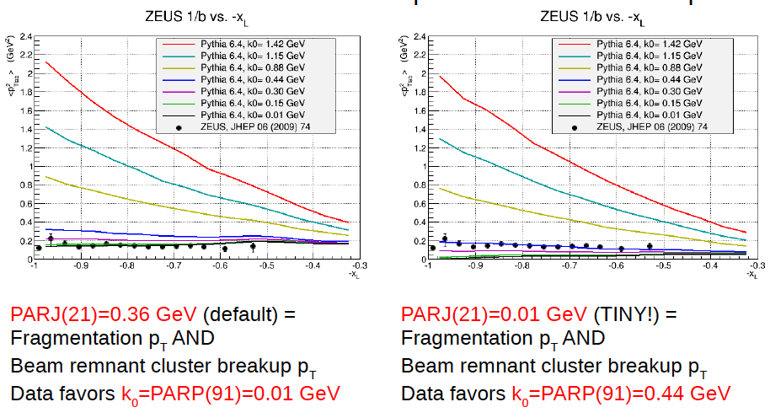
Fragmentation p_{T} vs intrinsic k_{T}
Having fragmentation p_{T} decreasing with W is weirder than k_{T} decreasing with W
EMC data (ZPC 36 (1987) 527 can give an first idea about the W-dependence

Slide 38
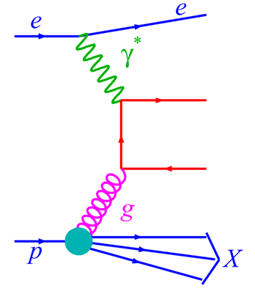
Accessing gluon dynamics in DIS
How to access the gluon information in DIS collisions?
Tag photon-gluon fusion events.
Find back-to-back hadron pairs/ di-jets from the quark-antiquark jet.
Reconstruct the gluon dynamics with the hadron pair / di-jet information.
p_{t}^{h1}
Gluon information can be extracted with the hadron pairs /di-jet from the quark-antiquark jet.
p_{t}^{h2}
Back-to-back limit:
P_{T}’ =|P_{T}^{h1}-P_{T}^{h2}|/2
k_{T}’ = |P_{T}^{h1}+P_{T}^{h2}|
k_{T}’ << P_{T}’

Slide 39
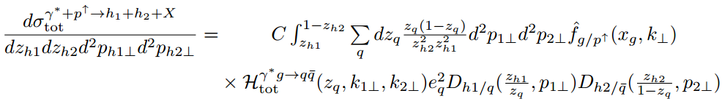



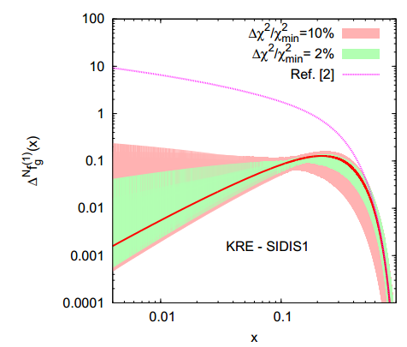


Theoretical framework to estimate the gluon initiated single spin asymmetry
TMD factorization with the back-to-back limit:
PRD 83, 105005 (2011)
Single spin asymmetry (SSA):
We use the RHIC A_{N} data constrained fits for gluon Sivers function.
JHEP 09, 119 (2015)

Slide 40
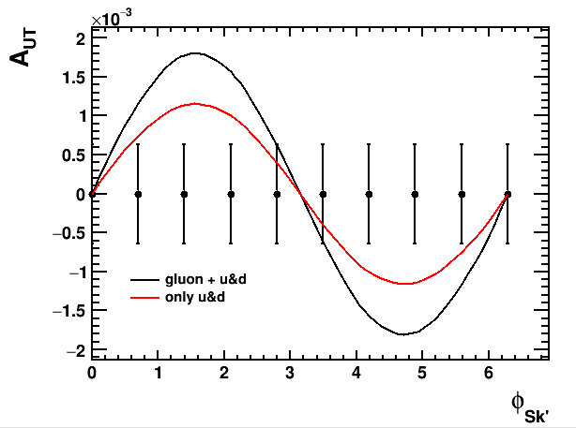
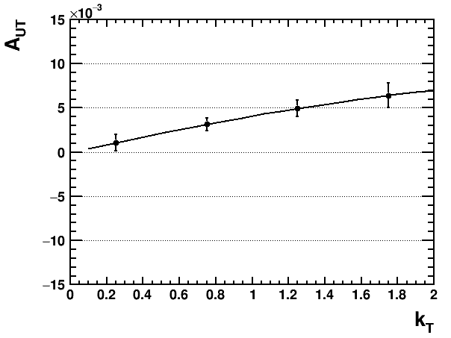
Statistical projections
Event sample summary:
ep: 20x250 GeV
√s = 141 GeV
0.01<y<0.95
1<Q²<20 GeV²
σ_{tot} = 562.5 nb (all events)
σ_{dihadron}= 0.61 nb,
dihadron cuts:
Charged hadron pairs
Acceptance; |η|<4.5
z>0.1, p_{T}>1.7 GeV
Correlation limit: k_{T}’ < 0.7 P_{T}’
80% PGF
δA_{UT} ~ 6.4 10⁻⁴
Quark Sivers function included according to the weight of QCDC cross section.
Di-Charm Mesons are golden to tag on PGF
But will be luminosity challenged
δA_{UT} ~ 2.8 10⁻²
∫L = 100 fb⁻¹
P=70%
Together with well understood quark Sivers function,
gluon Sivers sign and behavior can be extracted at an EIC.

Slide 41
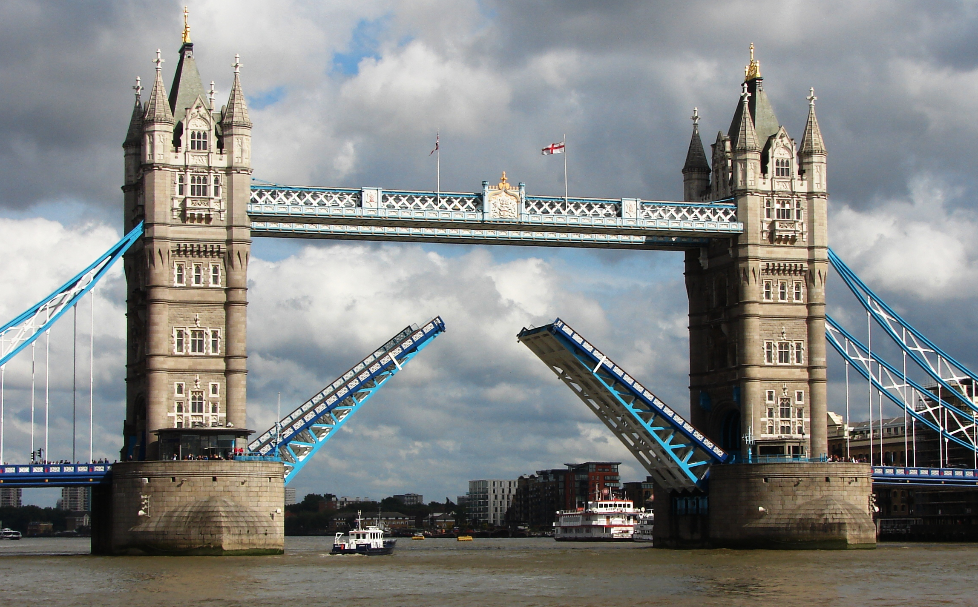
Summary
Unique program to RHIC pp/pA addressing several fundamental questions in QCD
and
essential to fully realize the scientific promise of the EIC
RHIC pp/pA
EIC
universality
factorization
evolution

Slide 42
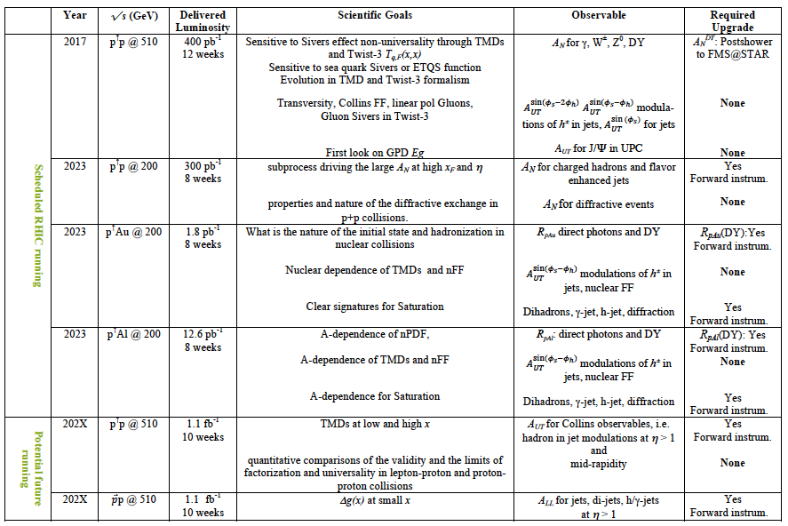
Summary

Slide 43


Slide 44
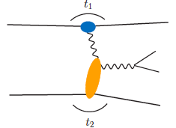
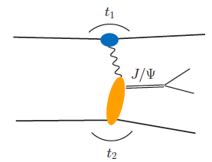
From ep tO pp to γ p/A
Get quasi-real photon from one proton
Ensure dominance of g from one identified proton
by selecting very small t₁, while t₂ of “typical hadronic
size”
small t₁ ←→ large impact parameter b (UPC)
Final state lepton pair ←→ timelike compton scattering
timelike Compton scattering: detailed access to GPDs
including E^{q/g} if have transv. target pol.
Challenging to suppress all backgrounds
Final state lepton pair not from γ* but from J/ψ
  Done already in AuAu
  Estimates for J/ψ (hep-ph/0310223)
transverse target spin asymmetry → calculable with GPDs
information on helicity-flip distribution E for gluons
golden measurement for eRHIC
Z²
A²
Gain in statistics doing polarized p↑A

Slide 45
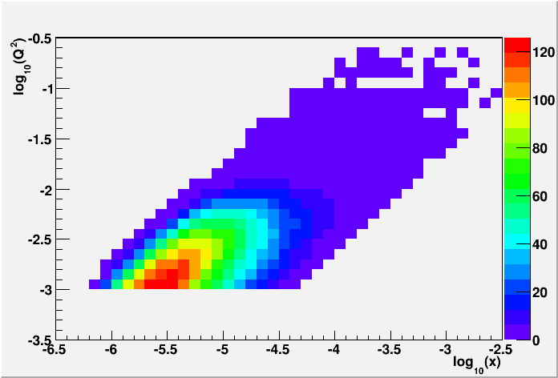
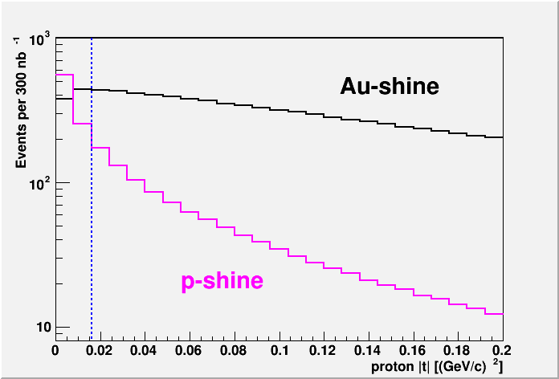
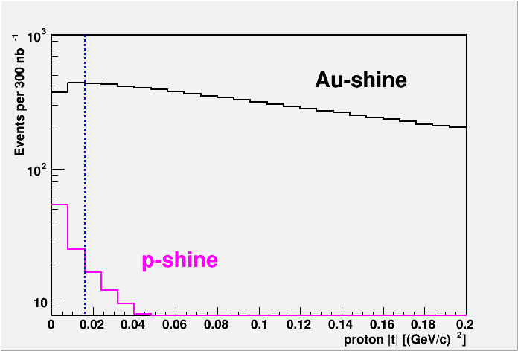
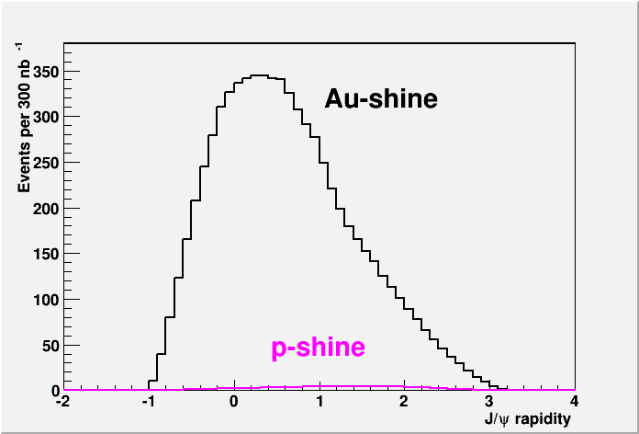
From ep tO pp to γ p/A
UPC in p+Au:
Required:
2015 p+A 300 nb⁻¹
RP-Phase II*
Cuts:
no hit in the RP phasing the Au-beam (-t > -0.016 GeV²) or in the ZDC
detecting the scattered proton in the RP (-0.016 > -t > -0.2 GeV²)
both J/ψ decay leptons are in -1 < h < 4
cut on the pt² of the scattered Au, calculated as the pt² of the vector sum
of the proton measured in the RP and the J/ψ to be less then 0.02 GeV²
→ 7k J/ψ

Slide 46
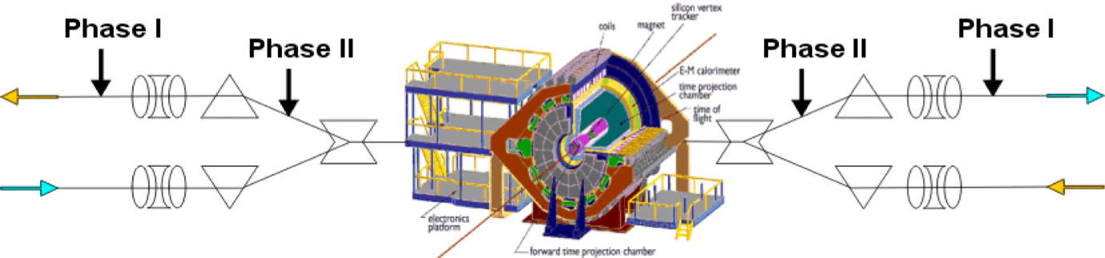



Forward Proton Tagging Upgrade
at 55-58m
at 15-17m
Follow PAC recommendation to develop a solution to run pp2pp@STAR with
std. physics data taking → No special β* running any more
should cover wide range in t → RPs at 15m & 17m
Staged implementation
  Phase I (currently installed): low-t coverage
  Phase II (proposed) : for larger-t coverage
  1st step reuse Phase I RP at new location only in y
  full phase-II: new bigger acceptance RPs & add RP in x-direction
    full coverage in φ not possible due to machine constraints
Good acceptance also for spectator protons from
deuterium and He-3 collisions
Phase-II: 1st step
1st step
full Phase-II

Slide 47




“Spectator” proton from deuteron with the current RHIC optics
Study: JH Lee
generated
Passed DX aperture
Accepted in RP
Rigidity (d:p =2:1)
The same RP configuration with the current RHIC optics (at z ~ 15m between DX and D0)
needs full PHASE-II RP

Slide 48



Spectator proton from ³He with the current RHIC optics
Momentum smearing mainly due
to Fermi motion + Lorentz boost
Angle [rad]
Study: JH Lee
generated
Passed DX aperture
Accepted in RP
The same RP configuration with the current RHIC optics (at z ~ 15m between DX-D0)
Acceptance ~ 92% with full PHASE-II RP

Slide 49


Confronting simulation with Data
Tune PYTHIA with HERA charged hadron density distribution measurement.
Kinematics:
ep: 27.6 GeV x 920 GeV
5<Q²<10, 0.0005<x_{Bj}<0.002
p_{T}*, η* defined in gamma-hadron center of mass frame
0<η*<1.5
1.5<η*<5
Data: EPJC 73, 2406 (2013)
H1 charged particle density data reasonably described by simulations.

Slide 50






Kinematic cuts and di-hadron pair selection
Event sample summary:
ep: 20x250 GeV
√s = 141 GeV
0.01<y<0.95
1<Q²<20 GeV²
p_{T}>1.7 GeV, z_{h}>0.1
acceptance: |η|<4.5
Back-to-back limit:
k_{T}’ < 0.7 P_{T}’
p_{T}>1.7 effectively enhances the gluon initiated process
Large z prefers forward rapidity
x_{g} probed by the pairs
Hadron pair distribution
<x_{g}>=0.062
Acceptance
Pair correlations

Slide 51





2020+: Dy in pA
Physics
Access to sea and valence quarks in nuclei
DY-h correlations → saturation Stasto et al. arXiv 1204.4861
very challenging
need big bkg. suppression
FCS + FTS
2.5 pb⁻¹ p+Au
200 GeV pp
2.5<η<4.0
2.5<η<4.0

Slide 52




Estimates of gluon SSA at an EIC
Kinematics:
W = 100 GeV
Q² = 4 GeV²
z_{h1} = z_{h2} = 0.3
P_{T}’ > 4 GeV
Gluon Sivers results in the single spin asymmetry depending on azimuthal angle between dihadron total momentum k_{T}’ and spin direction.
The gluon Sivers sign is positive based on D’Alesio fits
Larger asymmetry observed for larger k_{T}’

