Slide 1
Transverse phase-space
and its multipole decomposition
[C.L., Pasquini, PRD93 (2016)]
Based on :
Cédric Lorcé
CPHT
May 30, Nikhef, Amsterdam, The Netherland

Slide 2
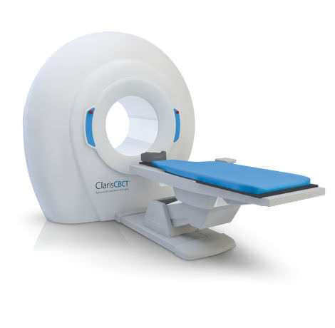
Outline
Phase-space distributions
Multipole decomposition
Angular correlations
Conclusions
Nucleon « tomography »

Slide 3
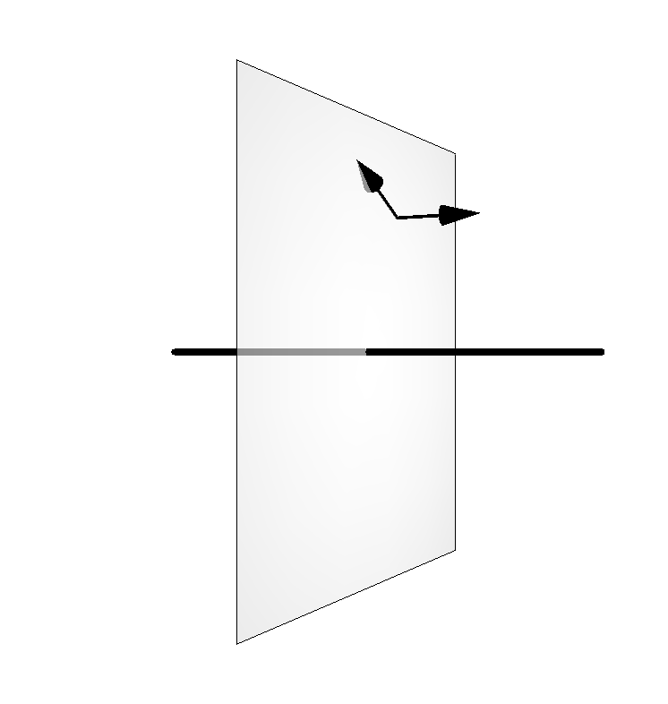
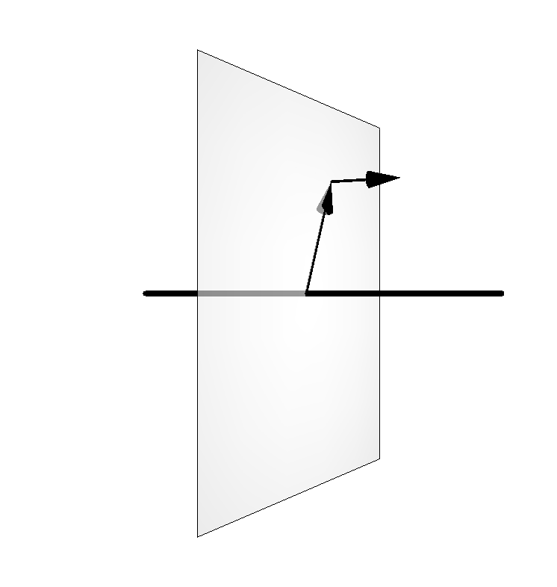
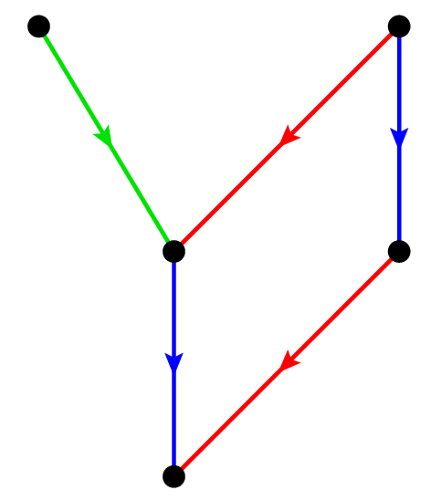
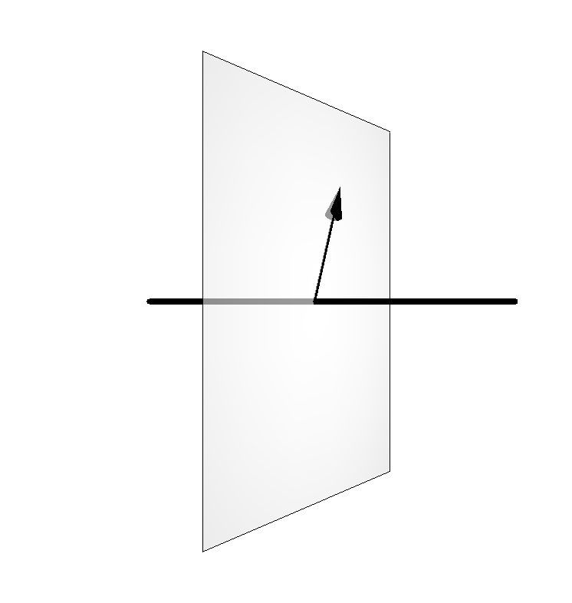
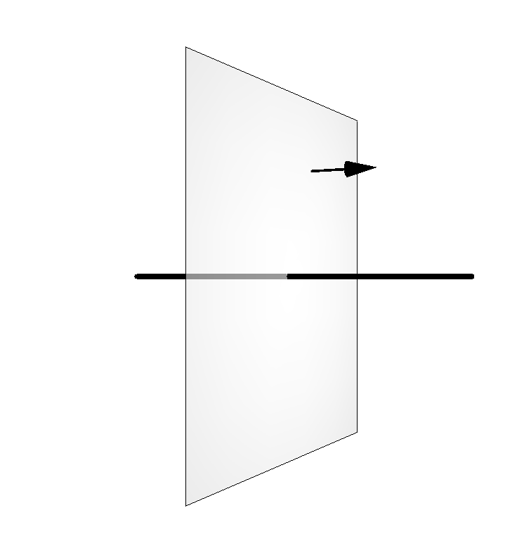
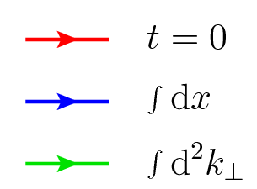
Parton distribution zoo
TMDs
GPDs
0+3D
2+1D
PDFs
FFs
2+0D
0+1D
Charges

Slide 4
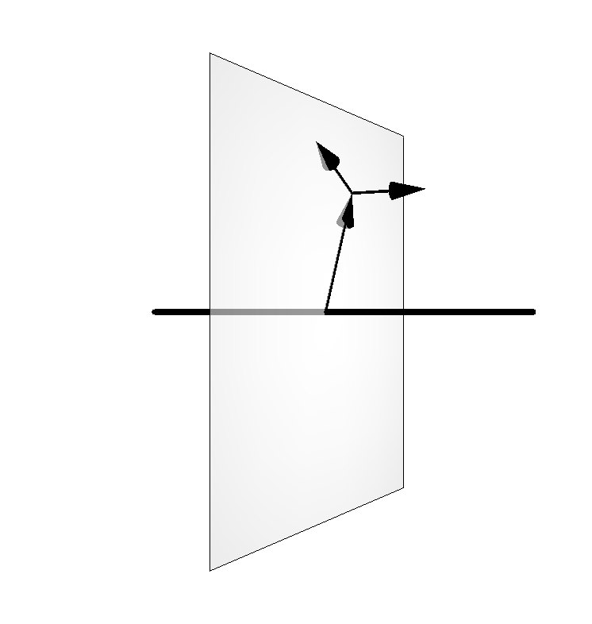
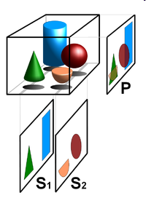
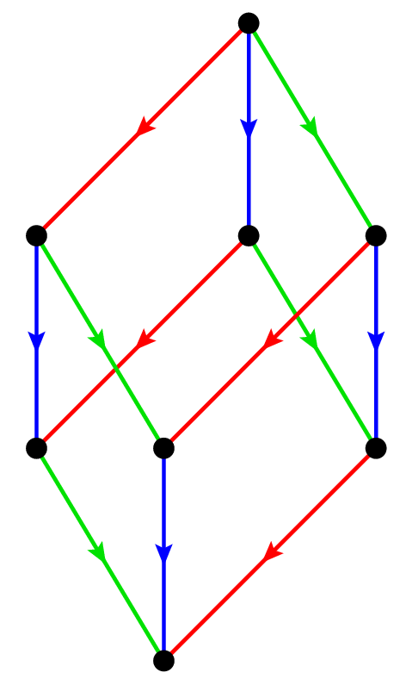
Parton distribution zoo
LFWFs
Phase-space distribution
Theoretical tools
GTMDs
2+3D
TMDs
GPDs
0+3D
2+1D
PDFs
FFs
«Physical» objects
2+0D
0+1D
Charges
[Meissner, Metz, Schlegel (2009)]
[C.L., Pasquini, Vanderhaeghen (2011)]

Slide 5
Phase-space distributions
[Wigner (1932)]
[Moyal (1949)]
Wigner distribution

Slide 6
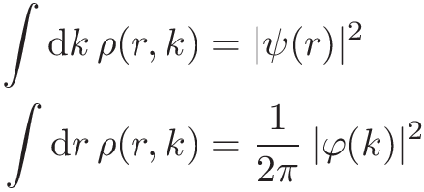
Phase-space distributions
[Wigner (1932)]
[Moyal (1949)]
Wigner distribution
Probabilistic interpretation
Heisenberg’s uncertainty relations

Slide 7
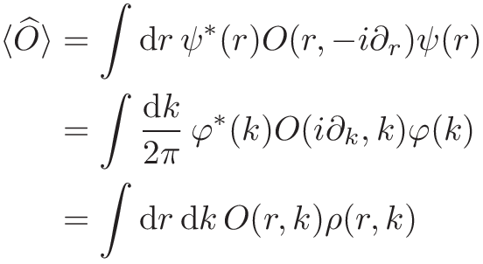
Phase-space distributions
[Wigner (1932)]
[Moyal (1949)]
Wigner distribution
Probabilistic interpretation
Heisenberg’s uncertainty relations
Expectation value
Position space
Momentum space
Phase space

Slide 8
Phase-space distributions
Quark Wigner operator

Slide 9
Phase-space distributions
Quark Wigner operator
Non-relativistic phase-space distribution
[Ji (2003)]
[Belitsky, Ji, Yuan (2004)]
3+3D

Slide 10
Phase-space distributions
Quark Wigner operator
Non-relativistic phase-space distribution
[Ji (2003)]
[Belitsky, Ji, Yuan (2004)]
3+3D
Relativistic phase-space distribution
[C.L., Pasquini, PRD84 (2011) 014015]
[C.L., Pasquini, Xiong, Yuan, PRD85 (2012) 114006]
GTMDs
2+3D

Slide 11
Phase-space distributions
Quark Wigner operator
Non-relativistic phase-space distribution
[Ji (2003)]
[Belitsky, Ji, Yuan (2004)]
3+3D
Relativistic phase-space distribution
[C.L., Pasquini, PRD84 (2011) 014015]
[C.L., Pasquini, Xiong, Yuan, PRD85 (2012) 114006]
GTMDs
2+3D
[Echevarria et al., arXiv:1602.06953]
pQCD-consistent definition :
see M. Echevarria’s talk on Thursday

Slide 12
Parametrization and physical content
Parametrization of a correlator is not unique unclear physical content
What do we learn about the nucleon structure from , , , , … ?

Slide 13
Parametrization and physical content
Parametrization of a correlator is not unique unclear physical content
What do we learn about the nucleon structure from , , , , … ?
Example: LF charge distribution

Slide 14
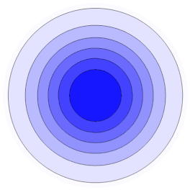
Parametrization and physical content
Parametrization of a correlator is not unique unclear physical content
What do we learn about the nucleon structure from , , , , … ?
Example: LF charge distribution
Transverse plane
Monopole

Slide 15
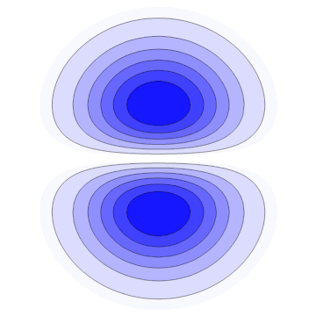
Parametrization and physical content
Parametrization of a correlator is not unique unclear physical content
What do we learn about the nucleon structure from , , , , … ?
Example: LF charge distribution
Transverse plane
Monopole
Dipole
Transverse OAM !

Slide 16
EM moments of elementary spin-j particles
Non-trivial multipole
OAM
Anomalous EM moments

Slide 17
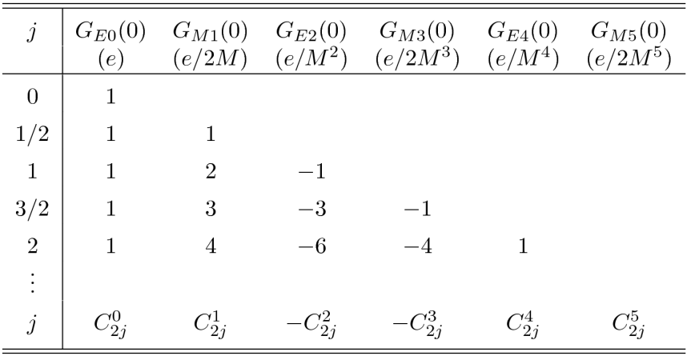
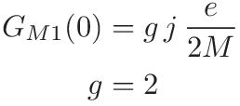
EM moments of elementary spin-j particles
Non-trivial multipole
OAM
Anomalous EM moments
Standard Model
Supergravity
Universal gyromagnetic ratio
Belinfante’s conjecture based on minimal coupling
[C.L. (2009)]

Slide 18
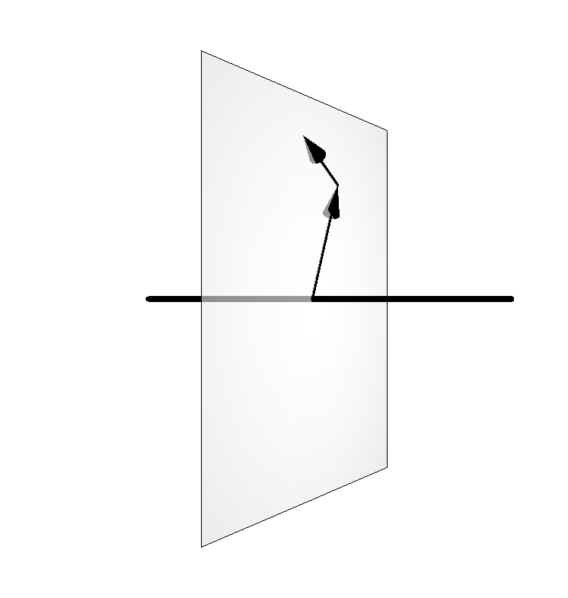
Phase-space transverse modes
16 leading-twist complex-valued GTMDs 32 phase-space distributions
[Meissner, Metz, Schlegel (2009)]
Let us focus on the transverse phase space
2+2D

Slide 19
Phase-space transverse modes
[C.L., Pasquini, PRD93 (2016)]

Slide 20
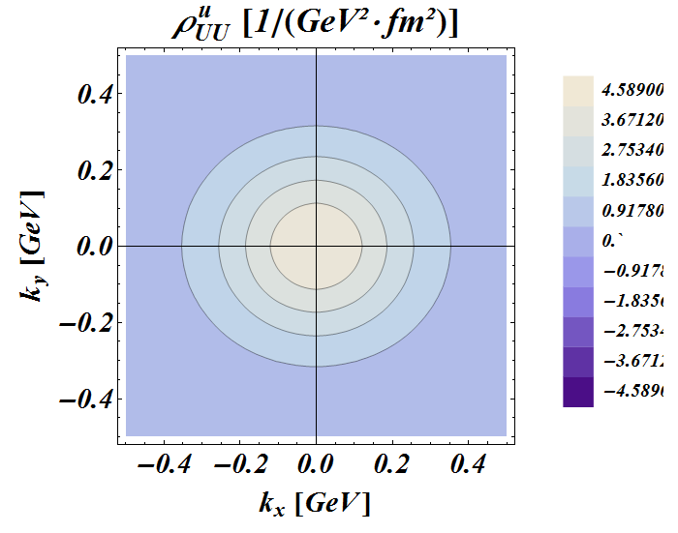
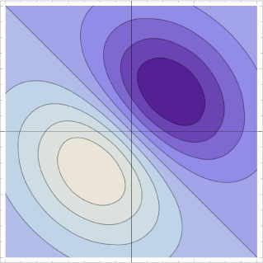
Phase-space transverse modes
[C.L., Pasquini, PRD93 (2016)]

Slide 21
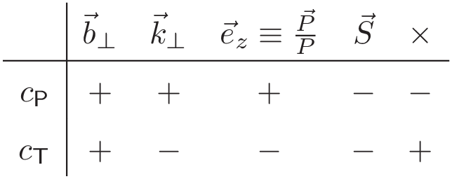
Phase-space transverse modes
Properties under
parity and time-reversal
[C.L., Pasquini, PRD93 (2016)]

Slide 22
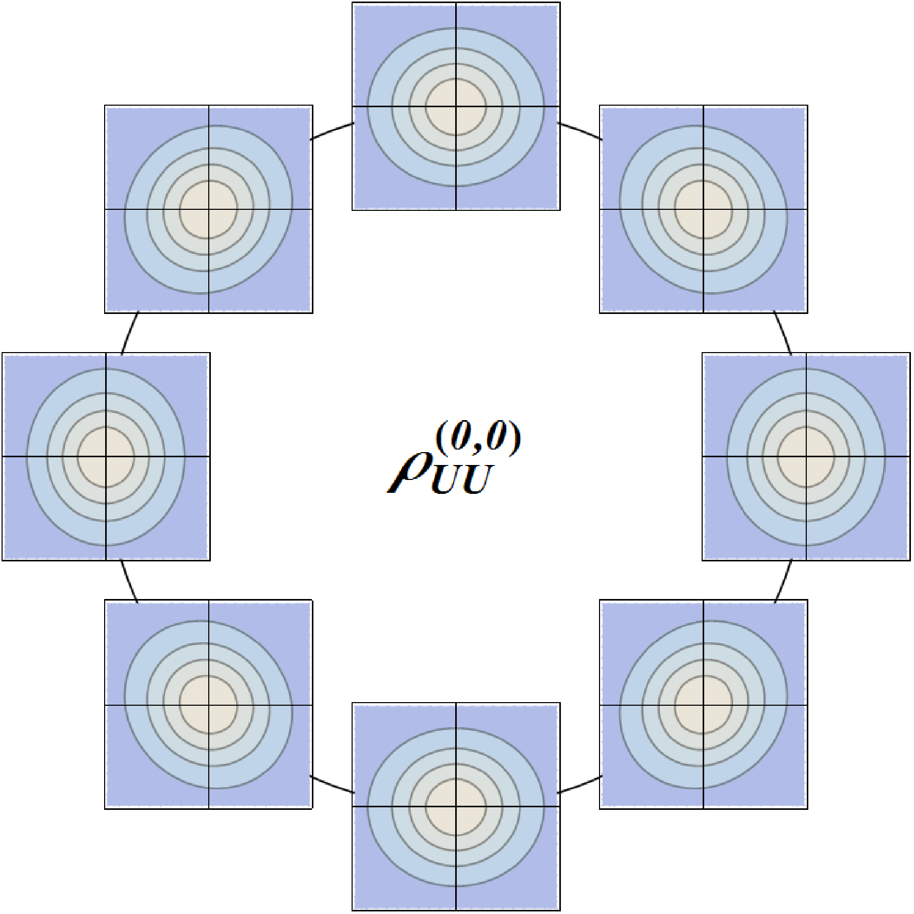
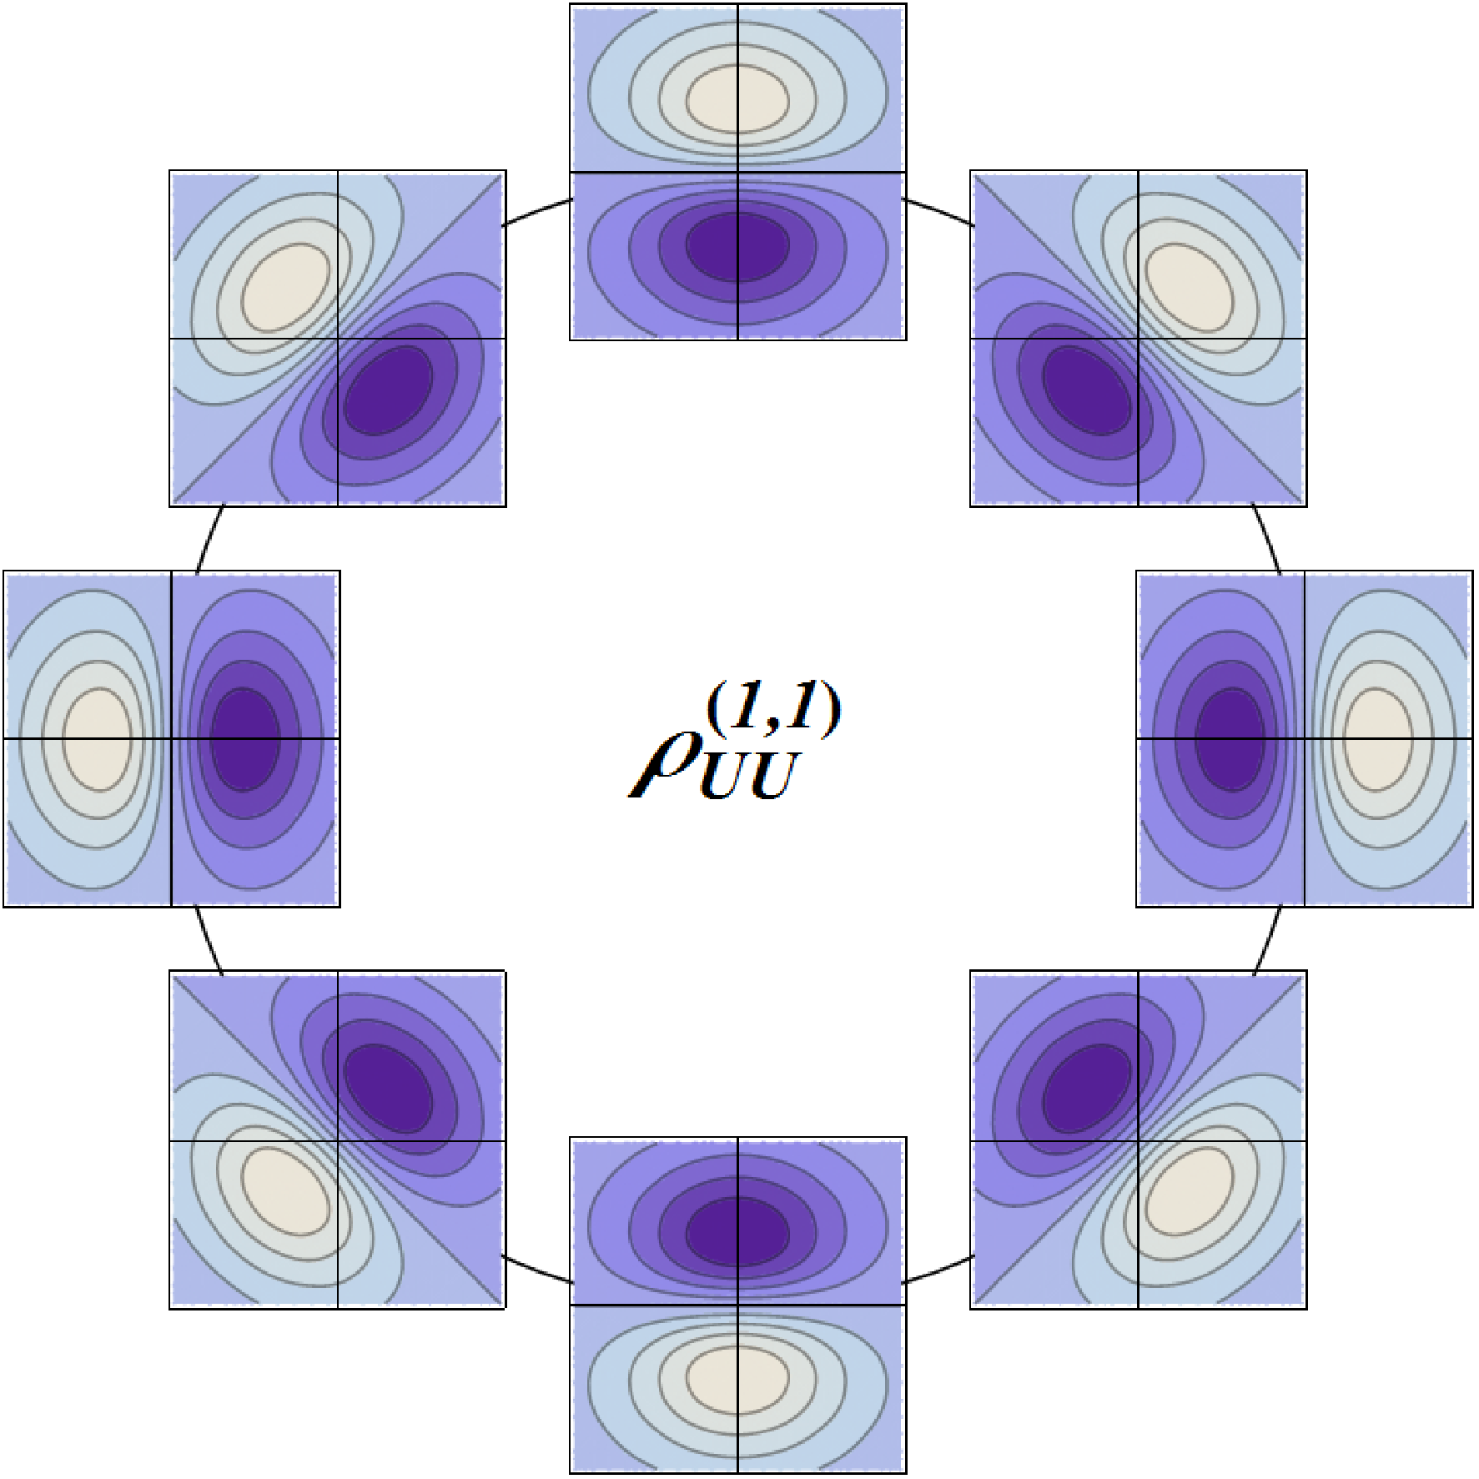
Phase-space transverse modes
UU

Slide 23
Phase-space transverse modes
UU

Slide 24
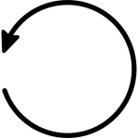
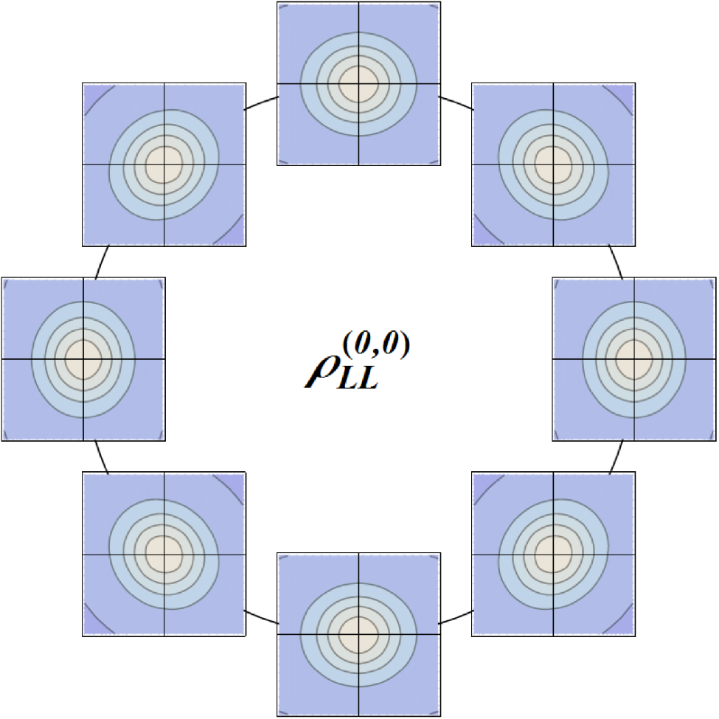
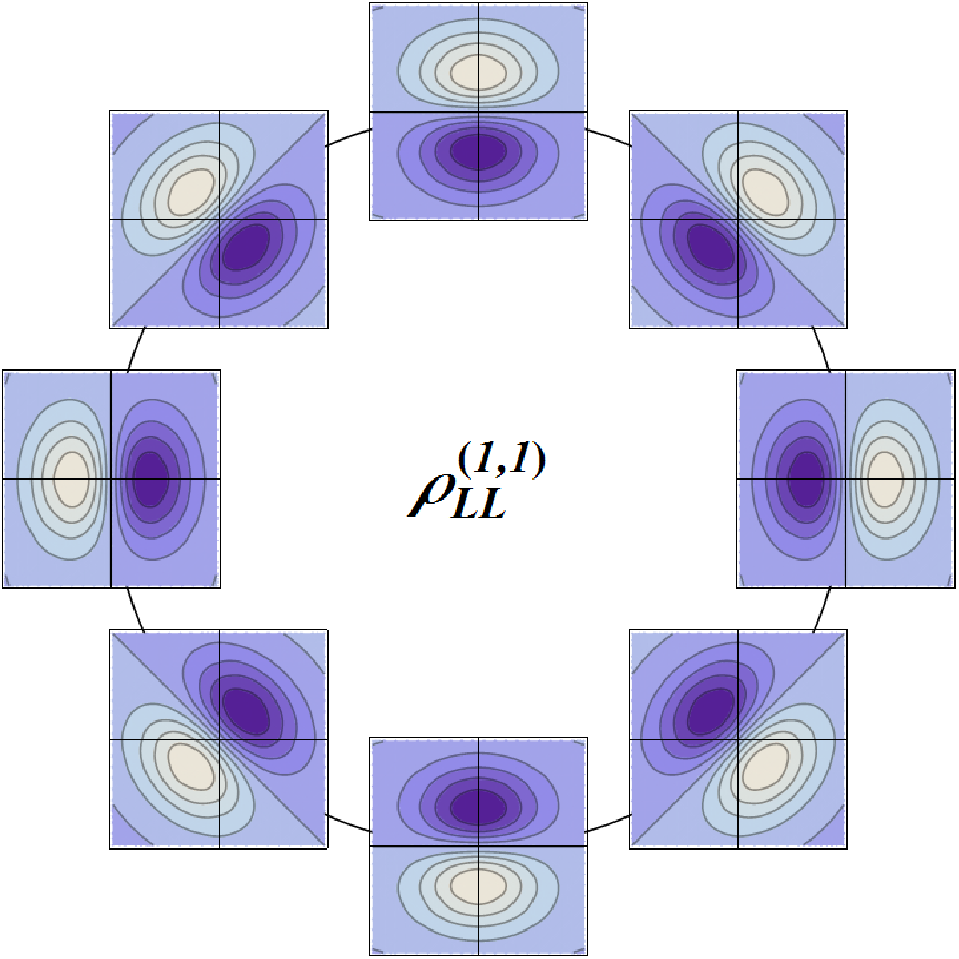
Phase-space transverse modes
LL

Slide 25
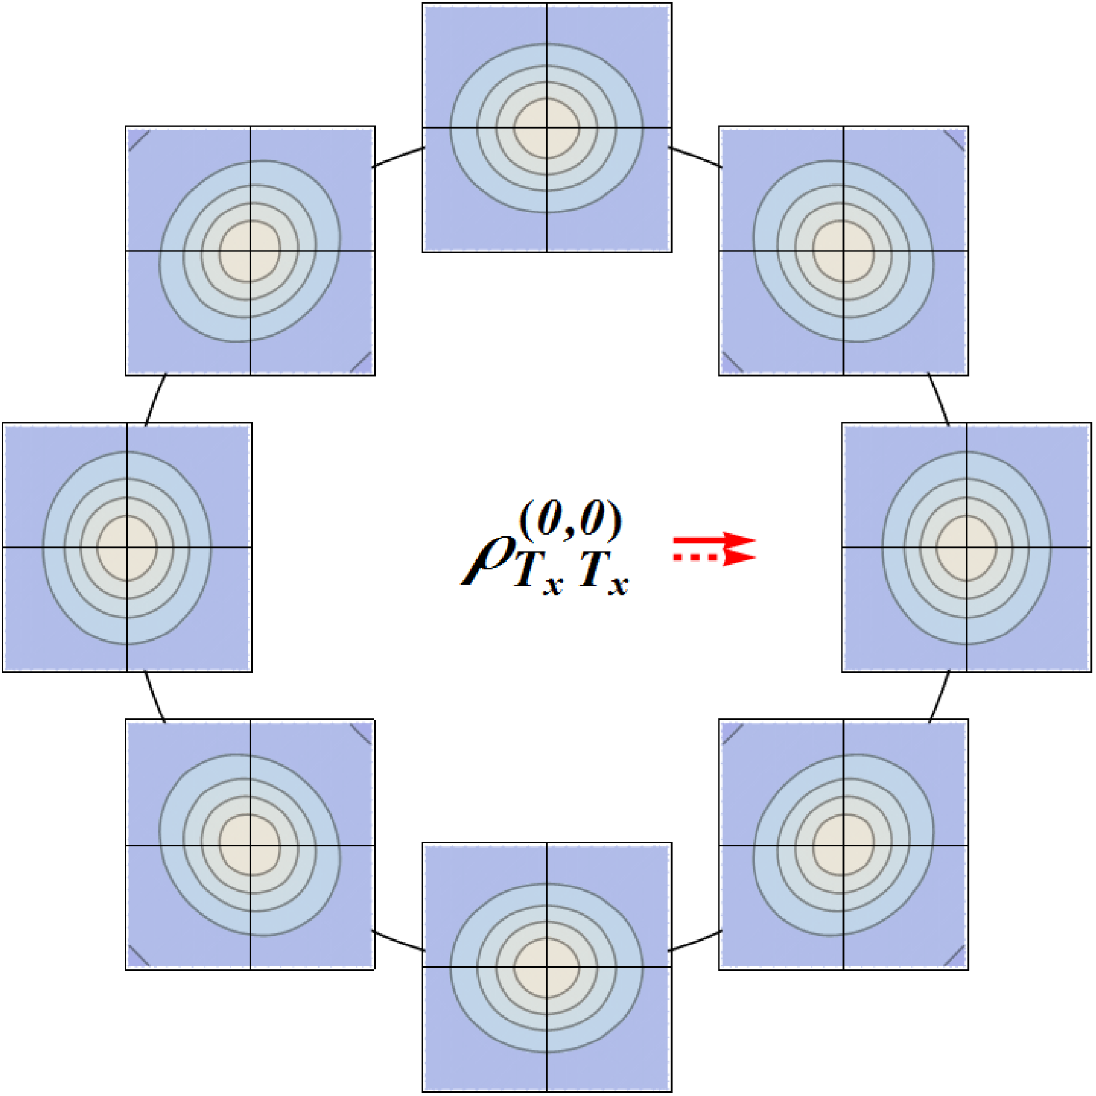
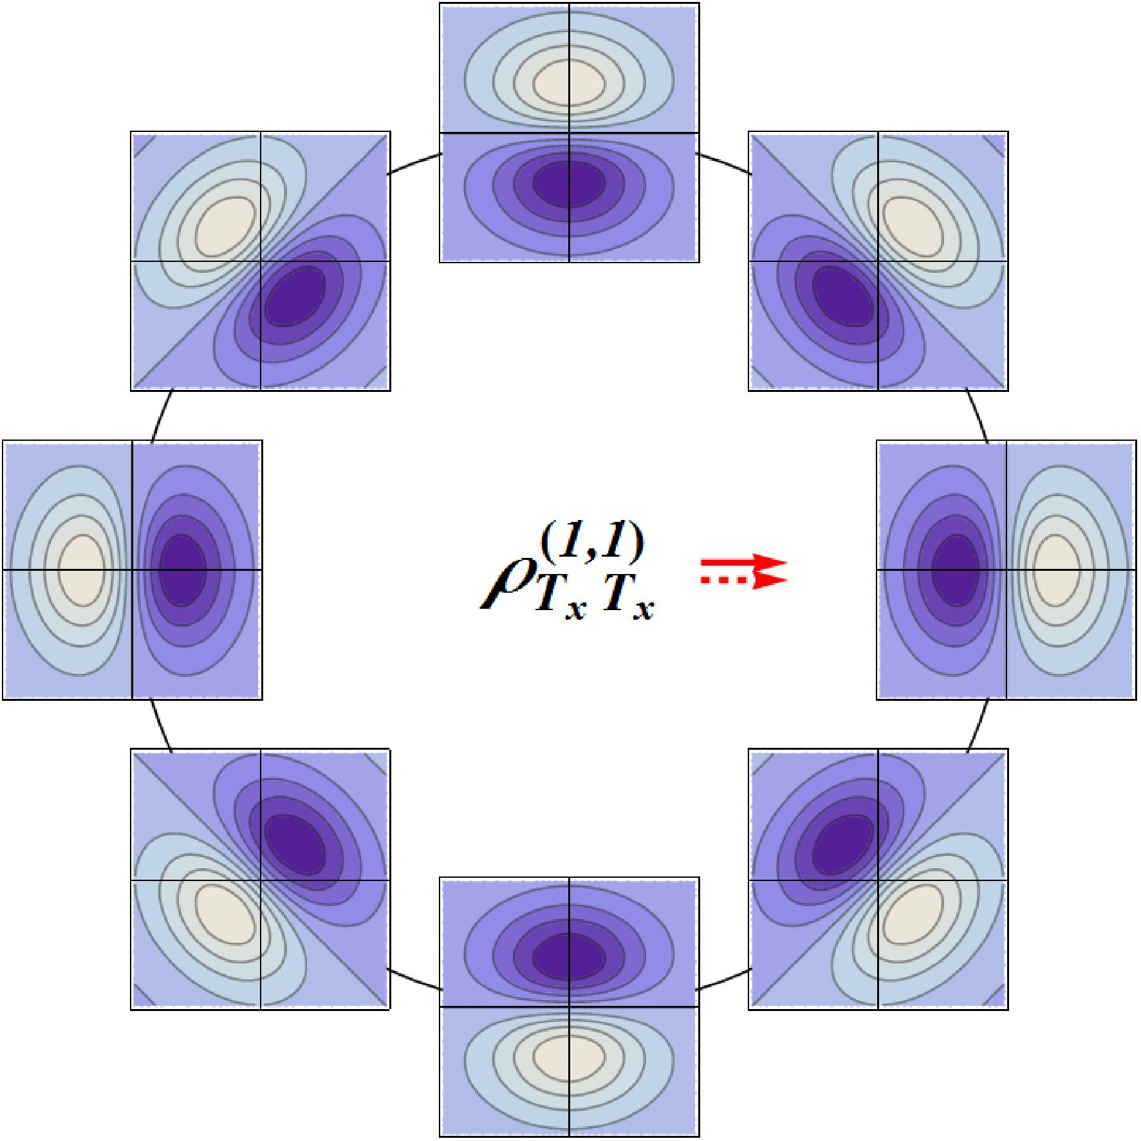
Phase-space transverse modes
TT

Slide 26
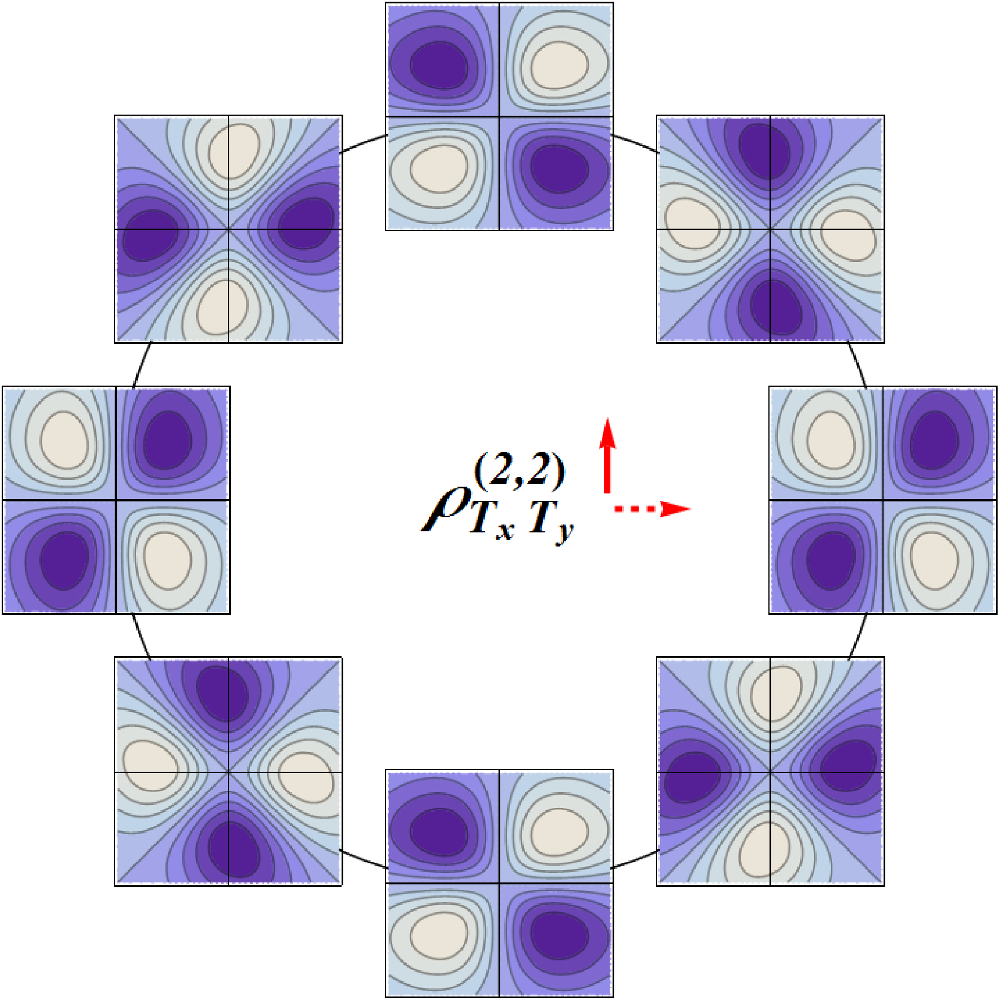
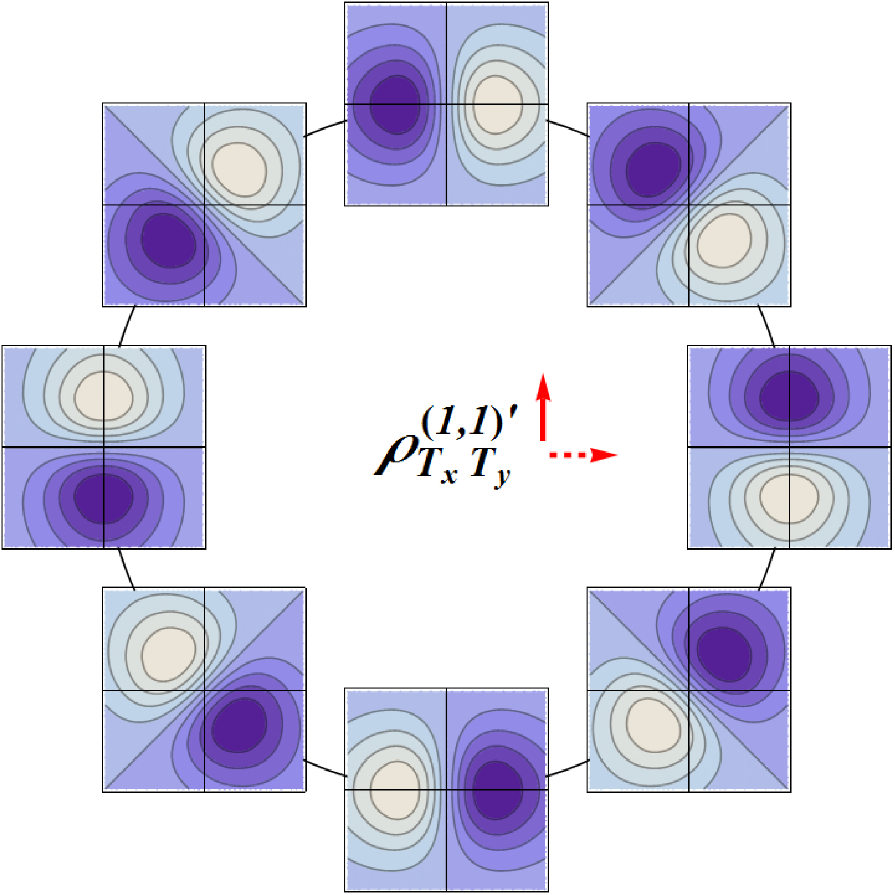
Phase-space transverse modes
TT’

Slide 27
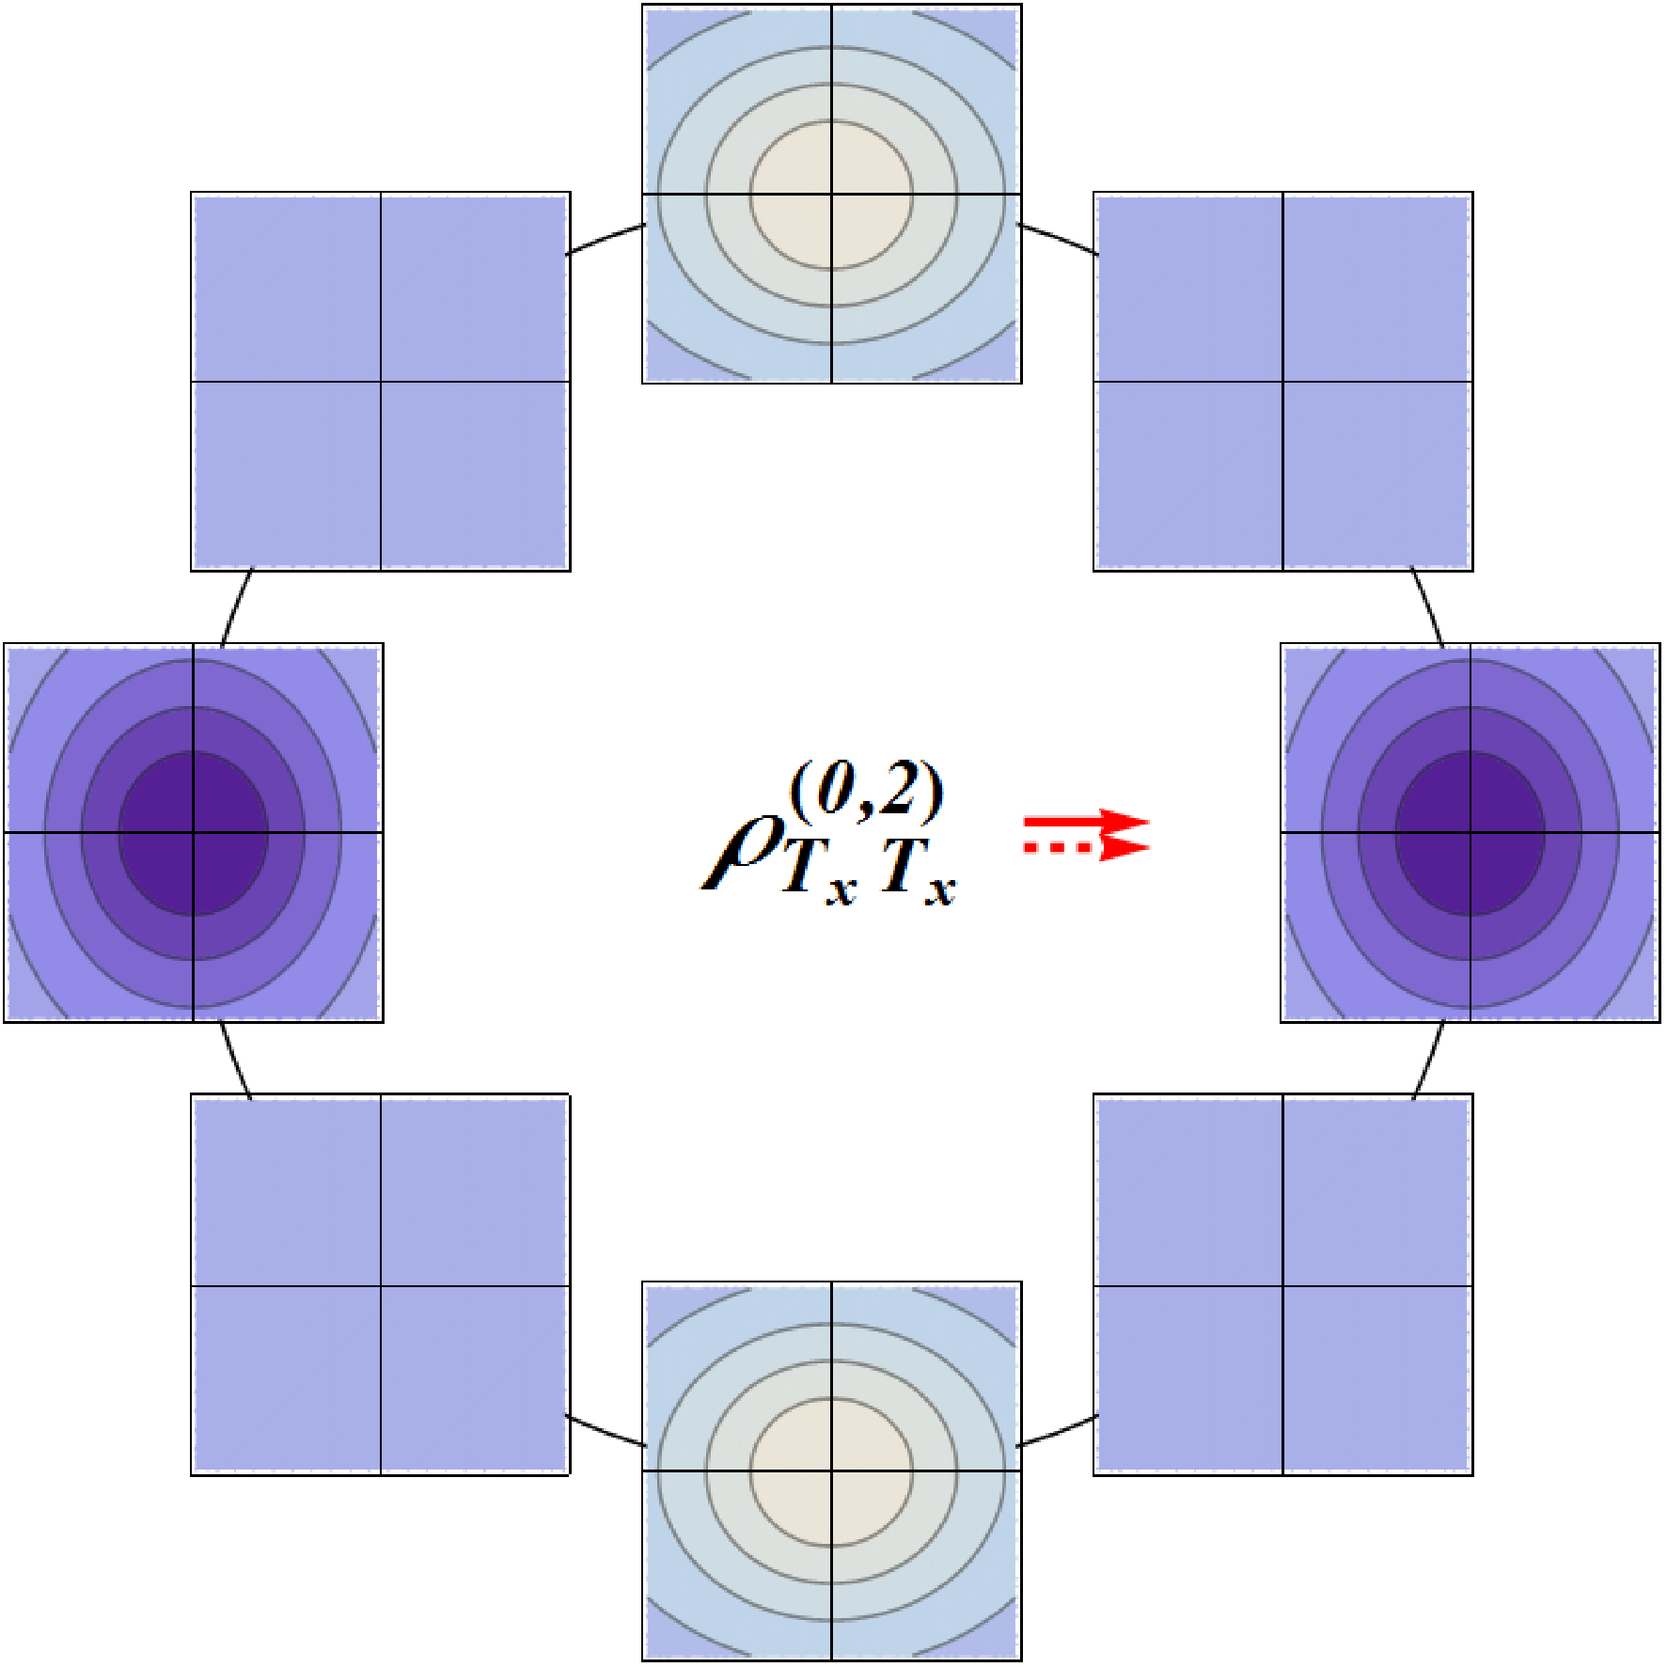
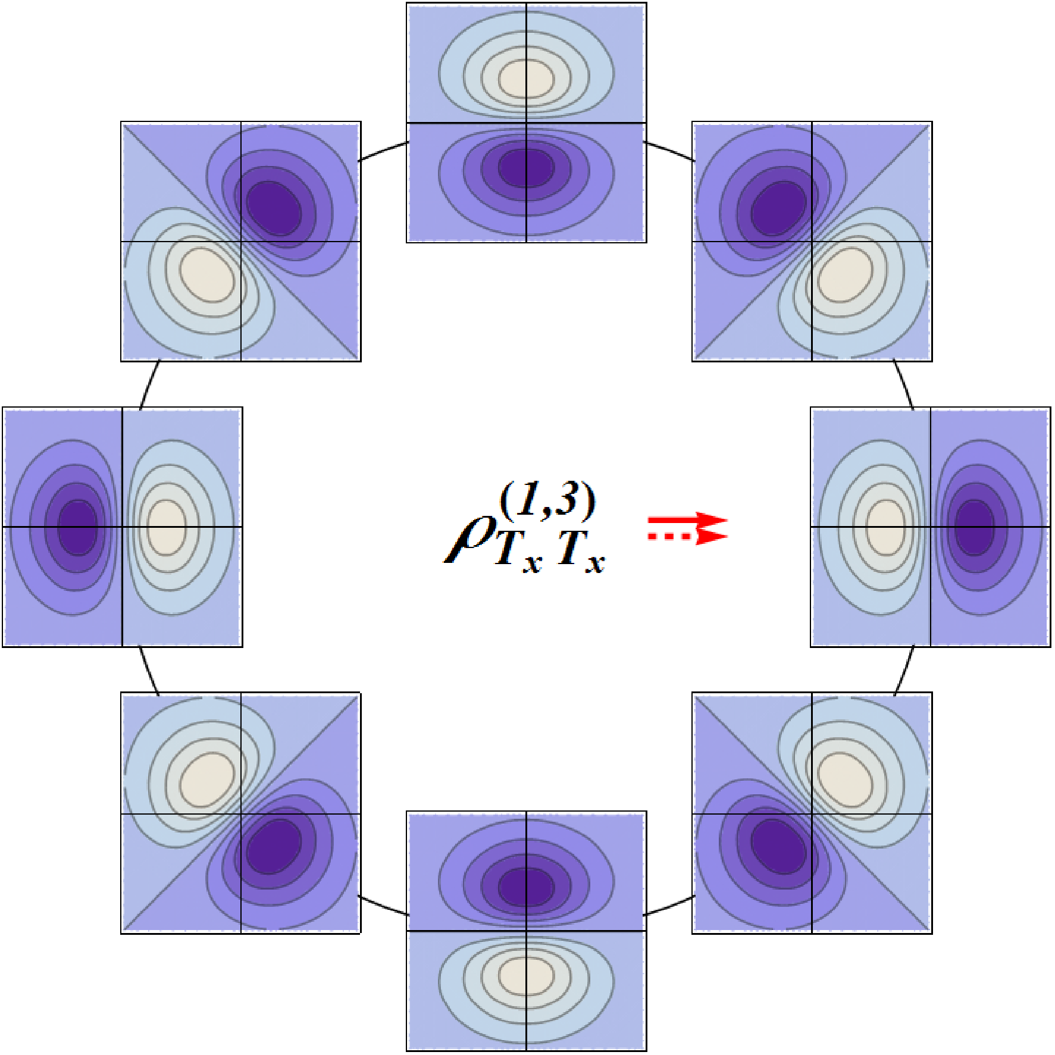
Phase-space transverse modes
Spatial modulation
TT

Slide 28
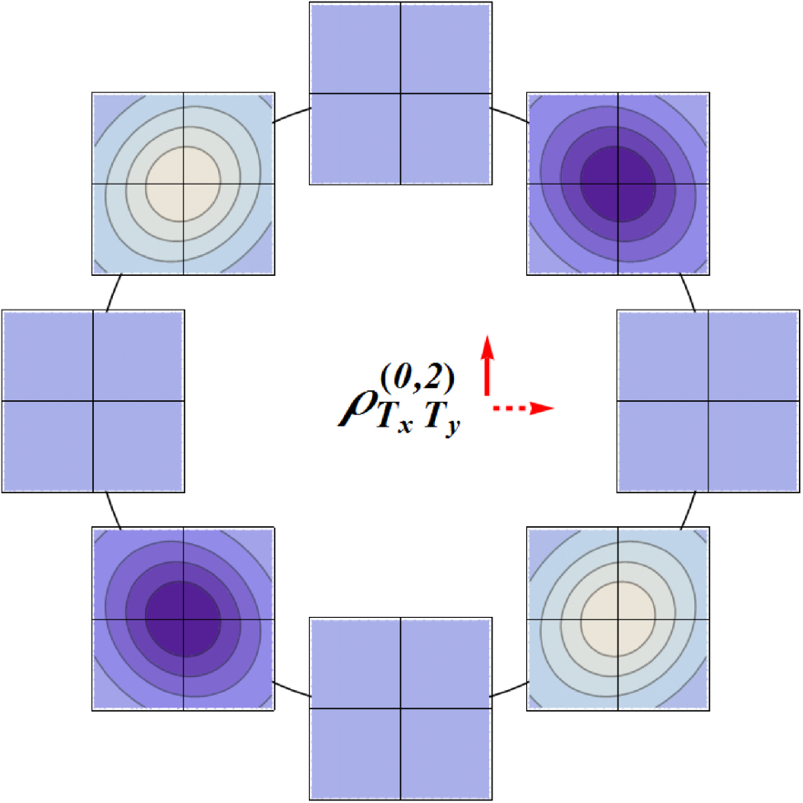
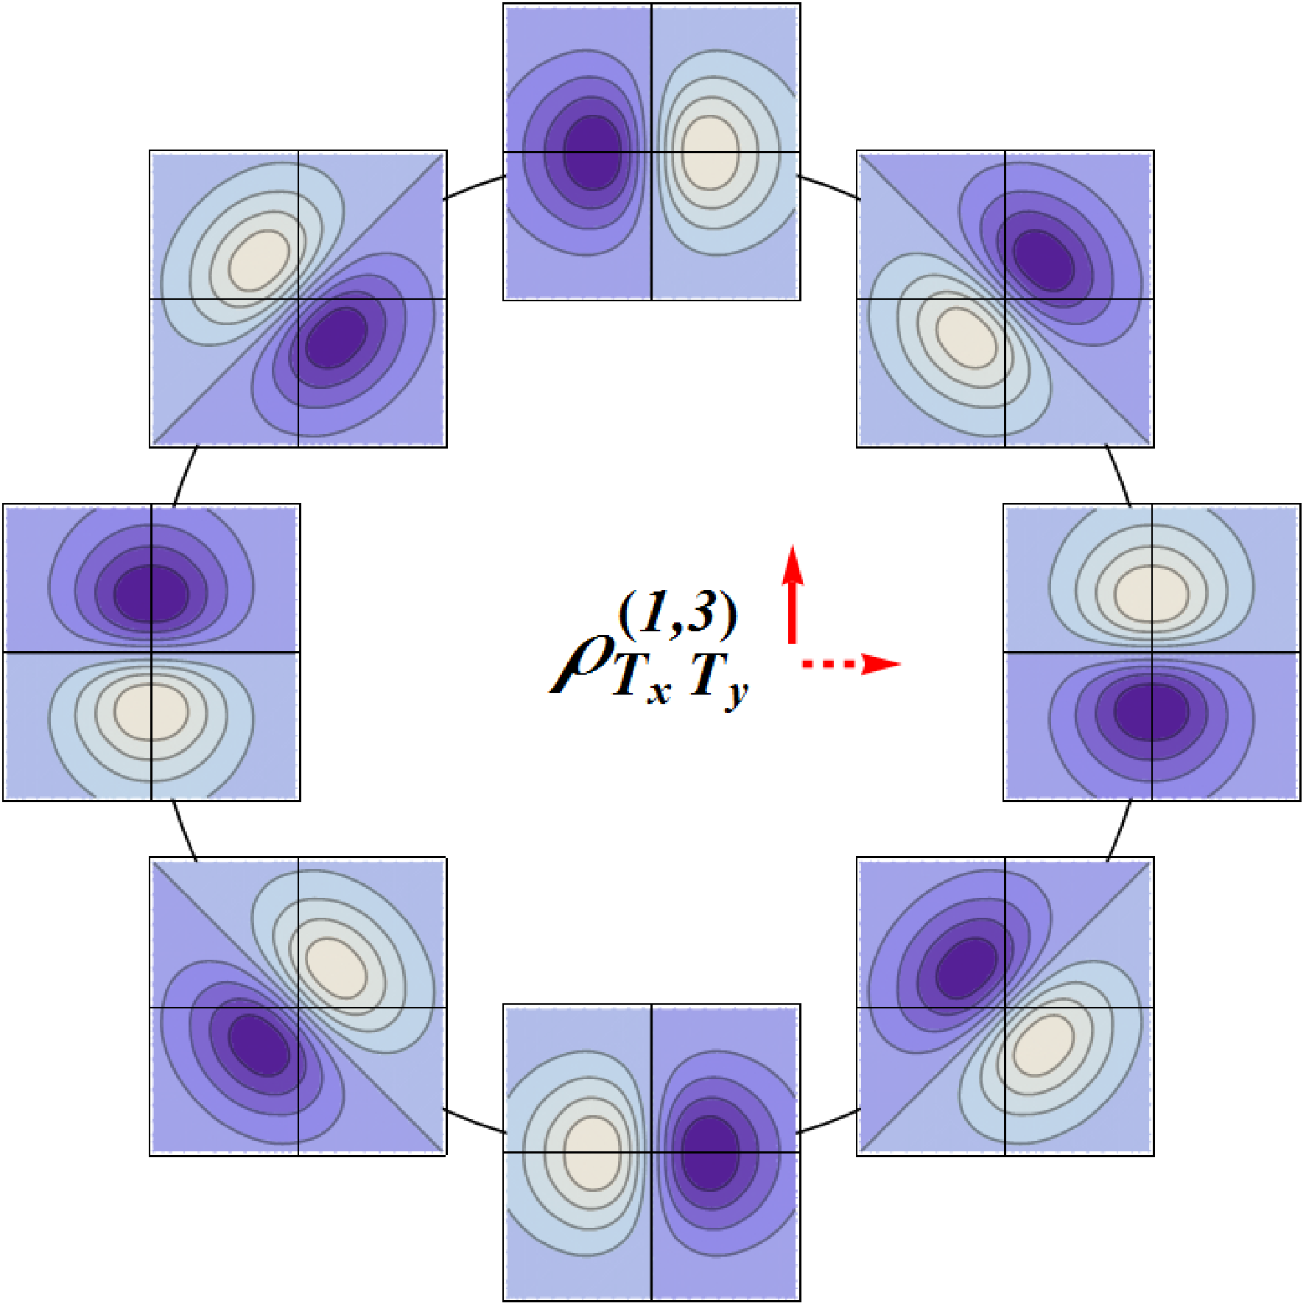
Phase-space transverse modes
Spatial modulation
TT’

Slide 29
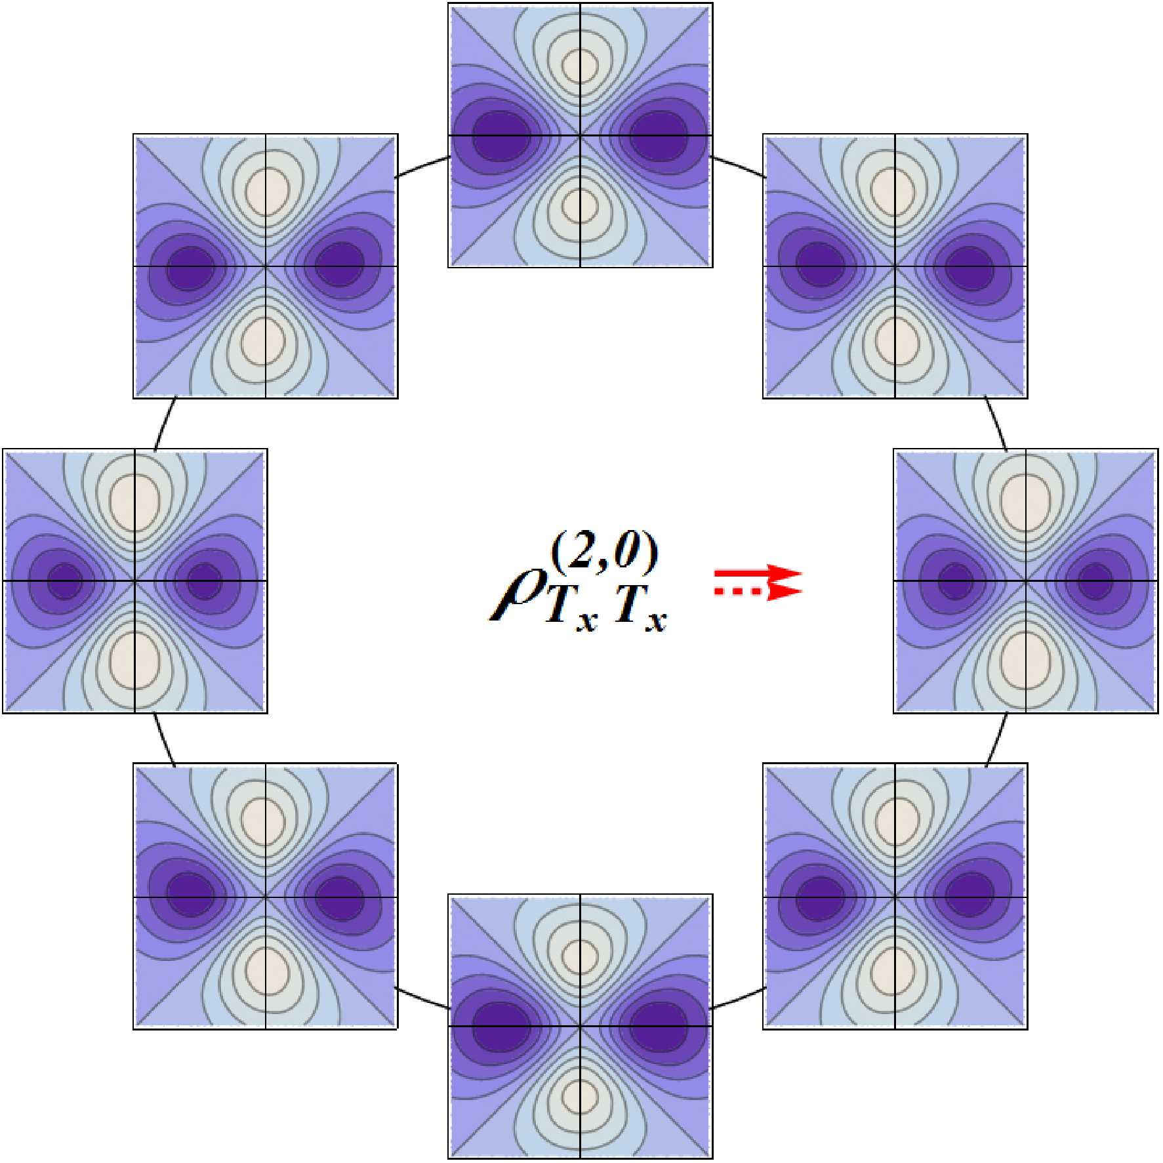
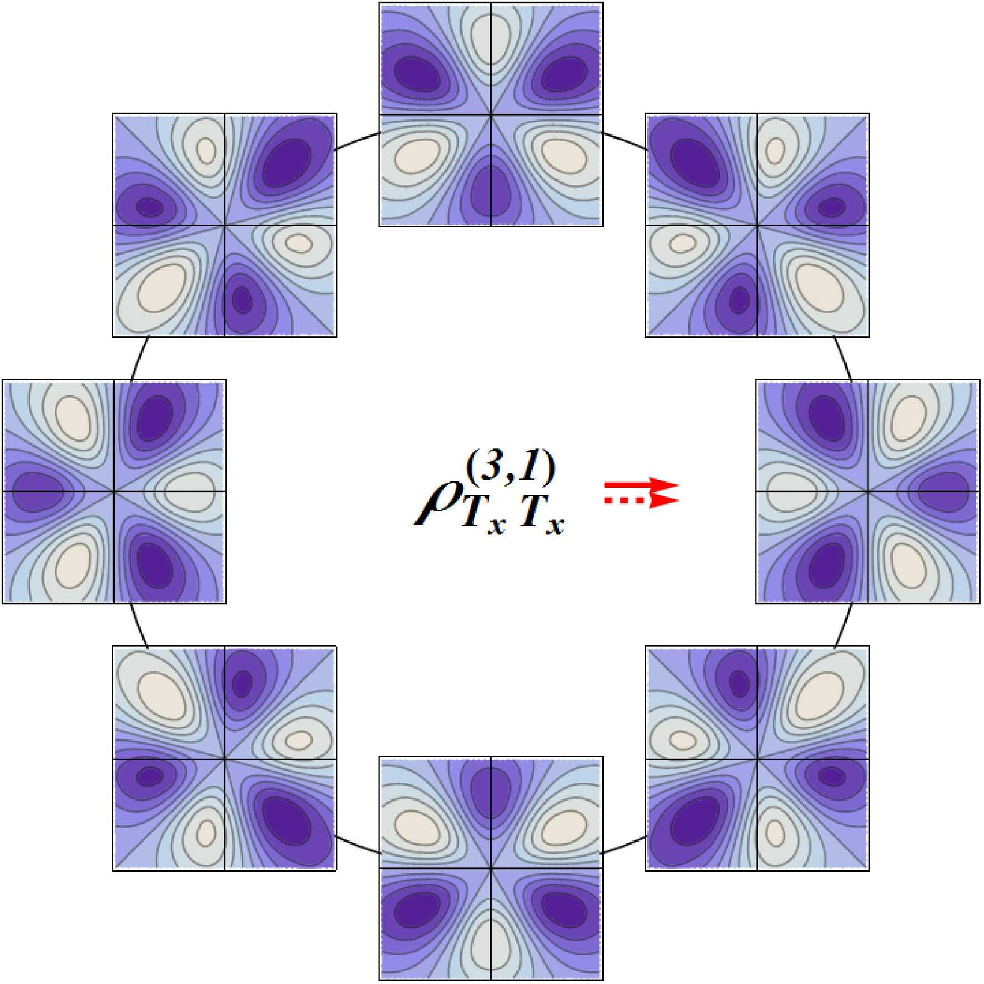
Phase-space transverse modes
Momentum modulation
TT

Slide 30
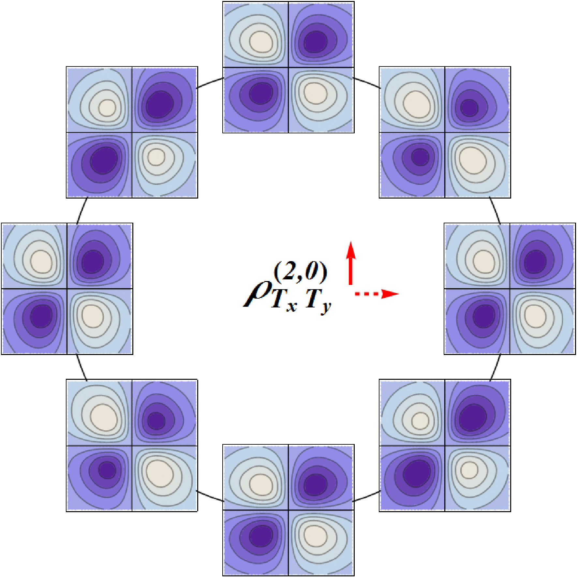
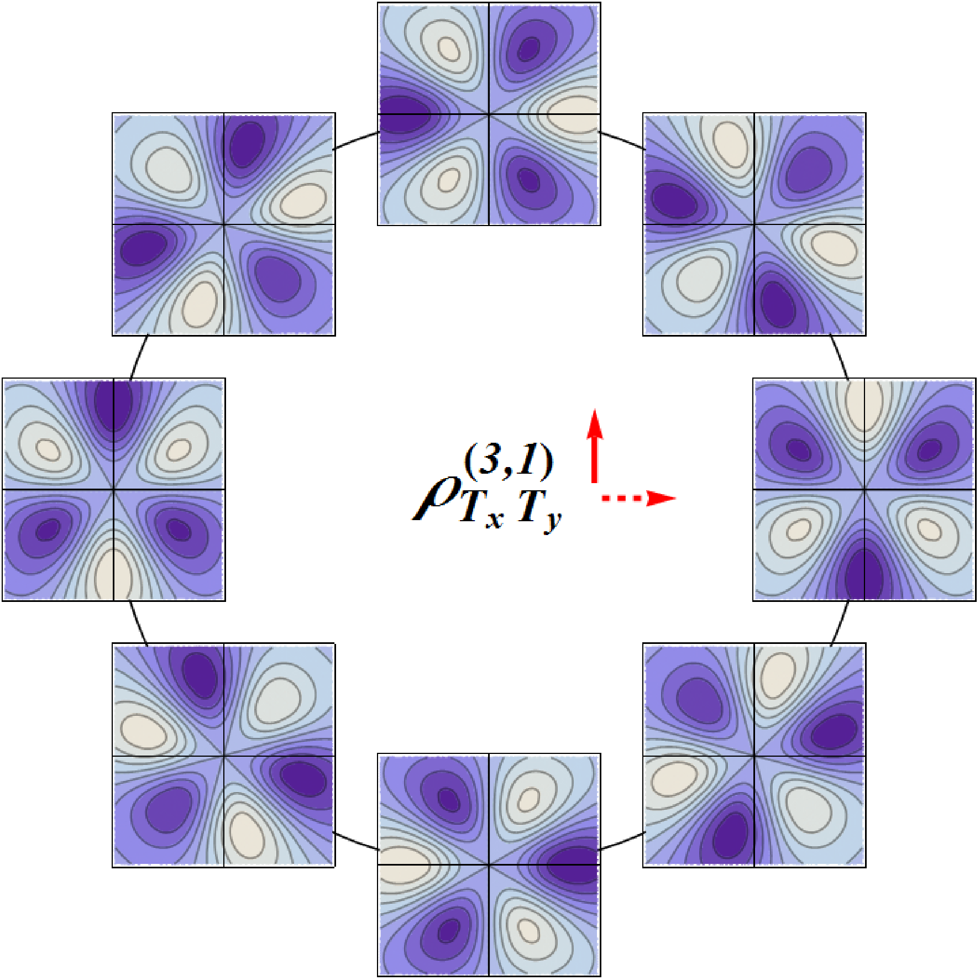
Phase-space transverse modes
Momentum modulation
TT’

Slide 31
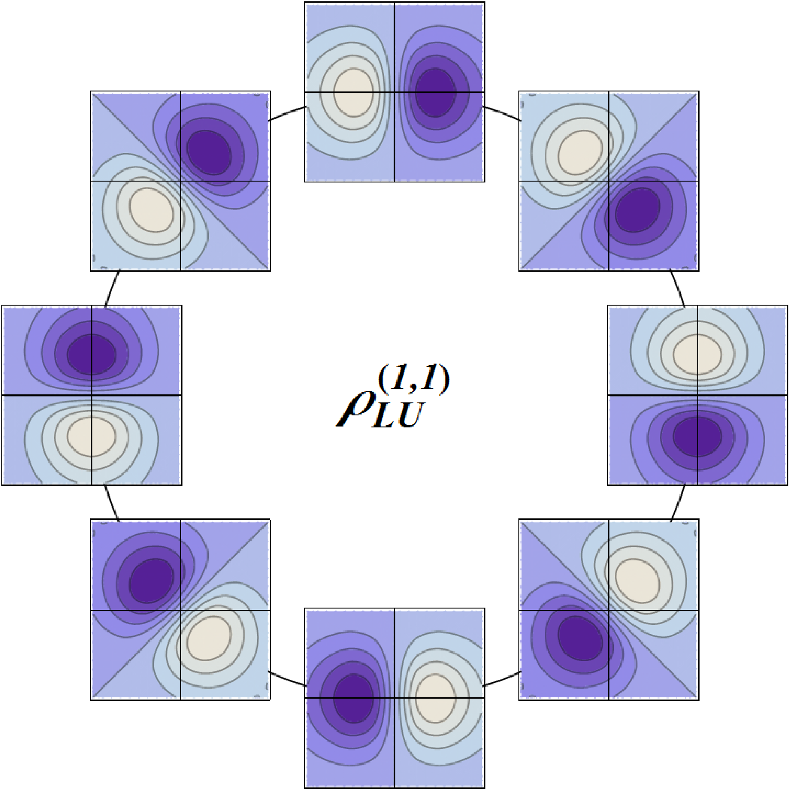
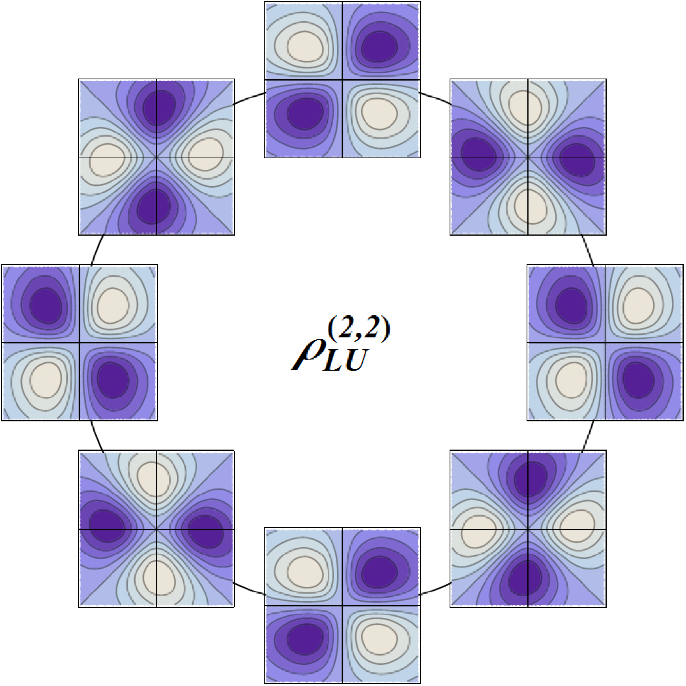
Phase-space transverse modes
LU
OAM !
[C.L., Pasquini (2011)]

Slide 32
Phase-space transverse modes
LU
OAM !
[C.L., Pasquini (2011)]

Slide 33
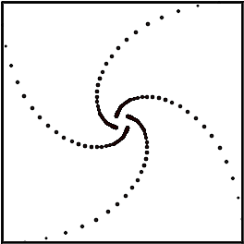
Phase-space transverse modes
LU
OAM !
[C.L., Pasquini (2011)]

Slide 34
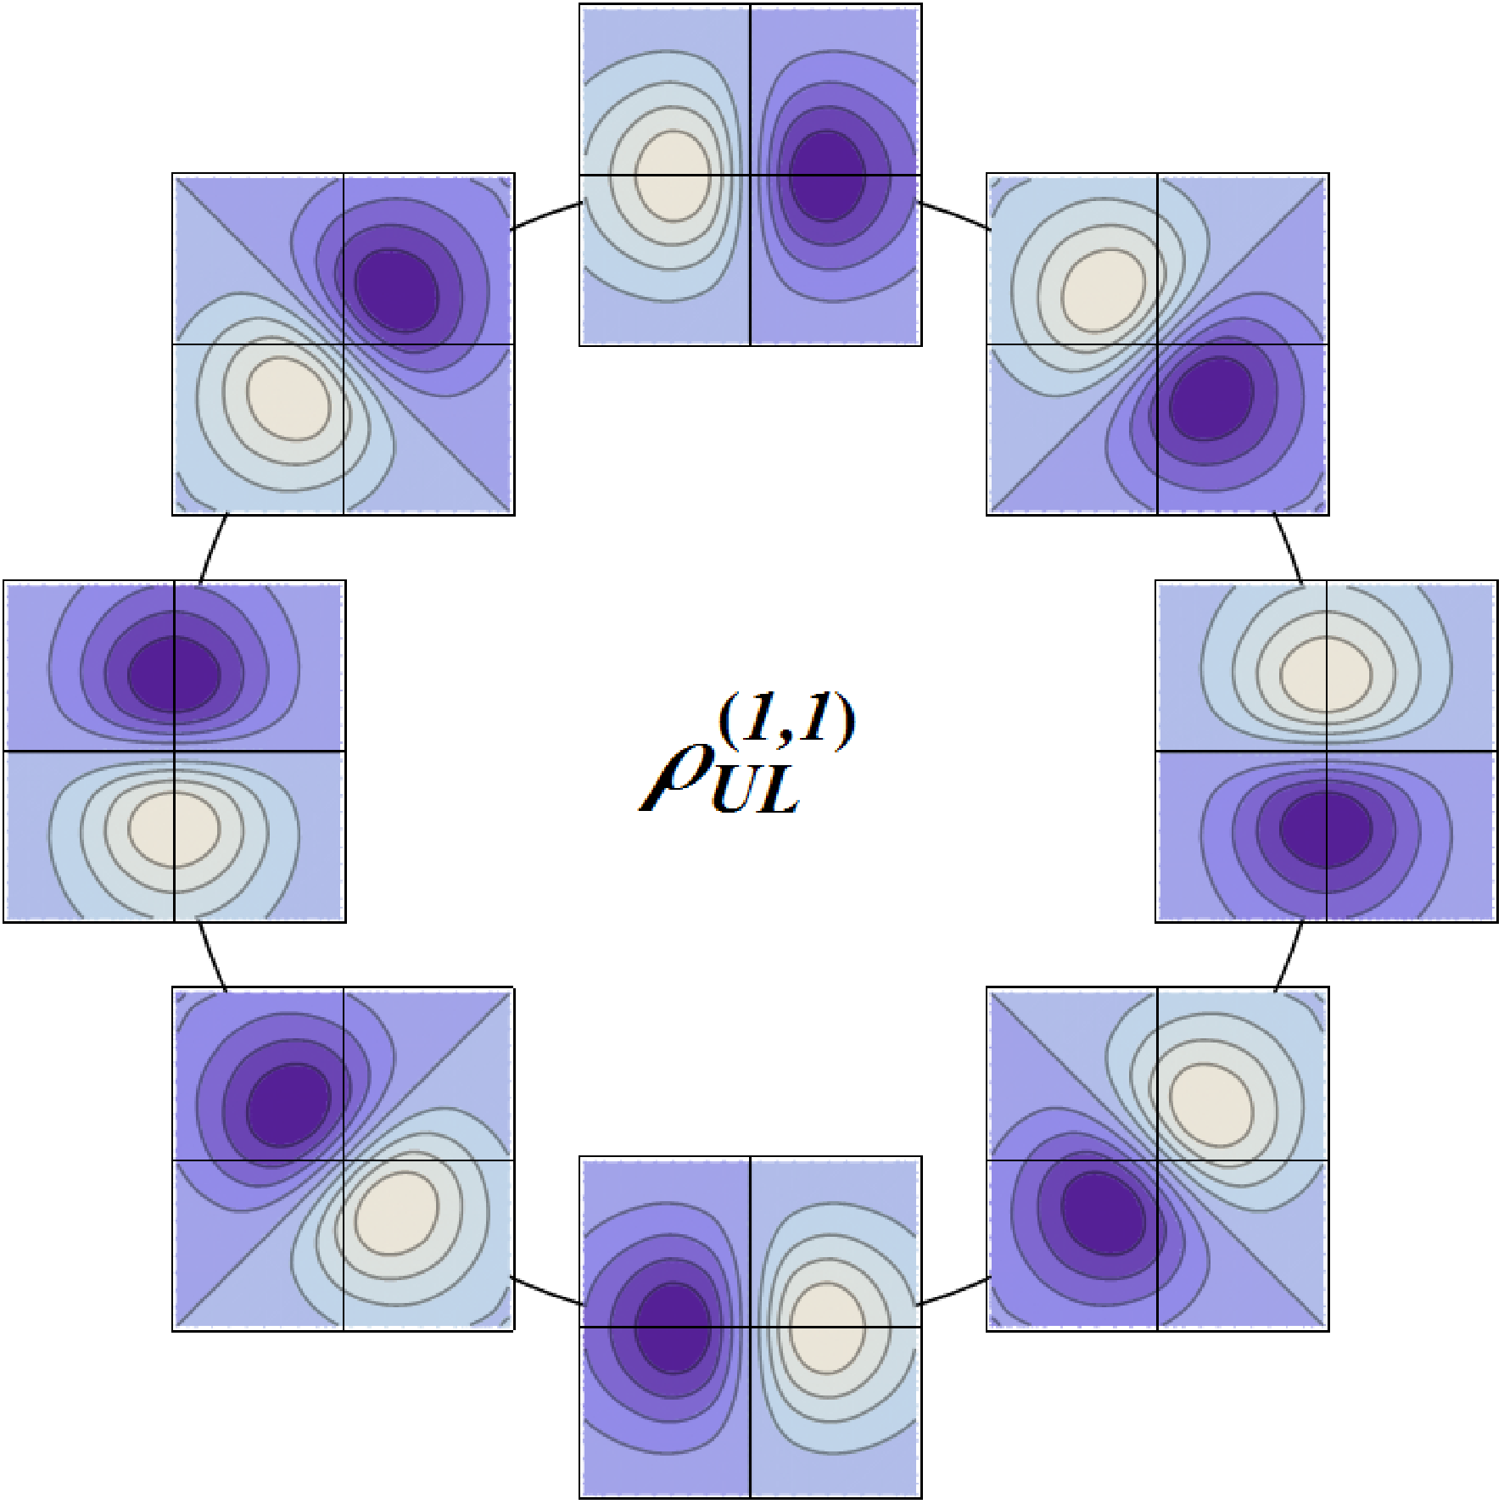
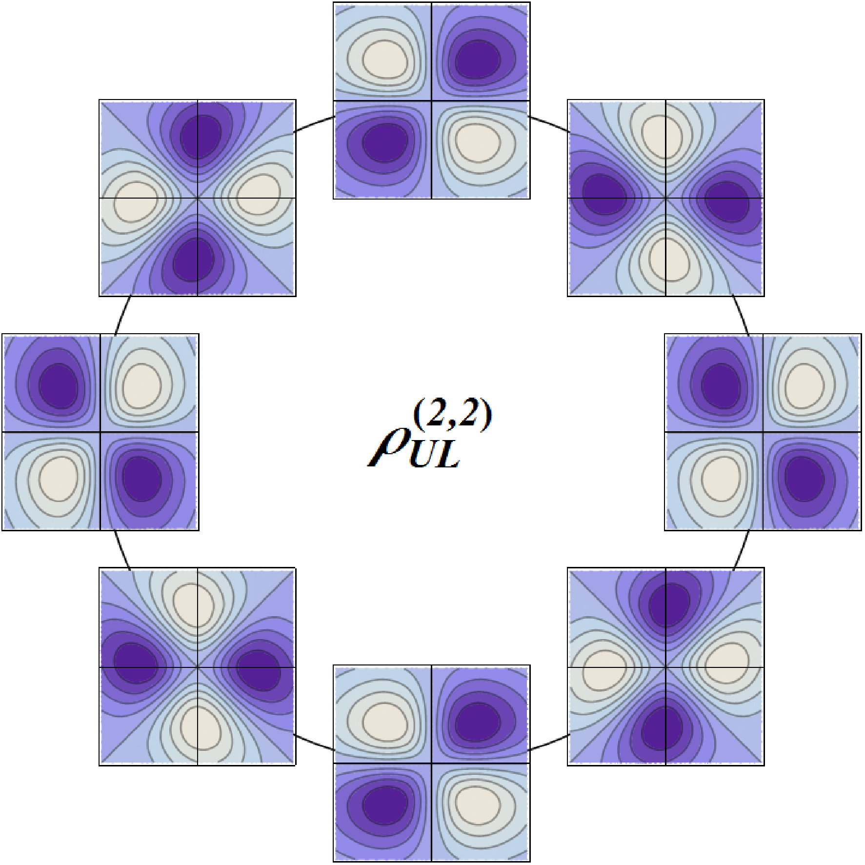
Phase-space transverse modes
UL
Spin-orbit !
[C.L., Pasquini (2011)]

Slide 35
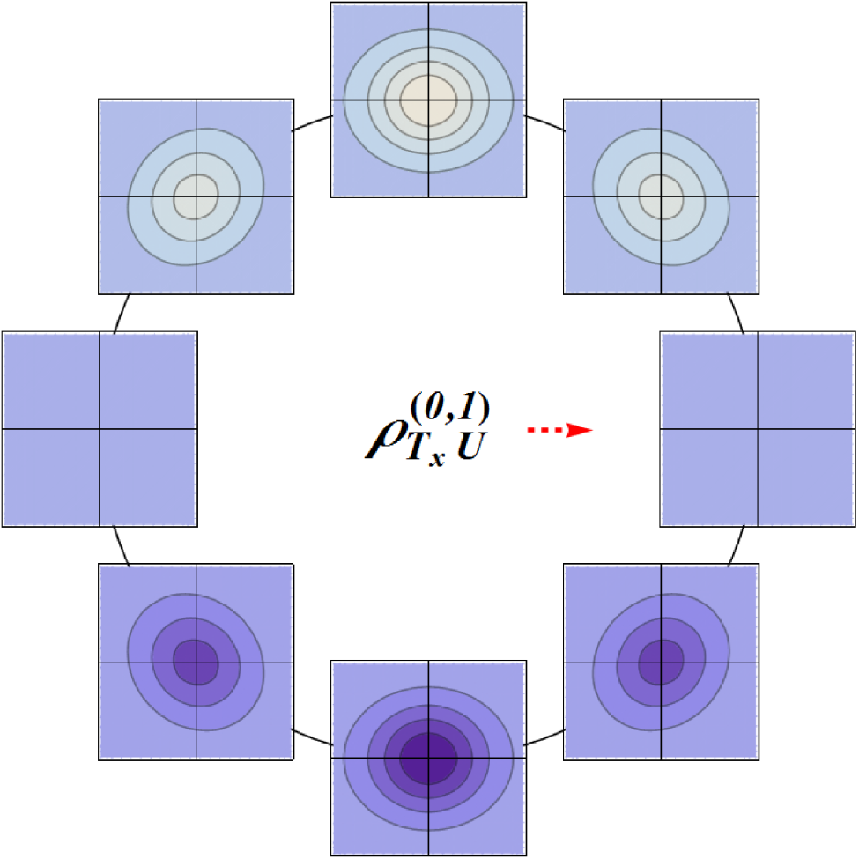
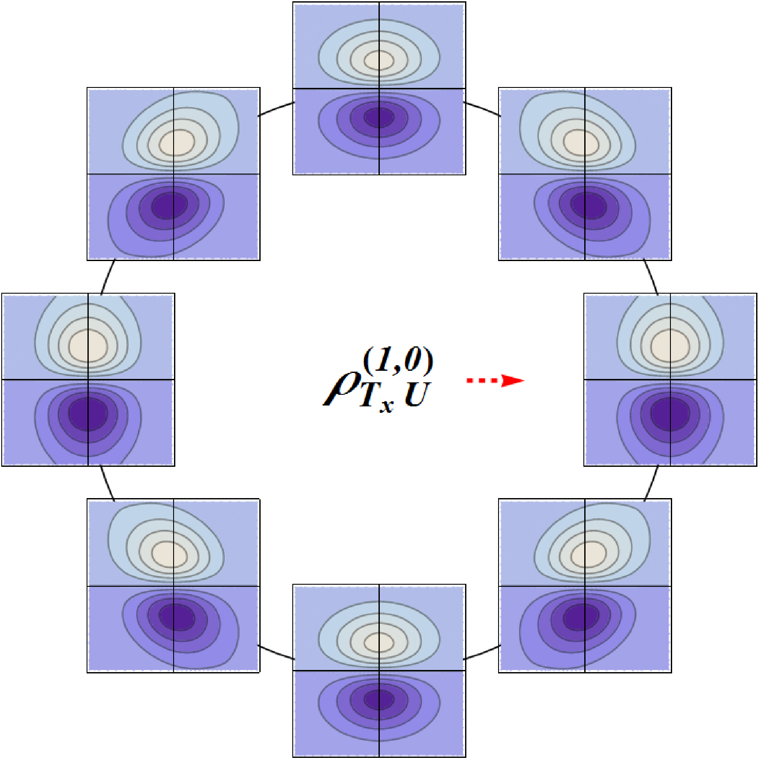
Phase-space transverse modes
TU
Transverse OAM !
[Burkardt (2005)]

Slide 36
Phase-space transverse modes
TU
Transverse OAM !
[Burkardt (2005)]

Slide 37
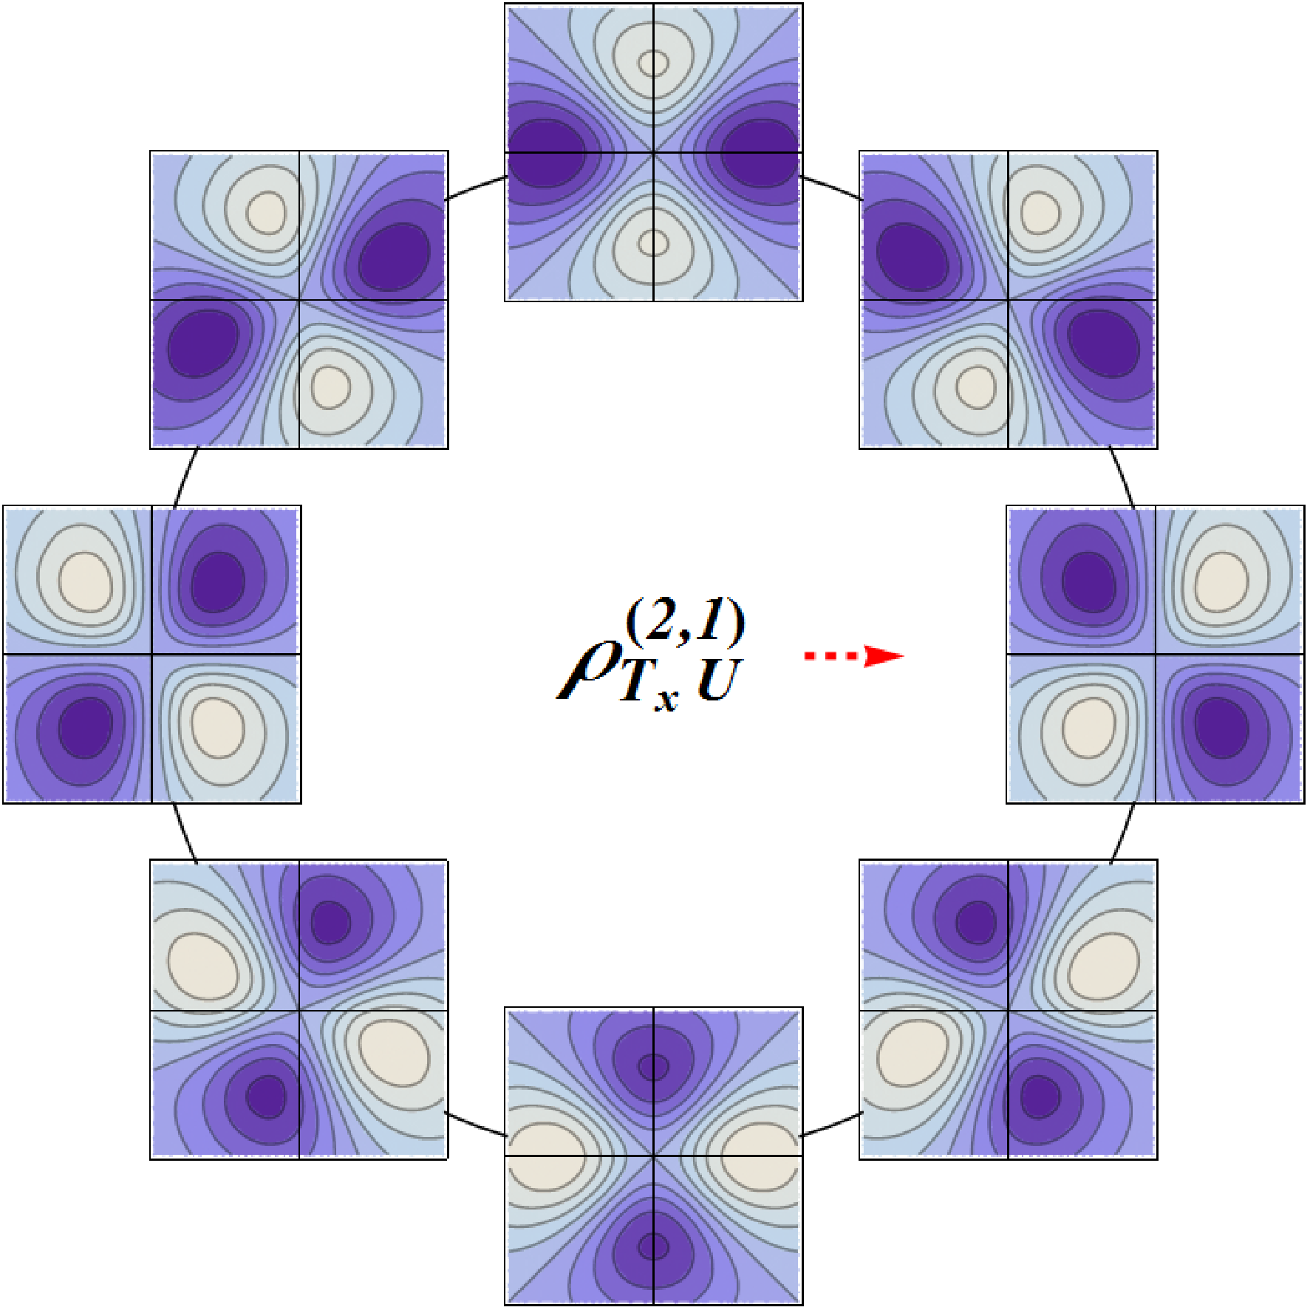
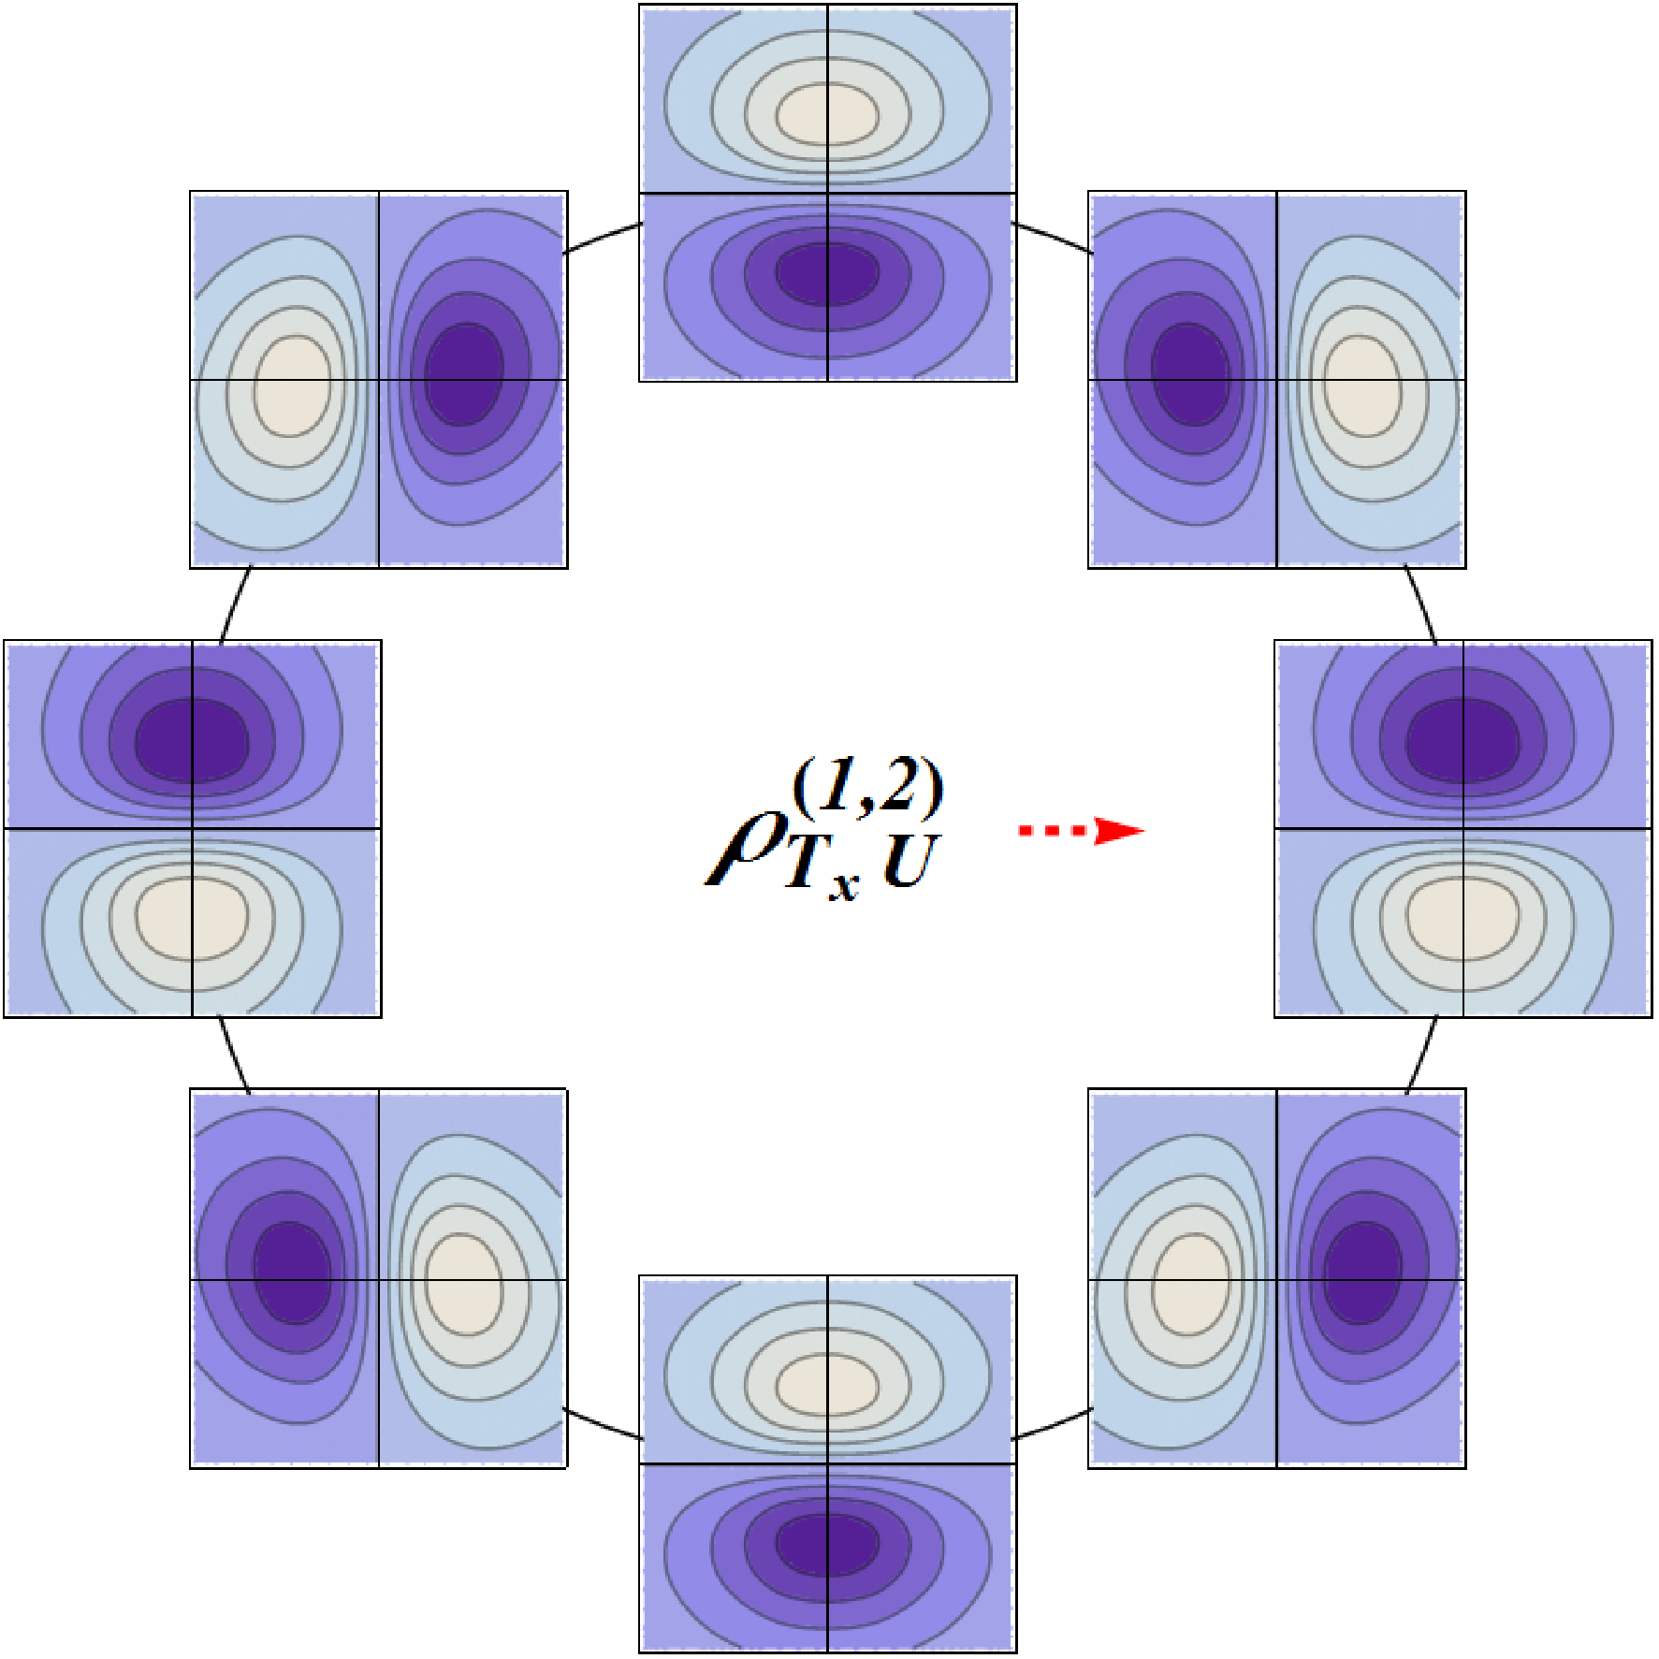
Phase-space transverse modes
TU

Slide 38
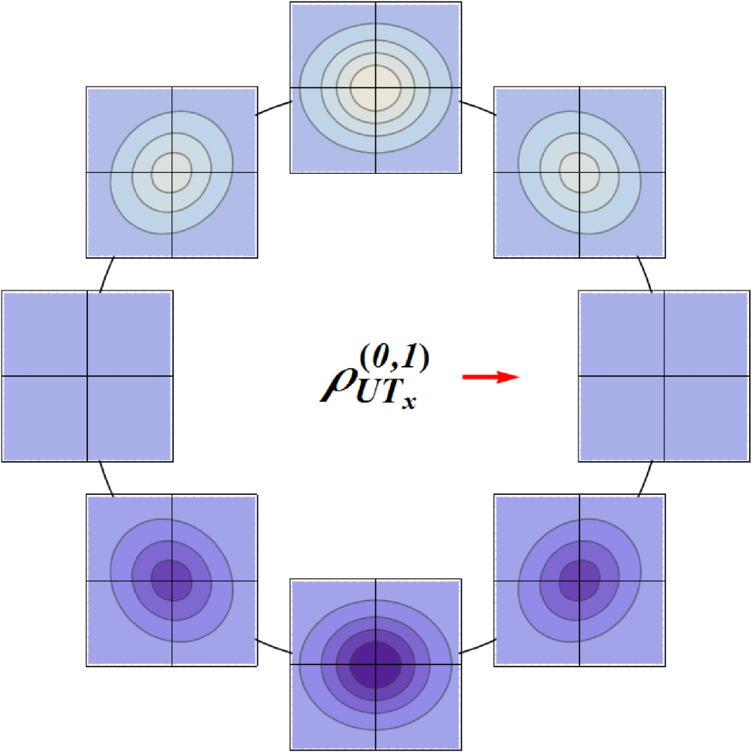
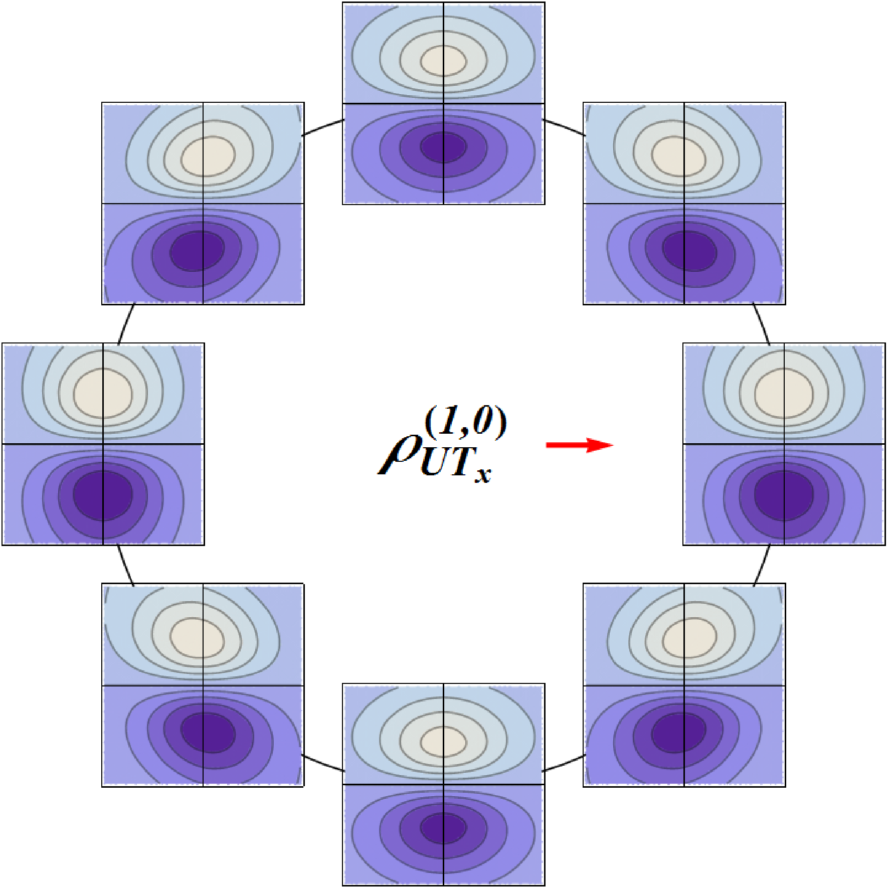
Phase-space transverse modes
UT
Transverse spin-orbit !
[Burkardt (2005)]

Slide 39
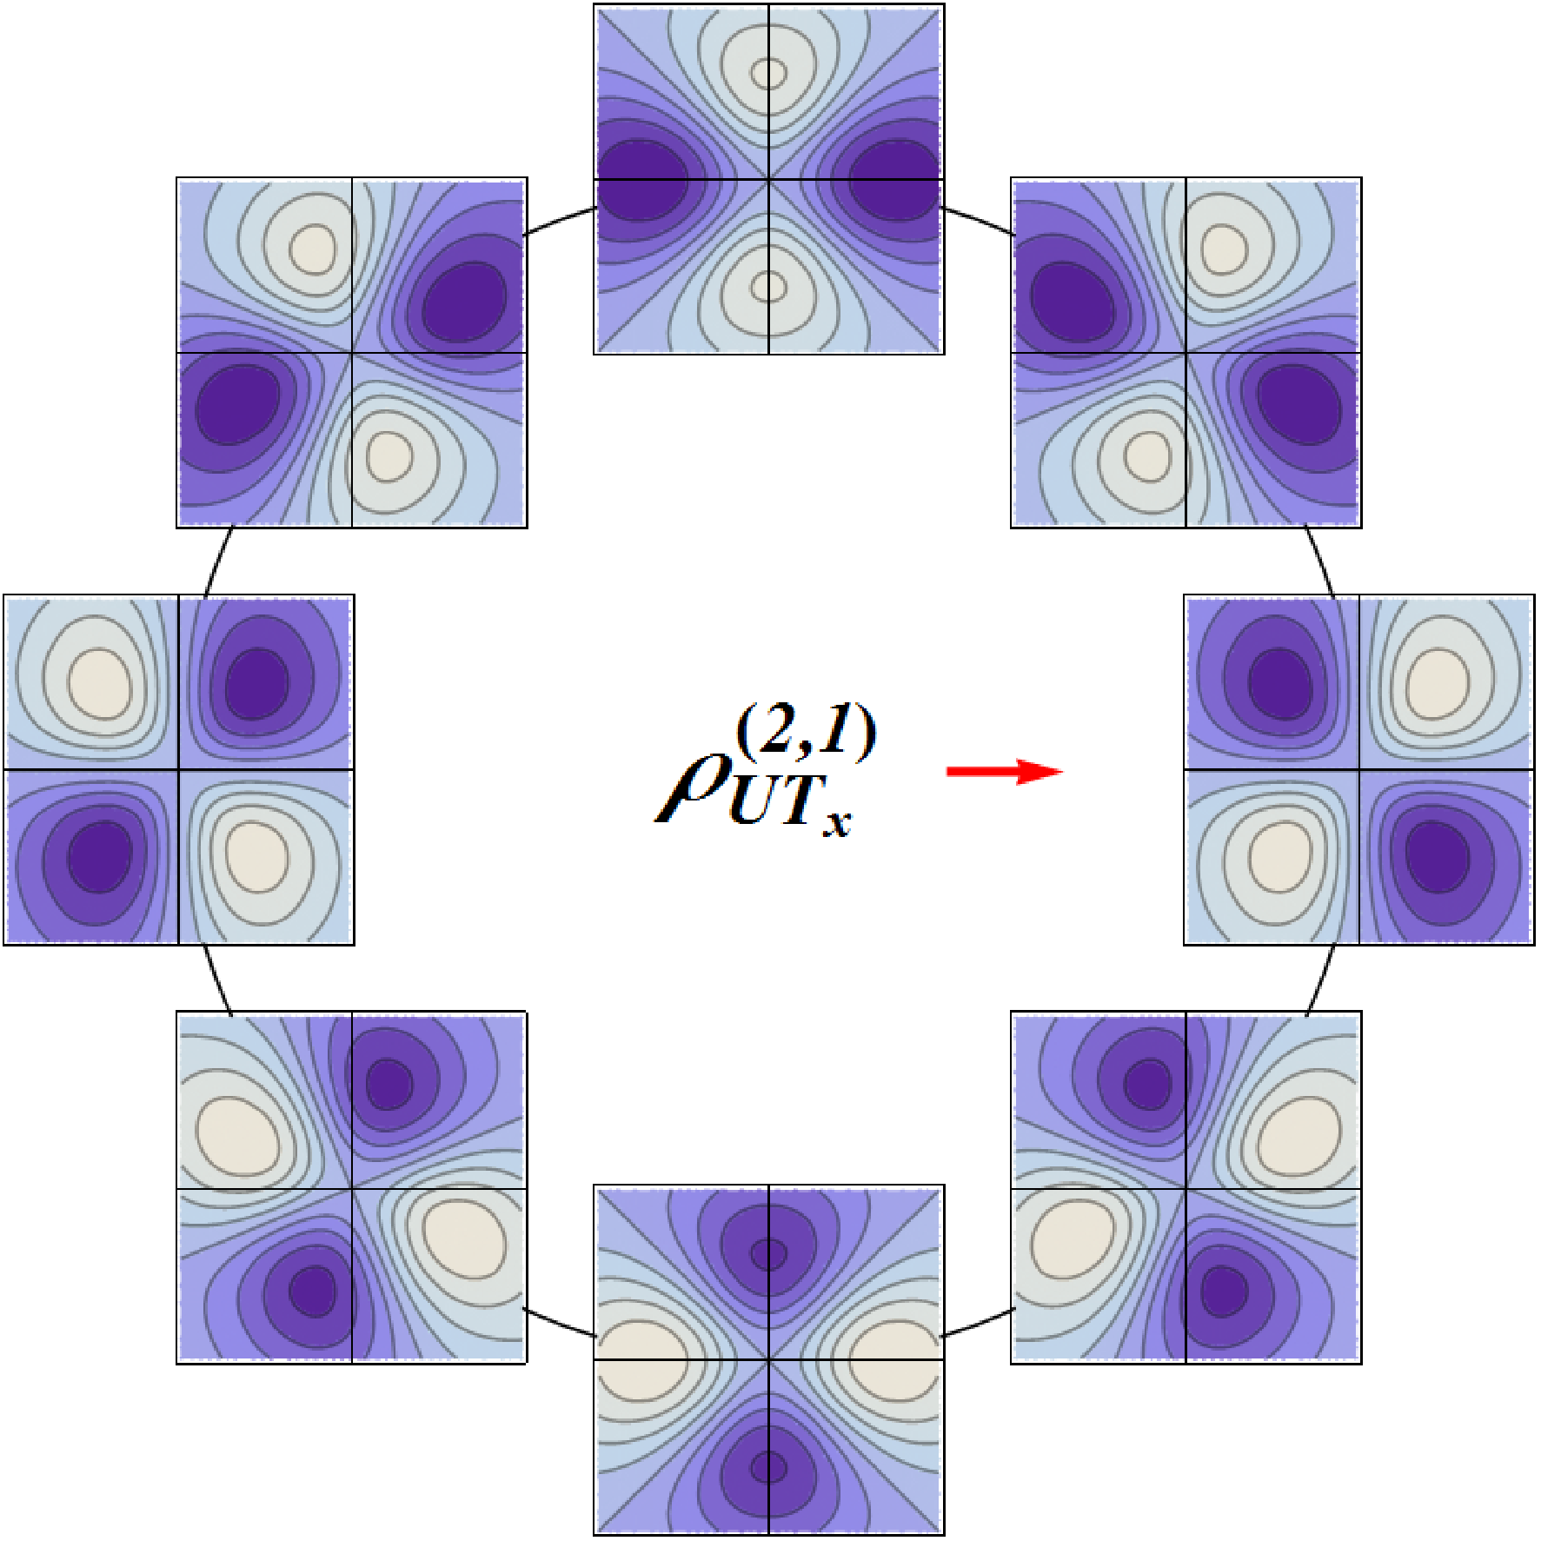
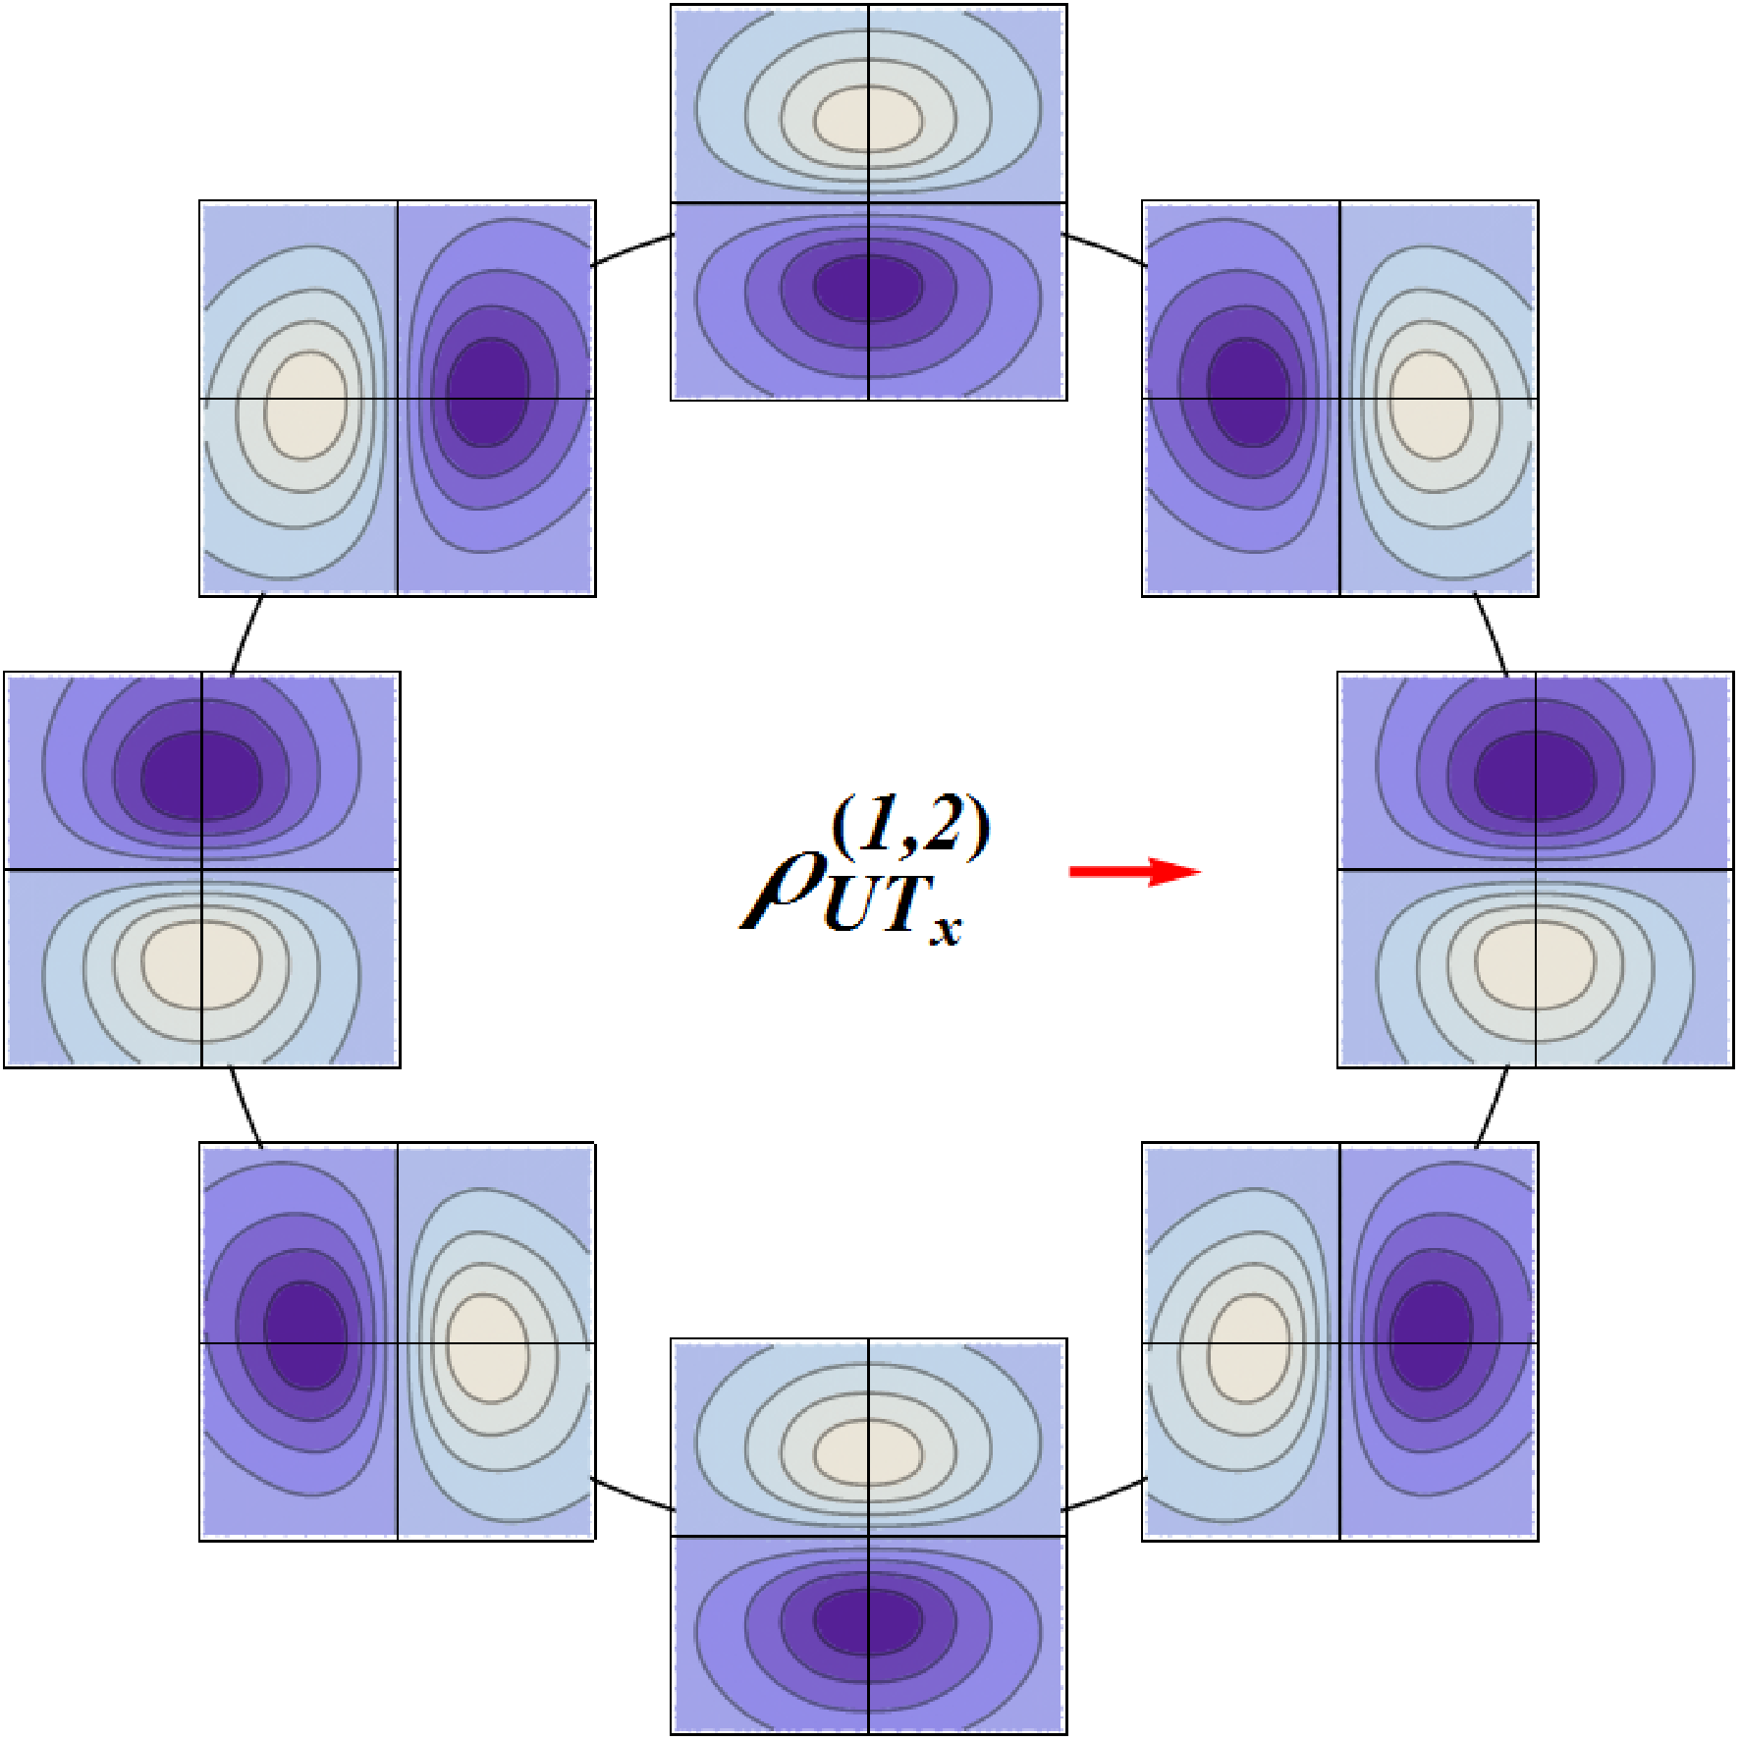
Phase-space transverse modes
UT

Slide 40
Phase-space transverse modes
LT
?

Slide 41
Phase-space transverse modes
LT

Slide 42
Phase-space transverse modes
TL
?

Slide 43
Phase-space transverse modes
TL

Slide 44
Angular correlations
All transverse multipoles are associated with 3D angular correlations !
Not always easy to recognize because of
Projection onto transverse plane
Relativistic artifacts
[C.L., Pasquini, PRD93 (2016)]

Slide 45
Angular correlations
Quark polarization
Nucleon polarization
GPDs
TMDs
[C.L., Pasquini, PRD93 (2016)]

Slide 46
Conclusions
Quark/gluon phase space can be explored by tomography (DIS, SIDIS, DVCS, …)
Multipole decomposition is a natural basis constrained by space-time symmetries
All leading-twist parton distributions can be understood as encoding particular angular correlation

