Slide 1

Electron Ion Collider: Physics and Prospects
We will give an outline of the anticipated physics program for a future electron ion collider. The status and prospects for construction of such a device will be discussed.
Hugh Montgomery
Jefferson Lab
QCD Evolution 2016

Slide 2
Acknowledgements
I appreciate input and conversations over the past couple of years from many colleagues including:
Markus Diefenthaler, Abhay Deshpande, Rolf Ent, Yulia Furletova, Charles Hyde, Bob McKeown, Pavel Nadel-Turonsky, Rik Yoshida, Zhiwen Zhao

Slide 3
Outline
Deep Inelastic and Parton Structure
The next ten years
The Electron Ion Collider
  The Physics
  The Collider
    e-RHIC
    Jefferson Lab EIC
  Detector Design
  The NSAC 2015 Long Range Plan and Path Forward
Conclusions

Slide 4
The Next Ten Years
  Compass
  Jefferson Lab 12 GeV
  RHIC
  Drell-Yan/Sea Quest
  Mainz, Bonn

Slide 5
Medium Energy Physics in The Next Decade
Meson and Baryon Spectroscopy
Valence Structure of the Hadrons
  Form Factors, Charge Radius of the Proton
  Spin Distributions
  3 Dimensional Structure, Transverse Momentum Structures
  Orbital Angular Momentum
Anti-quark sea
Gluon Spin
Nuclear Structure
  Short Range nuclear forces
  Neutron skin in nuclei
Fundamental Symmetries
  sin²Θ_{W} at low Q²
  Heavy photons?

Slide 6

Need for an Electron Ion Collider
In 2025, our ignorance in hadron physics will be related almost exclusively to the gluon.
The Electron Ion Collider with:
  high luminosity
  high and controllable polarization
  moderate and flexible energy
  and the availability of nuclear beams
Will enable the sophisticated studies of the nucleon from x_{Bj}~0.1 to x~0.0001, a regime in which the content of the nucleon and its interactions are dominated by the gluon.

Slide 7
Gluons and Hadronic Structure
Since ~1970 we have known that gluons must carry 50% of the momentum of the nucleon, this fact is the origin of the gluon concept.
Massless gluons & almost massless quarks, through their interactions, seem to generate more than 98% of the mass of the nucleons:
Without gluons, there would be no nucleons,
no atomic nuclei,… no visible world!
We do not know, but suspect that the gluons carry a finite fraction of the spin of the nucleon.
We believe that the residual component of the gluon interaction, the strong “van der Waals”, is the nucleon-nucleon force which controls the internal structure of the nucleus.
The plots suggest divergence, however, QCD has recombination as well as splitting, it is non-Abelian so, presumably a balance is reached, and “saturation” occurs. Where?

Slide 8
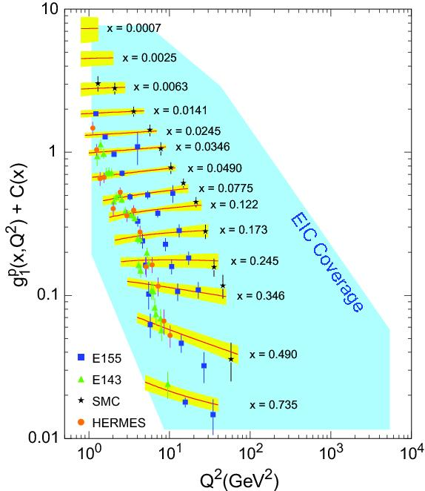
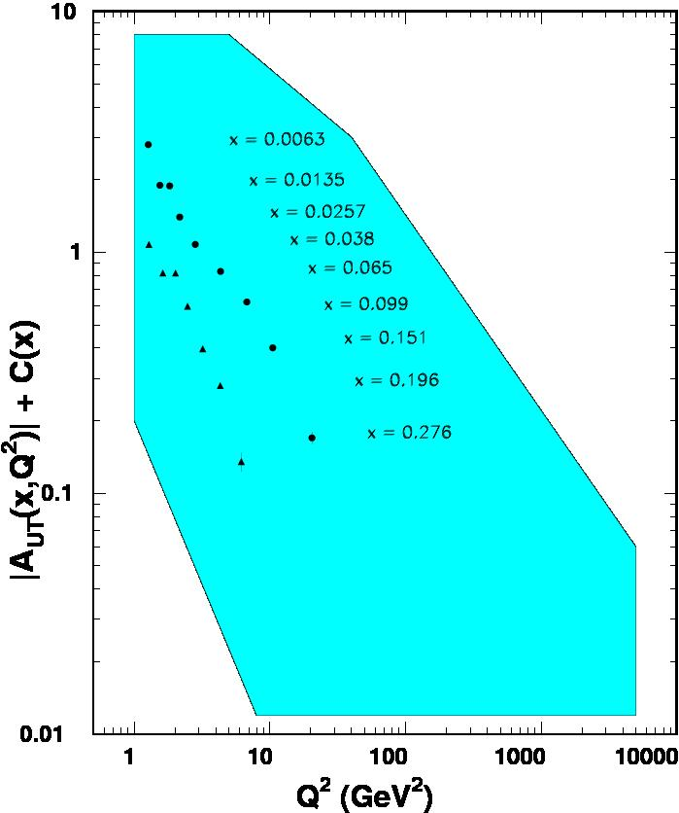
World Data on F₂^{p}
World Data on g₁^{p}
World Data on h₁^{p}
An EIC makes progress possible!
EIC coverage
COMPASS
HERMES
transverse spin ~ angular momentum
momentum
spin

Slide 9
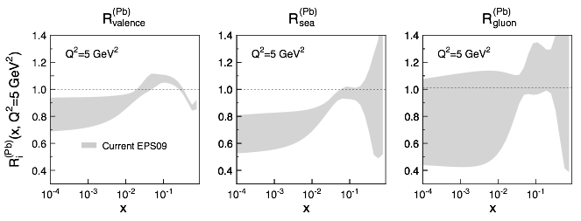
EIC: sea quarks and gluons in nuclei
What do we know of gluons in nuclei? Essentially nothing!
Ratio of Parton Distribution Functions of Pb over Proton:
Without EIC, large uncertainties in nuclear sea quarks and gluons
An EIC will significantly reduce uncertainties
Impossible for current and future pA data at RHIC & LHC data to achieve
Notes:
9
Note BSM not included in project

Slide 10
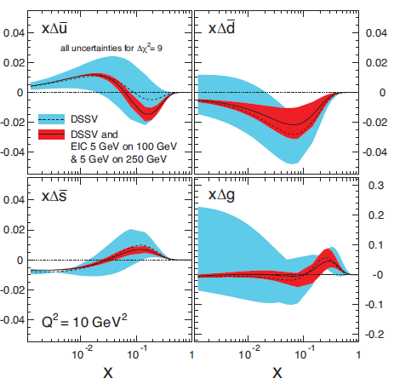
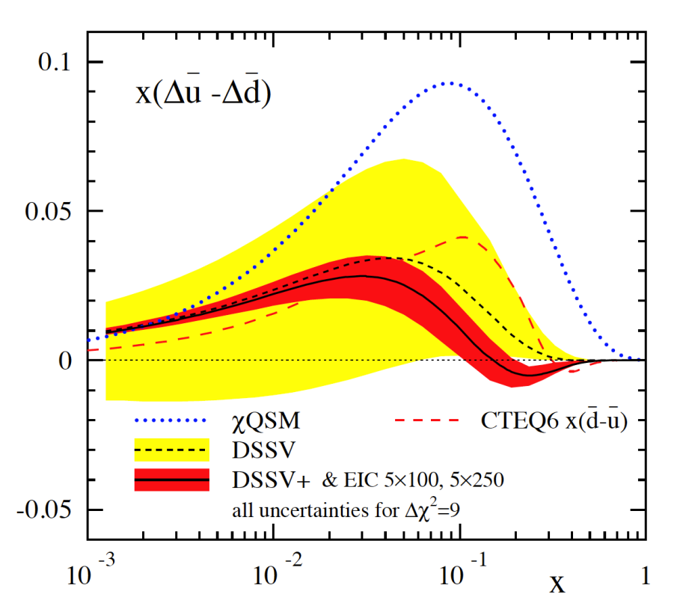
Helicity PDFs at an EIC
A Polarized EIC:
Tremendous improvement on xΔg(x)
Good improvement in ΔΣ
Spin Flavor decomposition of the Light Quark Sea
Many models predict
Δu > 0, Δd < 0
Needs range of √s, from ~ 45 to ~ 70 GeV²
Needs range of √s ~ 30-70 (and good luminosity)
Notes:
10

Slide 11
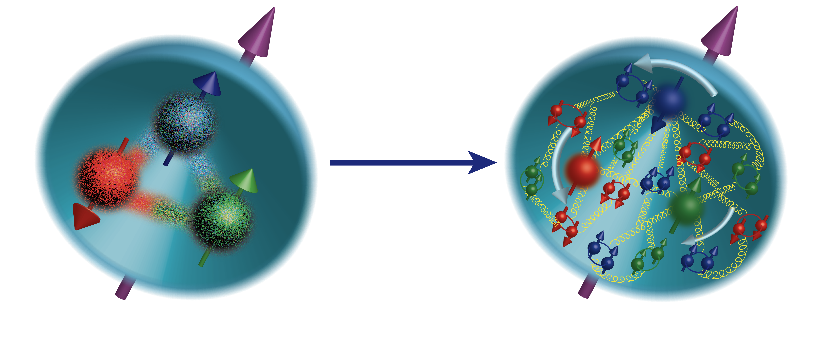
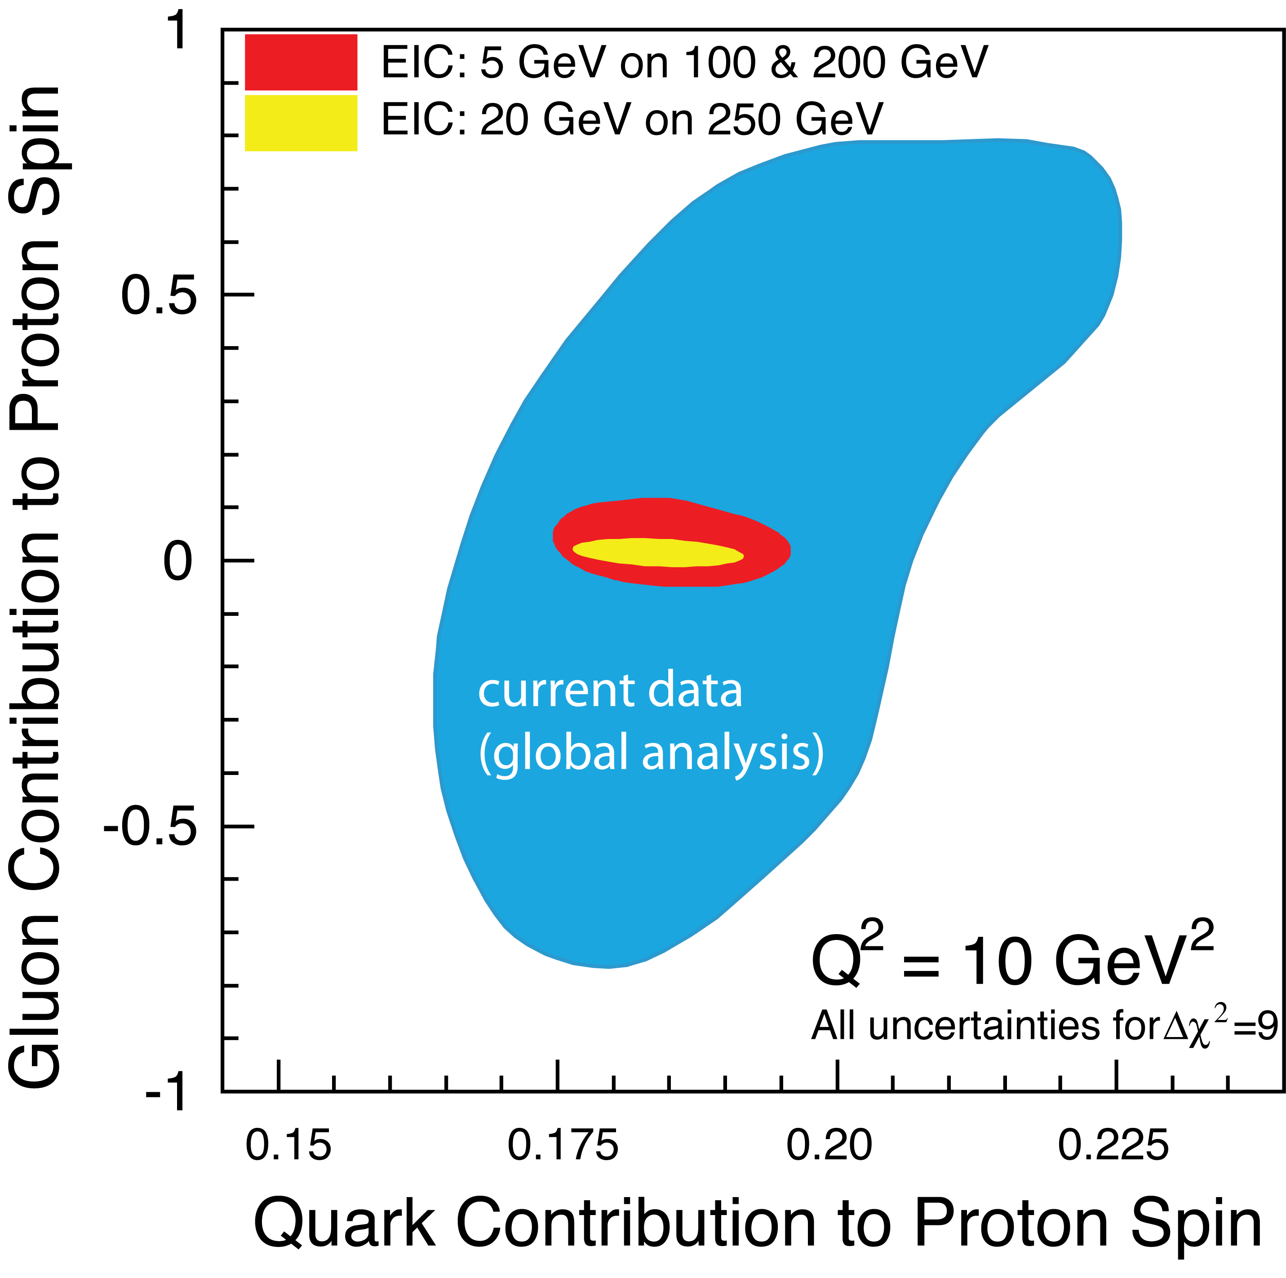

Nucleon Spin
ΔΣ/2 = Quark contribution to Proton Spin
L_{Q} = Quark Orbital Ang. Mom
Δg = Gluon contribution to Proton Spin
L_{G} = Gluon Orbital Ang. Mom
Precision in ΔΣ and Δg ➔ A clear idea
of the magnitude of L_{Q}+L_{G}
Notes:
Make the connection from measured x to unmeasured x very clear.
Figure on the right bottom: replace by the EIC money plot. Drop

Slide 12

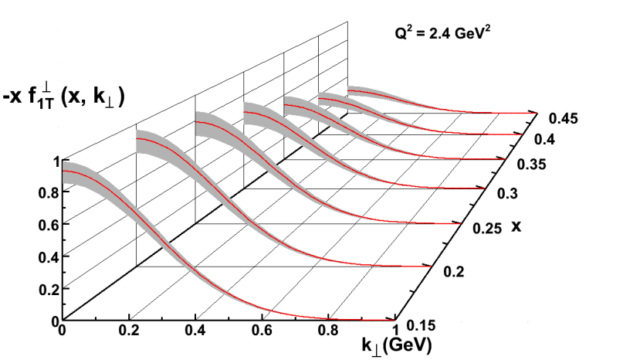
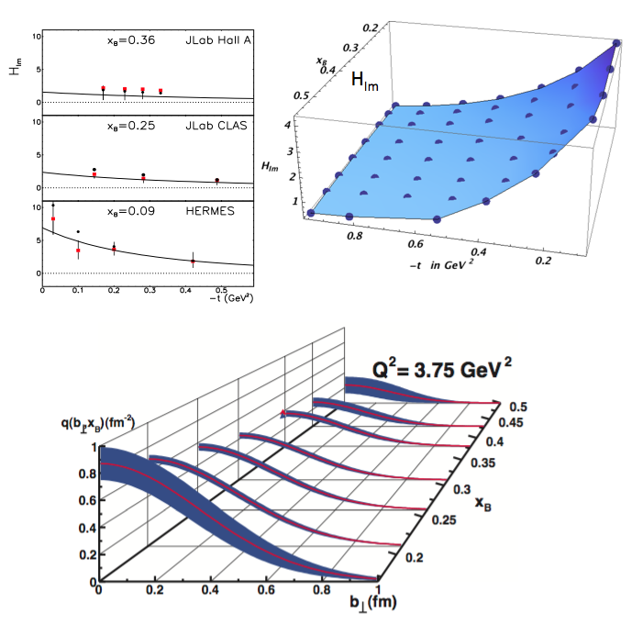
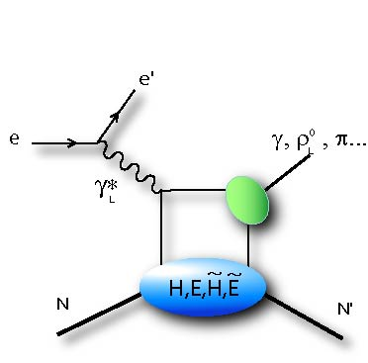
3D Mapping of the Nucleon
TMDs: Longitudinal momentum fraction x and transverse momentum k
GPDs: Longitudinal momentum fraction x at transverse location b
Transverse Momentum Imaging
Transverse Spatial Imaging
Q²
e
e’
γ∗
h
P
X
t

Slide 13
Saturation???
Many ways to get to gluon distribution in nuclei, but diffraction most sensitive:
At HERA
  ep: 10-15% diffractive
At EIC eA, if Saturation/CGC
  eA: 25-30% diffractive
Notes:
Amazing events: in the rest frame a 1 TeV e-beam on Nucleus (~binding energy of 10s MeV) and nothing happens to the nucleus 1/3 of time. The gluon matter is so “DISK” like that even when probed with high resolution probe acts like a “solid” Dark object, creating diffractive patters. Nuclei have a lot more gluons than protons, so the object is DARKER, and hence the diffractive part of the cross section RISES above 1 in ratio. If there is no saturation, then the nucleus may break more often, and hence the ratio of diffraction in nuclei to proton actually decreases.

Slide 14
Partons to Hadrons
Nucleus as a Femtometer sized filter
Unprecedented ν, the virtual photon energy range @ EIC : precision & control
Energy loss by light vs. heavy quarks:
Control of ν by selecting kinematics;
Also under control the nuclear size.
Colored quark emerges as color neutral hadron ➔ What is nature telling us about confinement?
Identify π vs. D^{0 (charm)} mesons in e-A collisions: Understand energy loss of light vs. heavy quarks traversing the cold nuclear matter:
Connect to energy loss in Hot QCD
Notes:
Large nu measurements, Q2 large, so Shadowing effects are absent

Slide 15
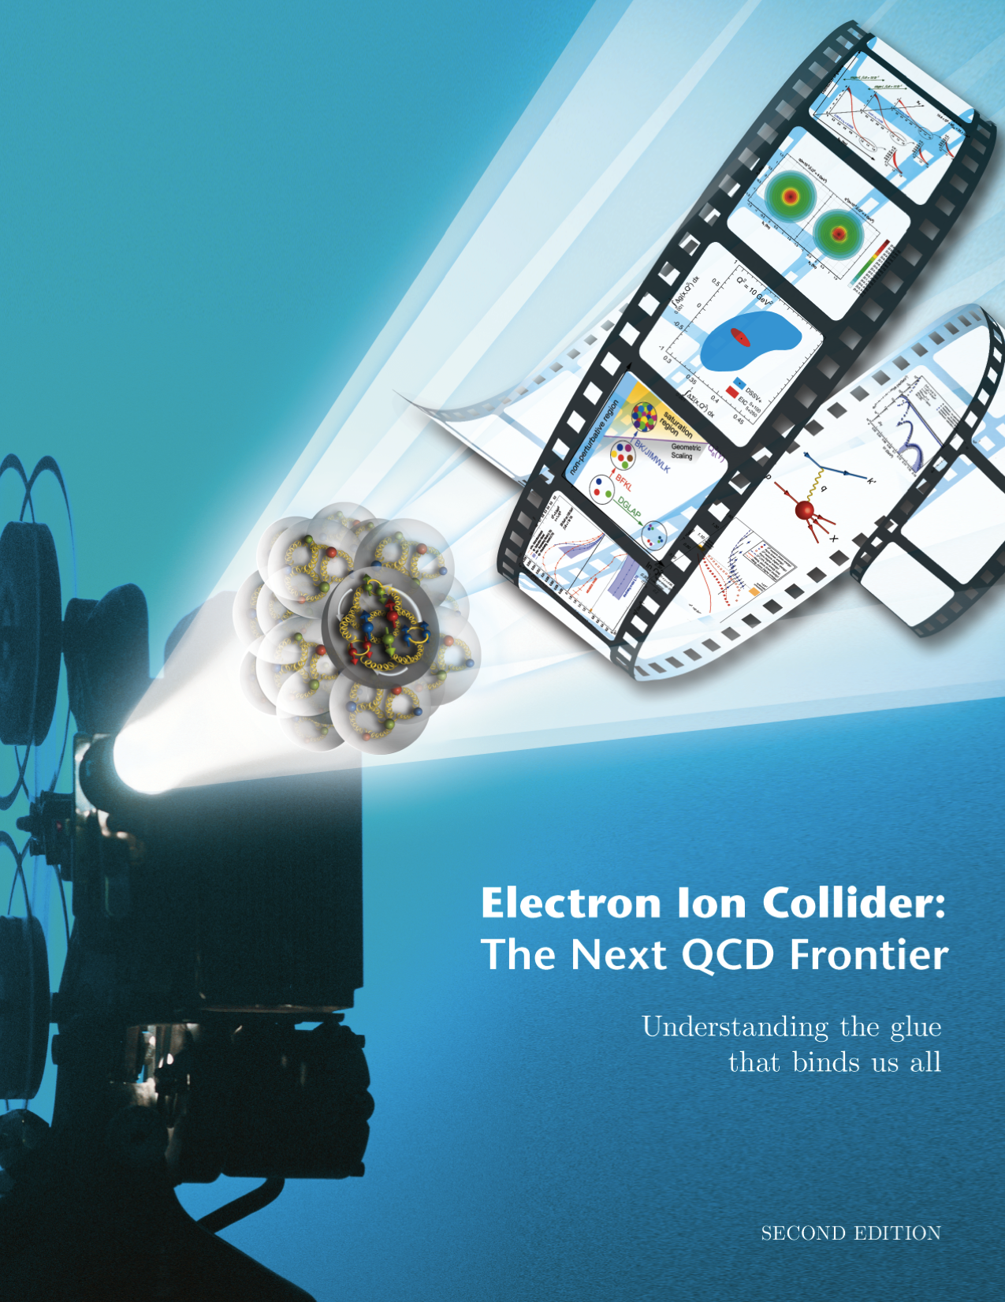
Electron Ion Collider Design Parameters
Electron Nucleus(p, d, … ) Collider
Collider Energy 20 – ~100 GeV
High Luminosity → 10³³ - 10³⁴ cm²s⁻¹
Low x regime x → 0.0001
High polarizations 70%
Ion beams up to U or PB

Slide 16
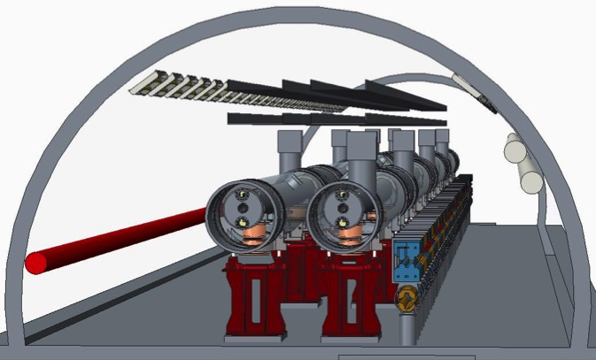
eRHIC Baseline Design
FFAG arcs
Highly advanced and energy efficient accelerator
1.32 GeV HOM-damped SRF linac
arXiv:1409.1633
Peak luminosity 2 × 10³⁴ cm⁻² s⁻¹ for √s ~ 70-105 GeV (250 GeV p↑)
Low-risk luminosity ~ 5-9 × 10³² cm⁻² s⁻¹
Notes:
Added collaborators

Slide 17
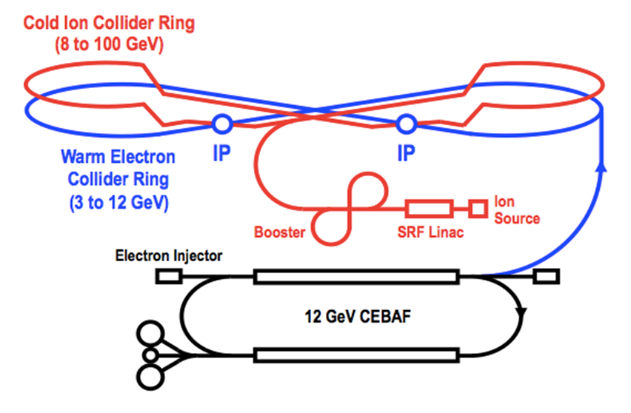
Jefferson Lab Electron Ion Collider
arXiv:1209.0757 (Sept. 2012)
arXiv:1504.07961 (April 2015)
Features:
Collider ring circumference: ~2100 m
Electron collider ring and transfer lines: PEP-II magnets, RF (476 MHz) and vacuum chambers
Ion collider ring: super-ferric magnets (3T)
Booster ring: super-ferric magnets
SRF ion linac
Goals:
Balance of civil construction versus magnet costs and risks
Aim overall for low technical risks
Collaborators:
ANL, LBNL, Fermilab, SLAC,
Texas A&M
Also DESY, Dubna
Low-risk luminosity ~ 5-10 × 10³³ cm⁻² s⁻¹
(3 to 10 GeV)
Notes:
Added collaborators

Slide 18
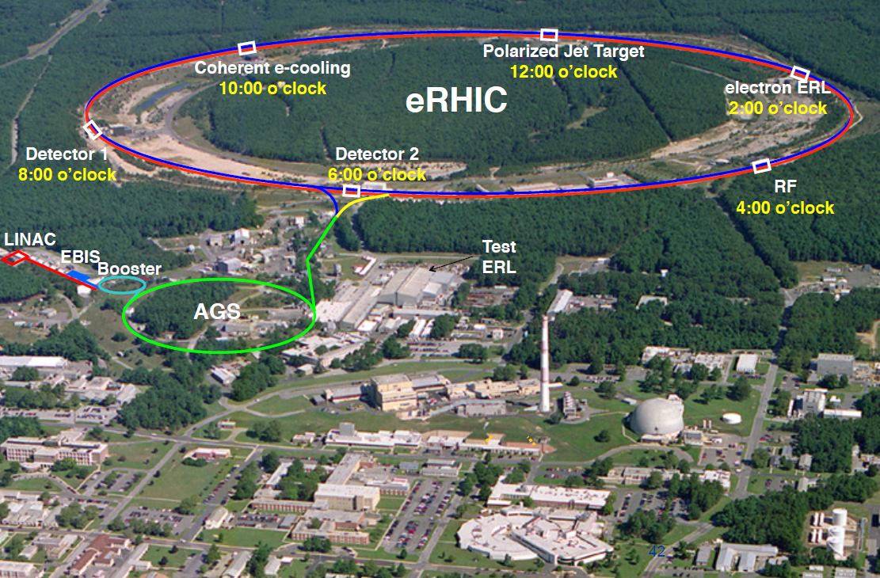
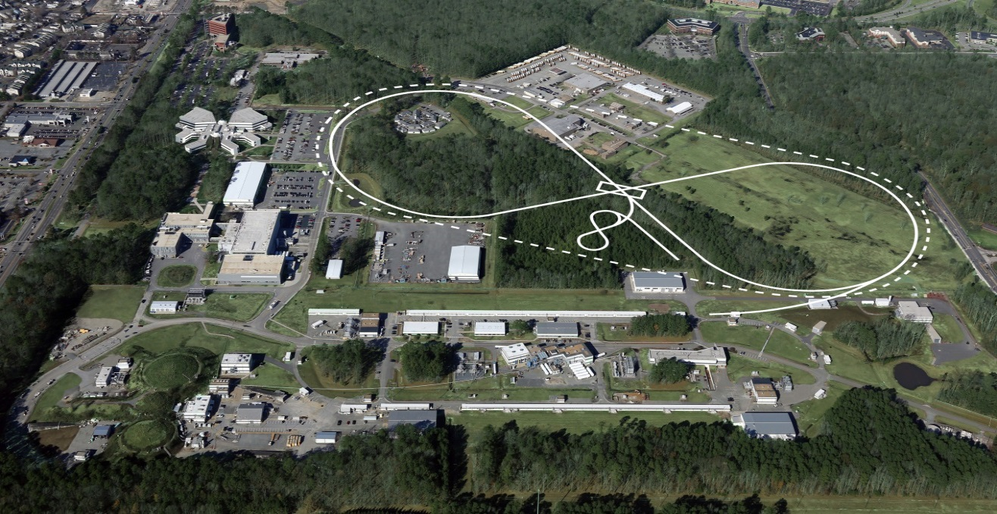
US-Based Electron Ion Collider
JLEIC
Notes:
18

Slide 19
EIC Electron-(backward) Direction Detection
Low Q² Tagger (Photoproduction)
Luminosity Measurement
Compton Polarimetry
Each puts a premium on detection close to the electron beam direction

Slide 20
EIC Ion-(forward) Direction Detection
Good acceptance for recoil nucleons (rigidity close to beam)
  Diffractive processes on nucleon, coherent nuclear reactions
  Small beam size at detection point (to get close to the beam)
    Secondary focus on roman pots, small beam emittance (cooling)
  Large dispersion (to separate scattered particles from the beam)
Good acceptance for fragments (rigidity different than beam)
  Tagging in light and heavy nuclei, nuclear diffraction
  Large magnet apertures (low gradients)
  Detection at several points along a long, aperture-free drift region
Good momentum- and angular resolution
  Free neutron structure through spectator tagging, imaging
  Both in roman pots and fixed detectors

Slide 21
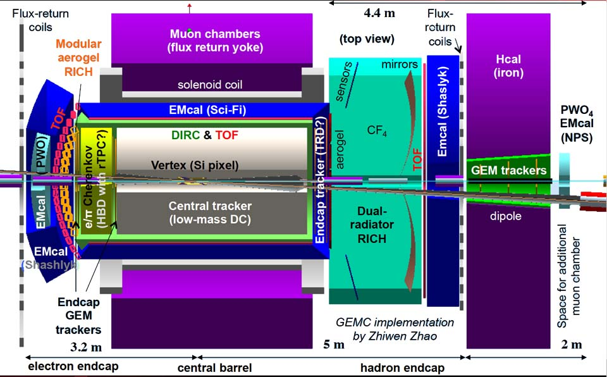
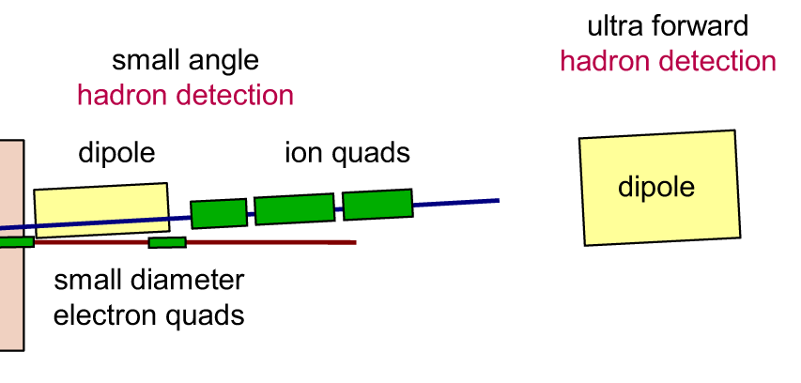
Detector Design
Detector
Backward (e Direction),
Central,
Forward, (ion direction)
and
Very Forward
ALL Important!
Zero Degree Calorimeter
hadron detection
2 Tm
ZDC
20 Tm
~70m
~35 m
~10 m
Notes:
Interior Page Design 2

Slide 22
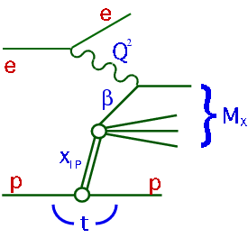
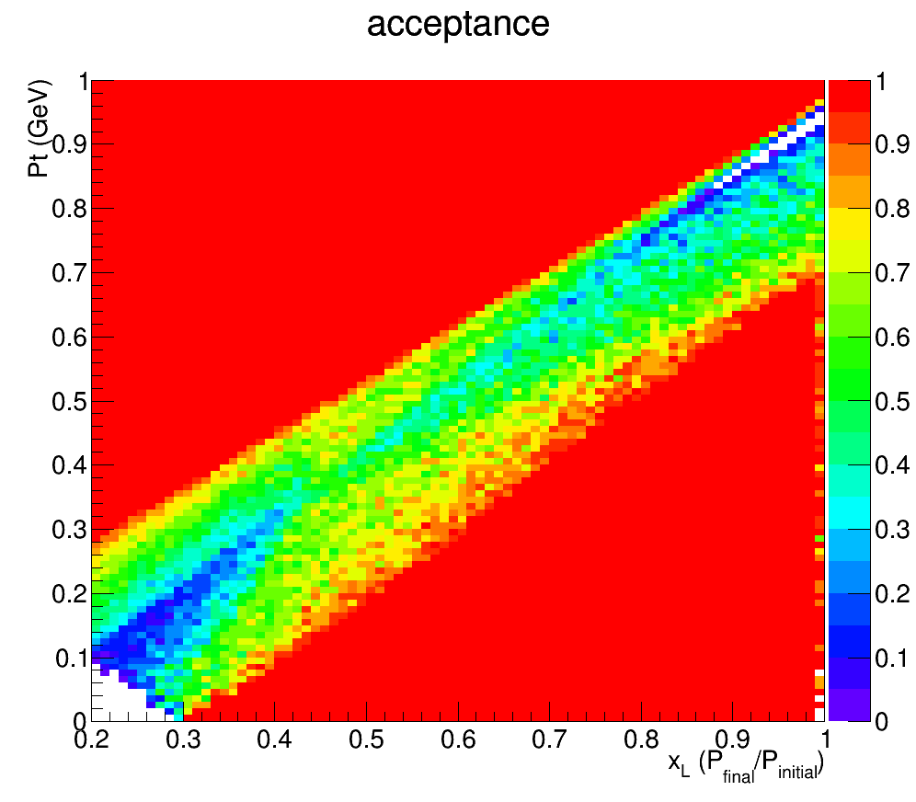
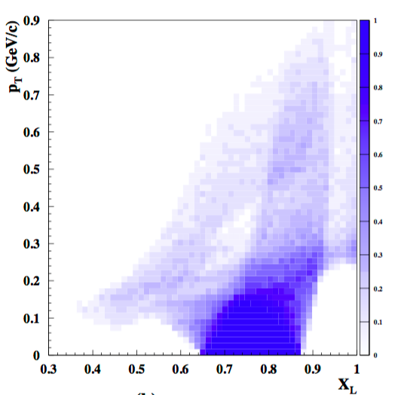
Acceptance for p’ in ep->e’Xp’
JLEIC
ZEUS
Leading Proton Spectrometer
Region 1
Region 2 (Hi. Res)
Zhiwen Zhao
X_{L}= Ep’/Ep
Acceptance in diffractive peak (X_{L}>~.98)
ZEUS: ~2%
JLEIC: ~100% (also covers much higher X_{L} than at HERA)

Slide 23

NSAC 2015 LRP
RECOMMENDATION I
The progress achieved under the guidance of the 2007 Long Range Plan has reinforced U.S. world leadership in nuclear science. The highest priority in this 2015 Plan is to capitalize on the investments made.
RECOMMENDATION II
We recommend the timely development and deployment of a U.S.-led ton-scale neutrinoless double beta decay experiment.
RECOMMENDATION III
We recommend a high-energy high-luminosity polarized EIC as the highest priority for new facility construction following the completion of FRIB.
RECOMMENDATION IV
We recommend increasing investment in small-scale and mid-scale projects and initiatives that enable forefront research at universities and laboratories.
Manifest impact on Electron Ion Collider
Users Organization/Meetings
National Academy Study
Enhanced explicit EIC Accelerator R&D
Increased interest in collaboration with Jefferson Lab

Slide 24
EIC Timeline
Activity Name | 2010 | 2011 | 2012 | 2013 | 2014 | 2015 | 2016 | 2017 | 2018 | 2019 | 2020 | 2021 | 2022 | 2023 | 2024 | 2025
12 GeV Operations
12 GeV Upgrade
FRIB
EIC Physics Case
NSAC LRP
NAS Study
CD0
EIC Machine Design and R&D
CD1(Down-select)
CD2/CD3
EIC Construction
CD0 = DOE “Mission Need” statement; CD1 = technology and site selection
CD2/CD3 = establish project baseline cost and schedule

Slide 25
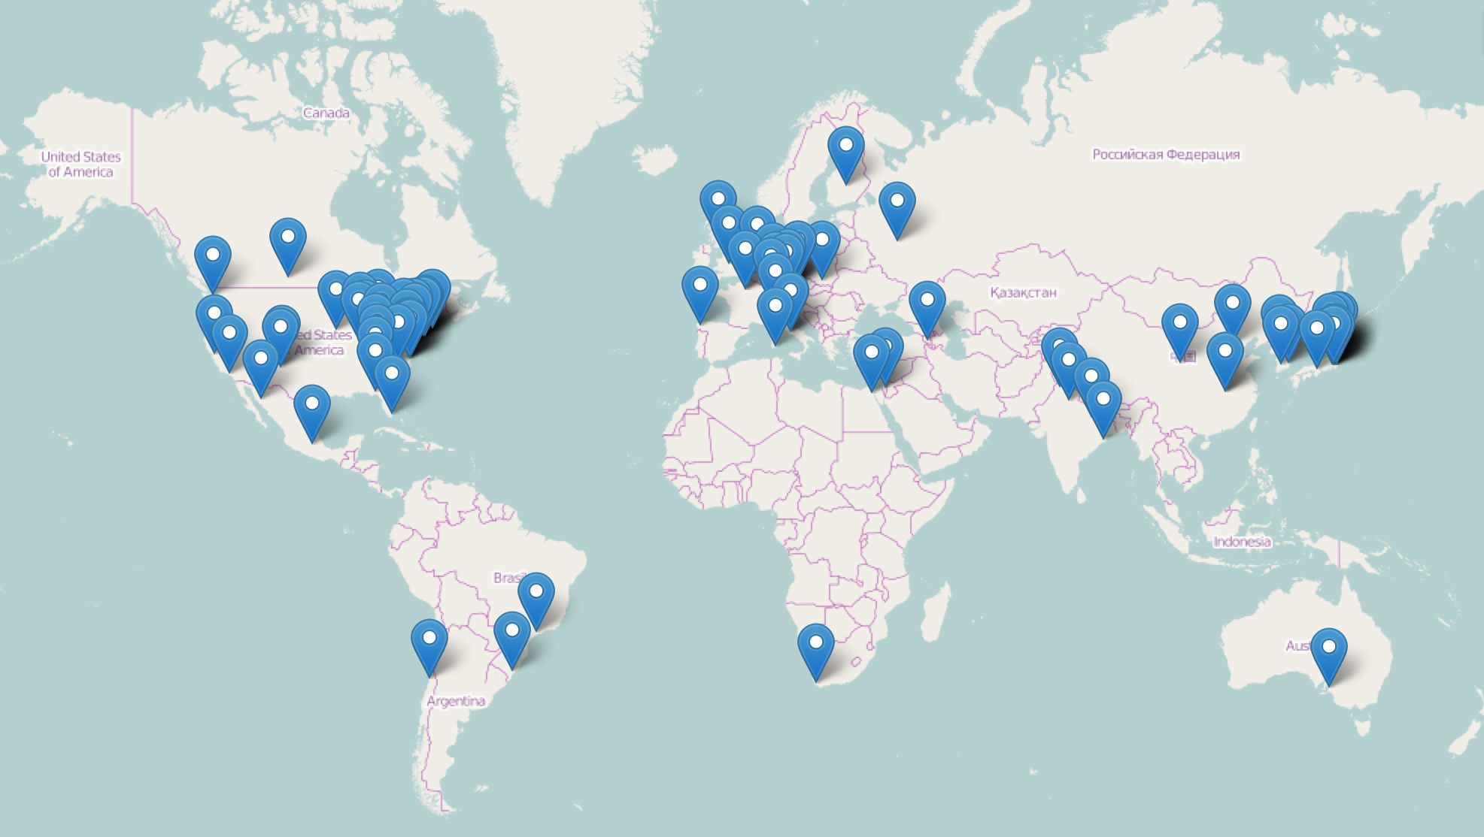
The EIC Users Group: EICUG.ORG
600+ collaborators, 26 countries, 104 institutions.. (April, 2016)
An incomplete picture of institution’s locations…
And growing….

Slide 26
Conclusion
Concept of Electron Ion Collider and the Physics Case
  Embraced by US Nuclear Physics Community
  Supported by the international nuclear physics community
  Treated Seriously by US-DOE
  To be considered by broader physics (NAS) community
Facility Designs, collaborative efforts
  Making palpable progress
  Addressing Risk
  Addressing Cost
Detector Designs advancing
  Expect dramatic improvements vis-à-vis HERA
  There is a movement afoot!!!! It is very exciting!!!

