Slide 1

PDF from Hadronic Tensor on the Lattice and Connnected Sea Evolution
Path-integral Formulation of Hadronic Tensor in DIS
Parton Degrees of Freedom
Numerical Challenges
Evolution of Connected Sea Partons
QCD Evolution 2016 Nikhef, June 1, 2016

Slide 2
Hadronic Tensor in Euclidean Path-Integral Formalism
Deep inelastic scattering
In Minkowski space
Euclidean path-integral
K.F. Liu, PRD 62, 074501 (2000)

Slide 3
W_{μν} in Euclidean Space
Laplace transform

Slide 4
Cat’s ears diagrams are suppressed by O(1/Q²).

Slide 5
Large momentum frame
Parton degrees of freedom: valence, connected sea and disconnected sea
u d s

Slide 6
Properties of this separation
Gauge invariant
Topologically distinct as far as the quark lines are concerned
Structure functions W₁ and W₂ are frame independent.
Small x behavior of CS and DS are different.

Slide 8
  Gottfried Sum Rule Violation
  NMC:
  two flavor traces ( ) one flavor trace ( )
  K.F. Liu and S.J. Dong, PRL 72, 1790 (1994)

Slide 9
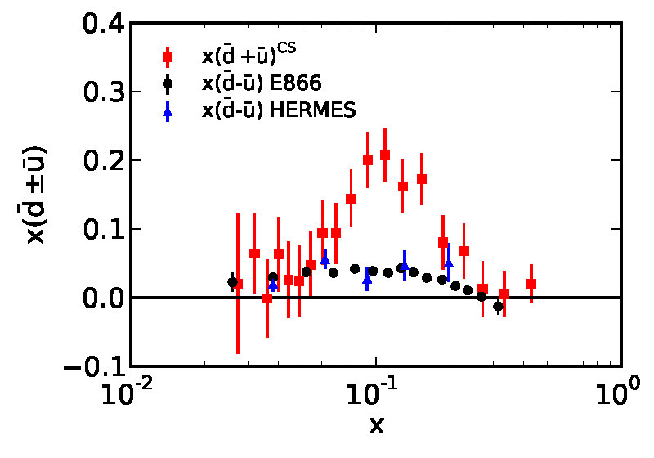

Connected Sea Partons
K.F. Liu, W.C. Chang, H.Y. Cheng, J.C. Peng, PRL 109, 252002 (2012)
CT10
lattice
expt

Slide 11
<x>_{s} /<x>_{u/d}(DI)
Lattice input to global fitting of PDF
Lattice calculation with
Overlap fermion at m_{π} ~ 300 MeV

Slide 12
Evolution Equations
S. Moch et al., hep/0403192,0404111
A. Cafarella et al., 0803.0462
NNLO
Valence u can evolve into valence d ?
Note:

Slide 13
Evolution equations separating CS from the DS partons

Slide 14
Comments
CS and DS are explicitly separated, leading to more equations
(11 vs 7) which can accommodate
There is no flavor-changing evolution of the valence partons.
is the sum of two equations
Once the CS is separated at one Q² , it will remain separated
at other Q².
Gluons can split into DS, but not to valence and CS.
It is necessary to separate out CS from DS when quark and antiquark annihilation (higher twist) is included in the evolution eqs. (Annihilation involves only DS.)

Slide 15
Comments
The connected sea partons (CSP) found in path-integral formulation are extracted by combining PDF, experimental data and ratio of lattice matrix elements.
It would be better to have separate evolution equations for the CSP and DSP. The separation will remain at different .
This way one can relate and compare the lattice calculation of moments in the CI and DI to the corresponding moments from PDF.
It will become necessary to separate out CSP and DSP in evolution equations when quark and antiquark annihilation is involved.

Slide 16
Improved Maximum Entropy Method
Inverse problem
Bayes’ theorem
Maximum entropy method: find from
Improved MEM (Burnier and Rothkpf, PRL 111, 182003 (2013))

Slide 17
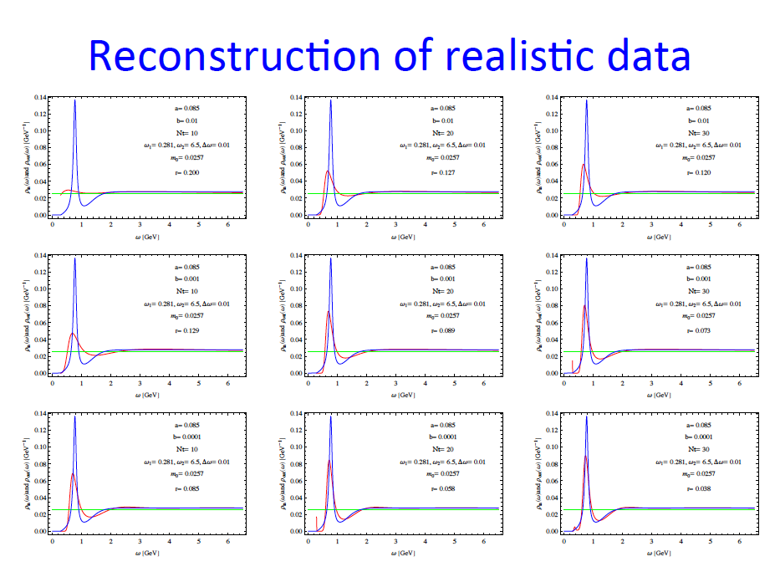
Frank X. Lee

Slide 18
Numerical Challenges
Lattice calculation of the hadronic tensor – no renormalization, continuum and chiral limits, direct comparison with expts PDF.
Bjorken x
Range of x:

Slide 19
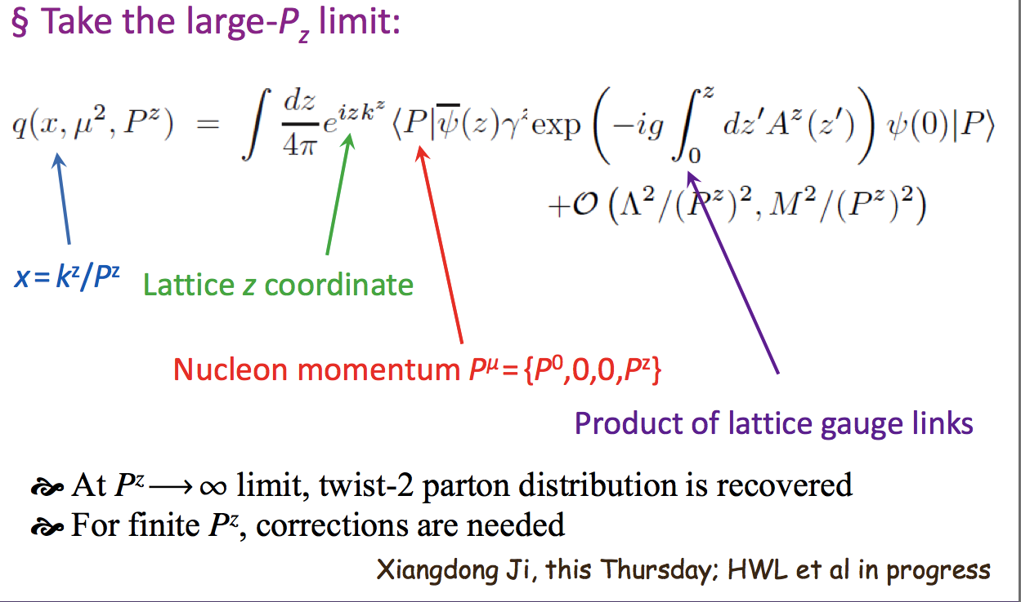
Large Momentum Approach
X. Ji, PRL, 110, 262002 (2013)

Slide 20
Theoretical Issues
Relatively simple numerically
Renormalization of quasi-distribution
  Perturbative lattice renormalization ?
  RI/MOM renormalization scheme for the CI ?

Slide 21
Negative puzzle
Larger P_{z} ? (How large)
Lattice scale (a⁻¹ ~ 2 GeV) too small?
Range of x limited?
x
present P_{z} ~ 1 GeV
H.W. Lin, 1402.1462

Slide 22
Summary
Formulation of the hadronic tensor in Euclidean path-integral has revealed the connected sea parton (CSP) dof.
It takes experiments, lattice calculation and global fitting of PDF to extract CSP.
It is better to have CSP and DSP parton separated in evolution. This would facilitate comparison with lattice calculation of moments.
Lattice calculation of hadronic tensor is numerically tough, but theoretically interpretation is relatively easy. No renormalization is needed.

Slide 24
Comments
The results are the same as derived from the conventional operator product expansion.
The OPE turns out to be Taylor expansion of functions in the path-integral formalism.
Contrary to conventional OPE, the path-integral formalism admits separation of CI and DI.
For with definite n, there is only one CI and one DI in the three-point function, i.e. (a’) is the same as (b’). Thus, one cannot separate quark contribution from that of antiquark in matrix elements.

Slide 25
Kinematics
Bjorken x
Range of x:

