Slide 1




Combination of A Cryogenic source With a Stark Decelerator
Parul Aggarwal
(NL-eEDM collaboration)

Slide 2
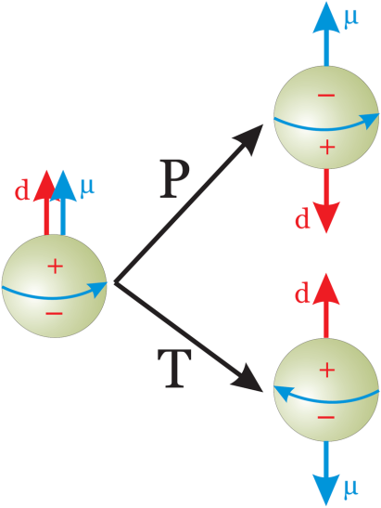
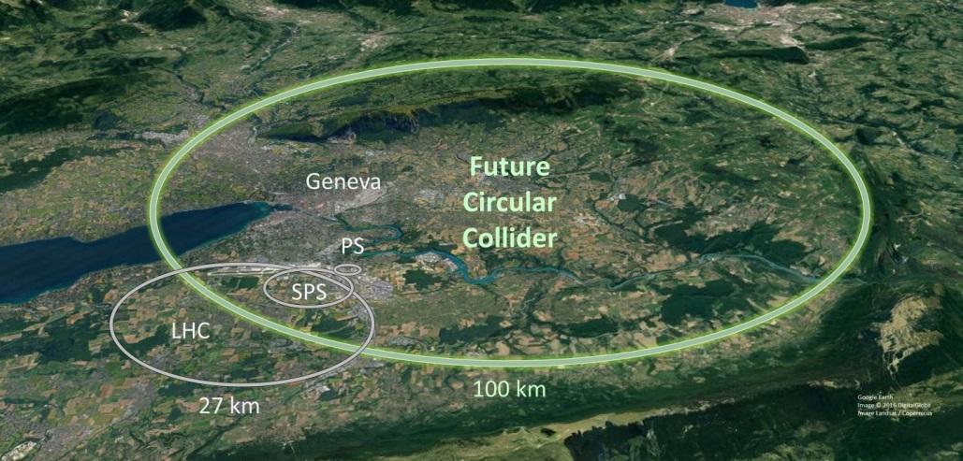
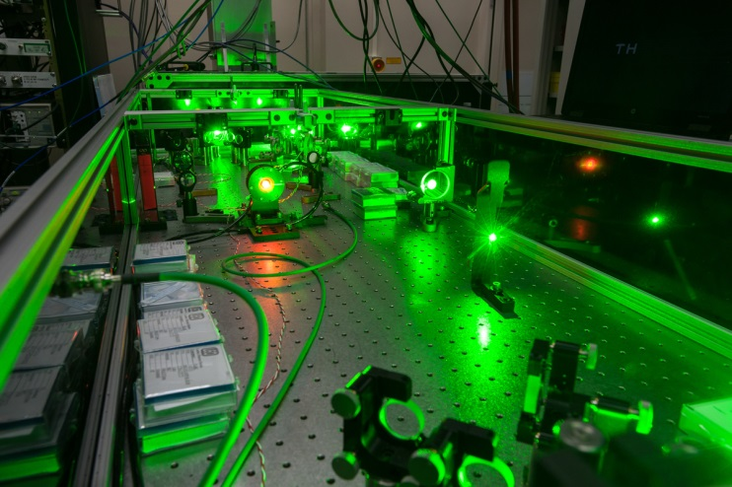
Motivation
Electron’s electric dipole moment (eEDM) violates time reversal (T) and parity (P) symmetry.
Additional sources of CP violation beyond the Standard Model.
Two complementary approaches

Slide 3
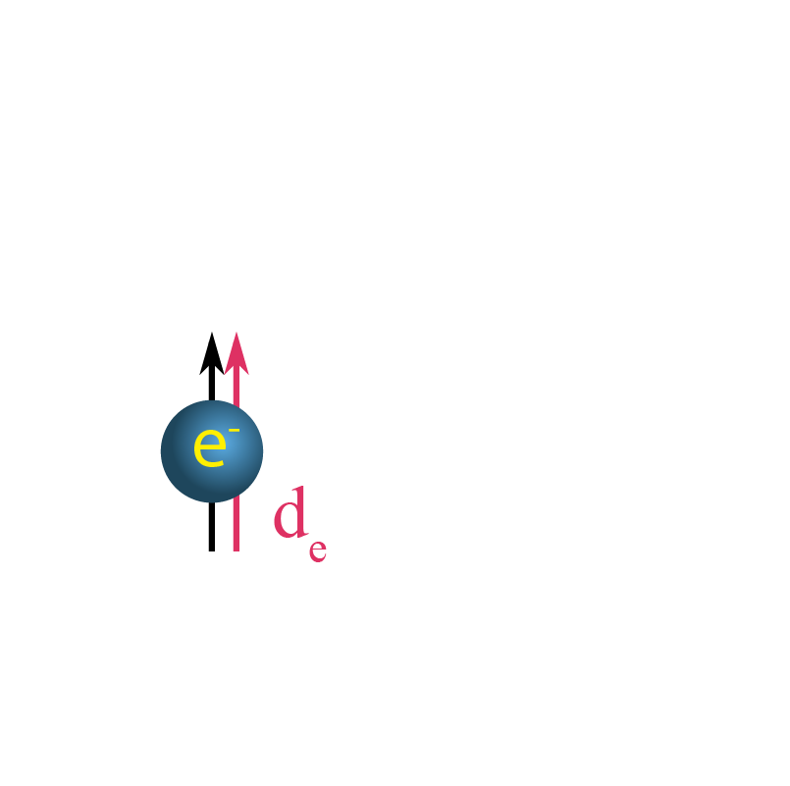
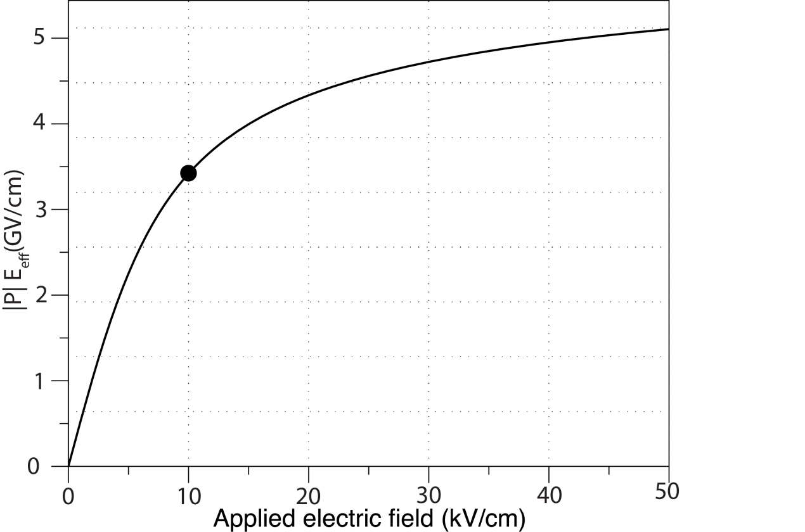
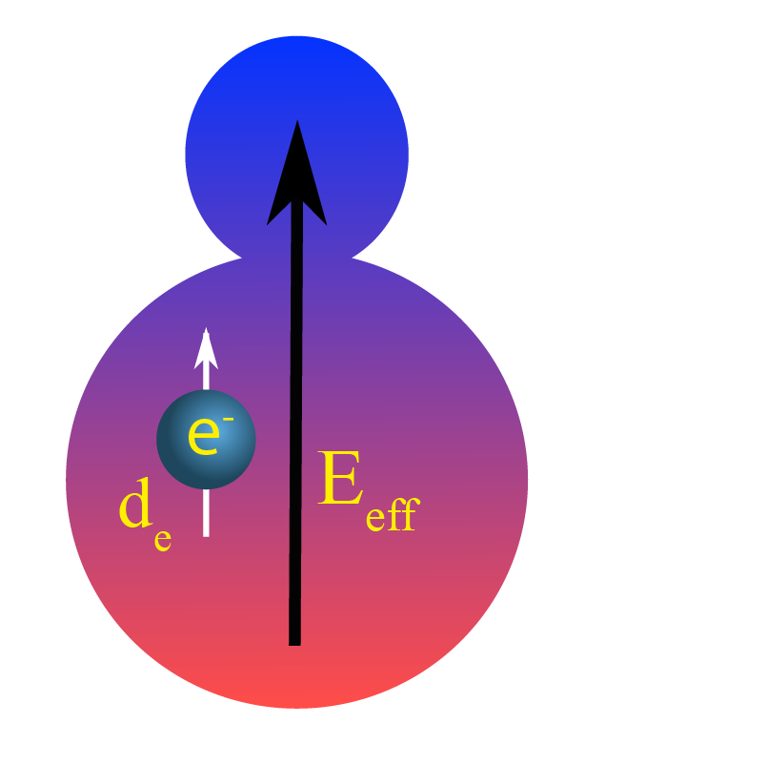
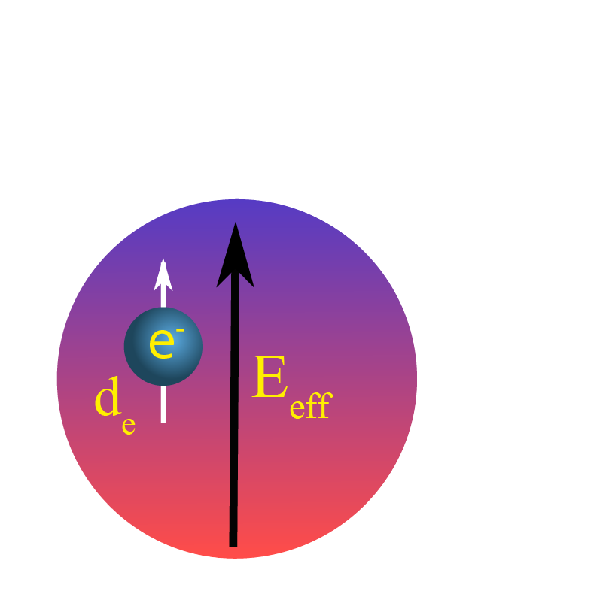




eEDM and polar molecules
E = (10-100) KV/cm
E_{eff} = (10-100) MV/cm
E_{eff} = (1-100) GV/cm
BaF has (E_{eff})_{max}= 6.4 GV/cm.
E_{eff} scales with Z³.

Slide 4
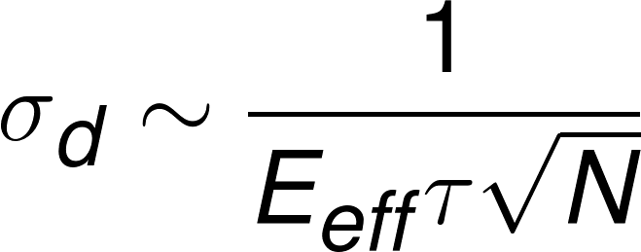
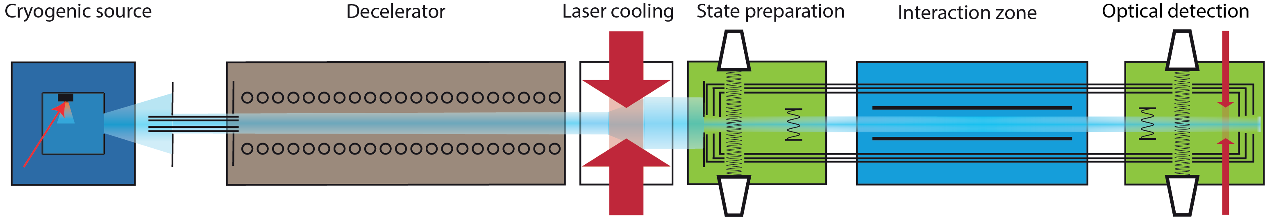
Statistical uncertainty
Molecules in use for eEDM searches: ThO, YbF, HfF⁺, BaF, YbOH
Best upper bound on eEDM: 1.1 ×10⁻²⁹ e cm
Our goal |d_{e}| ≤ 5 ×10⁻³⁰
Our Experimental Setup
The ACME collaboration. Nature 562, 355-360 (2018)
NL-eEDM collaboration, Eur. Phys. J. D (2018) 72:197

Slide 5
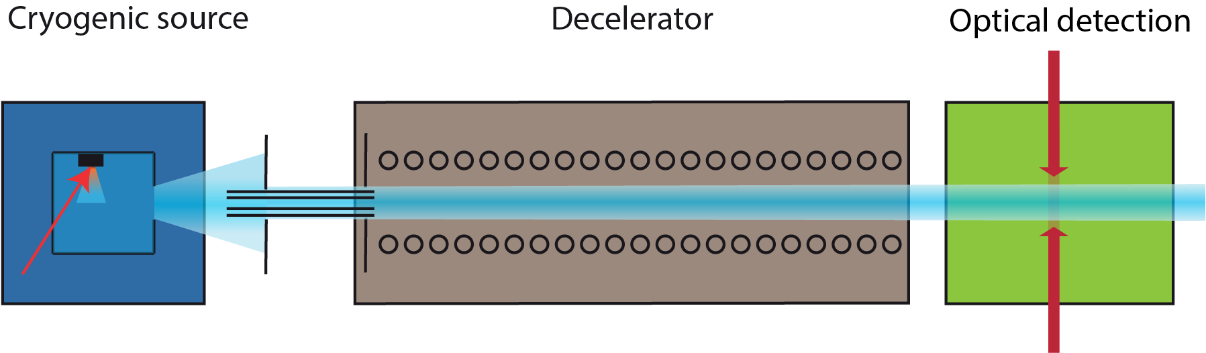
Focus of today’s talk
Variation of the guided signal with respect to change in source parameters.
Deceleration signal

Slide 6
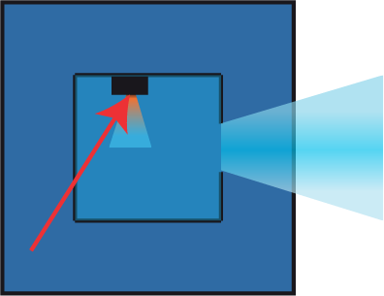
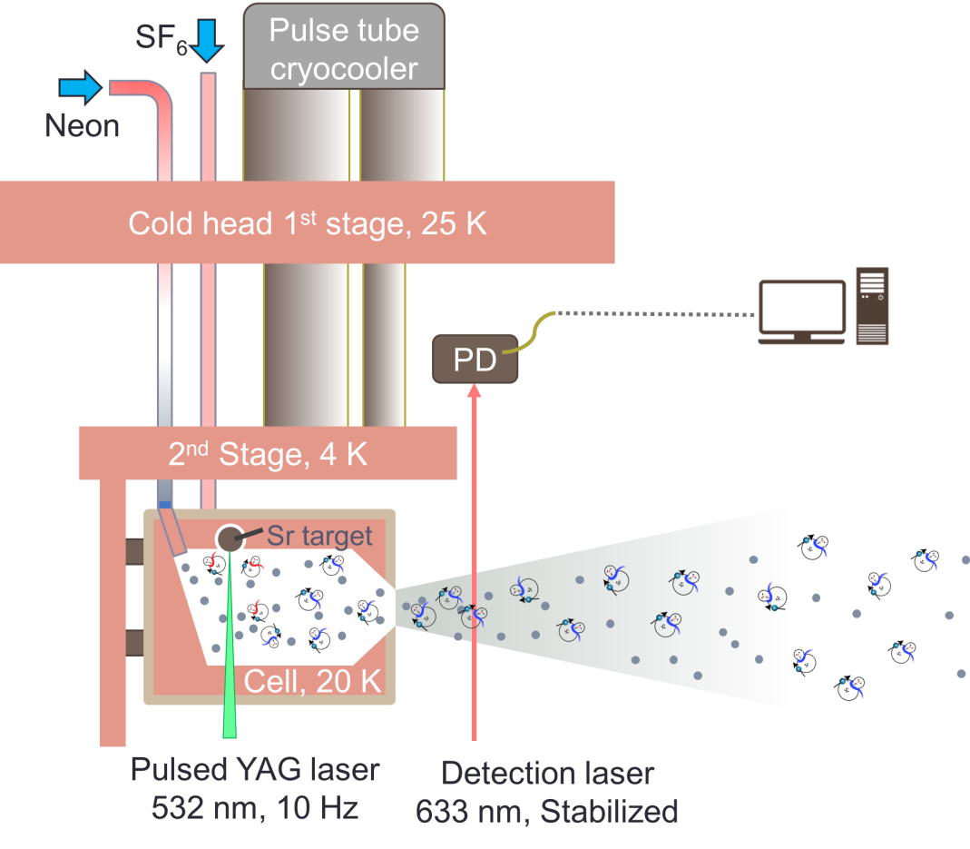
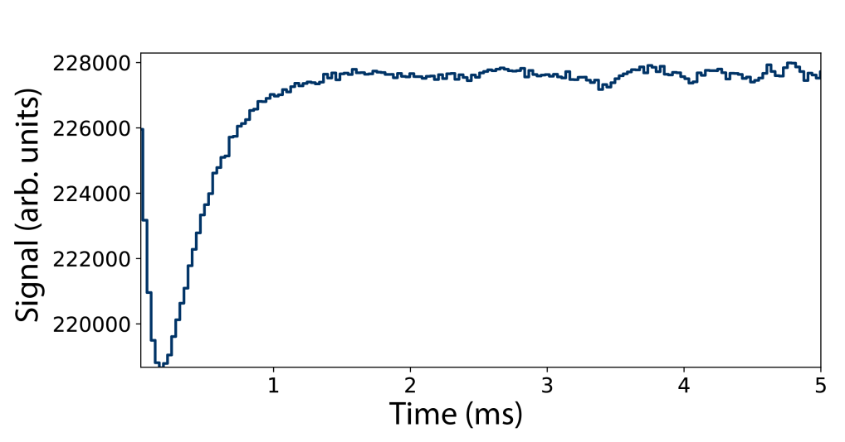
Cryogenic source setup
Sr (laser ablation) + SF₆ SrF + SrF₂……

Slide 7

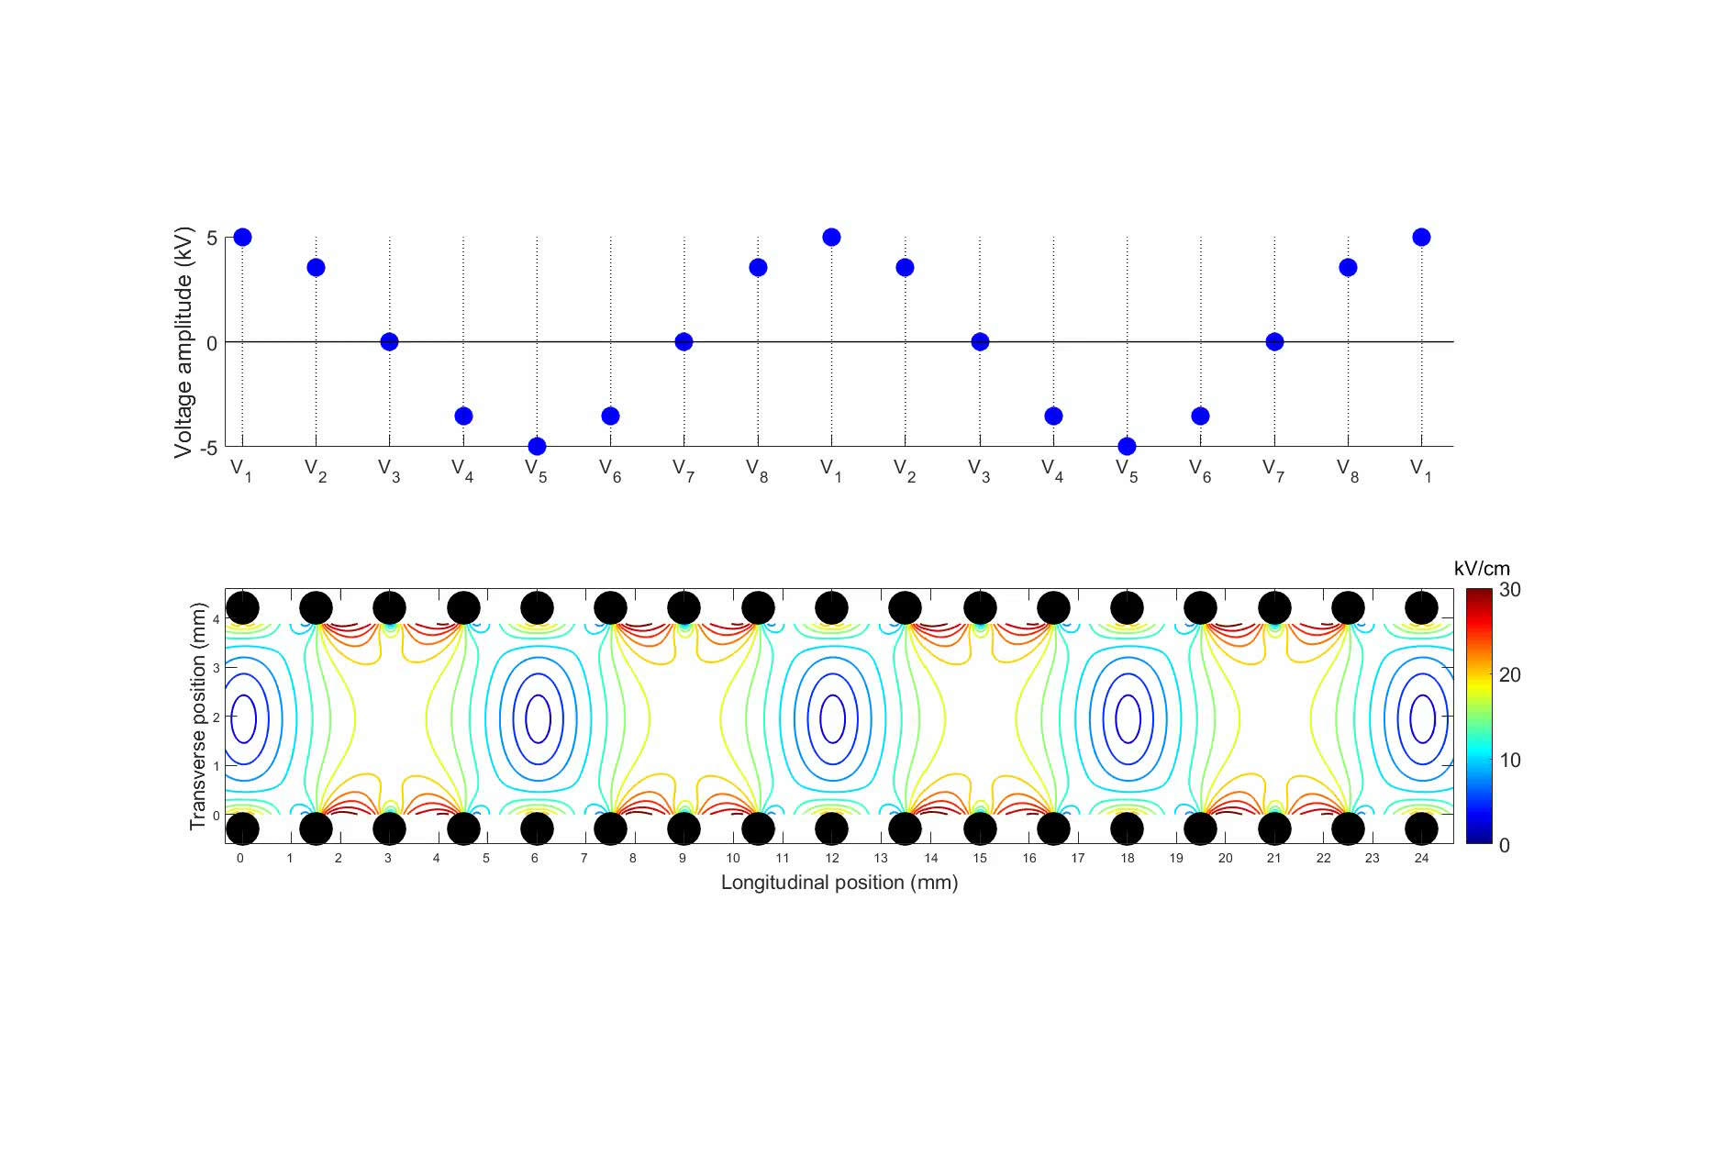
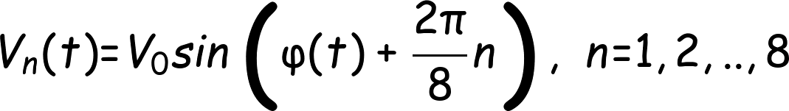
Traveling-wave Stark decelerator
Determines the mode of operation (guiding or deceleration)

Slide 8
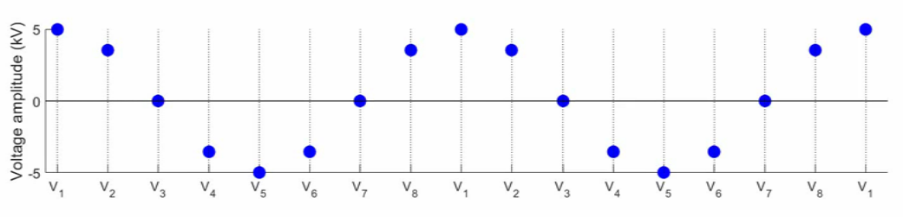
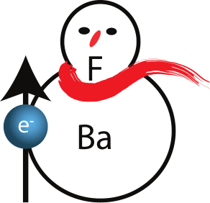
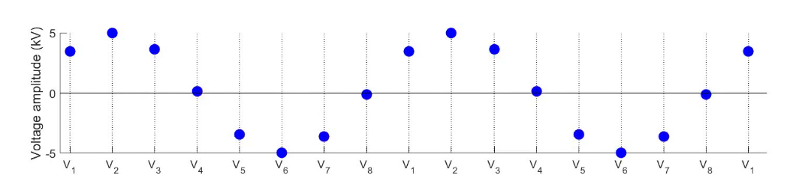
Simplistic picture for guiding
v₀
v₀
If the frequency of the waveforms matches the velocity of molecules, they are trapped in the electric field minima and guided well.

Slide 9
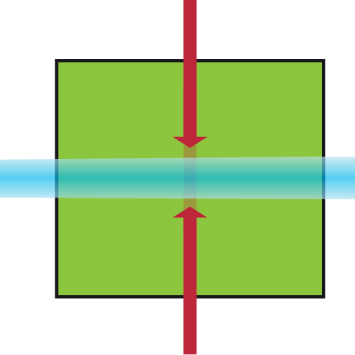
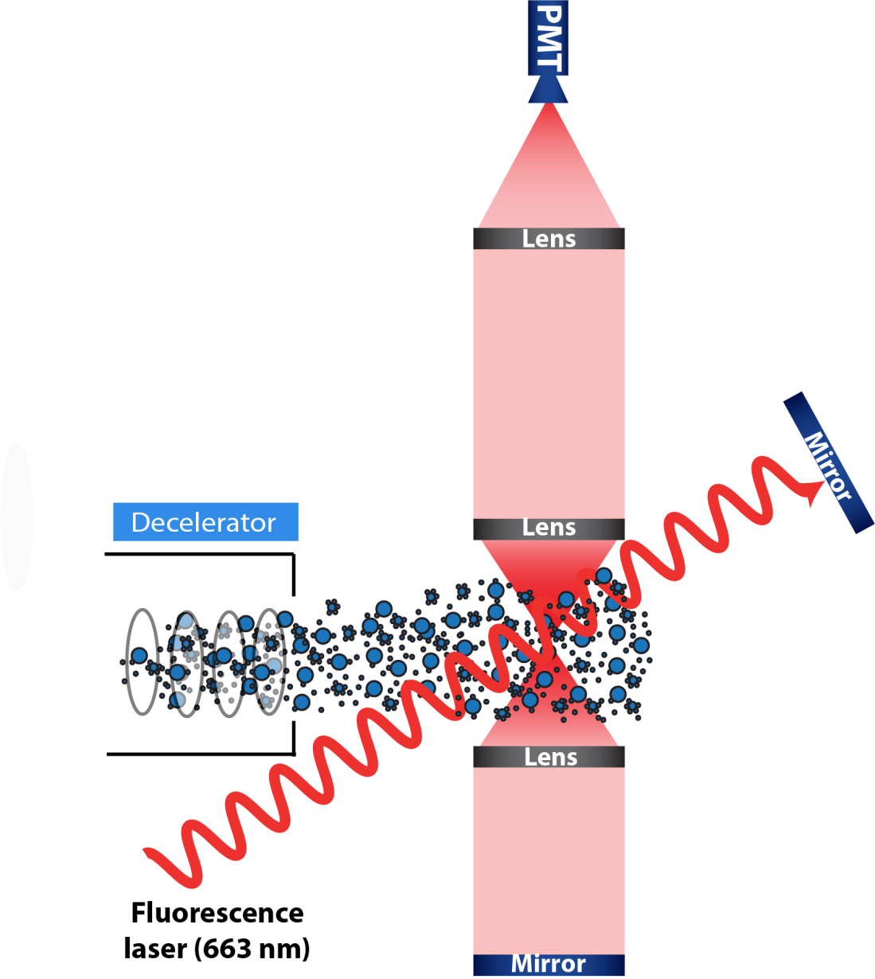
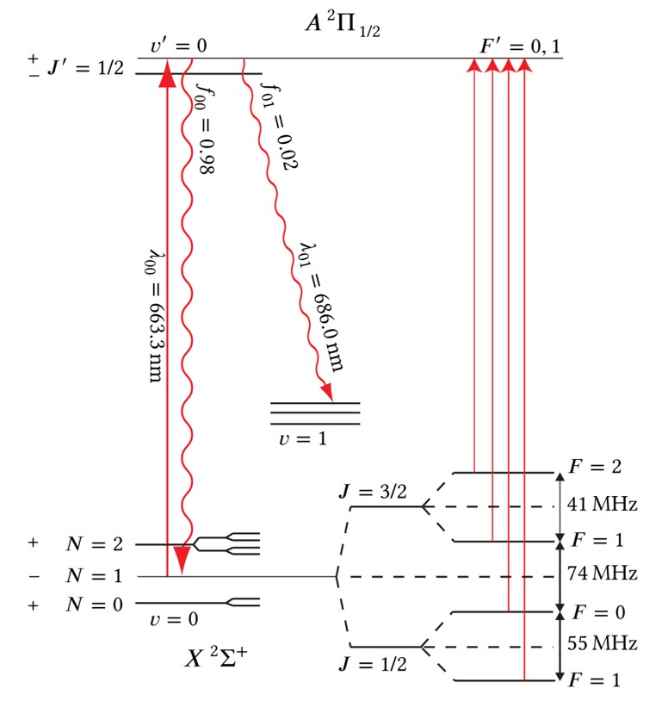
Detection
State-selective detection

Slide 10
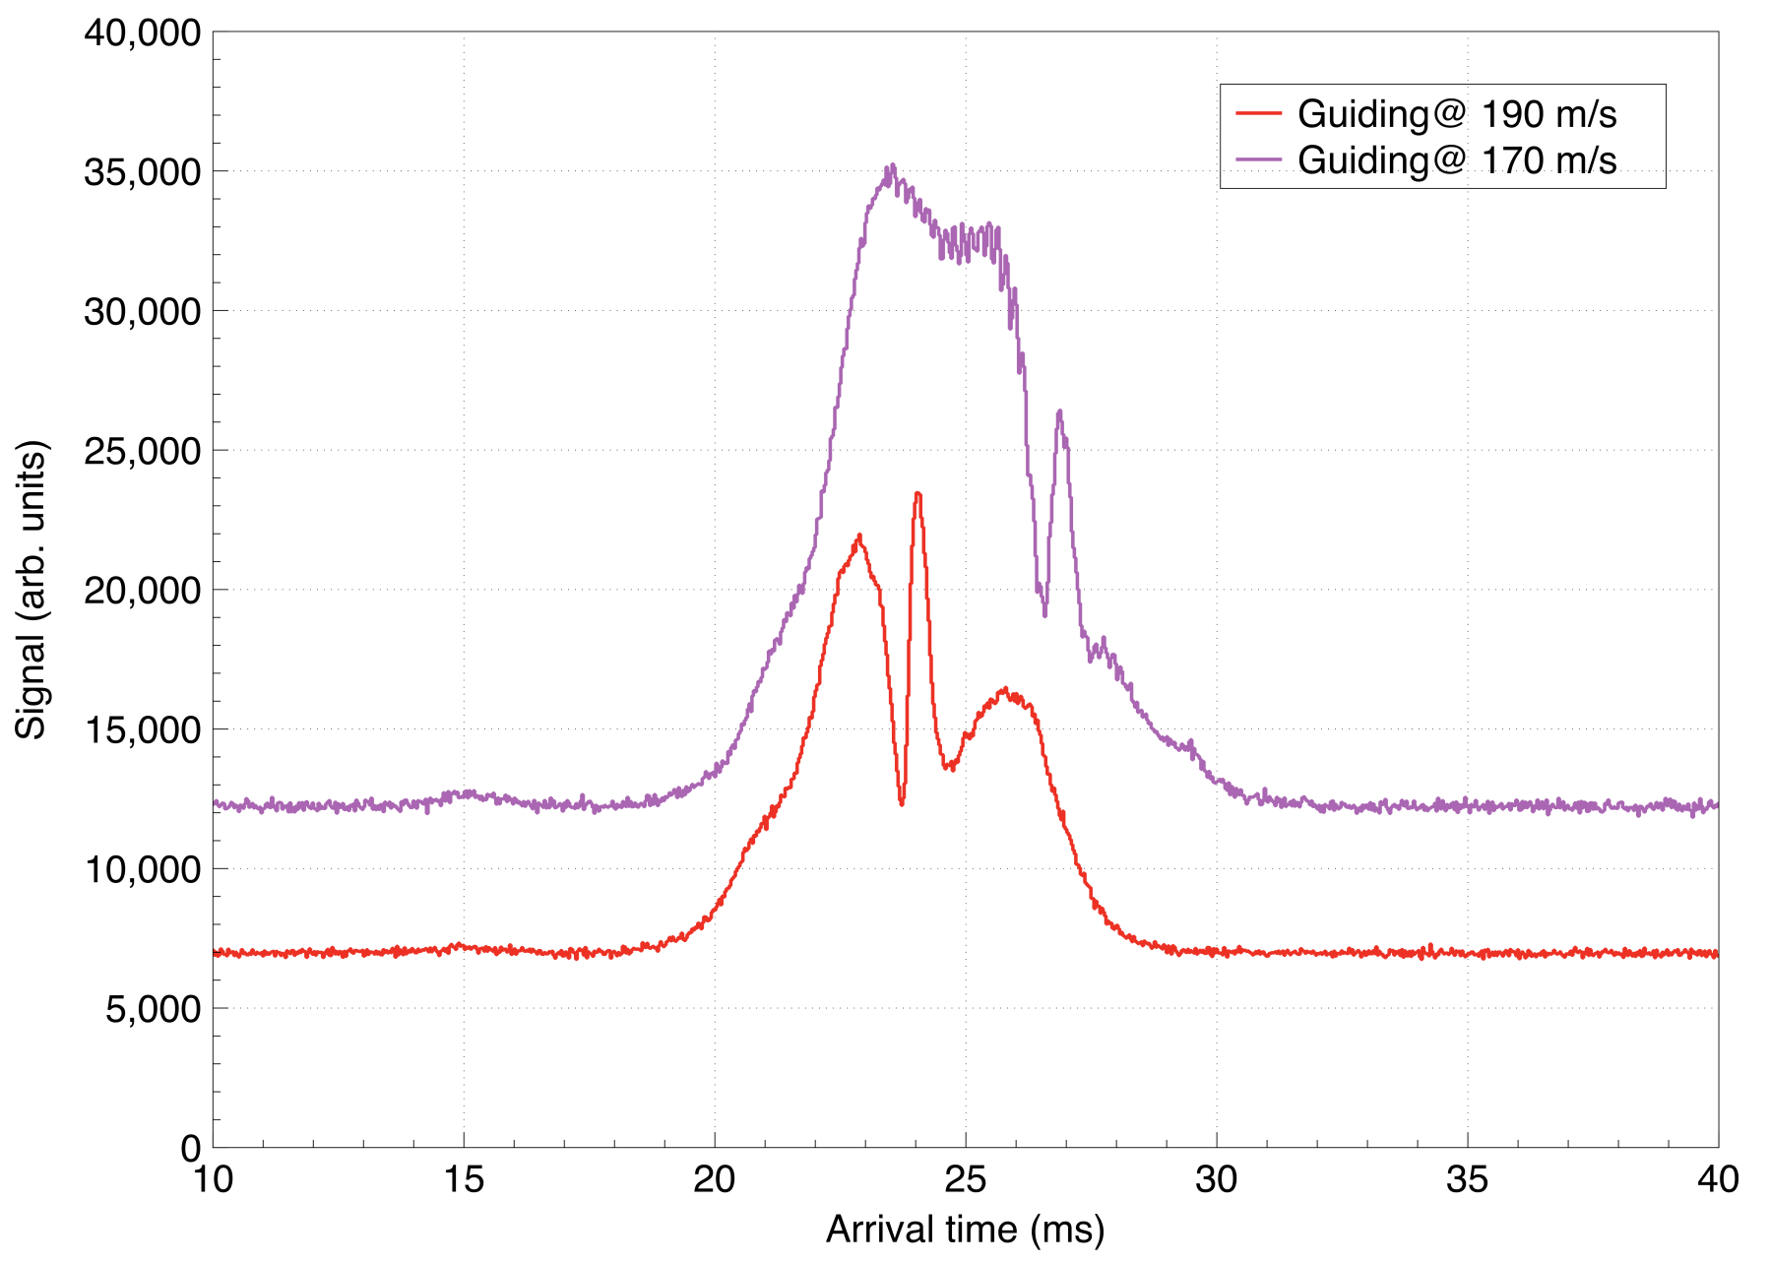
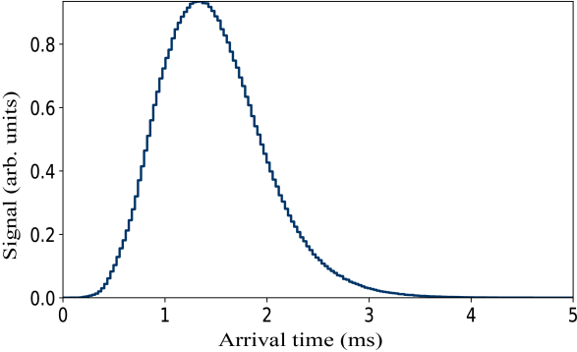
Guiding

Slide 11
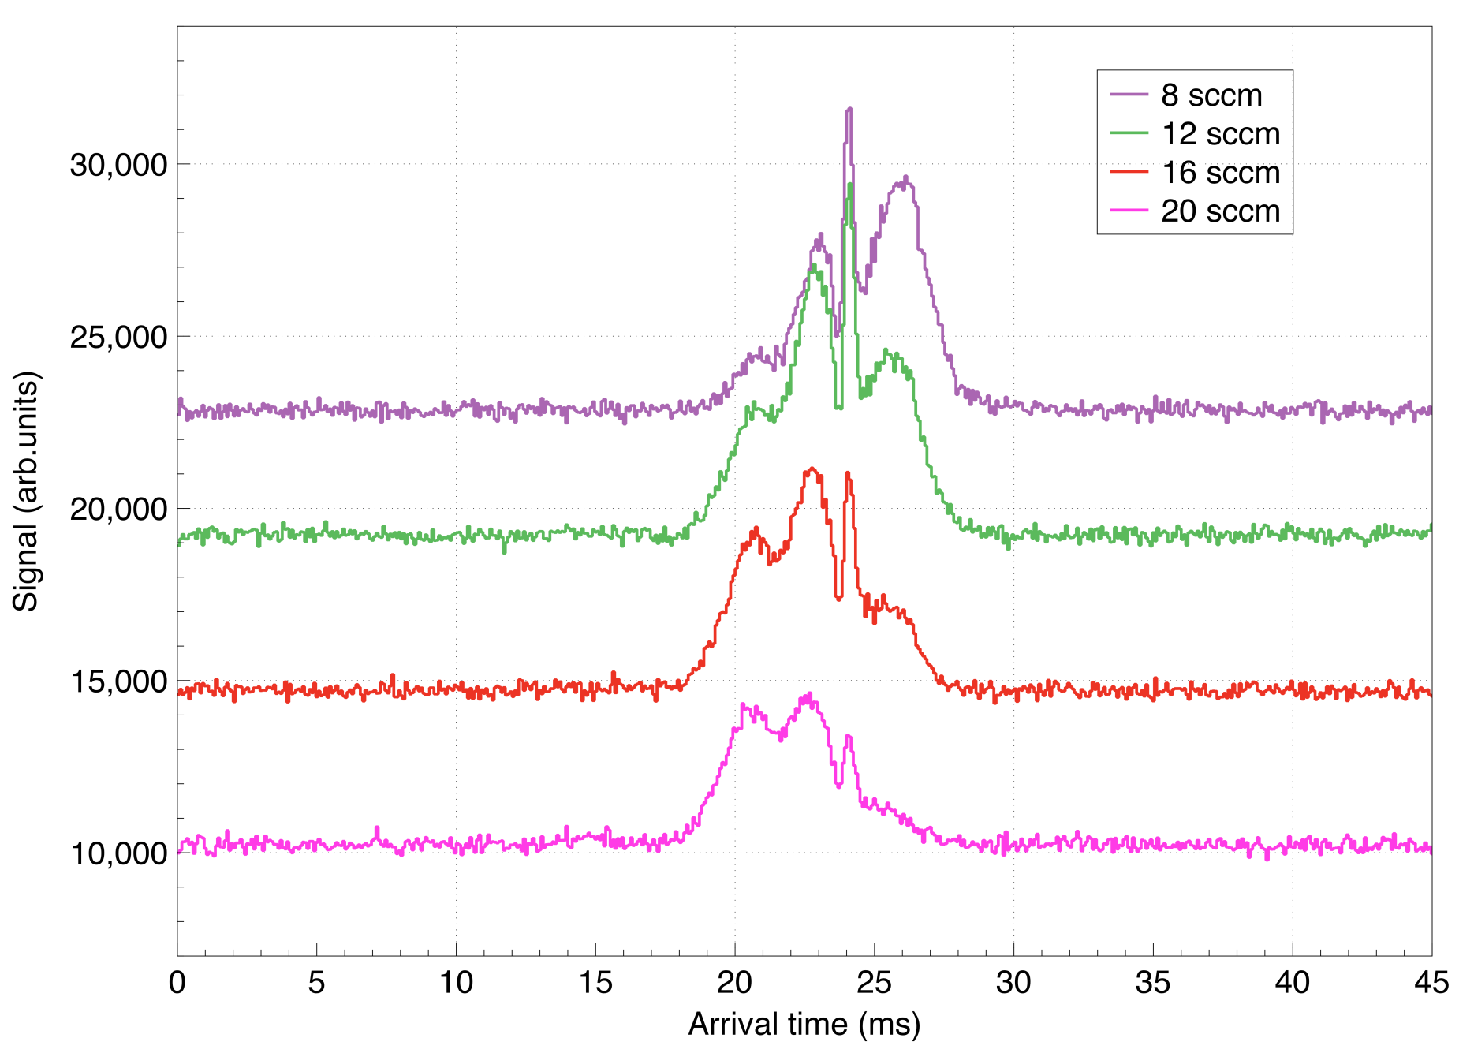
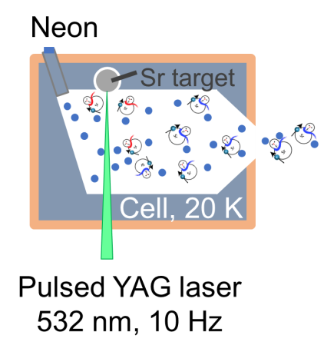
Control of parameters: Neon flow rate

Slide 12
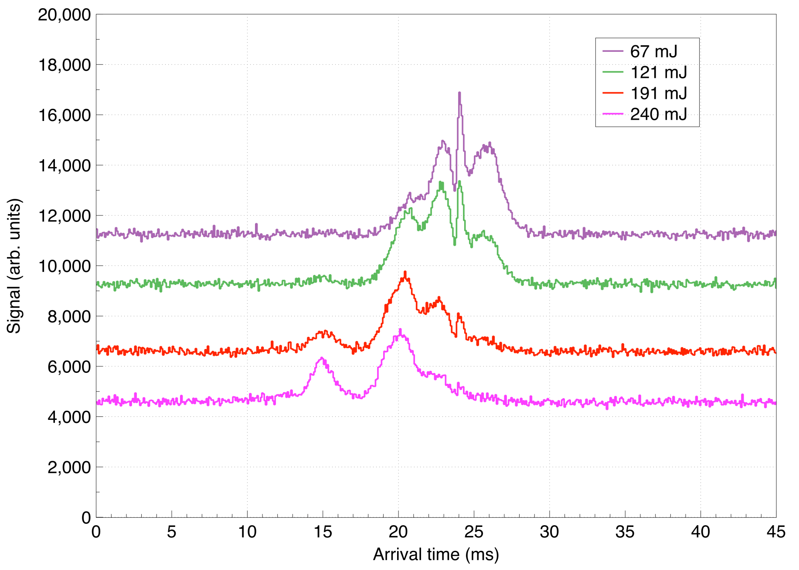

Ablation power

Slide 13
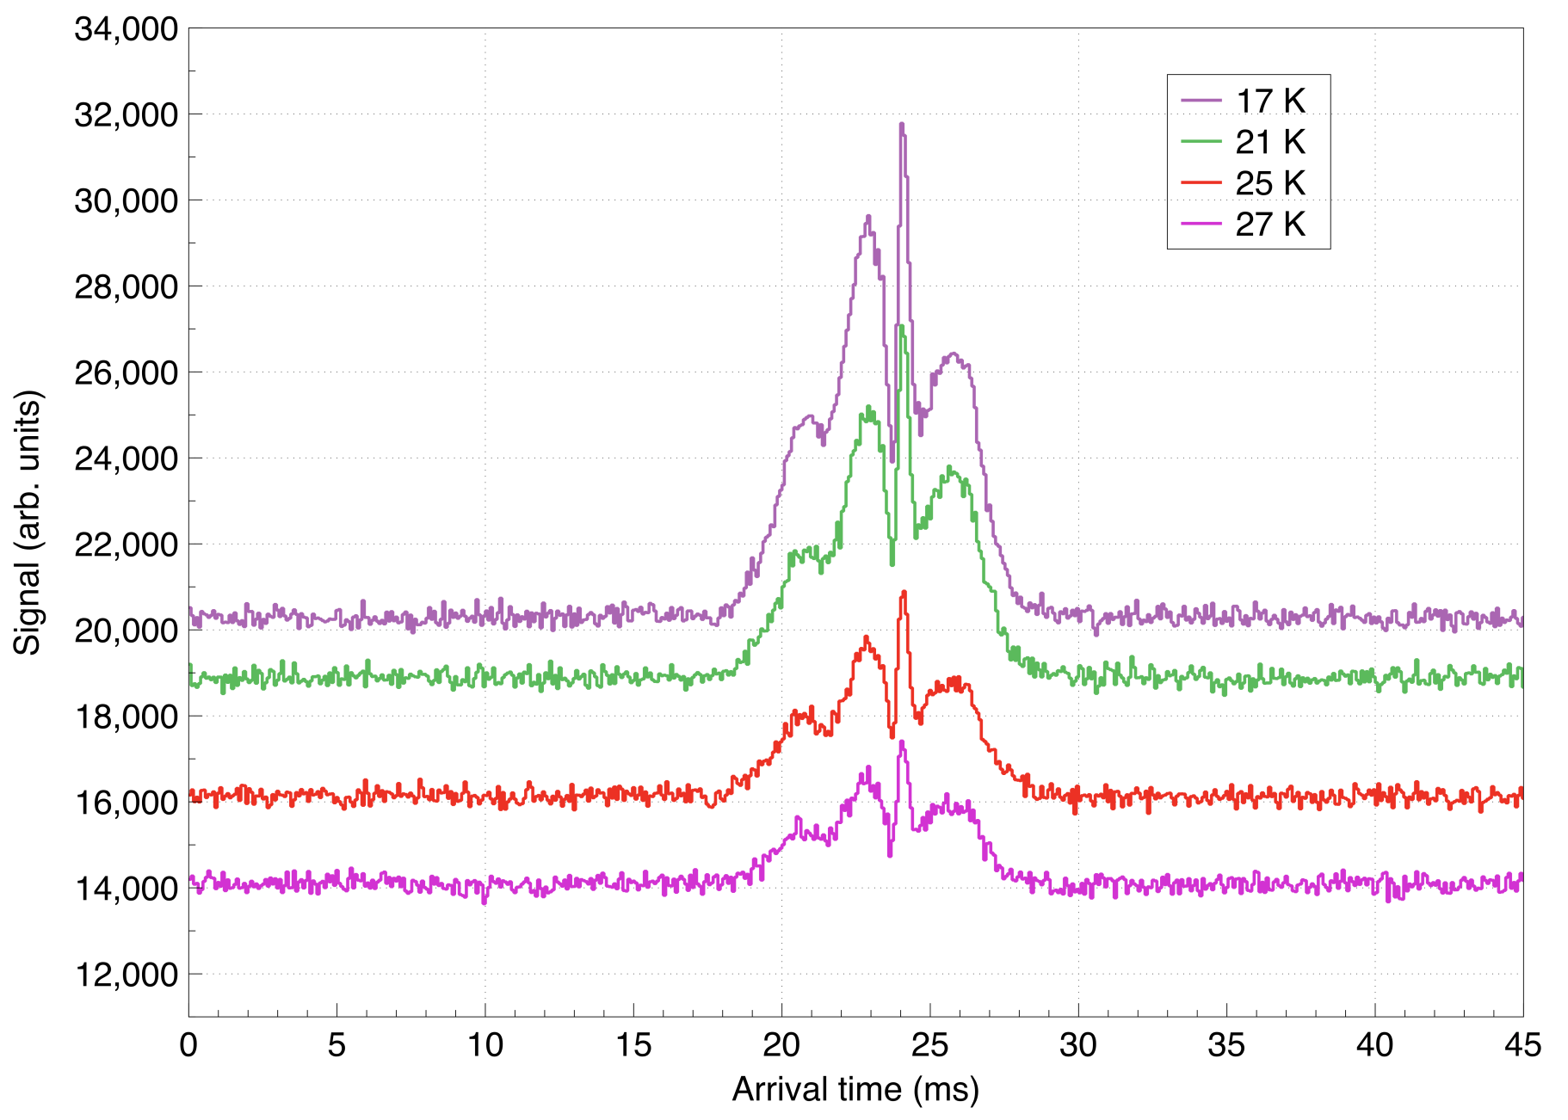

Cell temperature

Slide 14
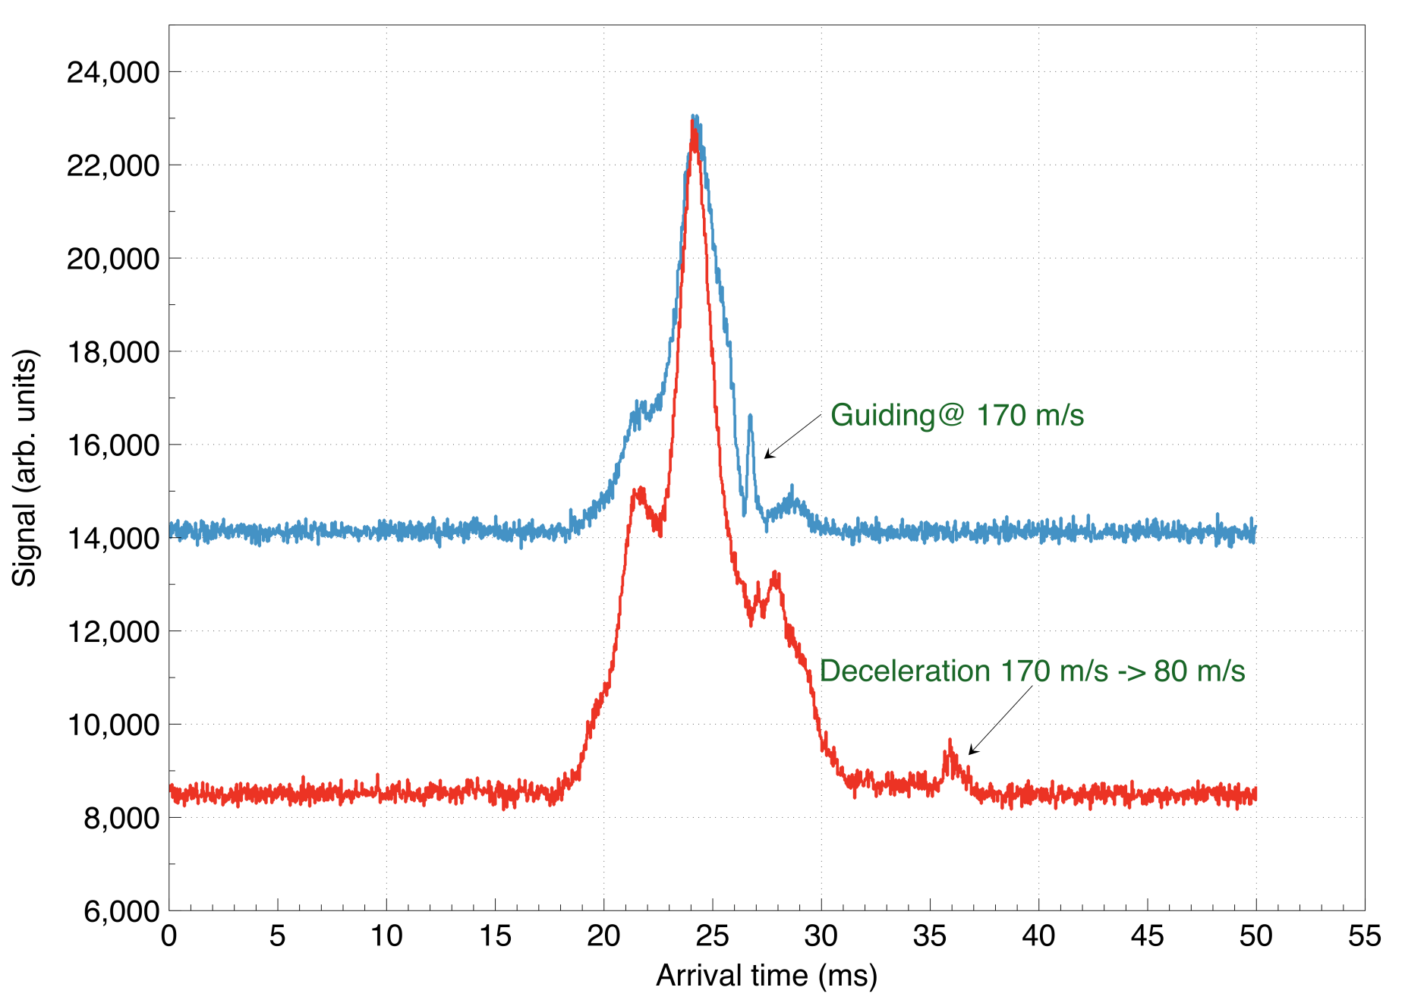
Deceleration

Slide 15
Conclusion and Outlook
A cryogenic source has been combined with a traveling-wave stark decelerator for the first time.
It is an important part of the whole eEDM measurement setup.
The combination has enabled us to do the full characterization of the cryogenic source beam.
In the near future, we will make a switch from the production and deceleration of SrF to BaF.

Slide 16
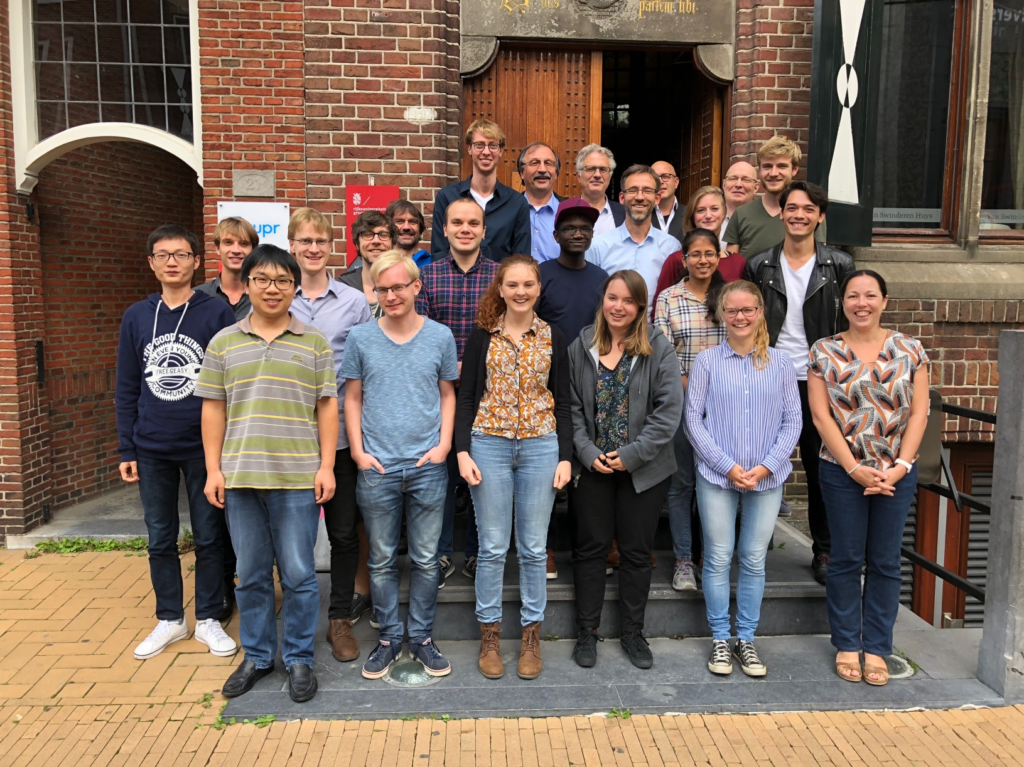
NL-eEDM collaboration
Scientific Staff
Rick Bethlem
Anastasia Borschevsky
Steven Hoekstra
Klaus Jungmann
Rob Timmermans
Wim Ubachs
Lorenz Willmann
PhD Students
Parul Aggarwal
Alexander Boeschoten
Kevin Esajas
Pi Haase
Yongliang Hao
Virginia Marshall
Thomas Meijknecht
Maarten Mooij
Anno Touwen
Artem Zapara
Postdocs
Malika Denis
Yanning Yin

Slide 17
Questions

Slide 18
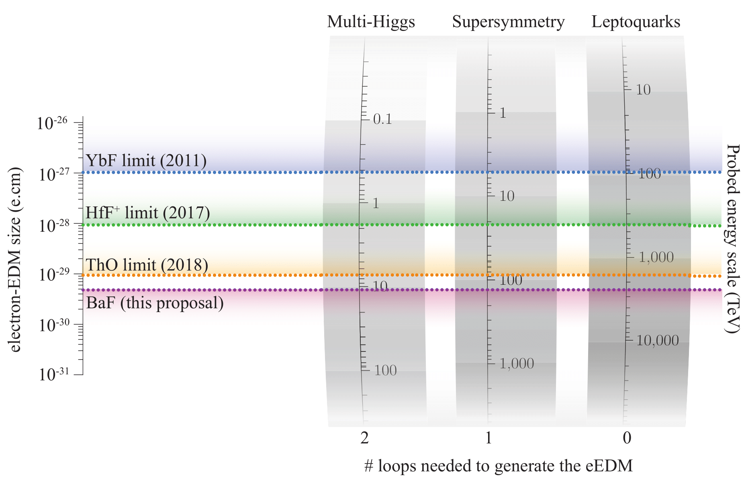
Physics beyond the Standard Model
NL-eEDM collaboration, Eur. Phys. J. D (2018) 72:197

Slide 19
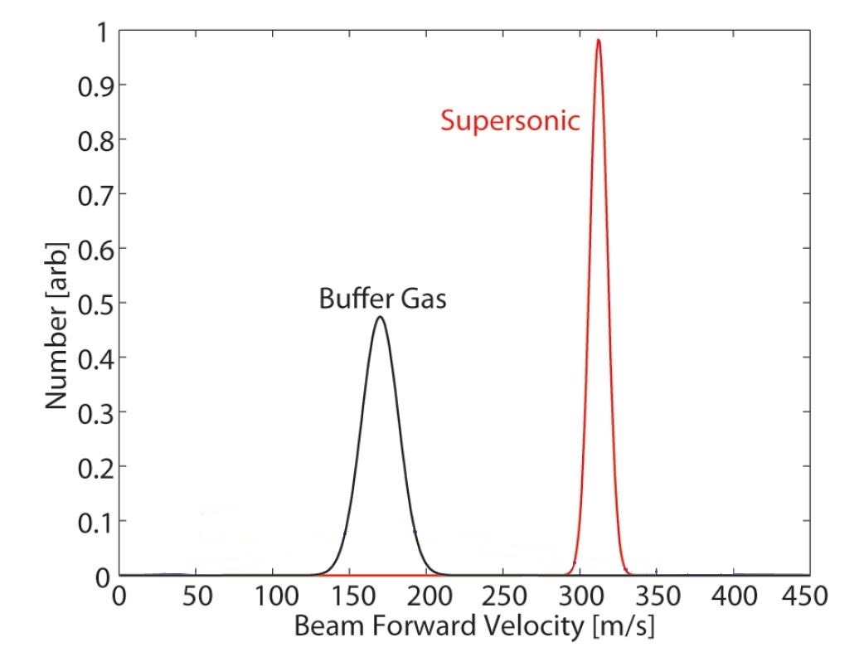
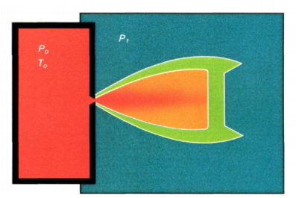
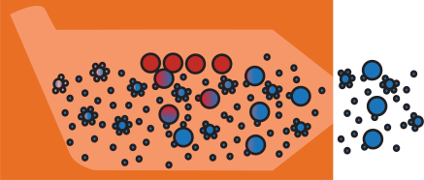
Cryogenic source
Buffer gas cooled source beam:
has a lower forward velocity.
has a considerably higher flux
than a supersonic source.
Adapted from N.R Hutzler et al. Chem. Rev. 112 (9), 4803 (2012)

