Slide 1
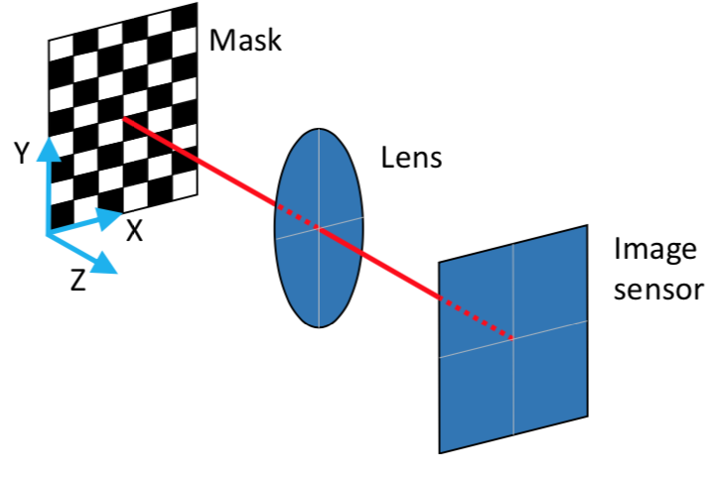

Slide 2
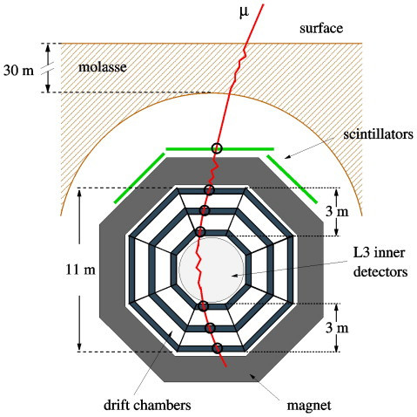
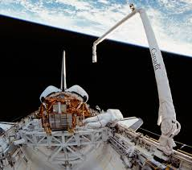
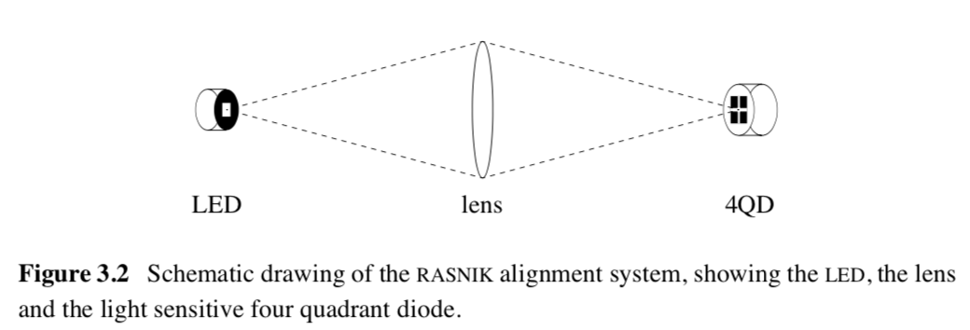
sagitta s
1983: Space Shuttle Robotic Arm
Bending monitor was required
Draper Lab: Mechanical Engineering
Next to M.I.T., Cambridge, Mass
Engineering for L₃ (Samuel Ting)

Slide 3
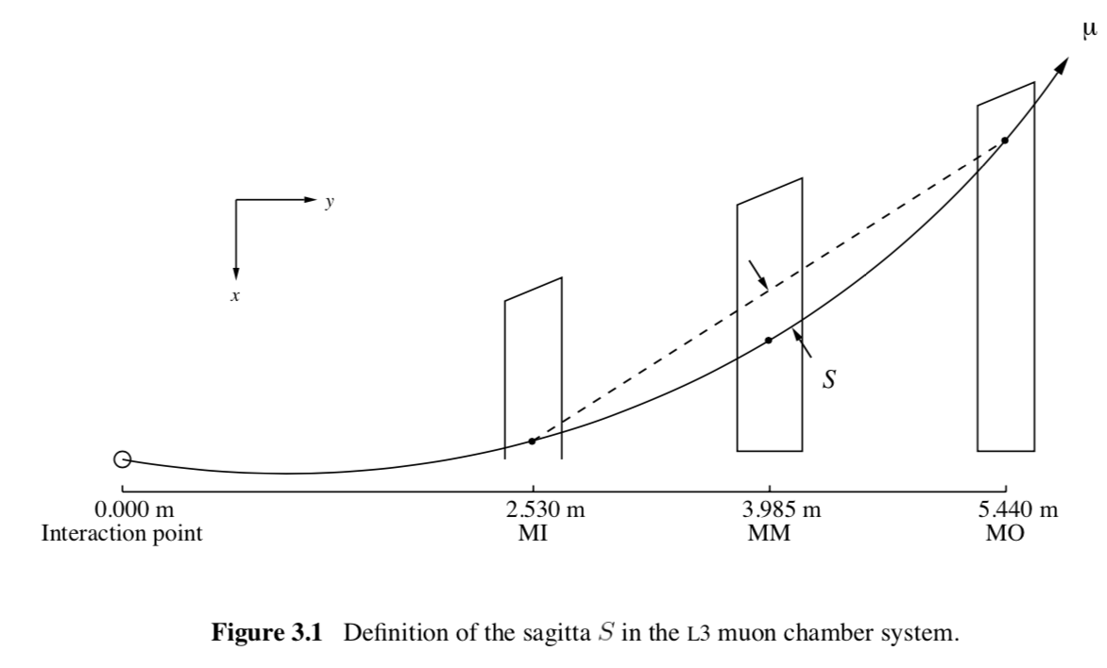
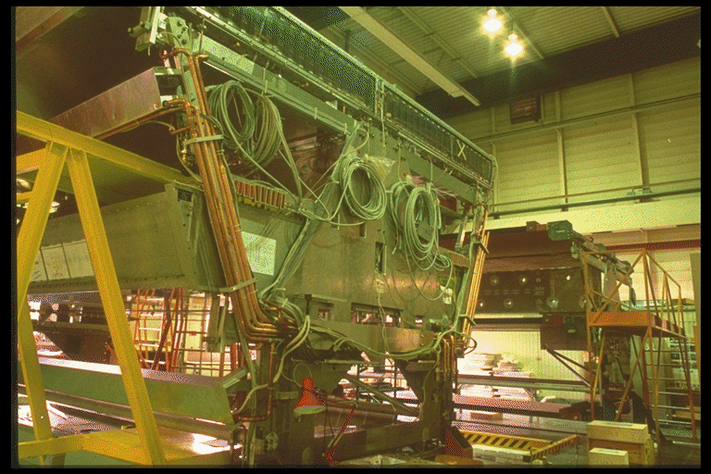

Slide 4
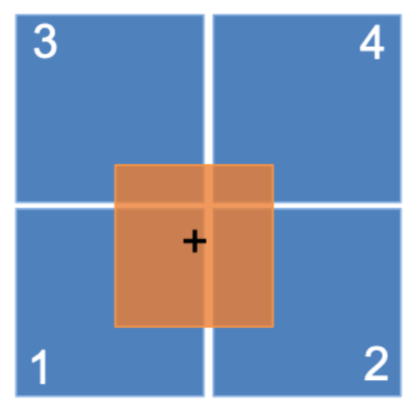
From Zero Target indicator
to
analog ‘proportional’ alignment monitor

Slide 5
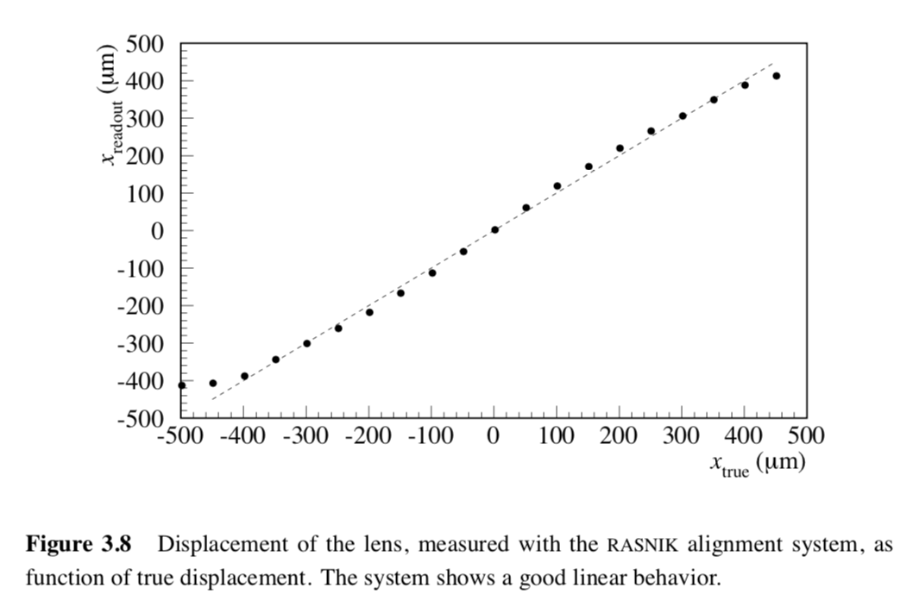

Slide 6
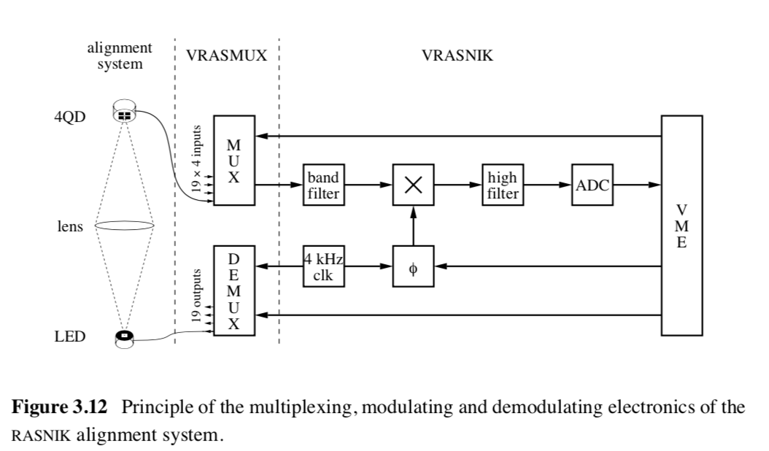

Slide 7
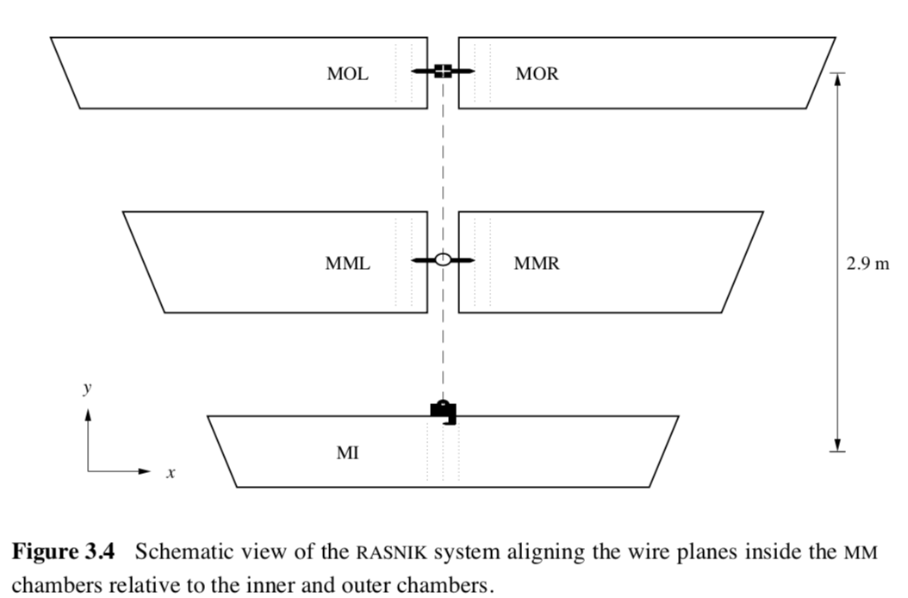
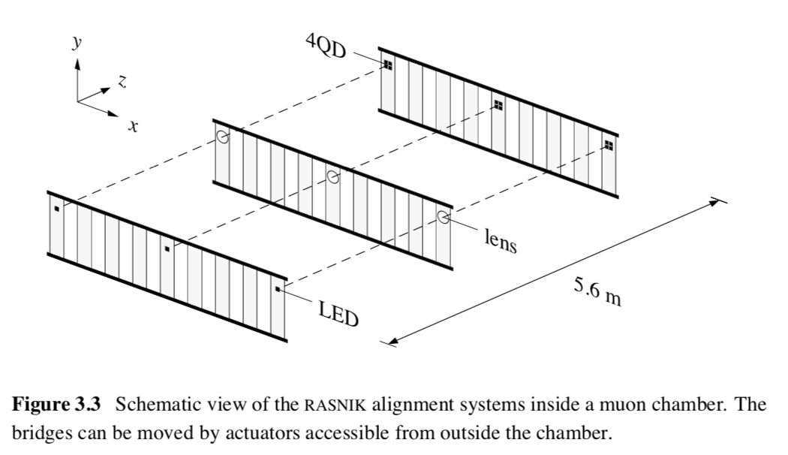
for chamber deformation
for sagitta correction

Slide 8
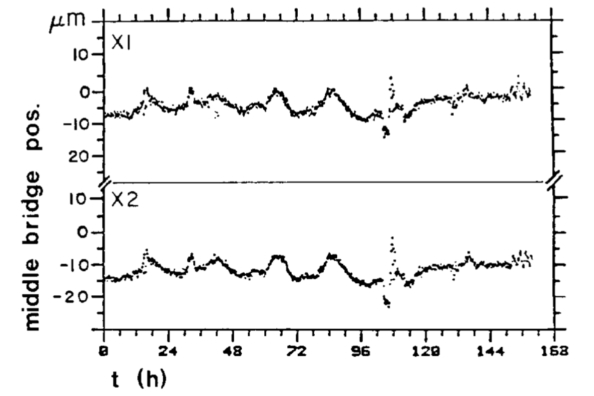
The X values of two Rasnik systems in one chamber
The 24 h temperature variations are clear, as well as a change in gas pressure
After a global empirical correction, a precision of 5 um is reached.

Slide 9
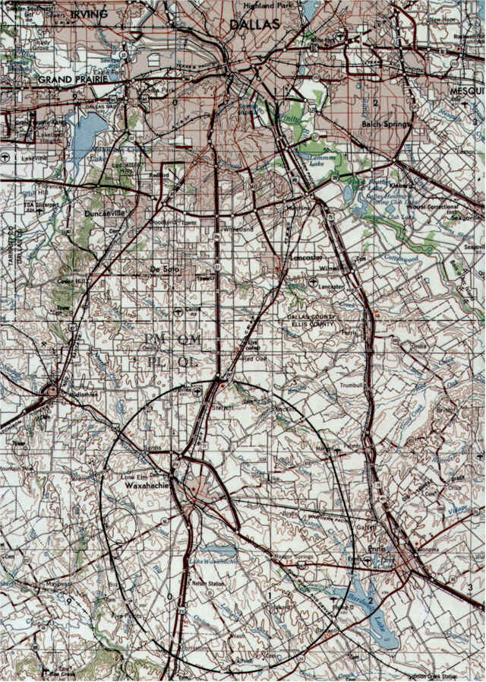
1990
Concept studies for the GEM experiment at the SSC, Texas, USA
Studies CMS, ASCOT and EAGLE experiments at LHC, CERN

Slide 10
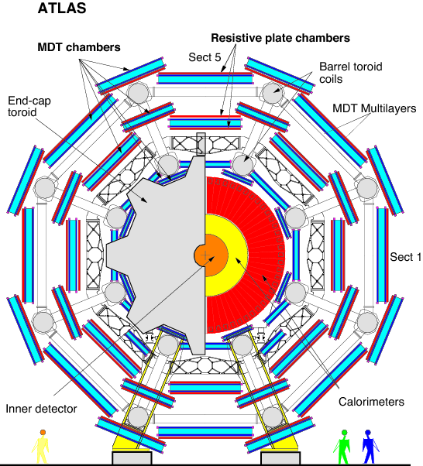
New experiments will include large Muon Spectrometer like in L₃:
larger dynamical range
better precision
In large numbers required: low-cost
Chamber positions may vary up to 10 mm:
thermal gradients & variations in experiment
Difference magnet(s) on and off
This requires a new alignment system:
large range of operation
high precision
at low cost

Slide 11
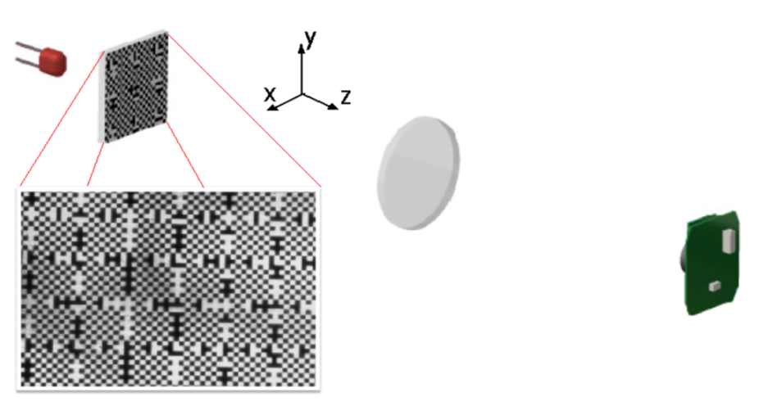
LED
Plano-convex lens
Image pixel sensor
CMOS or CCD
1992: the CCD-Rasnik system

Slide 12
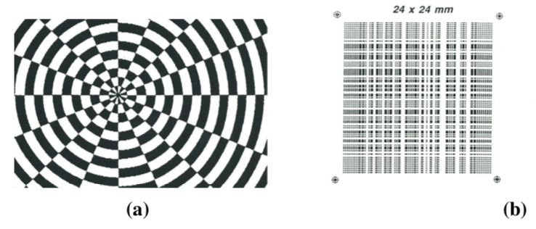

Slide 13
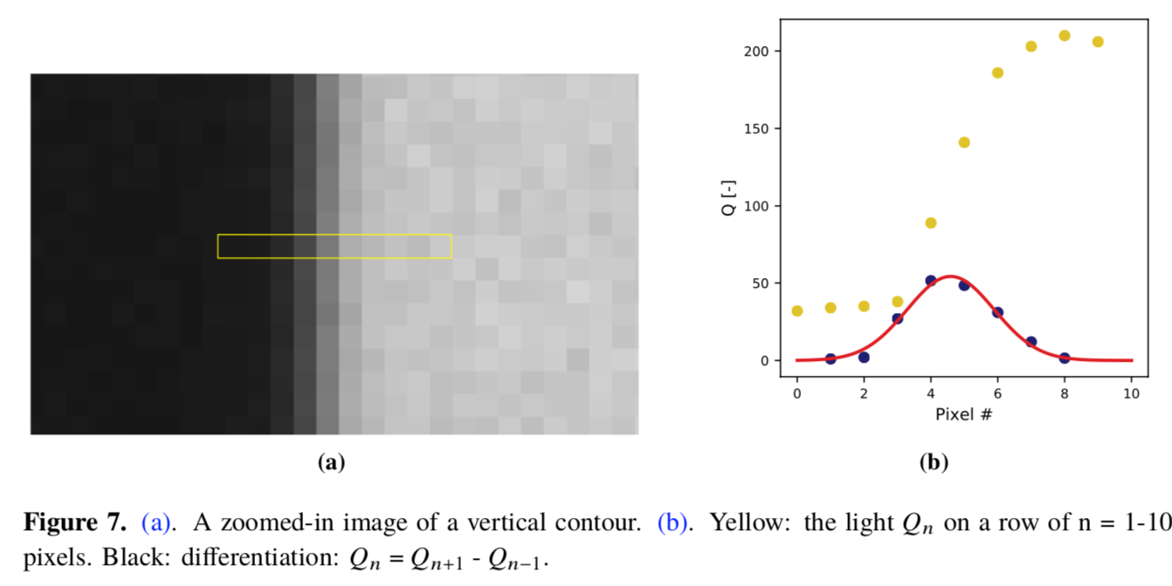

Slide 14
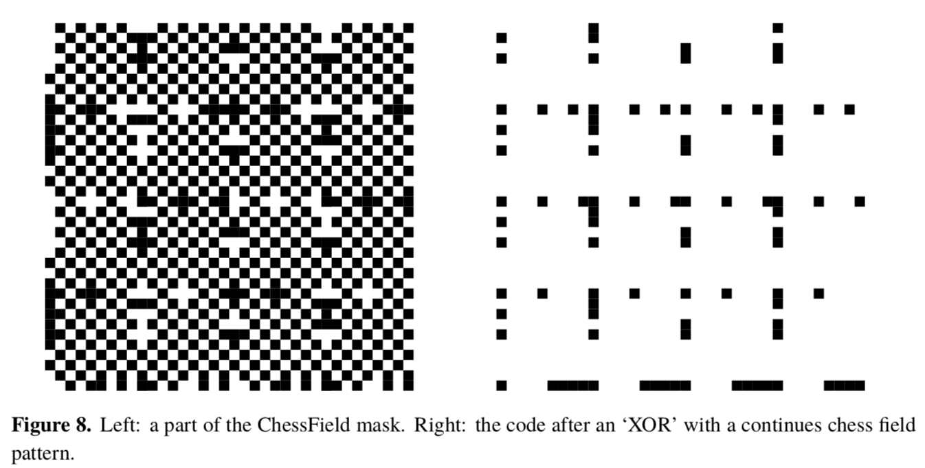

Slide 15
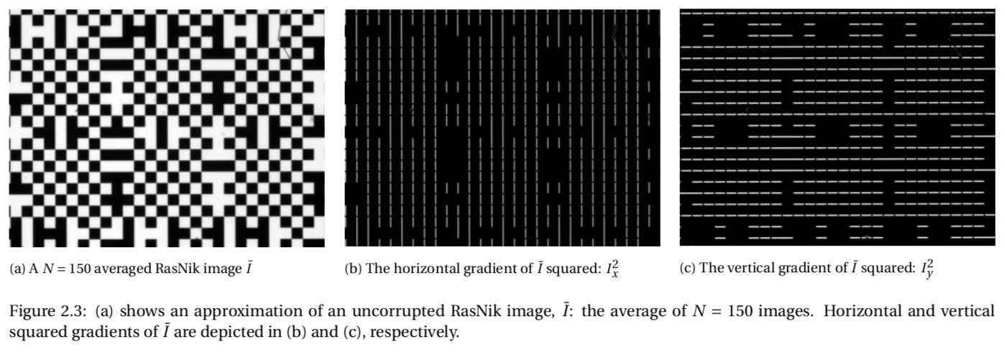
First Image Analysis routine: Linde-Woudstra
Q_{n} = Q_{n+1} – Q_{n-1}

Slide 16
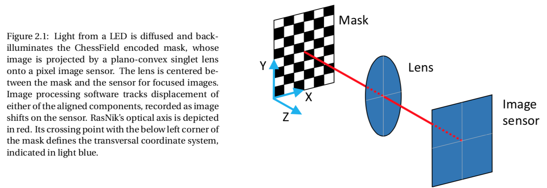
With the CCD-Rasnik system one measures:
Displacements (sagittas) in X and Y
Displacements in Z, due to a variation in image scale
Differential rotation of mask and sensor rotZ
rotX and rotY of mask: 2rd order effect: not very precise

Slide 17
CCD-Rasnik for ATLAS
Range of measurement: only limited by mask size
Low cost
Very precise: precision limited to 5 um due to fluctuations in air density

Slide 18
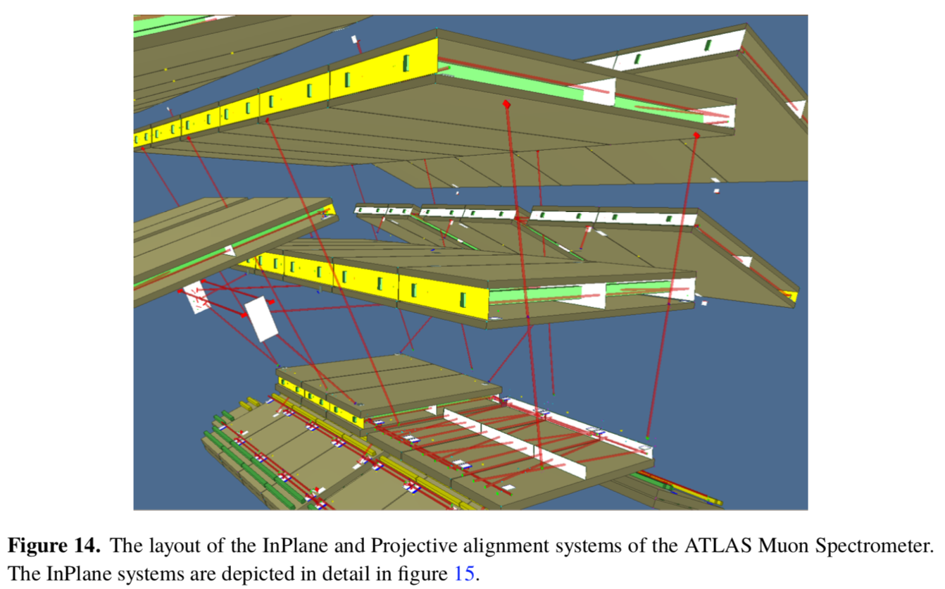

Slide 19
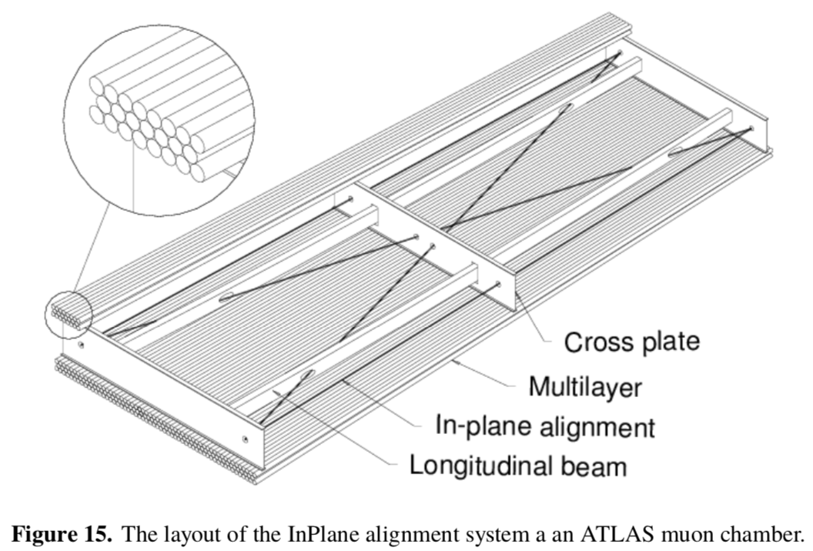

Slide 20
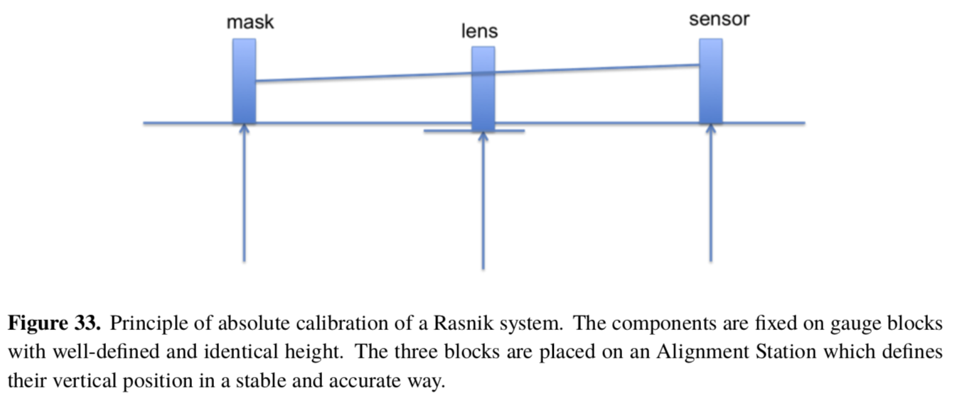
Three gauge blocks

Slide 21
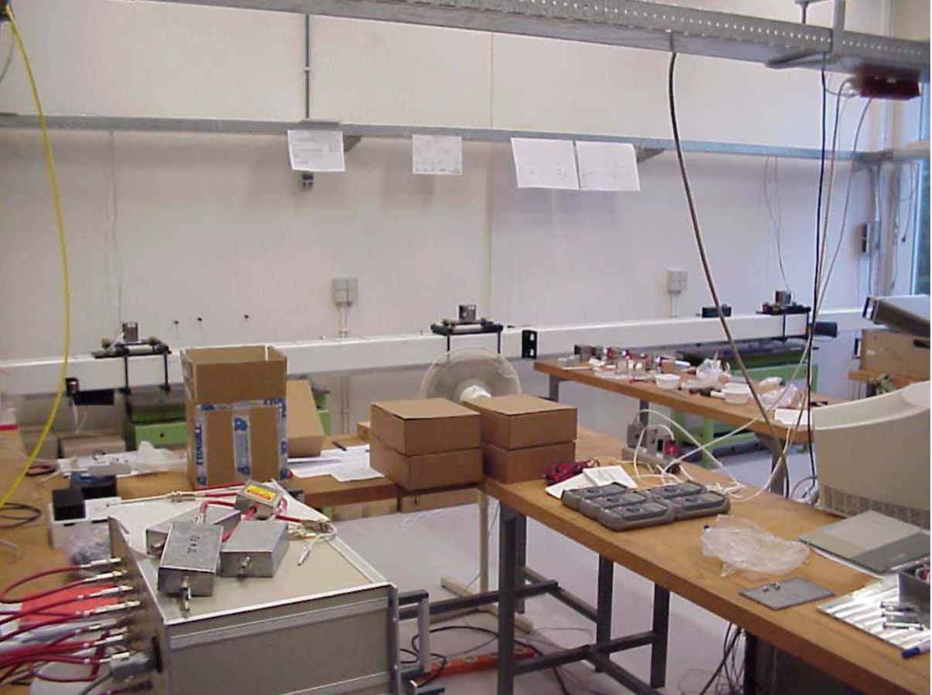
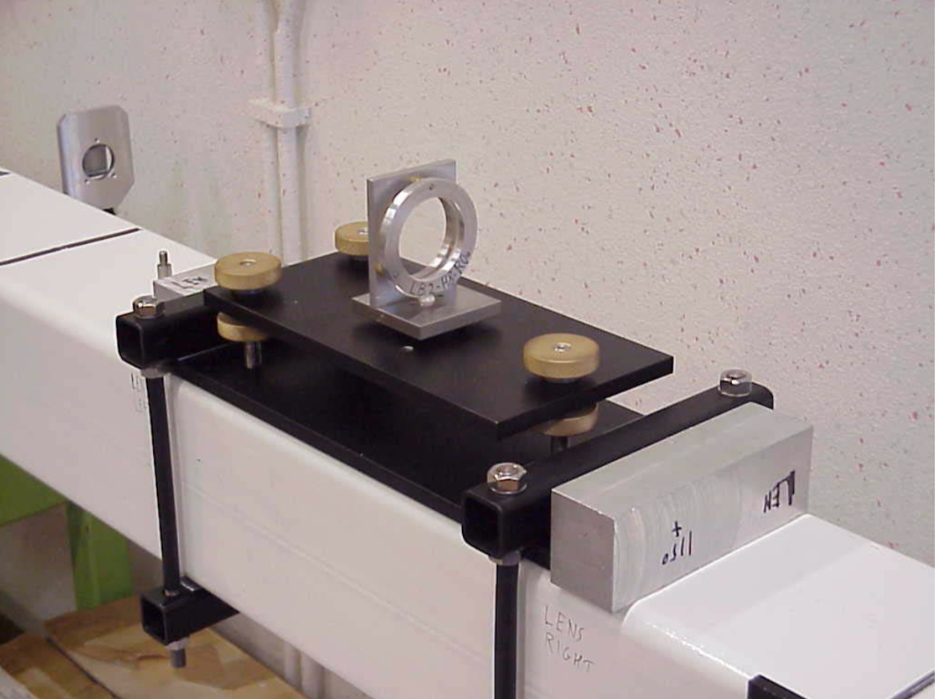

Slide 23
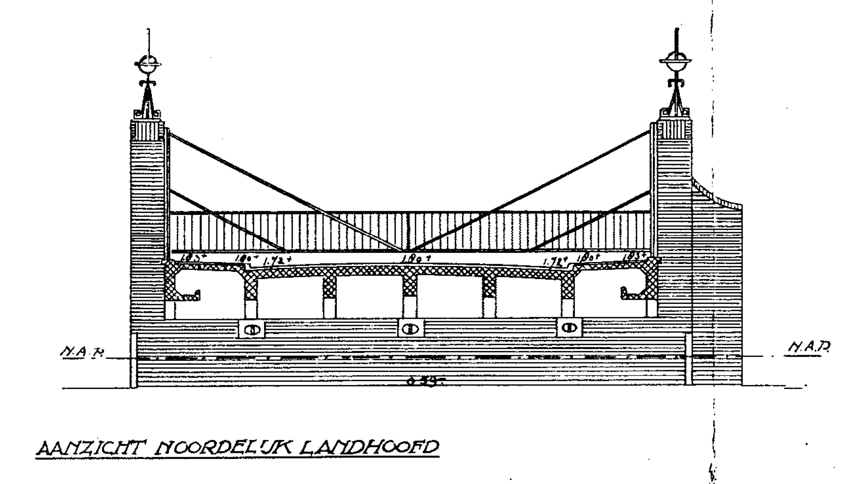
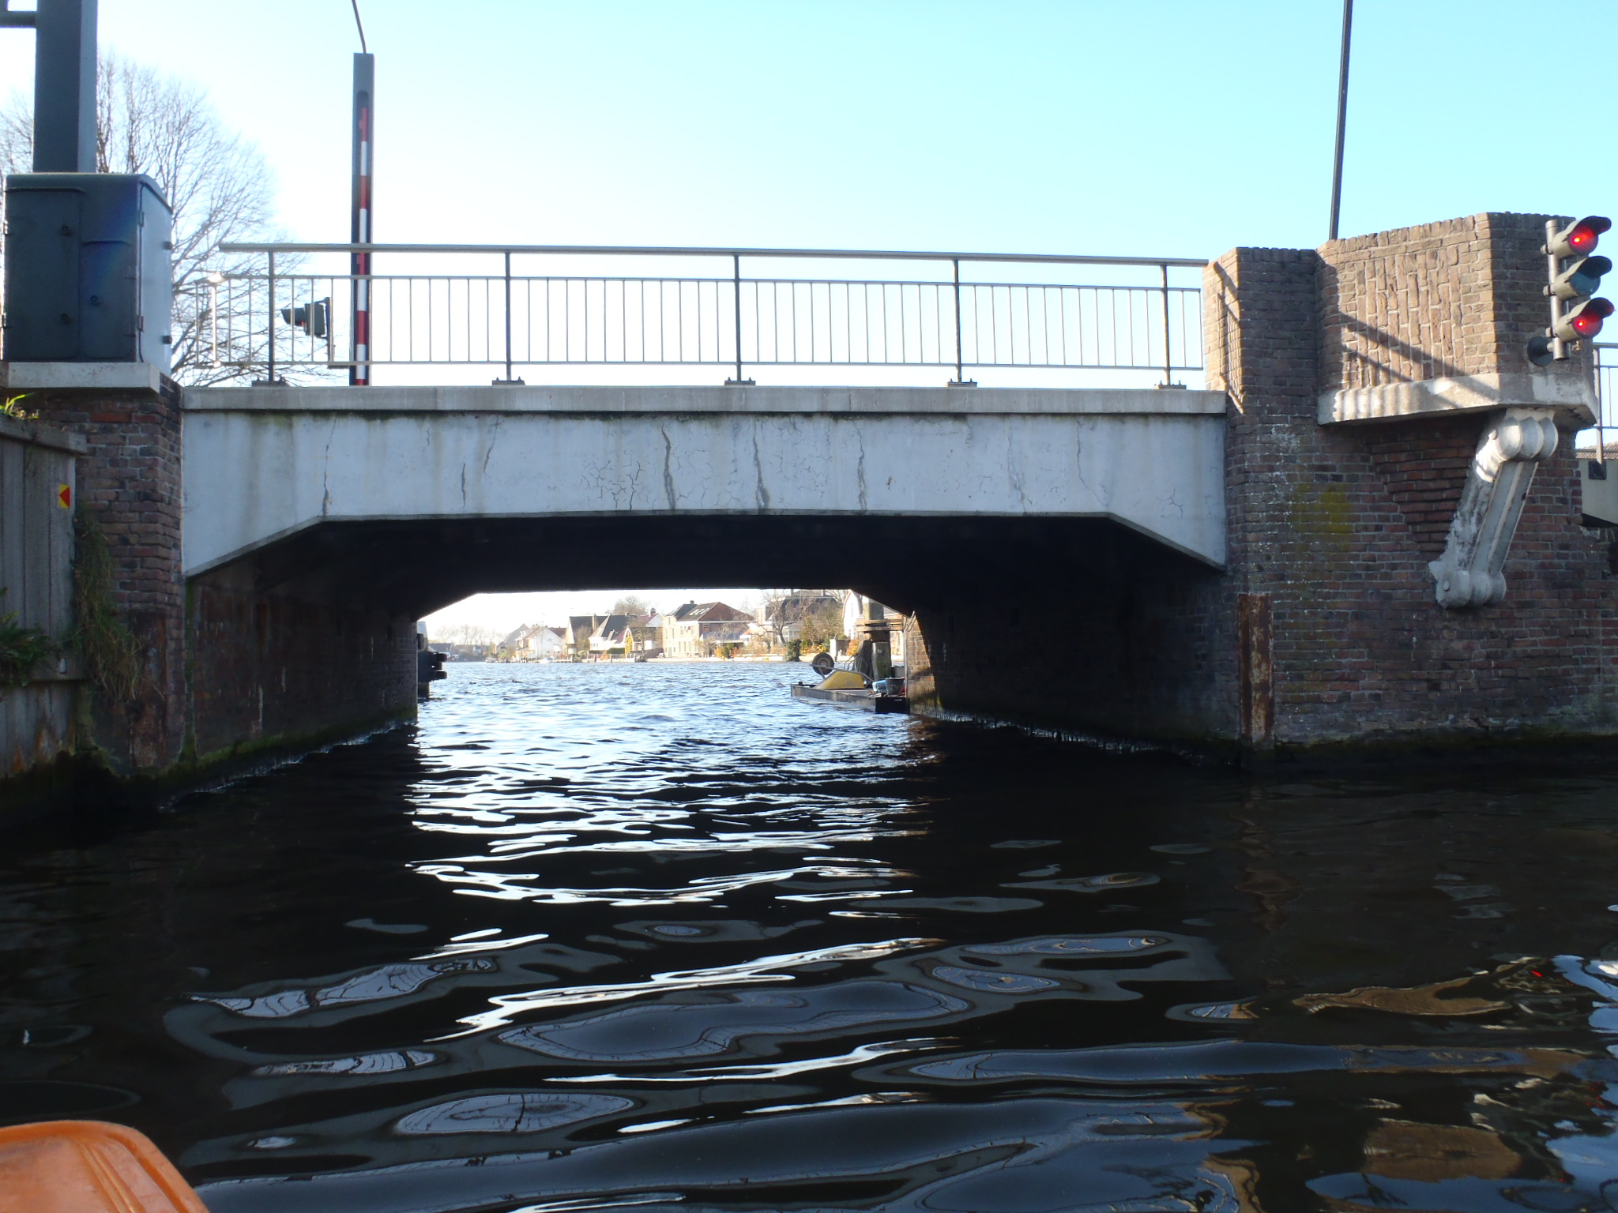

Slide 24
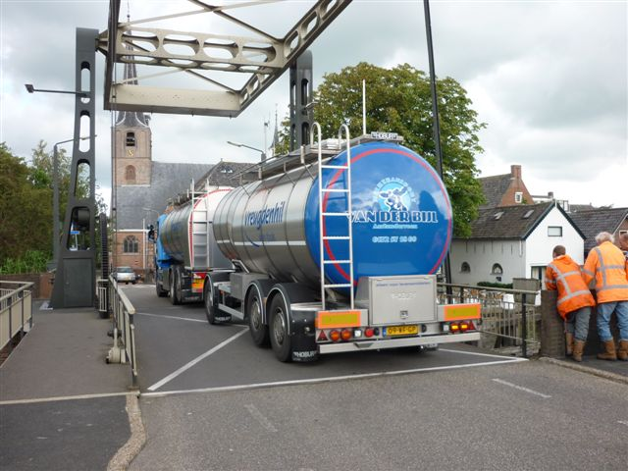

Slide 25
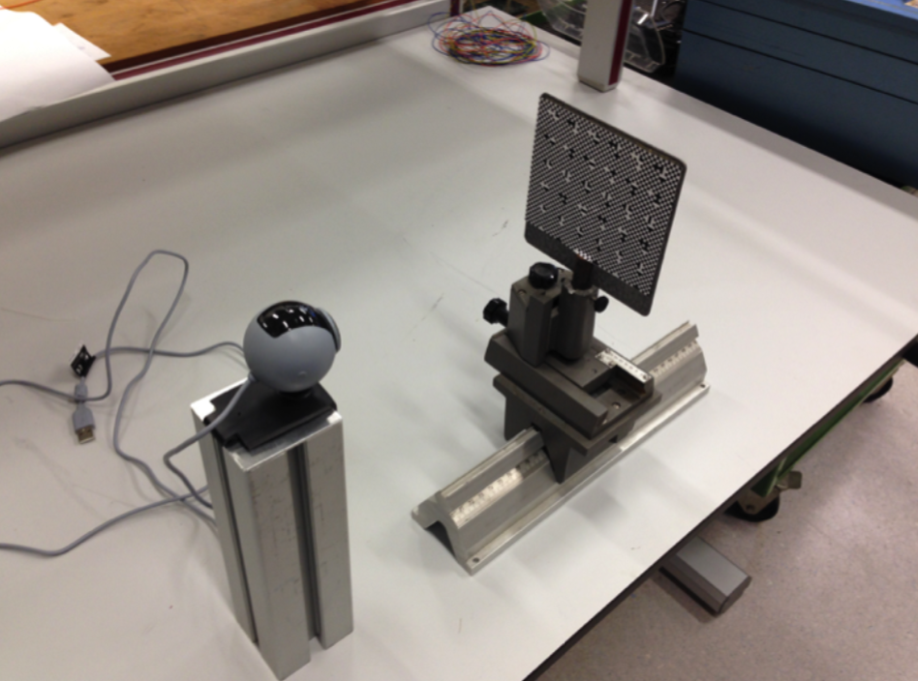
Displacement Monitor:
X, Y, Z and rotZ

Slide 26
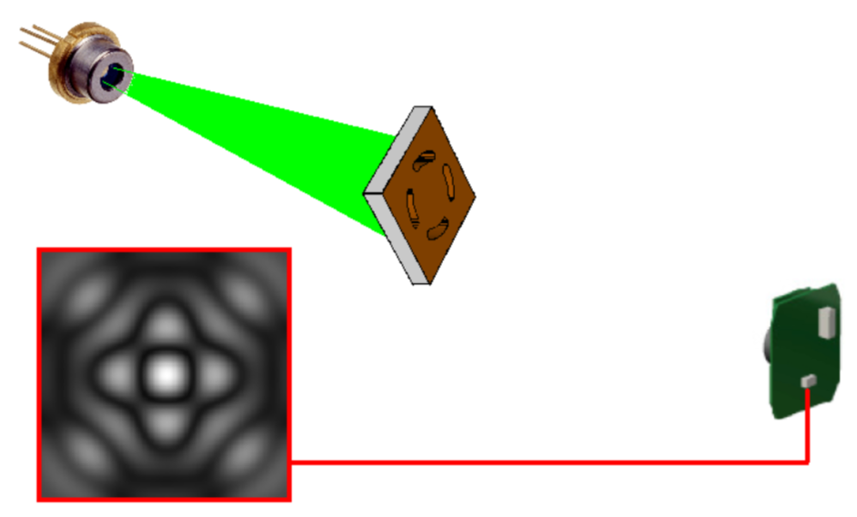
Rasnik for CLIC: long span system ~ 100 m for low-beta quadruple alignment
RasDif: avoid lens: unpractical diameter

Slide 27
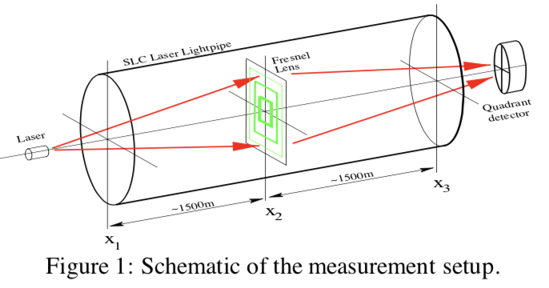
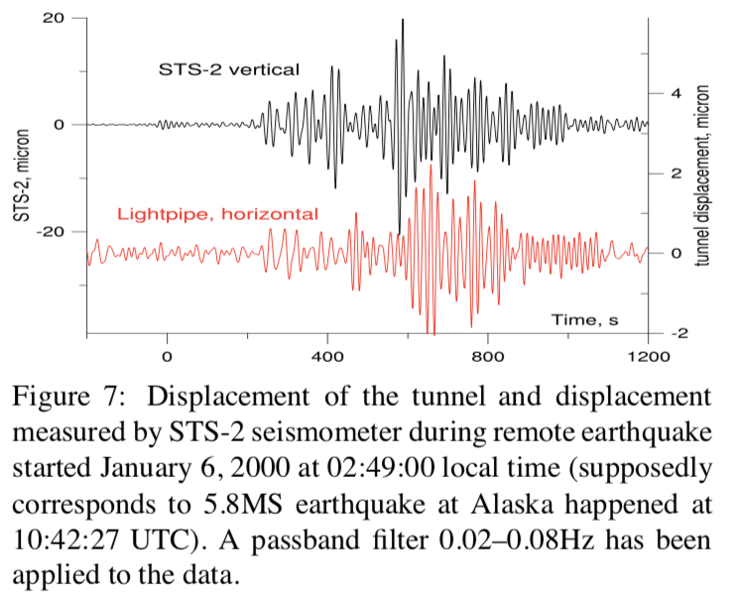
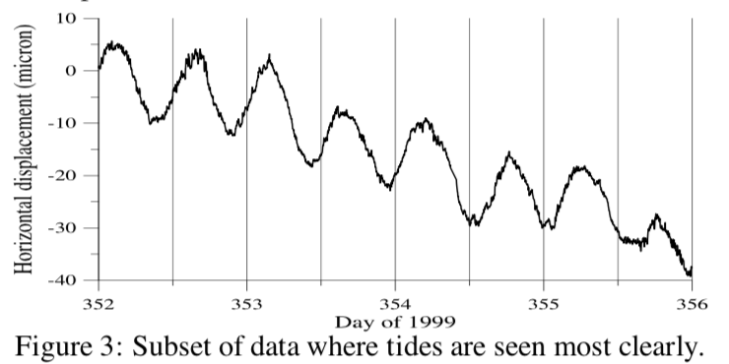
Long baseline interferometer at SLAC (1999)
Low-frequency seismometer

Slide 28
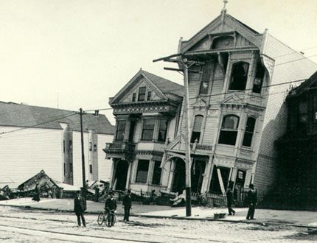
RasClic: een nieuwe seismograaf
FOM wedstrijd: Win de toekomst!
Henk Groenstege
Marc Kea
20 November 2006

Slide 29
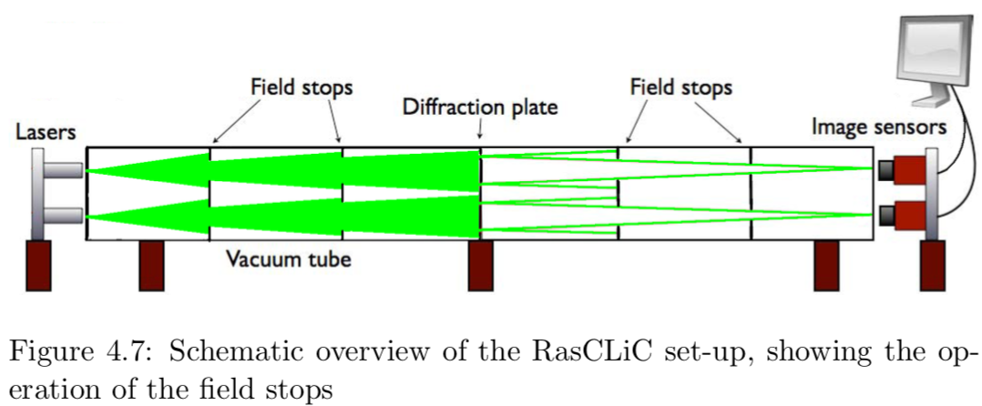
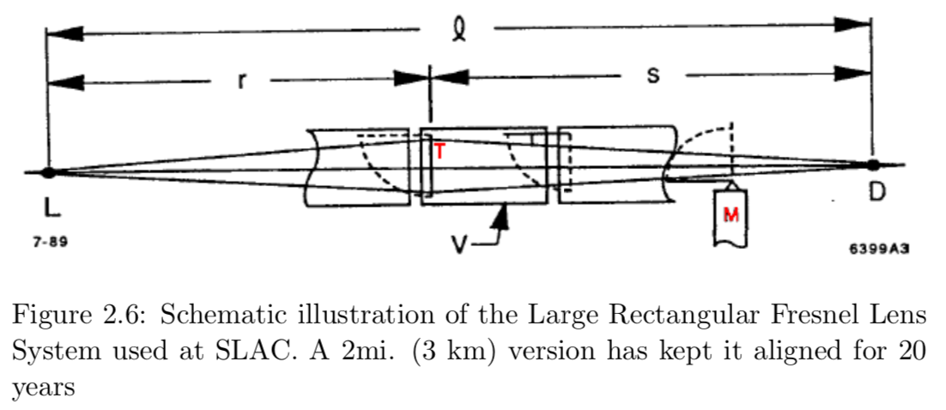

Slide 30
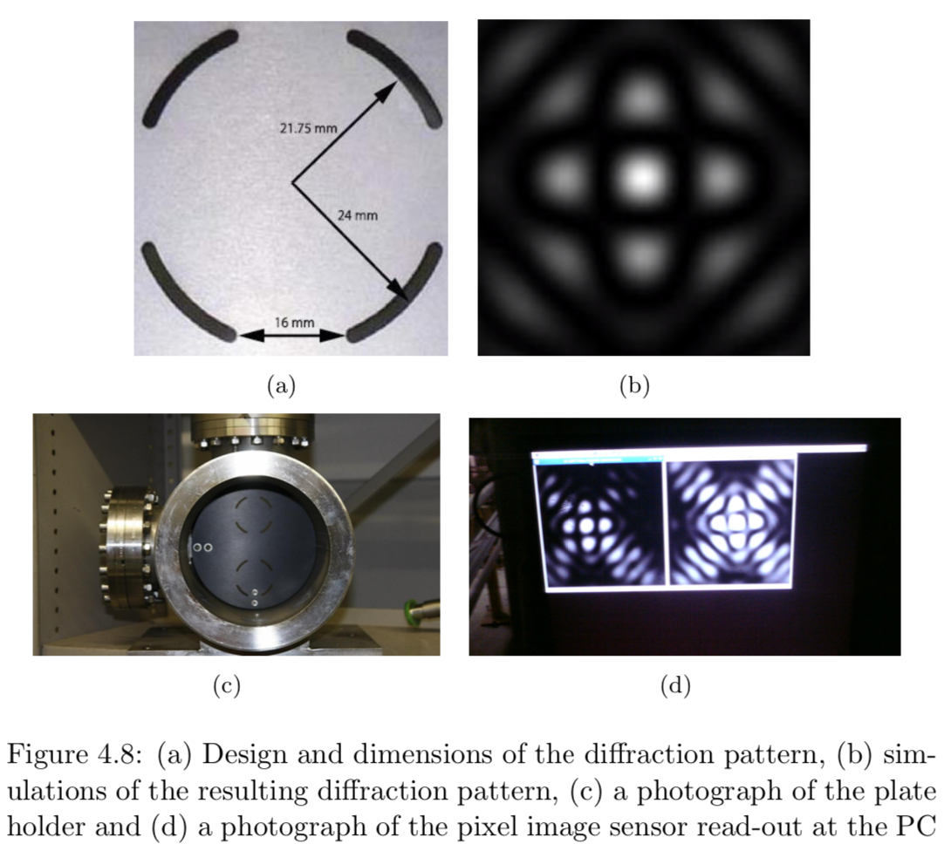

Slide 31
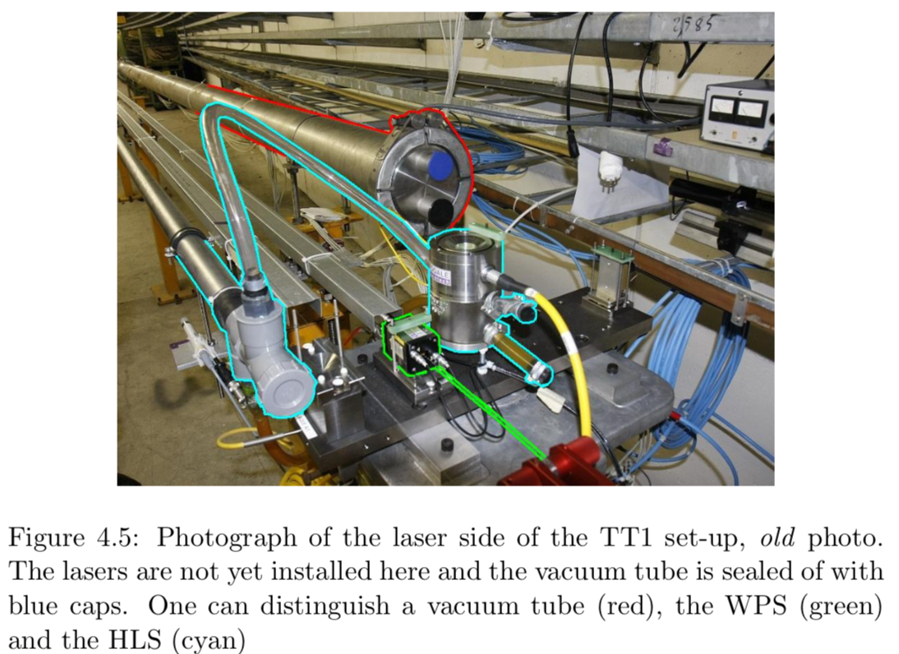

Slide 32
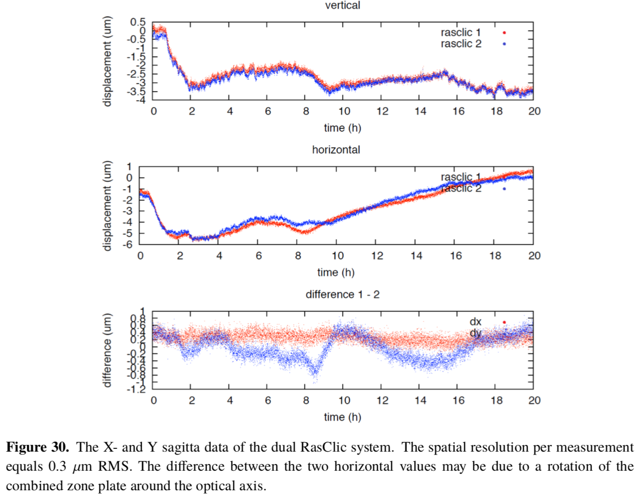

Slide 33
Image analysis
”steepest descent” method (Linde-Woudstra): fit of orthogonal grid

Slide 34
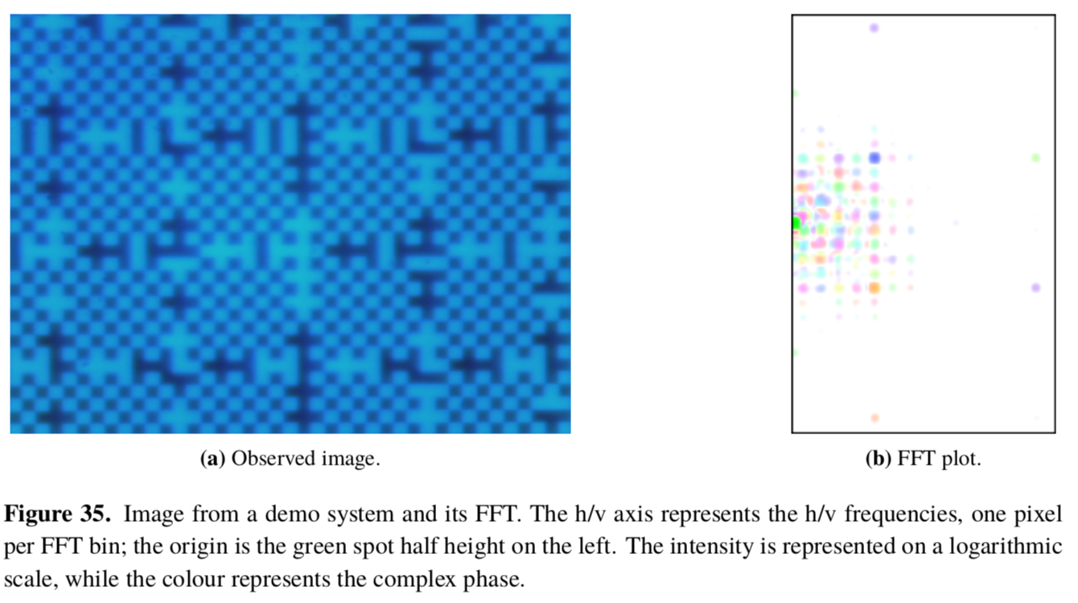
Image analysis:
For RasDif: 2D Fourier conversion: ‘arbitrary’ image displacement
Works very well ➔ also applied for CCD-Rasnik: FOAM

Slide 35
The precision of CCD-Rasnik
Error sources:
Variations refraction index of ambient air
Shielding of light path
apply vacuum
Error in mask contour positions
State of the art mask technology: 50 nm, 5 nm, dScale < 10⁻⁶
Image distortion
Diffraction: blurring of contours
Abberations: pin-cushion effects
Image sensor:
Deviations of pixel positions & geometry
Pixel noise & fluctuations in Q_{p}
Error in image analysis routine
Test routine using MC generated images

Slide 36
Precision
spatial resolution
linearity
systematical variations in measured position
Scale (slope)
The mask is the only precision element in CCD-Rasnik
The masks defines the Rasnik Coordnate System

Slide 37
In typical (webcam sensor) Rasnik systems, the contour position is determined with sigma = 0.1 um
Note that the typical pixel pitch of 6 um is 60x larger that this resolution.

Slide 38
Typical dimensions of webcam image sensor: 2 mm x 3 mm
Typical contour pitch: 0.10 mm, so total contour length is (2 x 3/0.1) mm = 60 mm vertical AND horizontal!
With a pixel pitch of 6 um, the total contour is sampled 60/0.006 = 10⁴ times.
So sigma _{total contour} = 0.01 x sigma _{pixel row}
Note: an image has ~ 1 Mb data. This is transformed in only 4 parameters.

Slide 39
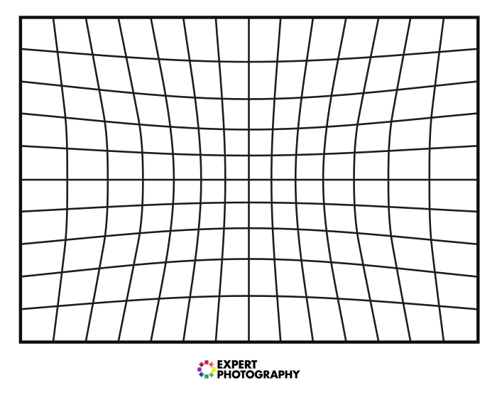
What about optical imaging errors?
Our contour position is the average of many measurements: effects of symmetrical ‘radial’ deformations vanish
Non homogeneous deformations cause a constant offset: these may cause an error in linearity

Slide 40
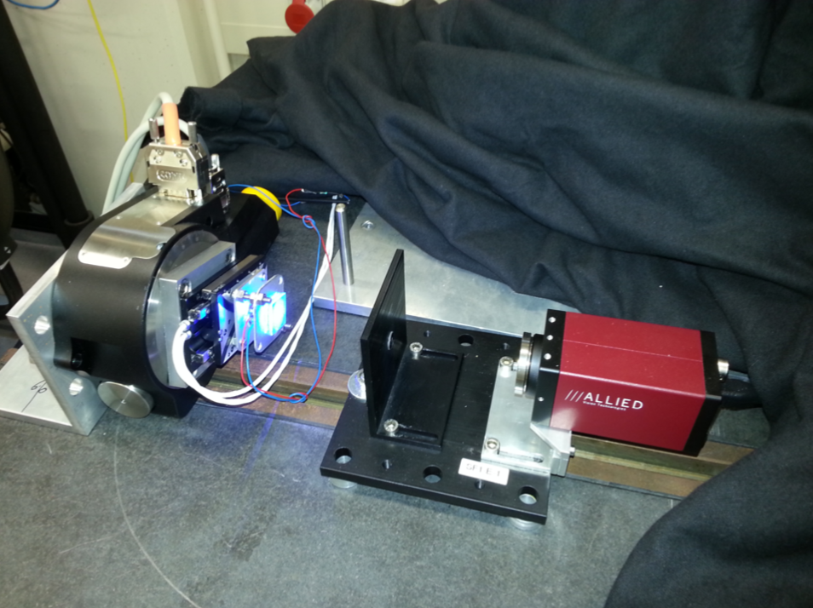
Resolution & linearity measurements
For the last 5 years:
Sigma _{image on sensor} > 30 – 6 nm

Slide 41
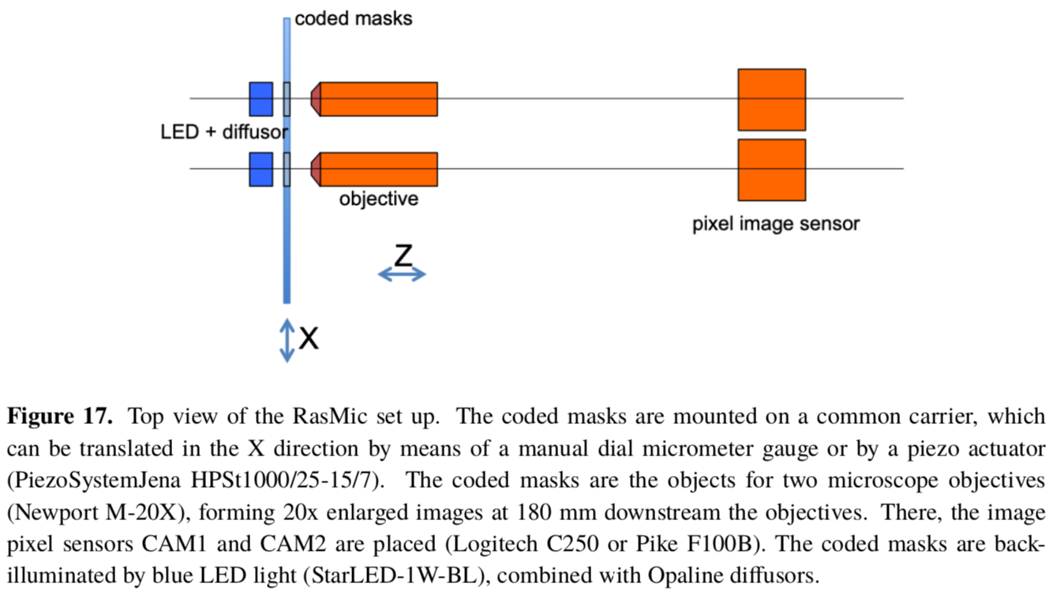
RasMic
Apply microscope objective
Dual (differential) system

Slide 42
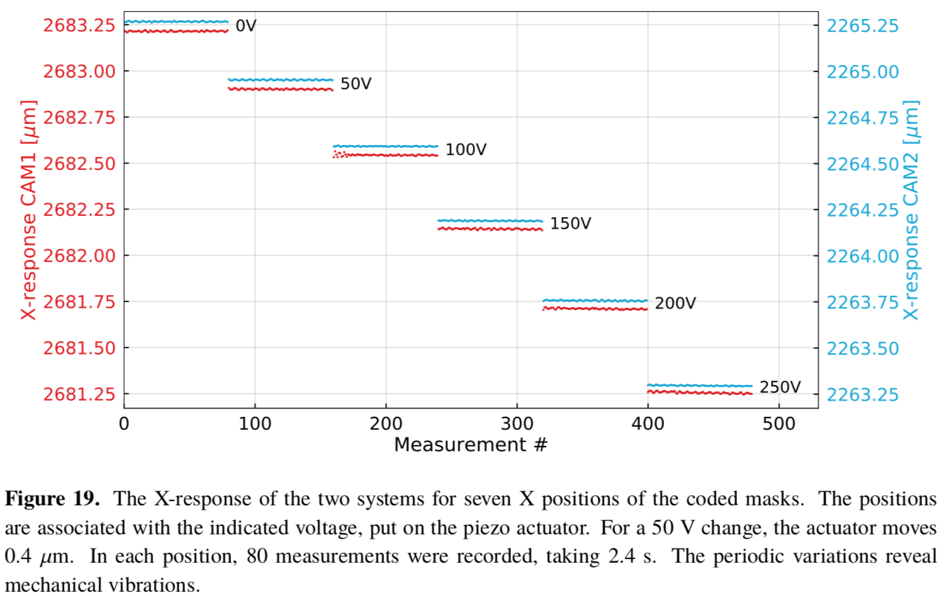

Slide 43
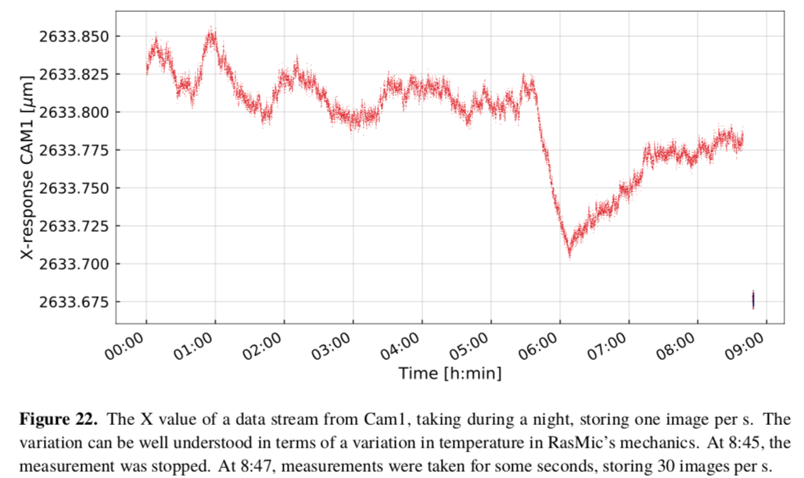
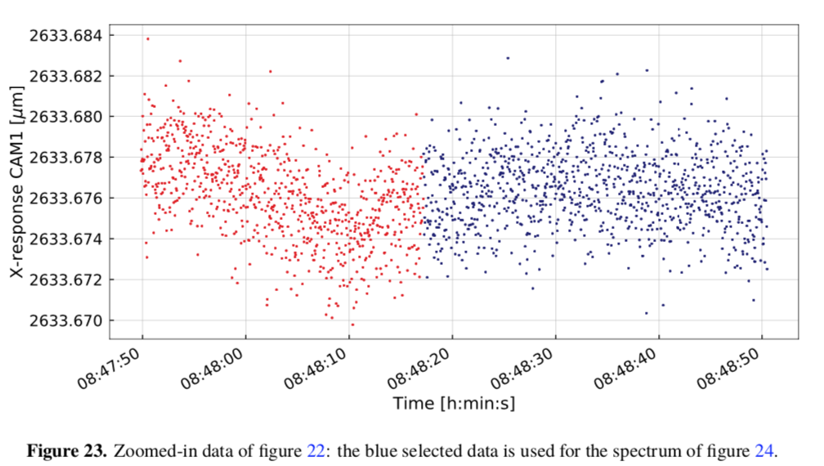

Slide 44
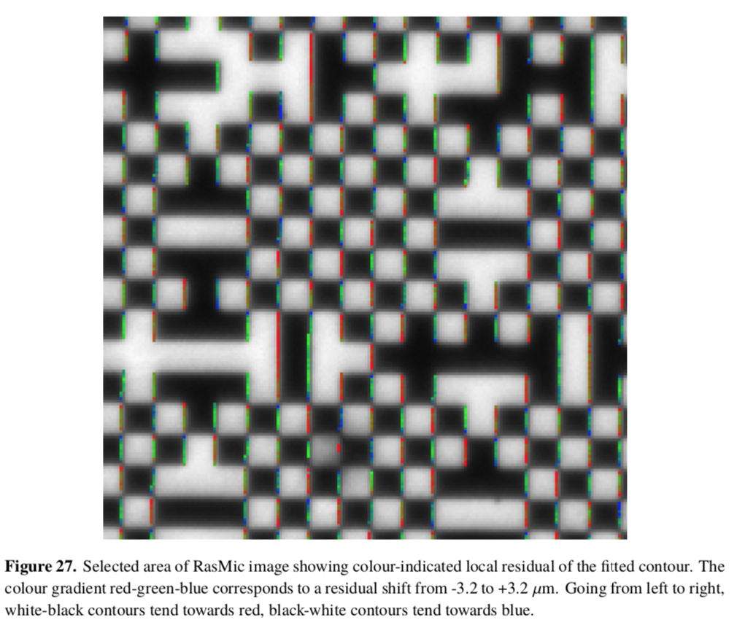

Slide 45
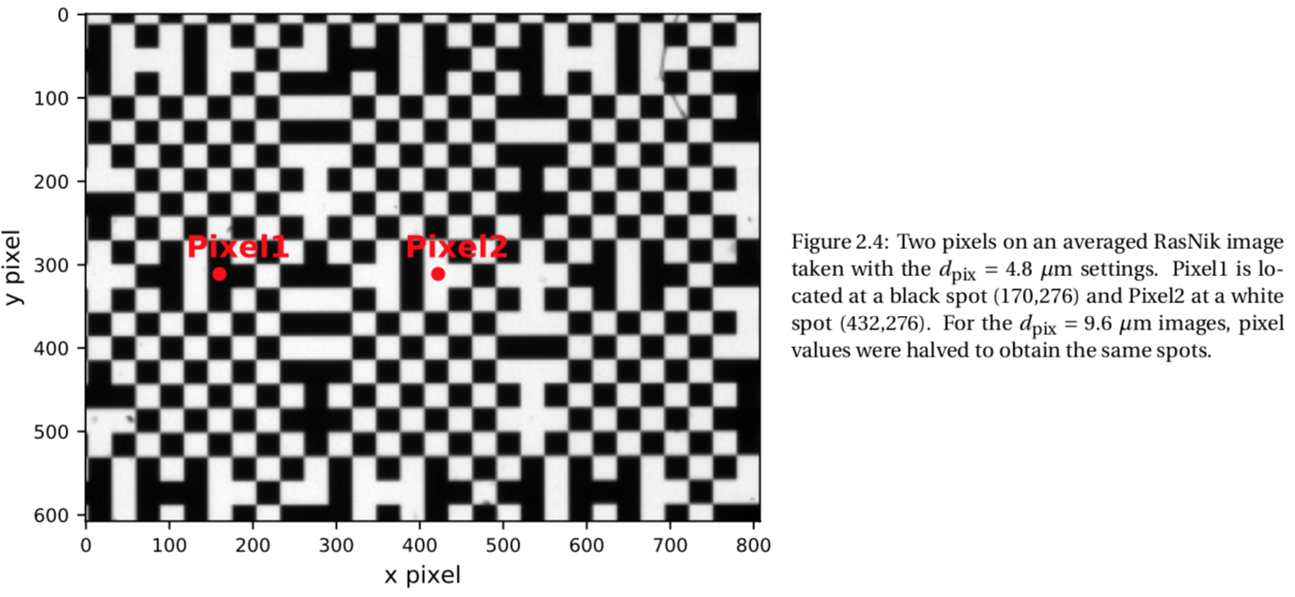

Slide 46
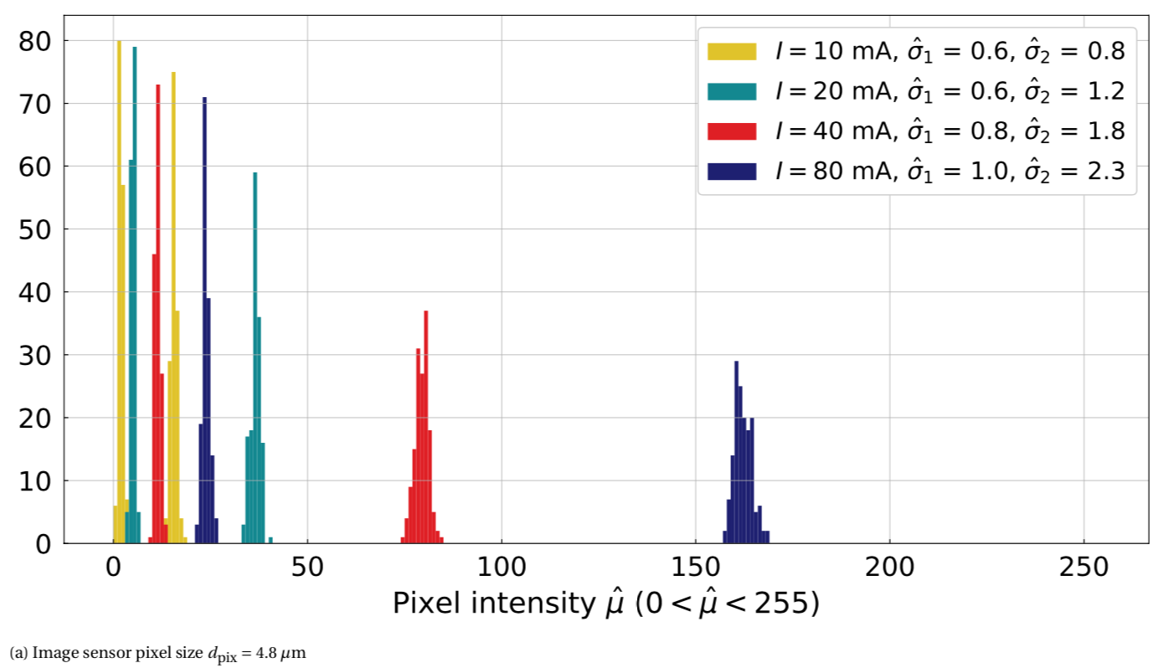
Pixel noise: dominated by quantum shot noise: sigma :: sqrt (Q)

Slide 47
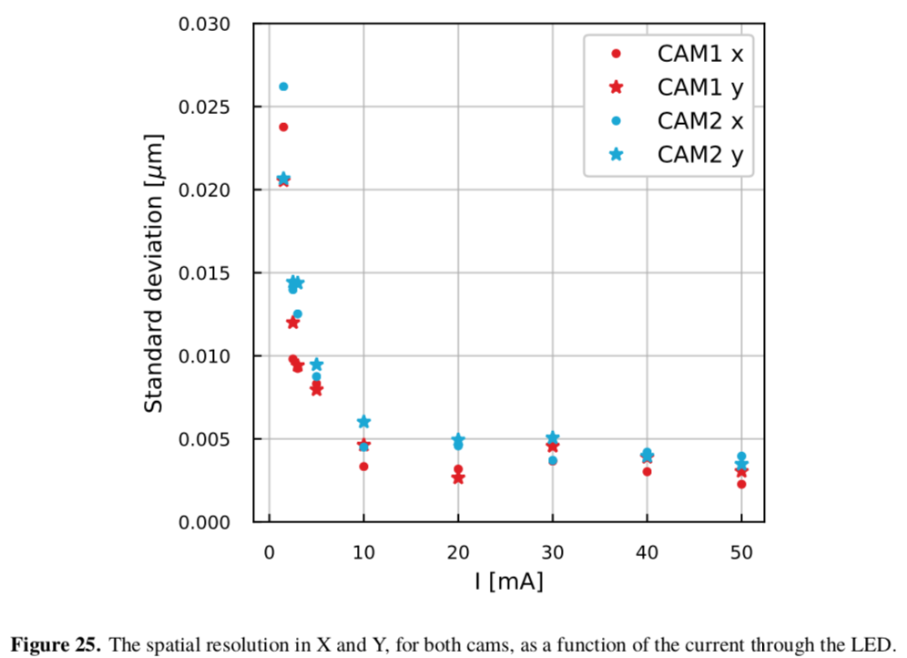
Spatial resolution should be determined by blurring (diffraction) and ‘pixel noise’.
But:

Slide 49
Aug - Sept 2019
Alessandro B. & Nelson deGF apply Welch method to the static data:
power of a signal at different frequencies (PSD)
250 pm !!!

Slide 51
So:
apply very bright light source (power LEDs, laser)
apply CCD with large dynamical range and 12-bits ADC
➔ Spatial resolution 50 pm, without warming up the system too much
Then:
apply microscope objective with 20x enlargement
Spatial resolution 2.5 pm [note1: at 1 kHz data rate!]
[note2: measures acceleration with 2.5 x 10⁻¹⁶ m/s²]

Slide 52
Applications
RasTilt
We propose to attach a second plate under the first one, suspended by the same wire. The bottom plate’s point of suspension is very close to its COG. The angular position of this plate is little affected by translations: thanks to its momentum of inertia it will maintain is horizontal position (for a certain amount of time).
The position of the bottom plate is constantly compared to the position of the top plate. By averaging, the slow drift in the angular position of the bottom plate is compensated by voice coil actuators acting between the ground plane and the bottom plate.
displacement monitor 1
displacement monitor 2

Slide 53
20 km baseline
Excellent vacuum
Excellent seismic wave sensor measuring Moon’s “Hum”
New ‘Grail’-like Gravitational Wave detector

Slide 54
Conclusions
Rasnik, developed since 1983, had demonstrated, in quite a large number of different applications:
its precision
its very low 1/f noise (absence of drift)
Monte Carlo simulations and Cramer Rao analysis point towards potential picometer spatial resolution
Recent measurements confirm the simulation results
There will be a wide field of applications, replacing state-of-the-art interferometers

