Slide 1
Beyond AARC
EnCo global engagement activities and the AARC-community.org
David Groep
EnCo eScience Global Engagement
Nikhef, PDP
EUGridPMA46, EnCo, EOSCH-ISM, AARC
20-22 May, 2019

Slide 2




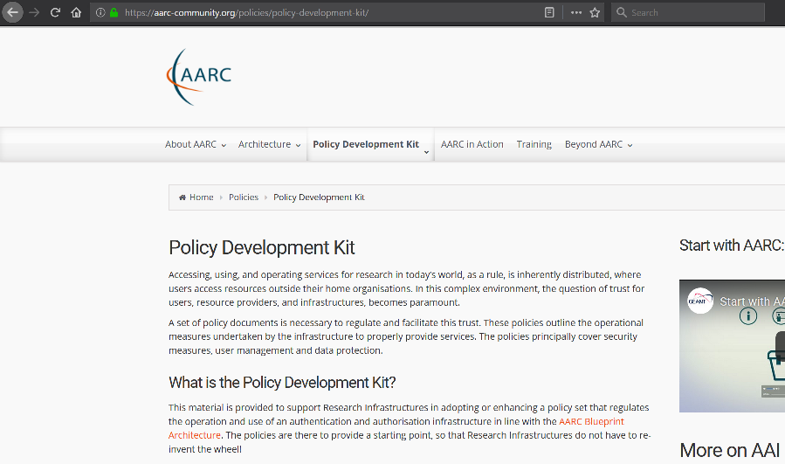
The AARC ‘legacy’ – the AARC community
Architecture
Blueprint BPA and the Proxy gudelines
Application Integration
AEGIS and a lively FIM4R
Alignment with & between range of
policy development groups dedicated to interoperation
WISE-community
IGTF
REFEDS
FIM4R
GN4 EnCo eSGE
EOSCH-ISM
WISE-community
IGTF
REFEDS
AEGIS
FIM4R
Collaboration EOSCH-GN4
national, domain and community groups

Slide 3
So much to do, so few people, …
Sirtfi & the Registry
Communications Challenges
Attribute Authority operations
SCI evolution and its assessment to support trust
Acceptable Use Policy
Assurance profiles: adoption & suitability in high-risk cases
Policy Development Kit evolution
Data Protection guidance for global research collaboration

Slide 4

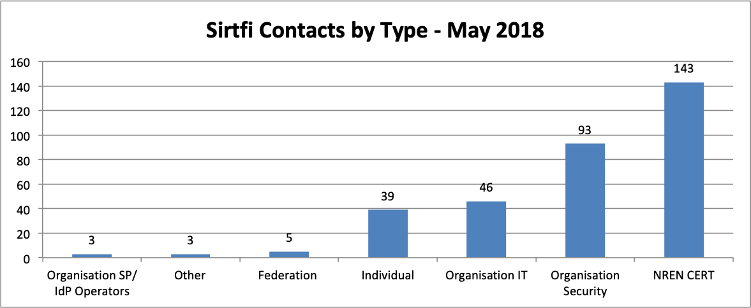
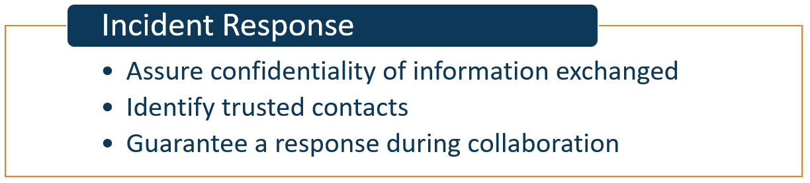
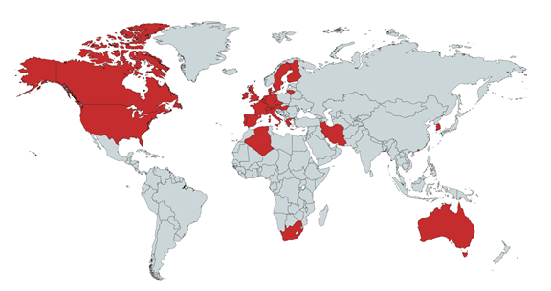
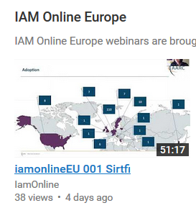
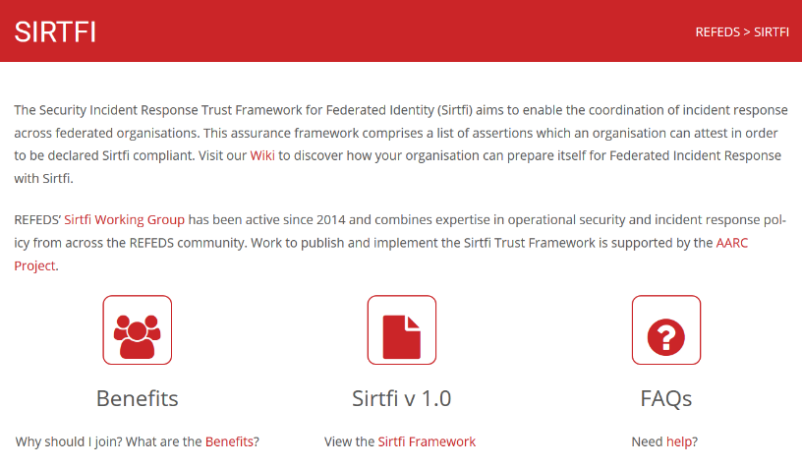
Sirtfi is there today – 561 parties (406 IdPs) joined, in 28 federations
https://refeds.org/SIRTFI
countries with at least one Sirtfi entity
graphics source: AARC2 DNA3.2 Report on Incident Response in FIM; data: technical.edugain.org

Slide 5
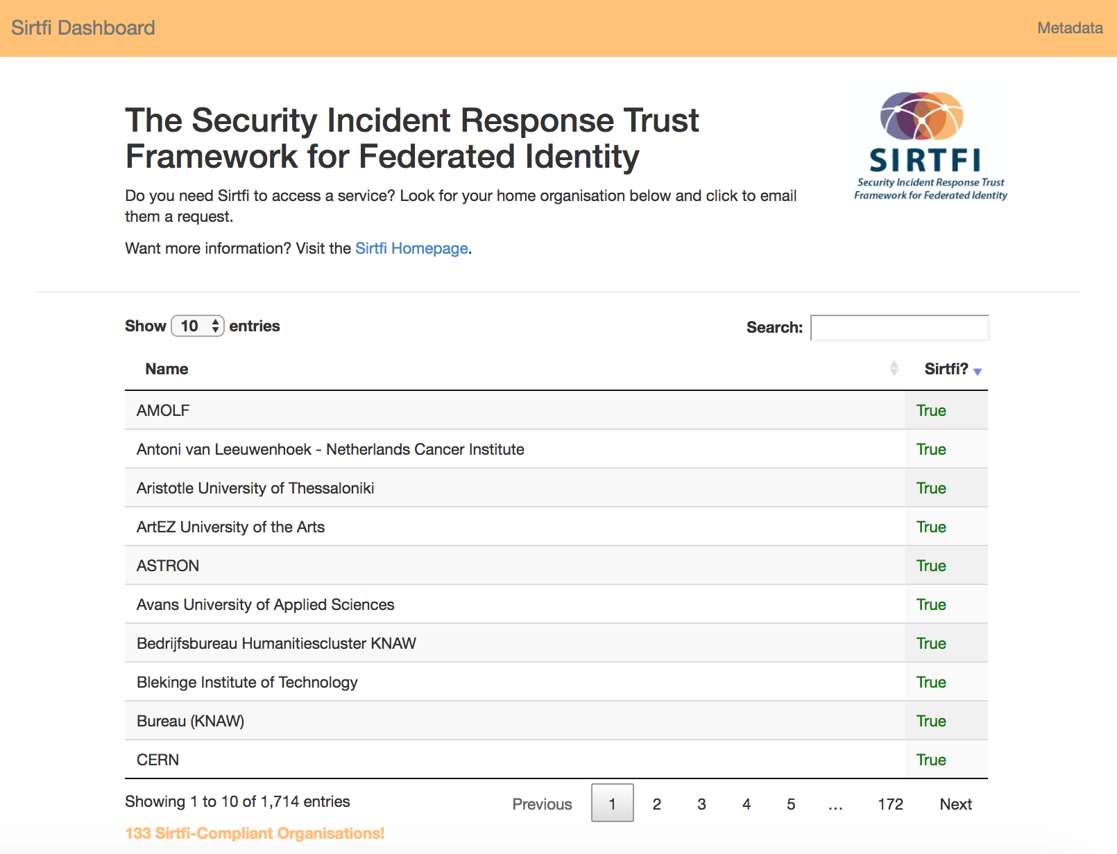
Promoting Sirtfi: through REFEDS and communities
Sirtfi ‘encouragement’
the tool certainly raises attention ☺
lack-of-Sirtfi (and R&S) is non-trivial to
diagnose – other causes may interfere
Sirtfi+ registry
enabling more entities to express Sirtfi
allow sharing of implicit trust between communities?
tool requirements (lead by Laura et al.)
Incident Response procedures for R&E Fed
AARC-I051 white paper guidance (based on challenges)
Good resource: SANS Incident Handlers Handbook
  Refer to SANS incident handling
  notes for a check on how our proposed preparations
  stack up against the SANS recommendation.
  What should be added?
  What should be removed?
  What should be altered? Make comments/edits in the doc.
handbook approach to the IR in R&E Feds
https://sirtfi.cern.ch/

Slide 6
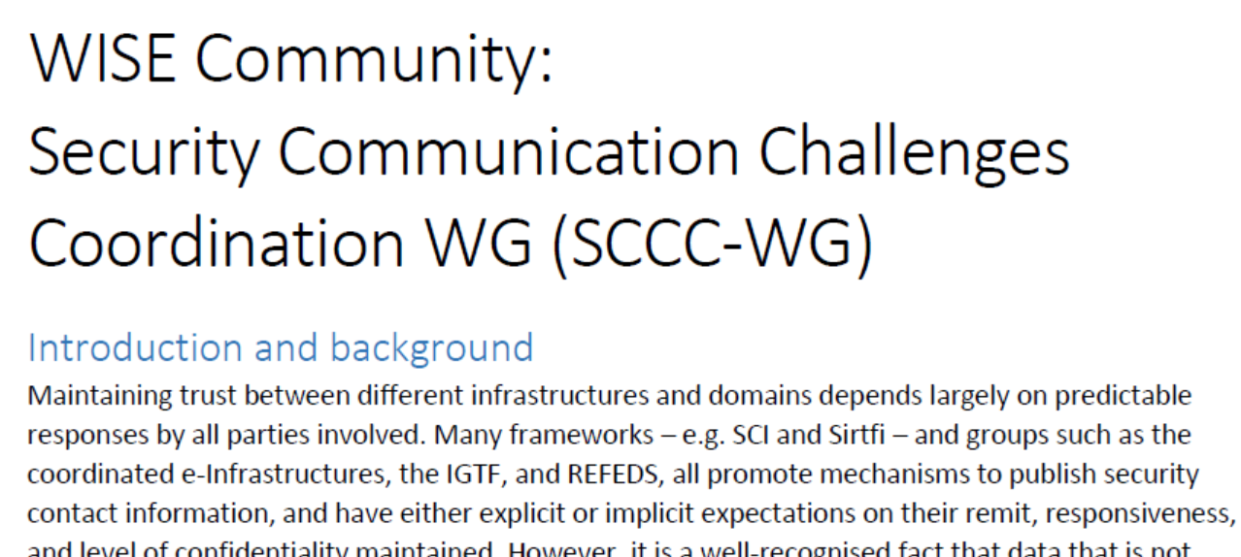
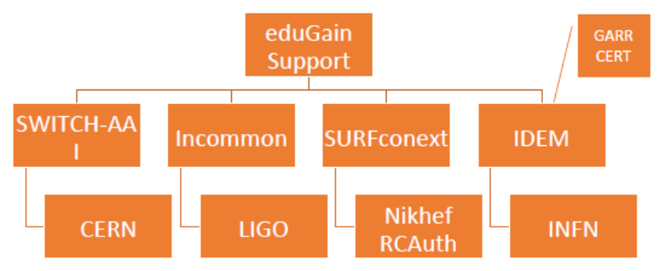
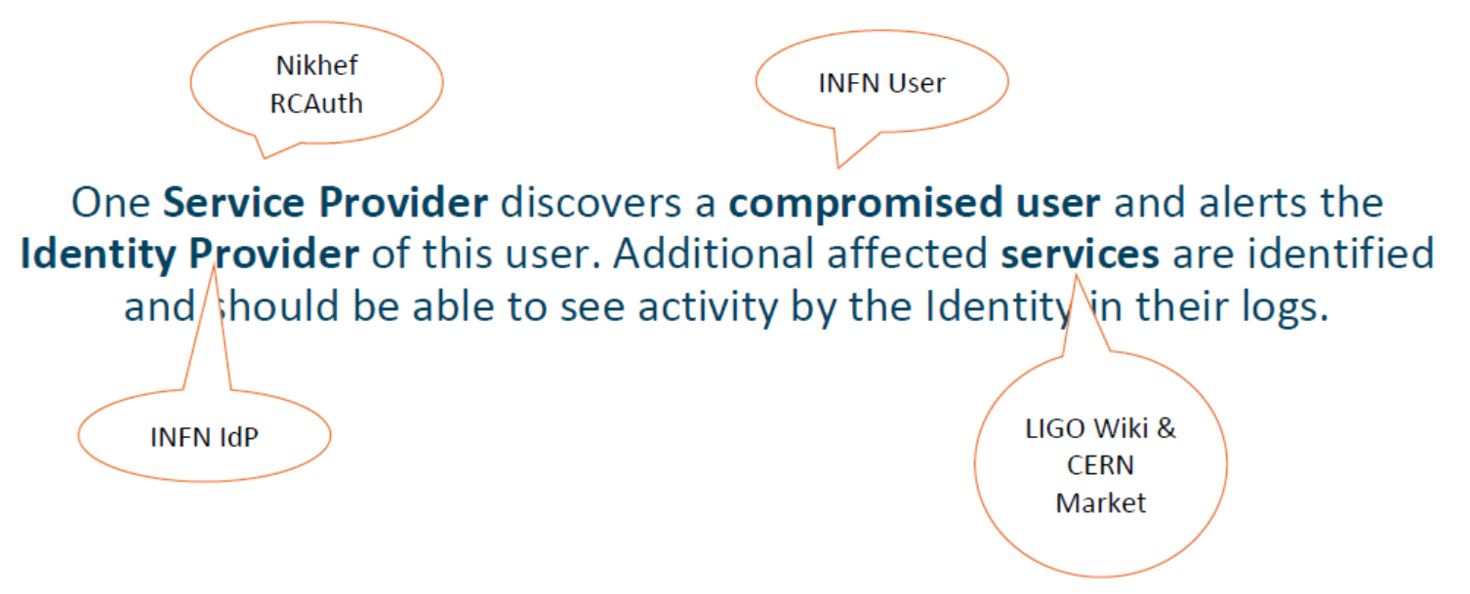


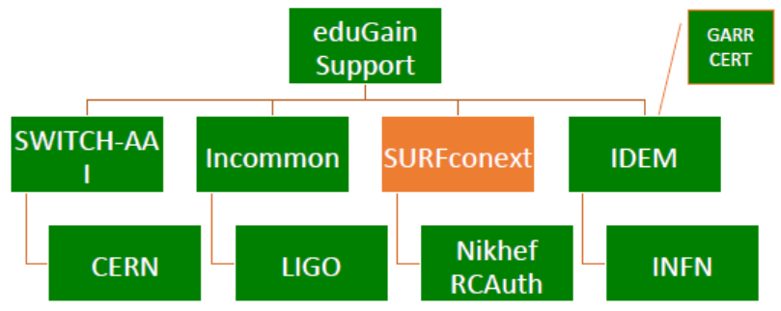



Testing incident response coordination
Can we coordinate our collective R&E response?
Communication guidelines to help timely resolution?
Two ‘challenges’: March 2018 and December 2018
parties involved in response challenge
Report-outs see https://wiki.geant.org/display/AARC/Sirtfi+Communications+Challenges%2C+AARC2-TNA3.1

Slide 7
SCCC JWG

Slide 8
Operational security focus in the BPA: beyond just the IdPs
Community membership management directories and attribute authorities
integrity of membership
identification, naming and traceability
site and service security
protection on the network
assertion integrity
Store and manage ephemeral user credentials
trusted credential stores
protection at rest
IGTF Guidelines on
Trusted Credential Stores
(pre-existing)
Guidelines for Secure Operation of Attribute Authorities and other issuers of access-granting statements
(AARC-I048, in collaboration with IGTF AAOPS)

Slide 9
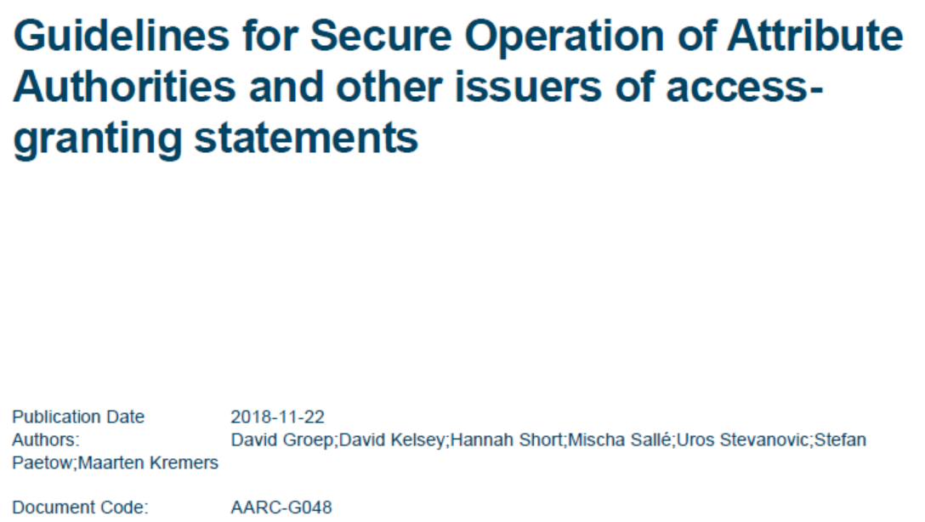
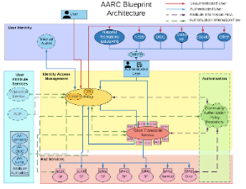

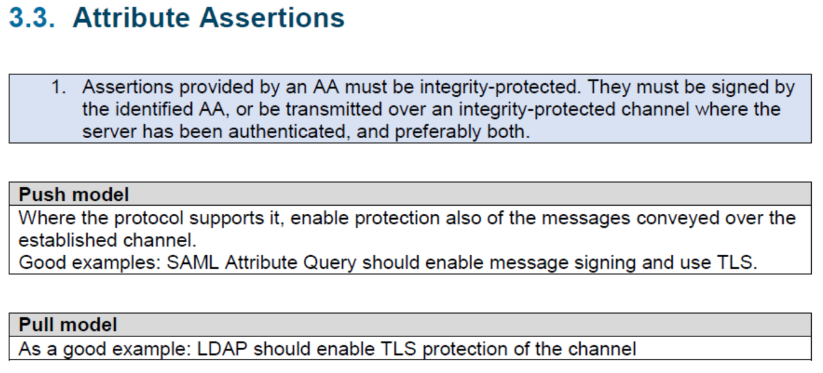
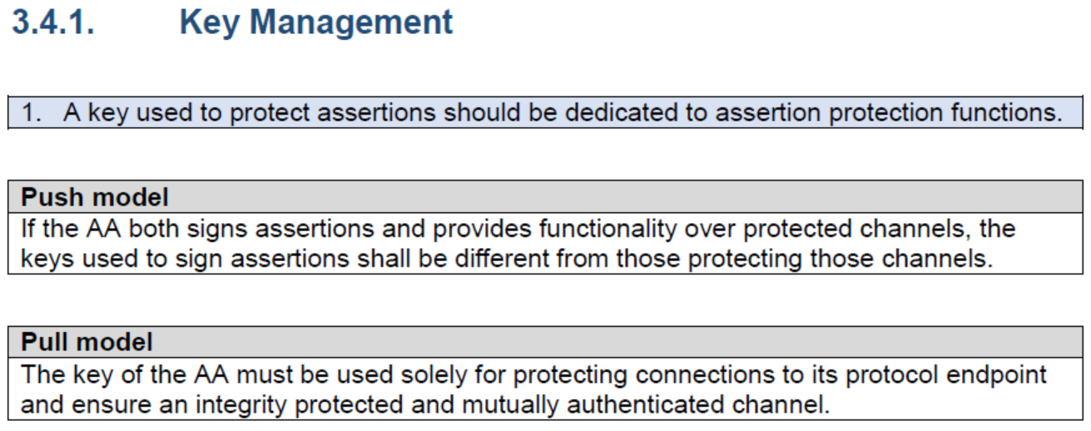
AARC-G048: keeping users & communities protected, moving across models
trusted delegation of response from communities to operators,
and from services to communities in recognizing their assertions
Structured around concept of “AA Operators”,
operating “Attribute Authorities” (technological entities),
on behalf of, one or more, Communities
`
Notes:
And dwells also on naming since that is the unique hook for the service providers to actually track back persistently to the proper community as well as operator …

Slide 10
AAOPS – engaging with the community AAIs and AASPs
usual targets to assess feasibility of the framework
WLCG
CheckIn
eduTEAMS
then evolve, expand, or explain and give as guidance to all communities?

Slide 11
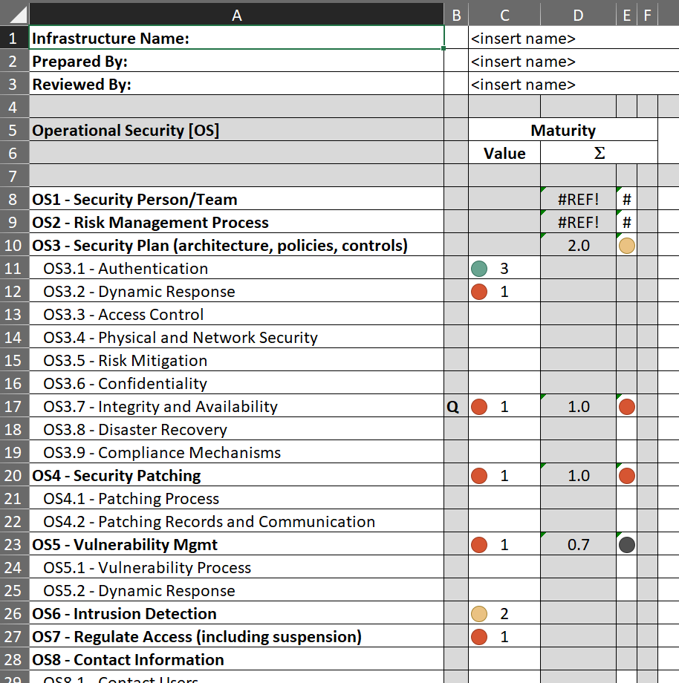
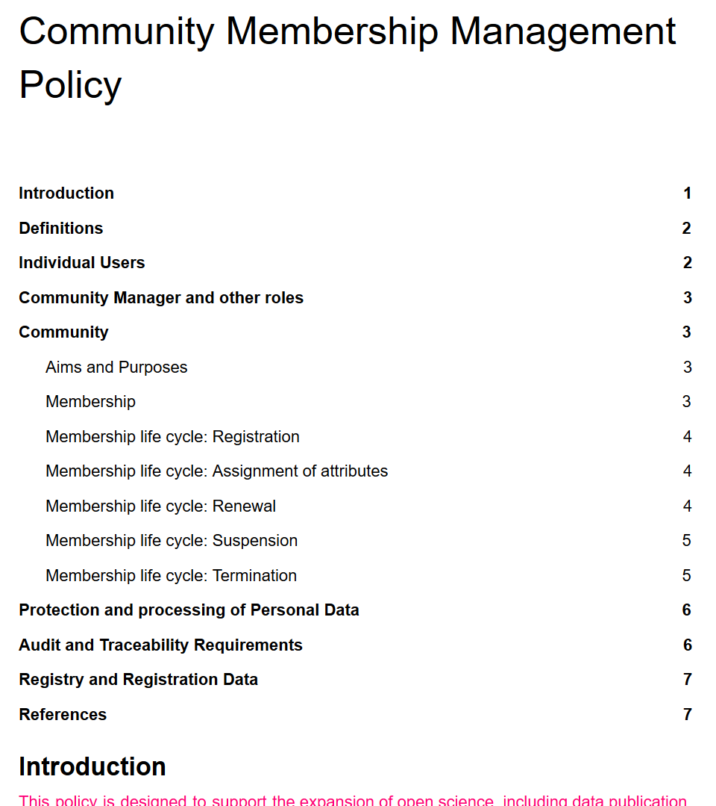

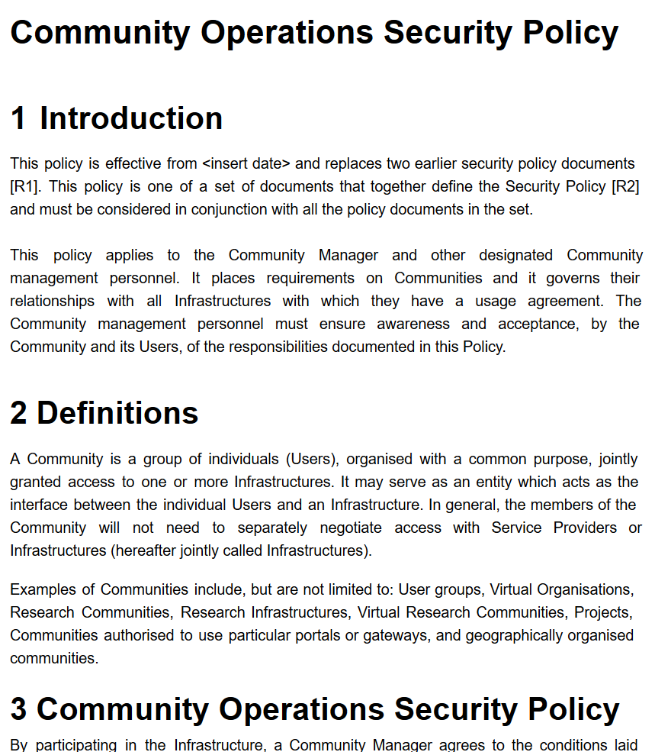
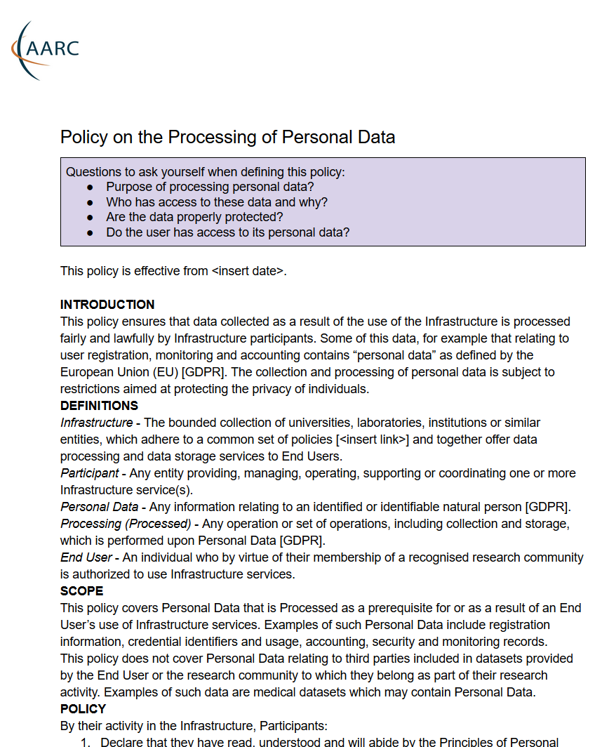
SCI – assessment, policy development, AUP, PDK
SCIv2 paper itself discussed assessment – start it!
Level 0 ..3 or “Justifiable exclusion”
Policy Development Kit
https://wiki.geant.org/display/WISE/SCIV2-WG+documents
http://wise-community.org/sci/

Slide 12
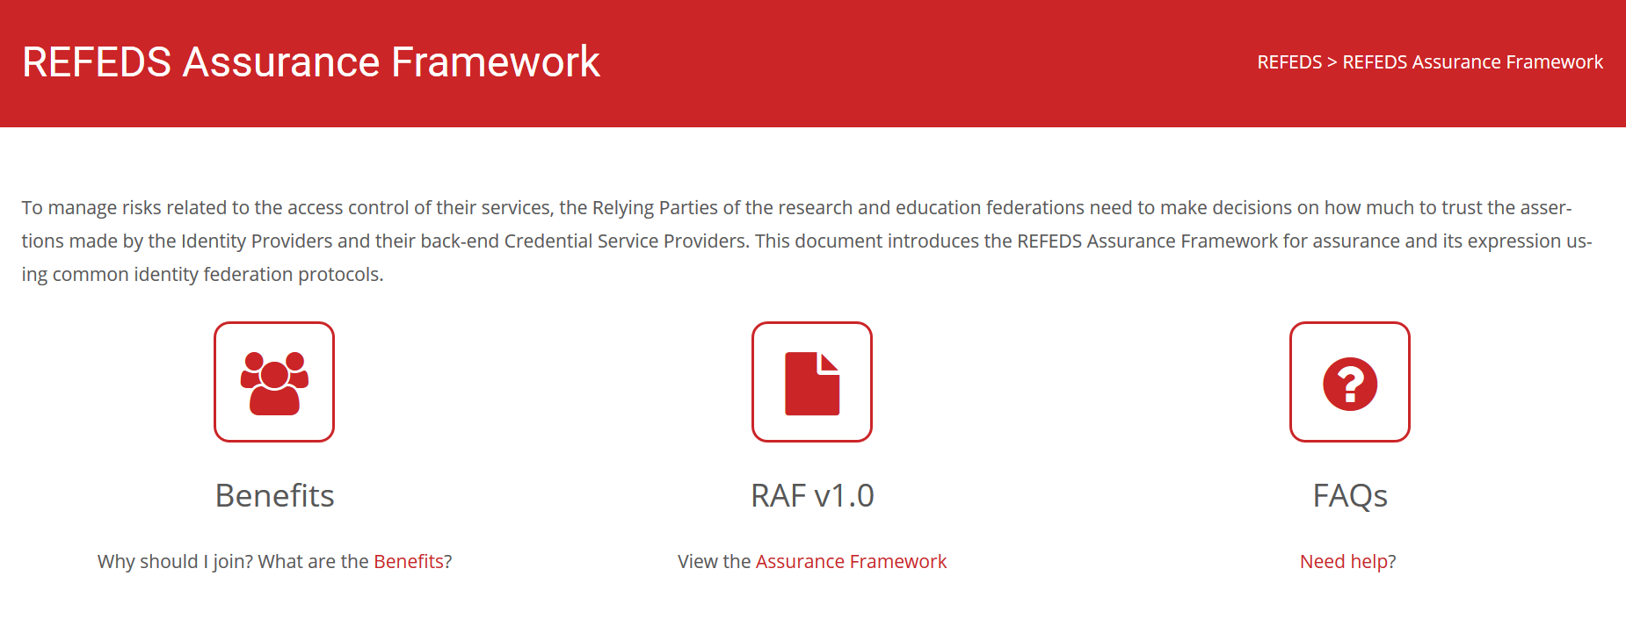
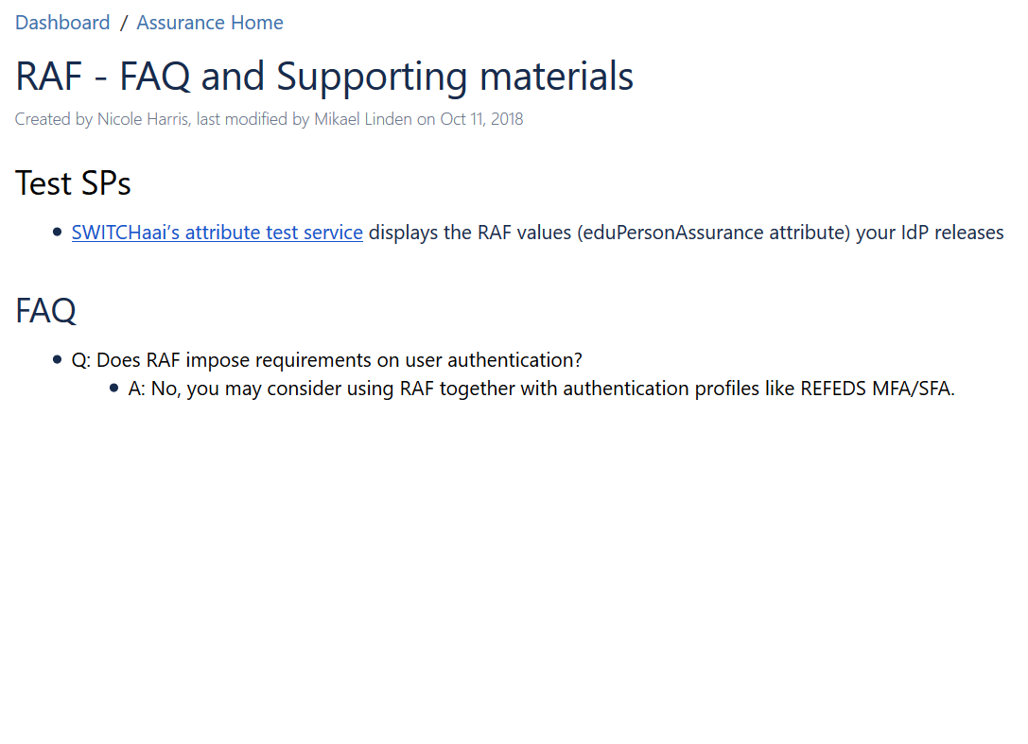
Assurance: REFEDS RAF, RAF adoption, …
?
We have the framework, we have a few good use cases (CILogon Silver, BBMRI)
How to break the deadlock for adoption?
More guidance, both on the IdP side (how) and SP side (why should I require,request it)?

Slide 13
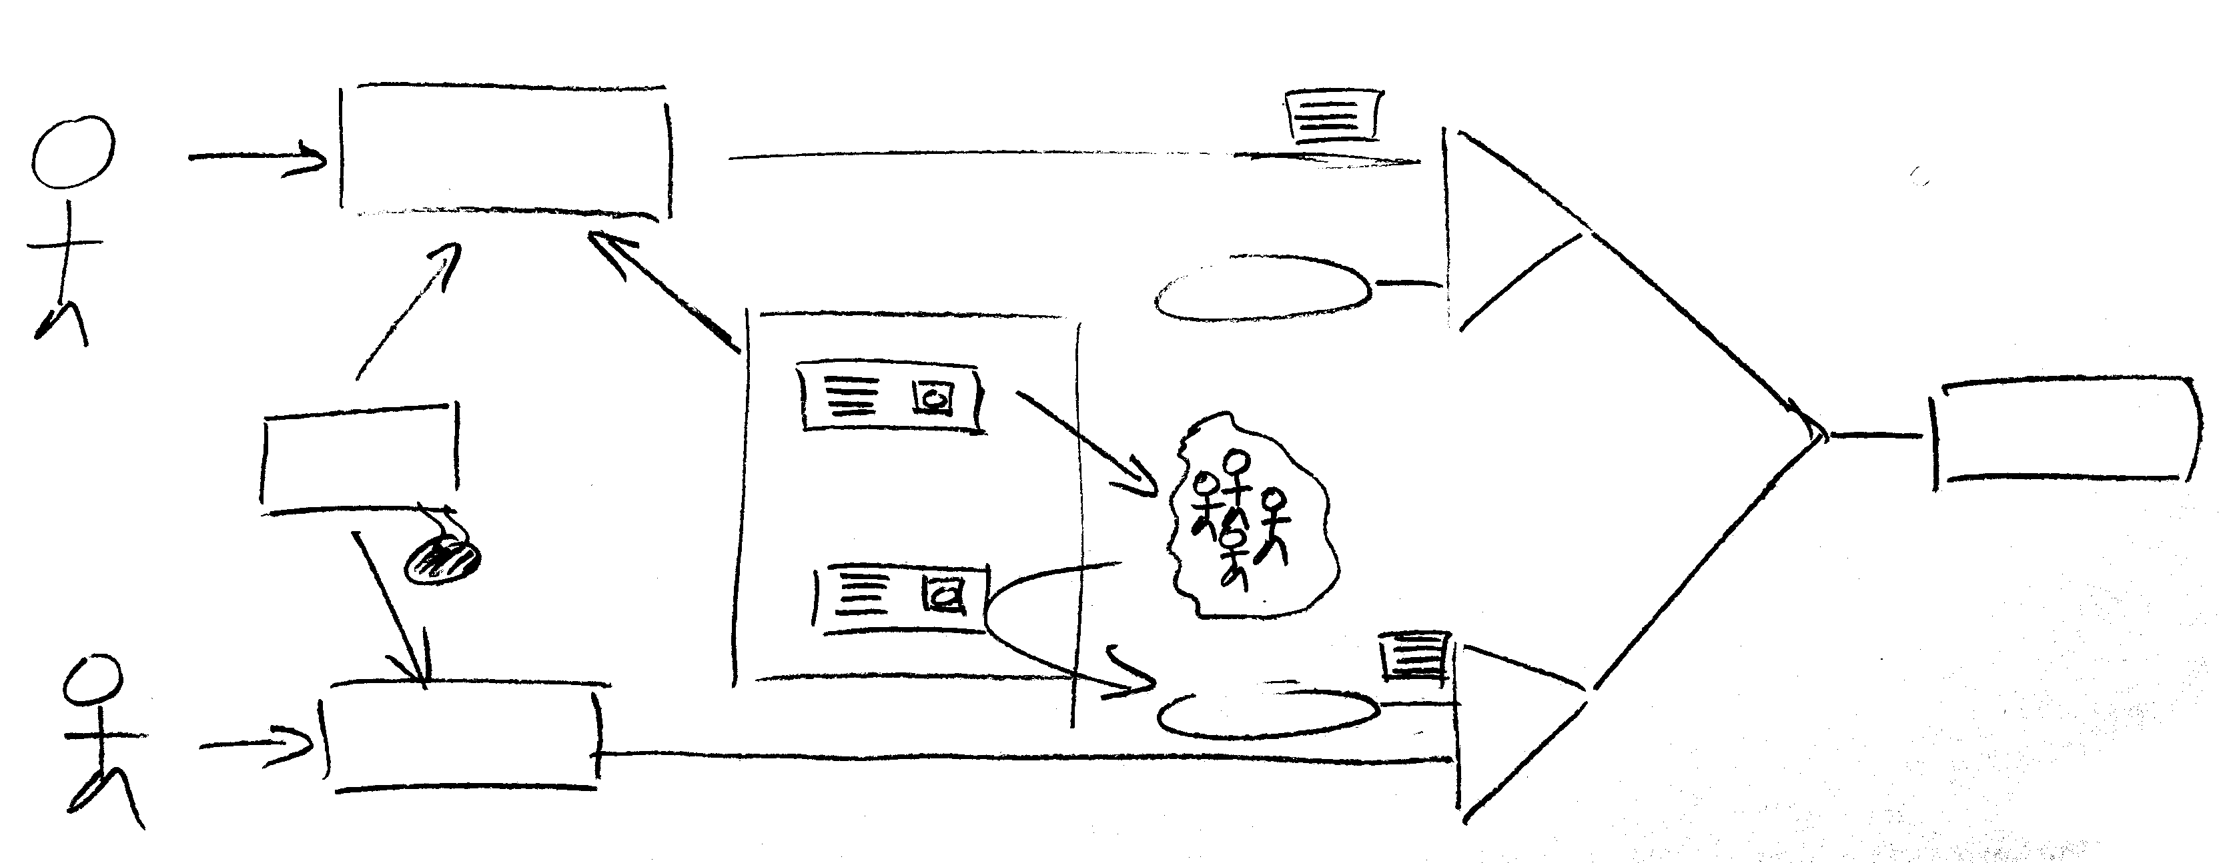
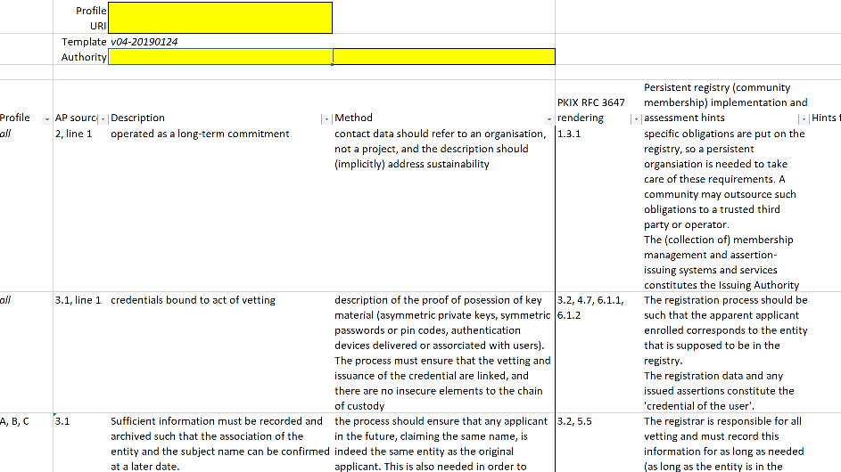
Example: Acceptable Authentication Assurance
– enabling flexible user communities by mapping assurance elements
ID proven?
BIRCH
ID vetting
AA-
national
community
management
service
ident#
community-
based
ID proven?
AA++
DOGWOOD
Identity vetting can be done
when credentialing the user
on enrolling the user in a community
e.g. LIGO LSC always does researcher vetting, and Assurance Policy accommodates linkage in either place – still meeting SP trust needs

Slide 14
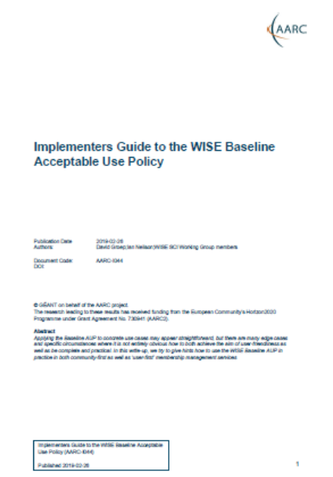
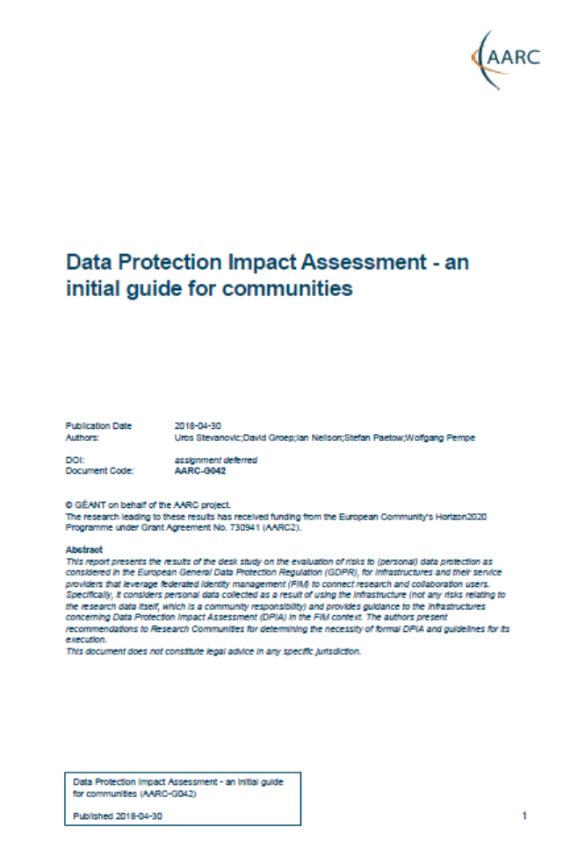
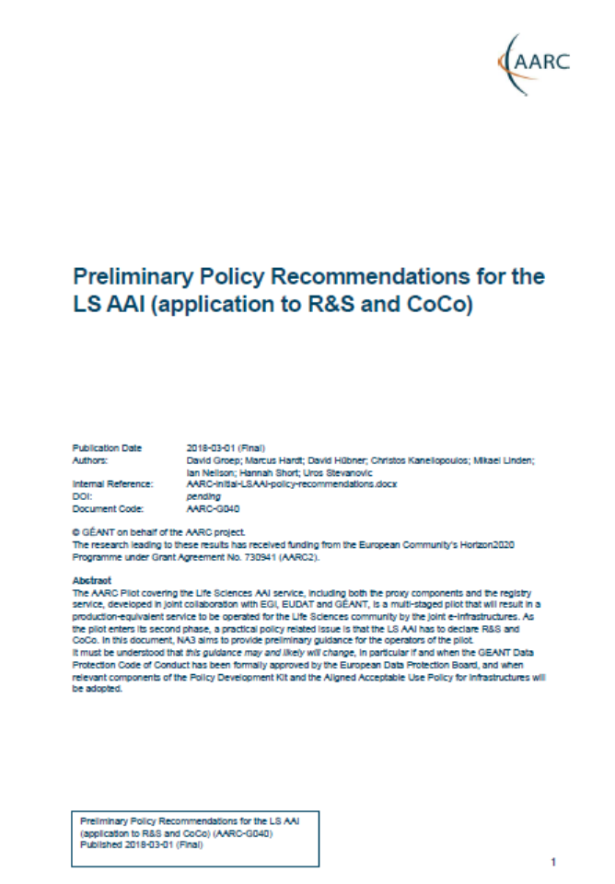
Community guidance: GDPR, privacy notices, implementation guidance
…

Slide 15
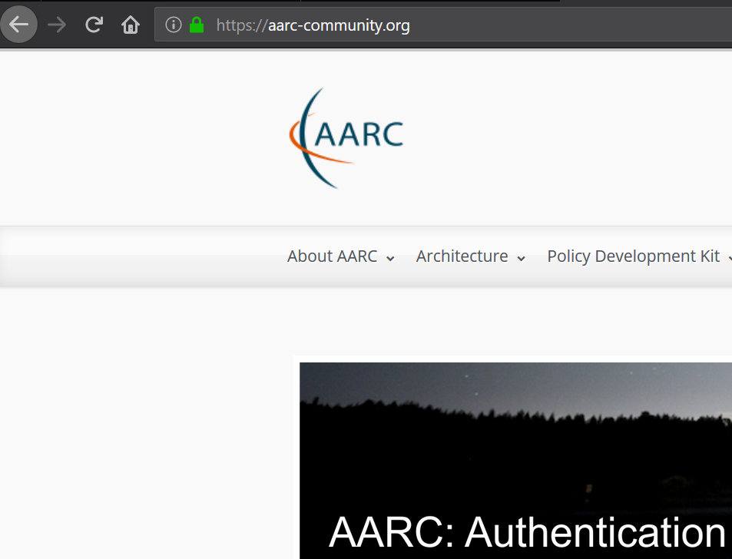
AARC-community.org: AARC forever!
for now just a reverse proxy for aarc-project.eu …

Slide 16
Beyond just AARC …

Slide 17
davidg@nikhef.nl

