Slide 1
IGTF EUGridPMA 46 in collaboration with
GN4-3 EnCo, EOSCH-ISM, and AARC-Community
May 20-22, 2019
SURF, Utrecht, NL

Slide 2
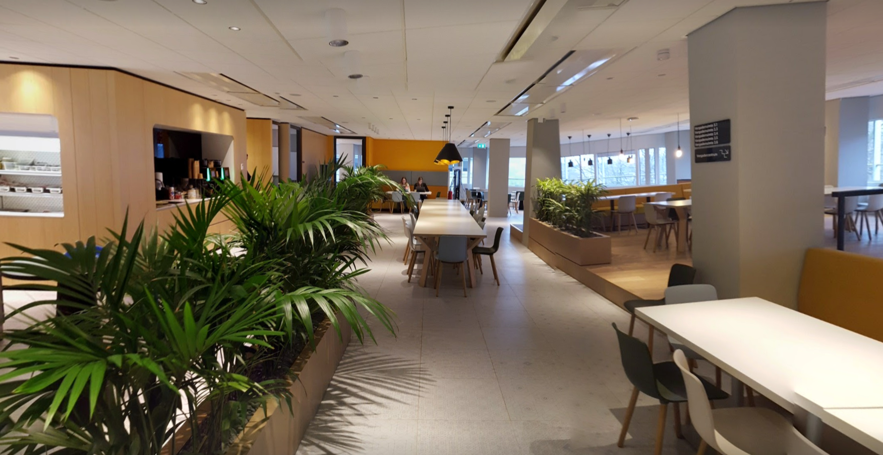

Welcome to Utrecht
photo credit: Raoul Teeuwen

Slide 3
Some logistical information
On-line agenda and materials at
https://www.eugridpma.org/agenda/46
Please upload presentations – use the ‘usual’ password if required
Videoconference and presentation sharing
https://www.nikhef.nl/pdp/video/?m=eugridpma

Slide 4
Introductions
For minutes of last meeting see https://www.eugridpma.org/meetings/2018-09/
Round of introduction: we have some ‘new’ people!
Note takers, anyone?
Agenda planning

Slide 5
Draft Agenda
13.00 Welcome introductions
13.15 Self-audit reviews
13.30 DigitalTrust (Scott Rea)
14.15 RCauth distributed operations
(DavidG, Jens, Mischa)
15.00 Tea
15.30 Assurance Assessment Matrix and the RPS
16.15 TAGPMA
(Derek Simmel)
16.40 APGridPMA (Eric Yen)
17.00 end
18.30 Dinner Taj Mahal
09.15 SCI assessment
(Dave Kelsey, Uros)
10.30 Coffee
11.00 Assurance evolution (Jule, IanN)
12.30 Lunch
14.00 EnCo planning (Maarten, David, Dave)
14.45 Data Privacy Notices (Dave Kelsey)
15.30 Tea
16.00 Data Privacy Notices
16.30 SCCC-JWG and RATCC (DavidG)
17.15 Next PMA meeting
19.00 dinner
09.15 Open Space
10.15 Jens’ Soapbox
10.45 Coffee
11.15 Open Space
12.15 Closing

Slide 6
Next meetings
TNC2019 & REFEDS Tallinn, EE June 16-20, 2019
TechEX2019 New Orleans, LA, USA Dec 9-12, 2019
APAN/APGridPMA
EUGridPMA47 to be chosen September (23-25?), 2019
APGridPMA 2020 Taipei, TW March 9, 2020 (tbc)

