Slide 1
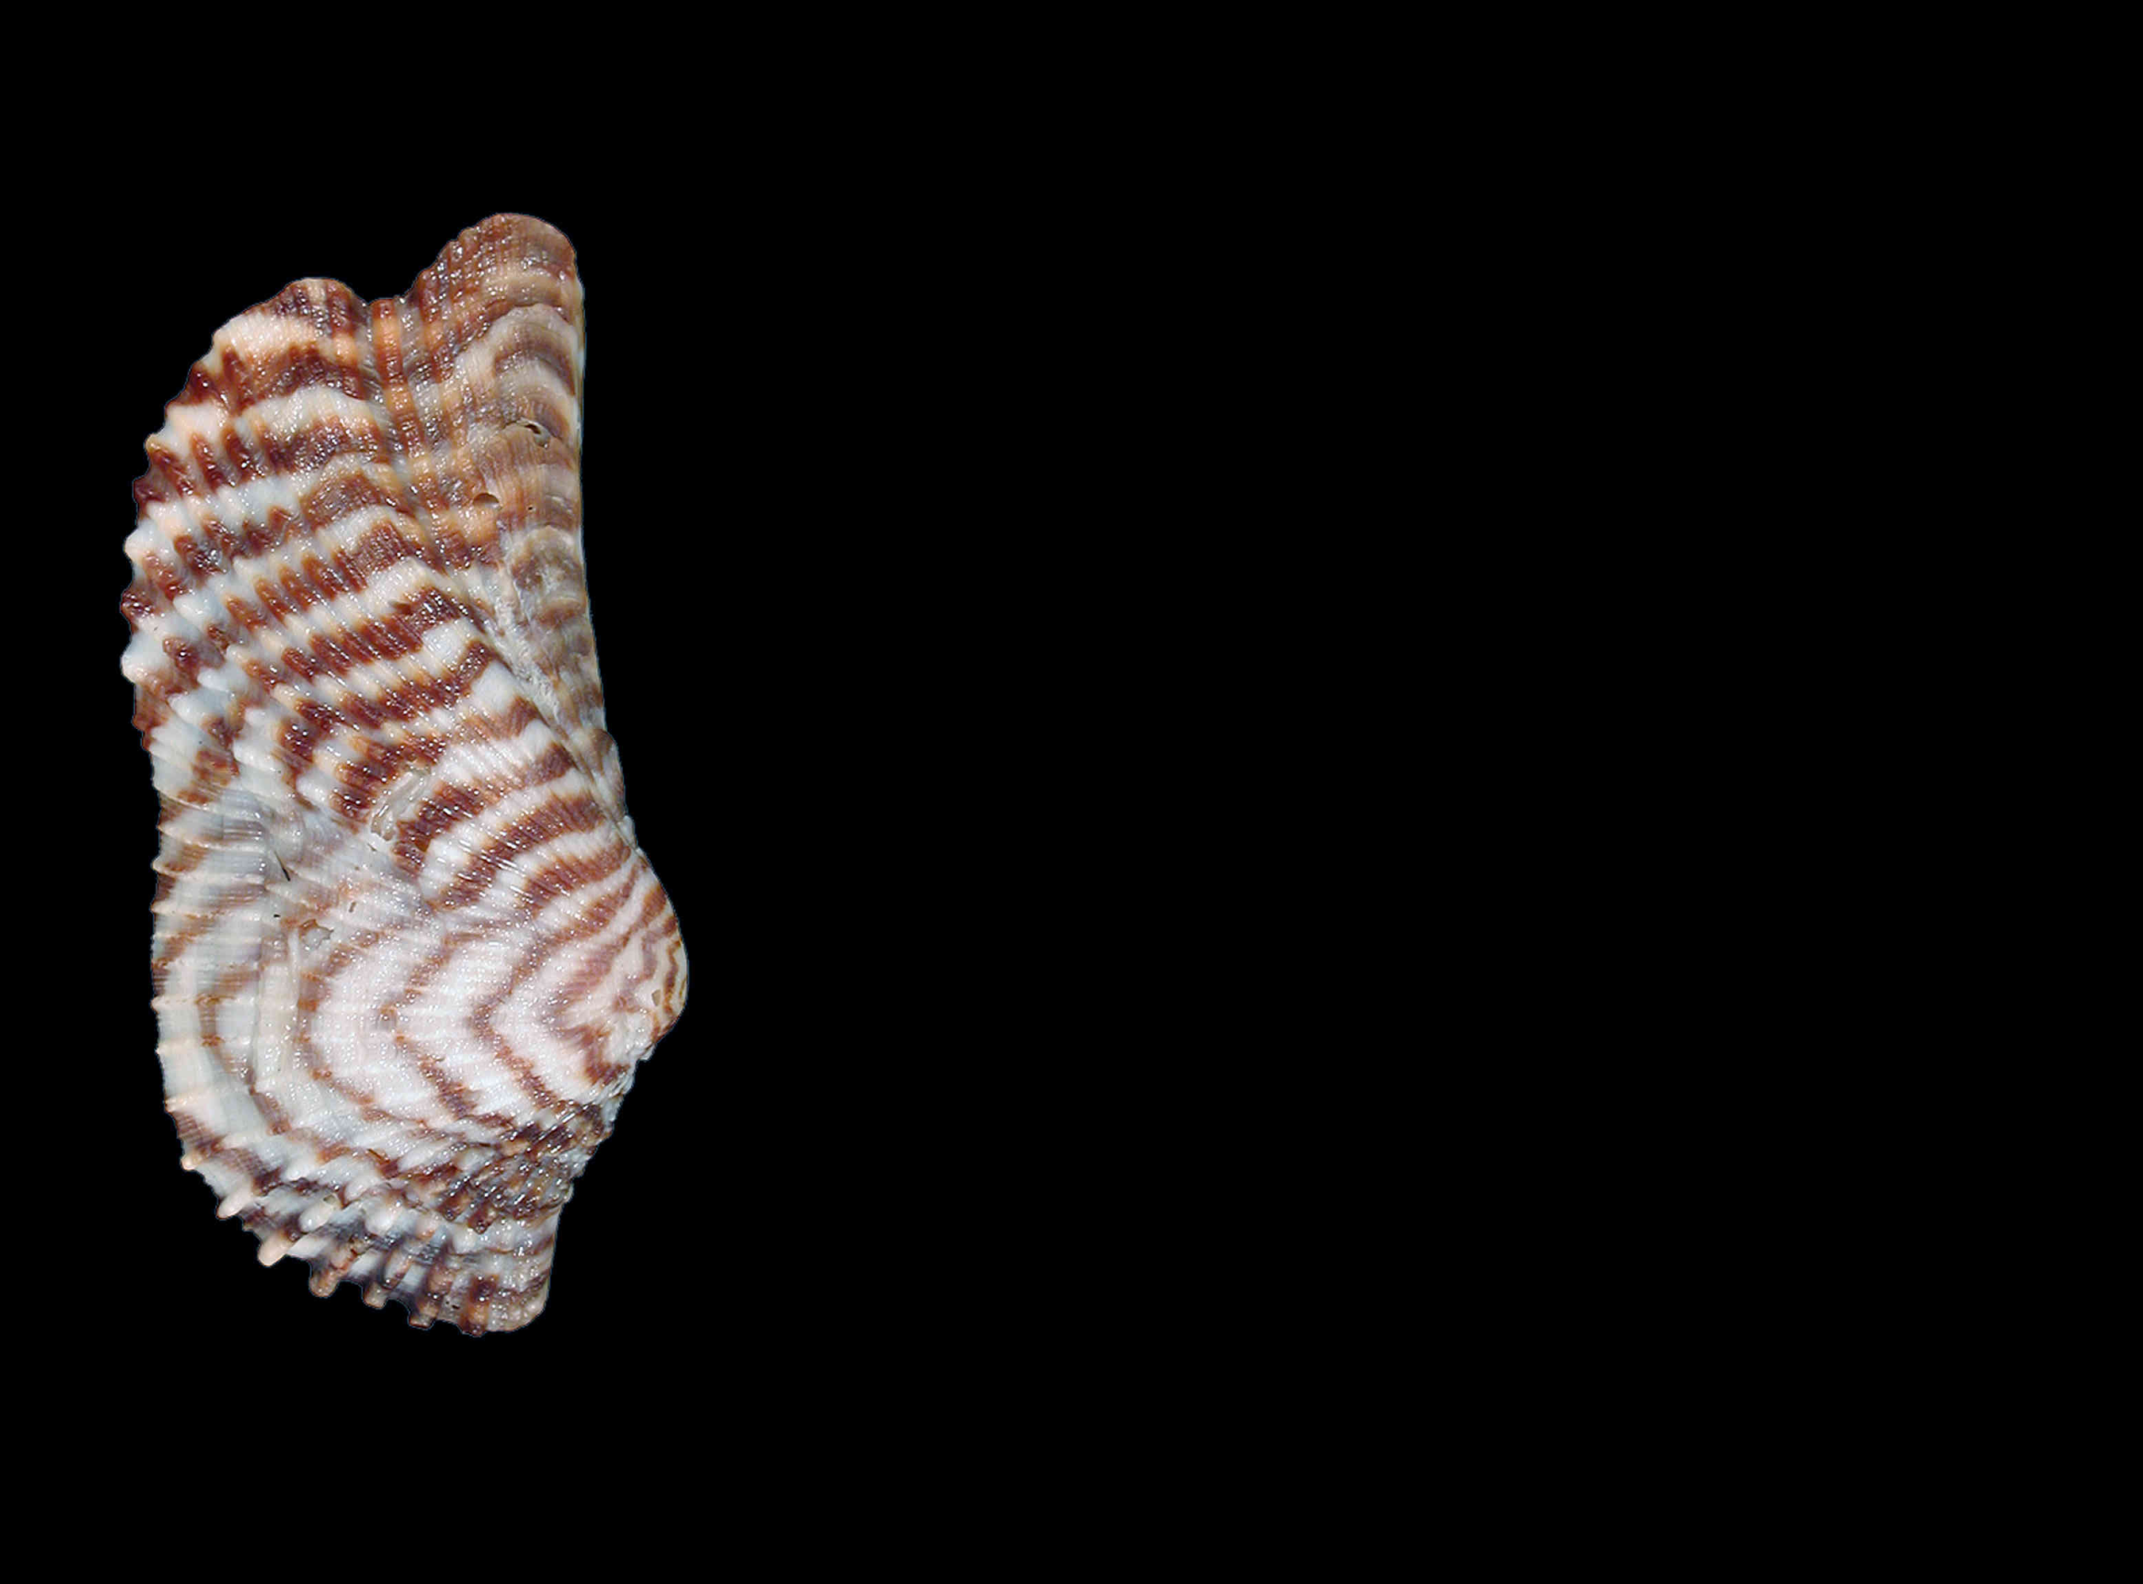
Light and clarity in KM3NeT
Jordan Seneca

Slide 2
My goal for this presentation
Inspire, stimulate questions and discussion

Slide 3
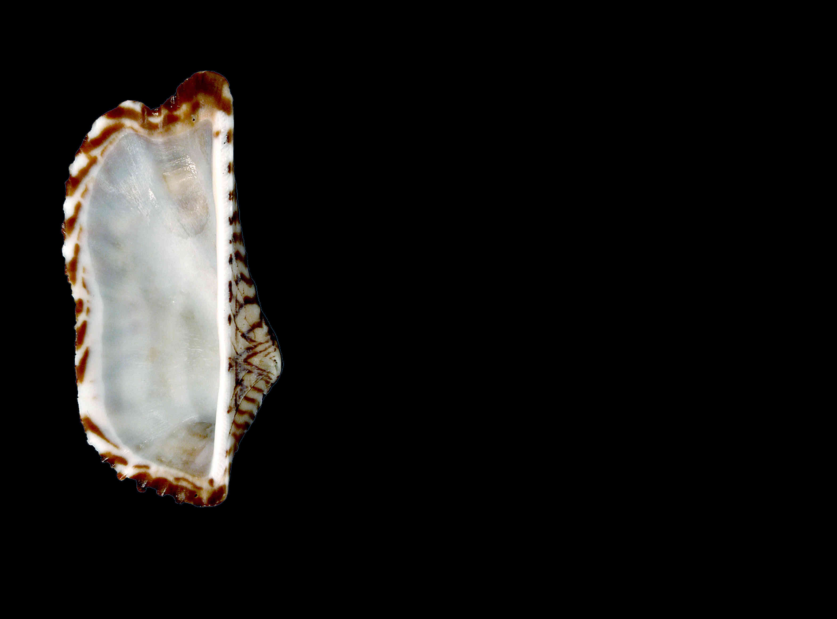
Working towards a better ARCA res
What I find exciting about my work
How to convey excitement to others

Slide 4
Working towards a better ARCA res
What I find exciting about my work
How to convey excitement to others

Slide 5
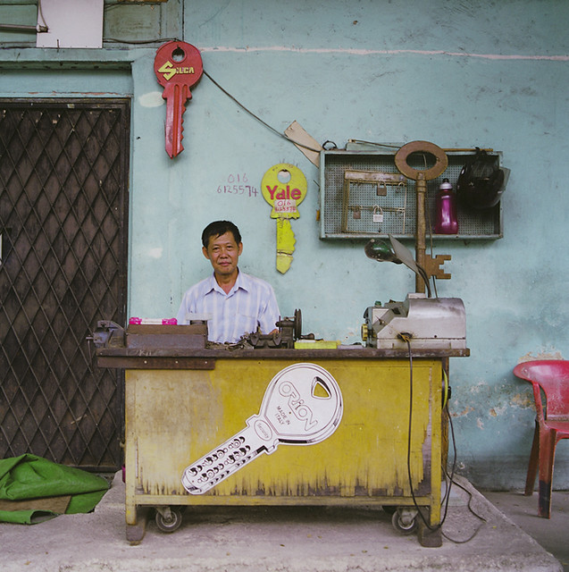
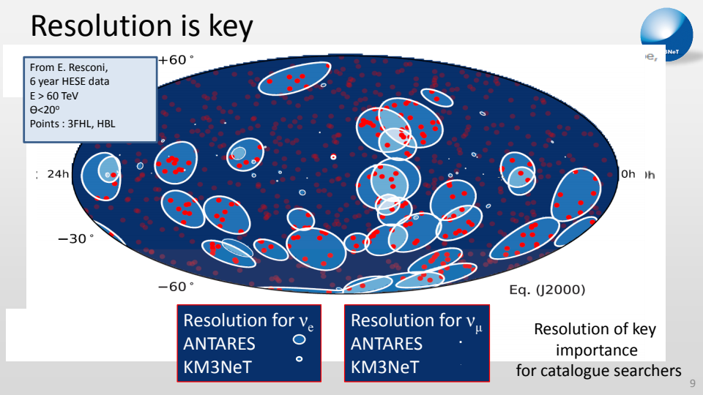
Last year, in Dalfsen
Me

Slide 6
Current reconstruction Aanet PDFs
PMT position
1 PMT direction
Reception angle
New reconstruction Jpp PDFs
PMT position
2 PMT directions
Reception angle
Arrival time

Slide 7
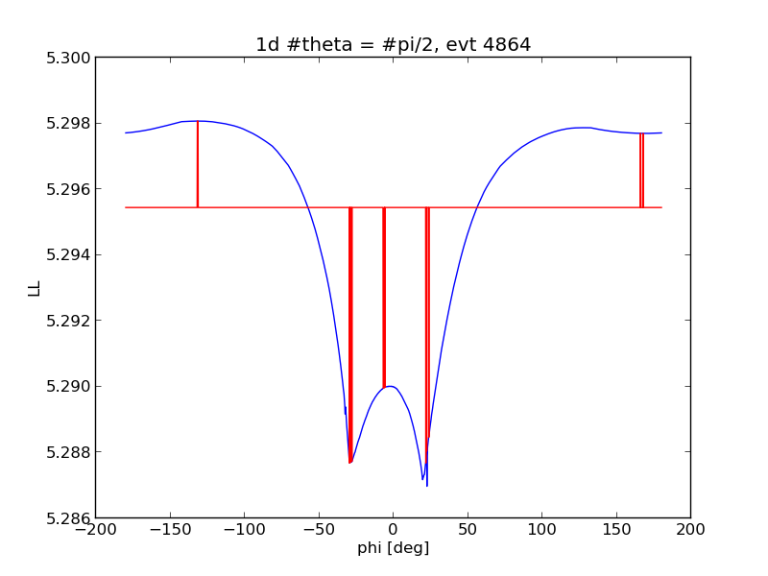
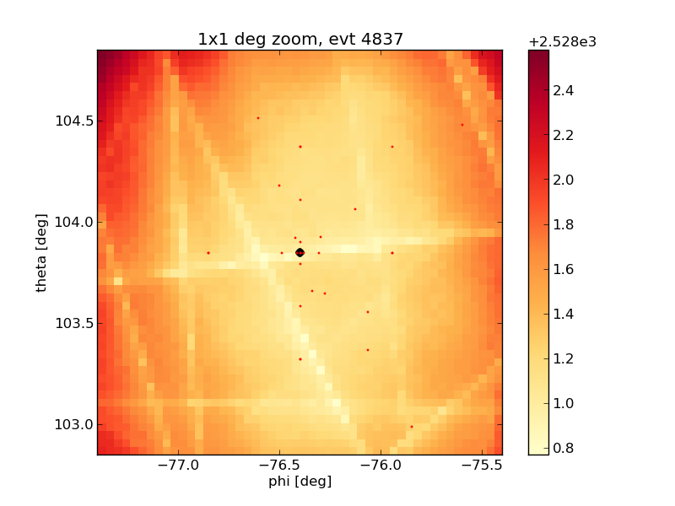
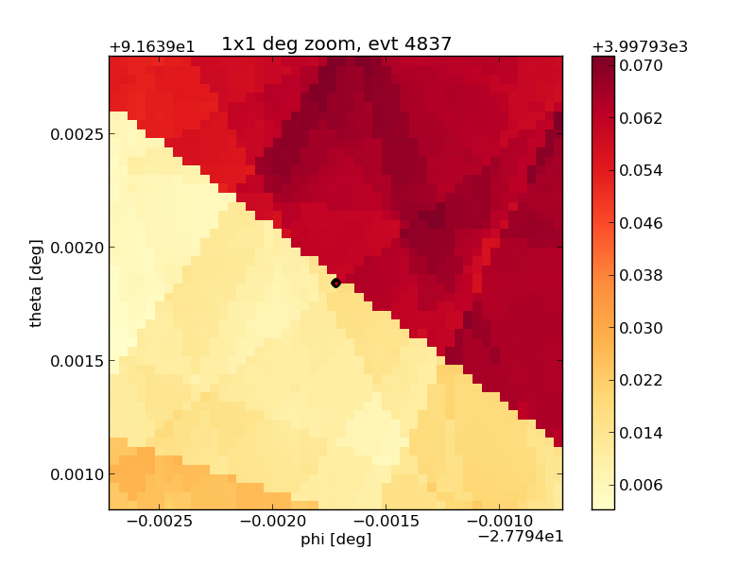
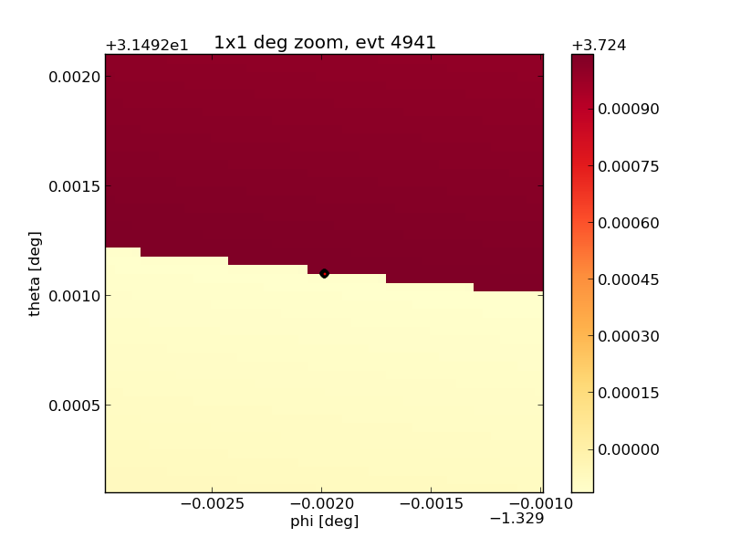
I found weird stuff.

Slide 8
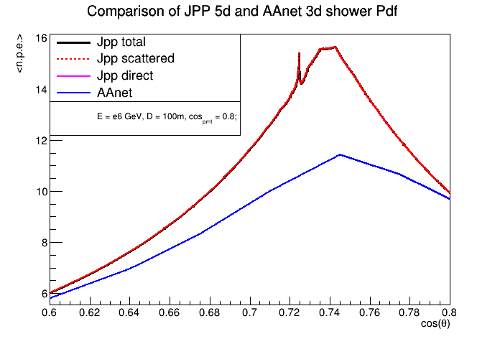
I found bugs in Jpp PDFs.

Slide 9
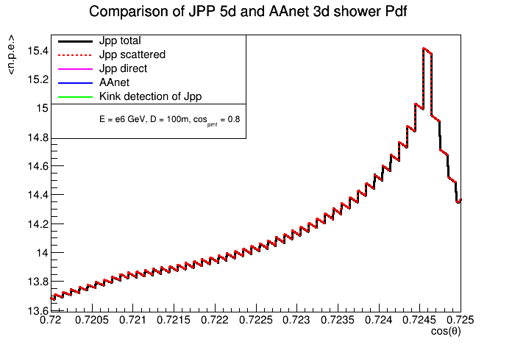
I found bugs in Jpp PDFs.

Slide 10
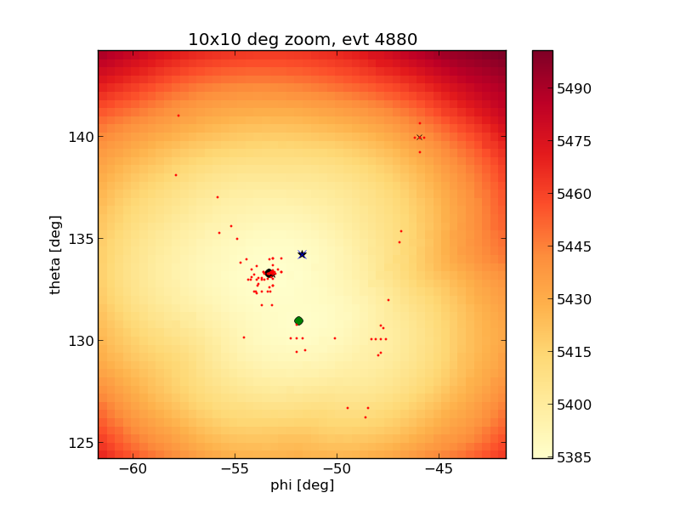
Bugs have now been fixed!
Thank you Maarten
MC truth
New reco
Old reco

Slide 11
Bugs have now been fixed!
Thank you Maarten
Sub 1 deg resolution

Slide 12
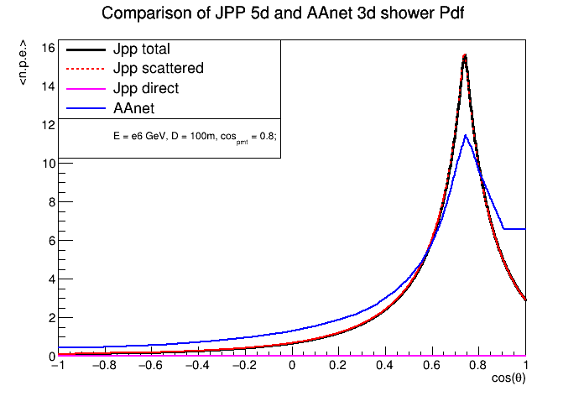
Bugs have now been fixed!
Thank you Maarten
Not so fast
!!!
Sub 1 deg resolution

Slide 13
Working towards a better ARCA res
What I find exciting about my work
How to convey excitement to others

Slide 14
Why are Jpp and AAnet PDFs different?

Slide 15
disagreement
Jpp PDF: based on theoretical approximations
AAnet PDF: MC interpolation

Slide 16
Why are Jpp and AAnet PDFs different?
N-scattered light? Other approximations?

Slide 17
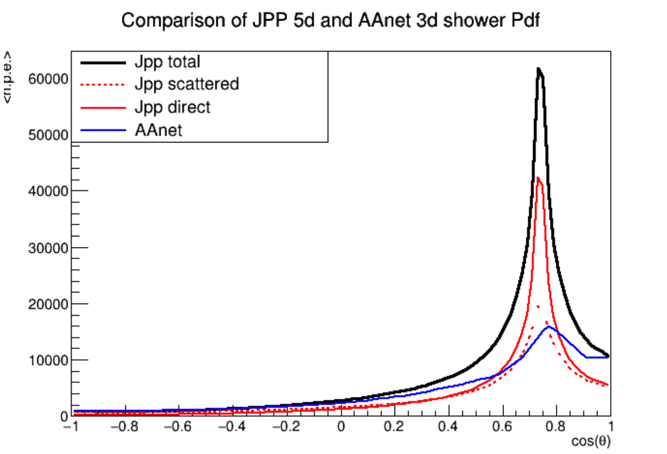
25m, PMT angle -1.0
When close, a lot of direct light

Slide 18
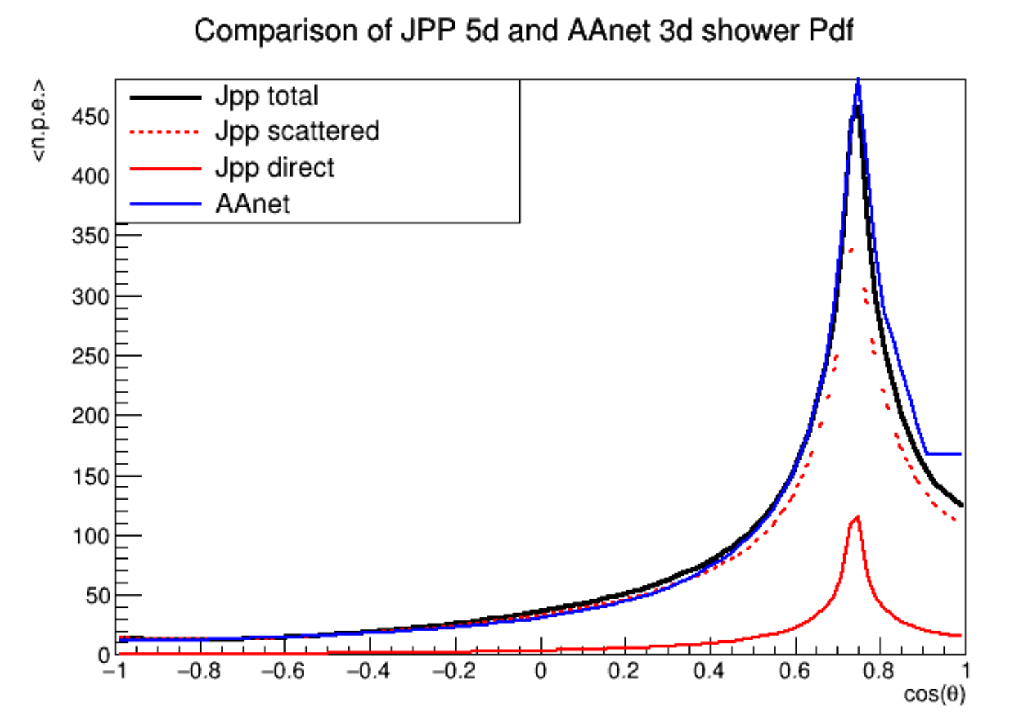
100m, PMT angle -1.0
When far away, mostly 1-scattered light

Slide 19
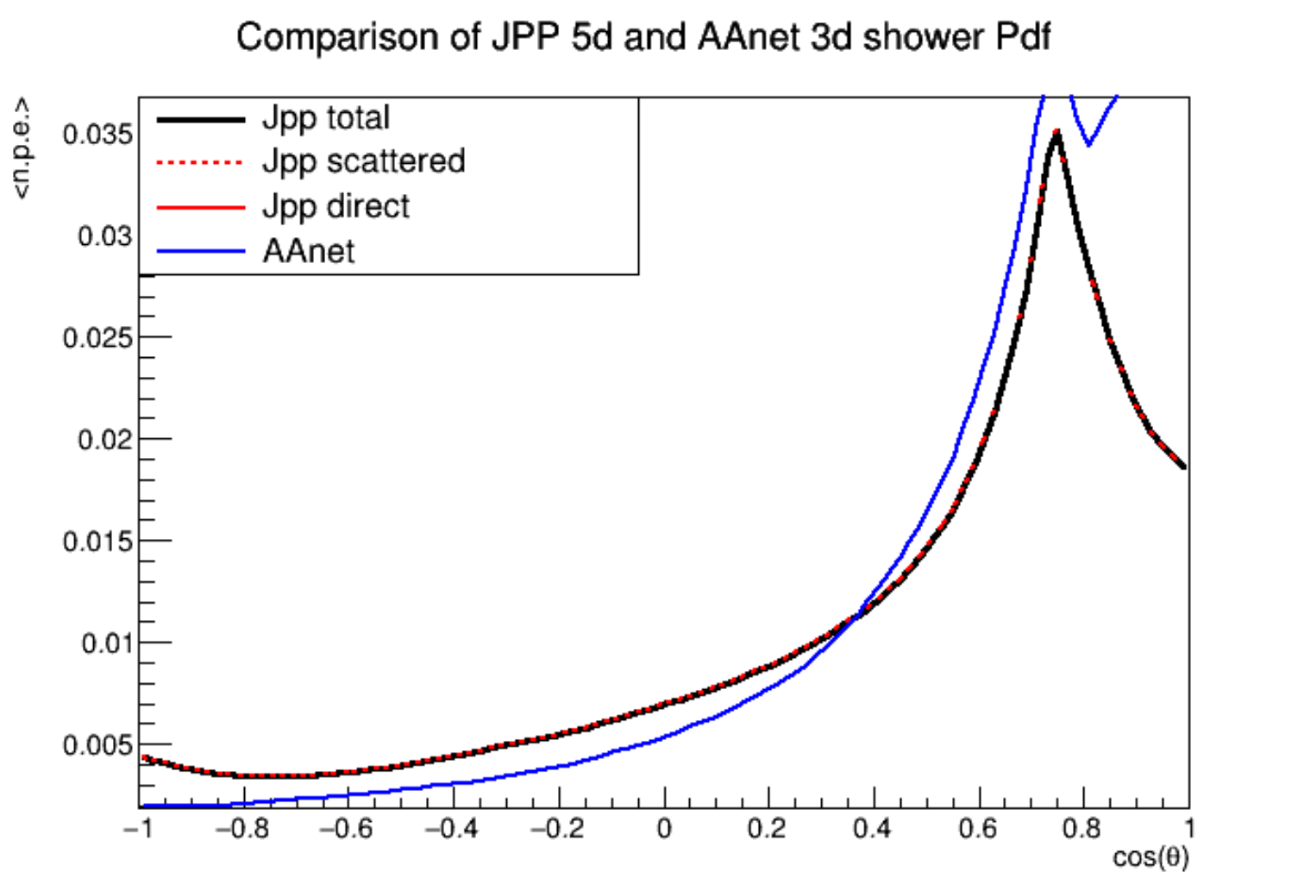
400m, PMT angle -1.0
When very far away, only 1-scattered light?

Slide 20
Why are Jpp and AAnet PDFs different?
N-scattered light? There are other approximations we could try.
Re-emission?

Slide 21
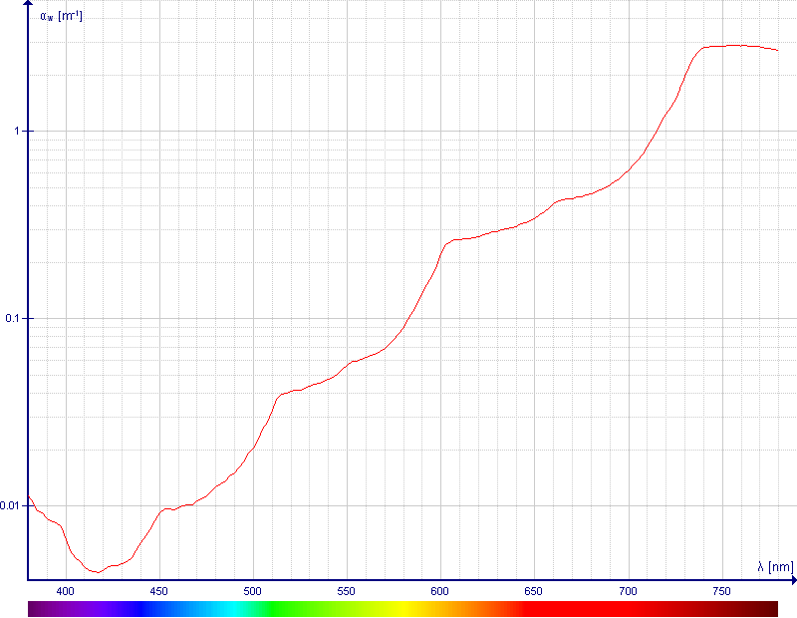
Less than 60% of visible light is not absorbed after 100m
63%
0.1%

Slide 22
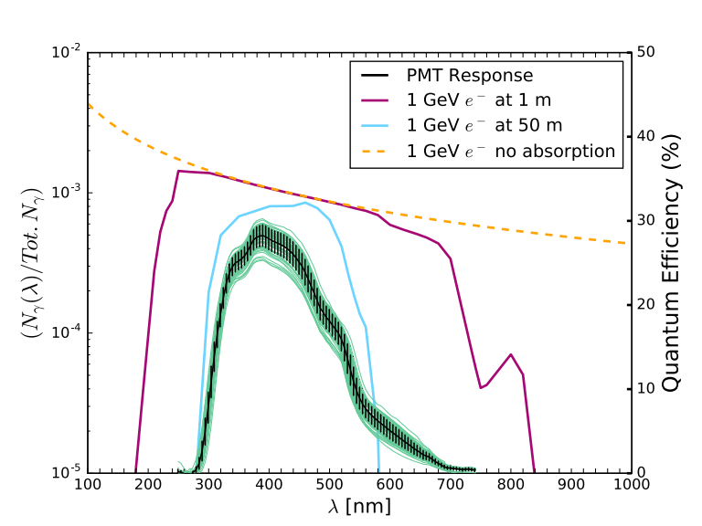
Less than 60% of the light is not absorbed after 100m
63%
0.1%
All these hard photons are absorbed.
Re-emission in visible?

Slide 23
Why are Jpp and AAnet PDFs different?
N-scattered light? There are other approximations we could try.
Re-emission?
Spread of particle shower

Slide 24
Particle shower
Cherenkov photons
63%
0.1%
At low energies, showers are small
Not so much at high energies
How does the longitudinal and radial spread affect the light profile?

Slide 25
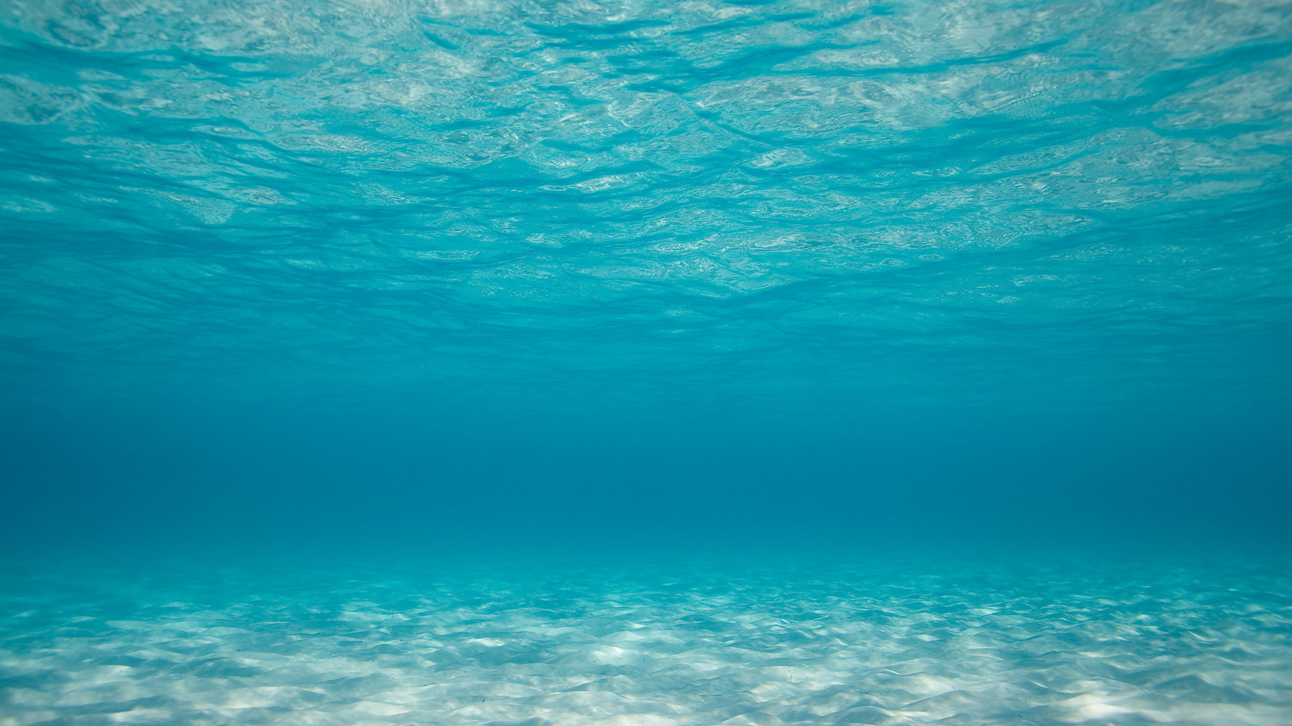
*distant snicker*

Slide 26
Working towards a better ARCA res
What I find exciting about my work
How to convey excitement to others

Slide 27
Exhibit A:
The type of slides we show each other during collaboration meetings in KM3NeT

Slide 34
Why?

Slide 35
“I need to know what to say”
Use notes in your PowerPoint-like program
Do a dry run

Slide 36
“I need to know what to say”
“Slides are used as work logs”
There are other ways of logging work:
Elog
Wiki
Uploading .ppt with notes
Uploading .pdf with notes
Backup slides

Slide 37
“I need to know what to say”
“Slides are used as work logs”
“It takes effort to make nice slides”
The KM3NeT template will help with that

Slide 38
The KM3NeT template
Slide types
Predetermined fonts
Predetermined colors
Bank of logos
Bank of images

Slide 40
Search for Neutrino counterparts of HAWC point-sources
Margaret Davis
Michael Smith

Slide 42
PMT efficiency calibration update
K40 simulations comparison
K40 simulation updates

Slide 43
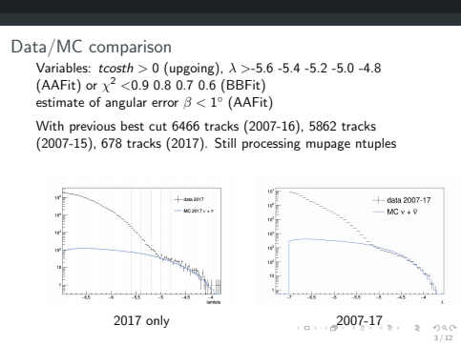

Slide 44
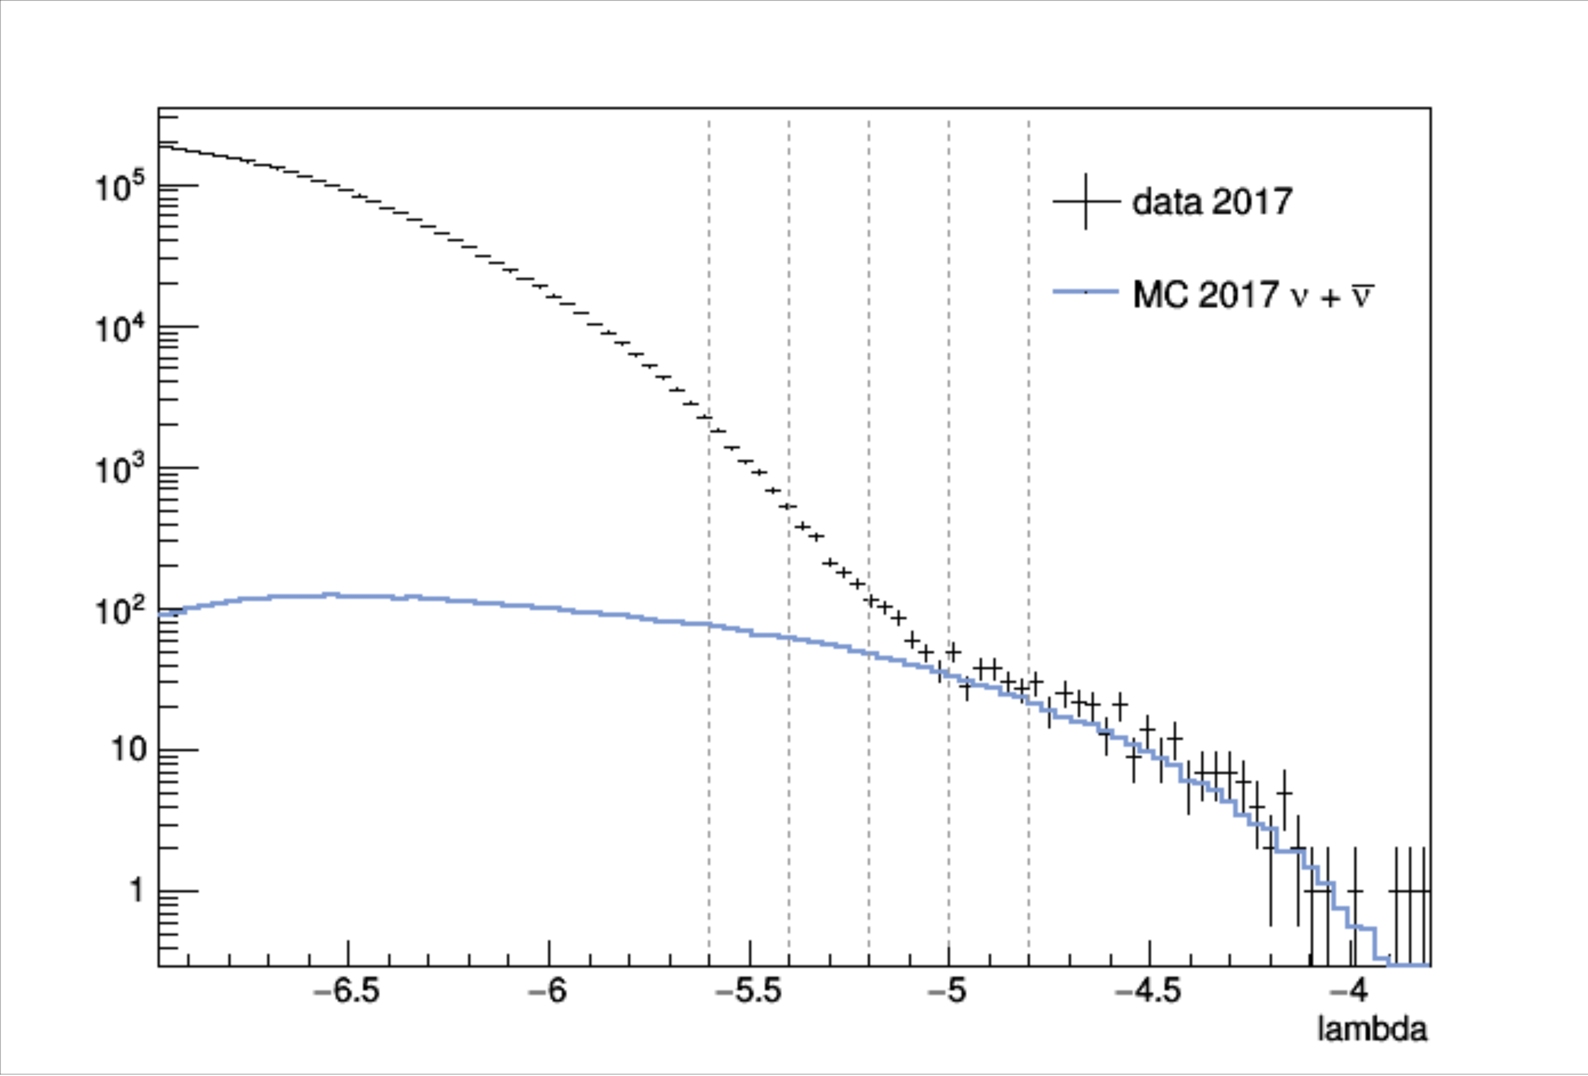
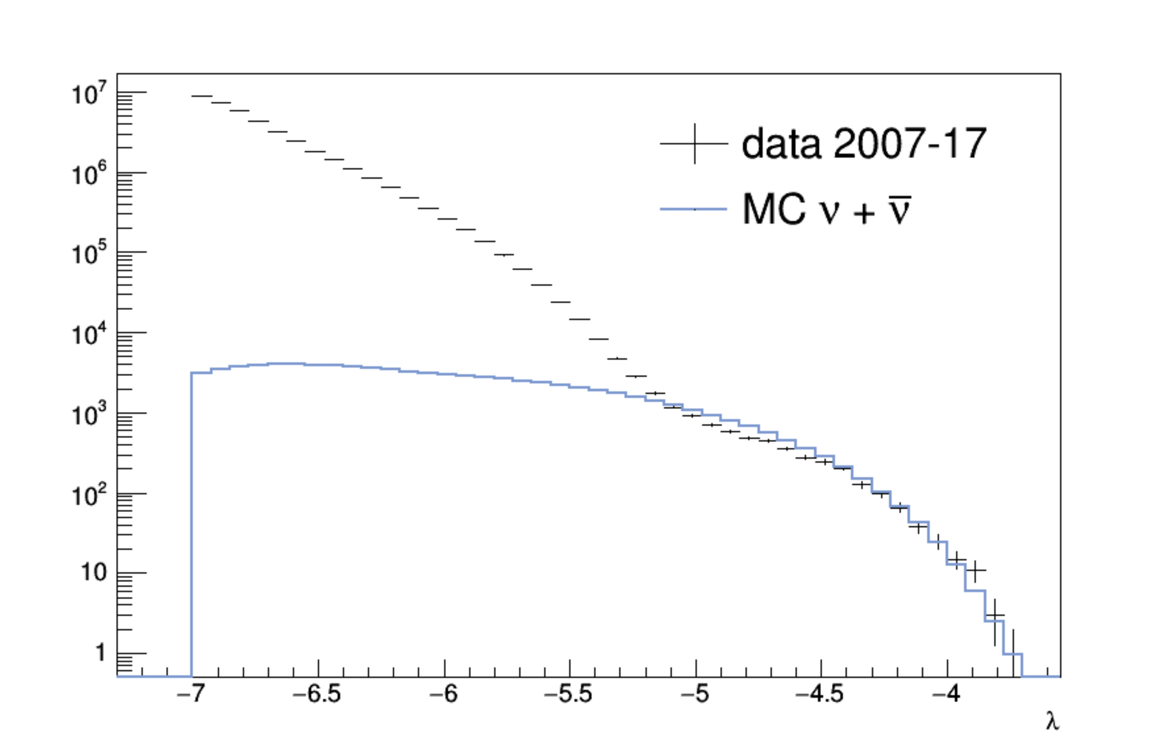
Data/MC comparison
Variables: tcosth>0 (upgoing), λ > -5.6 -5.4 -5.2 -5.0 -4.8 (AAFit) or χ 2 <0.9 0.8 0.7 0.6 (BBFit)
estimate of angular error β < 1 ◦ (AAFit)
With previous best cut 6466 tracks (2007-16), 5862 tracks
(2007-15), 678 tracks (2017). Still processing mupage ntuples
2017 only 2007 - 17

Slide 45
Data/MC comparison
Variables: tcosth>0 (upgoing), λ > -5.6 -5.4 -5.2 -5.0 -4.8 (AAFit) or χ 2 <0.9 0.8 0.7 0.6 (BBFit)
estimate of angular error β < 1 ◦ (AAFit)
With previous best cut 6466 tracks (2007-16), 5862 tracks
(2007-15), 678 tracks (2017). Still processing mupage ntuples
2017 only 2007 - 17

Slide 46
Data/MC comparison
Variables: tcosth>0 (upgoing), λ > -5.6 -5.4 -5.2 -5.0 -4.8 (AAFit) or χ 2 <0.9 0.8 0.7 0.6 (BBFit)
estimate of angular error β < 1 ◦ (AAFit)
With previous best cut 6466 tracks (2007-16), 5862 tracks
(2007-15), 678 tracks (2017). Still processing mupage ntuples
2017 only 2007 - 17

Slide 47
Data/MC comparison
Looking at upgoing neutrinos from GC
With previous best cut 6466 tracks (2007-16), 5862 tracks
(2007-15), 678 tracks (2017). Still processing mupage ntuples

Slide 48
Data/MC comparison
Looking at upgoing neutrinos from GC
2007 - 17: 7.2k tracks
2017: 0.7k tracks
Muons not included in MC
Is there an excess?

Slide 49
Data/MC comparison
Looking at upgoing neutrinos from GC
2007 - 17: 7.2k tracks
2017: 0.7k tracks
Muons not included
Is there an excess?

Slide 50
Data/MC comparison
Looking at upgoing neutrinos from GC
2007 - 17: 7.2k tracks
2017: 0.7k tracks
Muons not included in MC
Is there an excess?

Slide 52
“Looks good enough to be used out of the box,
is simple enough that it will rarely need cleaning up.”
~ me

Slide 53
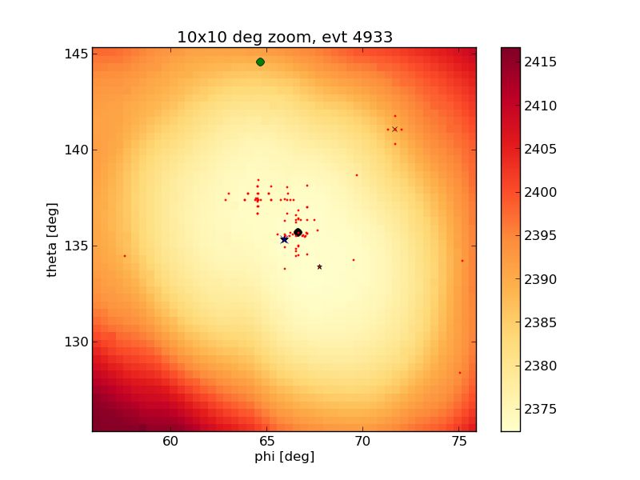
I am working towards improving the reconstruction of showers in ARCA
Light in our detector is interesting and important to think about
The KM3NeT template is in the works for streamlining quality presentations

