Slide 1
Dusj & shower reconstructions for 7 lines
Iris Reitsma

Slide 2
Recap
Shower
Dusj
Reconstruction performance:
How well are events reconstructed?
Which events are (not) reconstructed?

Slide 3
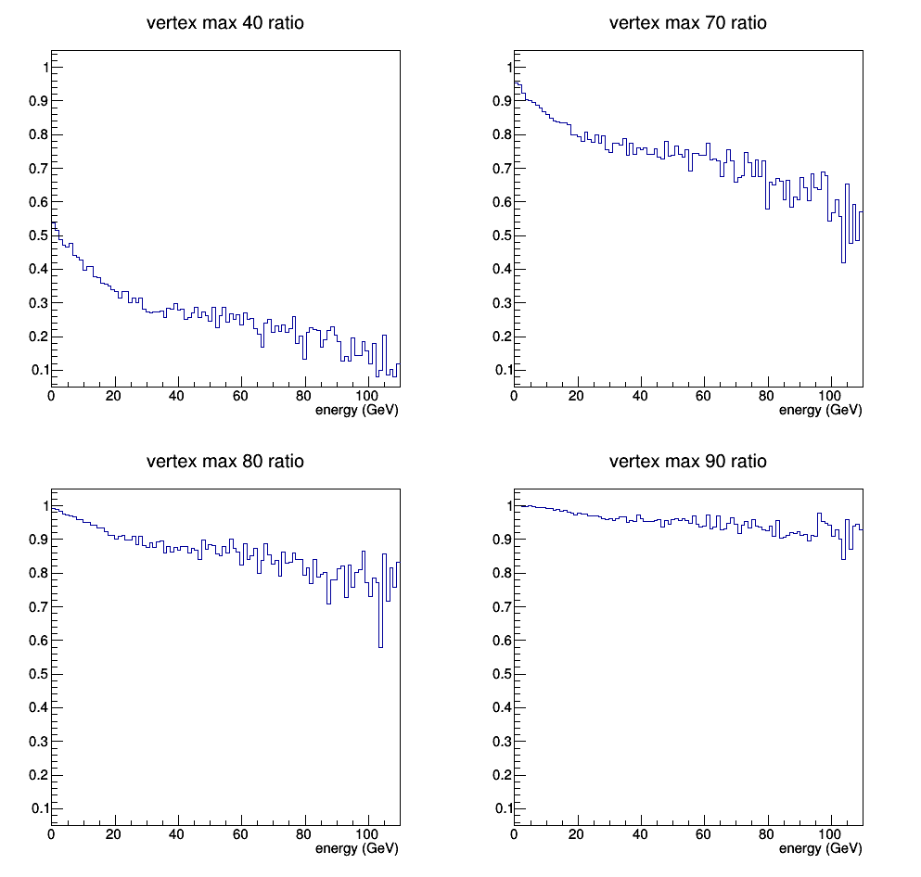
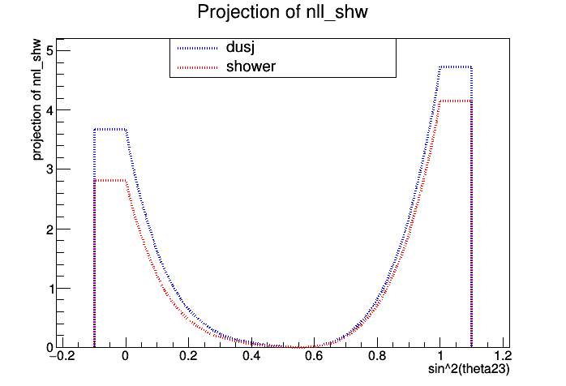
What I am working on now
Check sensitivity towards θ₂₃ and Δm₃₁
Choose cuts to improve this

Slide 4
Next steps
Try more cuts in shower events
Use track events
Repeat for Δm₃₁

Slide 5
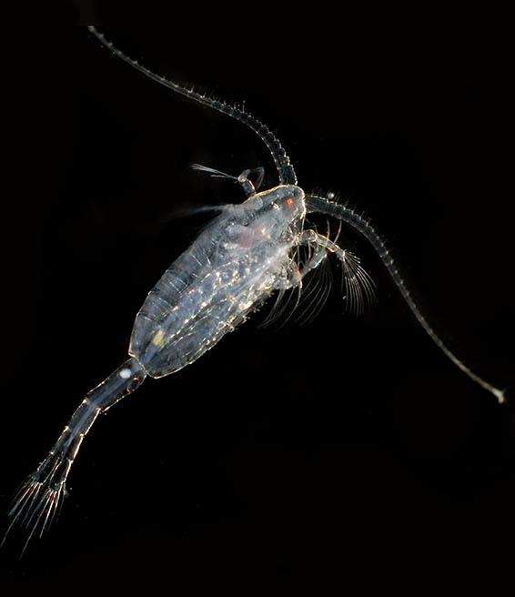
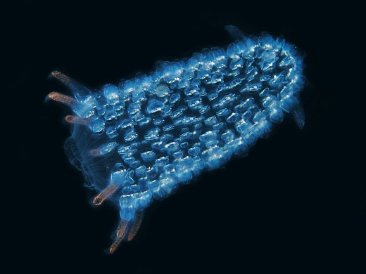
Bonus: bioluminescence

