Slide 1

Geant 4 / photon tracking
Aart Heijboer
Nikhef group outing – may 2019

Slide 2
introduction
How many photons arrive on a PMT? And when?
Crucial to know for reconstruction
Existing approaches
  KM3: geant-3 based tables used for lookup
  KM3Sim: geant-4 based, lets geant track photons (?)
  JSirene: analytical PDFs, with some approximations
This work:
  Based on code (aasim) developed 2012 for ANTARES, but not persued
  Geant for the particles, Cherenkov photons with custum code
  Full control over photon behavior, full information in output
  Good for: testing, generating tables, special jobs
  (optical beacon, shadowing, non-homogeneous water)

Slide 3

Particle simulation
Standard tool to simulate particle interactions with matter (detectors)
C++ based
Using standard ‘physics list’ (can probably be optimized)
Usage:
  Geant handles particle tracking
  Write functions that are called for each event / track / step

Slide 4


The geometry for Geant
Compared to most detectors, the
geometry is rather simple.

Slide 5
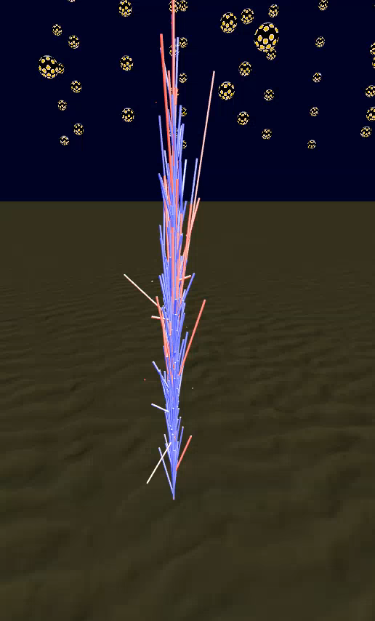
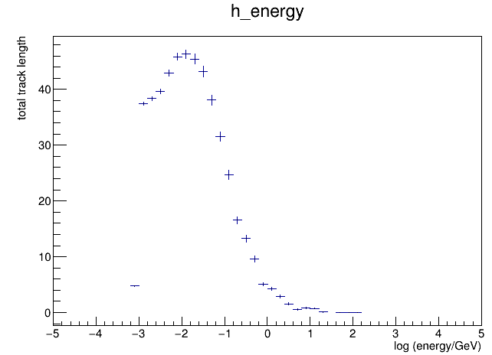
(m)
electrons
drop below
cherenkov
threshold
100 GeV electron
Showing particles with E > 0.1 GeV

Slide 6
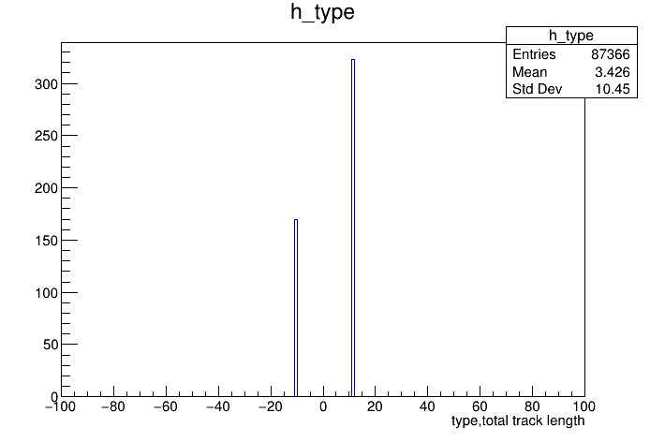
Track length (m)
positrons
electrons
100 GeV electron
Showing particles with E > 0.1 GeV

Slide 7
100 GeV electron:
31 k tracks
161 k segments
Track consists of steps/segments
Energy/beta/direction change over a segment, but assumed constant
Cherenkov photons are generated from each segment

Slide 8
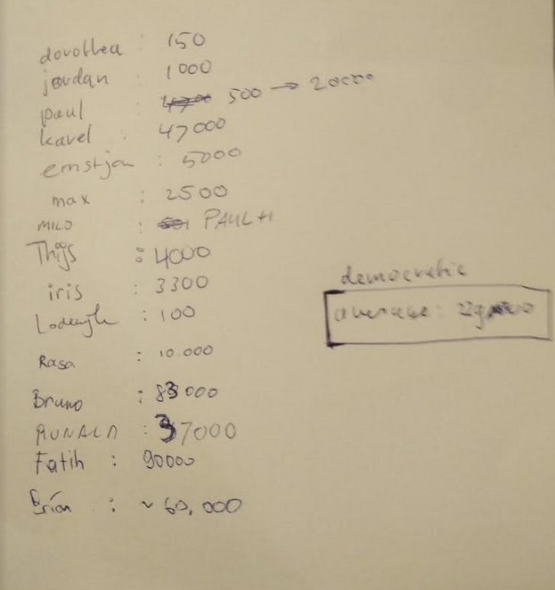
---------------------------------------------------------
timer ncalls total time/call
---------------------------------------------------------
PreUserTrackingAction : 75 30725 0.0575123 1.87184e-06
UserSteppingAction : 32 161598 0.903481 5.59092e-06
generate_photons : 21 87366 0.565641 6.47439e-06
simulate_geant : 74 1 9.34842 9.34842
---------------------------------------------------------
How many photons per m of track??
Interesting spread
and it contains the right answer
No correlation observed between
seniority and accuracy
Average : 23000 photons
is too low…

Slide 9
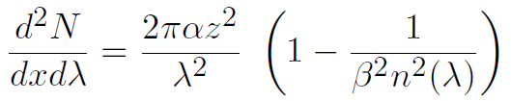
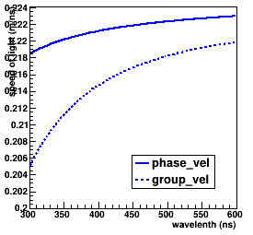

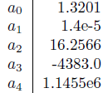
---------------------------------------------------------
timer ncalls total time/call
---------------------------------------------------------
PreUserTrackingAction : 75 30725 0.0575123 1.87184e-06
UserSteppingAction : 32 161598 0.903481 5.59092e-06
generate_photons : 21 87366 0.565641 6.47439e-06
simulate_geant : 74 1 9.34842 9.34842
---------------------------------------------------------
How many photons per m of track??
Gen. 1.3 :
“let there be light”
Particle data book:
Pressure taken constant : P = 300 bar

Slide 10
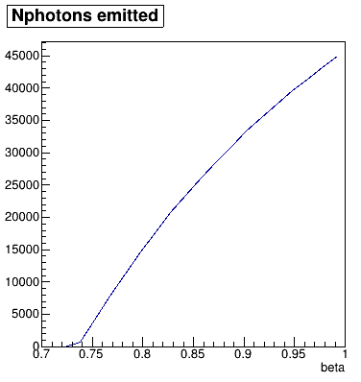
How many photons per m of track?
Particle data book:
45000 photons per meter*,
between 280 and 720 nm
β known, pick λ according to λ⁻²
ϴ_{c} (λ,β) also known
Next questions:
How long with the photon live?
Will it scatter?
Will it hit a dom?
100 GeV shower has 450 m of
charged tracks -> 20M photons

Slide 11
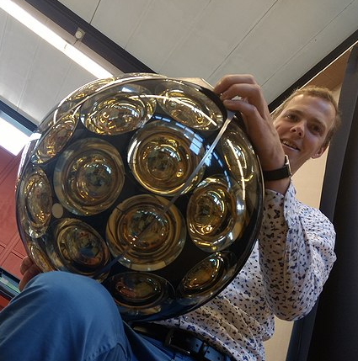
How many photons per m of track?
Particle data book:
45000 photons per meter*,
between 280 and 720 nm
β known, pick λ according to λ⁻²
ϴ_{c} (λ,β) also known
Next questions:
How long with the photon live?
Will it scatter?
Will it hit a dom?
The winner : Karel

Slide 12
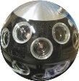
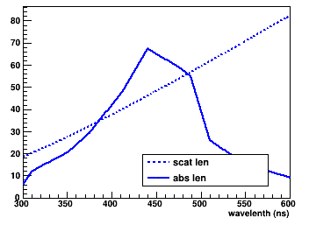
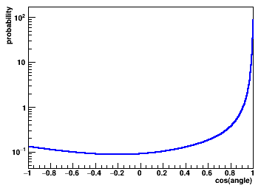
---------------------------------------------------------
timer ncalls total time/call
---------------------------------------------------------
PreUserTrackingAction : 75 30725 0.0575123 1.87184e-06
UserSteppingAction : 32 161598 0.903481 5.59092e-06
generate_photons : 21 87366 0.565641 6.47439e-06
simulate_geant : 74 1 9.34842 9.34842
---------------------------------------------------------
The path of a photon
All knowledge on water
and detector behavior
that is input the simulations:
https://git.km3net.de/simulation/input_tables

Slide 13
Full information
Example: one 13 MeV electron traveling for 5 cm, emitting ~100 photons
Trk: id=82893, pos=0.055005,0.063152,-0.281574, dir=0.990210,0.055791,0.127948, t=5.745197, E=0.013202 type=-11
---------------------------------------------------------------------------------------------------------
seg pos t len len-eff energy beta nphot phot/len
---------------------------------------------------------------------------------------------------------
82893 Vec: 0.055005 0.063152 -0.281574 5.7452 0.00816949 0.00821281 0.0132024 0.998823 17 2069.94
82893 Vec: 0.056467 0.062906 -0.273540 5.77217 0.0113356 0.011462 0.00902777 0.997888 24 2093.87
82893 Vec: 0.053119 0.064104 -0.262776 5.80873 0.00907138 0.00914982 0.00706394 0.996379 20 2185.84
82893 Vec: 0.051821 0.066168 -0.254039 5.83758 0.00693381 0.00707785 0.00532267 0.993681 15 2119.29
82893 Vec: 0.053865 0.064693 -0.247580 5.85954 0.0055218 0.00553782 0.0040448 0.989866 11 1986.34
82893 Vec: 0.056699 0.062064 -0.243637 5.87638 0.00265497 0.0027003 0.00327467 0.984123 6 2221.97
82893 Vec: 0.056399 0.062037 -0.240999 5.88489 0.00332926 0.00376348 0.00260077 0.974795 7 1859.98
82893 Vec: 0.055242 0.061867 -0.237882 5.89579 0.00306946 0.00309531 0.00207174 0.959333 6 1938.42
82893 Vec: 0.053849 0.062363 -0.235192 5.90443 0.00230857 0.00251671 0.00162979 0.919001 4 1589.38
82893 Vec: 0.051760 0.061593 -0.234581 5.91106 0.00137437 0.00173692 0.00111333 0.827772 2 1151.46
---------------------------------------------------------------------------------------------------------

Slide 14
So does it hit a DOM?
(well….. usually : no )

Slide 15
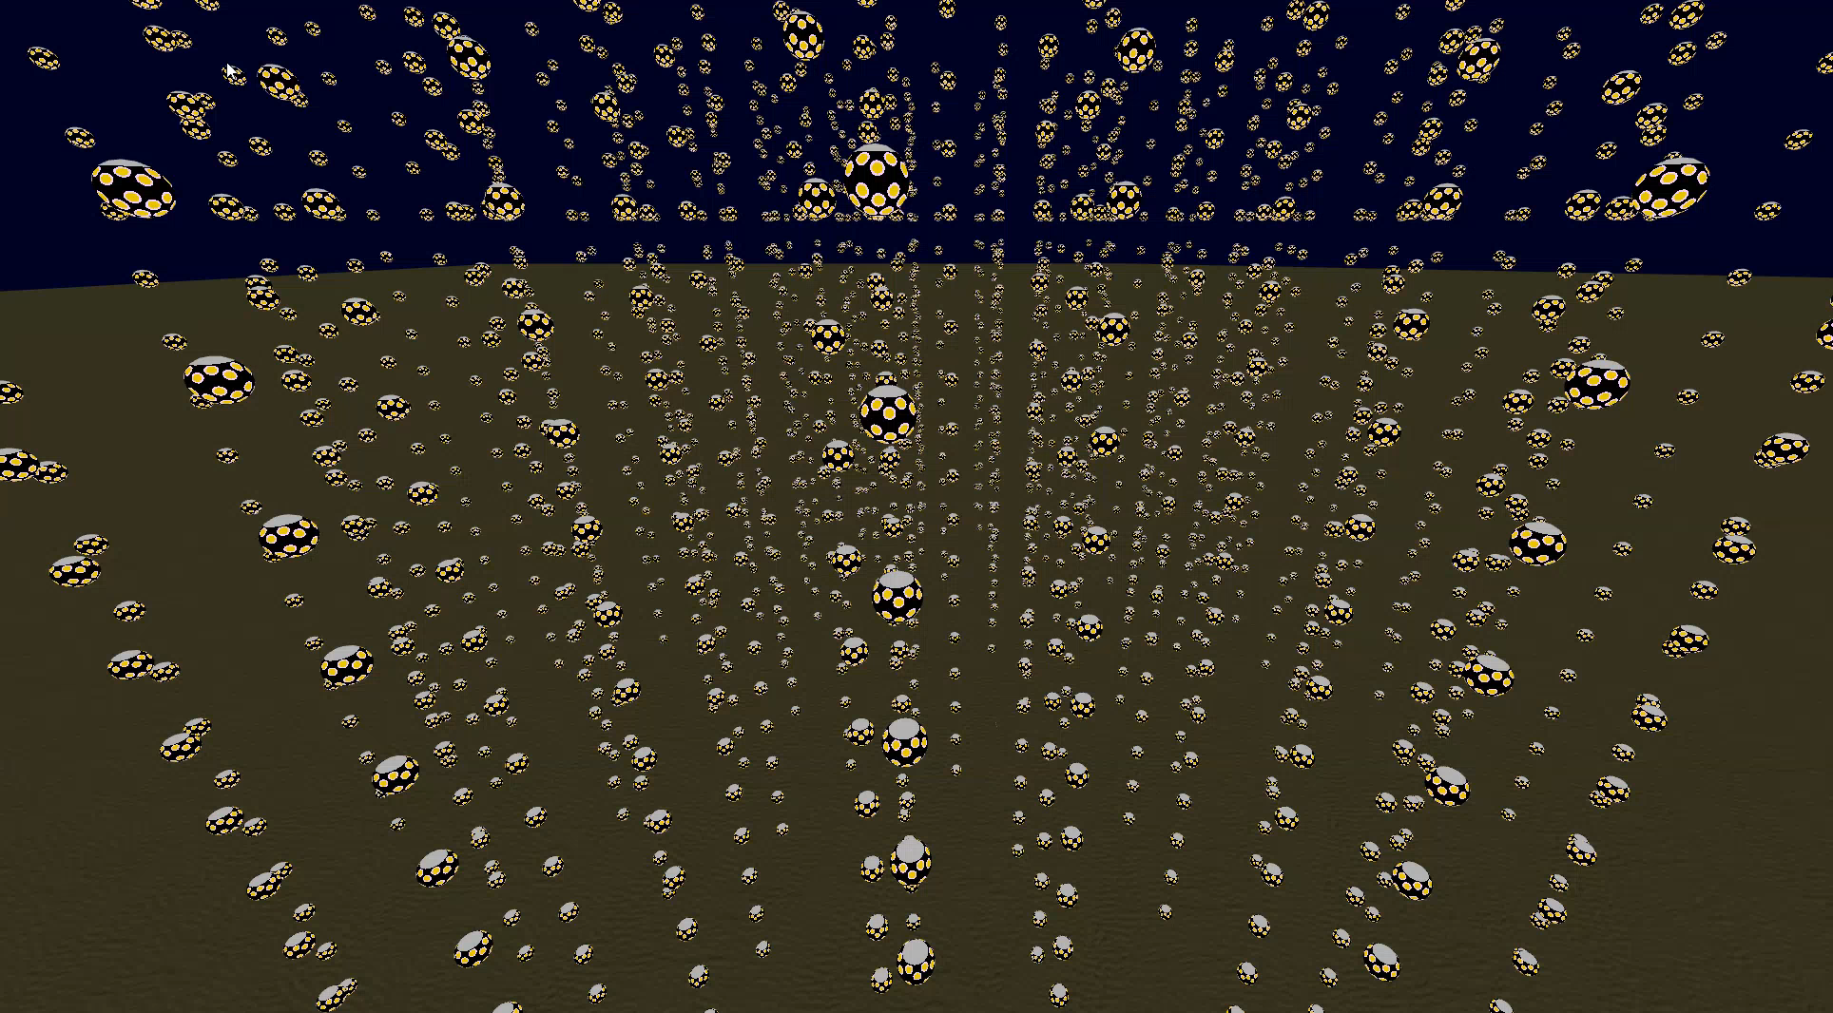
The problem: most photons will not hit any DOM

Slide 16
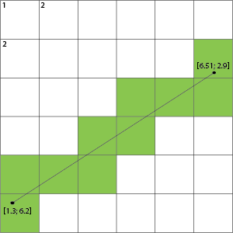
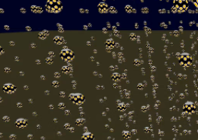
The problem…
Many photons, many will not hit a DOM
Generate only paths where photons hit the DOM -> MCMC
Try to prove the photon cannot hit a DOM as fast as possible
  Get rid of vast majority
  Spend more cpu time for the ones that have a chance
voxel traversal
Exploit detector layout

Slide 17
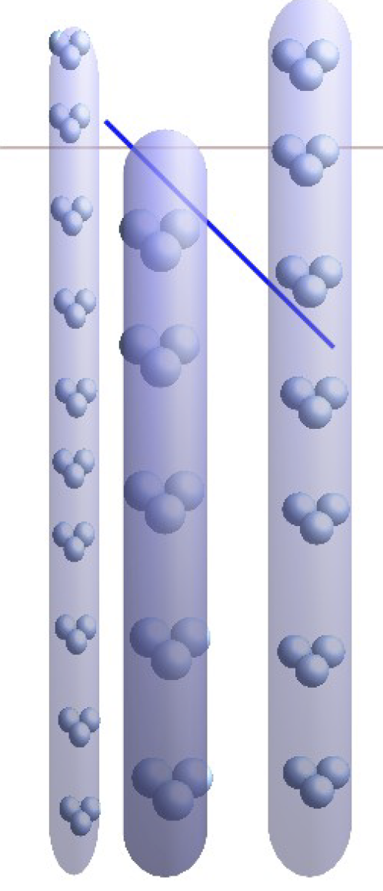
Does it hit?
In 2-D : does the line hit any circle?
Keep lines sorted according to distance to track
Only need to check the first N for a given live-length
Can check fast in 2d if line intersects a circle.
If yes: spend more time to check if it intersects a DOM
Nice as long as there is water current ☺

Slide 18
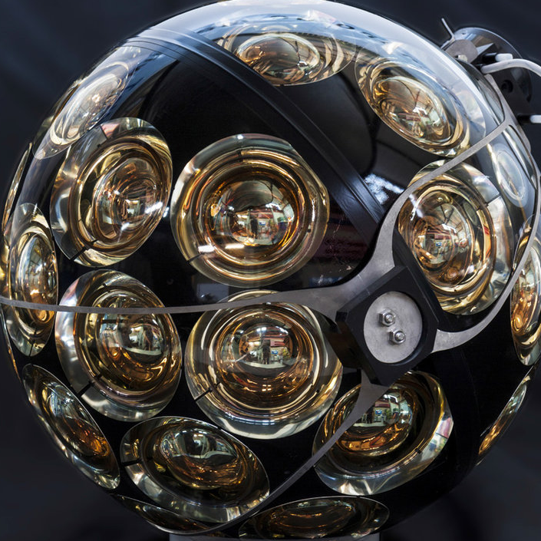
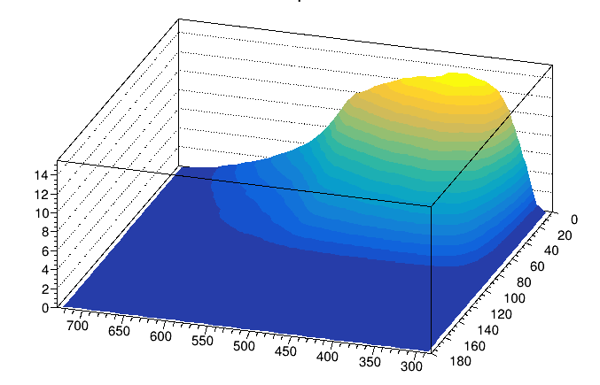
When we finally hit a DOM
We do not know PMT efficiency vs position of impact -> treat all points on the
DOM the same (equivalent to assuming the photon field is constant over the size of the DOM)
This means we could assume artificially larger DOMs improve computation efficiency.
PMT acceptance
(from OMGSim)
effective area (cm²)
angle photon-PMT
Nb: probably OMGsim numbers
Need a correction (+20%)
wavelength (nm)

Slide 19
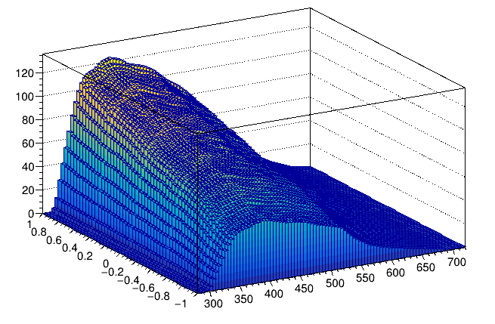
When we finally hit a DOM
Summing over all PMTs in the
DOM, gives total DOM acceptance.
120 cm² max; when hitting DOM
from below.
compare with DOM area
π(21 cm)² = 1385 cm²
Even in optimal case, only ~10%
of photon will become a Hit.
Effective DOM area (cm²)
wavelength (nm)
Cos(ang. w/dom axis)

Slide 20
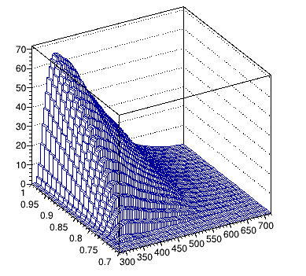
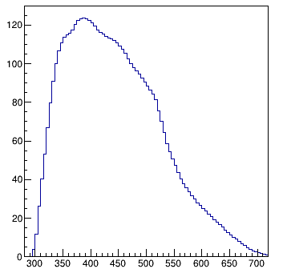
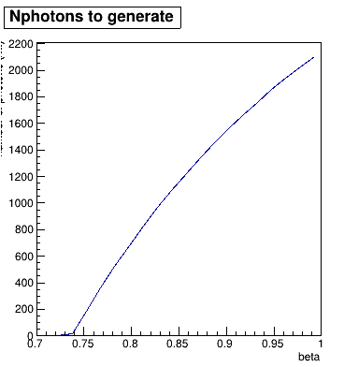
Smarter photon generation
X =
factor 20
less work

Slide 21
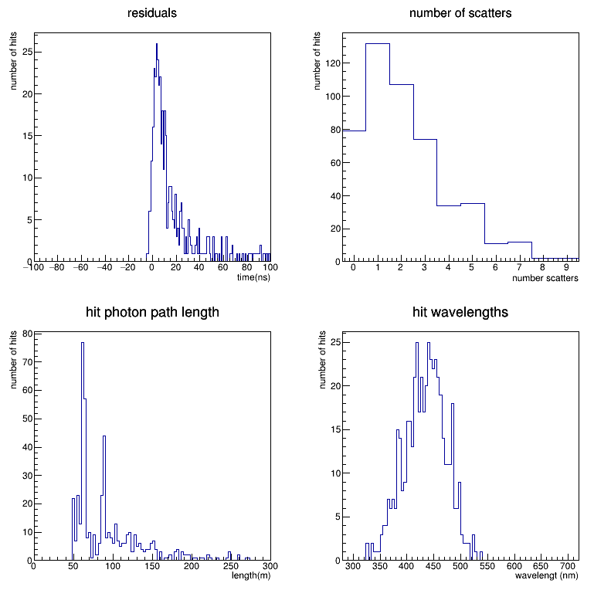
It works
10 TeV shower (600 hits)
All information available
(every photon-segment)

Slide 22
Timing : TeV electron shower
---------------------------------------------------------
timer ncalls total(s) time/call(s)
---------------------------------------------------------
simulate_geant : 1 18.2974 18.2974
+--PreUserTrackingAction : 309535 0.160611 5.18879e-07
+--UserSteppingAction : 1634263 7.3731 4.51157e-06
+--generate_photons : 875996 5.30131 6.05175e-06
---------------------------------------------------------
Photon tracking appears to be sub-dominant (!)
Optimize physics list (?)

Slide 23

Everything is a rapper!

Slide 24

Everything is a rapper!

Slide 25

Everything is a rapper!
oxide
MC neutrino

Slide 26

Everything is a rapper!
DOM
Hit-Boy

Slide 27
end

Slide 28
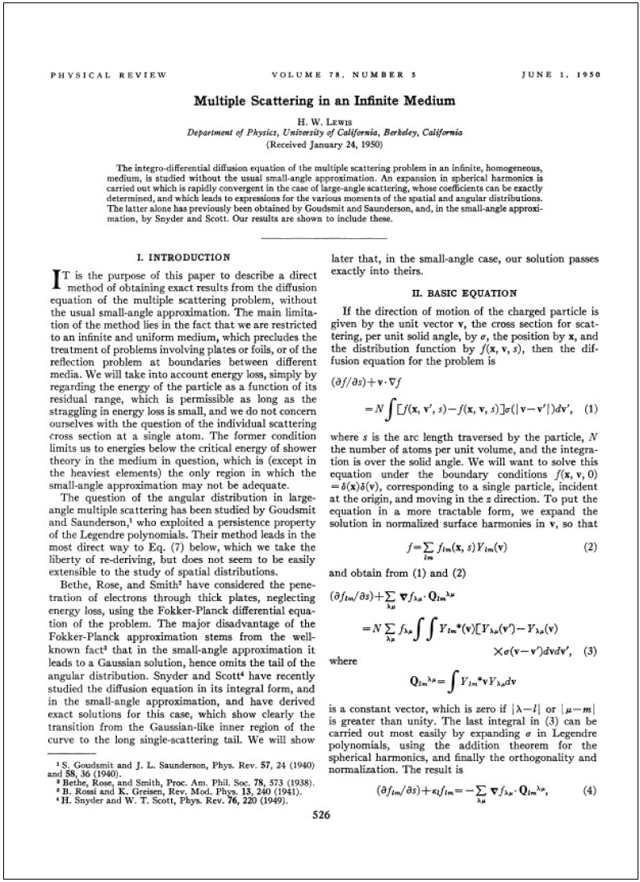
Analytical solutions?
Solutions exist e.g. for isotropic scattering, but not
the full general problem.

