Slide 1
Neutrino Source Searches
Motivation & Thoughts
Karel Melis
KM3NeT-Nikhef Group Outing
23 May 2019, Schoorl

Slide 2
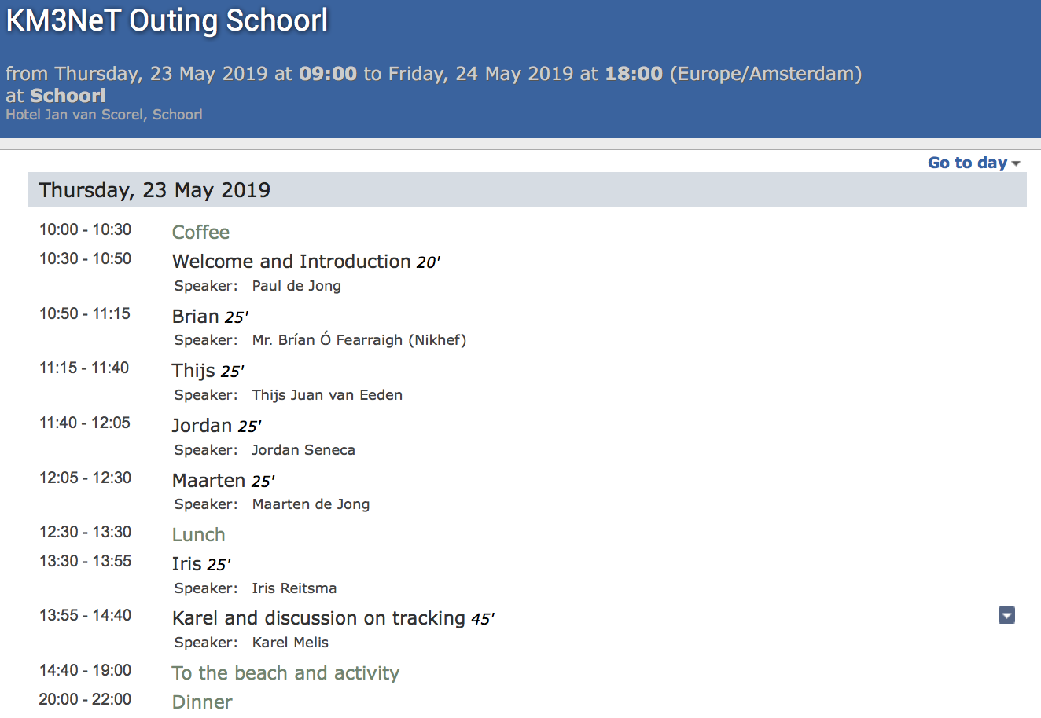
Good News

Slide 3
Good News
Karel 25’

Slide 4
Hypothesis Testing
Simple counting experiment
H0: μ_{b}
H1: μ_{b} + μ_{s}
n events detected

Slide 5
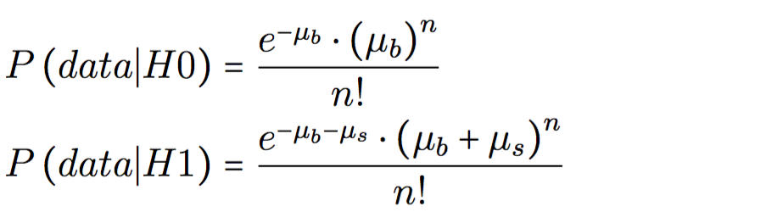
Hypothesis Testing
Simple counting experiment
H0: μ_{b}
H1: μ_{b} + μ_{s}
n events detected

Slide 6
Neyman-Pearson Lemma

Slide 7
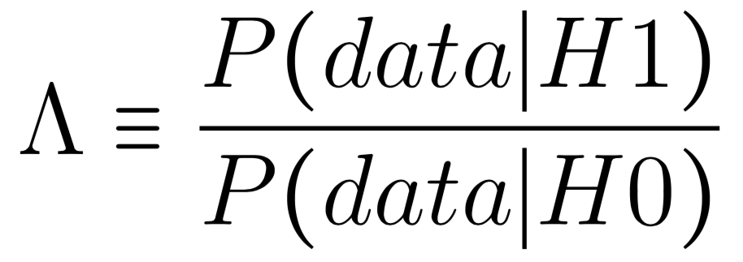
Neyman-Pearson Lemma
Most powerfull Λ definition:

Slide 8
Neyman-Pearson Lemma
Most powerfull Λ definition:
Simple Counting Experiment:

Slide 9
Hypothesis Testing
One observable parameter x
n
1
x

Slide 10
Hypothesis Testing
One observable parameter x
H0: μ_{b,i}
H1: μ_{b,i} + μ_{s,i}
n_{i} events detected in bin i
n
1
x

Slide 11
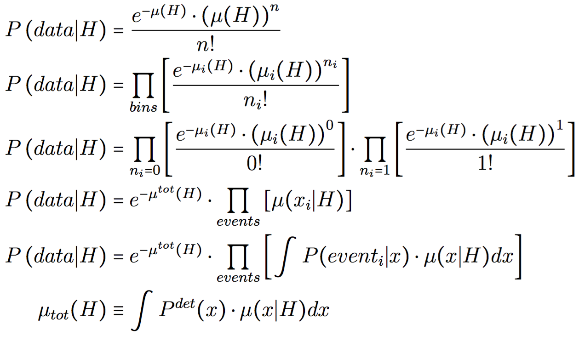
Hypothesis Testing
One observable parameter x
H0: μ_{b,i}
H1: μ_{b,i} + μ_{s,i}
n_{i} events detected in bin i
n
1
x

Slide 12
Hypothesis Testing
Unbinned (#bins == ∞)
n
1
x

Slide 13
Hypothesis Testing
Unbinned (#bins == ∞)
H0: μ_{b}(x)
H1: μ_{b}(x) + μ_{s}(x)
n events detected at {x₁, x₂, .. , x_{n}}
n
1
x

Slide 14
Hypothesis Testing
Unbinned (#bins == ∞)
H0: μ_{b}(x)
H1: μ_{b}(x) + μ_{s}(x)
n events detected at {x₁, x₂, .. , x_{n}}
n
1
x

Slide 15
Hypothesis Testing
Unbinned (#bins == ∞)
H0: μ_{b}(x)
H1: μ_{b}(x) + μ_{s}(x)
n events detected at {x₁, x₂, .. , x_{n}}
n
1
x

Slide 16
Hypothesis Testing
Unbinned (#bins == ∞)
H0: μ_{b}(x)
H1: μ_{b}(x) + μ_{s}(x)
n events detected at {x₁, x₂, .. , x_{n}}
n
1
x

Slide 17
Hypothesis Testing
Realistic case
H0: μ_{b}(x)
H1: μ_{b}(x) + μ_{s}(x)
n events detected
For each event: P(event_{i} | x)
n
dP/dx
1
x

Slide 18
Hypothesis Testing
Realistic case
H0: μ_{b}(x)
H1: μ_{b}(x) + μ_{s}(x)
n events detected
For each event: P(event_{i} | x)
n
dP/dx
1
x

Slide 19
Motivation
All information used, no assumptions
Most powerfull TS:
Best possible sensitivity

Slide 20
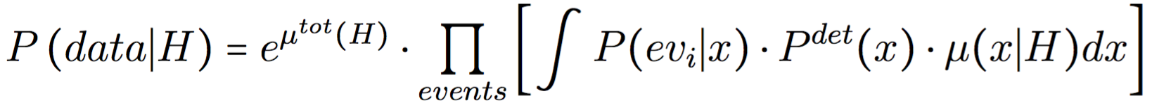
The KM3NeT Case

Slide 21
The KM3NeT Case

Slide 22
Event Parameterization
E_{Track}
Track
(Remote Vertex)
Track
(Contained Vertex)
Track + Bremsstrahlung Shower
⁴⁰K
Shower / Muon high b_{y}
E_{S}^{vis}

Slide 23
The KM3NeT Case

Slide 24
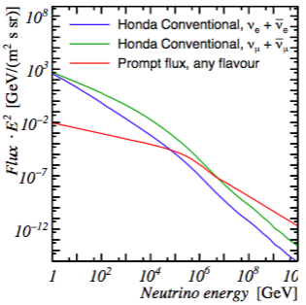
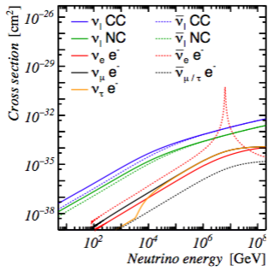
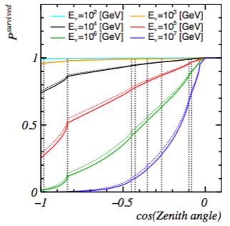
Expected Flux
Input Flux
Diff. Cross-Sec.
Earth Propa.
Shower Profile
4D table (d, E_{T}, E_{S}^{vis})

Slide 25
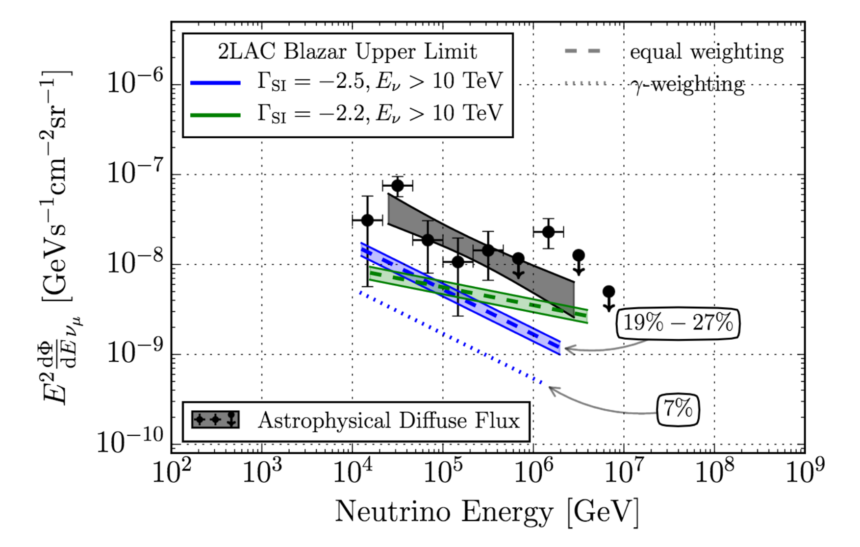
Expected Flux
Input Flux
Diff. Cross-Sec.
Earth Propa.
Shower Profile
4D table (d, E_{T}, E_{S}^{vis})

Slide 26
The KM3NeT Case

Slide 27
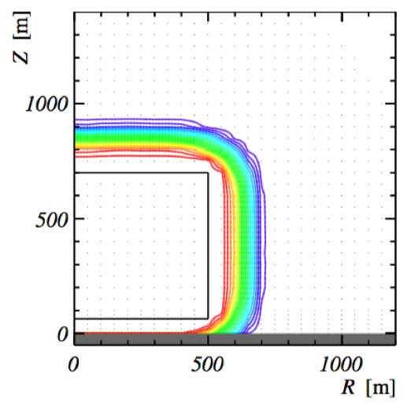
The KM3NeT Case
Detection efficiency P^{det}(x)
Per direction, position & energy
  Simulate N events (JSirene)
  Count #triggers k (JTE)
  P^{det}(x, d, E) ≈ k/N
6D interpolation table
E_{s}^{vis.} = 10⁵ GeV

Slide 28
The KM3NeT Case

Slide 29
The KM3NeT Case
Event likelihood P(ev_{i} | x)
JPP light PDFs
Hit & non-hit PMTs
Time of first hit on PMT
7D interpolation table

Slide 30
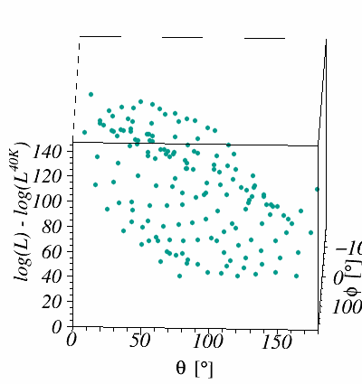
The KM3NeT Case
Event likelihood P(ev_{i} | x)
JPP light PDFs
Hit & non-hit PMTs
Time of first hit on PMT
7D interpolation table

Slide 31
Thoughts

Slide 32
Pro’s and Con’s
Con
CPU intensive
Disk space

Slide 33
Pro’s and Con’s
Pro
Best sensitivity (in theory)
  No information left unused
  Event-by-event resolution
  No parameterizations/approximations
No need for event selection
Flavor ID from first principles
Con
CPU intensive
Disk space

Slide 34
Pro’s and Con’s
Pro
Best sensitivity (in theory)
  No information left unused
  Event-by-event resolution
  No parameterizations/approximations
No need for event selection
Flavor ID from first principles
Con
CPU intensive
Disk space
Suggestion
Only use this method for small set of interesting events
  HE
  Close to known catalogue source(s)
  Multimessenger events

Slide 35
Spin-Off / Light Version
Concept of E_{S}^{vis}, E_{track} event classification
  Flavor ID without machine learning
P^{det}(x) and μ(x|H)
  Can also be used for conventional source searches / fast MC generator
Likelihood can also be used in conventional reconstruction
  No separate shower / track reco.
Tau events reconstruction

Slide 36
Tau Events
E_{Track}
Sugardaddy
Track
(Remote Vertex)
Track
(Contained Vertex)
Track + Bremsstrahlung Shower
⁴⁰K
Shower / Muon high b_{y}
E_{tau}
E_{S}^{vis}
Lollipop
Double bang

Slide 37
Backup

Slide 38
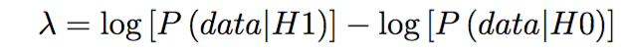
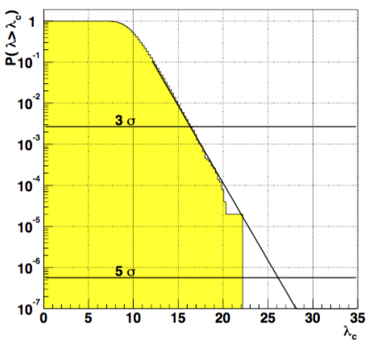
Recap

Slide 39
Hypothesis Testing
Realistic case + Detection efficiency
Detection efficiency P^{det}(x)
Interaction flux
Detectable flux
n
dP/dx
1
x

Slide 40
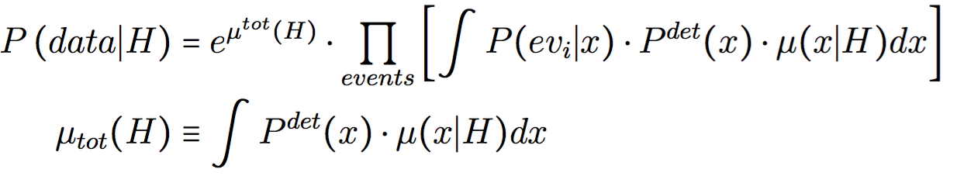
Hypothesis Testing
Realistic case + Detection efficiency
Detection efficiency P^{det}(x)
Interaction flux
Detectable flux
n
dP/dx
1
x

Slide 41
Recap
For each event & each hypothesis (H), solve:

Slide 42
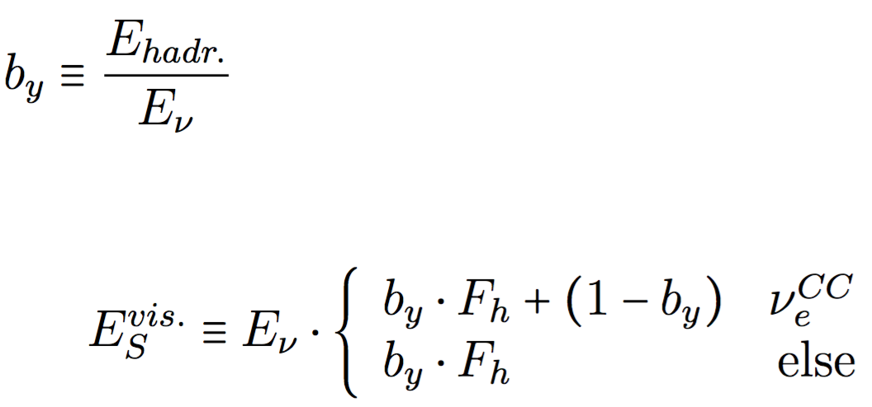
Visible Shower Energy
NC
eCC
Hadronic
EM
μCC

Slide 43
Visible Shower Energy
F_{h}

Slide 44
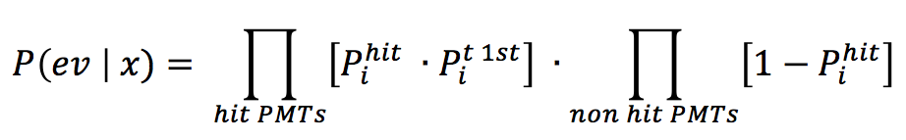
Event Likelihood
One probability function for all event signatures
Probability to observe first hit on PMT
Probability that nothing is detected on PMT

Slide 45
Practicalities
‘On-the-fly’
7D output table

Slide 46
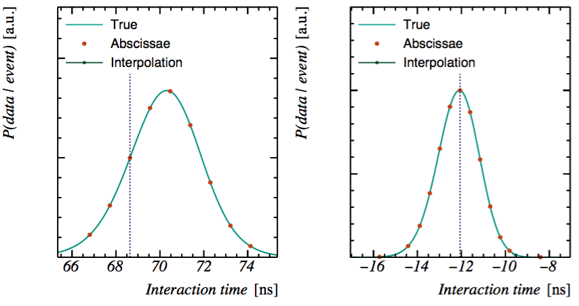
Integral over Time

Slide 47
Practicalities
‘On-the-fly’
7D output table
4D output table (dir., E_{s}^{vis,} E_{T})

Slide 48
Longitudinal Profiles
Colours: Different Perp. Positions
Dots: Evaluated abscissae
Lines: Gaussian fit

Slide 49
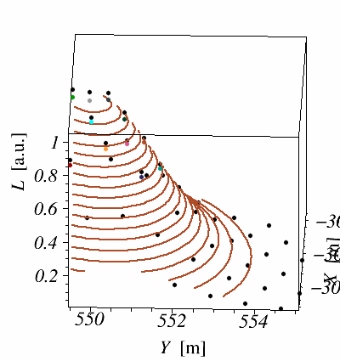
Perpendicular Profile

Slide 50
Practicalities
‘On-the-fly’
7D output table
4D output table (dir., E_{s}^{vis,} E_{T})

Slide 51
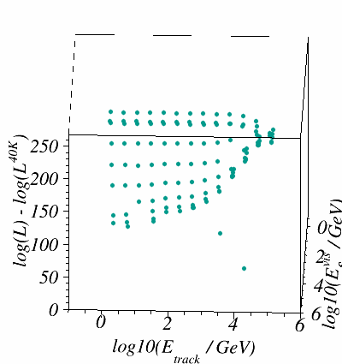
Energy ‘Landscape’
E_{T}
Track
(Remote Vertex)
Track
(Contained Vertex)
Track
(Contained Vertex)
Track + Brehmstrahlung Shower
Track + Brehmstrahlung Shower
⁴⁰K
Shower
Shower
E_{S}^{vis}
⁴⁰K

Slide 52
Direction Landscape

Slide 53
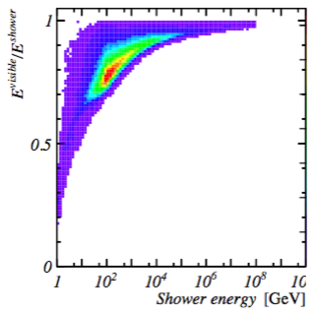
Practicalities
Catalogue of event likelihood landscapes
User defines his/hers flux to test:
Input Flux
Diff. Cross-Sec.
Earth Propa.
Shower Profile

Slide 54
Practicalities
Catalogue of event likelihood landscapes
User defines his/hers flux to test:
Input Flux
Diff. Cross-Sec.
Earth Propa.
Shower Profile

