Slide 1
Dusj and shower reconstructions of showers (7 lines)
Iris Reitsma

Slide 2
Goal for now
Understand behaviour of showers
Understand difference between dusj and shower
How well are events reconstructed?
Which events are (not) reconstructed?

Slide 3
Direction difference (reconstructed-simulated)
Dusj
Shower

Slide 4
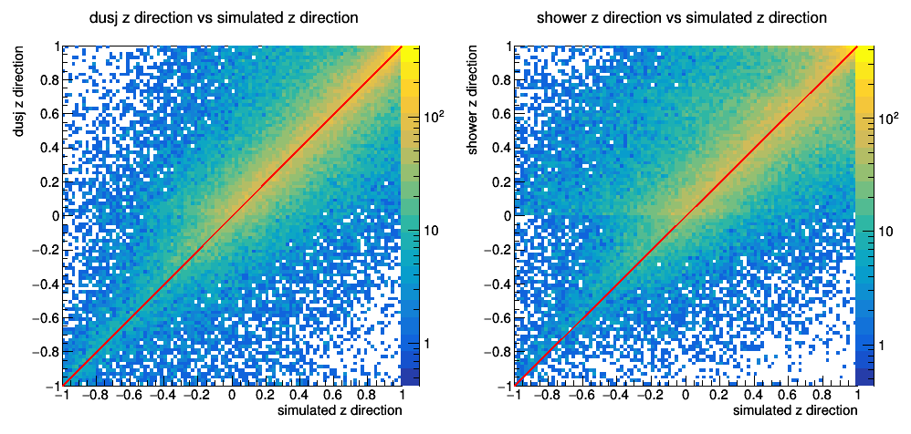
Reconstructed vs simulated z direction
Dusj
Shower

Slide 5
Reconstructed vs simulated energy
Dusj
Shower

Slide 6
Dusj energy cut
Energy cut
All events

Slide 7
Reconstructed vs simulated energy in detector
Dusj
Shower

Slide 8
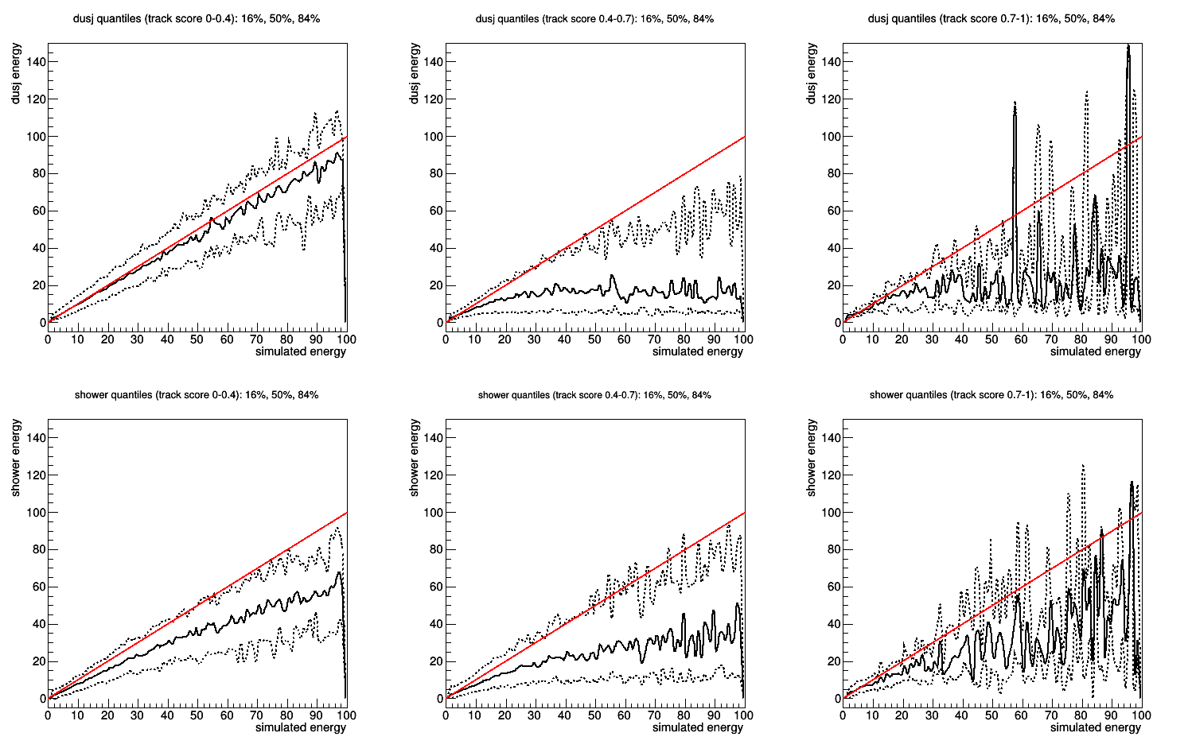
Track score separation
Dusj 0-0.4
Dusj 0.4-0.7
Dusj 0.7-1
Shower 0-0.4
Shower 0.4-0.7
Shower 0.7-1

Slide 9
Conclusions part 1
Shower underestimates energies more than dusj
For events of which the vertex is contained in the detector volume, dusj does a better reconstruction (shower not really)
Both reconstruction methods work better for more shower-like events

Slide 10
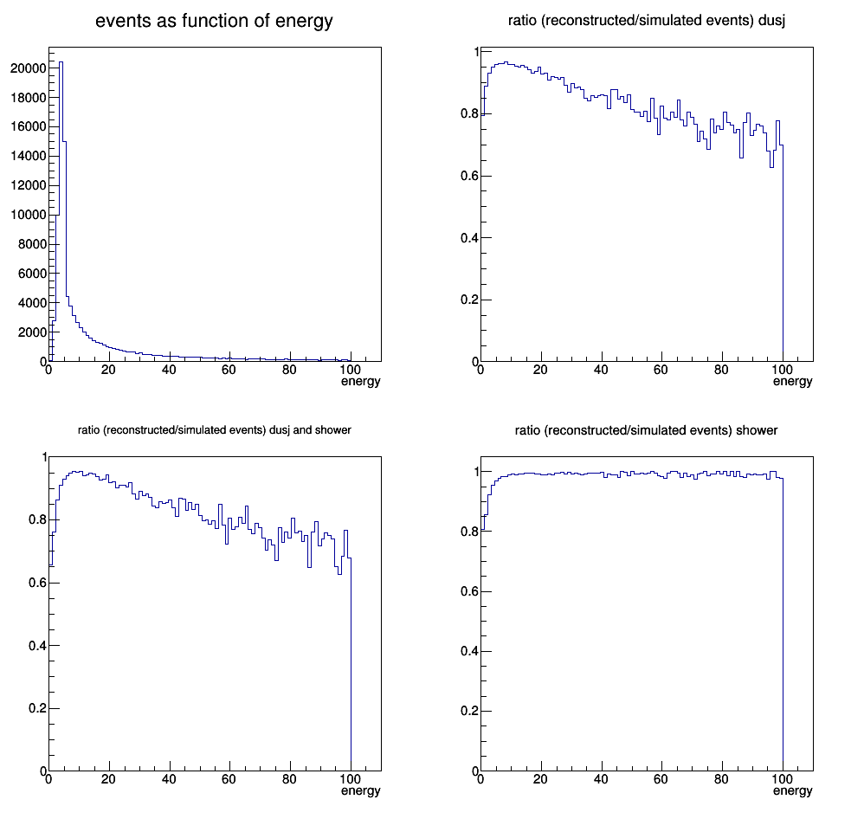
Reconstructed events ratio
Dusj
Dusj & shower
Shower

Slide 11
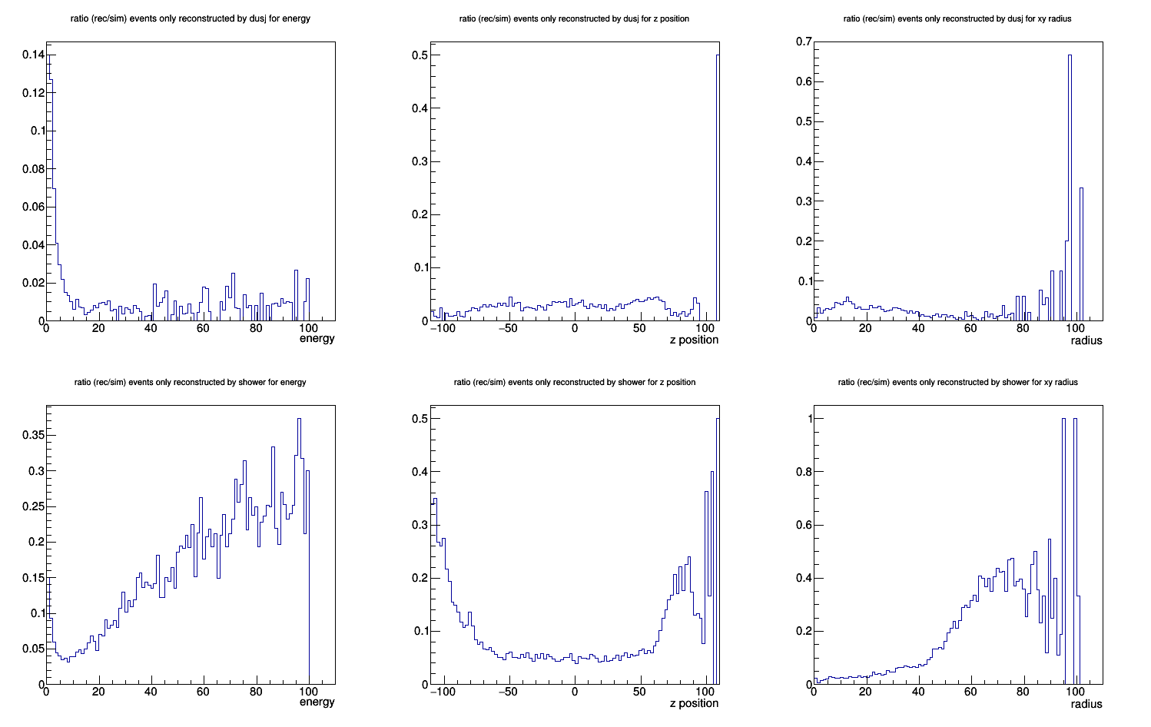
Only dusj: energy
Only dusj: z position
Only dusj: radius
Only shower: energy
Only shower: z position
Only shower: radius

Slide 12
Conclusions part 2
There are very few events only reconstructed by dusj
Shower reconstruct more events with high energies, z position and radius

