Slide 1

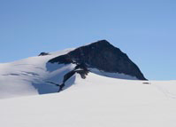
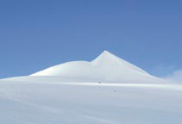
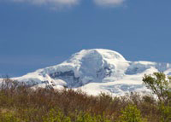
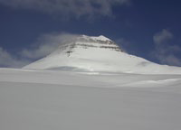
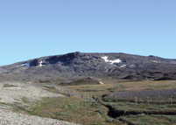
Gender in Science initiatives at NordForsk
GENERA Kick-off
Brussels 17 September 2015
Lotta Strandberg
Galdhøpiggen
2469
Kebnekaise
2102
Hvannadalshnjúkur
2110
Gunnbjørn Fjeld
3700
Halti
1328

Slide 2
      NordForsk
      Gender Equality in the Nordic countries
      NordForsk and Gender Equality
      NordForsk, Gender Equality and Physics - ideas

Slide 3
NordForsk
  NordForsk is a platform for joint Nordic research and research policy development in the Nordic countries.
  It was established by the Nordic Council of Ministers in 2005.
  The aim of the organisation is to facilitate cooperation in all fields of research when this adds value to work being conducted nationally.
  Basic funding is provided by the Nordic Council of Ministers and additional funding by stakeholders especially the Research Councils in the different countries (“The 2/3 principle”).
  The Board approved a new strategy for 2015 – 2018
Galdhøpiggen
2469
Kebnekaise
2102
Hvannadalshnjúkur
2110
Gunnbjørn Fjeld
3700
Halti
1328

Slide 4
New strategy - Strategic priorities for 2015-2018
Nordic cross-border research cooperation
Strengthening integrated cross-sectorial research with the aim to tackle societal challenges and ensure sustainable development
Nordic research infrastructure cooperation
Increasing cross-border access to and joint use of existing research infrastructures in the Nordic region and globally
Impact of Nordic research and research infrastructure cooperation
Increasing cross-border access to and joint use of existing research infrastructures in the Nordic region and globally

Slide 5
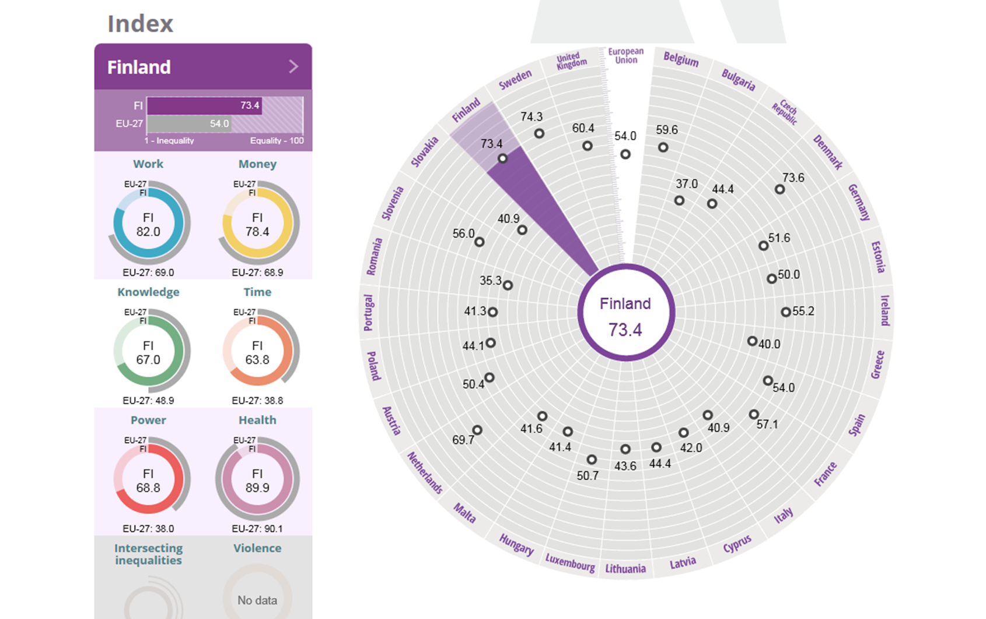
EIGE –Gender Equality Index
The three Nordic EU member countries are clearly the most gender equal countries in the EU.

Slide 6
Gender balance
However…
In 2013, The Norwegian presidency to the NCM together with
NordForsk and other stakeholders produced a report
The Nordic Region – a step closer to gender balance in research?
The report clearly demonstrated that the gender equality reached
in other areas did not extend to the research community.
The Nordic countries were not significanty different
from the European average. As in the rest of Europe, women fall out from the academic career
path after the PhD.
For the last 30 years half or more of the graduating students have been
women. Yet, this has not resulted in more women among the
academic staff at the universities. Currently, about 80 % of Grade A professors are men.

Slide 7
The leaky pipeline

Slide 8
Marja Makarow, NordForsk’s Chair
Director, Academy of Finland
In NordForsk magasin 2014
Focus on gender
The Nordic region is often associated with gender equality and equal opportunity. The new NordForsk Chair sees this issue both in a European and a Nordic perspective.
“I was surprised when I came back from Strasbourg. The trend was no better than when I left Finland in 2008, and it seems like the development has stopped. It is important now that we work on this.”

Slide 9
NordForsk’s Gender Policy
In 2013 NordForsk adopted a gender policy
The aim is to make visible how gender awareness improves the quality of Nordic research and research collaboration. Both gender balance among researchers and gender perspectives on research topics increase the quality of research and of policy decisions with implications for society as a whole.
The Policy assures that
all committees, groups or panels appointed by NordForsk should include at least 40% of each gender. They should also include gender expertise on the research topic.
NordForsk will analyse how men and women perform in NordForsk’s competitive funding (gendered success rate), what the gender balance is in the funding processes (both competitive and other-wise), and how the implementation of a gender perspective in the funded activities is achieved.
NordForsk shall have a visual expression that is gender balanced and reflects the diversity of society.

Slide 10
Gender in the Nordic Research and Innovation Area
On 5 March 2015 NordForsk Board approves a joint Nordic initiative to address the gender the research and innovation area in the Nordic region.
Gender Gap in the Nordic Research and Innovation Area
(working title)
Executive Director in the Research Council of Norway Jesper Werdelin Simonsen was appointed chair of the Programme Committee
- common pot with no fair return
- politically initiated

Slide 11
Gender in the Nordic Research and Innovation Area
The programme rests on three pillars:
Research
- Nordic research programme (envisioned research themes are the processes, sites and concepts which affect the gendere balance)
Nordic She figures
- Compilation of gendered statistics for the Nordic research and innovation area
Competence enhancement or training
- Results of the conducted research are disseminated. Joint Nordic enhancement of knowledge and awareness

Slide 12

Thank you for your attention!
www.nordforsk.org

