Slide 1
Dusj and shower reconstructions of showers (7 lines)
Iris Reitsma

Slide 2
Goal for now
Understand behaviour of showers
Understand difference between dusj and shower
Understand how they depend on the different variables

Slide 3
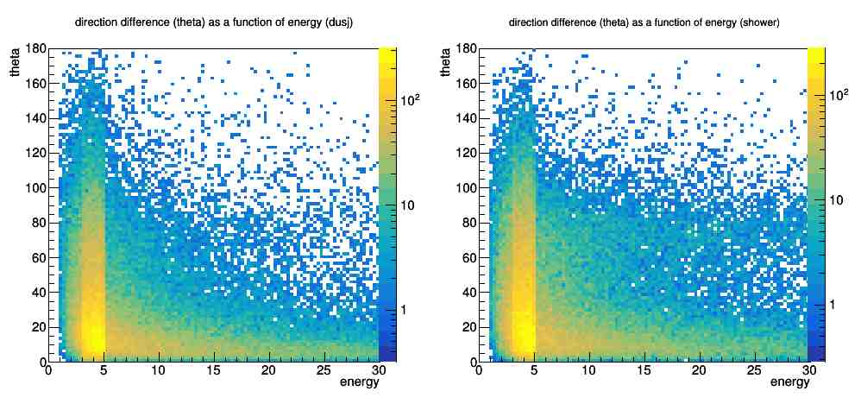
Direction difference (reconstructed-simulated)
Dusj
Shower

Slide 4
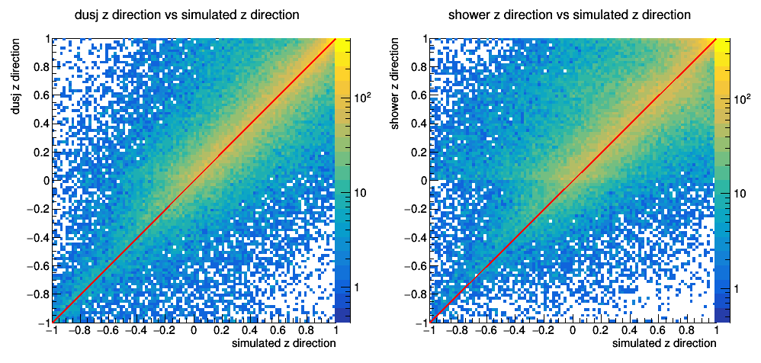
Reconstructed vs simulated z direction
Dusj
Shower

Slide 5
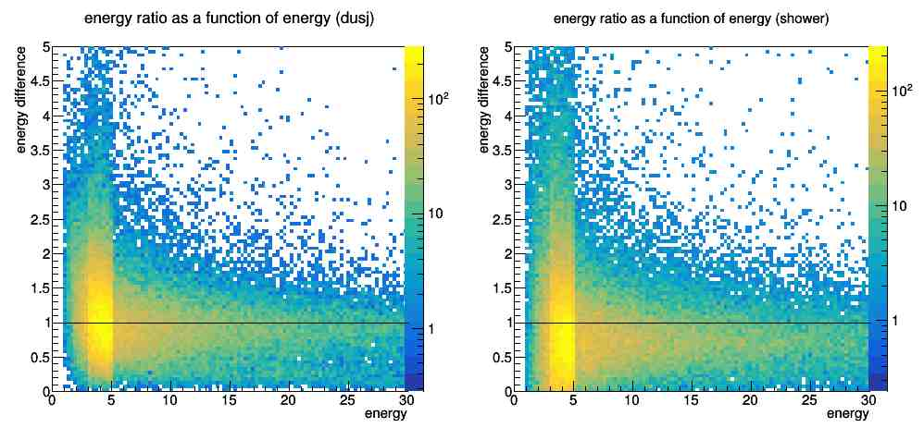
Energy ratio (reconstructed/simulated)
Dusj
Shower

Slide 6
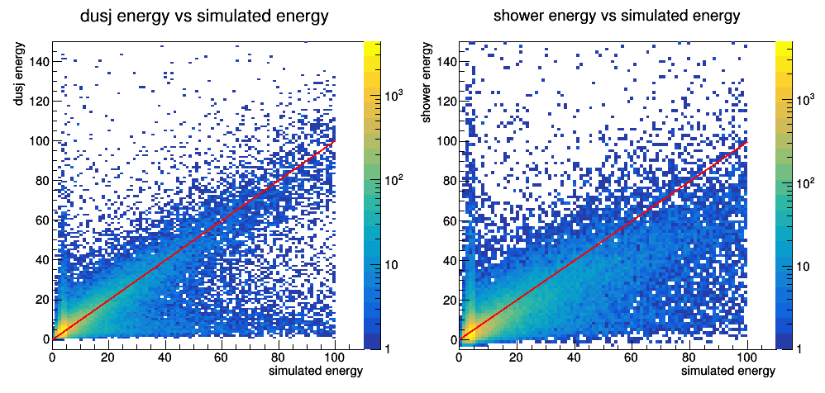
Reconstructed vs simulated energy
Dusj
Shower

Slide 7
Dusj energy cut
Energy cut
All events

Slide 8
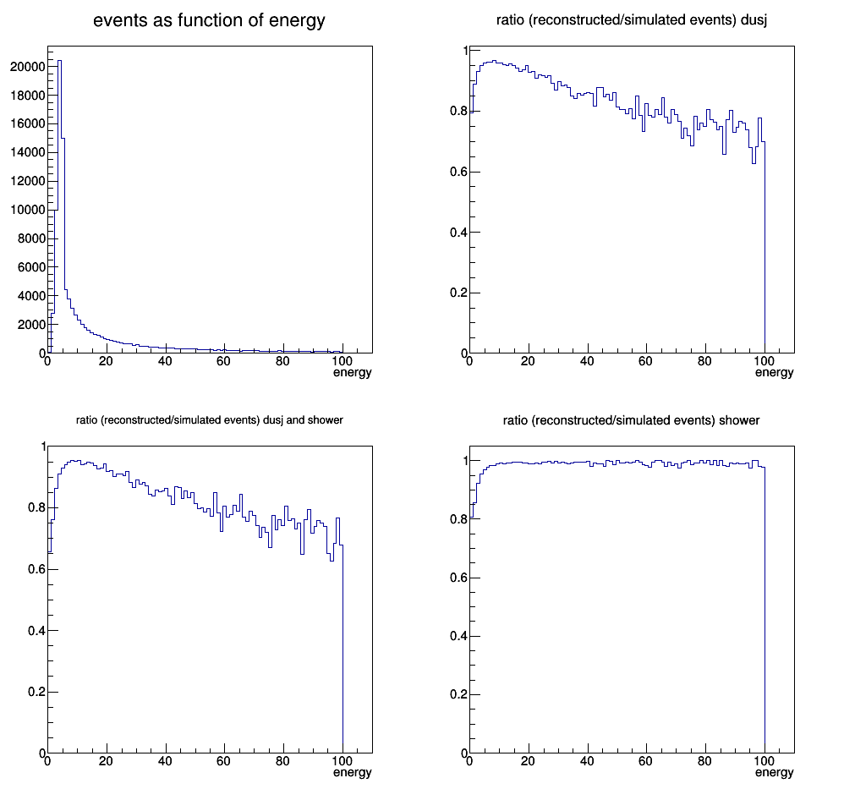
Reconstructed events ratio
Dusj
Dusj & shower
Shower

Slide 9
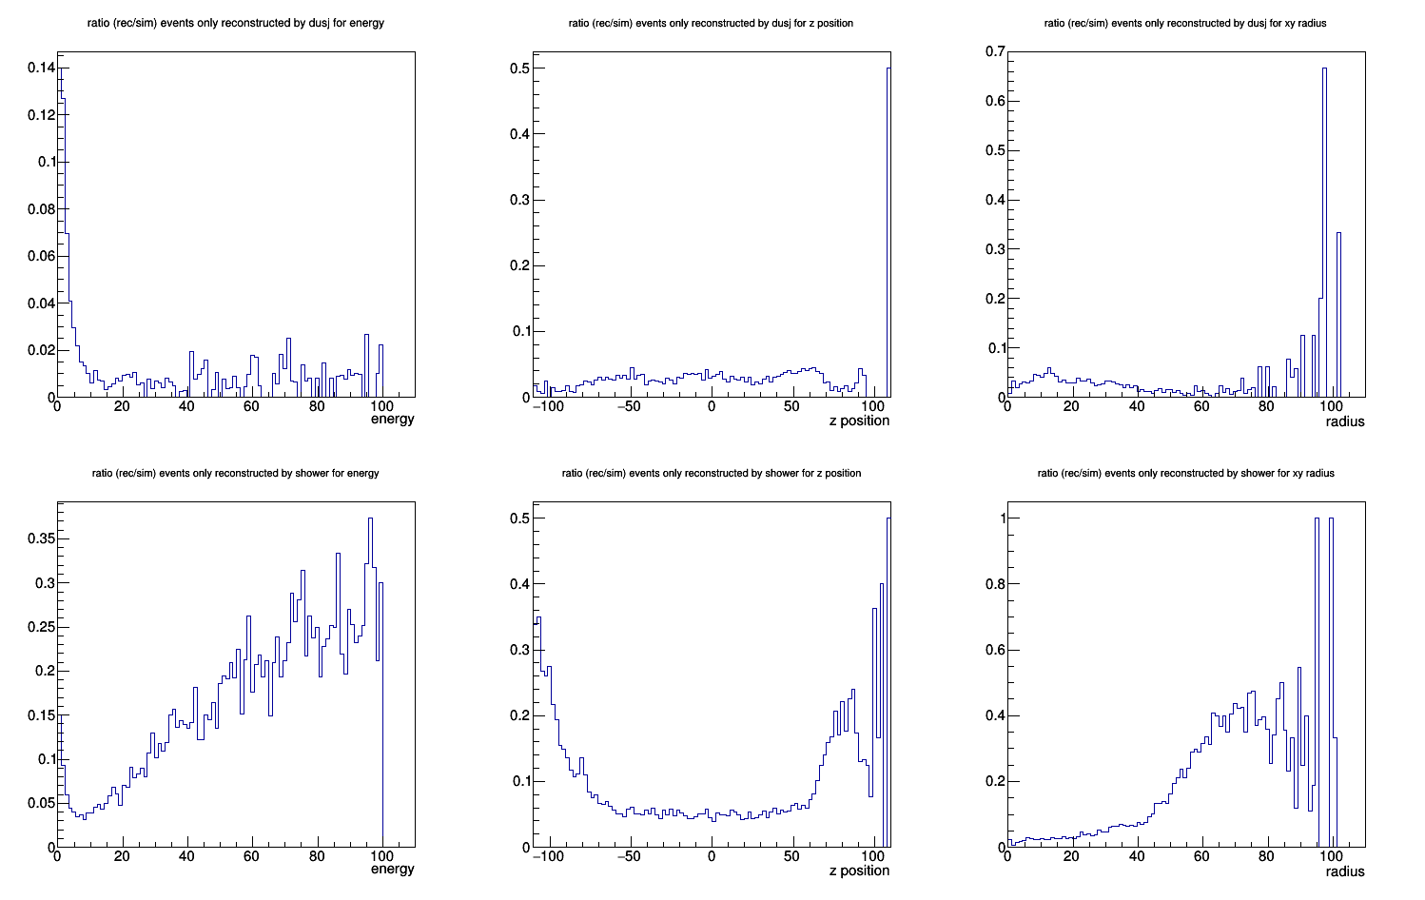
Only dusj: energy
Only dusj: z position
Only dusj: radius
Only shower: energy
Only shower: z position
Only shower: radius

Slide 10
Conclusions
Shower underestimates energies more than dusj
The deviant energy event cluster from dusj correspond mostly to ‘far’ events
There are very few events only reconstructed by dusj
Shower reconstruct more events with high energies, z position and radius
Next: quantitative analysis

