Slide 1
Shower Vertex Reconstruction

Slide 2
A Likelihood Landscape
10^4 GeV
nu_e CC event
(shower)
Colours: Different Perp. Positions
Dots: Evaluated abscissae
Lines: Gaussian fit

Slide 3
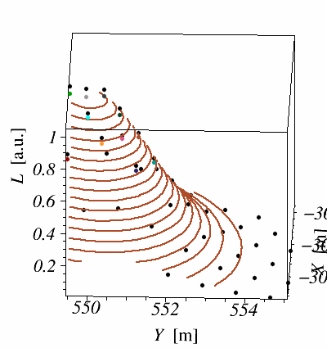
A Likelihood Landscape
10^4 GeV
nu_e CC event
(shower)

Slide 4
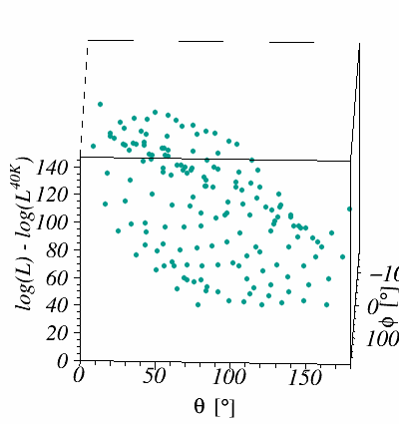
A Likelihood Landscape
10^4 GeV
nu_e CC event
(shower)

Slide 5
Motivation for Shower Vertex Reco.
Likelihood landscape is scanned around shower vertex
Currently: true interaction vertex used ☹
Shower vertex reconstruction needed

Slide 6
Motivation
Likelihood landscape is scanned around shower vertex
Currently: true interaction vertex used ☹
Shower vertex reconstruction needed
(Stretch) Goals:

Slide 7
Motivation
Likelihood landscape is scanned around shower vertex
Currently: true interaction vertex used ☹
Shower vertex reconstruction needed
(Stretch) Goals:
Reconstruct all (triggered) events
Few meters accuracy
  Likelihood landscape scan will do the rest

Slide 8
Shower Events

Slide 9
1st Triggered Hit on DOM
Direct light
Scattered light
⁴⁰K

Slide 10
1st Triggered Hit on DOM
dt/dD = n/C

Slide 11
1st Triggered Hit on DOM
dt/dD = n/C

Slide 12
#Hits Right on Time

Slide 13
1st Triggered Hit on DOM
dt/dD = n/C

Slide 14
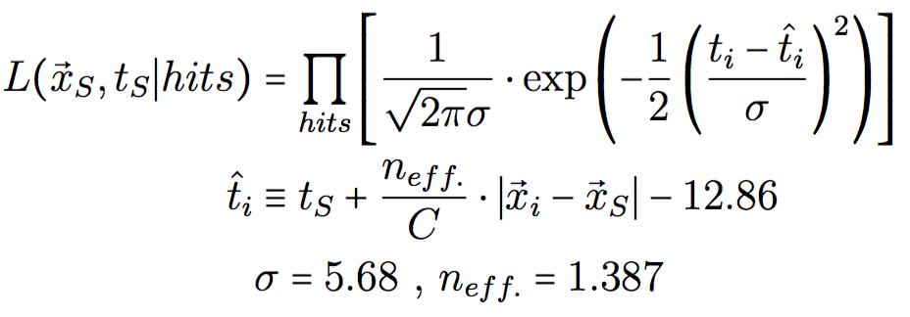
Shower Vertex Likelihood

Slide 15
Shower Vertex Likelihood
Non-linear -> no simple solution

Slide 16
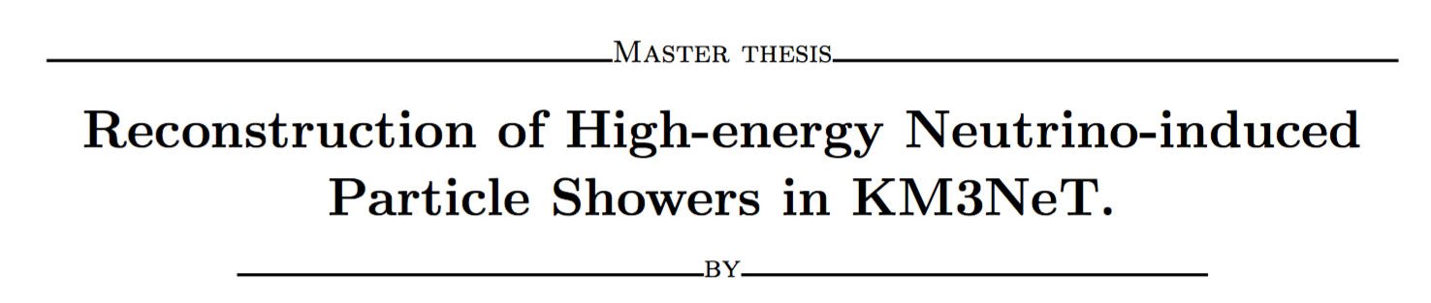
Algorithm
Chi² type fit (matrix inversion)
  Fast
  Sensitive to outliers (background hits)
Clustering algorithm à la JPrefit
  At least one background free set of hits
www.nikhef.nl/~kmelis/Masters_Thesis.pdf/Thesis.pdf

Slide 17

(Stretch) Goals:
Reconstruct all triggered events
  Only single-line events missed
Few meters accuracy
  Likelihood scan will do the rest

Slide 18
Reconstruction Resolution

Slide 19
Cut at chi2/NDF = 1e2?
-> Loss of events ☹

Slide 20
For quite some events
the global maximum is missed

Slide 23
Conclusions
New shower vertex reco seems quite promising
(Nearly) 100% of events reconstructed
  Few meters accuracy for most of them
Still some work needed
  badly reconstructed events
  Improve accuracy

Slide 24
Backup

Slide 25
Shower Events

