Slide 1

Authentication and Authorization for Research and Collaboration
David Groep, Nikhef
with materials gratefully provided by Licia Florio (GÉANT),
Paul van Dijk (SURFnet), and other AARC collaborators

Slide 2
Our status today?
Nat’l AuthN ✔
“Guest” access ✗/✔
Int’l AuthN ✗/✔
Attribute management for AuthZ ✗
Non-web SSO ✗
graphic: Paul van Dijk, SURFnet
Notes:
most pressing/or urgent topics that need to be addressed

Slide 3
AARC?
Authentication and Authorisation
for Research and Collaboration
support the collaboration model across institutional and sector borders
advance mechanisms that will improve the experience for users
guarantee their privacy and security
build on the very many existing and evolving components
ESFRI clusters, eduGAIN, national AAI fed’s, NGIs, IGTF, SCI, SirTFi, …
design, test and pilot any missing components
integrate them with existing working flows

Slide 4
AARC – Authentication and Authorisation for Research and Collaboration
Two-year project
19 funded plus 2 unfunded
  Coordinated by the Amsterdam Office
  NRENs, e-Infrastructure providers and Libraries as equal partners
About 3M euro budget
Starting date 1 May, 2015

Slide 5
AARC - Goals
OUTREACH and TRAINING
  To lower entry barriers for organisations to join national federations
  To improve penetration of federated access
TECHNICAL and POLICY Work
  To develop an integrated AAI built on production services (i.e. eduGAIN)
  To define an incident response framework to work in a federated context
  To agree on a LoA baseline for the R&E community
  To pilot new components and best practices guidelines in existing production services

Slide 6
AARC Strengths and Challenges
AARC Strength:
  Consortium with NRENs, Libraries, e-Researchers and campuses
  Good opportunity to work together as a team
  Consensus among different groups to work together
AARC Challenges:
  Address technical challenges to satisfy most of the communities
  Scale the training to EU dimension
  Deliver best practises in an ‘implementable’ way
  Scope the pilots to address use-cases and test results from other WPs in AARC

Slide 7
AARC – Work Packages
NA1
(GEANT Ass.)
Overall Management
NA3
(Nikhef)
To define scalable policies and operational models for the integrated AAI
NA2
(GEANT Ass.)
To train, disseminate and reach out
JRA1
(GRNET)
To research on technologies to deliver the design of the integrated AAI
SA1
(SURFnet)
To pilot key components of the integrated AAI
Liaison with other relevant user communities, e-Infrastructures and international relevant AAI activities

Slide 8





IdPs – extend coverage
National IdPs
  All SAML, national policies and formats
  Any issues? perhaps promote opt-out approach
VU
eduGAIN IdPs
  All SAML but differences in attribute management
  need policies and formats
TC
“External” access
  Lower barriers for non academia (“externals”)
  Use of Gov e-ID, social IDs, linking accounts
  Support scalable LoA for “externals” accounts
  Deal with “library walk-in users”
TC
graphic: Paul van Dijk, SURFnet
Notes:
Some outlines visible wrt guest access.

Slide 9
Training Activities
Training for IdPs
  Directly focusing on research use cases, engaging their local researchers and their requirements
  Encourage them to harmonize through best practices
  Expand coverage of national identity federations, supporting institutions with low levels of technical or organisational preparedness
Architectures for integrated/interoperable AAI
  technical elements needed for the integrated AAI: attribute frameworks and deployable web & non-web technologies
  Support for guest IdPs
  Risk-based models for AAI solutions
GÉANT,
Alessandra Scicchitano
GRNET,
Christos Kanellopoulos

Slide 10



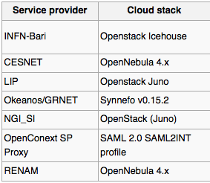
Building end-to-end prototypes example: PoC EGI, GRNET, CESNET, INFN, SURFnet...
University
Dirk Stap
dirkstap@uvk.nl
Staff member
ID#: 2989289283921
UVK
Authenticate
Add attributes
Collab Organisation
CO- admin
CO- researcher
University
Dirk Stap
dirkstap@uvk.nl
Staff member
ID#: 2989289283921
Self Asserted
+31(6) 120202020
Skype: DirkStap
LinkedIn: DirkHStap
add. attr. at logon
Attr provider
Aggregate attributes
Forward with ARP to SP
add. attr. by query
Verifies authenticity
Adds attributes
Provides workflows
Collab Organisation
CO- admin
CO- researcher
Self Asserted
+31(6) 120202020
Skype: DirkStap
LinkedIn: DirkHStap
graphic: Paul van Dijk, SURFnet

Slide 11
There are lots of components out there!
Non-Web Authentication
...but no solution ☹
CI-Logon &
Client PKI
Unity-IdM
FACIUS
SAML ECP
GSI over GSSAPI
X-realm KRB
Moonshot*
OpenID Connect
*lacks AuthZ system support
Delegation support - needed for broker scenarios & long-running workflows – mostly missing
PKI/GSI + RFC3820 does it
KRB TGT
SAML ECP could,
but with re-usable ‘golden’ token
OpenID Connect
promising, but not yet there …
Credential repositories + STS can
Attribute&Community management
VOMS &
VOMS-SAML
PERUN
REMS
HEXAA
Conext
LDAP queries
Co-manage

Slide 12
Technical pilots
Pilots on integrated R&E AAI
  Introduction of attribute management services
  Access to R&E + commercial services
  Guest services, also for SME/R&D collaborators
  Build PoCs together with the community
  Demonstrate ‘production-worthy’ pilots that
  have a sustainability model
  e.g. adoption by the GEANT services activity, run by the research community, or by the e-Infrastructures
  Facilitate researchers to collaborate in a secure and trusted virtual research environment
SURFnet,
Paul van Dijk

Slide 13
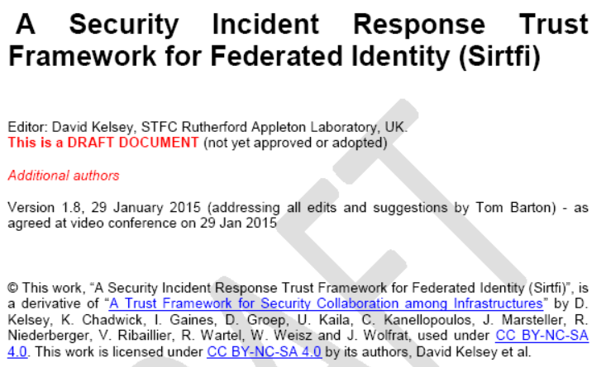
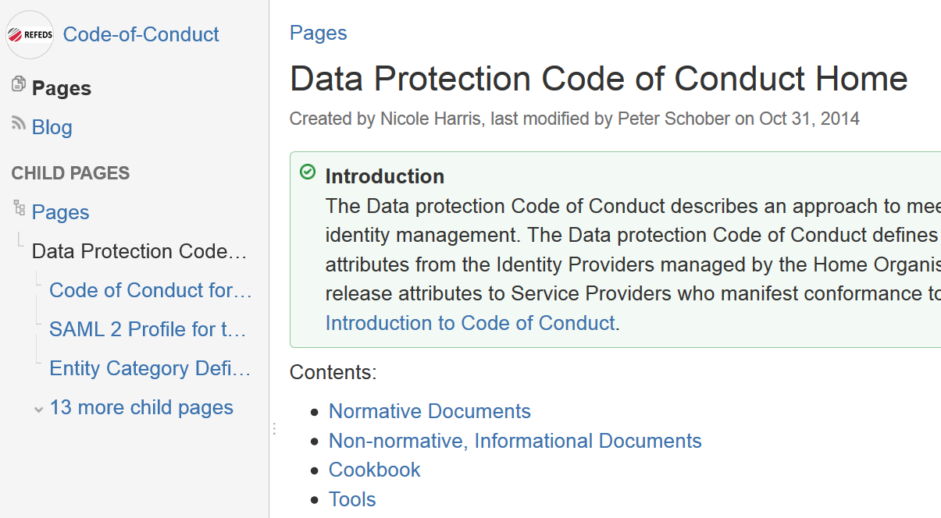
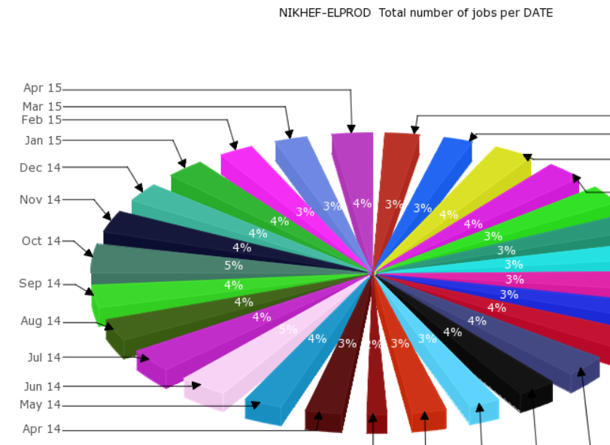
Policy challenges
‘What does assurance mean?
Who needs to say so?
Can we have ‘mixed quality’ attributes?
What’s a sustainable distribution of
responsibilities amongst AAI participants?
How can we share necessary accounting?

Slide 14
Policy and best practice harmonization
Policy and Best Practices harmonisation
  collate a level of assurance framework
    for SPs: where we already have DP CoC, R&S EC
    for IdPs: express reasonably achievable assurances
    for AAs and communities: a ‘new’ domain
  consistent handling of security incidents (in eduGAIN &c)
  scalable policy expression and negotiation
    identify policies needed for attribute aggregation
    policy & security to enable the integration of attribute providers and of credential translation services
  support models for (inter)federated access (i.e. how are we going to sustain something scalable once AARC is over?
  guidelines to enable exchange of accounting data
Nikhef,
DavidG

Slide 15
Liaisons with other groups

Slide 16
Approach
  Use existing e-infrastructures in the delivery chain
  Deliver a cross-discipline framework built on federated access
Liaison with existing e-Infras, communities and initiatives

Slide 17
AARC/REFEDS/GN4 – Working together
AARC
REFEDS
GN4
eduGAIN
Requirements
Pre-existing design work
Pilot the deployment (P2)
Incorporate (P2, P3)
Develop business case (P1)
Anchored in real use cases
Costing
Supply chain
Training
Federation Operators expertise
Pilot
AARC technical and policy findings
Validate AARC finding

Slide 18
Where are we now
Started on May 1st
Open kick-off meeting
June 3+4, Amsterdam, NL
  Theme sessions around cross-activity topics, e.g.
  ‘how to enable access for guests and non-academic users’, crossing topics such as technical IdPs of last resort, access policies, LoA for guests, engagement with industrial R&D, support for library walk-in users in a digital content world’
  ‘enabling expression of SCIRT collaboration by IdPs through federation through to resource providers’

Slide 19

















AARC

