Slide 1
Evolving models of global trust fabrics and of federation operations
with a slight bias towards global research communities
for the NeIC AAI Workshop, May 5th, 2015
David Groep, Nikhef

Slide 2
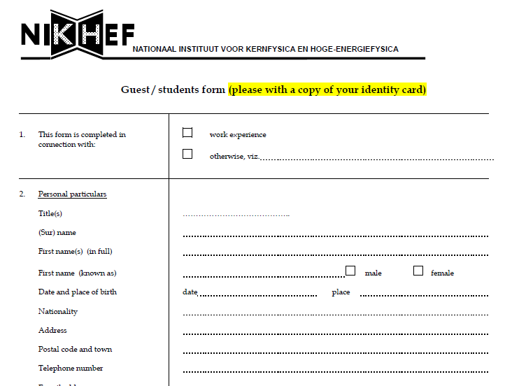
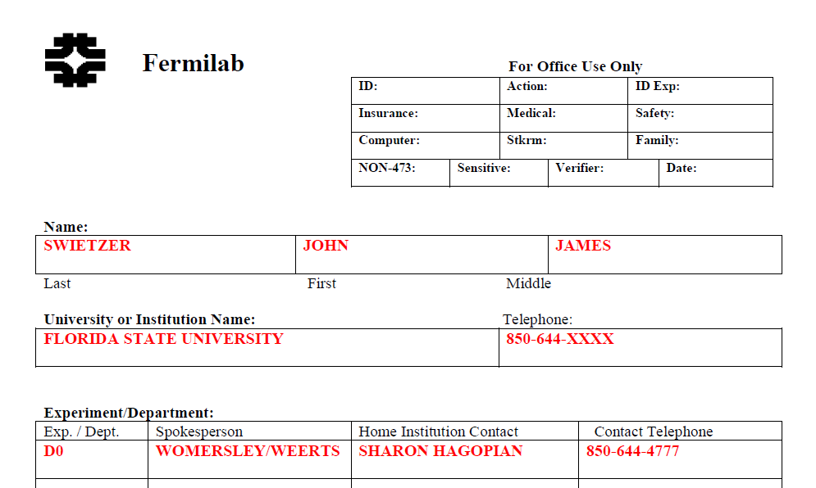
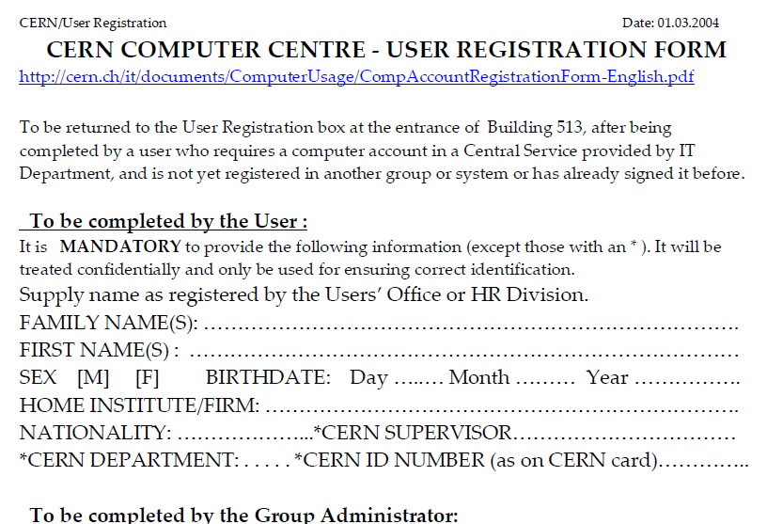
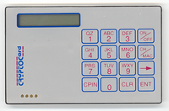
Anyone remember these days?

Slide 3
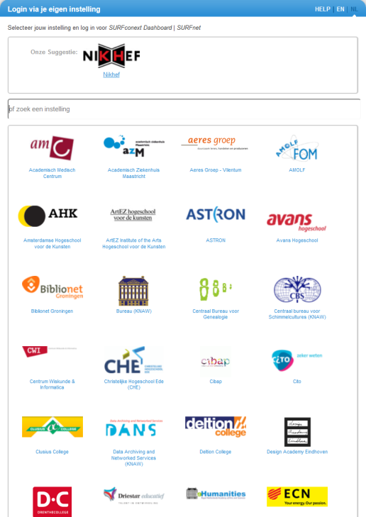
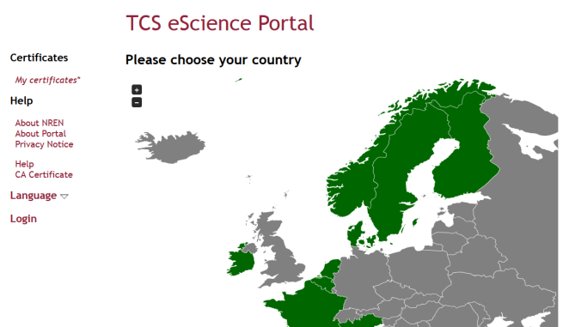
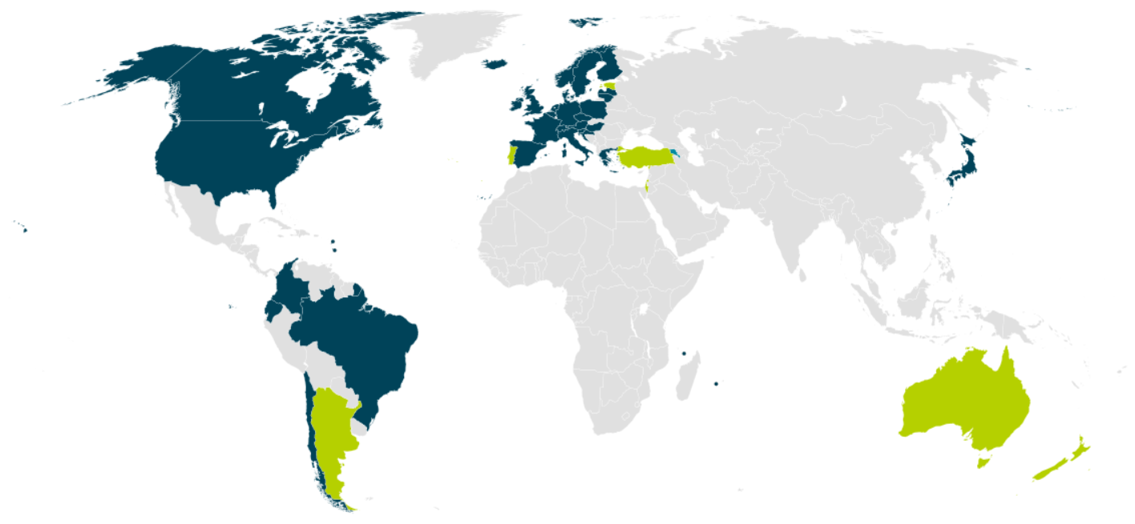


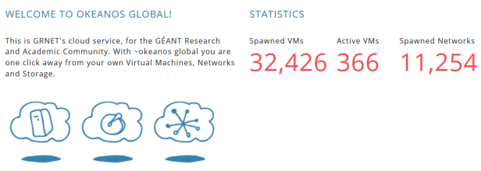

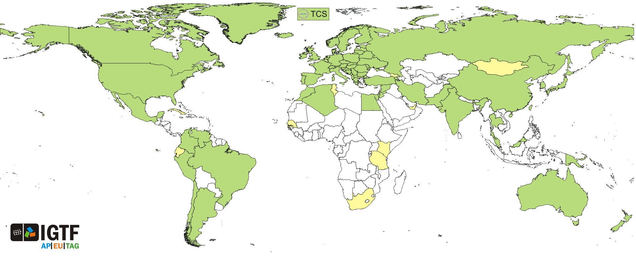
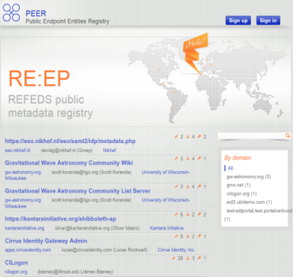
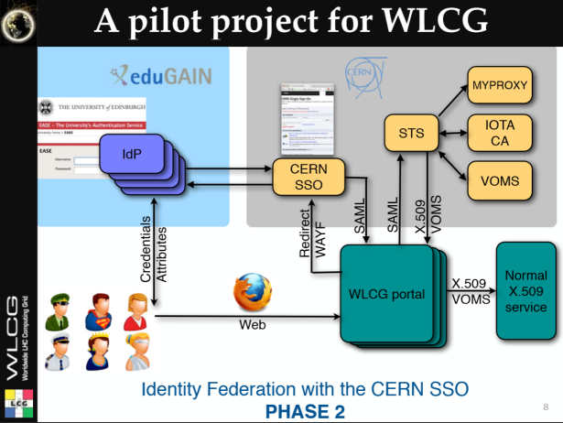

And now we have this!
wLCG FIM4R pilot
background: eduGAIN connected federations as of November 2014 – Brooke Schofield, TERENA

Slide 4
Something happened in the last 15 years!
research: a global collaborative endeavour
a connected world: distributing responsibility
common fabric, common policies - shared assurances, shared attributes
… and some technical glue

Slide 5
Research use cases: trust across domains
traditional service provider relationship
cross-domain and federated relationships
both resources and the users
are now working together

Slide 6
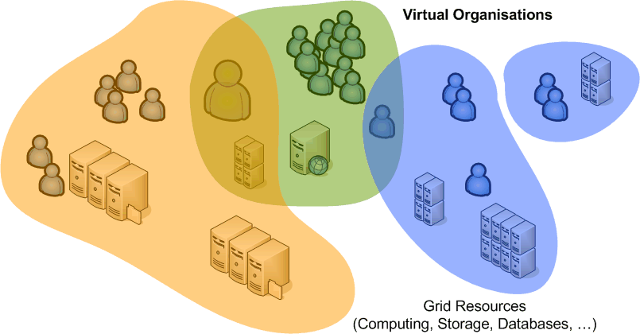
Overlapping Communities - Common Trust
Reduce policy burden
for providers and users
by adhering to common criteria
Goals
multiple sources of authority: User, Institute, Community
acknowledge long-term and ad-hoc community structures
enable security incident response and containment
balance data protection and right to privacy

Slide 7
Driving the trust framework
Multiple stakeholders
end-users (researchers, students, …)
collaborations and (research) consortia
resources owners and service providers
organisations (‘home’) hosting the users
keeping in mind that often research collaboration outlives any single employment, so the ‘home IdP’ the most transient entity of them all …
Ultimately, assurance in the trust framework ‘ought to’
be driven by the parties absorbing the risk
in most e-Infrastructures today (wLCG, EGI, …)
the risks ends up at the resource provider

Slide 8


On Risk
‘acceptable risk envelope’
Subject (ID/LoA) based
Defined identity assurance level
Includes Community-given LoA
For given actions, resources, and acceptable residual risk,
required ID assurance is a given
Action (app) based
More constraint actions can
lower need for identity LoA
(J)SPG VO Portal policy
does that: 4 levels of actions
Resource (value) based
e.g. access to wireless network does not pose huge risks,
so can live with a lower identity LoA (eduroam)
Residual Risk:

Slide 9
Differentiating actions by risk
JSPG (now: EGI) VO portal policy
https://documents.egi.eu/document/80
off-set lower (identity) assurance by limiting actions
differentiates levels of ‘impact’ on the infrastructure
Aims to retain critical traceability elements across all service and sites – incidents must not be allowed to flow from low impact > high impact services
Mixing risk levels in the same system (e.g. in a single batch compute cluster, shared storage): not a good idea!
an initiative of

Slide 10
Trust is global – research certainly is …
Interoperable Global Trust Federation IGTF
Achievable assurance levels, co-defined by providers and relying parties
based on peer-reviewed distributed trust providers
provides long-term persistent, globally-unique IDs
enables traceability and mitigation of last resort
… could get by with a single level for a long time …

Slide 11
Distributing responsibilities
Technical elements
integrity of the roots of trust
integrity of issuance process
process incident response
revocation capabilities
key management
credential management
incident response
‘Identity’ elements
identifier management
re-binding and revocation
binding to entities
traceability of entities
emergency communications
regular communications
‘rich’ attribute assertions
correlating identifiers
access control
IGTF Classic, MICS, SLCS
elements
RP, Community
Verifiability & Response, mitigation, recovery

Slide 12
Generalised IGTF LoA
IGTF ‘levels’ useful assurance levels for distributed
e-infrastructures as trust is technology agnostic
http://wiki.eugridpma.org/Main/IGTFLoAGeneralisation
Extract and emphasise generic global trust elements
  2 identifiable levels:reflecting distribution of assurance between ‘IdP’ and additional trusted providers
  (like strong, long-lived communities like the LHC collaborations)
  Reflects trustlevel Classic, MICS, SLCS vs. IOTA (‘DOGWOOD’)
  Many R&E federation IdPs are actually ‘good enough’
    - for an identifiable subset of their users, or even for all
    - but forget or are afraid to express their (usually quite good) practices

Slide 13
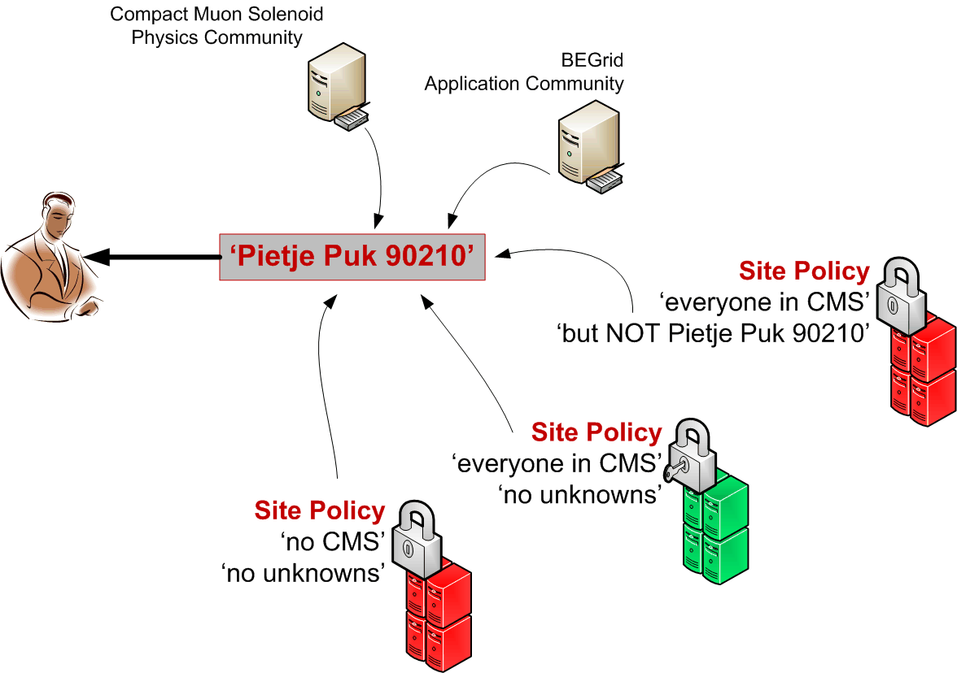
Providing collective services together
Having distributed the responsibilities,
participants have to collaborate to jointly provide
  end-to-end tracabilty and assurance
  collectively provide assurance and trust for manageable residual risk
  the assurances must be acceptable to the party absorbing the residual risk … and that party is usually the RP/resource provider/SP
And work together to ‘anchor’ the relevant attributes
  Linkage across domains is essential for collaborative model to work
  Who (one or many) will provide long-term non-reassigned ID, across multiple SPs?
  SPs will (should) also have a ‘local ID’, but that is not enough
‘Subject Distinguished Name’
‘(eduPerson)PrincipalName’
... at least something common

Slide 14
Sharing attributes and identifiers
For collaborative cases to work, attributes and (some personal) data must be shared
  Access control based on community roles/groups, identity, organisational roles, etc.
  For accounting, metering, and usage settlement –
  this is not ‘optional’, and not a ‘free choice’ of the user …
Who decides who gets or may use the attributes?
  ‘R&E Federation’ space: the IdP has subsumed this role
  most current e-Infra’s: managed by the end-user
  and who remembers MS InfoCard/CardSpace?

Slide 15
An unexpected advantage of ‘User PKI’
“We’ve by now found all researchers in the world that
will ever understand PKI – there are about 100 000 of them”
we cannot use end-user PKI beyond these ‘few’ users
but IGTF end-user PKI has one unique advantage:
it places the power in the hands of the end-user
  Each credential has an intrinsic unique ID (the subjectDN)
  end-user decides when and with whom to work & release attributes
  can do that without being dependent in policy, or technically, on an IdP that at times may feel ‘possessive’ of its users:
  ‘we decide what is good for you’
  ‘your use case is really, truly, very important to us, but just hang
  in there. We’ll get to you … in a few years or so’ yeah…

Slide 16
Who is the ‘owner’ of the user’s attributes?
Should IdP & federations not be there to empower the user?
Compare to STORK (the system for government inter-eID)
  end-user designated as the responsible party
  leverages user consent (and to them DLA Piper said that was fine!)
Release more freely by differentiating ‘consent’ vs. ‘necessary’
(the model Nikhef now uses)
    Internal services – release without asking
    Necessary services – minimal release, and not based on ‘consent’
    Optional external services – based on consent + information about status of service (ToU’s, DPCoC, trust marks, or even none at all)
Some IdPs are just cooperative, and/or honour R&S/DPCoC
But many (DE,UK) are just afraid and don’t give anything ☹

Slide 17

Assurance in R&E federations
Most of the work till now has been to get good-quality SPs
and give IdPs sufficient trust in the service providers
  Data Protection Code of Conduct – see talk by Mikael later
  SPs having a developed Privacy Policy
  And justification for the attribute(s) requested
  https://wiki.edugain.org/Recipe_for_a_Service_Provider
For SPs ‘reciprocal’ mechanisms will also be needed,
and guidance to IdPs on what constitutes ‘useful’ interaction
  release at least some identifiers that are ‘useful’ and ‘true’
  given that many IdPs are run as a business case,
  this will need a sustainable logic behind it (“show the benefits”)
  what IdPs can’t provide must come from elsewhere: the community

Slide 18
Collaboration to reduce our joint residual risk
So can SPs trust what is sent by the IdP, and: can we expect IdP and community attribute providers to ‘do the right thing’?
some SP typical concerns
  Incident response, traceability, emergency suspension
  collaboration, sharing, follow-up: current-ness of all registered info
    but traceability and incident response are not ‘primary goals’ of community attribute providers – and they may even have wrong short-term ‘incentives’!
and even federations are not all ‘operational’ entities … yet
  meta-data in e.g. eduGAIN may be stale, missing, out-of-spec,
  or simply not defined – depends on country again ☹
  there is no good place to get ‘all IdPs’ for transnational services
  not always well-connected to national or NREN CSIRTs
Unfortunately, solving this in one or a few countries doesn’t help
For collaboration, things need to work everywhere and consistently
Notes:
Research communities have the wrong incentive because their aim to to get papers out now, and work together, and they will not bear the burden of incident response since the risk rests with the resource owners and RPs, not with the individual researchers that will grant access to write their software frameworks.

Slide 19
IdP quality – no-one is the same, and many are better than advertised!
Public statements by some federations had long been:
‘take our IdPs as is: we cannot change any of their practices.
They ought to be good enough for you, so stop bothering us’
but others have really good IdPs (e.g. ‘Kantara LoA 2’ for all students)
Depends also on how federation was ‘sold’ to the institutions
  as ‘cost savings’: end up with IdPs that … want to save cost
  as ‘enabling technology’: get IdPs that … want to enable things (obviously at reasonable cost!)
But collaborations are global: national differences kill use cases!
fortunately campus practices often better than federation dared to express ;-)
and also the latter is now changing … for the good!
and campus SCIRT people are more pro-active than registrars, HR, or ‘traditional’ library contacts that usually took care of the IdP

Slide 20
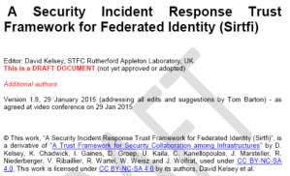
SirTFi – incident response coordination
‘enable a coordinated response to a security incident in a federated context that does not depend on a centralised authority or governance structure to assign roles and responsibilities for doing so’. … example (self-asserted )items:
provide security incident response contact information
able and willing to collaborate in the management of a security incident with affected organisations that participate in the Sirtfi trust framework
Mechanisms are deployed to detect possible intrusions
Users and Service Owners within the organisation can be contacted
security incident response capability exists within the organisation with sufficient authority,
But realise: SAML meta-data does not even have a field for a security contact!
https://wiki.refeds.org/display/GROUPS/SIRTFI

Slide 21





Trust in the SP, IdP, and in the ‘broker’
Moving towards a world of ‘trust marks’?
Well known in meatspace
Convey both ‘trust’, ‘qualities’ & some review process
Emerging in federations for SPs as ‘entity categories’
GEANT Data Protection Code of Conduct
Research & Scholarship Entity Category, …
And we should have one for IdPs as well
‘SirTFi compatible’?
(as an EntCat, or convey SirTFi-ready even per user using ePAssurance or a SAMLAuthenticatonContextClassRef)
and for attribute providers use e.g. IGTF AA Operations Guidelines
plus a defined membership enrolment and de-provisioning process?

Slide 22
Federation statements in meta-data
Why is there no ‘security contact’ for (confidental) information requests defined in SAML metadata?
Does the registering federation check correctness of data periodically? Are there ‘challenges’ done?
Nice of a single federation does it, but it must hold
either for all entities and federations
or IdPs/federation should be trust-marked (and that trust mark must be protected and exclusive) so that the SP/relying party can filter on these

Slide 23
Adding technical glue
Collecting attributes
Augmenting IdPs
Adding assurances and traceability
Beyond the Web

Slide 24
Collecting attributes
Every resource (SP) ‘should’ be prepared to handle multiple credentials for their users
  Or you’ll have created the inverse of vendor lock-in: customer lock-in to the one source of your (SP’s) identifier providers / AA server
But some aggregation and some standards would
be welcome:
  HEXAA, REMS, PERUN, VOMS, Co-manage, OpenConext Teams, … and plain old LDAP, …

Slide 25
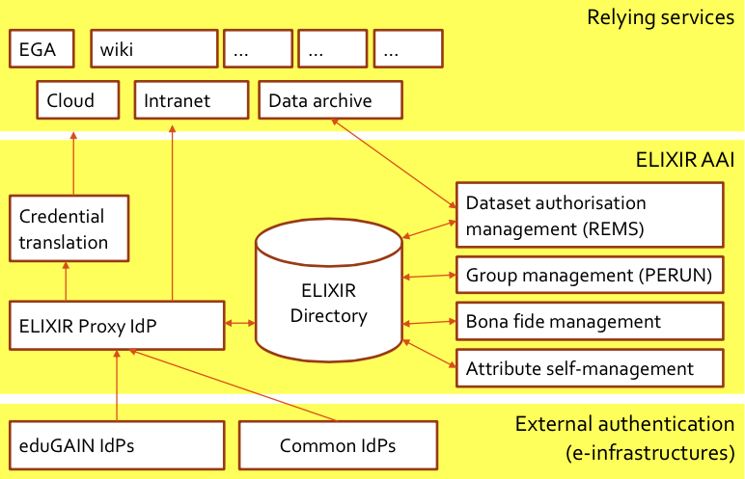
Working ‘around’ the limitations: proxying!
Elixir Setup (draft)
Graphic sourced from Paul van Dijk, SURFnet

Slide 26
Beyond the Web
Most currently deployed services are web-only, but:
many research and e-Infra cases are non-web
(collective) services need to perform certain tasks on behalf of the user (delegation)
credential token must be renewal (for long-running jobs) without the user being present
  since revocation in a distributed system is too complex
  For instance: in the grid today the only effective control on run-away jobs is by the identity-credential source (CA) revoking the entire identity ☹

Slide 27
Many technologies for plain non-web AuthN … maybe just too many …
‘CILogin’ – MyProxy + OpenID + SAML
  A credential management suite using short-lived tokens and PKI
Direct PKI service, e.g. via TCS* bridging to all R&E IdPs
  Both web and non-web, delegation & long-running workflow support
  works really great, also for delegation, if only the users would understand it - and be able to securely manage a key pair
SAML ECP – seems to just never get there …
STS – SAML<>PKI on demand any time
OpenID Connect, FACIUS, Unity-IdM, X-realm KRB, GSI
Moonshot?
  AuthN only (!), but can (only) do non-web
  requires a parallel non-trivial infrastructure
*or TCS equivalents, like the InCommon Silver CA, AusCERT, DFN SLCS, …

Slide 28

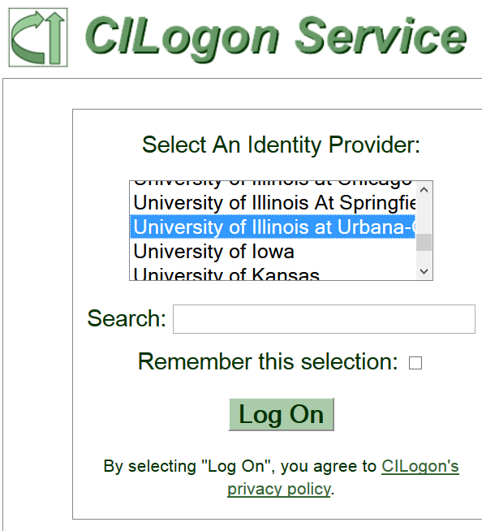
Proxying, credential stores, and user management
CILogon/MyProxy could act as a ‘credential hub’,
as well as the many ‘community proxy’ solutions
SAML, OpenID Connect, &PKI in and out
  TCS backing a credential store?!
  Yes, it’s allowed …
  TCS G3 “Grid Client” governed by
  IGTF Private Key Protection
  supporting credential stores
A trusted ‘credential manager’ for user e-Infra credentials?
  That takes care of automatic refresh for long-running workflows? And of revocation? And RFC3820 delegation?

Slide 29

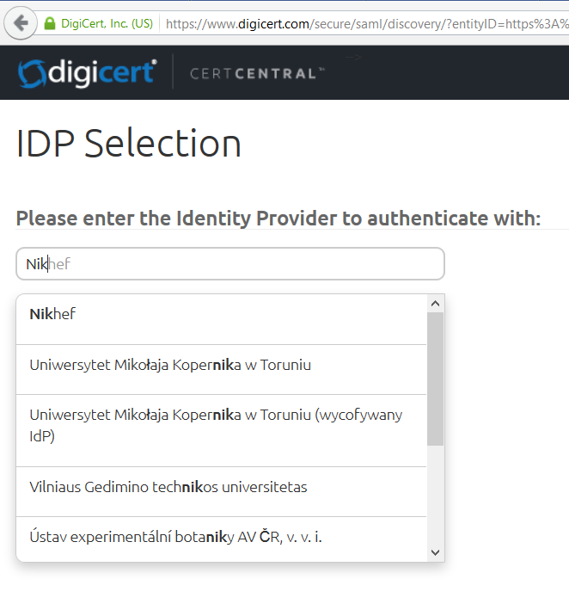
3rd gen TCS Trusted Certificate Service
Thus full-blown TCS can be used
in the back of a credential store and
thus gain instant global recognition
Initially available ‘as usual’
via a user-initiated request
Increased availability – since
‘e-science’ and ‘regular personal’ are now the same entitlement
Has a API, accessible to subscribers, to that credential stores can more easily talk to it

Slide 30
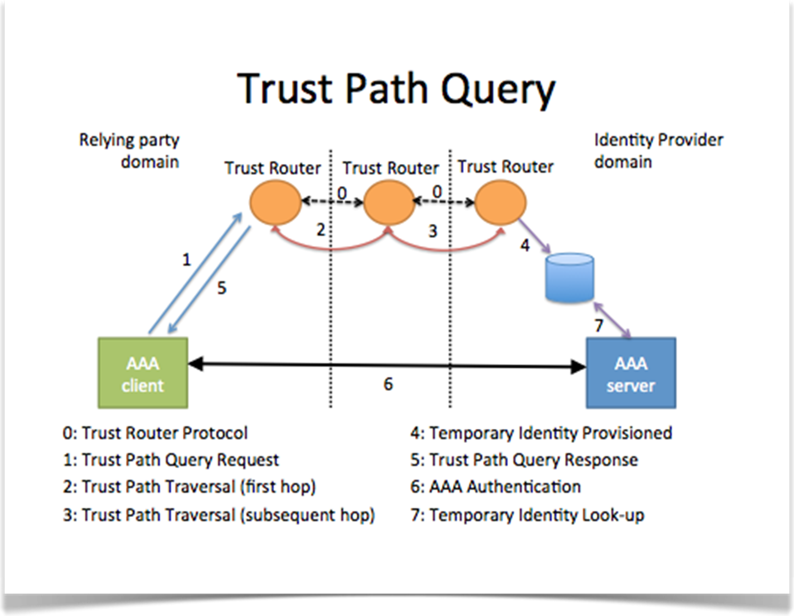
Moonshot
‘inspired by RADIUS and eduroam’
authN over an inner tunnel, and the resulting attributes travel on the ‘outside’ back to the client
TR is a relying party like any other: it mediates trust (and does that through a quasi-DH key exchange
The trust router instead acts as an introduction service - once a trusted path is found, it provides the end client and server with a temporary credential.
This temporary credential is used to create a RadSec connection directly between the client and server.
liberally took some graphics from Janet at the last moment … see wiki.moonshot.ja.net!

Slide 31

Moonshot infrastructure relations
Yeah, he’s over there!
P.S. I’ve done some DH magic.
Hmm, I don’t. TR2 is my default peer, I’ll ask it…
Hmm, I don’t. TR3 is my default peer, I’ll ask it…
He’s over there. P.S. DH magic.
Hey TR3, do you know bob.com?
He’s over there. P.S. DH magic.
Hey TR1, do you know bob.com?
Hey TR2, do you know bob.com?
He’s over there. P.S. DH magic.
Eventually will have routing tables across the whole network
For now, default peers can be configured.
liberally took some slides from Janet at the last moment … see wiki.moonshot.ja.net!
Notes:
Now, the RP wants to find an IdP connected to a different TR than itself. How does that work?
Someone tries to log into RP, RP sees realm of user
RP doesn’t know IdP for that realm, asks its TR
Tr1 doesn’t know IdP for that realm, tells IdP to ask its peer TR2
TR2 doesn’t know IdP for that realm, tells IdP to ask its peer TR3
TR3 knows, so passes back info about IdP – IP addr, and enables DH magic so IdP and RP can generate secure keying material
RP connects to IdP directly.
Note, all of this is simplified – doesn’t discuss APCs or communities.

Slide 32
Moonshot application communities: a mesh of trust routers and policy groups
Community A
Community B
Community C
Policy coming from community
requirements. Could include:
Registration LoA
AuthN LoA
Operational Practices
User behaviour
Attribute release (RADIUS
& SAML)
Etc.
Authentication Policy Community /
(Community of Registration)
Organisation validation
to APC’s defined standards
graphic taken from slides from Janet … see wiki.moonshot.ja.net!

Slide 33
Moonshot applications
Basically, anything that does GSSAPI/SASL – provided it has been generically coded and is not ‘krb-ish’:
including again Firefox GSS to Apache httpd ☺
ssh (but beware of lack of authZ & provisioning support)
also NFSv4 shows to work (again with some tweaks, since the Linux kernel things the GSS world is only Krb ☹)
MyProxy, for proxies and in PKI CA mode
and more demos, like iRODS, CIFS, OpenLDAP, OpenLDAP-to-ActiveDirectory/SSPI, IIS+SSPI, Jabberd, console login

Slide 34
WebFTS3 –wLCG FIM4R pilot and STS
X509 delegation is needed to let WebFTS access the grid on users behalf
Users make private key available to browser
Not available via browser API
We are trying to replace user certificate delegation with transparent access via Identity Federation (pilot project for WLCG)
The same technology may be used for other types of services, e.g. job submission.
Slides content from Romain Wartel, CERN and wLCG security officer

Slide 35
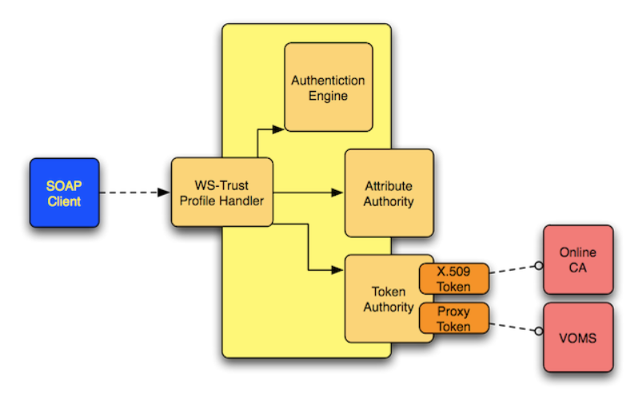
Security Token Service ‘EMI STS’
WS-Trust compliant translation from any-to-any
Including hooks to attach attribute authorities
With access control to the service, so it can
implement distributed controls
support & info henri.mikkonen@nimbleidm.com
see also https://twiki.cern.ch/twiki/bin/view/EMI/EMISTSDocumentation

Slide 36
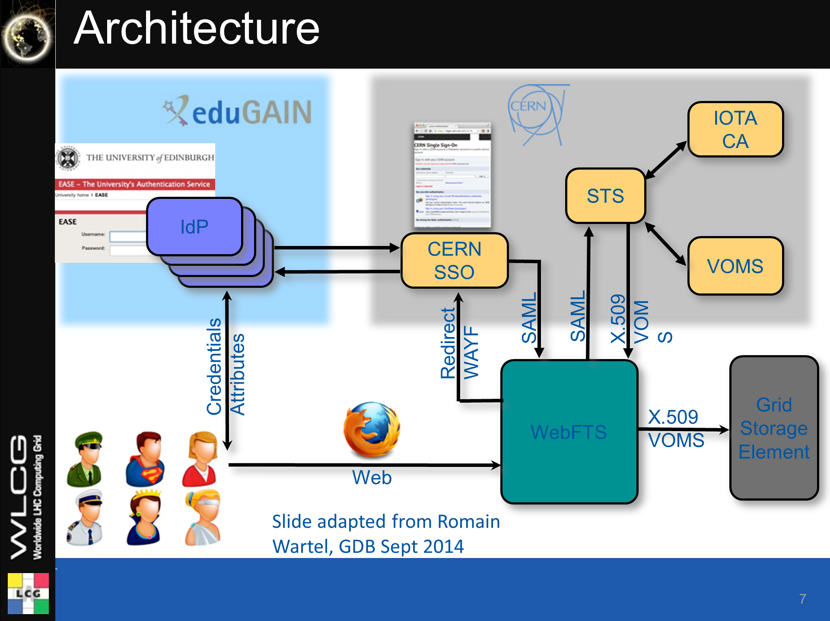
STS Security Token Service supported by Henri Mikkonen of NimbleIDM.com
For wLCG FIM4R pilot romain.wartel@cern.ch

Slide 37




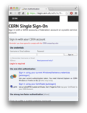
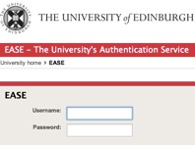


thinking beyond just WebFTS …
Wider accessibility & public use status of eduGAIN?
IOTA
CA
Add TCSG3?
STS
IdP
IdP
IdP
Trust
Mark
Filter?
+Govt eID
+DiffLoA Guest IdP?
IdP
Community WAYF?
Other community AA services?
CERN SSO
VOMS
SAML
SAML
X.509
VOMS
Redirect
WAYF
Credentials
Attributes
WebFTS
Grid
Storage
Element
Web
GSI/PKI
SASL
IMAP/SMTP
SSH
…
National or Community Credential Management?
X.509
VOMS
Web
+ direct credential provisioning client?
A CILogon clone here?
Just some random thoughts – let’s discuss where this could all go in the next 2 years!

Slide 38
A selective summary
“We have plenty of elements, just little glue”
Trust fabric are evolving and converging rapidly, for
both e-Infrastructures and ‘traditional R&E’ federations
Focus must now be on enabling use, not be overly legalistic
or we will be by-passed by the closed-silo commercials
that are just less scrupulous than R&E IdPs have been...
The only solution will be a global one
Federation enables research, the ERA, and much more,
so should not be primarily seen as a cost, but as opportunity
  which presumes that actual costs are shared responsibly between
  all parties that will benefit: research groups, faculties, universities, collaborations, infrastructures, and funding agencies

Slide 39

up later …
Authentication and Authorization for Research and Collaboration

Slide 40
Supplementary viewgraphs

Slide 41
A provocative thought?
“AuthN ‘Home’ IdP is peripheral to the issue”
Today, there is anyway
no consistent guarantee you get anything out of the IdP
  many countries still lack a federation, IdPs, or not the right IdPs are signed up (in particular we lack ways to get industrial R&D in)
  in many cases not even an persistent ID, let alone a name is given
  in some countries you get a constantly varying ID – where
  the variation is between the ‘consumers’ of this ID –
  killing collective and collaborative services
  So why use the IdP for anything but an authenticator at all?
But then: where do we get a persistent identifier?
  ORCID maybe? Our own single big SP/IdP proxy?
  One such proxy per e-Infrastructure?
  We’ll have to see, but ePTID is quite useless
Unfortunately, solving this in one or a few countries doesn’t help
For collaboration, things need to work everywhere and consistently

Slide 42
Divide and conquer the AA space
We used to separate ‘AuthN’ and ‘AuthZ’, but …
for collaboration we may need to go further, and separate
  provisioning of a (long-term) persistent non-reassigned IDs as ‘anchors’ of information
  the authenticator or authenticators that link to the ID
  Collection of attributes from many sources: from the collaboration(s), identity sources (real name), etc.
  AuthZ at the resource based on many attributes:
    Input to the decision has collective sources:
    community control + resource owner control
    Attributes from sources can be combined
    also assurance can be composite, from multiple sources

Slide 43
Service stratification
Web Rendering (“Closed Self-Contained Simple One-Click”)
use a Robot certificate, but no identification of end user.
Portal must keep list of source IPs. Infrastructure use must be stateless and rate-limited
Parameter sweeping
User provide verified email address or pseudonym (must be human)
Robot cert for portal or user’s real credential
Infrastructure use rate limited and stateless (copy data back to portal)
Data Processing portals
Identified users (well-verified email address, known domains) or better
… e.g. anyone with an IdP in ‘eduGAIN’, or people ‘known’ to the service
Portal may use robot or user credential
Use rate-limited, store output only in pre-agreed locations on infrastructure
Job Management portals
strongly traceable user credentials via, e.g. SLCS, MICS (TCS), Classic

