Slide 1
Communications
Ensuring a responsive IGTF community through periodic validation of communication
co-supported by the
Dutch National e-Infrastructure coordinated by SURFsara,
and EGI Core Services

Slide 2
Interacting with the IGTF ID providers
Today
Every 1-6 hours: CRL retrieval
Every 24 hours: CRL Availability/Reliability check
Every ~2 years: RAT Communications challenge
but is that enough, and is it ‘healthy’?

Slide 3
Last RAT challenge results
In a strict interpretation we can say that ~30 % missed out on the requirement
to react within one business day – only 70% were compliant
.. and 13% did not reply at all – and the rechallenge only marginally improved it ☹
Results communication test 2013: 76 % fullfilled the requirement - 24 % failed.
Data: Ursula Epting, KIT

Slide 4
CRL availability
Retrieved hourly, and assessed 2x per day
February: 40(!) warnings generated, so 20 fault-days
CRL expiration time too close
CRL download unavailable
at times seems like CAs are using the PMA warnings as their calender – this is not how it should be!
Warnings are auto-generated and do not require response apart from fixing the issue
– so are no measure of communication responsiveness

Slide 5
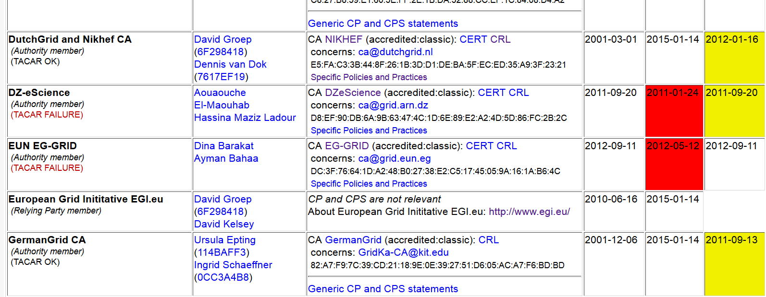
Self-audit status
At least for EUGridPMA, self-audit are requested for the agenda (3x per year) from those CAs that are ‘due’ for one
Some requests (to a very small number of CA managers) by the PMA chair lacked any response by e-mail
  Might complete non-response be an EUGridPMA-specific issue? EUGridPMA does not have monthly videoconfs …

Slide 6
We need to communicate
What do we do with
  Non-responsive CAs and CA managers
  Consistently failing CRLs
  Consistently non-updated CRLs
  Non-response to the RAT challenge within a defined window?
EUGridPMA proposed transparent and consistent process

Slide 7
Suspension consistency guidance proposal
What is your view?
suspend a CA for operational reasons if after N days of commencement of a failure condition it cannot be resolved
time starts after the last test, so for an off-line CRL it means it has not been updated for already 60 days
suspend a CA also after failure to respond to a Communications Challenge for more than N days
increase the frequency of the RAT Challenges to twice-yearly
and set the grace period N to 30 days unless there specific alleviatory circumstances are communicated

Slide 8
Getting more from the RAT CC
Merge in the request for SHA-2 status?
  “Are you issuing exclusively SHA-2 EECs now?”
  “Do you have any SHA-1 certs lets today?”
Considerations
Must be able to respond quickly (1 day) – asking for complex things that need checking might delay response
Can ask for ACK, later measure follow-up?
Separate questions from RAT CC process

Slide 9
Building a global trust fabric
Questions?

