Slide 1
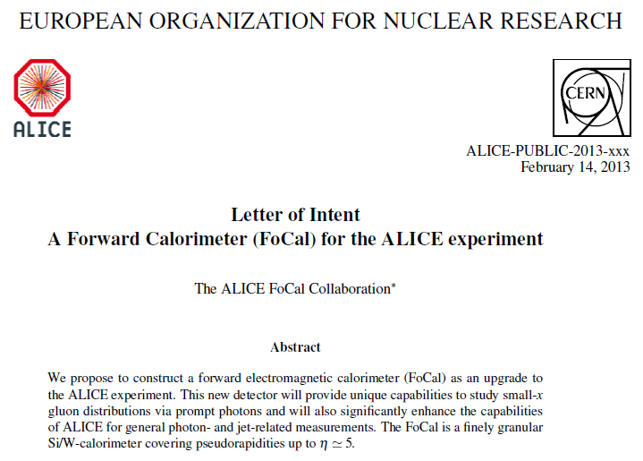
Alice upgrades
Topical lectures 2015-06-16
P. Kuijer
https://aliceinfo.cern.ch/ArtSubmission/papers/upgradedoc

Slide 2
LHC Run 2 (2015-2017)
Aim for Pb-Pb more than 1 nb⁻¹ at √s_{NN} ≈5 TeV
pp reference at √s_{NN} ≈5 TeV (p-Pb energy 2013)
High luminosity p-Pb
5-10 times more statistics → precision, p_{T} reach, new observables
Higher energy → energy dependence
However, several measurements require 10 nb⁻¹

Slide 3
Installed now
Energy resolution ~ 10%/√E
Coverage |Δη|<0.7 Δ φ=0.7
Trigger capability
Opposite to EMCAL
Available during run 2 (2015-2018):
DCAL TDR: https://cds.cern.ch/record/1272952

Slide 4
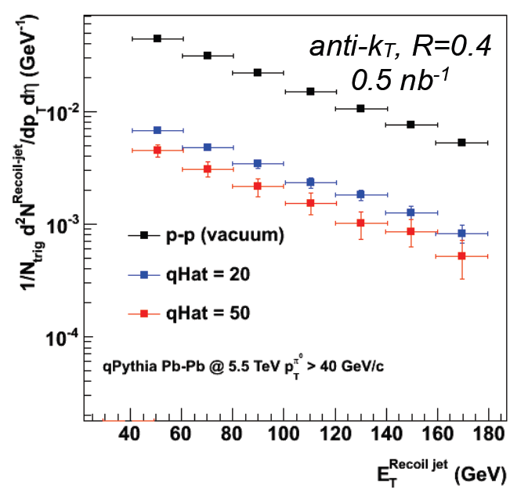
EMCAL/DCAL
hadron-dijet and dijet correlations with R=0.4 up to p_{T} < 150 GeV/c
Jet (recoil) – π⁰

Slide 5
Runs 3+4 High luminosity LHC programme
Aims:
Pb-Pb recorded luminosity 10 nb⁻¹ (0.5 T) + 3 nb⁻¹ (0.2 T)
pp @ 5.5 TeV recorded luminosity 6 pb⁻¹
p-Pb 50 nb⁻¹
ALICE focus:
Flavour dependent in-medium fragmentation functions of jets
Low p_{T} production of heavy flavour hadrons
Elliptic flow of heavy flavour hadrons
Low p_{T} charmonia production
Charmonia flow
Low p_{T} and low mass di-electrons and di-muons
Light nuclear states....

Slide 6
Upgrades
New Inner Tracking System (ITS)
high resolution (20 micron pixels)
low material budget
Smaller radius beampipe (D=58mm → D=<38 mm)
Time Projection Chamber (TPC)
Gas Electron Multiplier (GEM) readout
Pipelined (continuous) read-out
Time of flight (TOF)
High rate operation
Transition Radiation Detector (TRD)
High rate operation
Muon Spectrometer
High rate operation
5 plane silicon vertex telescope (MFT)
Trigger detectors upgrade (FIT)
Online system
Online data reduction using clusters and tracks
Offline software
FoCal
Record up to 50 kHz MB events
→ Reduced statistical errors
Improved vertexing
→ Reduced statistical/ systematic errors

Slide 7
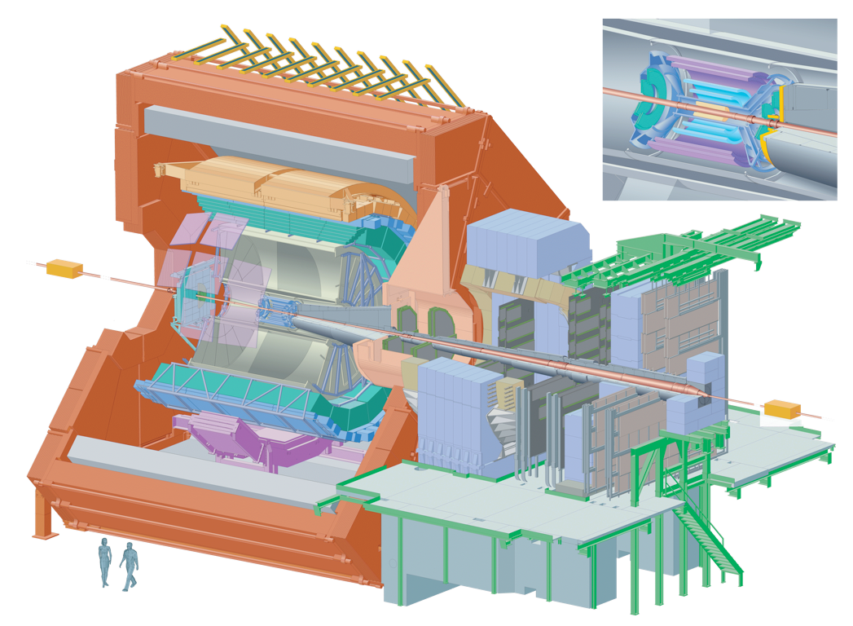
ALICE Detector Upgrades
new ITS: high resolution,
low material budget
TPC: new GEM readout chambers,
pipelined readout
FoCal project
TRD, TOF, PHOS, EMCal,
Muon spectrometer:
new readout electronics
new beam pipe: smaller diameter
Upgrade of forward/trigger detectors
(ZDC, VZERO, T0)
MFT: tracking in front of absorber,
secondary vertex
resolution
LoI endorsed by LHCC, TDRs in preparation/submitted,
planned for installation in LS2 (2018/19)
Trigger
Offline
under internal review

Slide 9
https://edms.cern.ch/file/398930/1/ALICE-DOC-2003-011.pdf

Slide 12
ITS
Electronics integrated with the sensor
Continuous read-out
With zero suppression

Slide 13
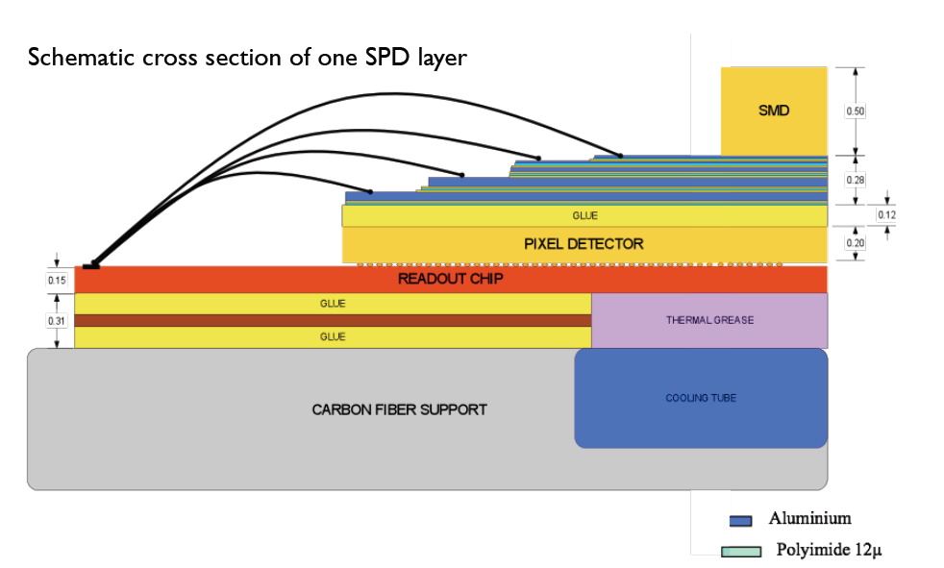
Material budget of each current SPD layer
In one current SPD layer
Carbon fiber support: 200 μm
Cooling tube (Phynox): 40 μm wall thickness
Grounding foil (Al-Kapton): 75 μm
Pixel chip (Silicon): 150 μm  0.16%
Bump bonds (Pb-Sn): diameter ~15-20 μm
Silicon sensor: 200 μm  0.22%
Pixel bus (Al+Kapton): 280 μm  0.48%
SMD components
Glue (Eccobond 45) and thermal grease
Two main contributors: silicon and interconnect structure (bus)

Slide 14
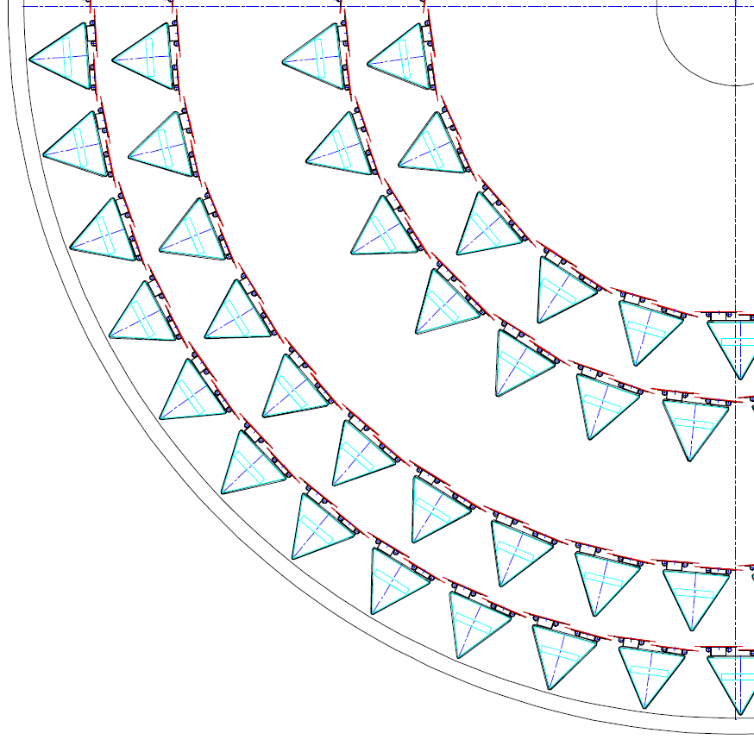
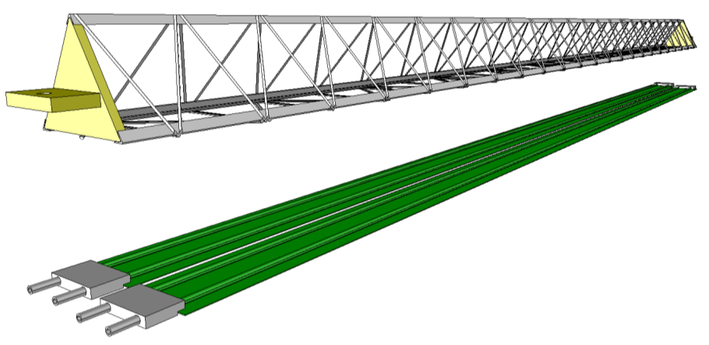
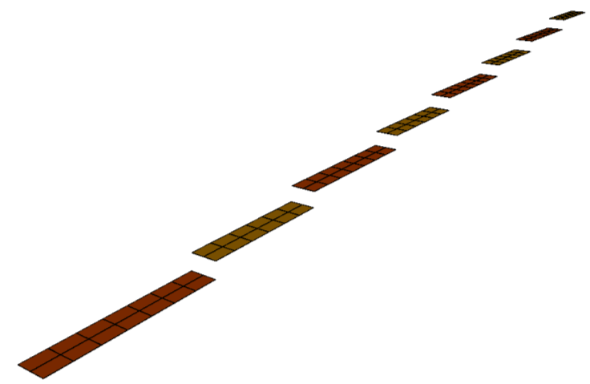
OUTER BARREL (OB)
Middle
Layers
Nikhef participation
Together with It, Cz, CERN
Stave
Spaceframe
1.5m
Outer
Layers
Based on Layout-TDR-5
Cold Plate
Outer Barrel (OB): 4 layers pixels
Radial position (mm): 194, 247, 353, 405
Length in z (mm): 843, 1475
Nr. of staves: 22, 28, 40, 46
Nr. of modules: 176, 224, 560, 644
Nr. of chip: 2464, 3136, 7840, 9016
Nr. of chip/module: 2x7
Nr. of modules /half stave: 4, 4, 7, 7
Nr. of modules/stave: 8, 8, 14, 14
Nr. of chips/stave: 112, 112, 196, 196
Cold Plate
Half-Stave
Half-Stave
Pixel chip
(15mmx30mmx0,05mm)
Module

Slide 15
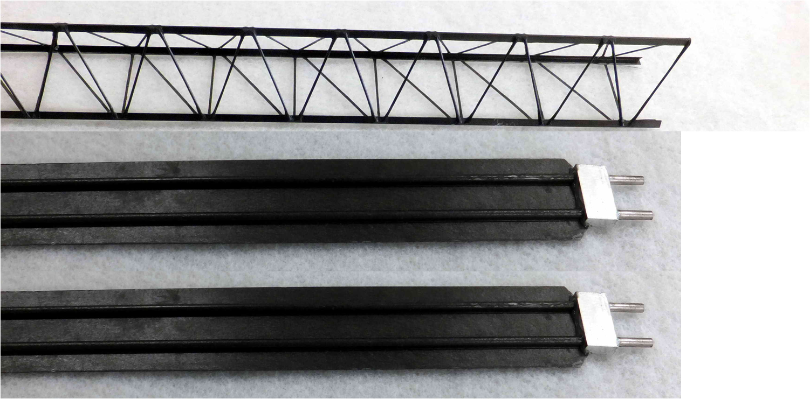
OUTER BARREL
STAVE baseline layout
ID= 2.67mm
Protyping mechanics and cooling (CERN) well underway.

Slide 16
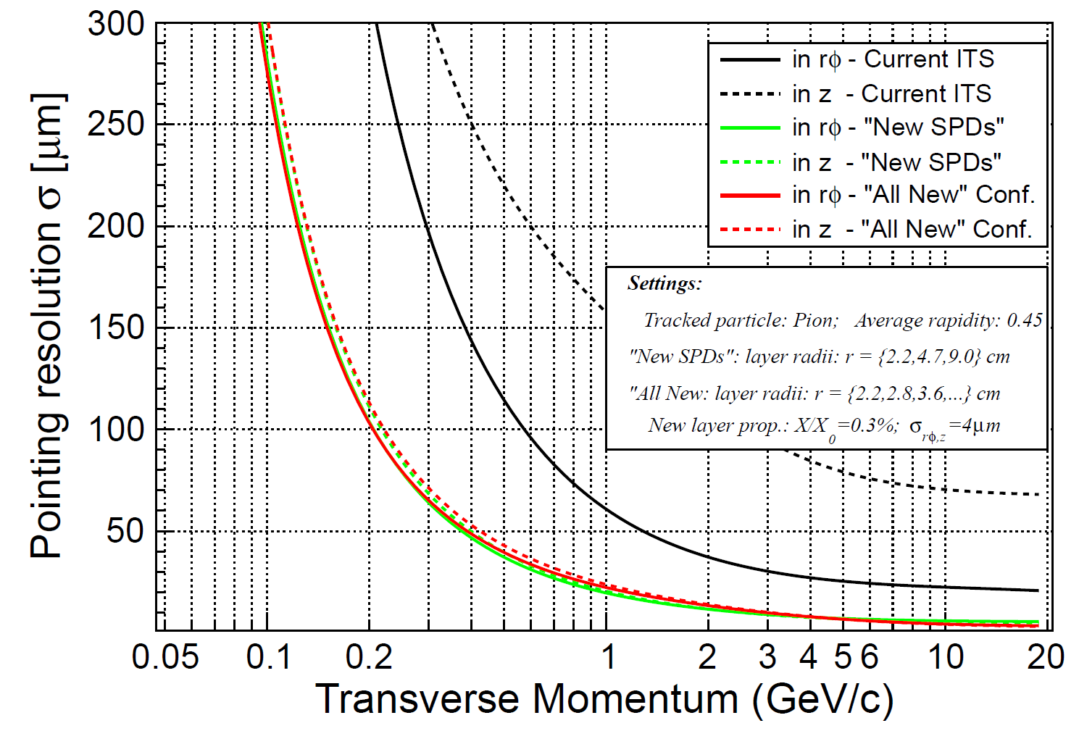
Improvement of the
impact parameter resolution

Slide 17
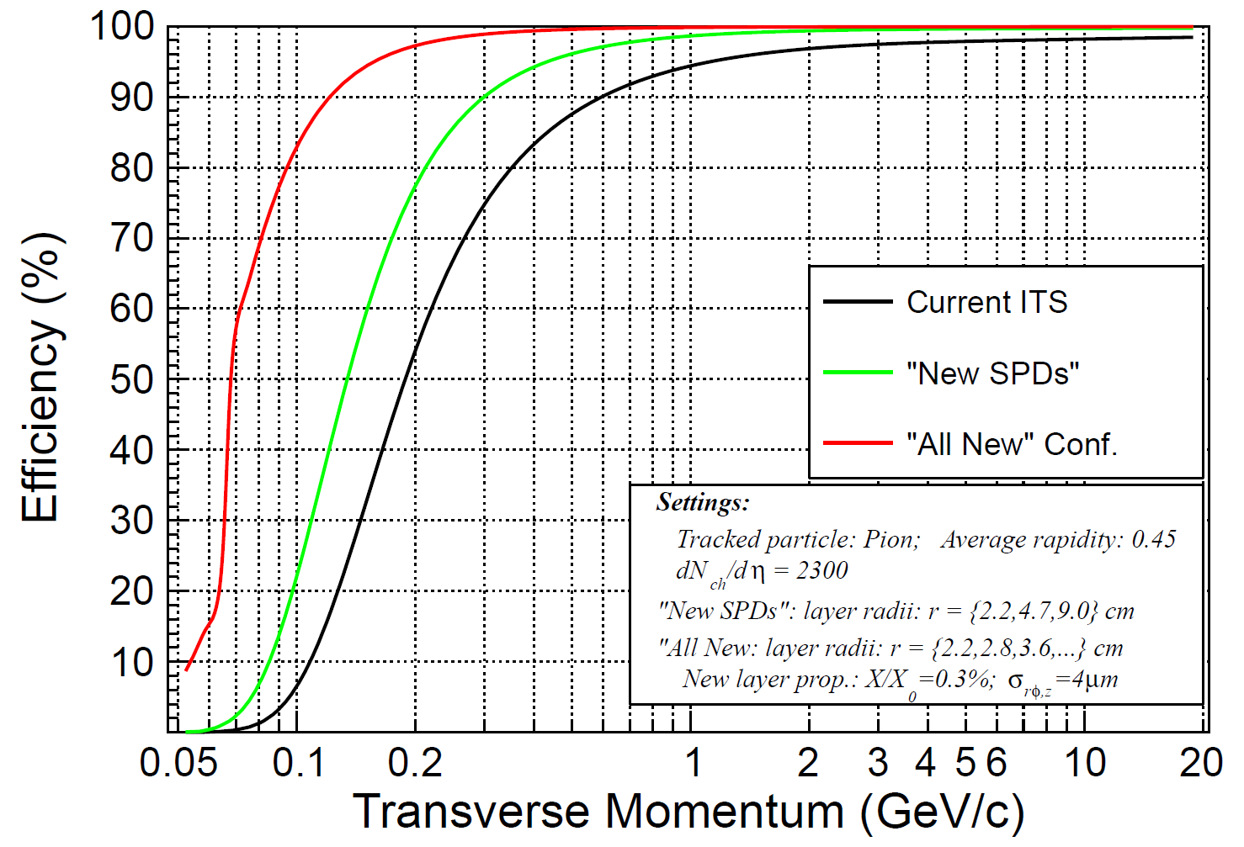
Improvement of the
standalone tracking efficiency

Slide 18
Heavy-flavour production
Two main topics under study:
thermalization of heavy quarks in the medium
baryon-to-meson ratio, i.e. Λ_{c}/D, Λ_{b}/B
azimuthal anisotropy v₂
in-medium energy loss
separately for D and B mesons
wide p_{T} range, and especially low p_{T}
Two topics connected via transport coefficient
Significant differences between c and b predicted
Benchmark analyses:
charm meson production D⁰ → K⁻π⁺
charm-strange meson D_{s}⁺ → K⁺K⁻π⁺
beauty meson production B → D⁰(→ K⁻π⁺) + X; B → J/ψ(→l⁺l⁻) + X
charm baryon production Λ_{c} → pK⁻π⁺

Slide 19
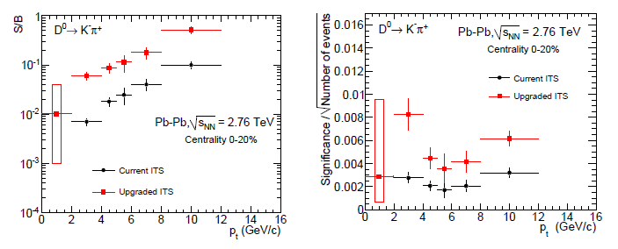
D⁰ → K⁻π⁺
Signal-to-background ratio
Significance (multiply by ~10⁵)
With new ITS: signal-to-background improved by one order of magnitude
significance per event improved by factor 2–4
(additional factor 10 due to event statistics)

Slide 20
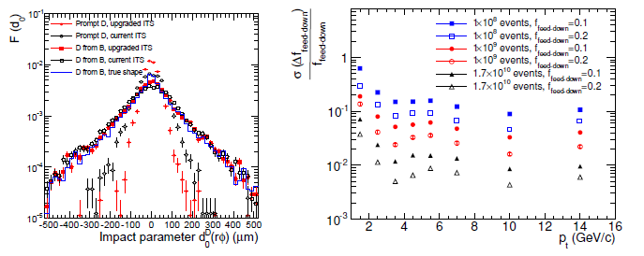
B → D⁰ (→ K⁻π⁺) + X
Impact parameter distribution
for D and B
Relative statistical error
on B fraction (new ITS)
Significantly improved resolution for prompt D meson with new ITS
For B-meson measurement high statistics necessary
Study of systematic uncertainties presented in LoI

Slide 21
Heavy quark probes

Slide 22
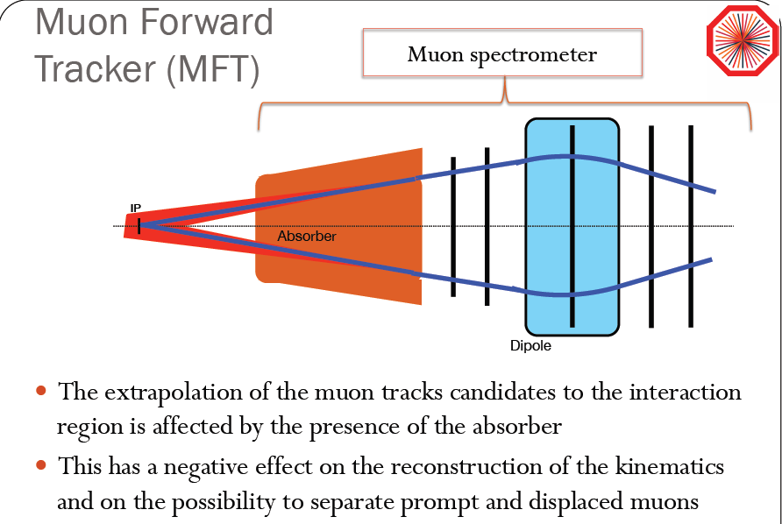
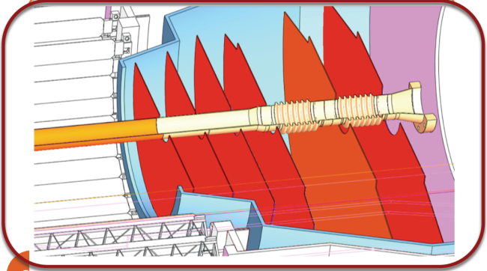

Slide 23
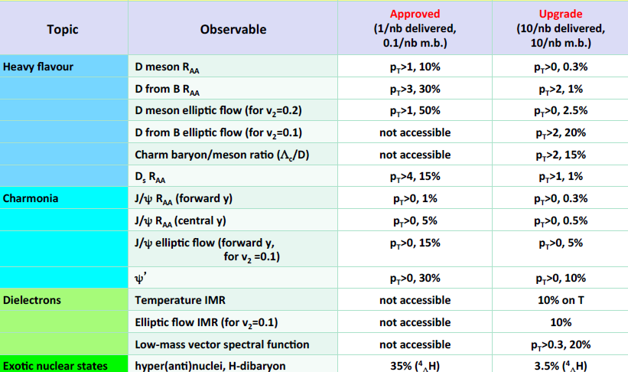
Upgrade performance summary p_{T} reach and measurement precision
Current

Slide 24
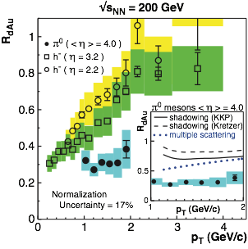
New ideas Evidence for Gluon Saturation?
indirect hints of gluon saturation in a number of observables
e.g. geometric scaling, particle multiplicity in A–A collisions, “ridge” phenomena, …
more direct evidence for reduced gluon density:
suppression of particle yields in d–A/p–A vs pp at forward rapidity and intermediate pT
hadron suppression observed at RHIC
difficult to interpret: very low pT, close to kinematic limit, final state modifications?
still inconclusive, no proof of saturation yet
results at LHC?
STAR, PRL97, 152302

Slide 25
Forward Physics in ALICE
additional physics potential in ALICE: forward/low-x physics
fundamental interest in low-x PDFs/gluon saturation
information on initial state yields important constraints for interpretation of QGP studies
e.g. knowledge of eccentricity for elliptic flow
forward detector enhances general physics scope
em calorimeter (FoCal): significant increase of coverage for photons, jets compared to existing calorimeters (PHOS, EMCal)
FoCal: new upgrade project under discussion
main objective: measurement of large rapidity direct photons
possible installation in LS3 (≈2024)

Slide 26
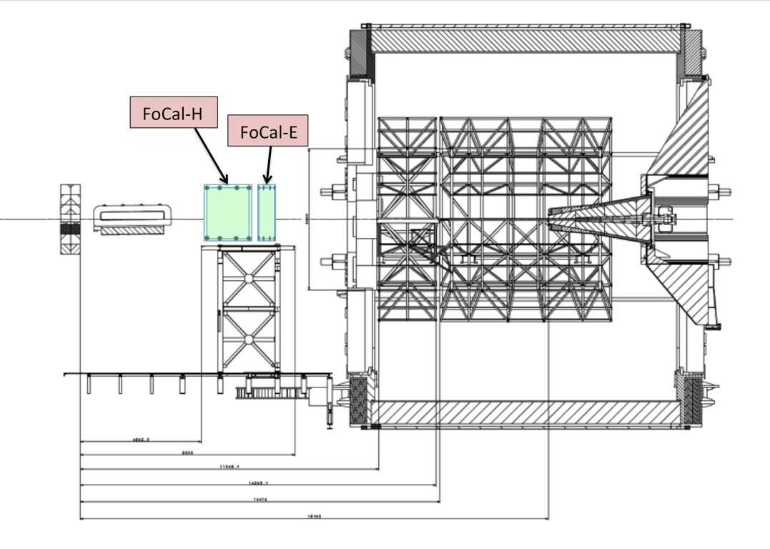
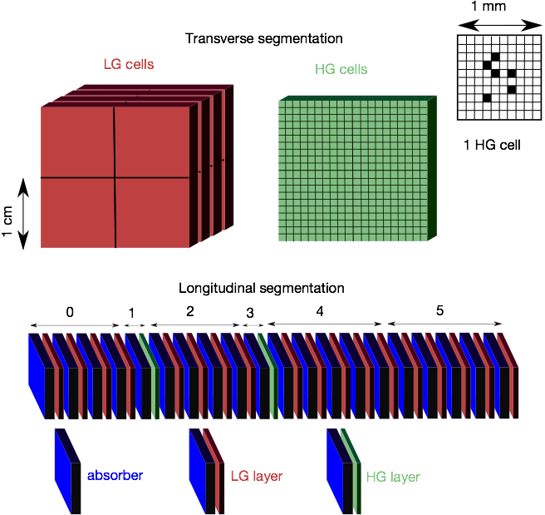
FoCal in ALICE
electromagnetic calorimeter for γ and π⁰ measurement
+ hadronic calorimeter for isolation and jet measurement
baseline scenario: at z ≈ 7m (outside magnet) 3.3 < η < 5.3
project under internal discussion/preparing for internal review
possible installation in LS3
main challenge: separate γ/π⁰ at high energy
need small Molière radius, high-granularity read-out
SiW EM calorimeter with low- and high-granularity layers (≈ 25 X₀)
effective granularity: 1mm²
conventional hadronic calorimeter (≈ 8 λ)

Slide 27
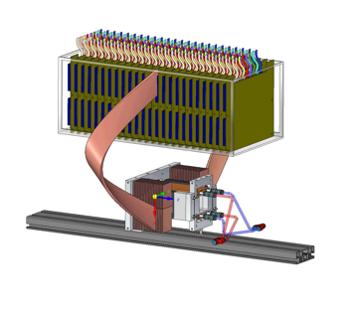
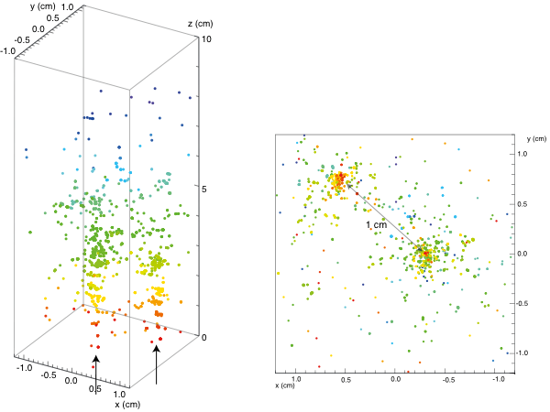
Prototypes and Test Beams
pile-up of two electrons of 5.4 GeV (DESY test beam)
R&D ongoing
(Utrecht/Nikhef, Bergen, Tokyo, ORNL, Kolkata, Prague, ...)
e.g. full MAPS prototype
39 M pixels in 4x4x10 cm³ !
first results from test beams encouraging
side view
front view

Slide 28
Summary
After upgrade for high luminosity (LS2)
Faster detector → more integrated luminosity
Improved vertexing → better S/N (systematics)
ALICE focus after LS2:
Flavour dependent in-medium fragmentation functions of jets
Low p_{T} production of heavy flavour hadrons
Elliptic flow of heavy flavour hadrons
Low p_{T} charmonia production
Charmonia flow
Low p_{T} and low mass di-electrons and di-muons
Direct photons suggested as a promising probe for CGC
Look for gluon saturation with FoCal LS3)
Alice upgrade LOI: CERN-LHCC-2012-012
Alice Upgrade LOI muon addendum: CERN-LHCC-2013-014
Alice ITS CDR: CERN-LHCC-2012-013

Slide 30
Backups

Slide 31
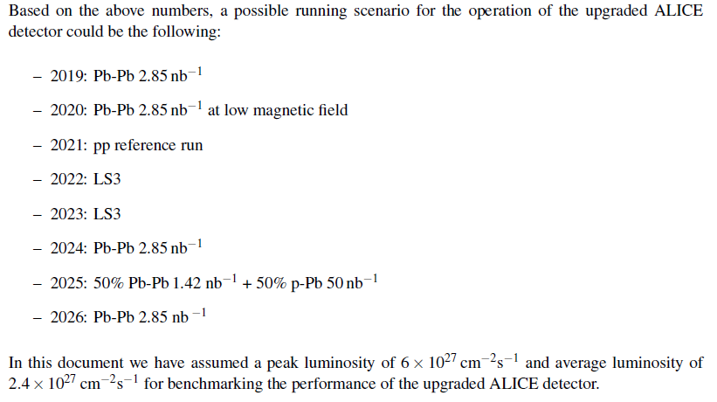

Slide 32
Performance with upgrades and high lumi
Heavy Quarks as probes of in-medium interactions and thermalization

Slide 33
Heavy flavour hadronization?

Slide 34
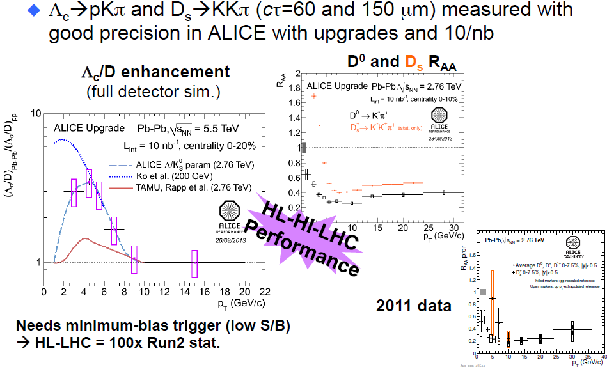
Heavy flavour performance

Slide 35
Quarkonia dissociation (re)generation ?
Measurement proposed:
high-statistics measurement of J/ψ in wide rapidity range
nuclear modification factor R_{AA}
azimuthal anisotropy v₂
J/ψ polarization
low-p_{T} J/ψ excess
ψ(2S) production – nuclear modification factor
access to χ_{c} under study
Measurement both in e⁺e⁻ (barrel) and in
μ⁺μ⁻ (forward muon spectrometer) channels
Complementary measurement of Υ family in forward region

Slide 36
Charmonium performance

Slide 37
Low mass di-leptons
Potentially giving access to:
chiral-symmetry breaking mechanism by modification of ρ-meson spectral function
direct photon thermal emission extrapolating to zero dilepton mass
partonic equation of state studying space–time evolution with invariant-mass and p_{T} distributions of dileptons
Measurements to be done:
mapping of dilepton yields in invariant mass and p_{T}
elliptic flow of dileptons
(after experimentally driven subtraction of all backgrounds…)
Need for special run at lower magnetic field (B = 0.2T) to enhance acceptance at low p_{T}, thus integrated luminosity of 3 nb⁻¹ assumed

Slide 38
Low mass di-leptons performance

Slide 39
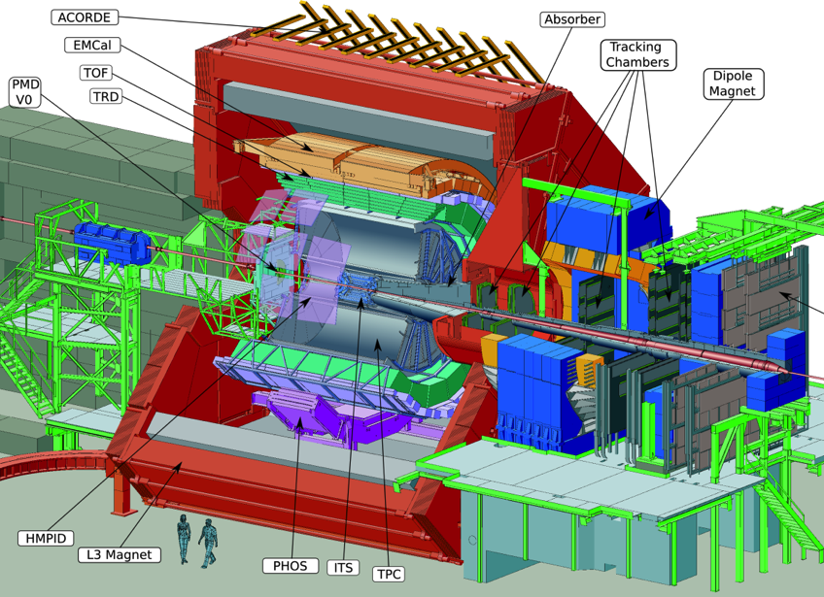
Limited readout rate capability
pp minimum bias: ~ 1kHz
Pb-Pb minimum bias: ~500 Hz

Slide 40
Schedule
Next chance
to improve
Really high
luminosity
Higher energy
More luminosity
(your thesis)

