Slide 1





The gaseous QUAD pixel detector
Yevgen Bilevych, Klaus Desch, Jean-Paul Fransen, Harry van der Graaf, Markus Gruber, Fred Hartjes, Bas van der Heijden, Kevin Heijhof, Charles Ietswaard, Dimitri John, Jochen Kaminski, Peter Kluit, Naomi van der Kolk, Auke Korporaal, Cornelis Ligtenberg, Oscar van Petten, Gerhard Raven, Joop Rövekamp, Lucian Scharenberg, Tobias Schiffer, Sebastian Schmidt and Jan Timmermans
VCI2019 - 15th Vienna Conference on Instrumentation

Slide 2

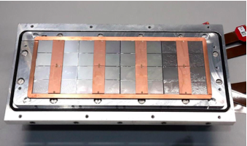

Pixel TPC
Single chip Quad Module TPC plane
2017 2018 2019

Slide 3
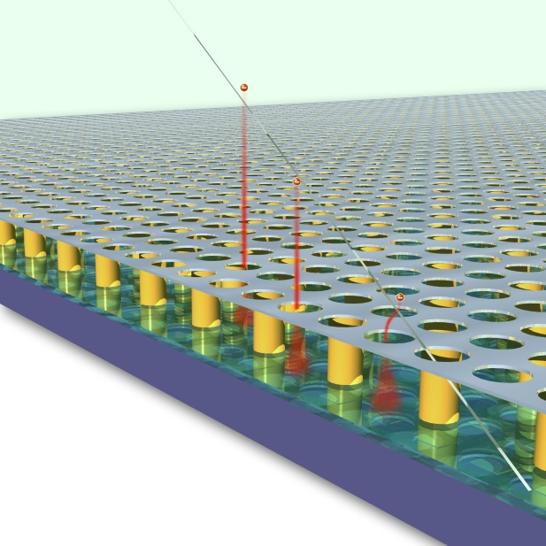
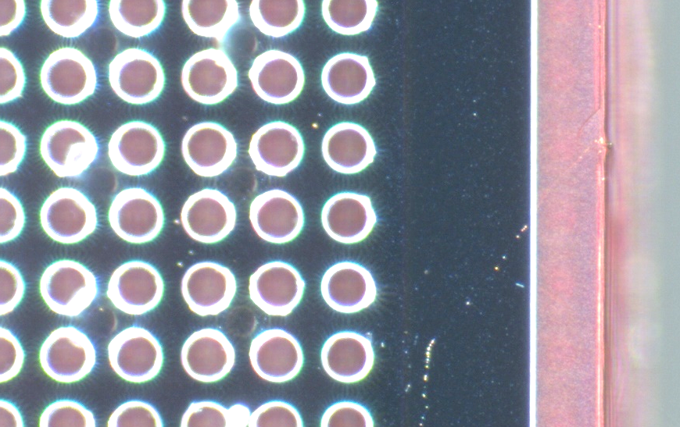
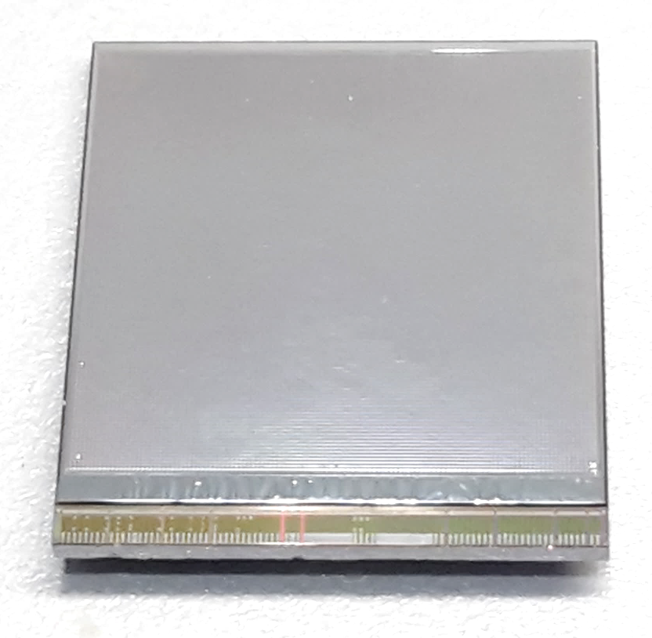
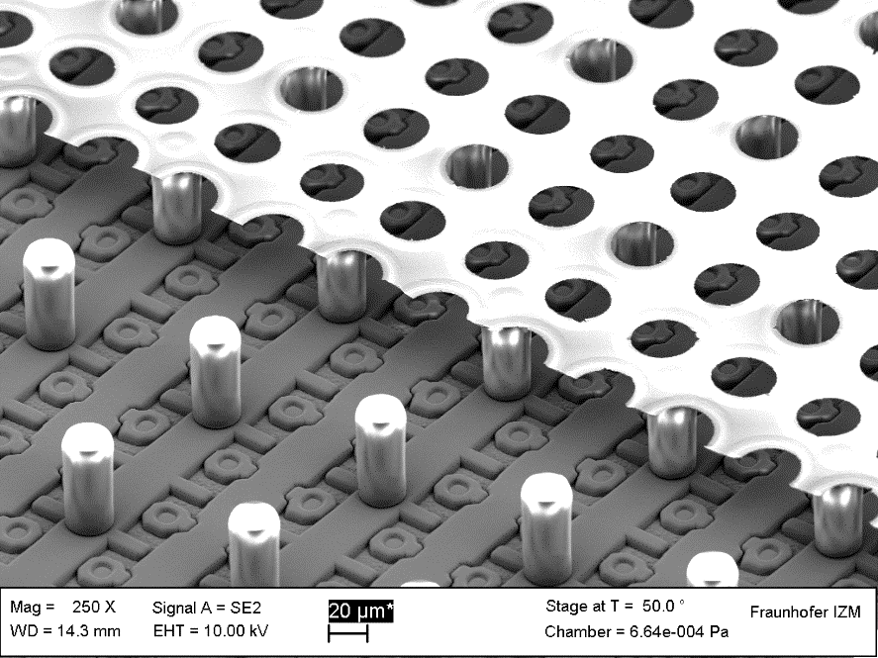
GridPix technology
Pixel chip with integrated Grid (Micromegas-like)
InGrid post-processed @ IZM
Grid set at negative voltage (300 – 600 V) to provide gas amplification
Very small pixel size (55 µm)
detecting individual electrons
dyke
55 µm
Aluminium grid (1 µm thick)
35 µm wide holes, 55 µm pitch
Supported by SU8 pillars 50 µm high
Grid surrounded by SU8 dyke (150 µm wide solid strip) for mechanical and HV stability
50 µm

Slide 4
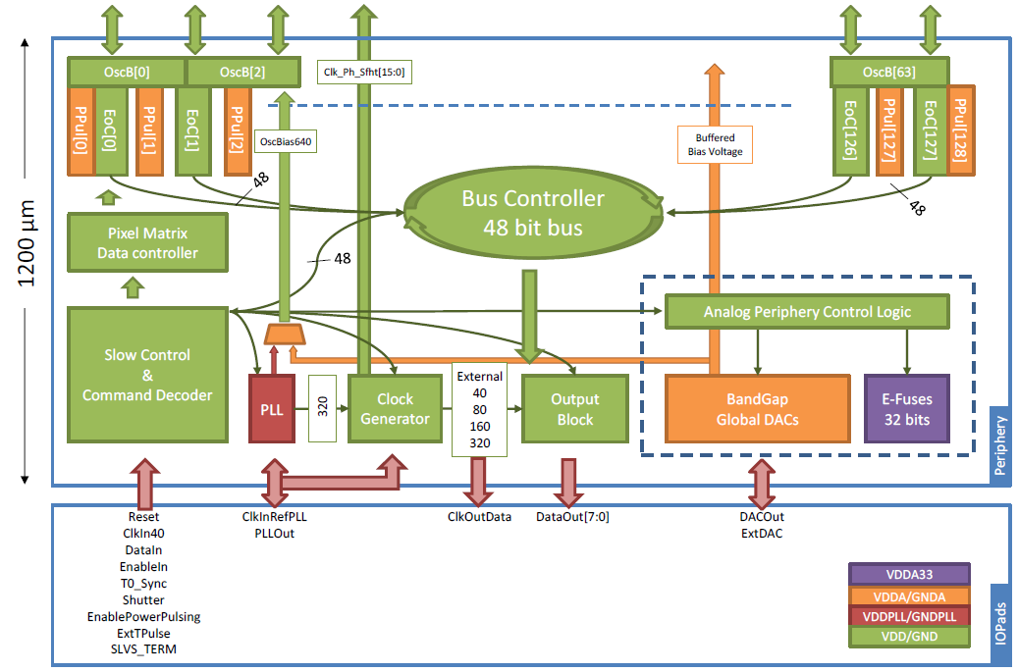
Pixel chip: TimePix3
256 x 256 pixels
55 x 55 µm pitch
14.1 x 14.1 mm sensitive area
TDC with 610 MHz clock (1.64 ns)
Used in the data driven mode
  Each hit consists of the pixel address and time stamp of arrival time (ToA)
  Time over threshold (ToT) is added to register the signal amplitude
  compensation for time walk
  Trigger (for t₀) added to the data stream as an additional time stamp
Power consumption
  ~1 A @ 2 V (2W) depending on hit rate
  good cooling is important
Sensitive area
14.1 mm
2+3 mm

Slide 5
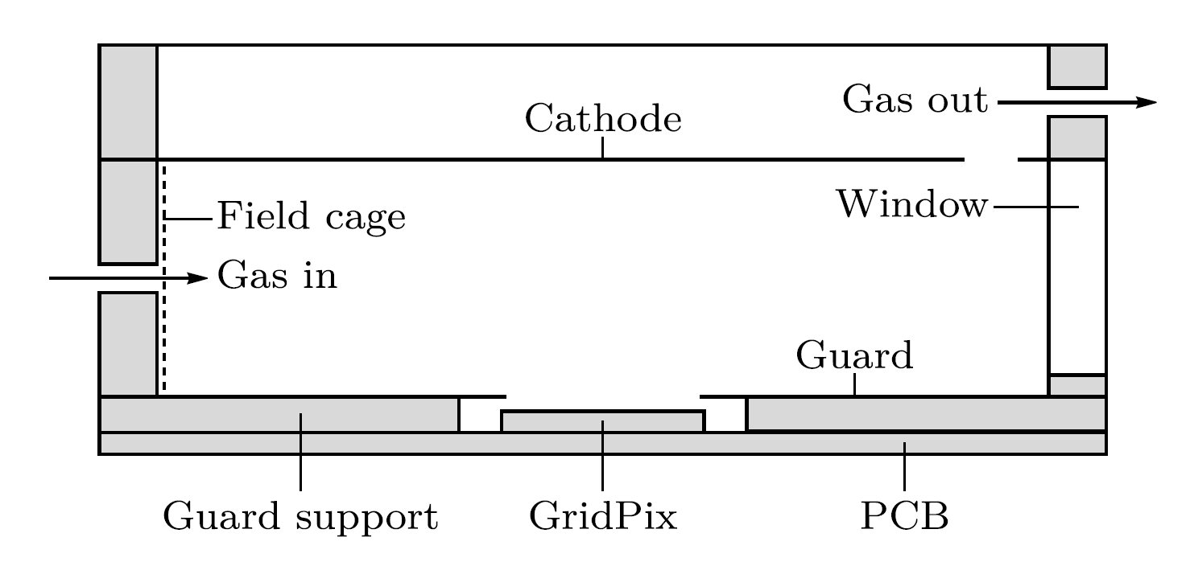
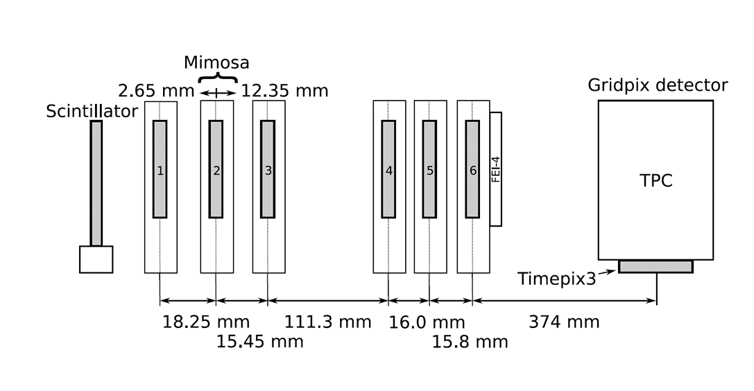

Single chip test in test beam Bonn (June 2017)
ELSA: 2.5 GeV electrons
Tracks referenced by Mimosa telescope
Gas: Ar/CF₄/iC₄H₁₀ 95/3/2 (T2K)
Electrons: ~100 e/cm
E_{d} = 280 V/cm, V_{grid} = -350 V
--------- Mimosa telescope ---------
Detector with guard and field shaper
@Bonn
Published paper on 2017 testbeam: https://doi.org/10.1016/j.nima.2018.08.012

Slide 6
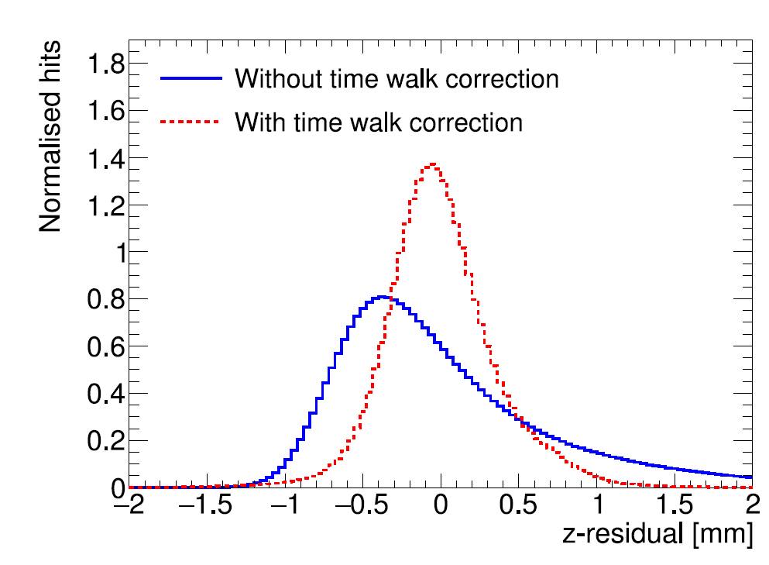
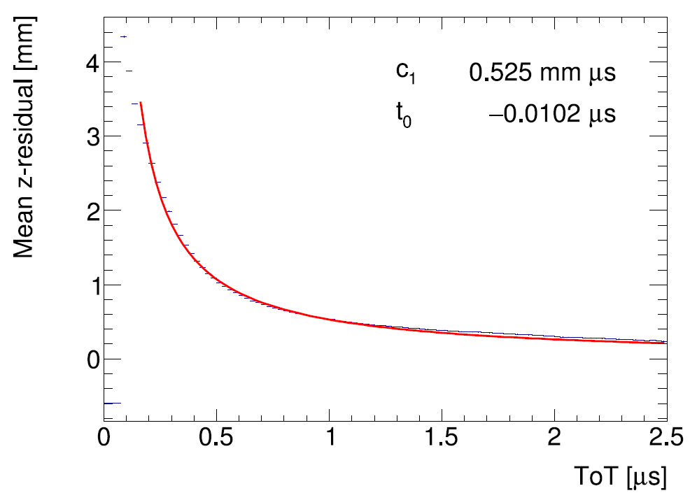
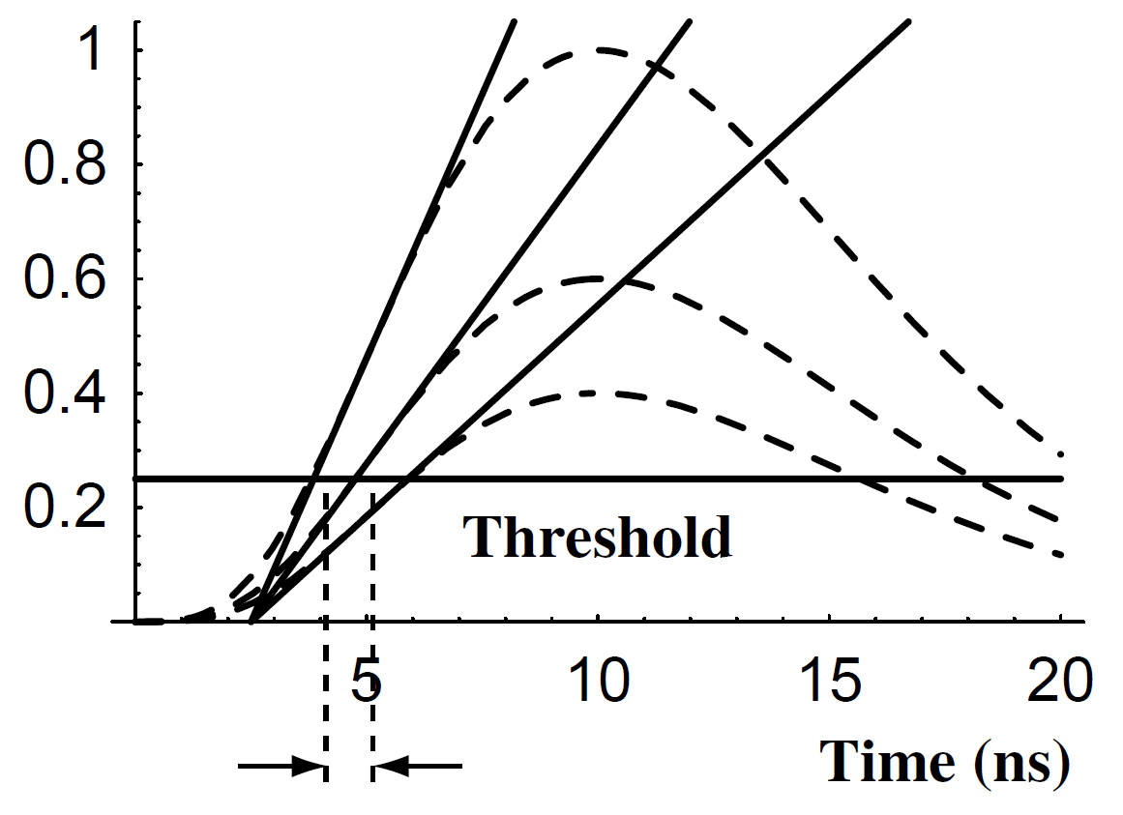
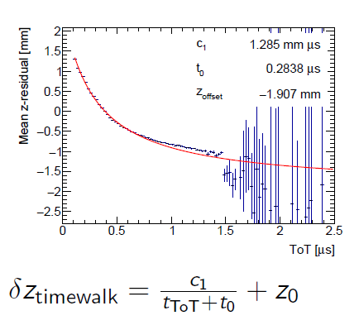
TimePix3 time walk correction
Time walk error: time of arrival depends on signal amplitude
Residual distribution improved
Higher order corrections did not yield further improvements
Correction using Time over Threshold (ToT) as a measure of signal strength
(Blum, Particle detection 2008)

Slide 7
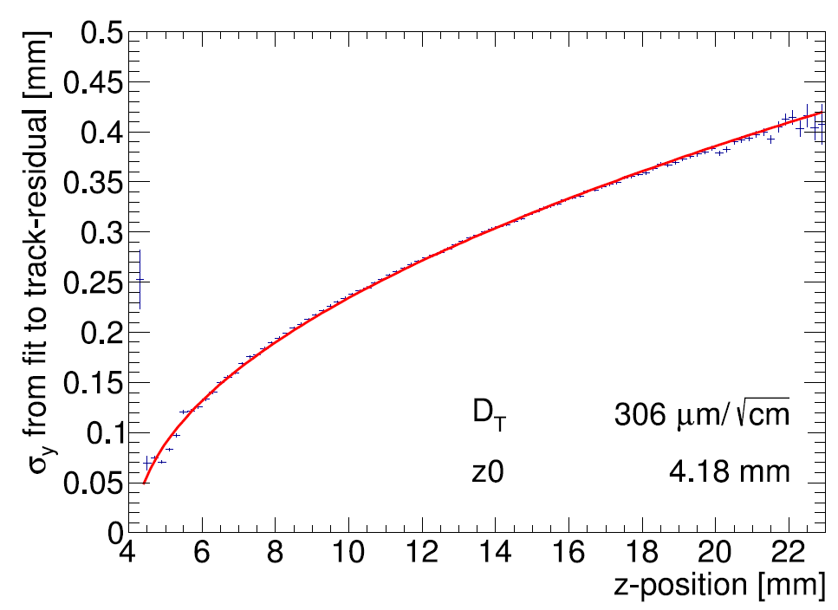
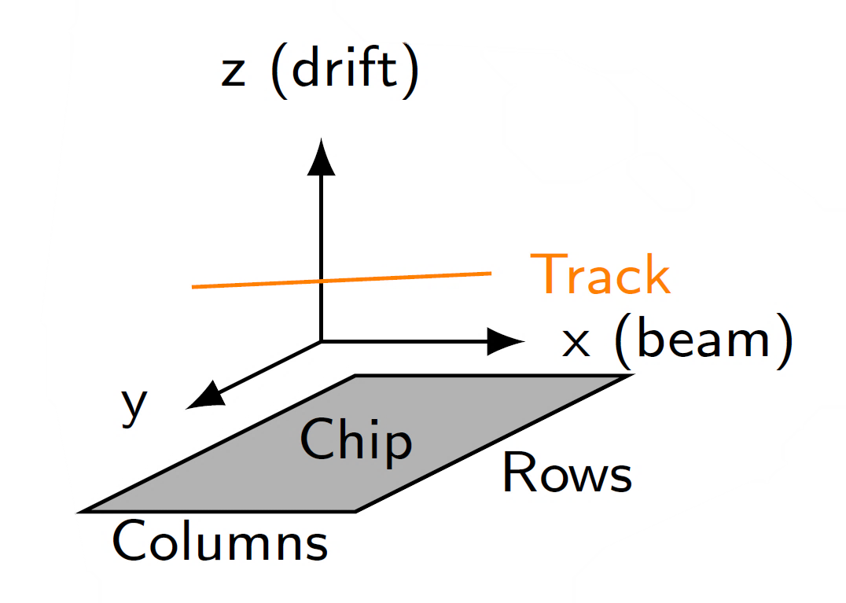
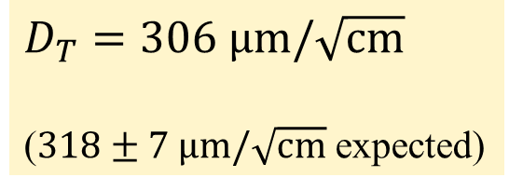
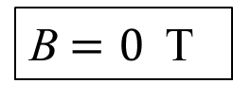
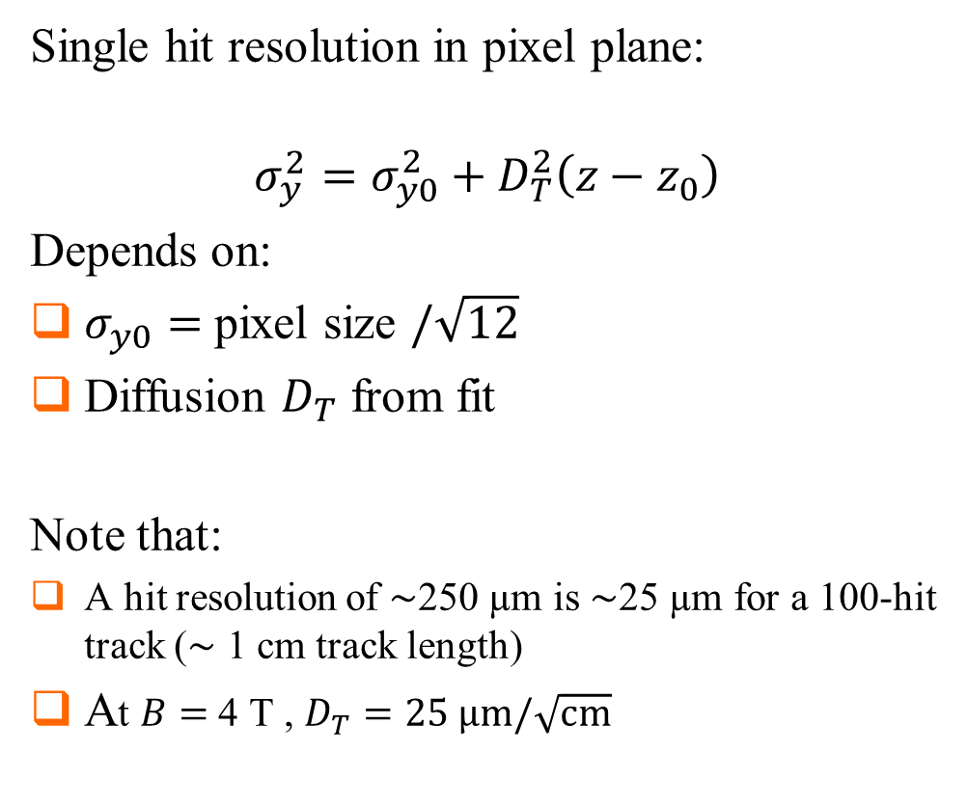
Single hit resolution in transverse direction
Single hit resolution in pixel plane:
$$σ_{y}^{2}=σ_{y0}^{2}+D_{T}^{2}\left(z−z_{0}\right)$$
Depends on:
$σ_{y0}=$ pixel size $/\sqrt{12}$
Diffusion $D_{T}$ from fit
Note that:
A hit resolution of $\sim$250 µm is $\sim$25 µm for a 100-hit track ($\sim$ 1 cm track length)
At $B=$ 4 T , $D_{T}=25 \text{μm}/\sqrt{\text{cm}}$
B$=0$ T
$D_{T}=306 \text{μm}/\sqrt{\text{cm}}$
($318±7 \text{μm}/\sqrt{\text{cm}}$ expected)

Slide 8
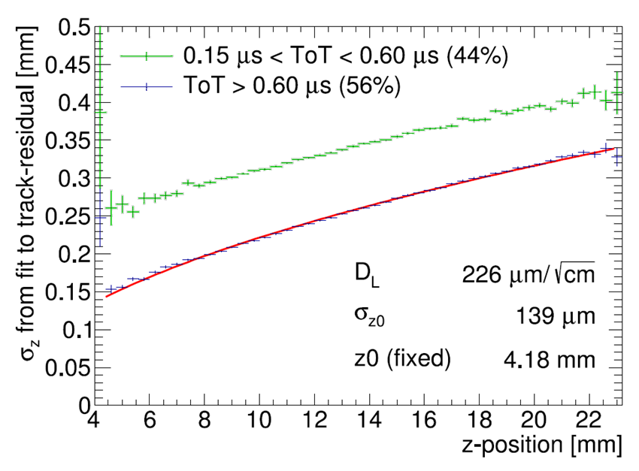
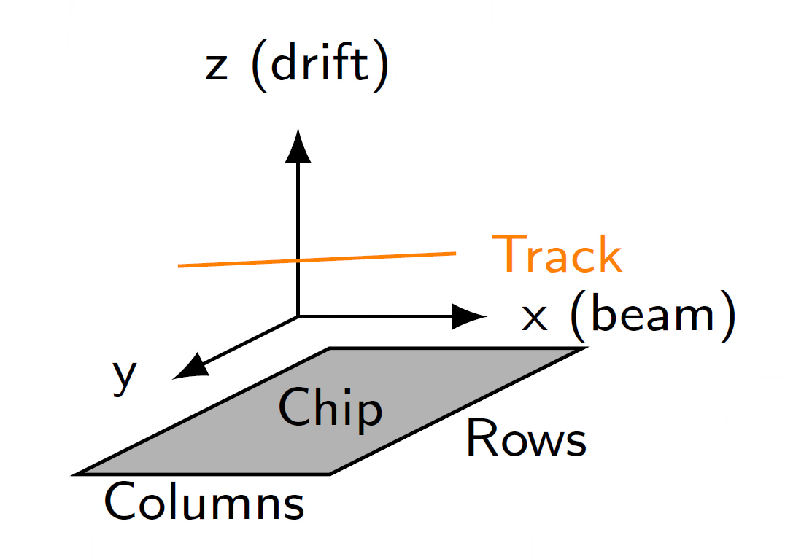
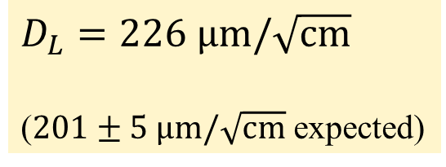
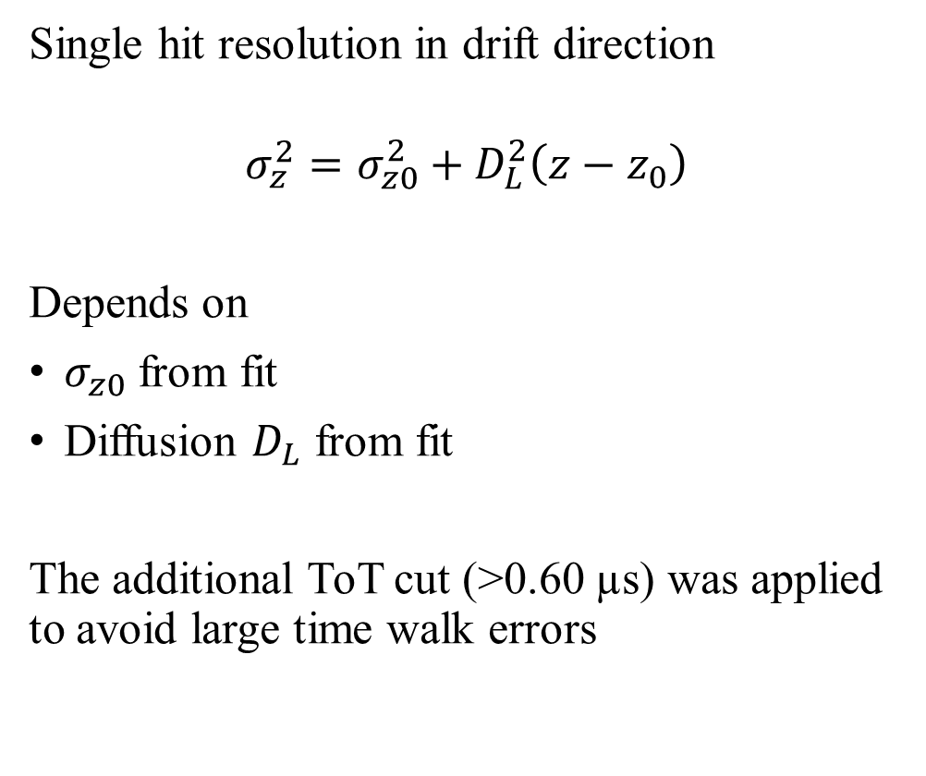
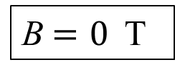
Single hit resolution in longitudinal direction
Single hit resolution in longitudinal direction
Single hit resolution in drift direction
$$σ_{z}^{2}=σ_{z0}^{2}+D_{L}^{2}\left(z−z_{0}\right)$$
Depends on
$σ_{z0}$ from fit
Diffusion $D_{L}$ from fit
The additional ToT cut (>0.60 µs) was applied to avoid large time walk errors
B$=0$ T
$D_{L}=226 \text{μm}/\sqrt{\text{cm}}$
($201±5 \text{μm}/\sqrt{\text{cm}}$ expected)

Slide 9
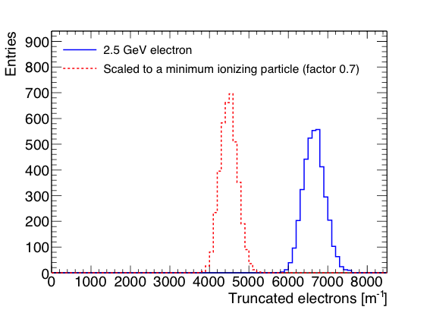
Pixel dE/dx performance
dE/dx resolution with truncated mean
  From the single chip tracks; 1 m long tracks are made;
  nr of electrons counted in slices of 20 pixel and reject 10% highest slices
  Distances along track are scaled by 1/0.7 to get an estimation for the dE/dx of a MIP
  Resolution is 4.1% for a 2.5 GeV electron and 4.9% for a MIP
Separation S = (N_{e} − N_{MIP})/σ_{e}
8σ MIP-e separation for a 1 meter track
A pixel readout can in principle within the resolution (diffusion) separate primary from secondary clusters. dE/dx can be measured by cluster counting and performance separation enhanced.

Slide 10
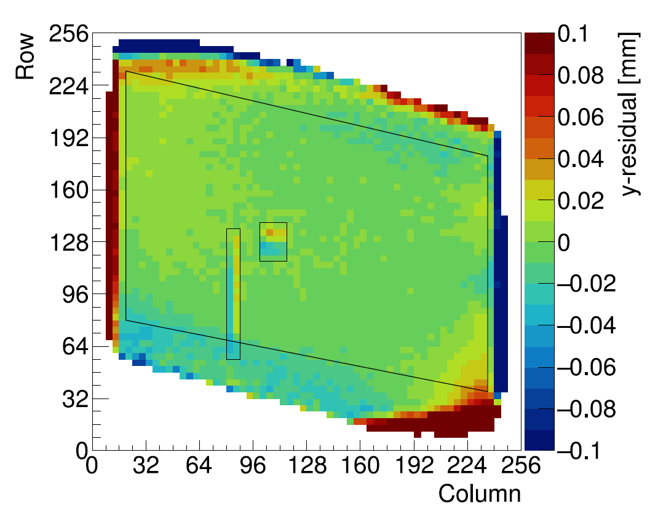
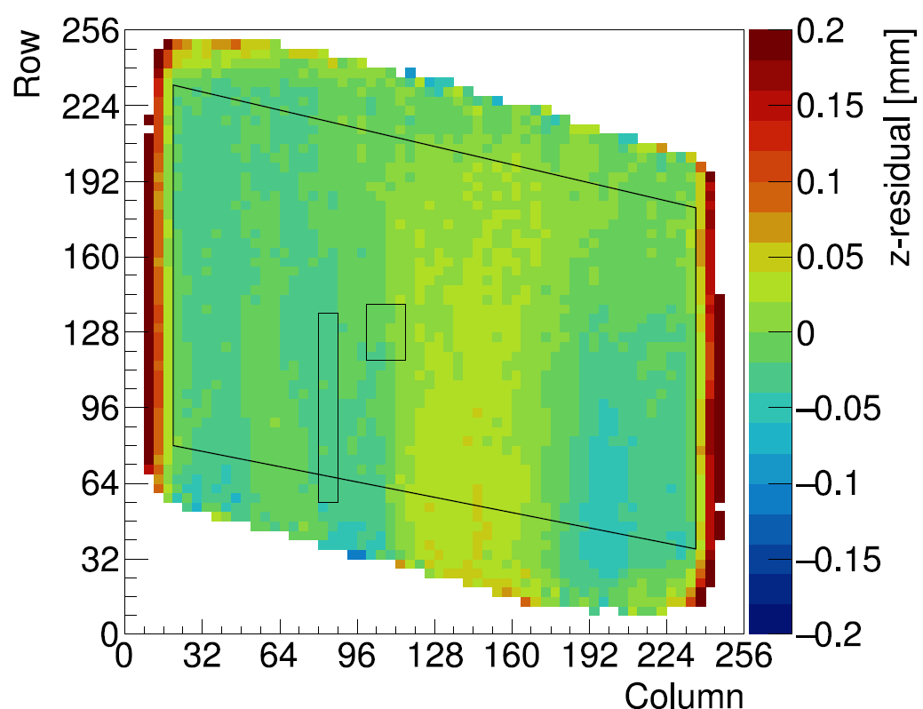
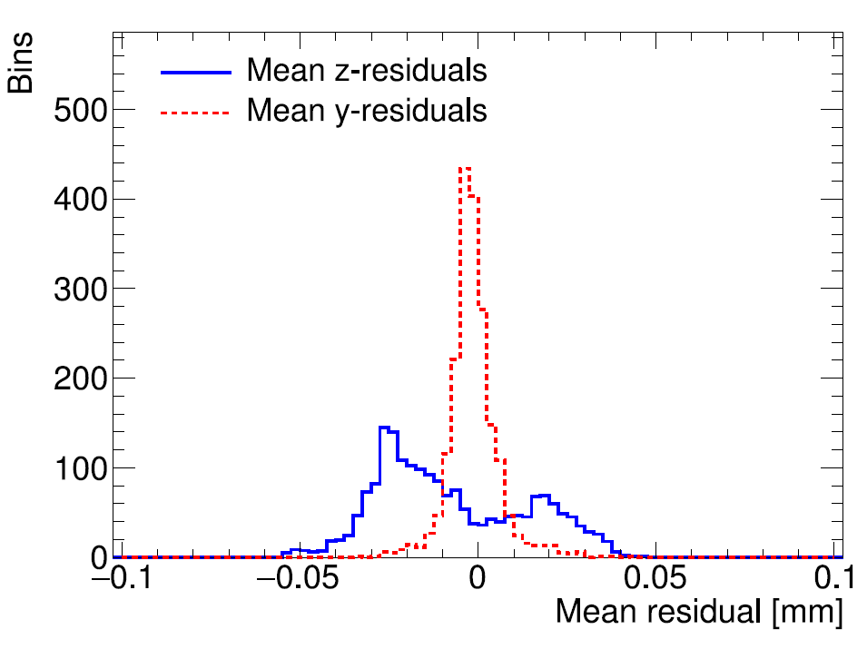
Deformations in pixel plane (XY) and drift direction (Z)
The RMS of the mean residuals is 7 μm in the pixel plane and 21 μm (0.3 ns) in the drift direction in the selected region
XY
Z
How can we make an even better detector?
  Improve the quality (homogenity) of the InGrid; redesign the dike and edges
  Go to a large areas keeping the field distortions (at edges) minimal -> QUAD

Slide 11
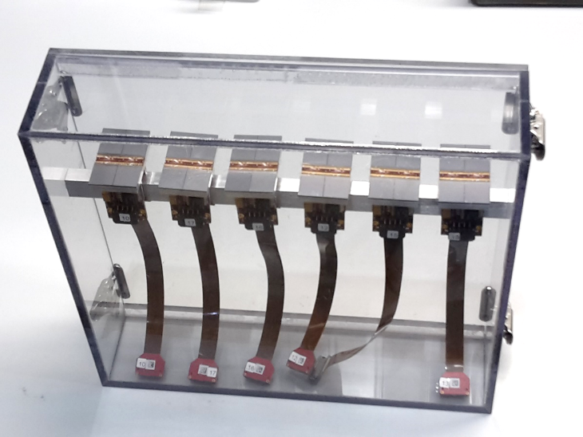
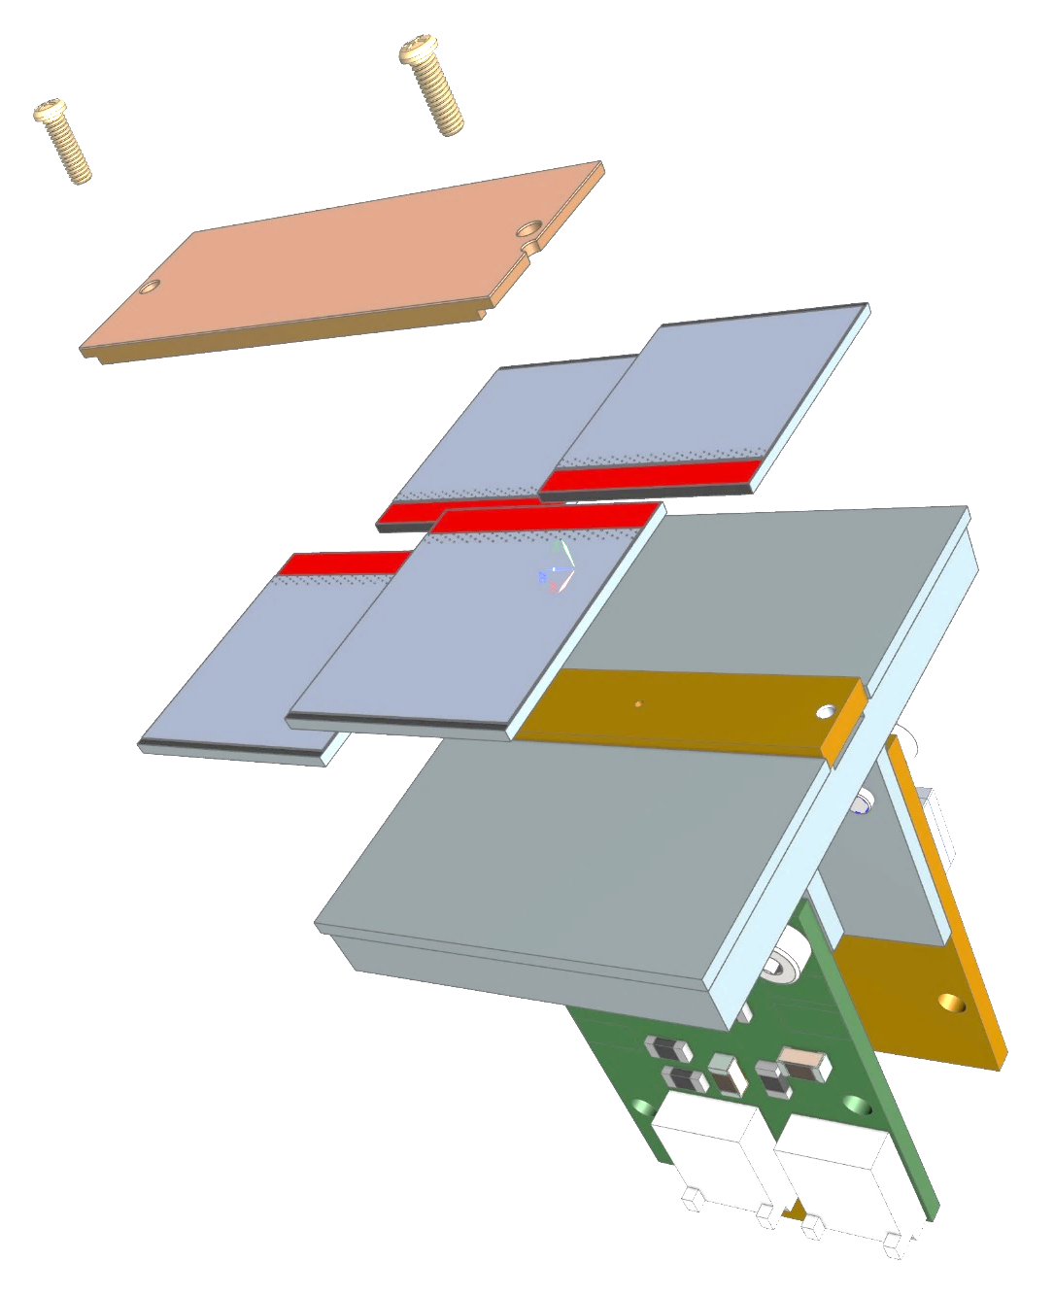
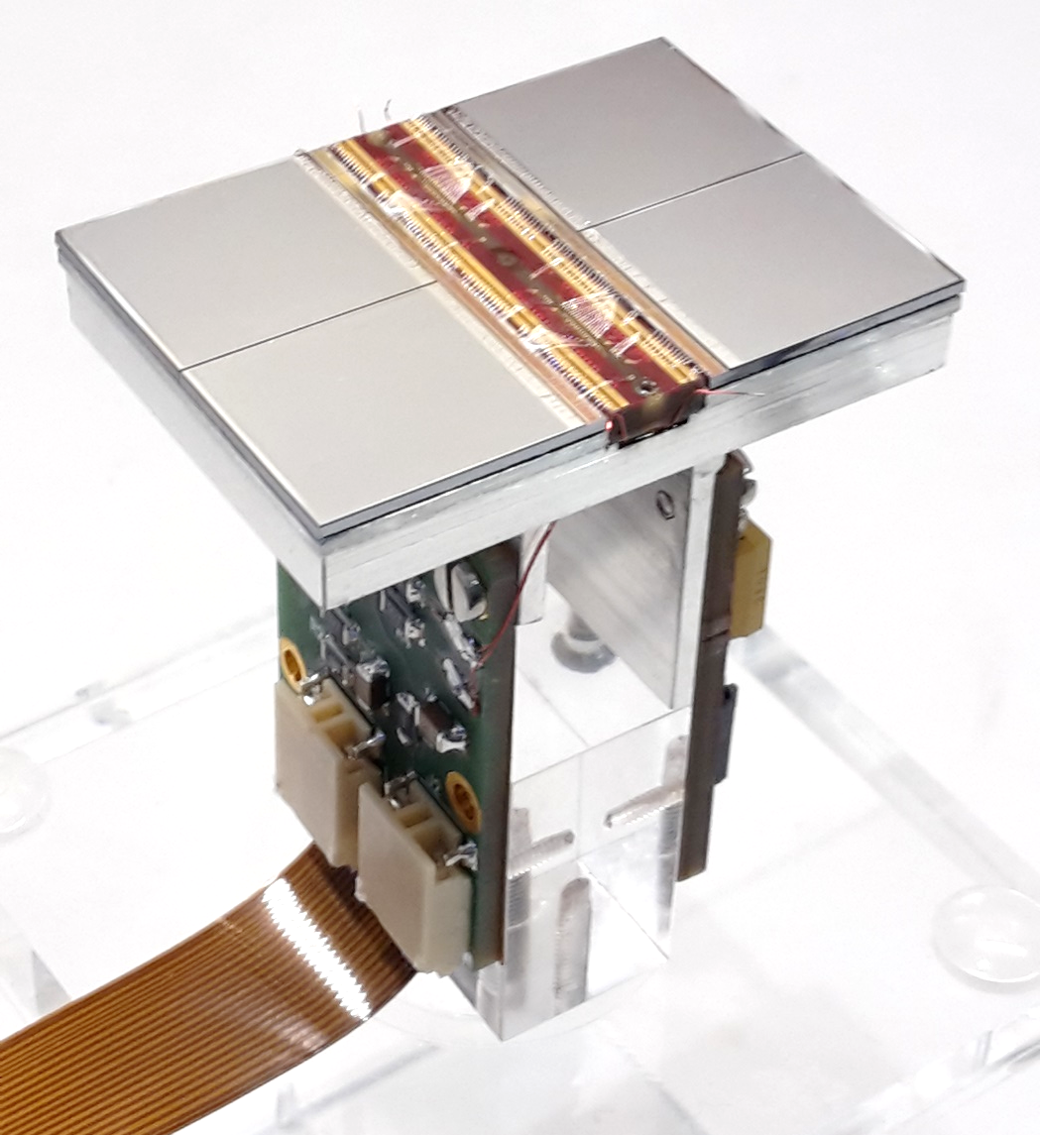
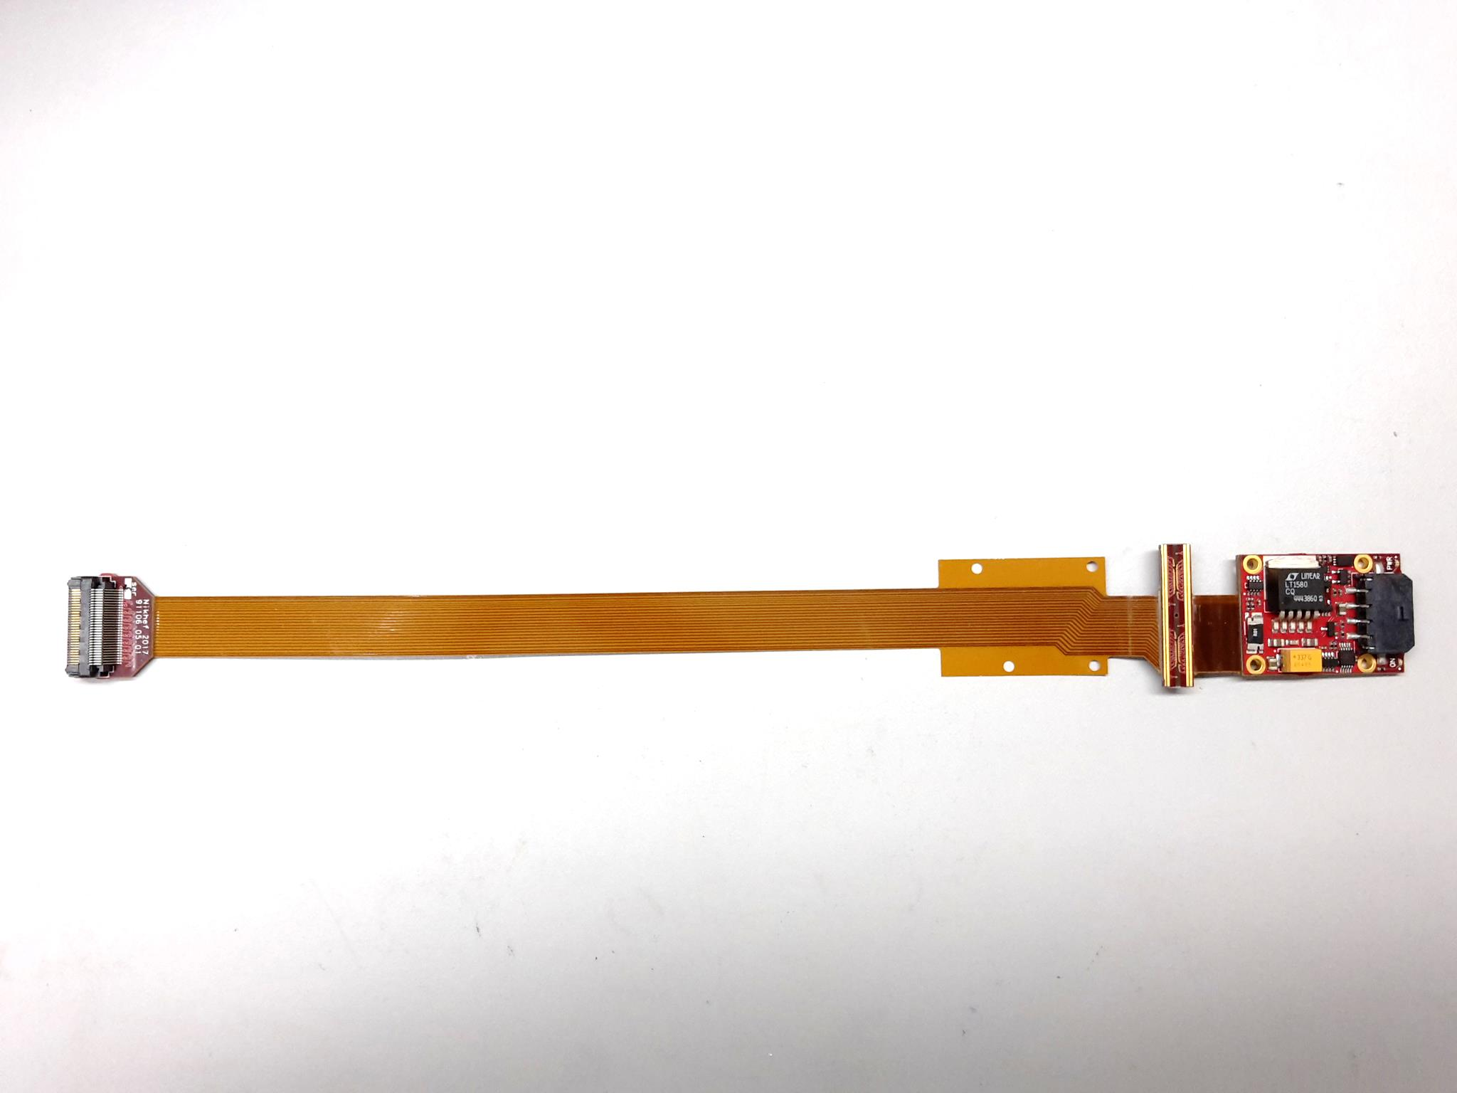
QUAD design and realization
Four-TimePix3 chips
All services (signal IO, LV power) are located under the detection surface
The area for connections was squeezed to the minimum
Very high precision 10 μm mounting of the chips and guard
QUAD has an sensitive area of 68.9%
DAQ by SPIDR
39.6 x 28.38 mm
series of QUADs
Guard
TPX3
TPX3
TPX3
TPX3
COld
CArrier

Slide 12
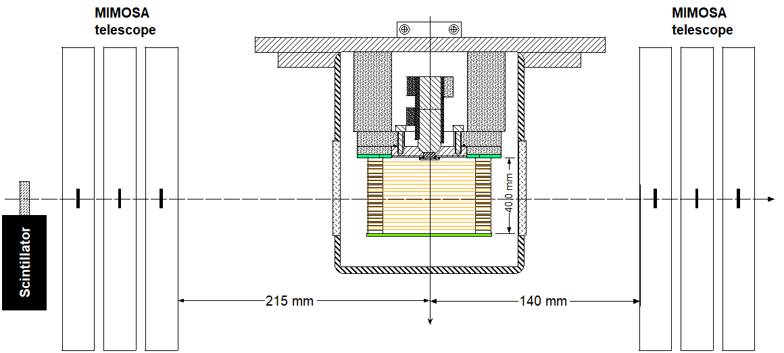
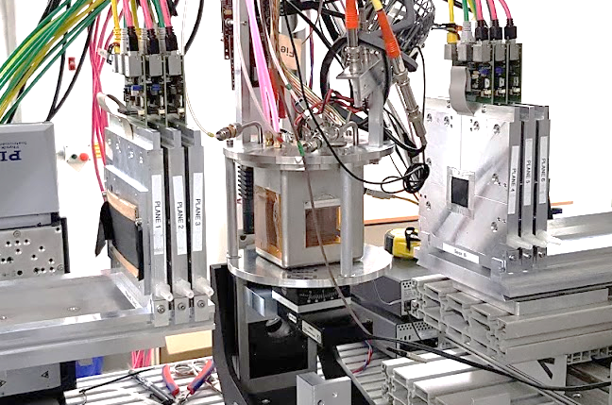
QUAD test beam in Bonn (October 2018)
ELSA: 2.5 GeV electrons
Tracks referenced by Mimosa telescope
QUAD sandwiched between Mimosa planes
  Largely improved track definition
Gas: Ar/CF₄/iC₄H₁₀ 95/3/2 (T2K)
E_{d} = 280 V/cm, V_{grid} = -300 V
Typical beam height above the chip: ~1 cm
Preliminary results will be presented here
QUAD
40 mm
@Bonn
Field cage

Slide 13
QUAD time walk results
Preliminary
Preliminary
Time walk correction works well
Applied for all analysis results

Slide 14
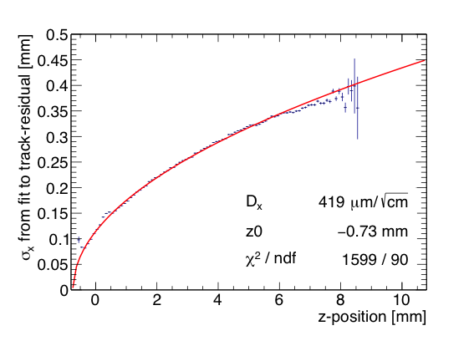
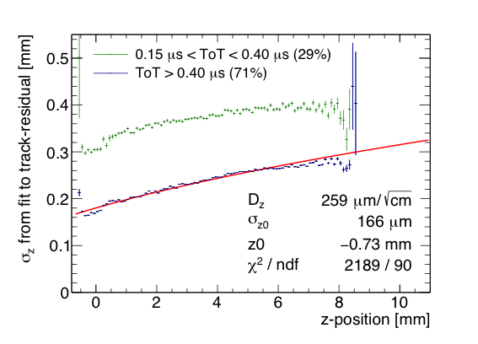
QUAD single hit resolution
Transverse
Longitudinal
Preliminary
Preliminary
D_{T} = 419 μm/√cm
D_{L} = 259 μm/√cm

Slide 15
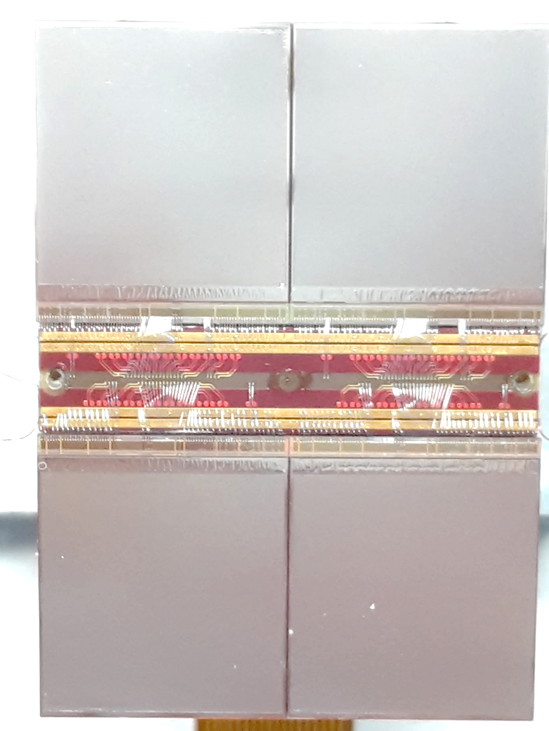
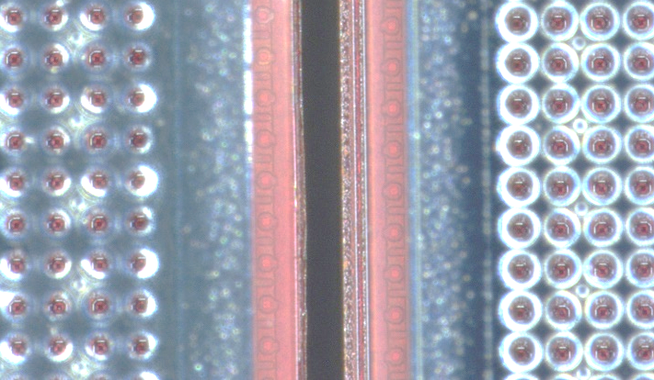
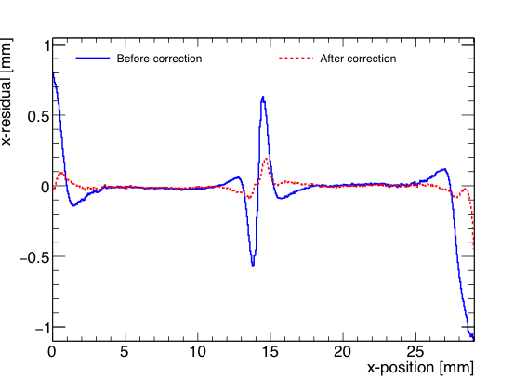
QUAD edge deformations
Small deformations due to
  Dead zone between chips
  Grounded region between chips
Are corrected by:
  fitted correction function
  adding proper guard wire electrode
Grounded region
Preliminary

Slide 16
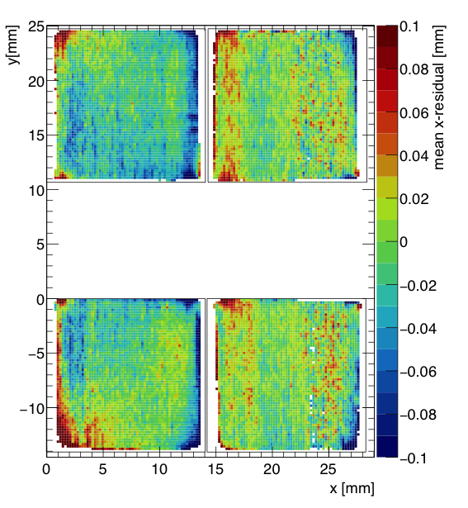
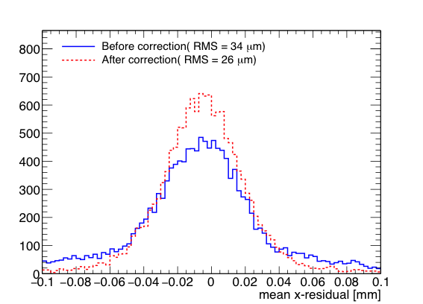
QUAD deformations in transverse plane (XY)
After applying fitted edge corrections
RMS of the mean residuals are 26 μm over the whole QUAD
XY
Preliminary
Preliminary

Slide 17
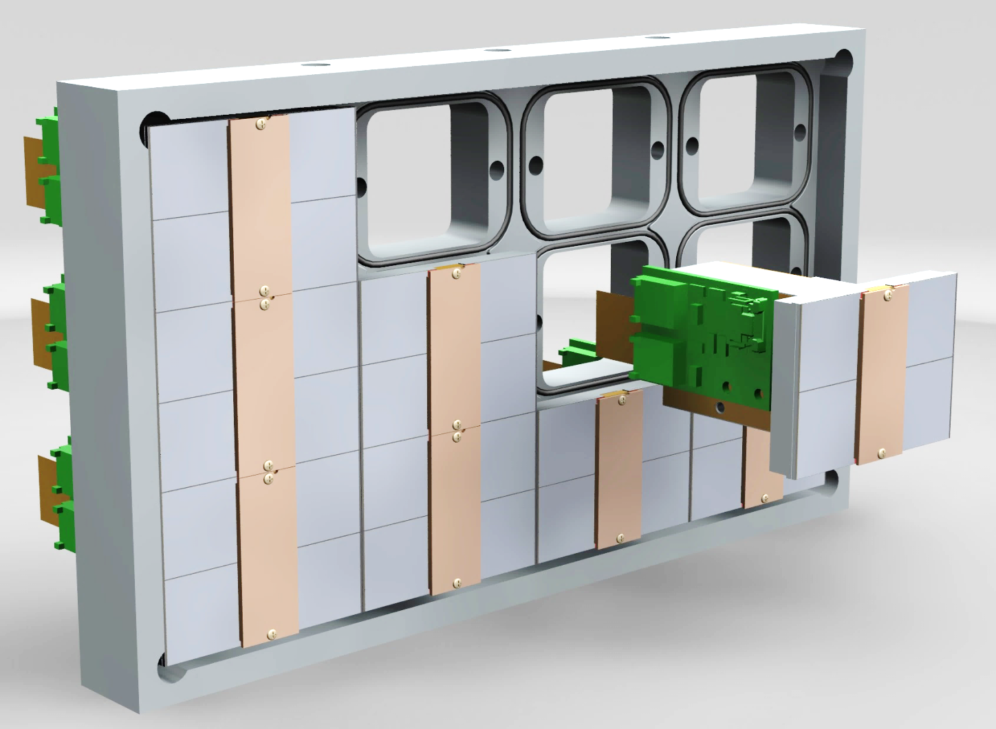
Next: QUAD as a building block
Cooling channels
8-QUAD module
Guard wires not yet installed

Slide 18

Conclusions
Since 2017 three TimePix3 wafers were successfully equipped with an InGrid
A single chip GridPix detector from this production was reliably operated in a test beam in 2017
  Single electron detection => the resolution is primarily limited by diffusion
  Systematic uncertainties are low: < 10 µm in the pixel plane
  dE/dx resolution for a 1 m track is 4.1%
  Preliminary results from a recent 2018 QUAD test beam were presented
  Data quality and resolutions are similar to the single chip test beam results
Small edge deformations at the boundary between two chips are observed
  We will add guard wires to the module
A production of 14 QUADs is finished
  QUADs are installed in an 8-QUAD module

