Slide 1
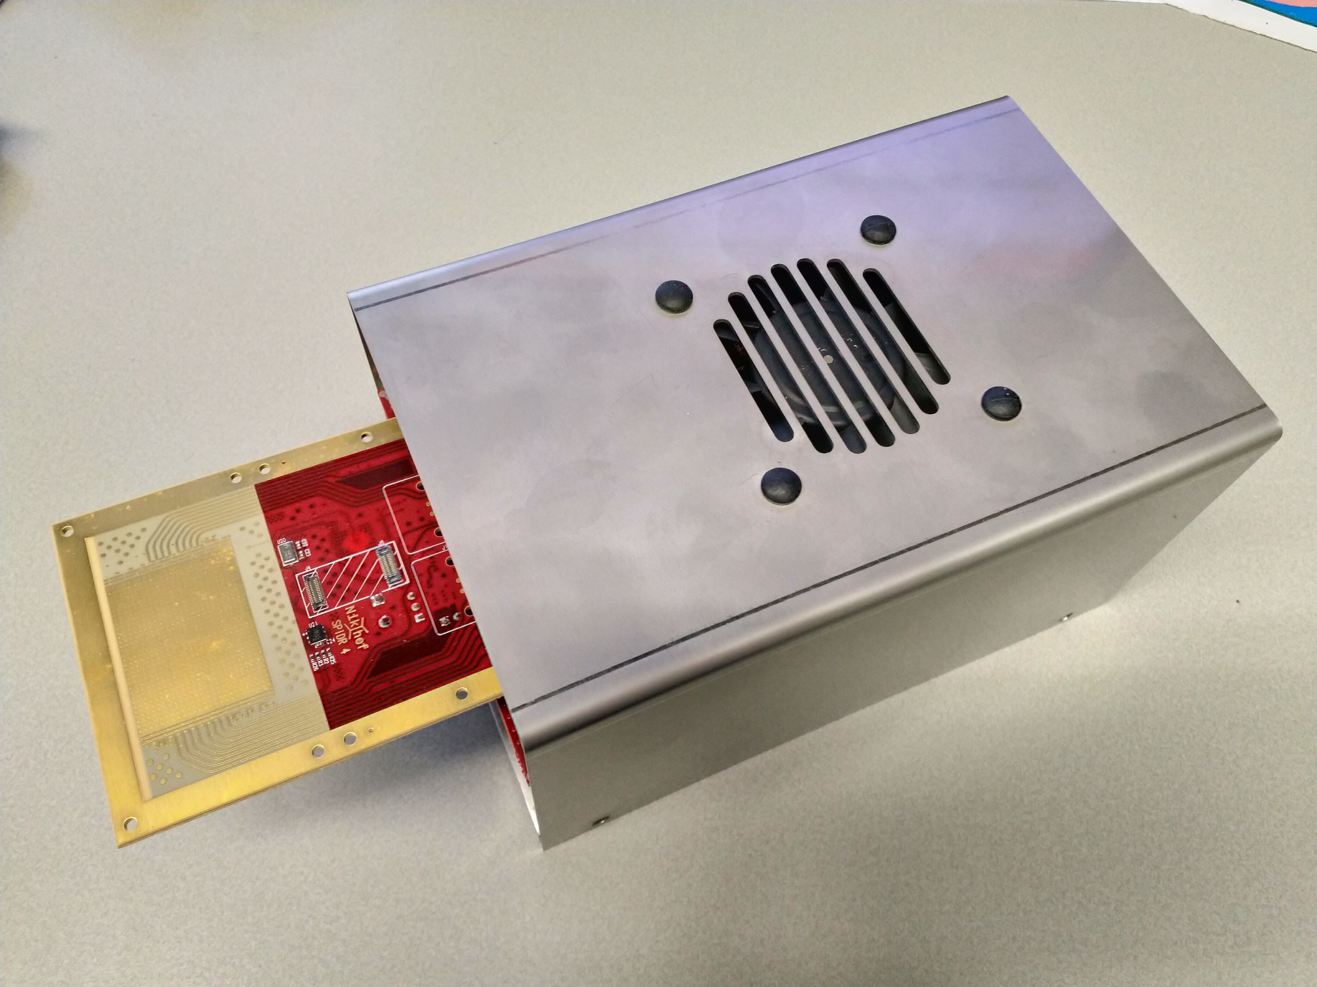
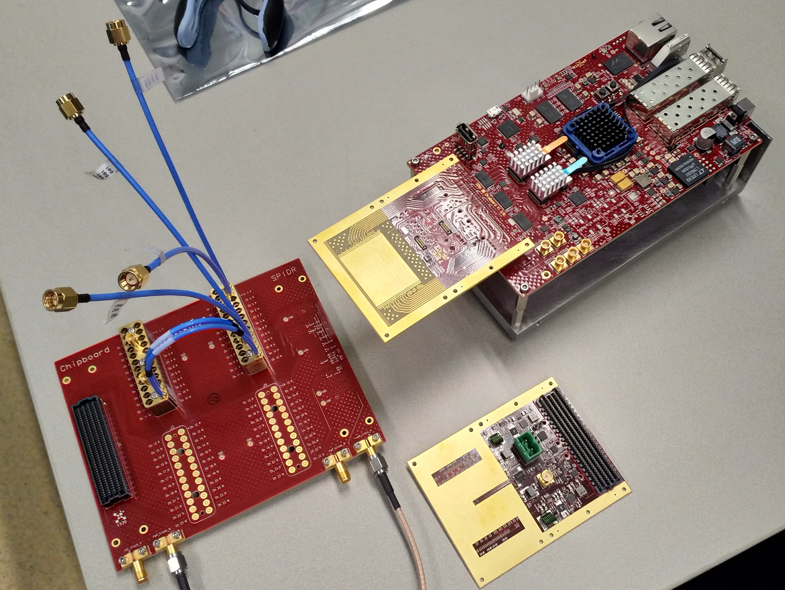
SPIDR-4:Timepix4 readout system
SPIDR4 team:
Nikhef:
Bas vd Heijden
Charles Ietswaard
Vincent v Beveren
Henk Boterenbrood
Berend Munneke
Martin Fransen
ASI:
Kiavash Matin
Bram Bouwens
Jord Prangsma
Steven Tan
ET
Everything works!
CT
MT
R&D
Last years Jamboree
Agile working pilot project

