Slide 1
Gravitational Waves
Update GW analysis/O3
Virgo upgrade
Update drilling campaign
Update ETpathfinder
Update GW group
Chris van den Broeck & Frank Linde

Slide 2
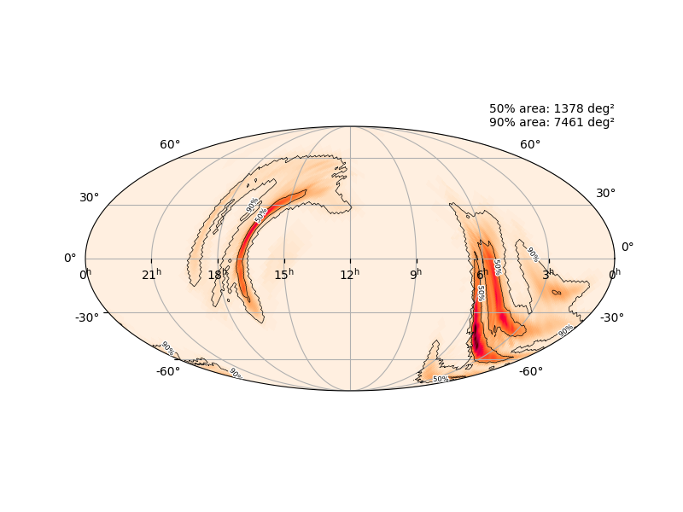
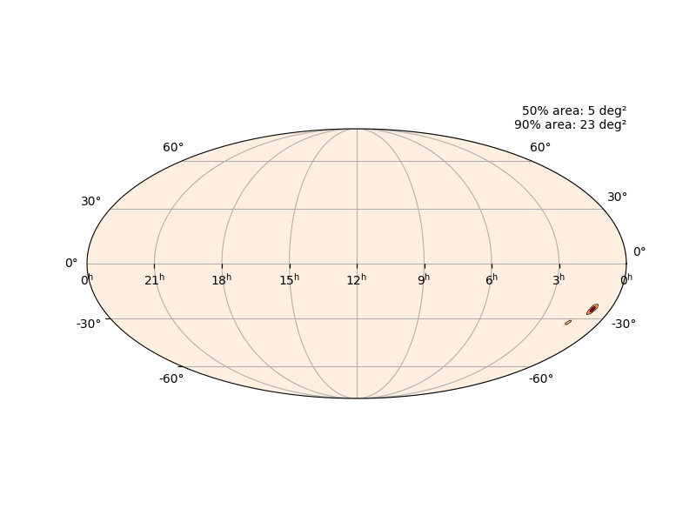
Harvest of the third observing run (O3)
Started 1 April 2019
41 events with public alerts (8 retracted)
  https://gracedb.ligo.org/superevents/public/O3/
  Notable high-significance events:
    Binary neutron star? (S190425z)
      LIGO Livingston + Virgo
      No good sky localization
      No counterpart found
    Neutron star-black hole? (S190814bv)
      LIGO Livingston + LIGO Hanford + Virgo
      Excellent sky localization but no counterpart found
    Many binary black holes

Slide 3
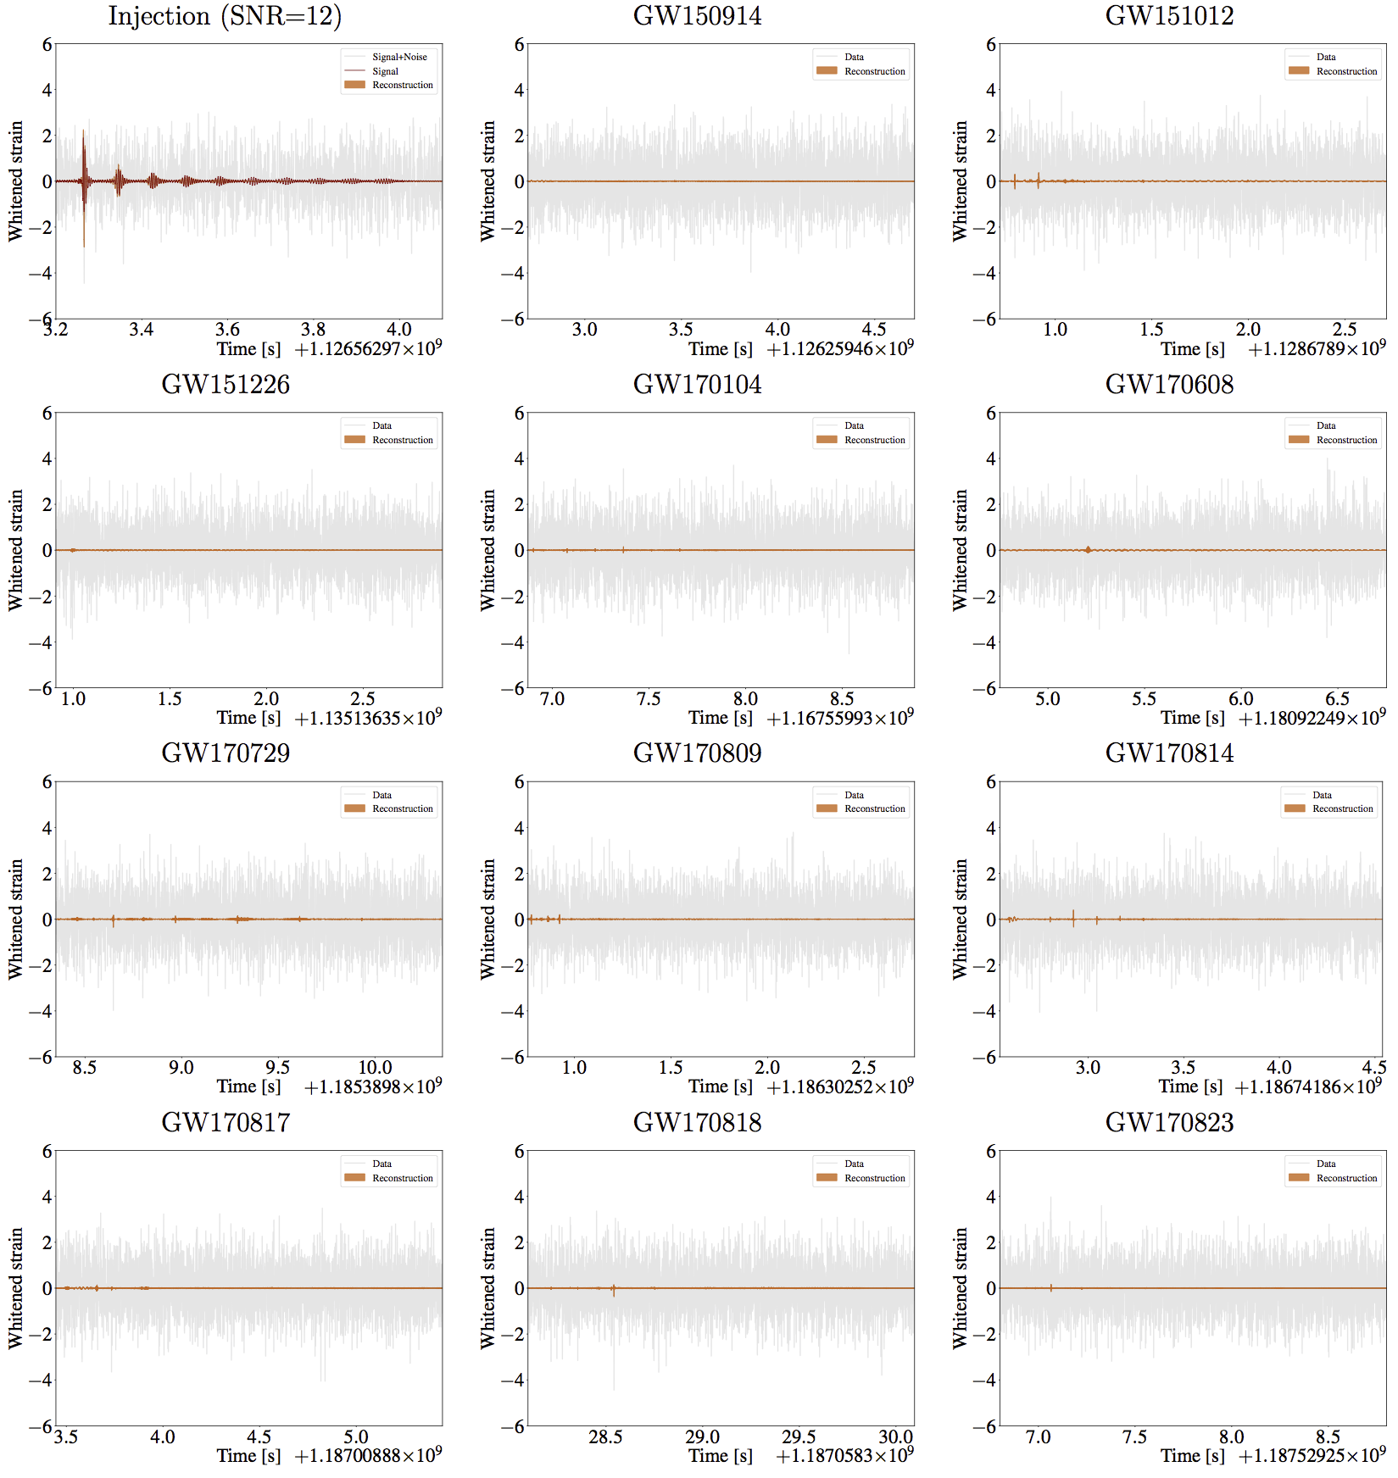
New data analysis methodology
What happens after neutron stars merge & how do we find out?
Black holes, or something else?
Searching for gravitational wave echoes

Slide 4
Virgo upgrade: frequency dependent squeezer

Slide 5
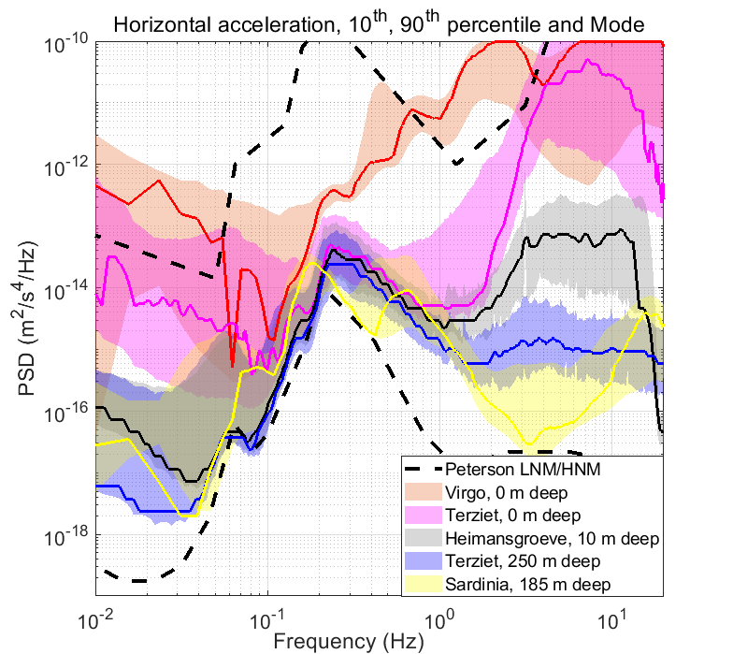
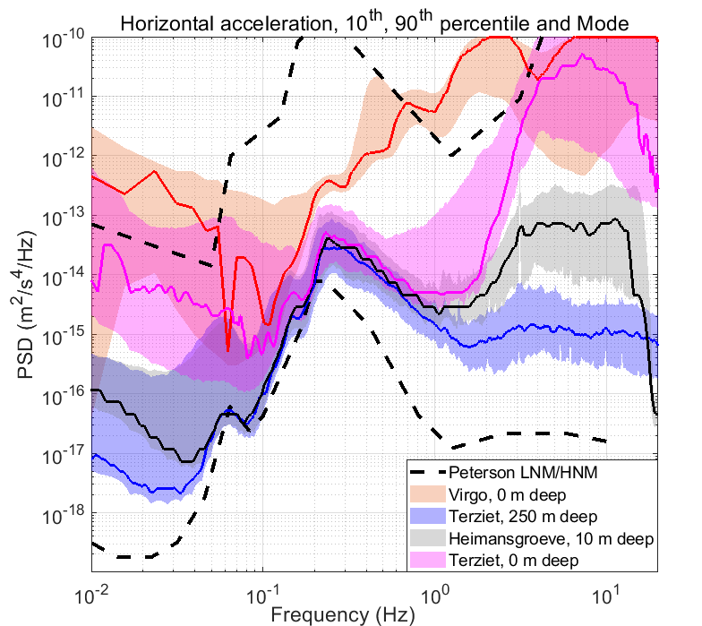
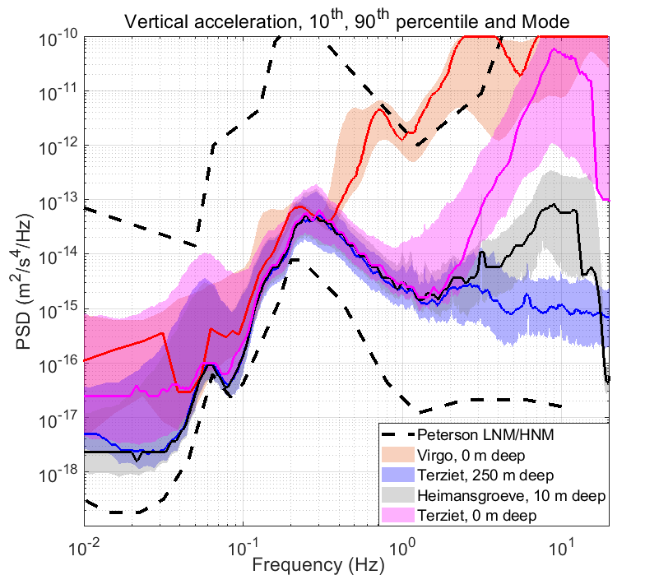
Terziet trilling campaign
0 m
-10 m
-250 m

Slide 6
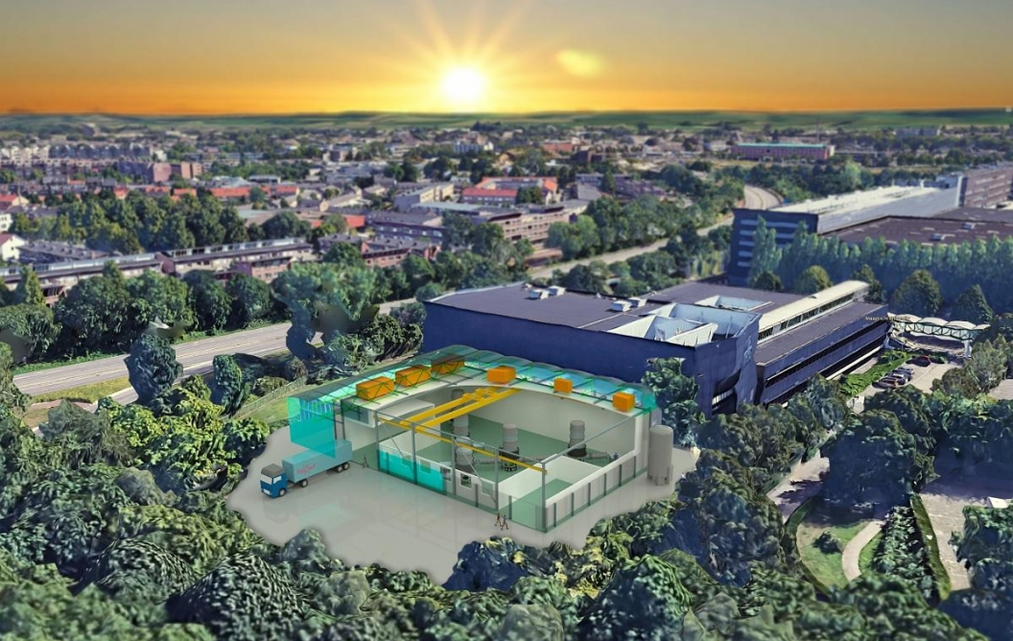
Update ETpathfinder

Slide 7

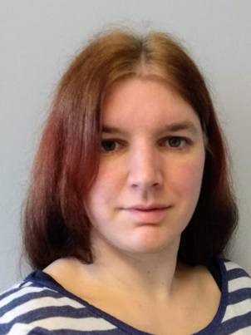

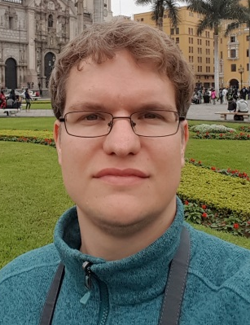

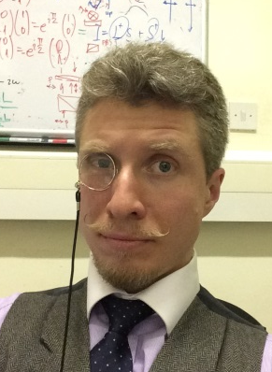

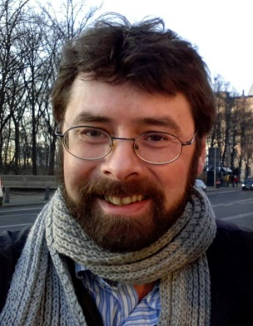


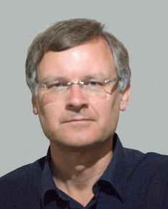

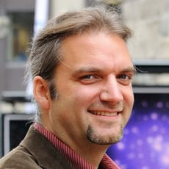
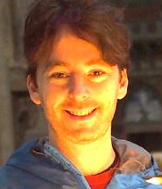

Update GW group
Stefan
Jessica
Gideon
Sebastian
Stefan
Chris
Paul
Andreas
Conor

