Slide 1
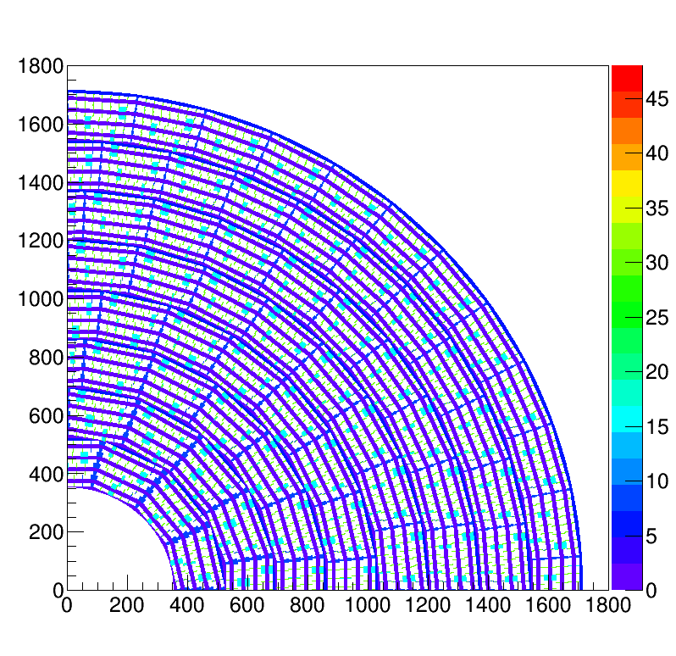
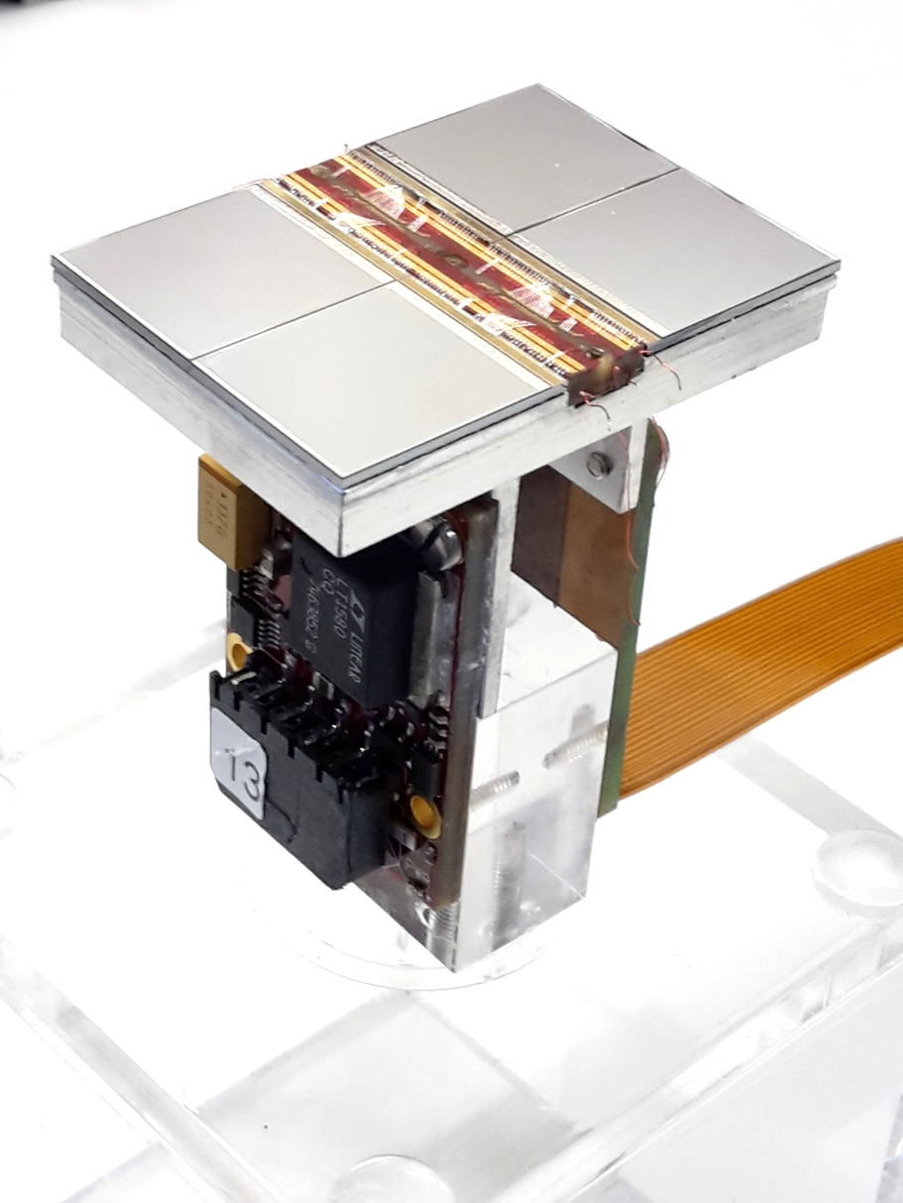
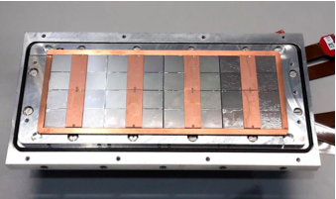
Pixel TPC
Single chip Quad Module TPC plane
2017 2018 2019

Slide 2
QUAD testbeam results: VCI & MPGD 2019
Transverse
quad top view
Transverse deformations
Longitudinal
ground
Separate guard and guard cage (around quads)
Add proper guard wires over chip boundaries
Preparing for 8-quad module test beam DESY december 2019
Guard

Slide 3
QUAD results
Preliminary
8-quad module
one quad uncorrected deformations (laser)
quad corrected deformations (testbeam)
quad paper submitted
NIMA
rms 17 μm large box
rms of the mean transverse (long-z) residuals are 13 (19) μm over the whole quad

