Slide 1
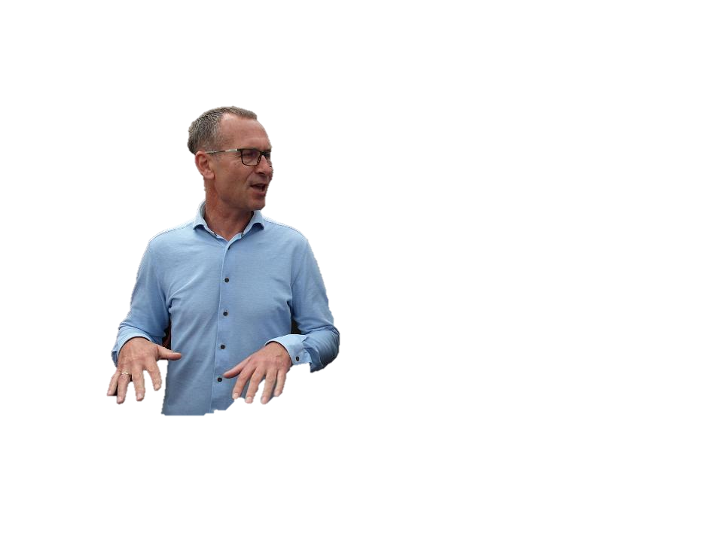
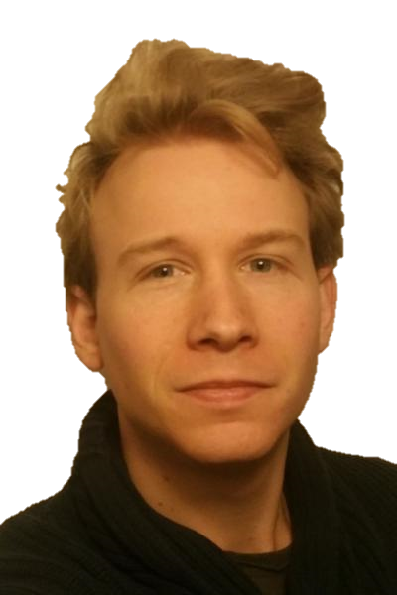
Conclusions MT Workshop Instrumentation @Nikhef focus and challenges (6feb19)
14 February 2019
Presentation by: Patrick Werneke
Presented by: Jesse van Dongen

Slide 2
Conclusions MT: Workshop Instrumentation @Nikhef
The cracks (between MT & ET/CT):
Controls - Automation
We need a person (like FS) for the future
No clear agreements if this person should be MT, ET or CT - to be decided
Harness & cable routing:
Very important for the operation of detectors – high speed readout
Harness design should be responsibility ET
Implementation in NX will be done by MT (NX Electrical routing)
Controls need to be followed up with MT, ET, CT and DT

Slide 3
Conclusions MT: Workshop Instrumentation @Nikhef
The flexibility within the MT (i.e. workshop)
Resources are limited. Manpower limit is set to 26 fte
The ratio between workshop and engineering cannot be changed rapidly
1 fte in the workshop flexible for projects – including projects currently without workshop manpower: GW, XENON, VELO Modules, eEDM
Options:
From within the project: plan your work!
1 flexible fte, but often very busy – prioritize for this fte better
Switch manpower between projects – usually causing more problems
Outsourcing
Do not know what to do more than what we are doing now!

Slide 4
Conclusions MT: Workshop Instrumentation @Nikhef
3D printing
Train better our designers – tolerances need special thinking
Buy some decent machine, and use it!
We have a SLA and FDM printer for small prototypes
SLS printers are still expensive and require special attention: explosion danger, exposure to chemical agents and significant manpower.
Conclusion:
Train our designers and motivate them to use 3D printing
Start using topology optimization in NX
Keep following the development of 3D printing

Slide 5
Conclusions MT: Workshop Instrumentation @Nikhef
Carbon fiber structures
CF structures difficult to outsource
Get more knowledge by doing more
Not enough work to justify large investments in knowledge and lab.
Acknowledge that CF structures are an important technology
Outsourcing carbon fiber structures is “expensive”
A lot of knowledge is available at Dutch universities and companies
Conclusion:
Will not invest in infrastructure – room temperature curing is always possible
Develop CF structures together with outside universities and/or Dutch companies: TU Delft, InHolland, Windesheim, NLR and other Dutch companies - worked very well in the past.

Slide 6
Conclusions MT: Workshop Instrumentation @Nikhef
Measuring tools
Little knowledge/equipment for measuring large structures
Contactless measurement options minimal
Measurement systems old
Working group measuring systems: Berend, Krista & Martijn
Last 15 years not much invested on measurement tools
Conclusion:
Proposal to invest in new large CMM for contact and contactless measurements
We will review the measurement systems we have and check if investments are needed including laser tracker, photogrammetry, strain gauges.
Review if knowledge of the systems is still up to date.

Slide 7
Conclusions MT: Workshop Instrumentation @Nikhef
Working together with companies
Little knowledge of working together with companies
Projects prefer in house: manpower is for free – focus is internal
Most people within the MT have no network
Working with Jan Visser to improve working with companies
KM3NeT working with Windesheim, MCAP and possibly FMI
ETpathfinder working with TU Eindhoven, TU Twente and possibly Settles Savenije and Janssen precision engineering.
Conclusion:
Working with companies is difficult. Working with Jan Visser to improve
Should there be an incentive for projects to work with companies?

Slide 8
Conclusions MT: Workshop Instrumentation @Nikhef
Further Conclusions:
Make joining techniques a real MT competence
Improve the knowledge on materials
Knowledge of cryogenics should stay in the MT
Find a replacement for Martin Doets ASAP
Setup an MT knowledge / competence matrix
Improve team spirit between MT, ET and CT
Get MT involved in R&D: develop knowledge in MT for future detectors!

Slide 9
Conclusions MT: Workshop Instrumentation @Nikhef
Further Conclusions:
Failure analyses (FMEA): no knowledge within MT – outsource if needed
Knowledge of MEMS: not an MT priority for the future
What to do with system engineering? Need more discussion how to implement.

