Slide 2
Plan S
Contents
Why Plan S?
Main characteristics of Plan S
From principles to implementation
Plan S and SCOAP3
Notes:
- Thanks for intro. Prepared some slides to introduce Plan S: what it is, where we are in the process.
- Conclude with some information on possible consequences for journals in your field, especially the SCOAP project.
- Have to stress: Plan S is still heavily under discussion / construction. Sure you have seen the debate in the national Newspapers. For the past 2 months there has been a consultation phase where everyone could give feedback to the proposals. In that contex: consultation meeting in NLs by NWO and Zonmw. More than 2000 submissions received. This will lead to changed / modications of the plan. But in what direction is still unclear.

Slide 3
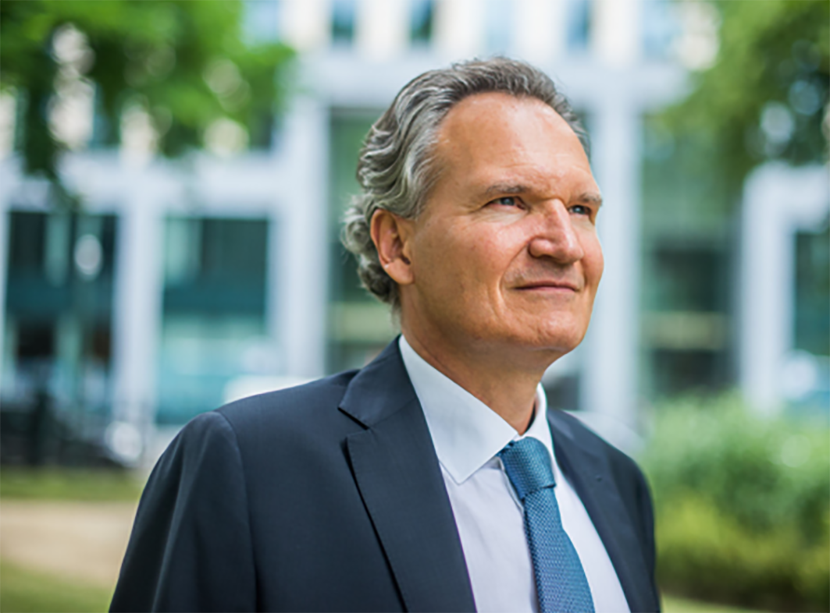
Plan S
Robert-Jan Smits
EU's special envoy on open access
Notes:
Initiative for Plan S was taken by Robert Jan Smit who was appointed special envoy open access a year ago by the Commission to come up with a plan to accelerate the transition to OA. Because

Slide 4
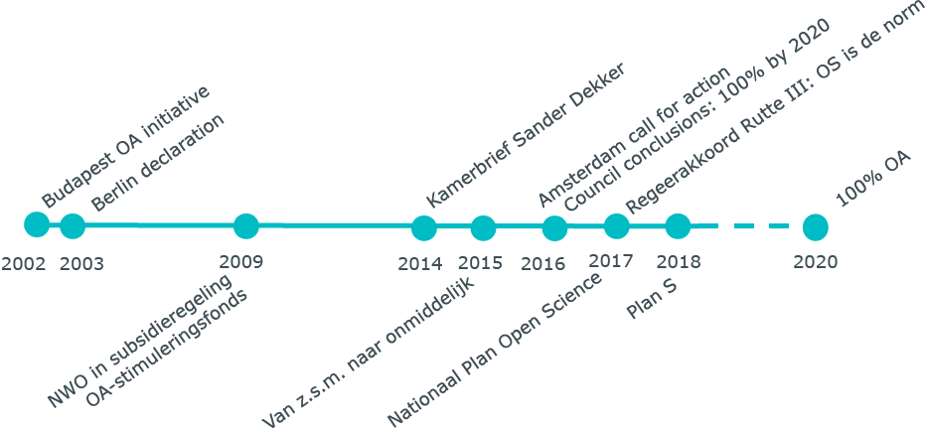
The long way to Open Access
Notes:
As is well known: OA has been out there for many years. Earliest statements go back at least 15 years. But progress is slow.

Slide 5
OA: where we stand
Source: VSNU
Notes:
These are some figures for the Dutch situation. Where you can see that roughly 50% of all articles published by Dutch researchers are openly available. If you look at the articles arising from NWO funding this picture is a little bit better. But…

Slide 6
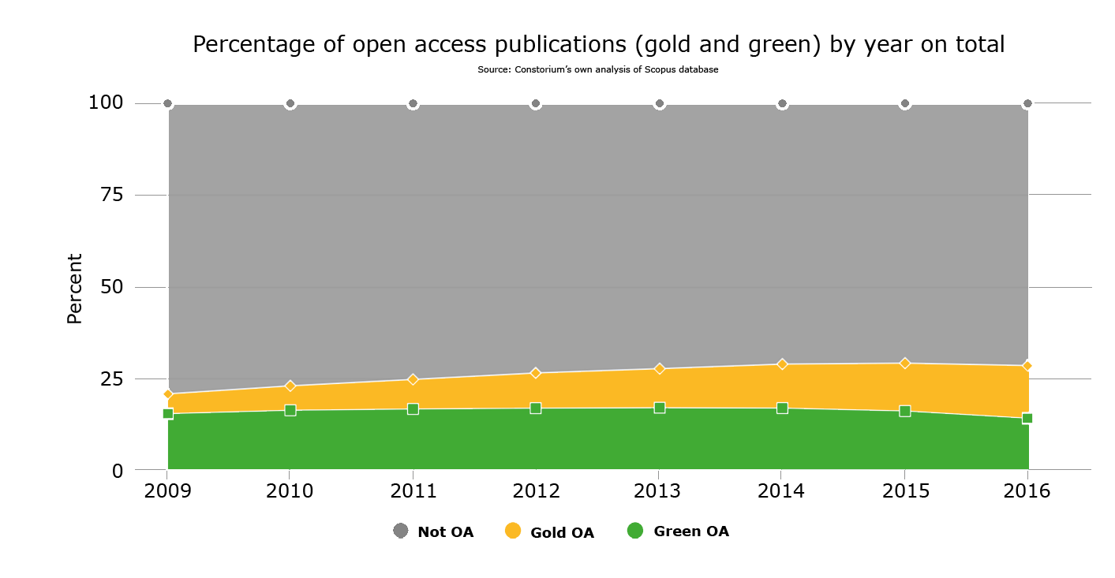
But internationally…
Bron: Open Science monitor EC
Notes:
The international situation is not positive at all. These are figures by the European Commission showing that progress has been very slow and only 25% of the output is openly accessible. This is the main motivation for Plan S.

Slide 7
Main characterics of Plan S
What? A plan by research funding organisations …
… to accelate the transition to 100% Open Access.
How? Require that all publications arising from funding by members of Coalition S be published in journals that are fully OA or subscription based journals that allow self-archiving in repositories without embargo.
Publication in hybrid journals only allowed when covered by transformative agreements (untill 2025).
Requires: that publishers and journals change their policies and business models.
Notes:
What is Plan S?
It is a Plan by funding councils. Its aim is to accelerate the transition to full and immediate OA.
How? By aligning the grant conditions of as many funders as possible and to require all researchers funded by these councils to either be publish in full gold OA journals ór in closed journals that allow self-archiving articles in an Open Access repository.
Plan S also wants to put an end to the so called hybrid model of OA. It is allowed but only for a transition period of 5 years and only if these journals are covered by a transformative agreement.
This requires that publishers change there policies and really move to full and immediate OA. Not cessarily gold APC-based model. Plan S does not favour any specific business model. Goal is to speed up the move to full and immediate OA.

Slide 8
Who is Coalition S?
15 national reseach councils
3 charities
Supported by
Notes:
Of course this plan will only succeed if enough funders support Plan S.
So the aim is to bring together a coalition that is as big as possible.
Now there are 15 national research councils
3 charities
Also supported by the ERC and EC. Idea is that the requirements of Plan S will also be applied to the grants from the next Framework Program HorizonEurope.

Slide 9
Proposed routes to compliance with Plan S
Full OA-journals or platforms (= gold, diamond, etc.) | Deposition of articles in OA repository (= green) | Hybrid journal (until 2025)
Provided journals comply with quality criteria of Plan S (e.g. solid peer review and transparancy of APC’s (if any). | Immediately (no embargo) Version of Record or Author’s Accepted Manuscript. | Provided these journals are covered by a transformative agreement that has a clear and time-specified commitment to convert journals to full OA.
Required for all routes: immediate OA (no embargo), CC BY licence, full copyright retention.
Notes:
This slide shows what – boiled down to its very essence – is the core op Plan S.
It is proposed that there will be three routes to compliance with Plan S.
Gold / Green / Hybrid
For all three routes it is required that the publication is OA immidiatly, that a CC BY license is applied and that the copyright is retained by author (not handed over to publisher)
And there are additional requirements for every route.
The intention of these requirements are to really induce the transition to OA and incentivize publishers to make the move to full OA.

Slide 10
Support, monitoring, evaluation
Where publication fees are applied they will be covered by funders or universities
COAlition S will consider to cap / maximize APC’s but will first commission a study on OA publication costs and fees (including APCs).
If no HQ journals exist in certain fields cOAlition S will stimulate that new journals / platforms will be established.
Funders will monitor compliance.
Plan S will be evaluated in 2023 to look into effects (especially of transformative agreements)
Notes:
In the interest of time I will skip this slide. Main message is that Plan S is not only about setting requirement and putting pressure on publishers to change. There are also accompanying measures. One of the most important is the promise that funders agree to cover publication fees. Also to stimulate the estabilsment of OA journals where no OS options exist.

Slide 11
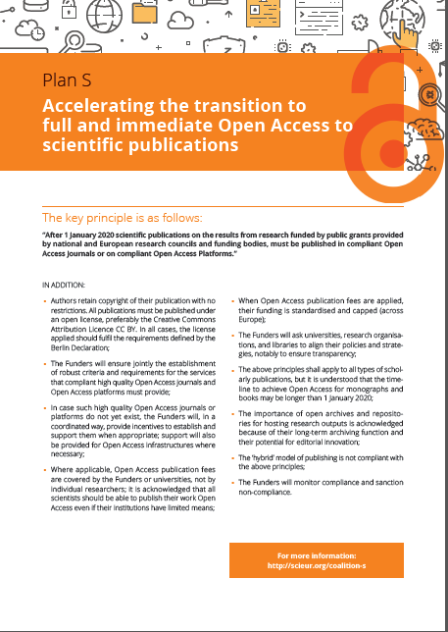
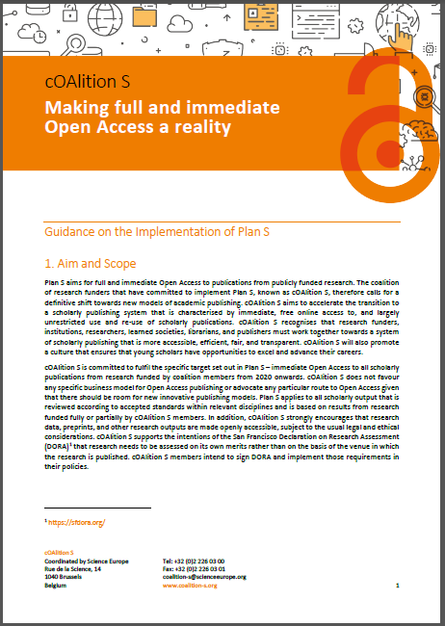
From principles to implementation
Revised Guidance document
Implementation
sept. 2018 nov. 2018 until 7 Febr. 2019 Q2 2019 (?) Q3 2019
Start
Plan S
1/1/2020
Launch of Plan S.
1 key messages and 10 principles outlining the plan
Publication of Guidance to implementation
Consultation phase. More than 1000 (!) reactions received
Revision of Guidance document bij Coalition S
Implementation of common policies by national funders
Notes:
In a nutshell this is Plan S.
This slide shows how the proces looks like.
Plan S was launched in september.
End of november an Implementation document was produced and a consultation was started.
This consultation has run untill 7th of February.
The coalition has received a lot of feedback. More than 1000 submissions. This will have to be analysed and reviewed and will lead to an adapted plan.
Only when we have this adapted plan it is possible to start implementing locally.
\Whether it will be feasable to start Plan S on the intended date of 1 januaru 2020 remains to be seen.

Slide 12
Plan S and SCOAP3
SCOAP3 is essentially a Transformative Agreement.
Money formerly used to pay for subscriptions is pooled to pay for APC’s in 13 journals covering 90% of HEP publications
Thereby transforming these journals to full gold OA.
Notes:
Finally I would like to comment a little bit on the question of how Plan S will effect the journals in your field? Especially the journals that are under SCOAP3.
I think I can reassure you. In the world of OA SCOAP3 is very well known innovation. One that has attracted a lot of admiration.
This figure depicts how SCOAP3 works. You know this better than I do. I think.
Essentialy SCOAP3 can be seen as a Transformative Agreement. But one that has already resulted in the conversion of the journals to full OA.
Basically what happens is that money that formerly was used to pay for subscriptions is pooled and used to pay for publication fees of the global High Energy Physics community.
Thereby effectivly transforming these journals to full gold OA.

Slide 13
Is SCOAP3 compliant?
Basic mandatory requirments Plan S | SCOAP3 | Quality / technical requirements Plan S | SCOAP3
Immidiate OA (upon publication) | √ | Transparent information on costing and pricing on website of journal | ?
Copyright stays with the author / institution | √ | Use of DOIs as permanent identifiers | √
Application of CC BY licence | √ | Long-term digital preservation or archiving programme (such as CLOCKS) | √
Quality: solid system of peer review according to COPE standards | √ | Availability of the full text in format that allows for TDM | √
Automatic APC waivers for authors from low-income countries | √ | Link to underlying data, code | ?
 |  | High quality article level metadata | √
 |  | Machine readable metadata on OA status | √
Notes:
So are the journals covered by SCOAP3 compliant?
My impression they would.
Here I have listed all the requirements that are currently in the implementation document.
It is my impression that all requirements are being met.
Certainly the most important ones that I have made bold here.
Note there are 2 question marks. They dont mean the journals are not compliant. Just that I have not yet seen any information about it.
At this moment my impression would be the 14 journals covered by SCOAP are Plan S compliant.
If not: Plan S has to be changed.

Slide 14
Questions…?

