Slide 1
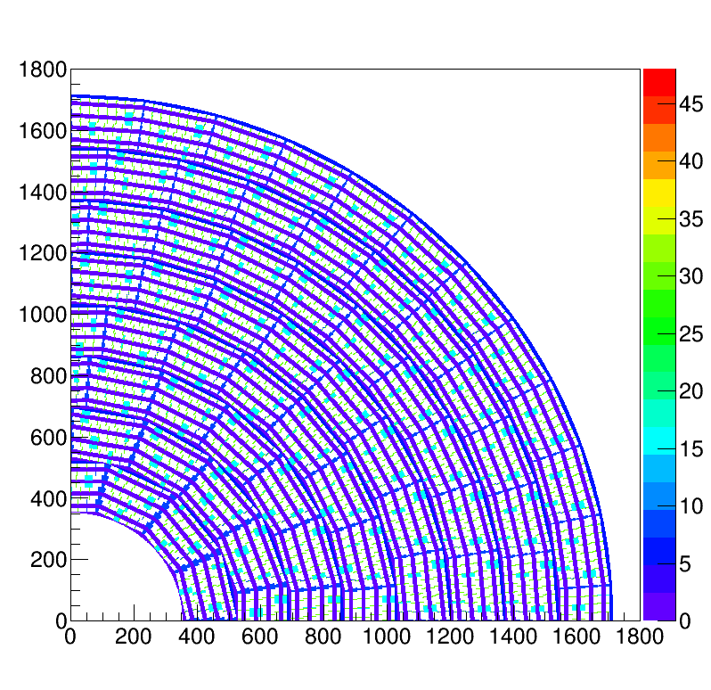
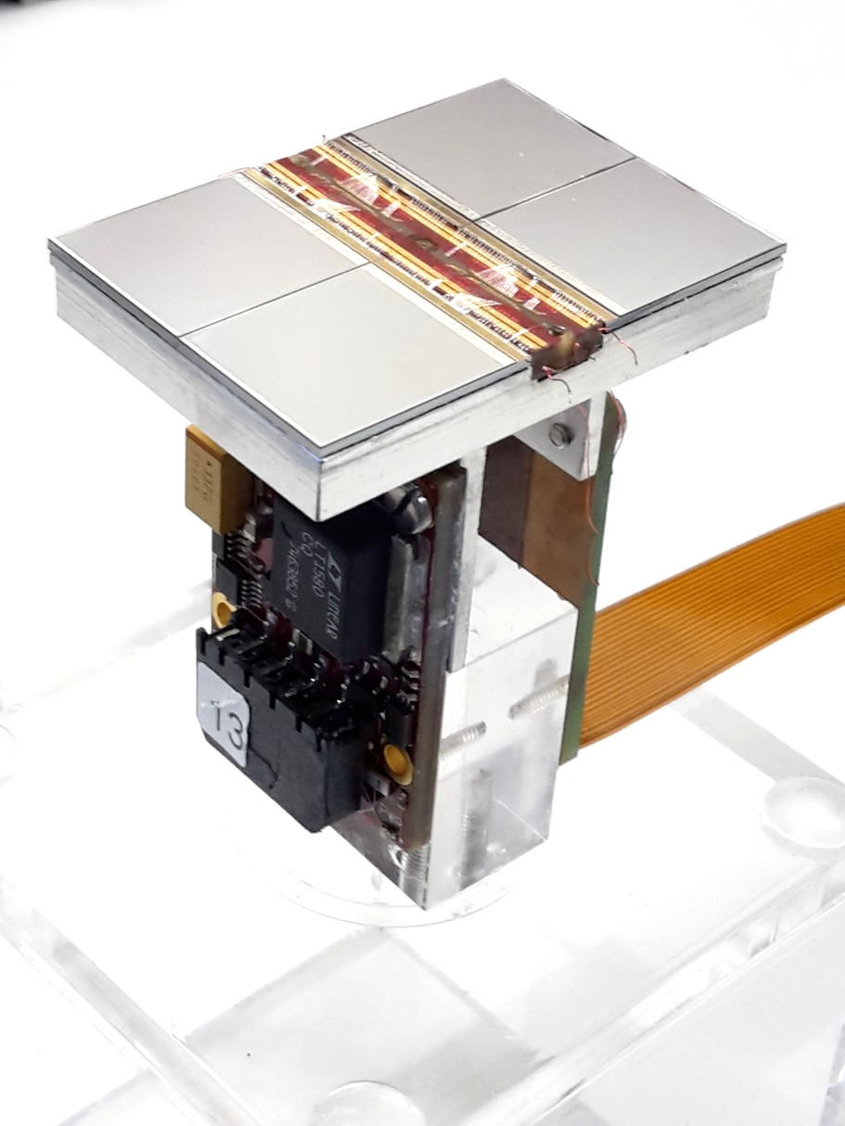
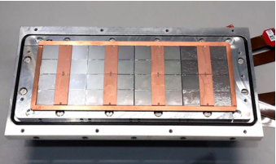
Pixel TPC
Single chip Quad Module TPC plane
2017 2018 2019

Slide 2
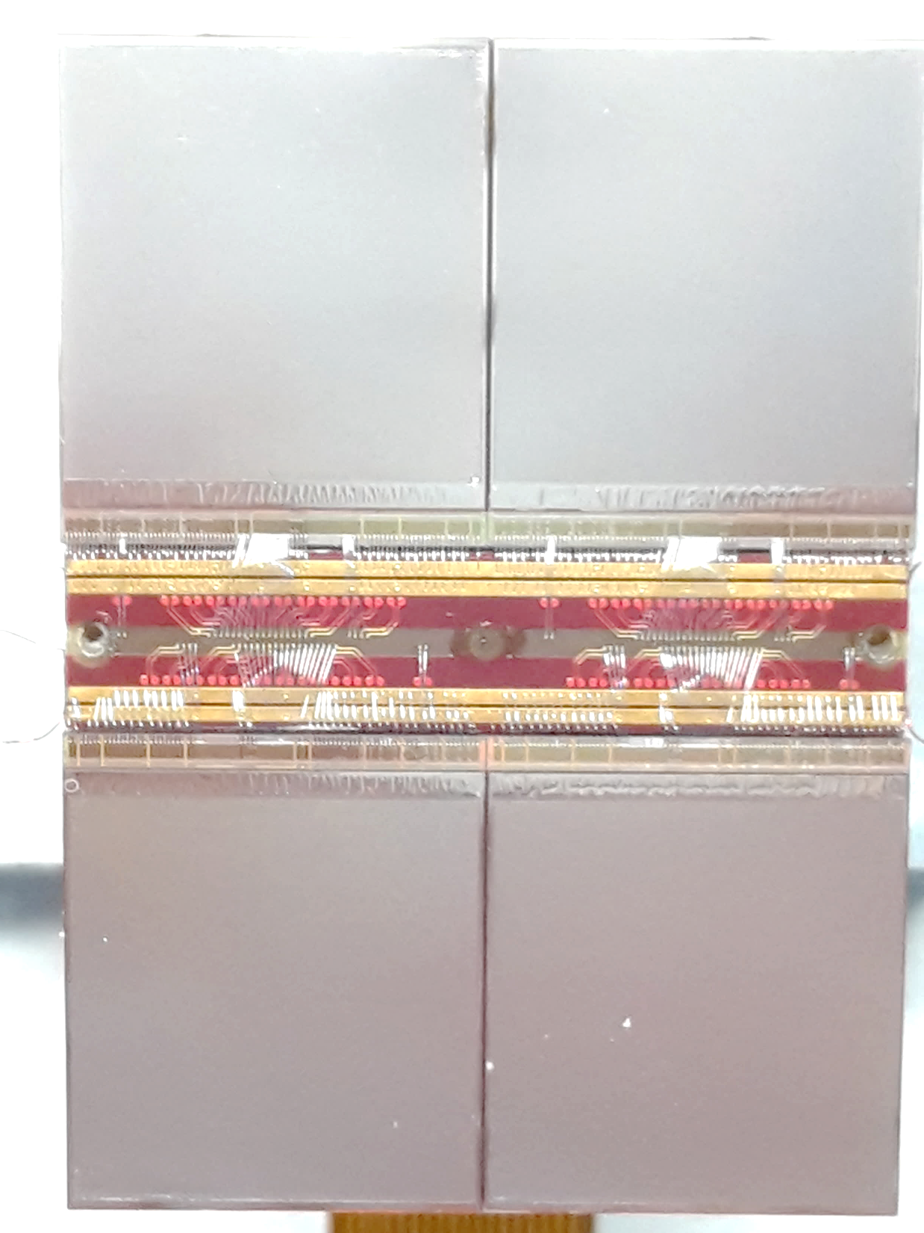
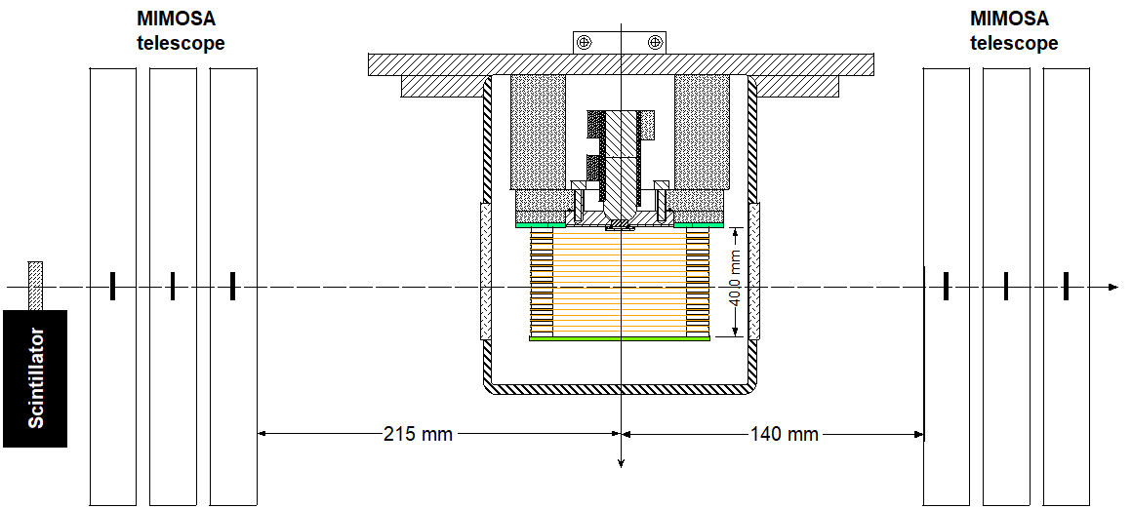
QUAD test beam in Bonn (October 2018)
ELSA: 2.5 GeV electrons
Tracks referenced by Mimosa telescope
QUAD sandwiched between Mimosa planes
Largely improved track definition
Gas: Ar/CF₄/iC₄H₁₀ 95/3/2 (T2K)
E_{d} = 280 V/cm, V_{grid} = -300 V
Typical beam height above the chip: ~1 cm
guard
QUAD
40 mm
@Bonn
Field cage

Slide 3
QUAD single hit resolution
Transverse
Quad top view
Transverse deformations
Preliminary
Preliminary
Longitudinal
ground
Guard
RMS of the mean residuals are 26 μm over the whole QUAD
For module: add proper guard wire electrode over chip boundaries

