Slide 2
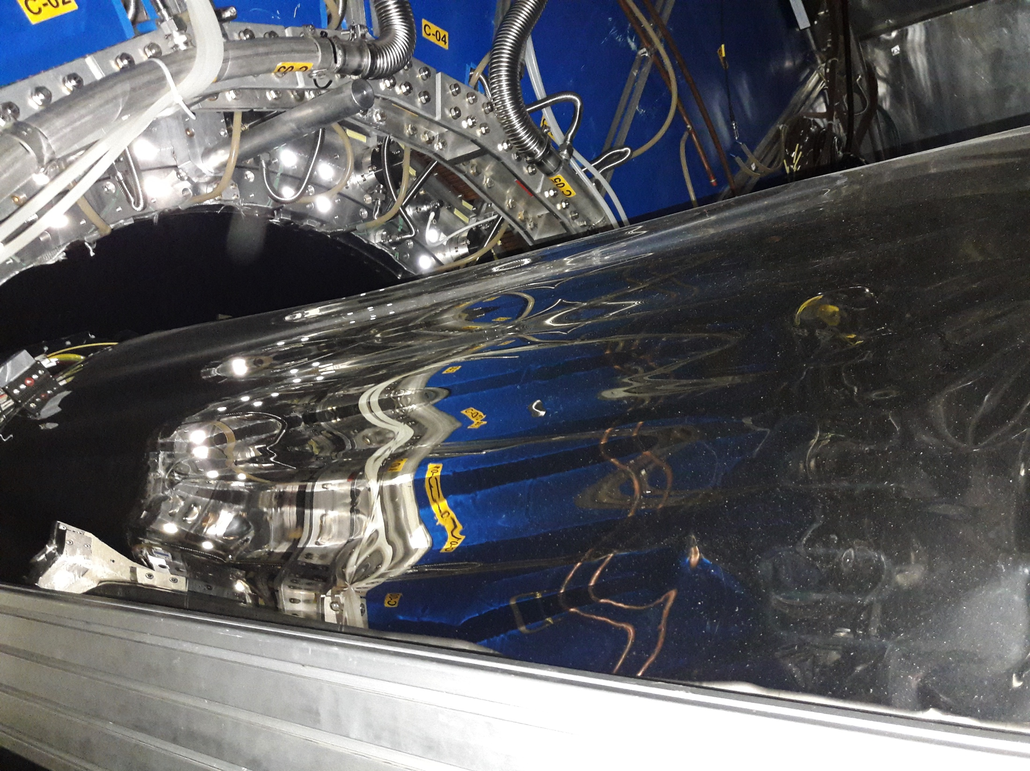
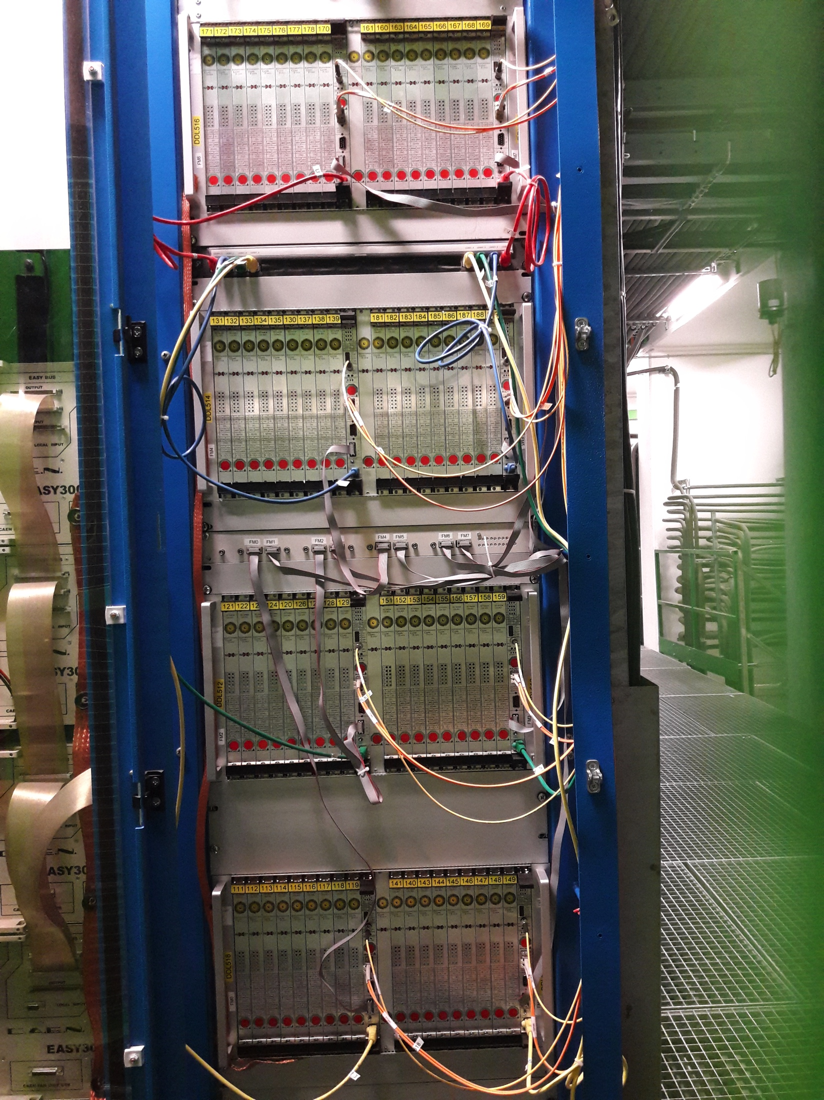
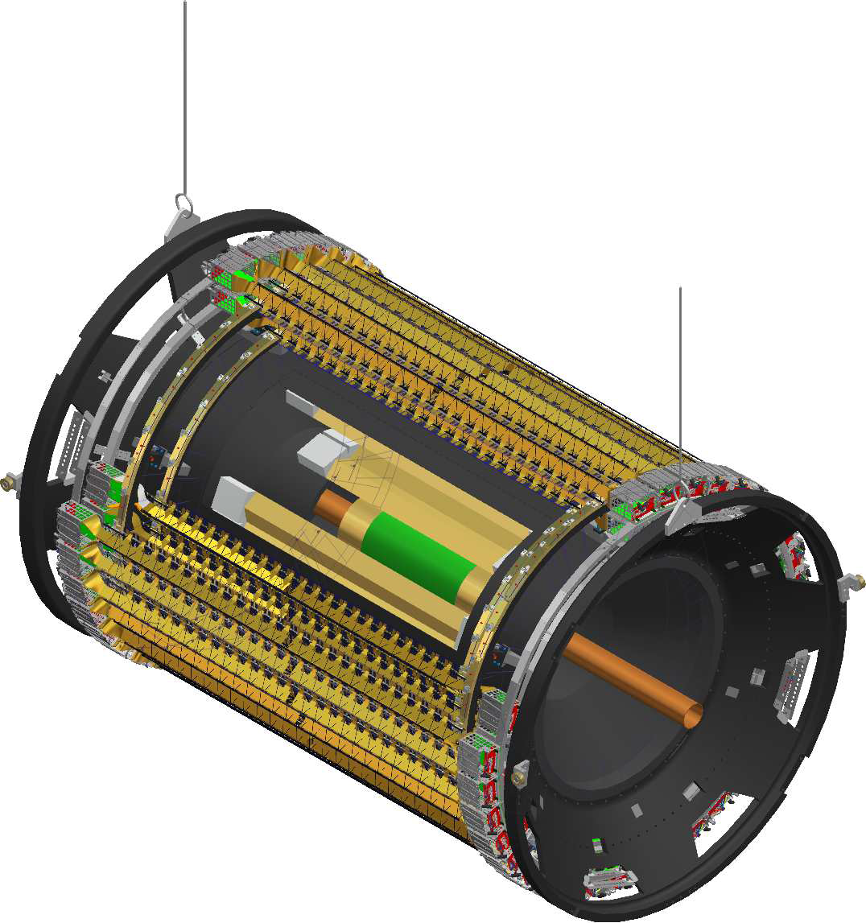
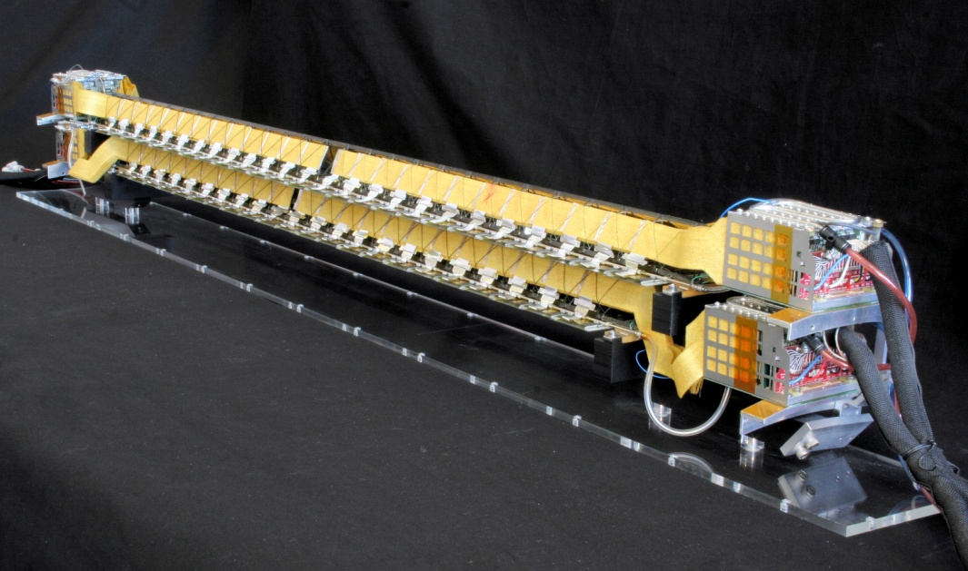
ALICE SSD removed yesterday
TPC
Read-out electronics to be removed soon
ITS
The ITS will get a second life at the ALICE exhibition at cern.
Each lab gets a smaller ladder display.

