Slide 1
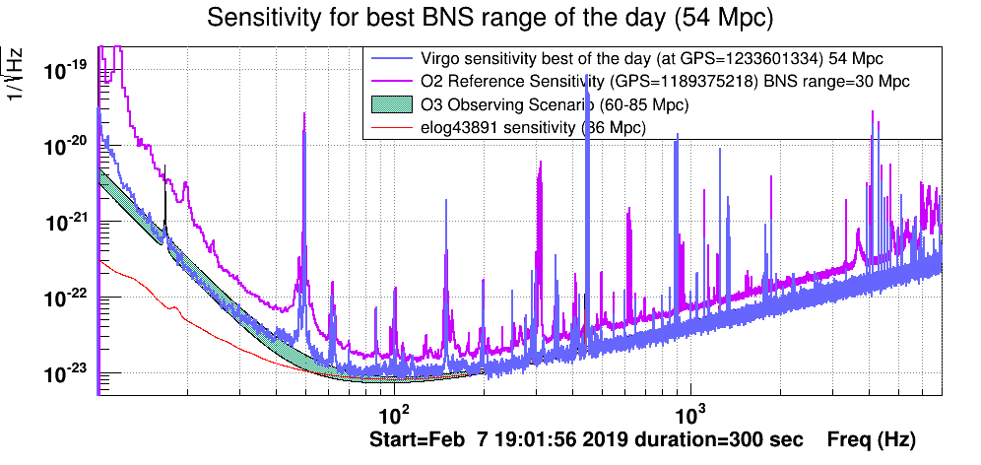
Gravitational
Waves
Virgo upgrades (‘NWO-groot’)
Virgo running (‘ENW-vrij programma’)
Einstein Telescope: consortium
ETpathfinder
politics
drilling …
‘Interreg Vlaanderen/Nederland’
Jo, Matteo, Bas, Martin, Alessandro, …
Early March:
start O3 engineering run
Late March:
start O3 observation run
End of 2019:
tens of detections?
Nikhef stafoverleg, 14 februari 2019
Sarah, Chris, Raimond, …

Slide 2
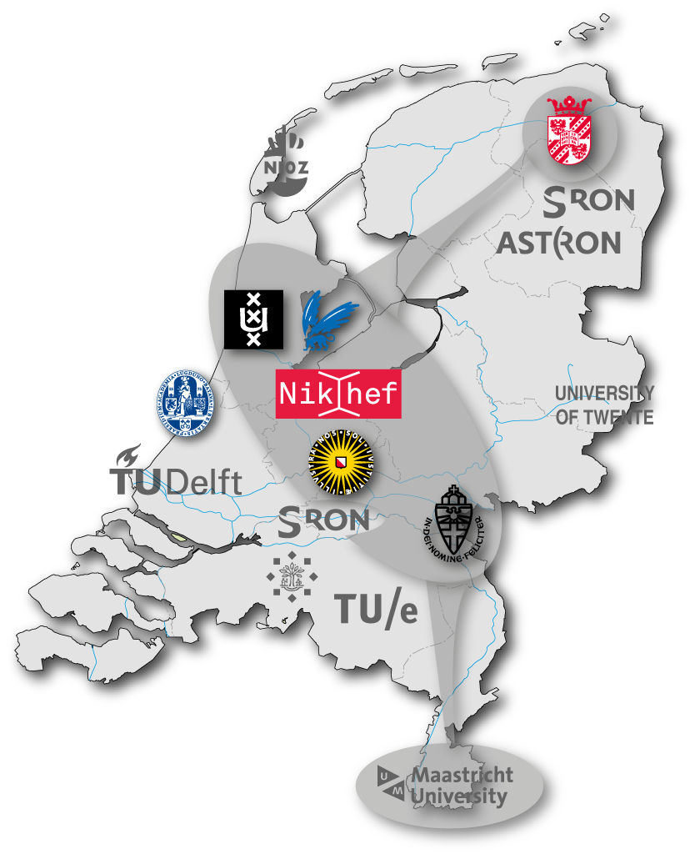
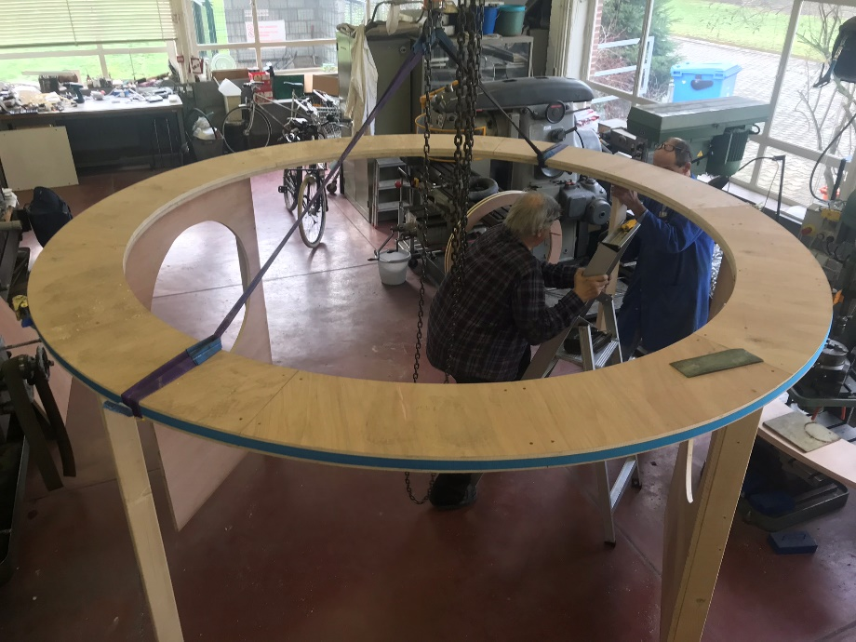
Gravitational
Waves
Virgo upgrades (‘NWO-groot’)
Virgo running (‘ENW-vrij programma’)
Einstein Telescope: consortium
ETpathfinder
politics
drilling …
‘Interreg Vlaanderen/Nederland’
Alessandro, Stefan, Henk-Jan, Bas, Martin,
Frank, Paul, Niels, … (Doets, Kraan, Hennes!)
Frank, Stan, …
(Nikhef) consortium – 25 February?
ETpathfinder – March final verdicts
politics – ask Stan!
Nikhef stafoverleg, 14 februari 2019

Slide 3
Terziet
drilling
Frank, Arjen, Alessandro, Henk-Jan, …
Start: November 2019
Today: 14 February 2019 139 m
Troubles:
Excess water
Road works
Broken drill last week …
Broken drill retrieved!
Hope/expectation:
To reach 290 m before camping season starts …

Slide 4
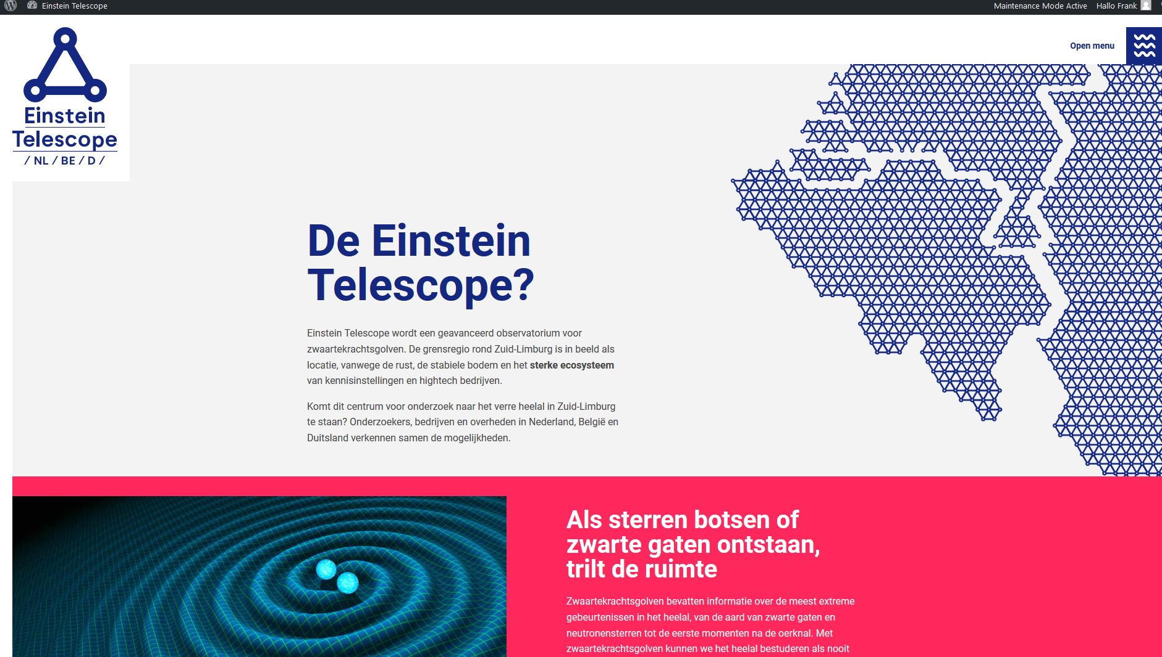
Martine!

