Slide 1
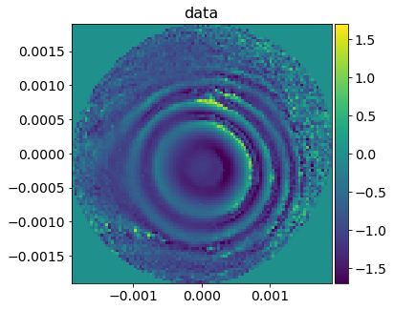
Nikhef instrumentation workshop my biased view
Martin van Beuzekom
6 February 2019
* martinb@nikhef.nl

Slide 2
General remarks (open doors)
The power of Nikhef is:
Its size, and hence its combined experience/expertise, not (only) the smartness of individuals
We have (and need) critical mass in certain disciplines / techniques
The close collaboration between CT/ET/MT
Building up experience takes years -> be critical at new ‘opportunities’
Risk of scattering -> keep focus, we can’t do everything
Medipix + readout is a 15+ year activity
Don’t mix up ‘competence’ and ‘tools’
For example, a student that has taken a VHDL course is not a designer
Engineering / applied physics students are often more suited for the development of instrumentation than a standard physics student

Slide 3
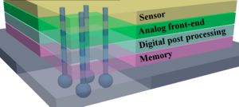
We should keep working on smart pixels
Lot of experience, many applications, also outside of HEP
Trends: much faster timing, much higher bandwidth, somewhat lower noise, smaller pixels, increased radiation hardness, (more functionality -> vertical integration?)
Currently we are (mainly) active in hybrid pixels
Many non-Nikhef groups are jumping on the HV/HR CMOS (monolithic) bandwagon
Should we follow them? Choose one of the two, not both (focus)!
(my opinion NO, hybrid is more universal. Useable for/with silicon, gas, high-Z, membrane)
ET:
ASIC design: fast timing circuits, high speed serialisers, ASIC verification (new)
Maintain critical mass, technology becomes more complex, higher threshold for critical mass?
Higher data rates, hence HF transmission: over copper, maybe photonics (rad hard)
Collaboration with other ASIC groups is essential

Slide 4
Smart pixels
ET/CT:
Matching readout system: combination with ASIC design is very powerful (1+1=3)
Challenges: efficiently use available bandwidth, data reduction/compression (unfortunately application dependent)
Where we can do better: verification / unit testing
MT:
Wire bonding, (relatively simple) mechanics for test setups
Mechanical issues are often not addressed in the R&D phase, is this a mistake?
Power per cm² will not go down -> importance of (micro channel) cooling, especially after irradiation
But also, vibrations of e.g. beam telescope (cooling fans often added last minute)

Slide 5
Wave-front sensors for GW
Pushing the sensitivity limits of quadrant photodiodes and phase cameras
3 main ingredients:
Photodiode (mostly R&D dept)
Analog signal conditioning (everything up to the ADC)
Digital signal processing (in the FPGA and beyond)
Analog expertise is quite rare, while low noise and (RF) signal conditioning become more and more important
Importance of PCB design and simulation -> expand expertise
Digital signal processing expertise at the algorithm/mathematical level is basically lacking (CT/ET)

Slide 6
And we also need:
Support for test setups at Nikhef
for example virgo SW environment with realtime PCs for controls
Support for ‘facilities’ like silicon alley, optical lab
Bottleneck: PCB manpower, quicker turn-around (currently often limited by queue)
People that can do the quick fixes (e.g. Wim G., Oscar v. P., Joop R., CT helpdesk etc.). These people are the “Haarlemmer olie”
Strengthen collaboration with other institutes, technical universities, companies
though collaboration with commercial parties it can be difficult (IP issues)

