Slide 1
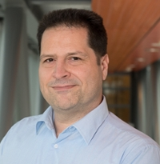
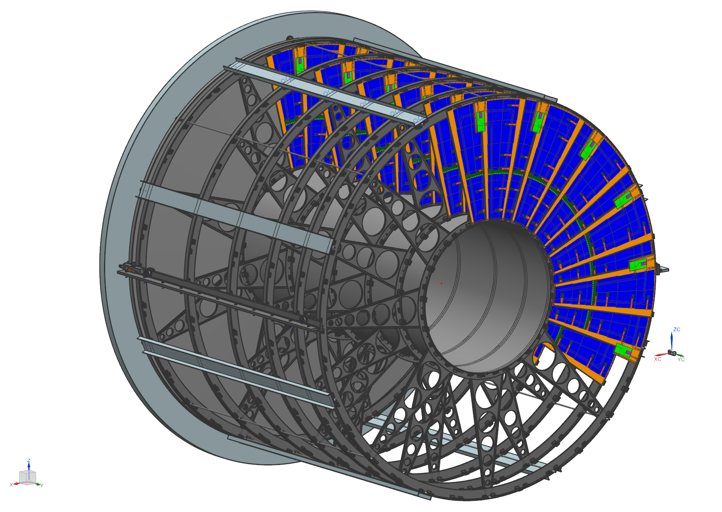
A few words on the nikhef technical infrastructure
Objective, but totally biased
Marcel Vreeswijk
Projectleader ITK-nikhef
Some impresions
Some statements

Slide 2
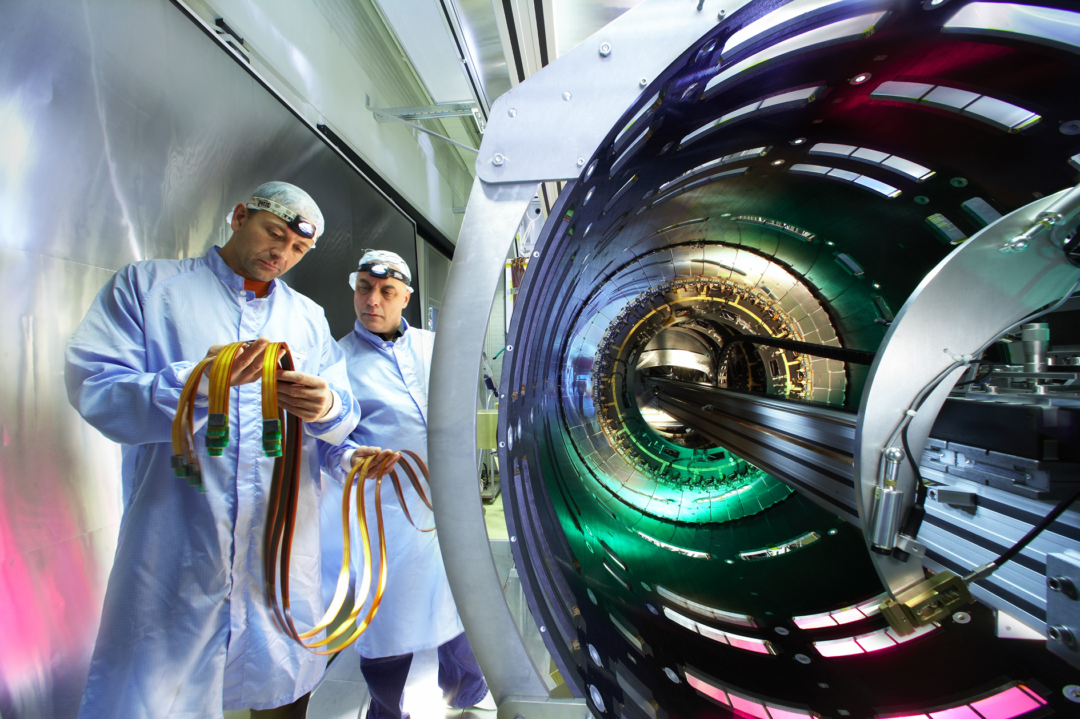
Some history: SCT at nikhef
@Nikhef:
Space for SCT stand
Metal tools/support
All kinds of measurements/monitoring and ICT contributions
Skilled People

Slide 3
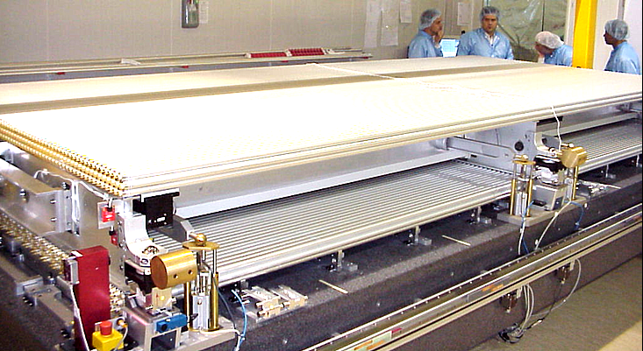
More history: Muon chambers at nikhef
Space for large setups!
Metal tools/supports
Note the measurement tools – ET/ICT suport!

Slide 4
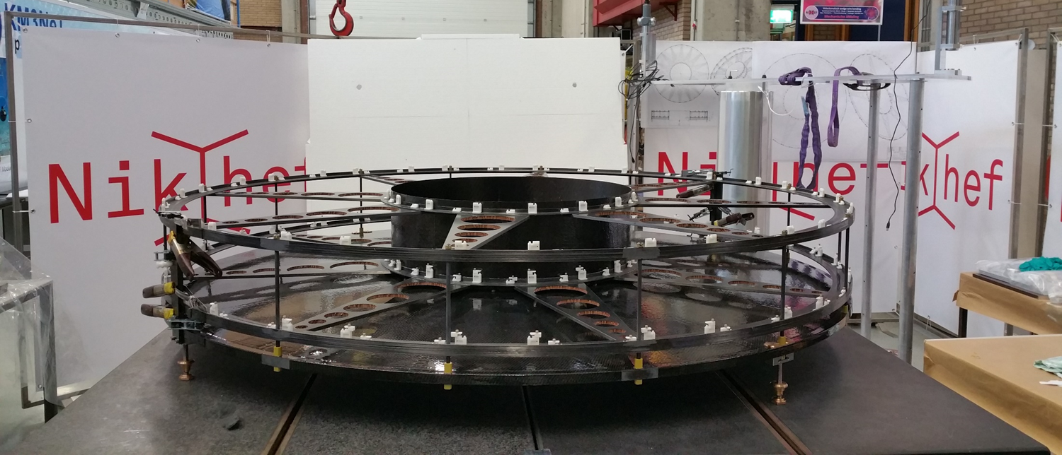
Back to the future: ATLAS ITK
Delivery date: 2024

Slide 5
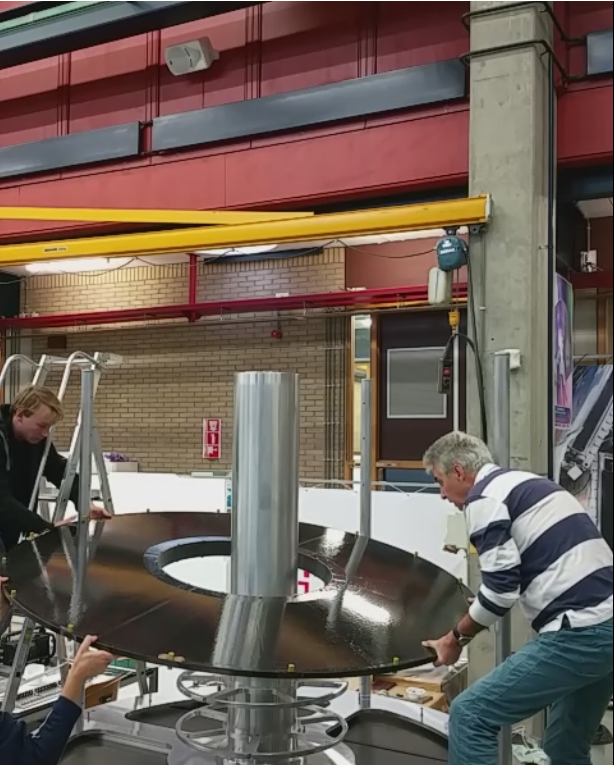
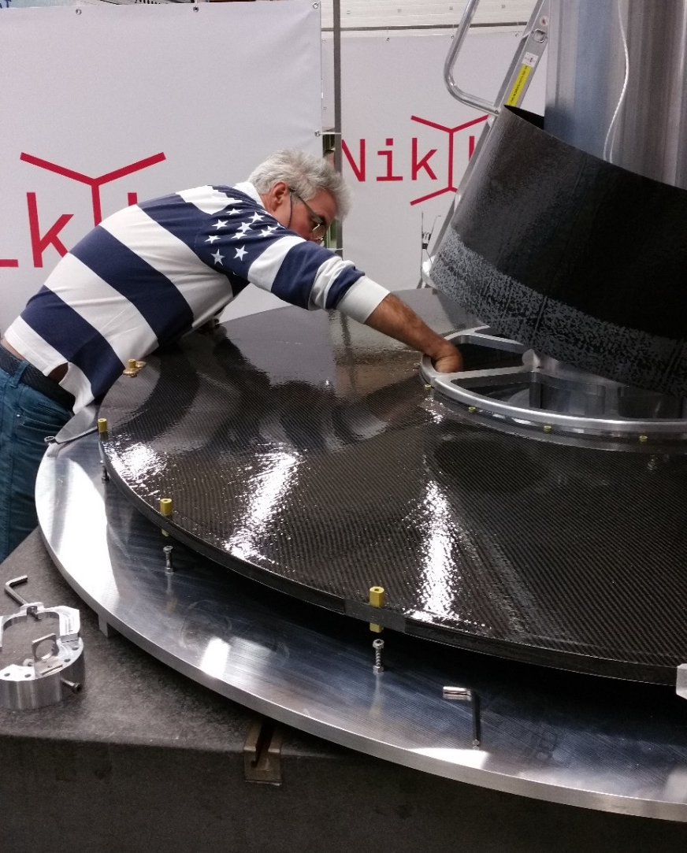
ITK prototype (the ‘’mock-up’’’)
@Nikhef
People!
(Some) space!
Metal tools/support
CF structure → learning curve
Jesse van dongen
Martin Doets
Johan vd Berg

Slide 6
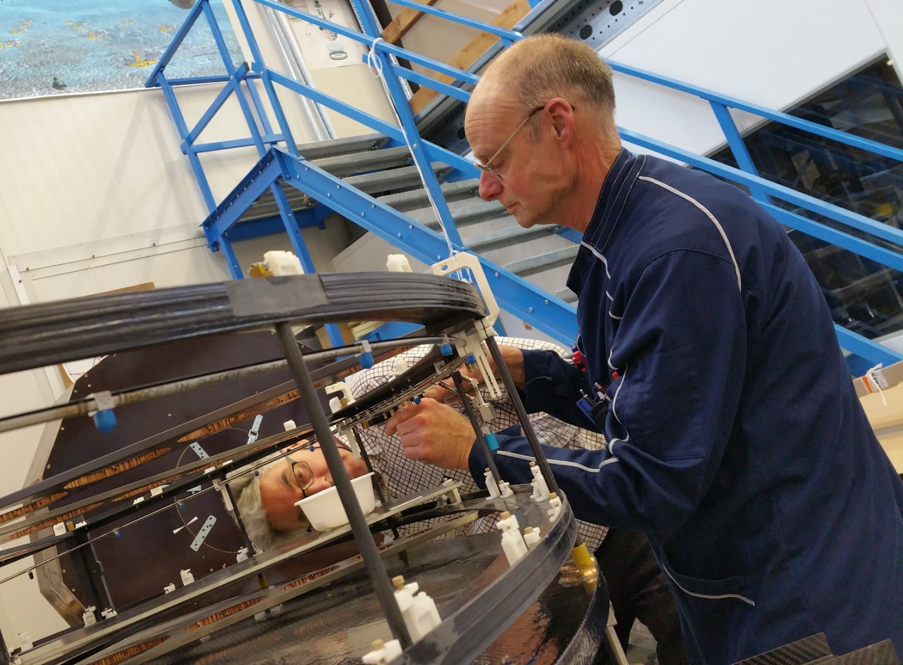
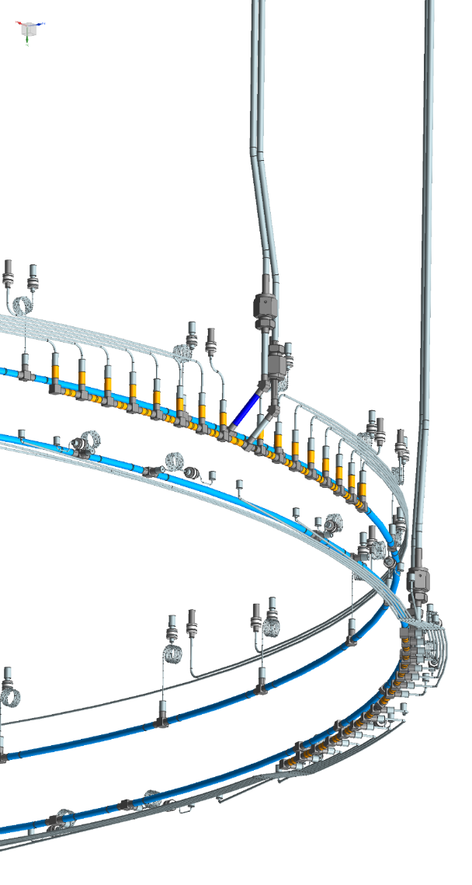
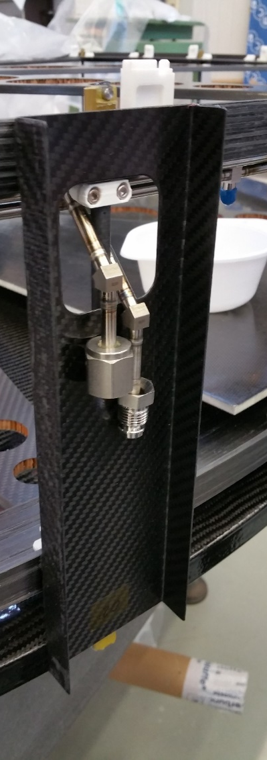
Making cooling loops
State of the art orbital welding
Rob Leguyt
For cooling machine:
Erno Roeland
Martijn v Overbeek

Slide 7
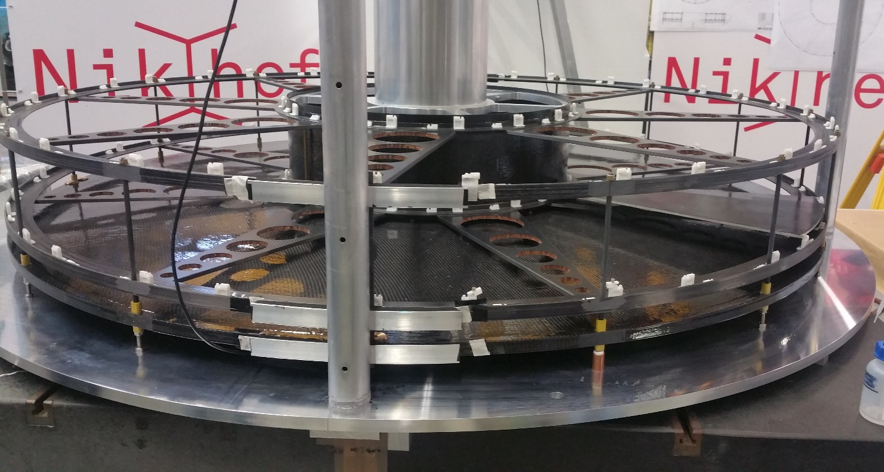
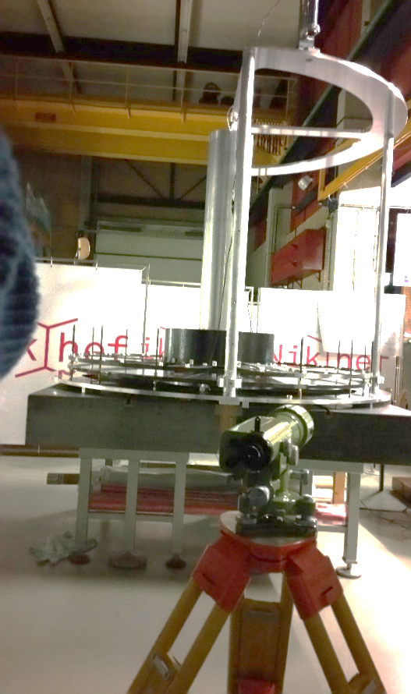
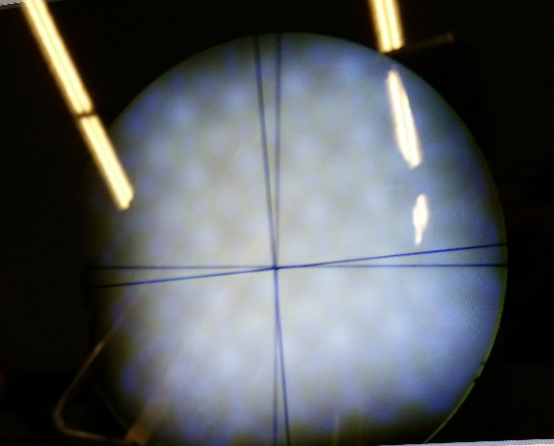
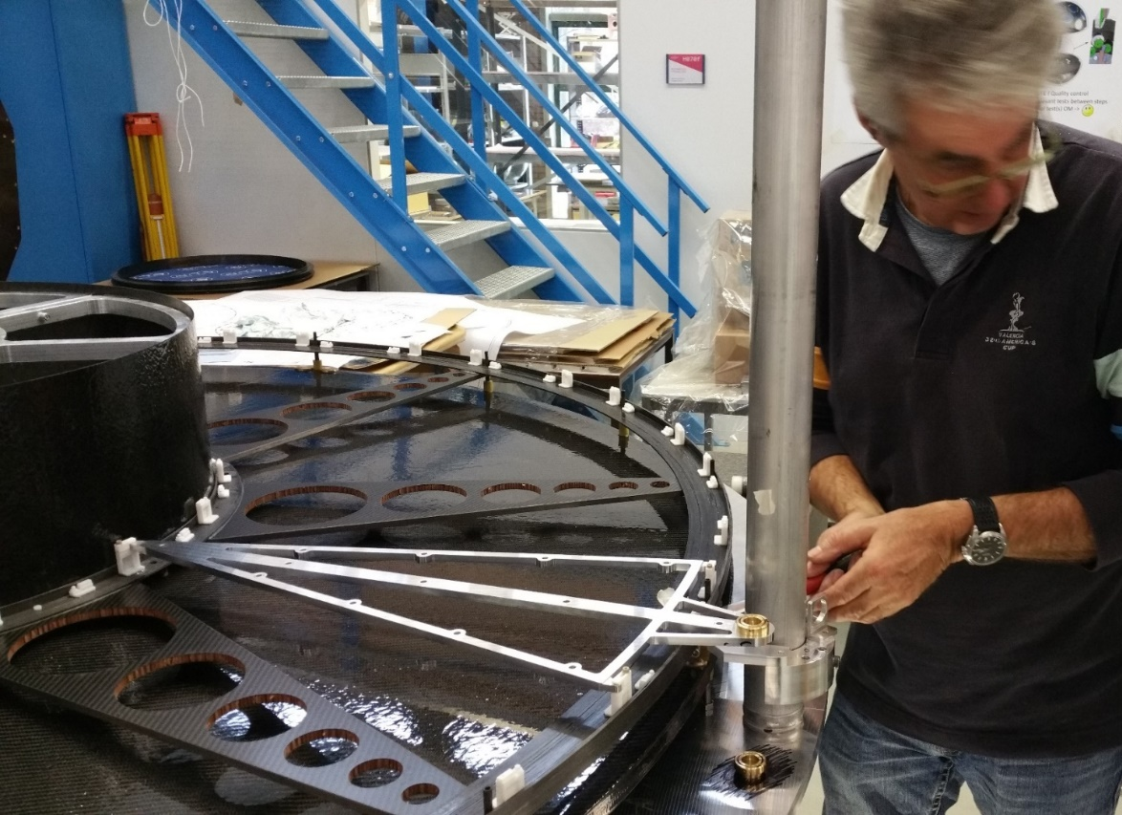
Alignment ITK
Difficult to get down to 10um.
Do we have sufficient tools/expertise on 3D measurements in situ?

Slide 8
Now Some statements
Excellent in house | Little knowledge/equipment | Remark
Metal (Alu.) milling and such | Carbon Fibre structures | Carb fibre difficult to outsource
Orbital welding | Sleeve welding → smaller structures | Other institutes: adress issues of welding near electronics
3D printing small stuff | 3D printing of fancy stuff | Sofar: easy to outsource
 | Brazing (vacuum) | Outsource relatively easy
3D measurement machine | 3D measurements of large structures | Get phototelemetry equipment/knowledge
Help with outsourcing | Working together with companies | Like Valencia group with Scientifica
Competences | big experiments working together with R&D, IT, ET department
Get more knowledge by doing more.
Get photometry equipment and knowledge?
Some other institutes have more non-hep-physicist involvement

Slide 9
Thank you

