Slide 1
Skills & competences
Electronics technology
New projects ??
Opportunities ??

Slide 2
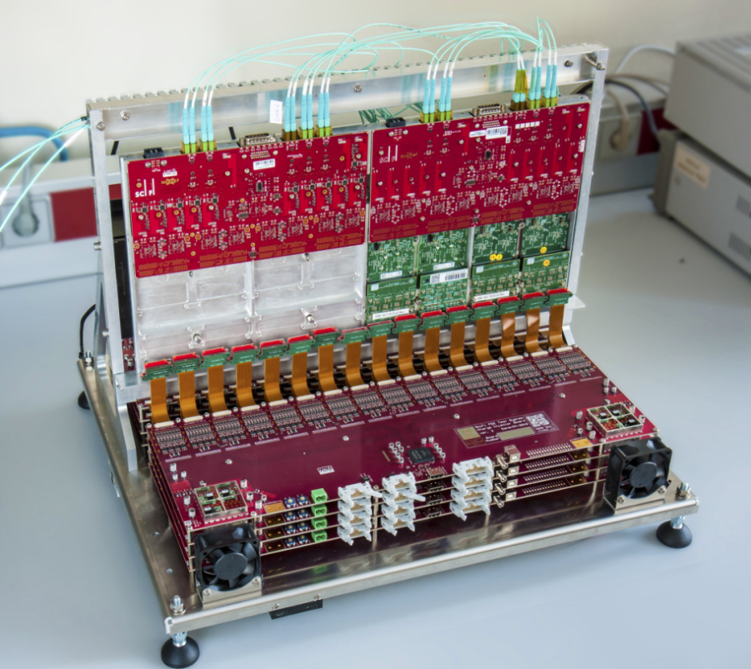
Why does the ET exist?
Develop & support electronic systems for subatomic-physics experiments in close collaboration with the physicists.
Systems that are not commercially available.
Provide instantly specific knowledge, skills and tools on electronics that match requirements for the design and maintenance of these experiments in their specific environments.
Examples:
Radiation (CERN) , Deep-sea (Km3Net), extreme low noise (GW), specific detector/sensor systems (ET/LISA), IC’s and readout (Senseis,TPIX4), SciFi,….
LHCb SciFi FE-box test setup

Slide 3
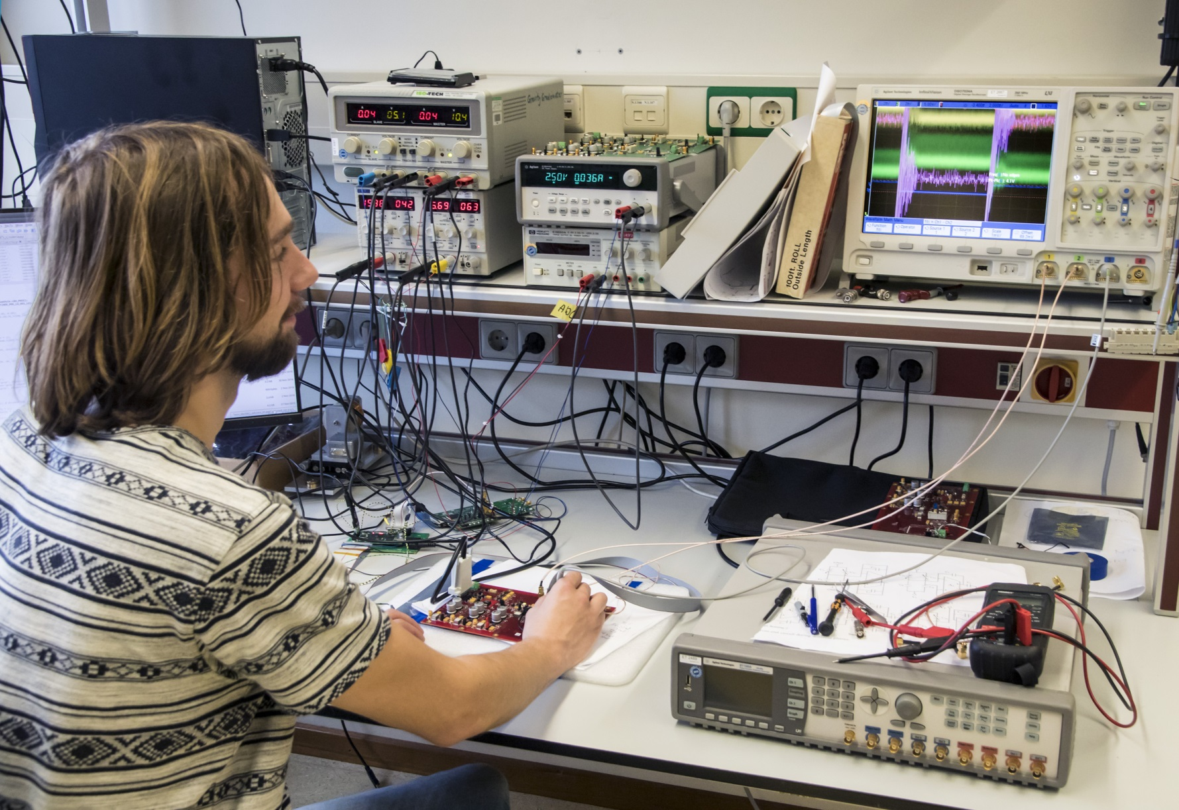

Some
Generic
issues….

Slide 4
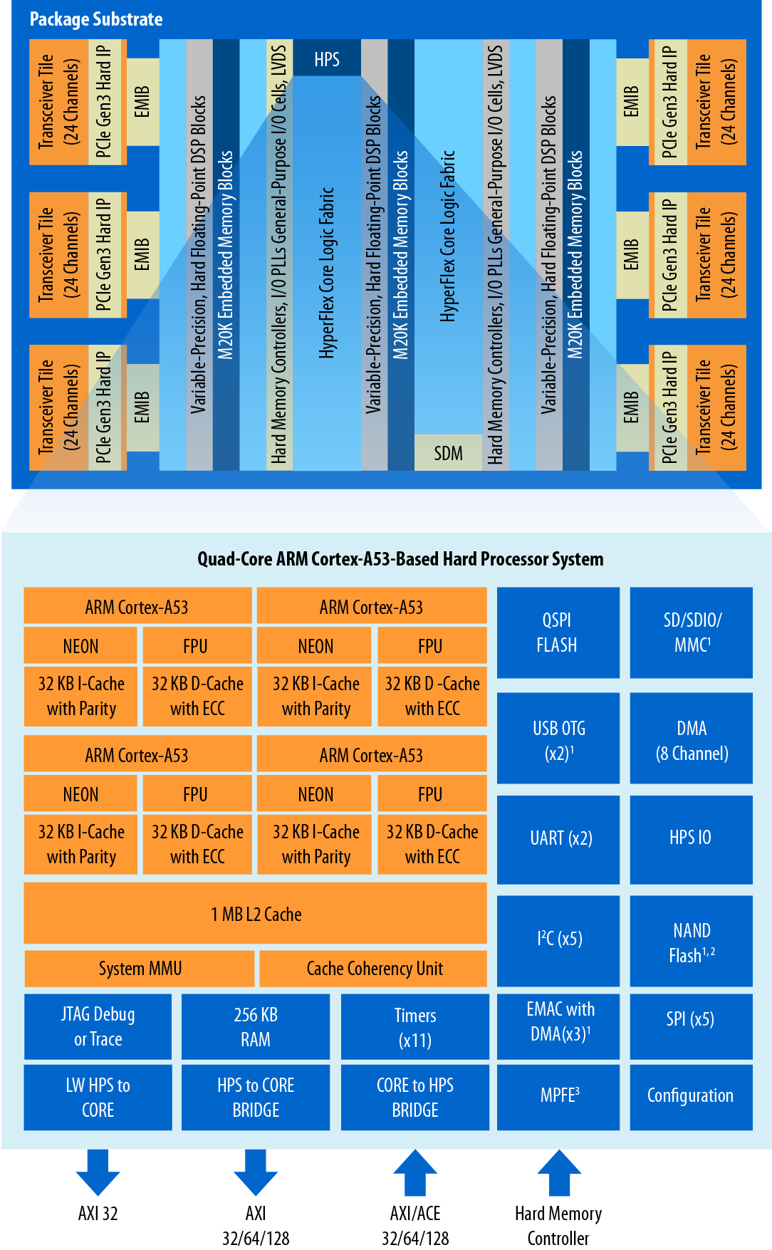
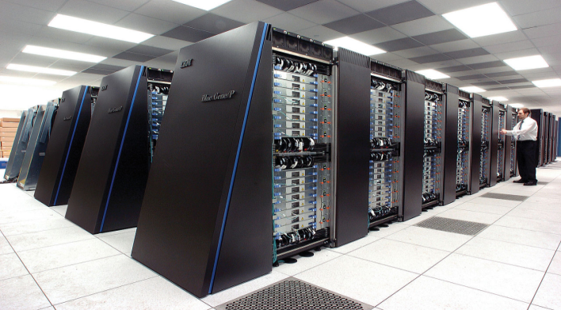
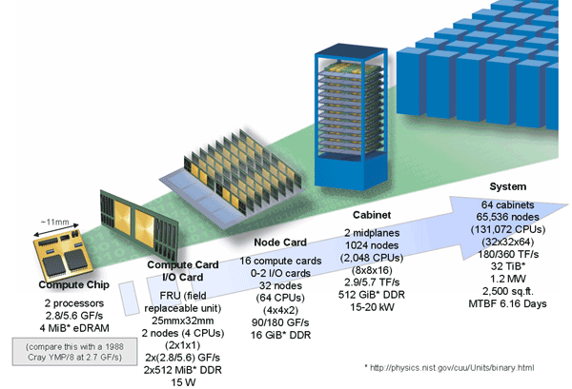


Technology progress
14 years
later :➔
Design teams:
Multi site, highly skilled specialists
Concurrent design (design repositories)
Hardware/-software co-design;
Software engineers in design team
Progress in design tools & methodologies
Emphasis on Technical project management
Strong design integrator.
Multi disciplinary in early stage:
Cooling & 3D mechanical integration.
2018: 1 FPGA 10TFLOPS
2004 16 rack system
total 70TFLOPS
Example:ATLAS
FELIX
FTK

Slide 5
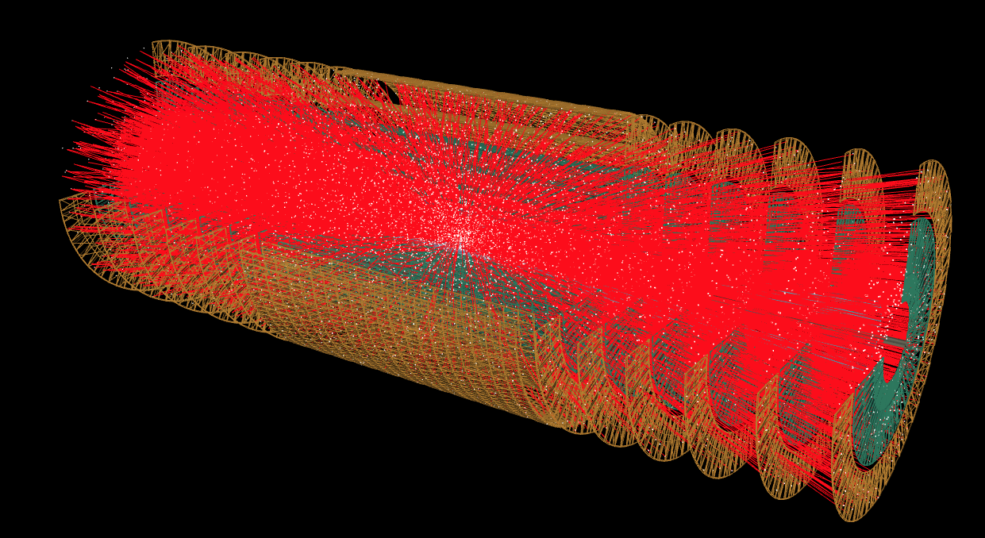
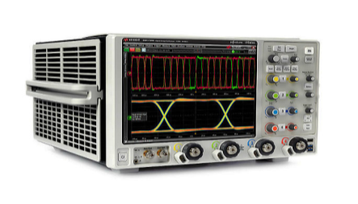
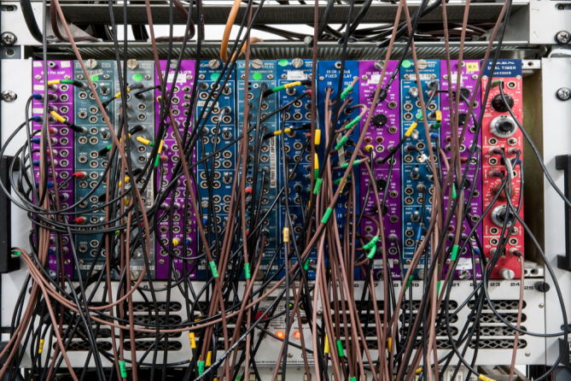

Data transmission
HL-LHC/ILC challenges
+Extreme radiation !
(IC design/replacable?)
Advanced RF technology (€’s!!)
Components, PCB, connectivity (µwave),
simulation, Test & Measurement.

Slide 6
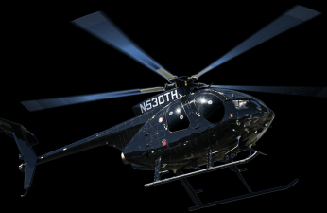
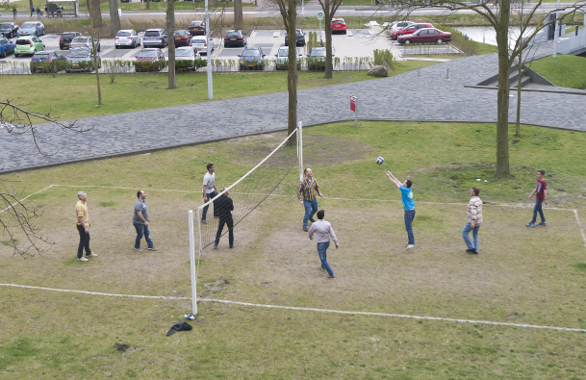
Team work!
Good multidisciplinary team spirit!
Need to improve on System Design &
project management
(+ in the collaboration!)
?
?

Slide 7

ET Expertises
Highly challenging
Technologies!!

Slide 8
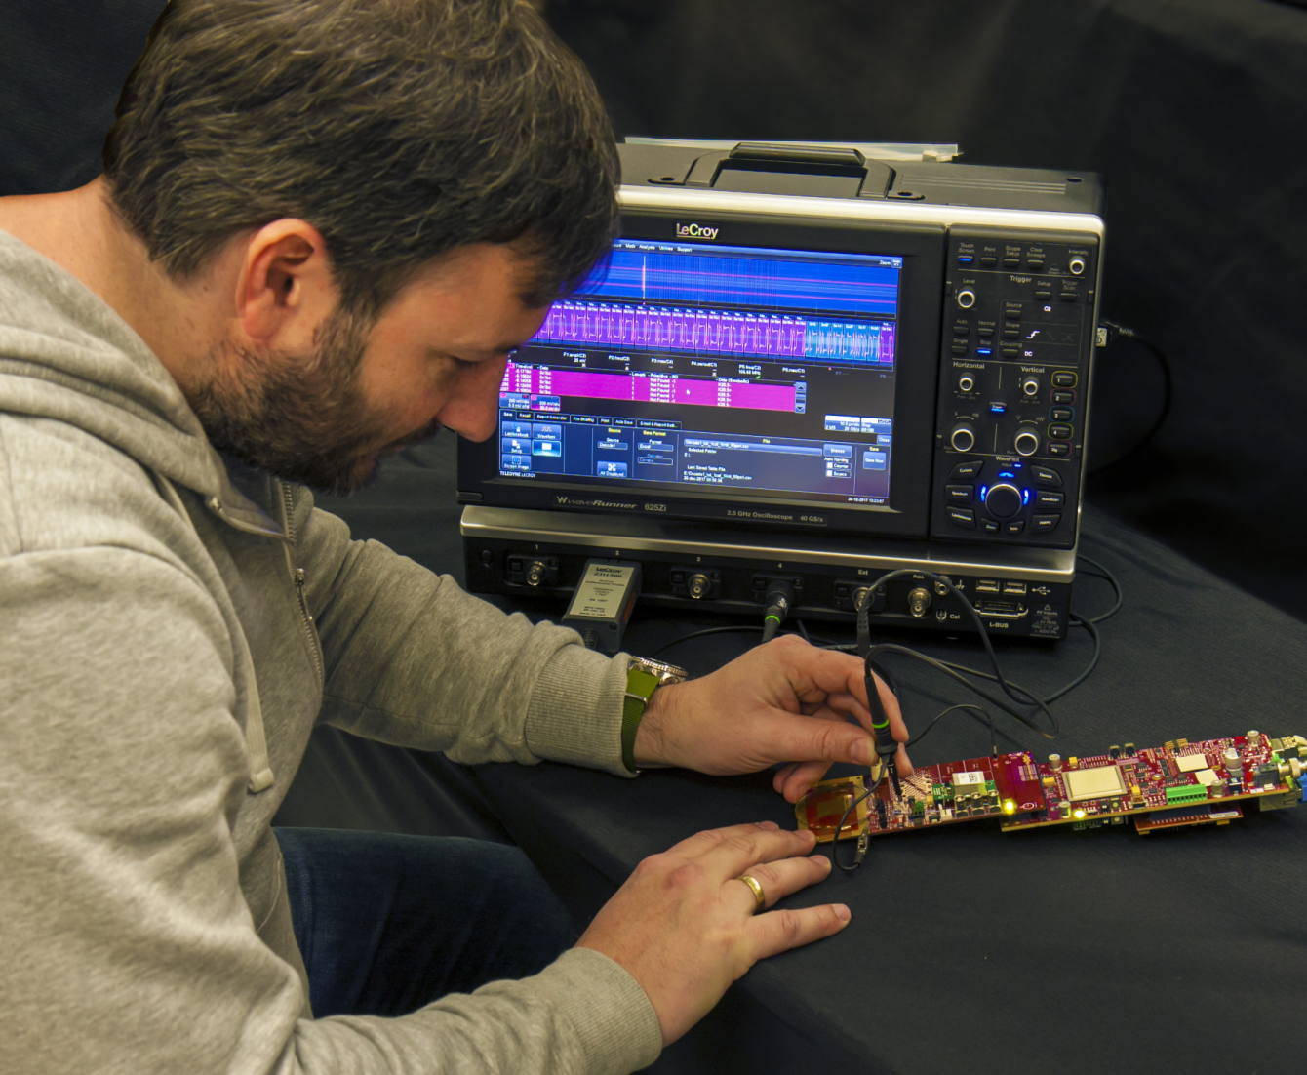
ET Expertise
Not all generic engineers, but:
Digital design:
embedded systems : Data acquisition.
Analog design:
Sensor readout & controls
Data communication/Clocks & timing:
Optical and Electrical High speed data transfer
IC design:
mixed signal, rad hard, application specific.
Printed Circuit Board (PCB) design:
small & simple – multilayer BGA’s & RF

Slide 9
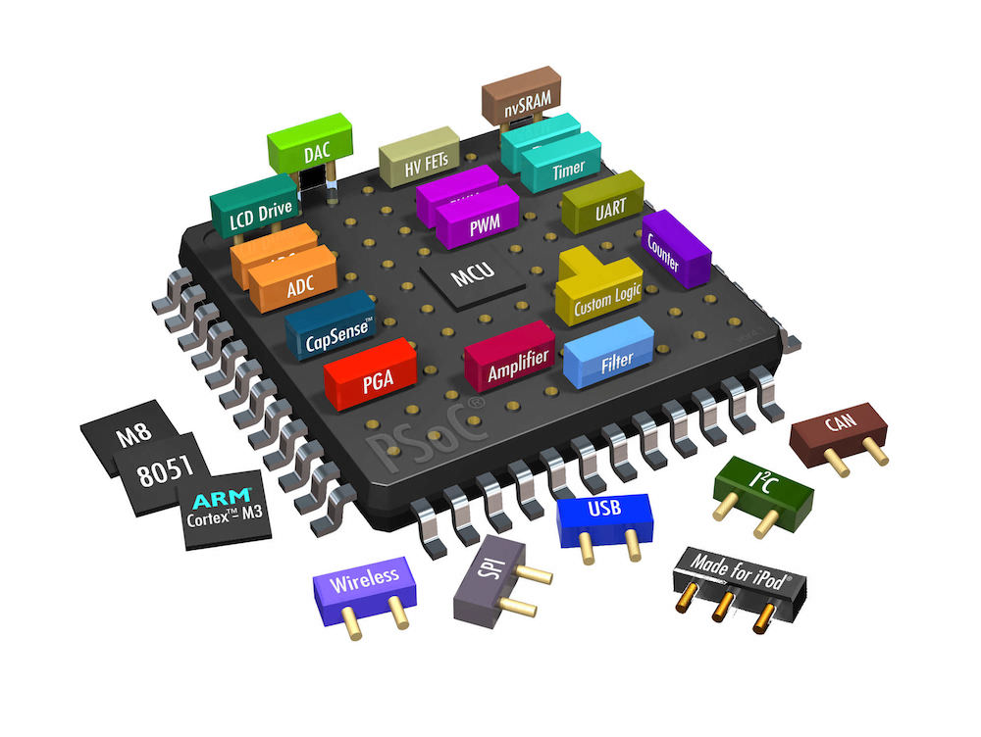
Embedded systems
Logic in FPGA:
CPU’s, DSP’s, transceivers (>>10Gbps), memory, interfacing, timing, computing, etc.
Advanced design tools, skills & learning
Real Team work: ➔ Git, Collaborative tools
Co-design with software engineers (DAQ).
Advanced PCB design;
“Analog” design for Gbps data transfer and interfacing
ATLAS FELIX, Scifi readout, SPIDR,

Slide 10
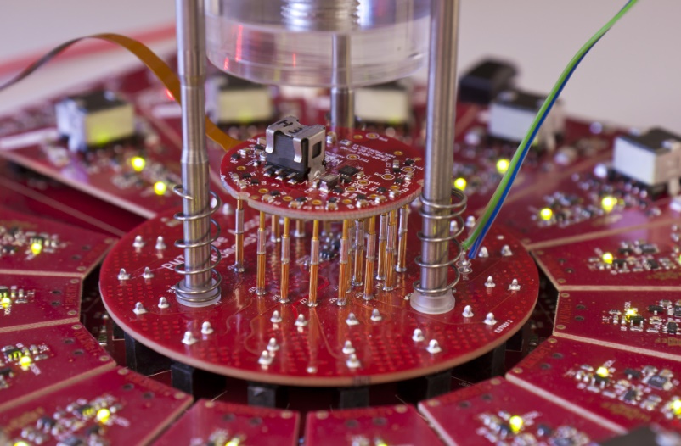
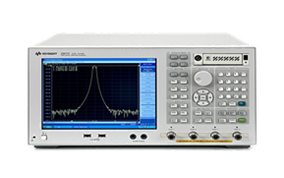
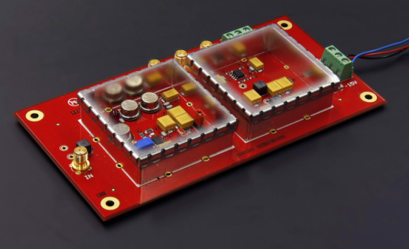
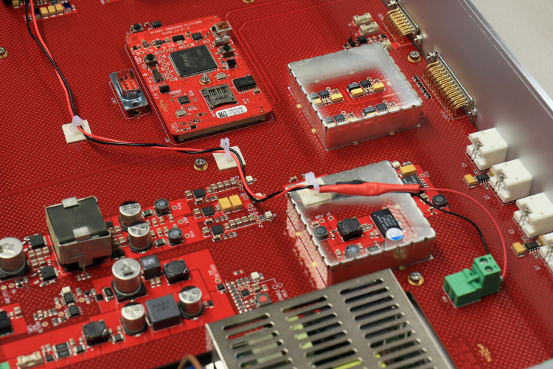
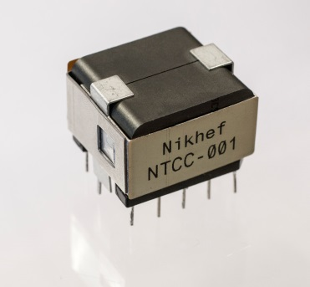
“Old school” Analog
Sensor Front-Ends. Low-noise & power.
Power: DC/DC convertors LV & HV.
Digitizers / ADC modules.
EMC: design & test (+ chamber)
Machine/instrumentation & Controls:
analog interfacing to control systems:
Matlab/Simulink, LabView/ LabWindows, Python, C/C++, etc.
(modeling & Multiphysics simulations)
Virgo, Senseis, km3net PMT, EMC
+Migration to digital world!

Slide 11
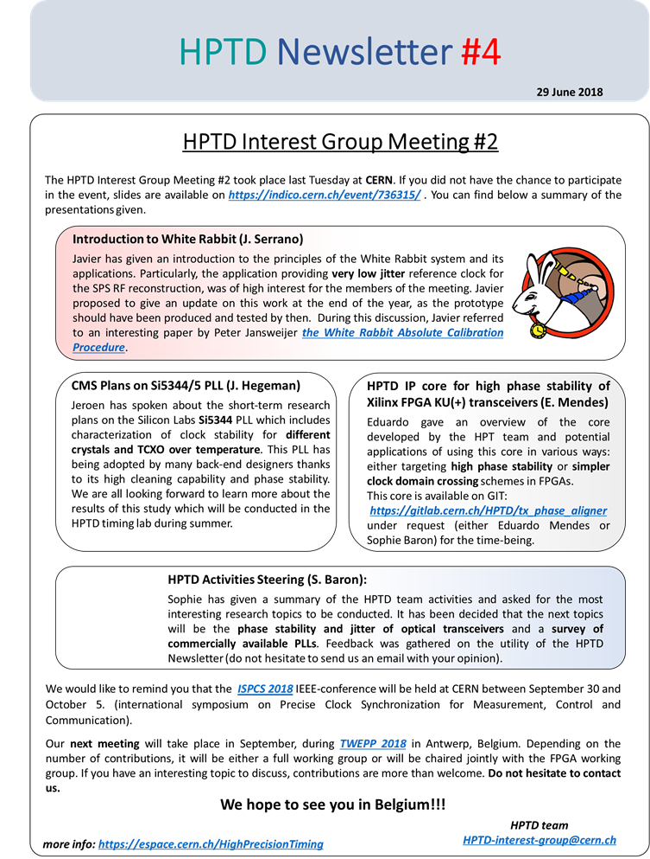
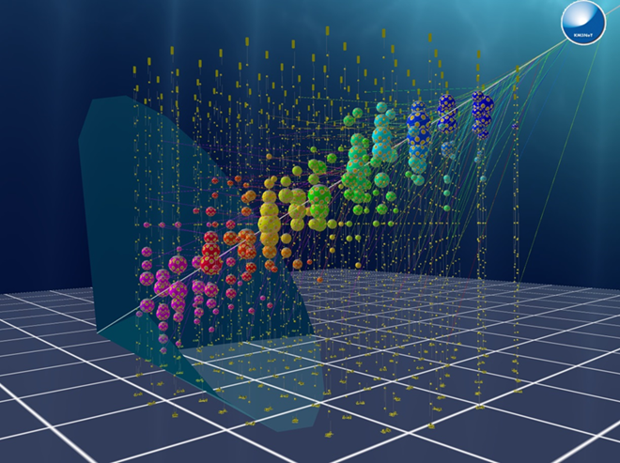
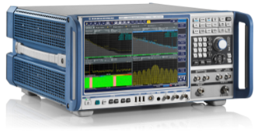

Data communication
Example:
High Precision Timing Distribution
+Clock’s & Timing:
Nano ➔ Pico second accuracy
LHCb upgrade : fast timing !
White-Rabbit
R&D Pix20?
TimePix4
HighRes ADC’s
28Gbps

Slide 12
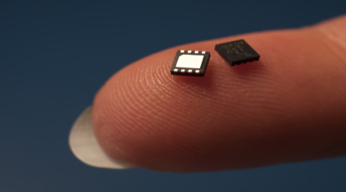
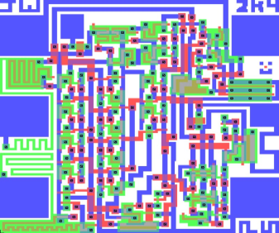
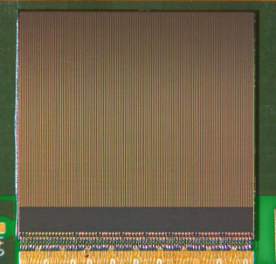
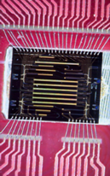
IC design
CERN: R&D in 28nm
Multi disciplinary design (team):
Architecture design & simulation.
System design.
Low power analog (input)
Digital system design & verification
Mixed signal design & verification
Multi-site concurrent design (tooling)
Power design, clock design, 10 Gbps serializer design, PLL, DAQ, I/O’s, etc.
Top level integration & verification
+ Test, readout etc.
Pixel detectors, Km3Net PMT HV& readout, MEMS control, data transmission, etc.
LHCb VeloPix
ET team
+ Integrated
Photonics

Slide 13
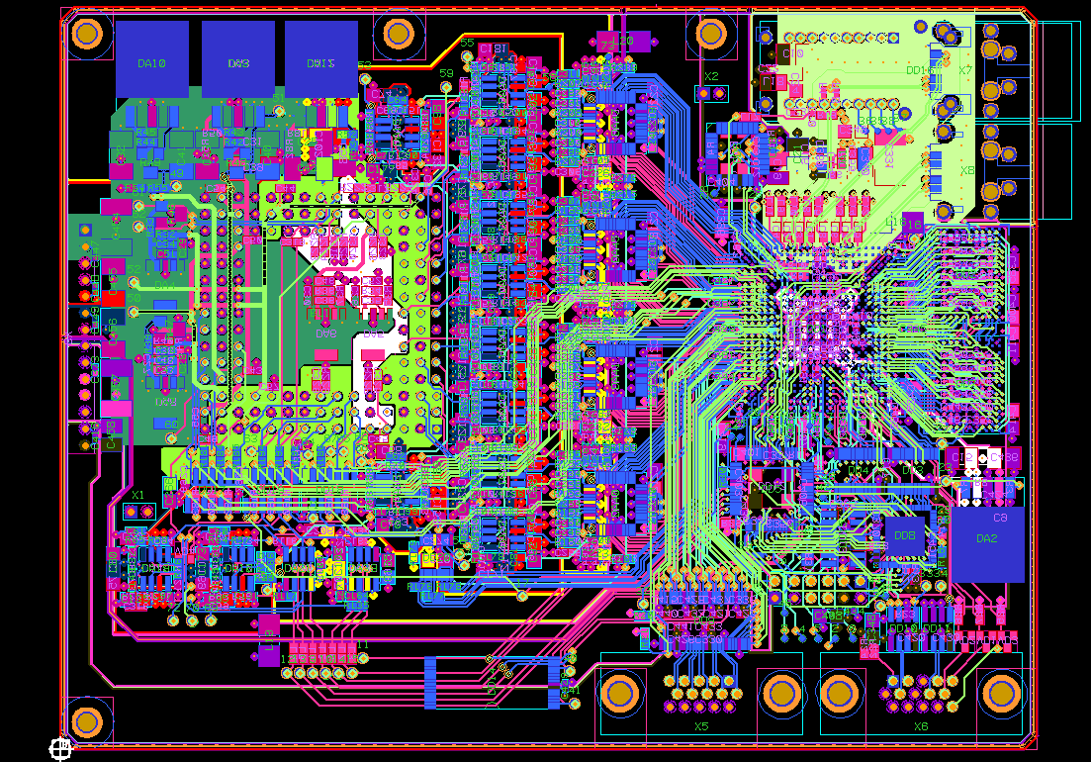
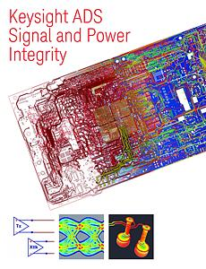
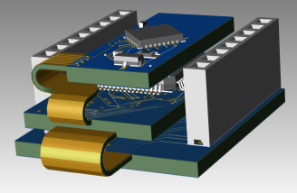
PCB design
The ever “annoying” closing activity in electronics…
Challenges and skills for PCB design:
More than drawing connecting lines
High speed signals: use RF technology ➔ transmission lines, impedance matching, power distribution, shielding, low Ɛ_{r} PCB materials, etc.
PCB simulation for signals and power
Mechanical integration 3D+
cooling + Manufacturability !!!
Collaboration with Industry &
outsourcing.
>20 layers
3D
More than just an Arduino board……..

Slide 14
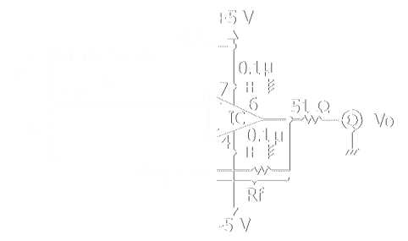
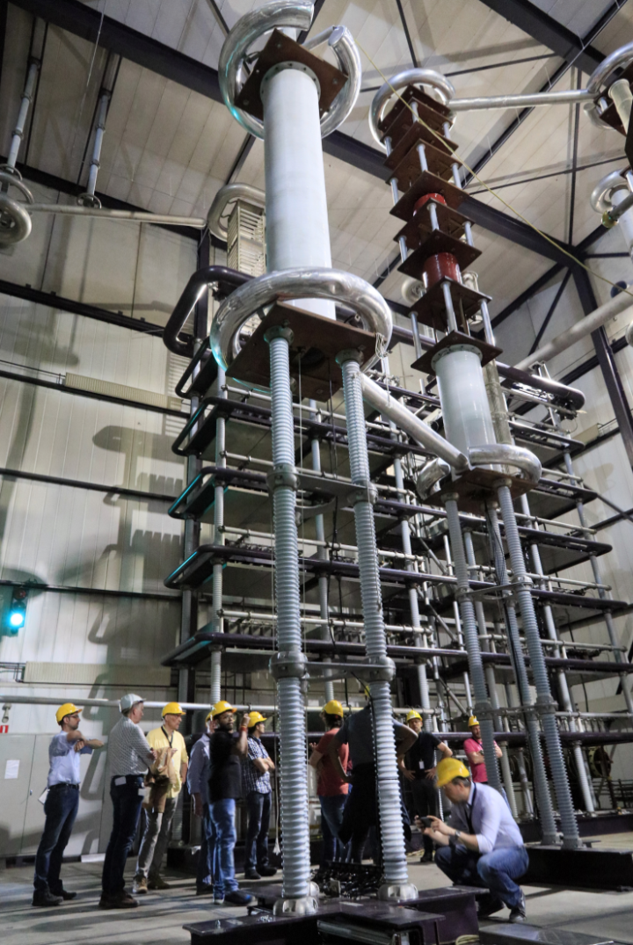
People
Present:
3+1
4 ½ +2
4
2
3+ ½
2
2 “vacant”
25
Expertise: FTE
IC design 3-5
Digital FPGA design 4-7
Analog design 3-5
PCB/Mechatronics 2
Technical lab. support 2-4
Fiber optics 1-2
Flex “layer” 3-6
(3 lead engineers)
Group size 25

Slide 15



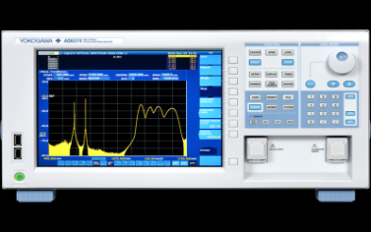
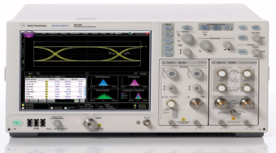
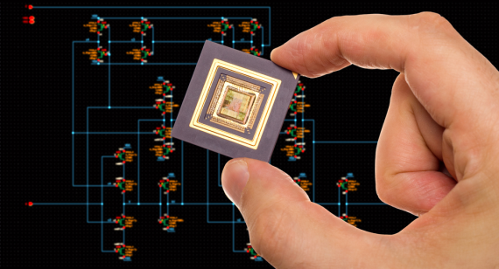
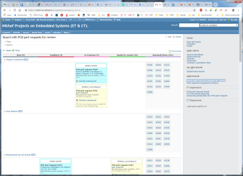
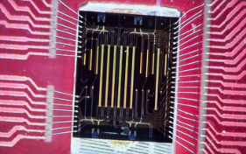
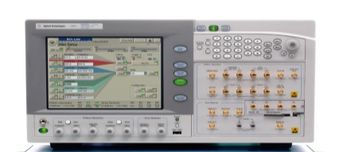
Many Labs/Uni’s are jealous
at our facilities !!!!
(or are not aware of
what is needed….☹)
summary:
EMC & Dark lab
Optical Lab
We have:
Expertise: designers & specialists
Flexibility
Great facilities!
Advanced development & simulation software:
PCB, IC, FPGA, Code synthesis,…
Onsite Collaborative tools, Git, SVN, Gitlab,
Redmine project management, Agile, TC,..
Good Outsourcing capabilities for mass production in Industry!
new

Slide 16

DESIGN YOUR “OWN” DETECTOR;
TOGETHER WITH US !!!!!!
To discuss:
What technologies do You need
for Your future experiments ??

Slide 17
What the ET can not do (now):
(In no particular order)
Series production capacity/manpower (outsource work!)
Programming PLC systems, (outsource work?)
Cable harnass design & integration (MT-ET?)
Deliver a new PCB design in a week (?)
High voltage >> ~5kV (buy)
High Power >> kW power systems or amplifiers (buy),
Real RF ➔ antenna’s, waveguides, accelerator technology ( collaborate: ASTRON, ?)
Ethernet & internet network systems & switches (outsource work)
Quality control & Quality assurance (outsource)
Advanced ADC IC design (buy, unless rad-hard)
SPACE technology (collaborate: SRON)
Specific knowledge of protocols/technologies: GSM, GPS(a bit), Wi-Fi, RF ID, NFC, LTE, USB, Bluetooth, Audio, etc. (buy)
FPGA High Performance Computing, GPU’s, (CT & ET ??)
Industrial process automating systems & fieldbus systems (outsource work?)
Mobile phone repair (buy new)

Slide 18
backups

Slide 19



Project goals & capabilities
Top
quality
Low
cost
Engineering challenges & capabilities:
Can’t
do!
Fast
delivery

Slide 20
opportunities
New detectors: ILC/FCC; new detectors & radiation hardness:
Expertises: IC design, precision timing (!) front-ends, detection, DAQ (FELIX follow-up), power design (IC), DAQ & contr. softw.
Gravitational Waves; Virgo/Ligo, ADC’s, DSP, High speed links, Controls.
Expertises: FPGA, RF technology, clocking, (P)IC, analog-e, PCB, EMC, ..
DUNE: expertises: Timing➔White Rabbit, DAQ system: FELIX, software eng.
LHC-b upgrade LS3:
Expertises: IC design, precision timing (!) front-ends, DAQ, High speed links,..
Technology opportunities:
High Performance Computing in FPGA’s <> DAQ. & Photonics.
The ATLAS High Granularity Timing Detector for HL-LHC:
expertises: Fast & precision timing (!), FELIX, IC design, fast sensors….
ATLAS PIXEL IC’s RD53:
expertises: IC design (front-end, Serializers, Control, I/O, LDO, DataPath,..), Fast timing, test system, DAQ:FELIX.
Missed
opportunities

Slide 21
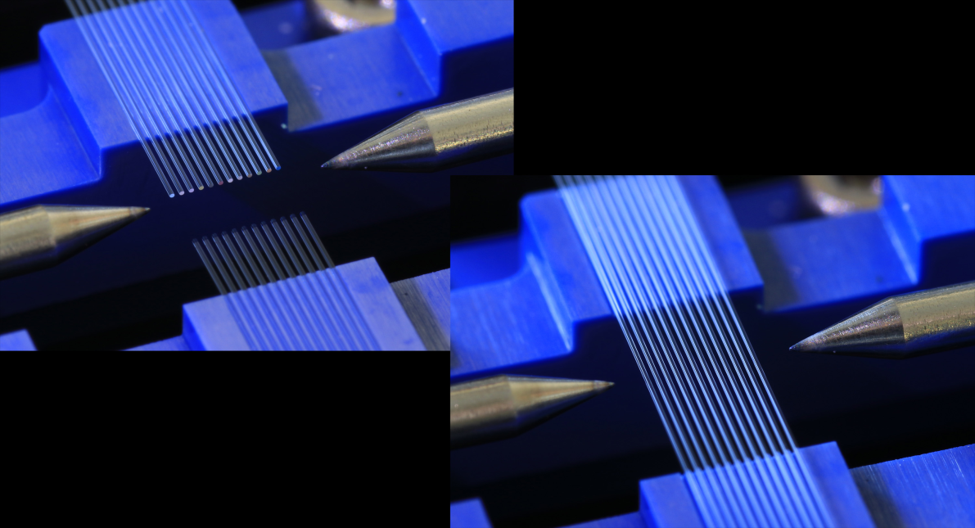
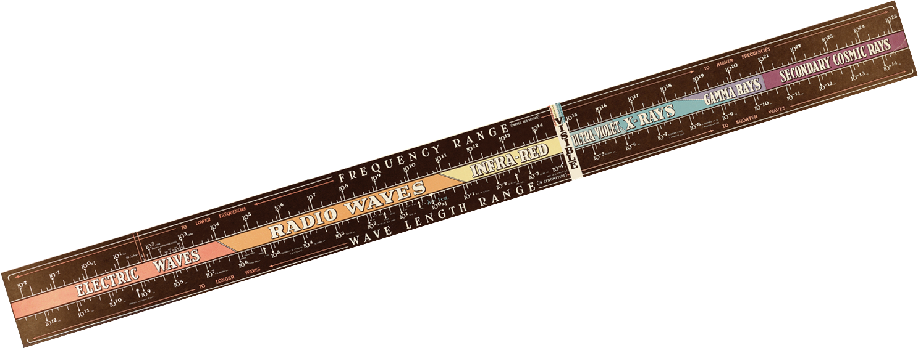
backups
Ribbon fiber splicing

Slide 22
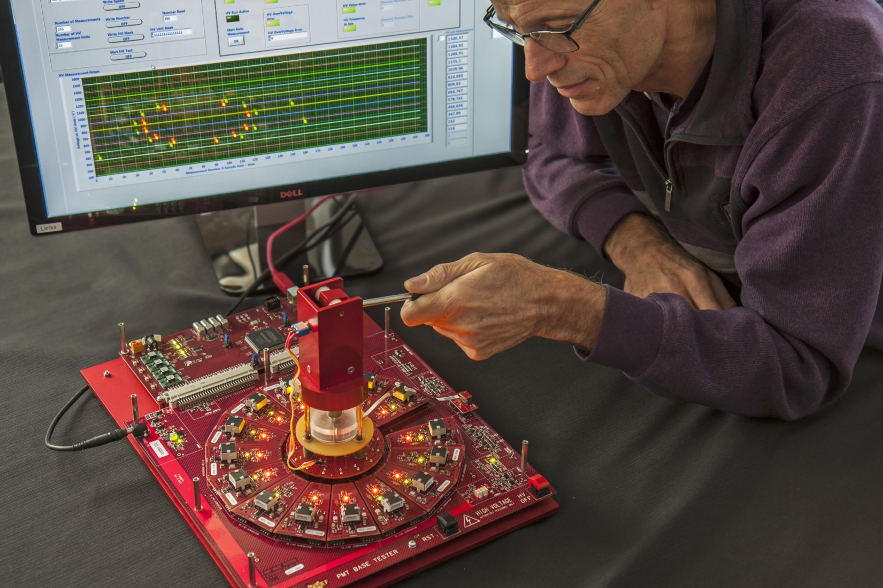
Facilities/tooling
Advanced RF (> 20GHz) test & measurement instrumentation
RF PCB & IC design + simulation software.
EMC measurement lab.
Fiber optics lab + instrumentation.
Dedicated PCB soldering equipment
Climate chambers for Quality Assurance (QA)
Increase in software tools:
design, simulation, modeling.
➔ Continuous training !!

