Slide 1
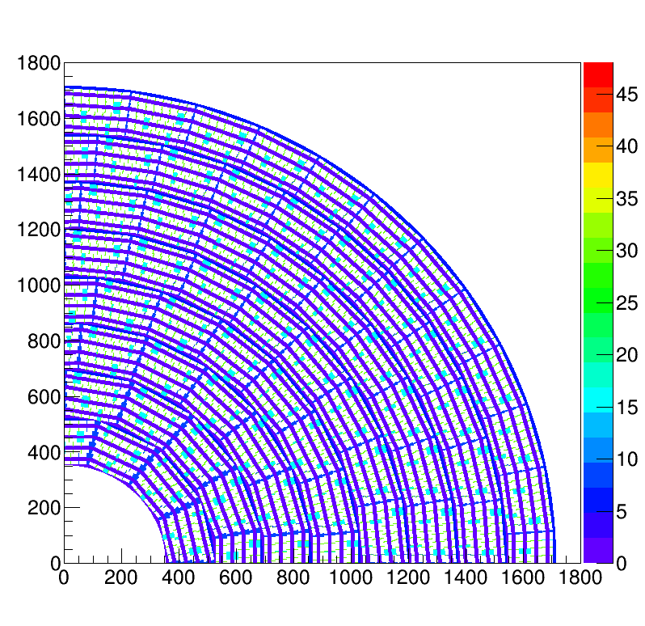
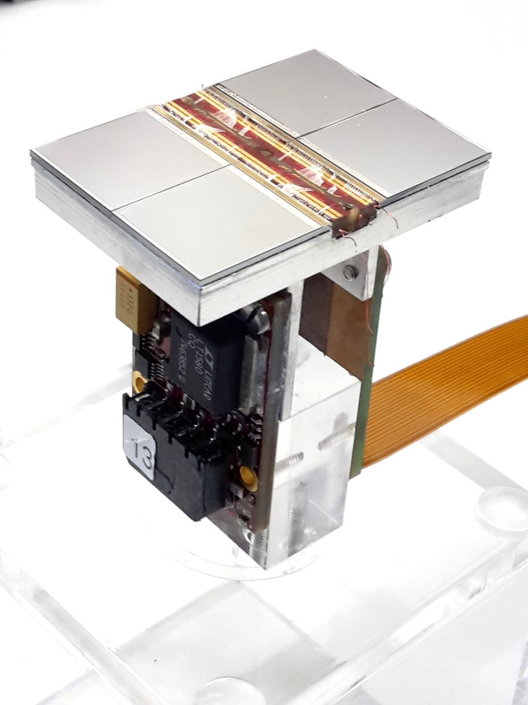
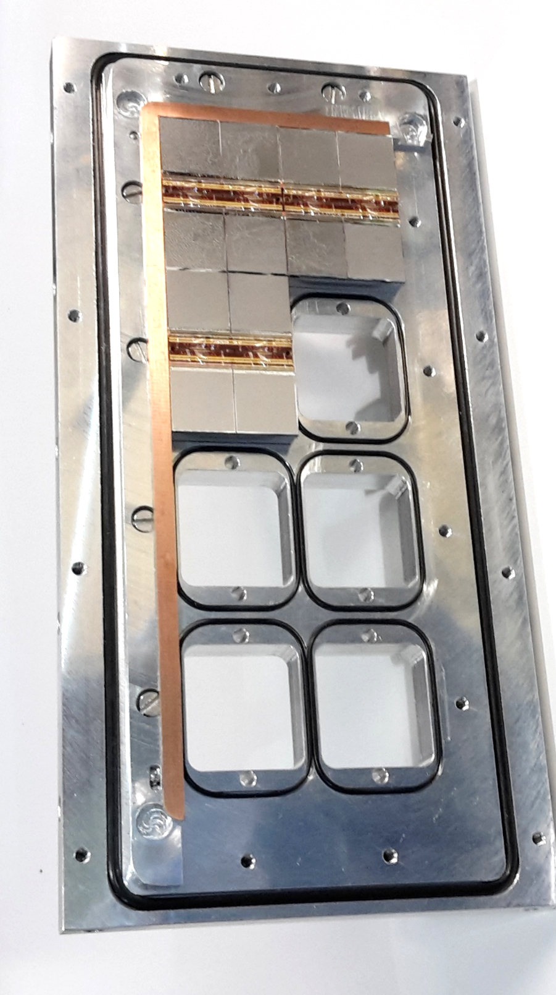
Pixel TPC
Yevgen Bilevych, Klaus Desch, Jean-Paul Fransen, Harry van der Graaf, Markus Gruber, Fred Hartjes, Bas van der Heijden, Kevin Heijhof, Charles Ietswaard, Dimitri John, Jochen Kaminski, Peter Kluit, Naomi van der Kolk, Auke Korporaal, Cornelis Ligtenberg, Oscar van Petten, Gerhard Raven, Joop Rövekamp, Lucian Scharenberg, Tobias Schiffer, Sebastian Schmidt and Jan Timmermans
LCTPC Collaboration meeting @ DESY 9 – 11 january 2019

Slide 2
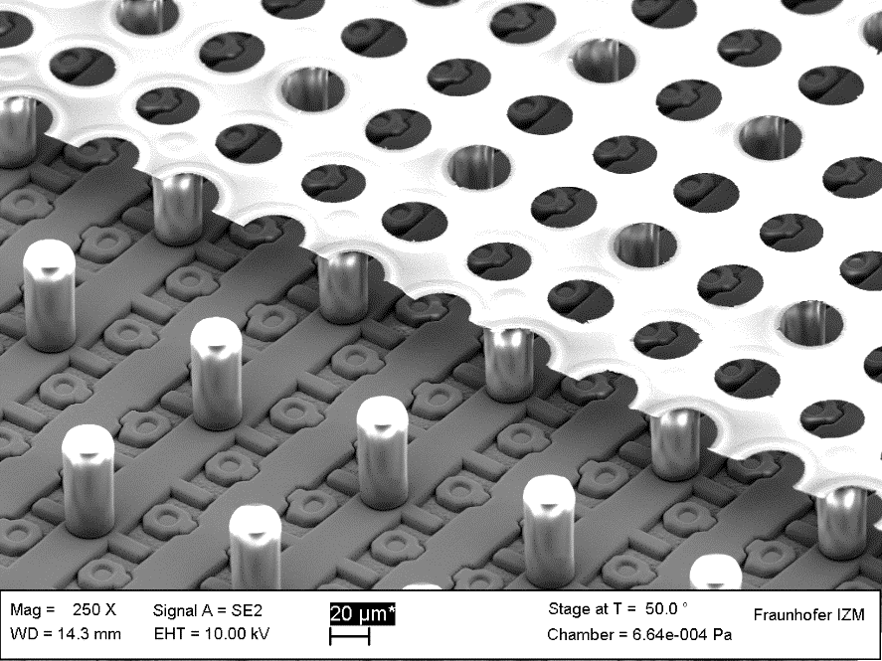
Ingrid, GridPix and Quad
50 µm
Quad total size 39.6 x 28.38 mm
Sensitive area of 68.9%

Slide 3
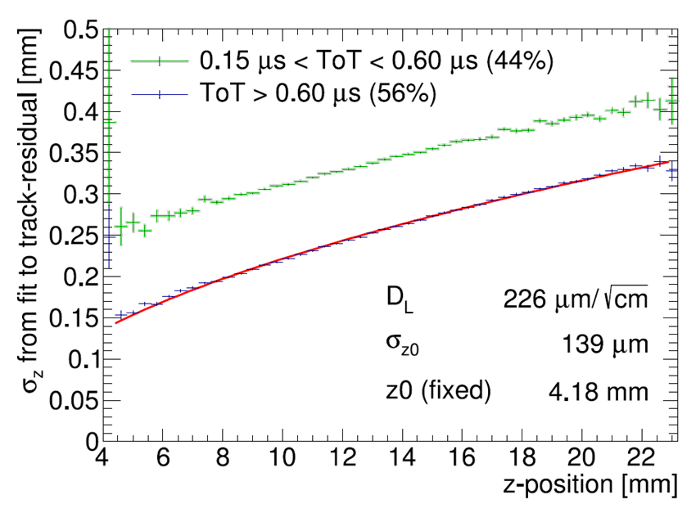
Pixel TPC single hit resolutions B= 0 T
NIM https://doi.org/10.1016/j.nima.2018.08.012

Slide 4
Pixel TPC dEdx resolution
Truncated mean resolution is 4.1% for a 2.5 GeV electron for a 1 m long track
Separation defined as
S = (N_{e} − N_{MIP})/σ_{e}
So 8σ MIP-e separation
Cluster counting based on the distance gives 10σ MIP-e separation or a resolution of 3.3%.
NIM https://doi.org/10.1016/j.nima.2018.08.012

Slide 5
Pixel TPC references
NIM https://doi.org/10.1016/j.nima.2018.08.012
Detailed references in the paper.
For more detailed information and results:
https://agenda.linearcollider.org/event/8067/timetable/#20190110.detailed
For overview: LCTPC_PixelModule.pptx
For dEdx: LCTPC_PixelTopics.pptx

Slide 6
Pixel TPC
Single chip Quad Module TPC plane
2017 2018 2019

