Slide 1



QUAD and Module Building, Cooling and Electronics
Fred Hartjes
On behalf of
Nikhef
and
Physikalisches Institut
Universität Bonn
LCTPC Meeting. Desy, January 9, 2019

Slide 2
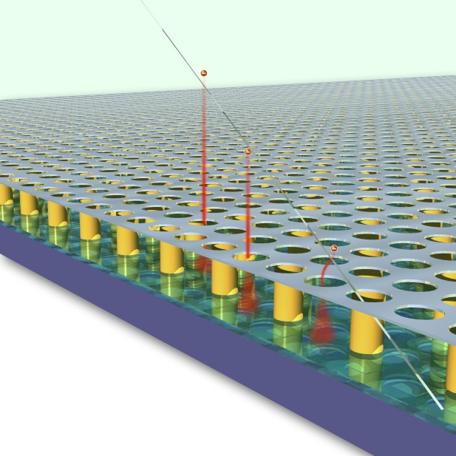
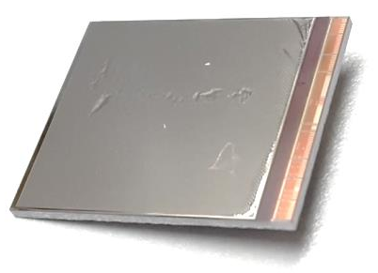
GridPix technology
Pixel chip with integrated Micromegas
=> InGrid
Grid set at negative voltage (300 – 600 V) to provide gas amplification
Very small pixel size (55 µm)
=> mostly detecting individual electrons
300 – 600 V
GridPix chip
55 µm

Slide 3
GridPix: detecting individual electrons
Uses the complete information of the ionization profile
The best resolution that can be obtained with a gaseous detector
  dE/dx by single electron counting
Fine granularity enables rejecting background tracks and deltas in offline analysis
Measured track in test beam

Slide 4
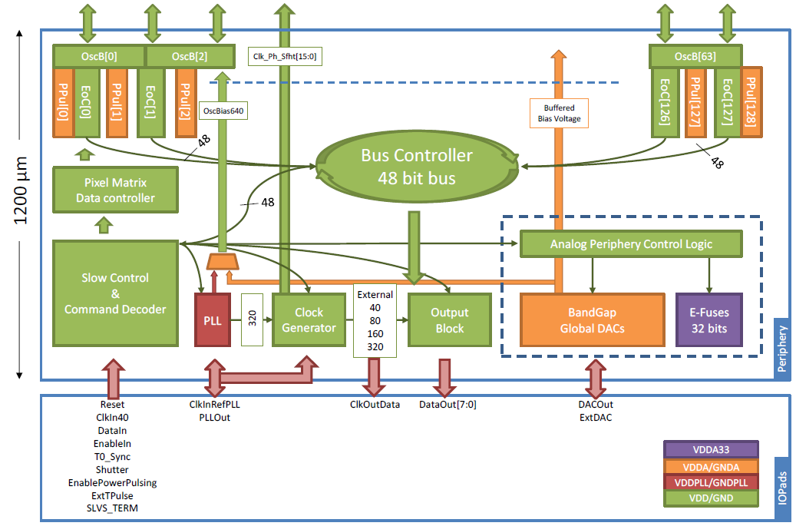
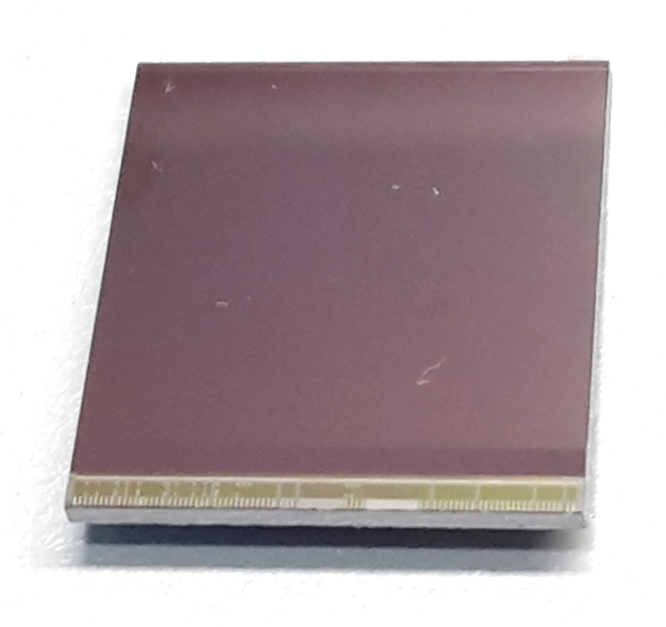
Pixel chip: TimePix3
256 x 256 pixels
55 x 55 µm pitch
=> 14.1 x 14.1 mm sensitive area
TDC with 610 MHz clock (1.64 ns)
Used in the data driven mode
  Each hit consists of the pixel address and time stamp of arrival time (ToA)
  Time over threshold (ToT) is added to register the signal amplitude
  => compensation for time walk
  Trigger (for t₀) added to the data stream as an additional time stamp
High power consumption
  ~ 1 A @ 2 V (2W), depending on hit rate
  => good cooling is important

Slide 5
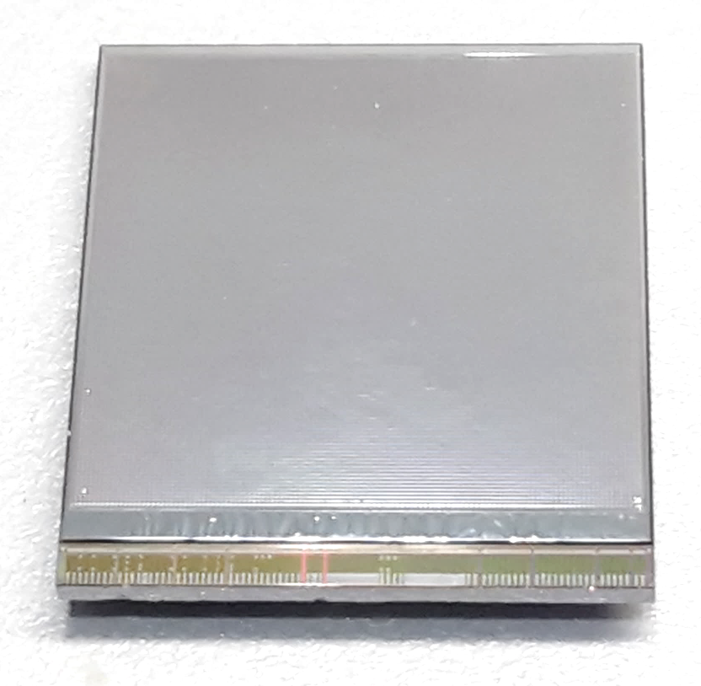
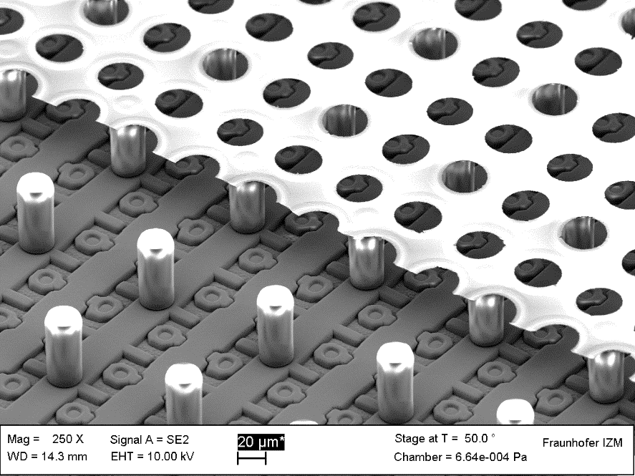
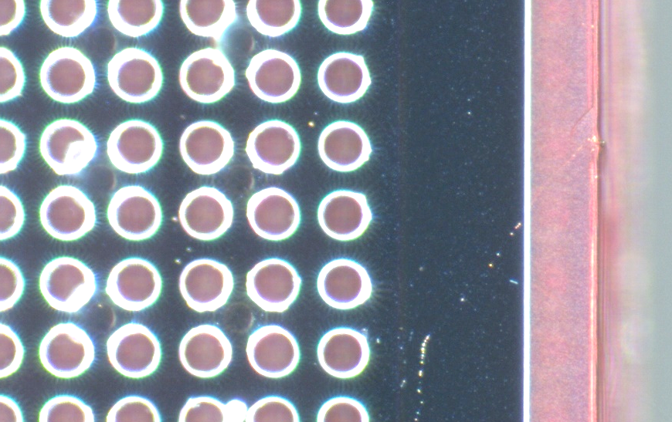
TimePix3 equipped with InGrid
Wafer post-processing at IZM Berlin
Aluminium grid (1 µm thick)
35 µm wide holes, 55 µm pitch
Supported by SU8 pillars 50 µm high
Grid surrounded by SU8 dyke (150 µm wide solid strip) for mechanical and HV stability
dyke
50 µm
Cut view

Slide 6
Maximizing active area
Using TimePix3 chip
Wirebond board squeezed to smallest width possible => 3 mm
Inactive zone (wirebond pads + electronics) => 2 mm
=> we need a 5 mm wide inactive zone per chip for connection + electronics
(only applies when the connecting PCB is shared with an opposite chip)
Sensitive area
2 mm
3 mm

Slide 7
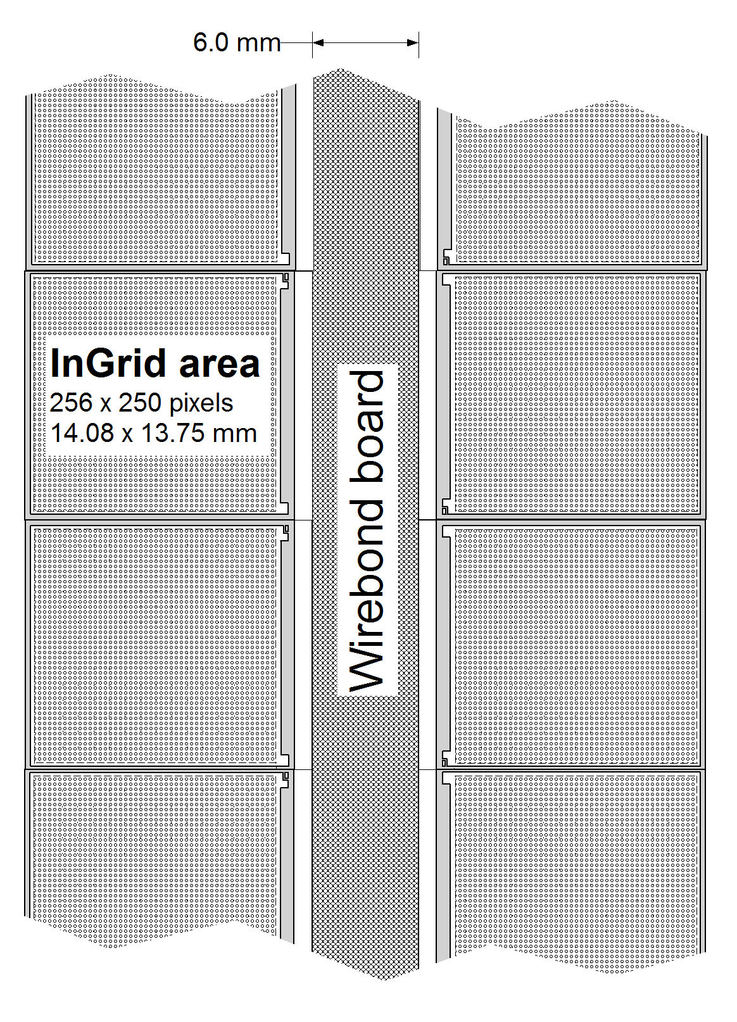
Getting the optimal detector size
10 mm
1 x 2 chips
  Not sufficient space (14 mm) for a LV stabilisation, chip control lines and a data RO
2 x 2 chips (QUAD)
  All fits
≥ 3 x 2 chips
  Less flexible, lower yield, more handling risk

Slide 8
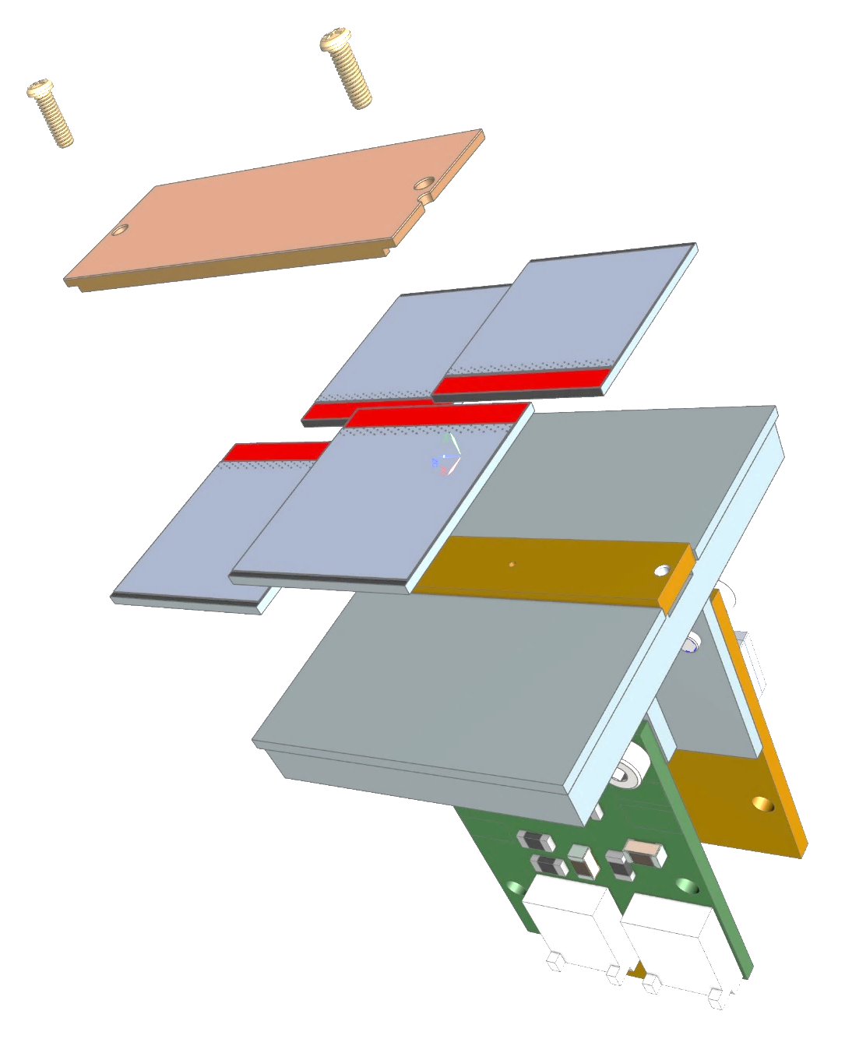
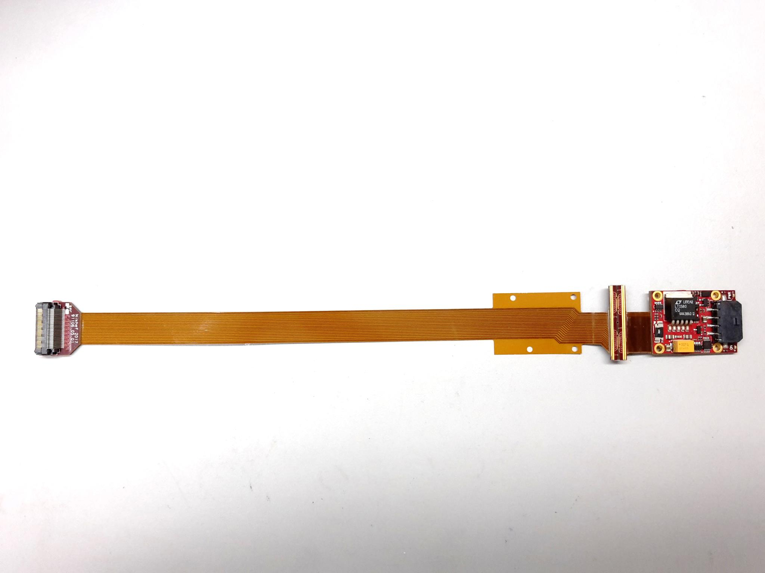
Covering large detection areas: QUAD
Four-TimePix3 chips
All services (signal IO, LV power) are located under the detection surface
The area for connections was squeezed to the minimum
Detection surface can be extended by adding other QUADs at all 4 sides
  => no limit on detection area
39.6 x 28.38 mm
Guard
TPX3
TPX3
TPX3
TPX3
COld
CArrier
LV PS

Slide 9
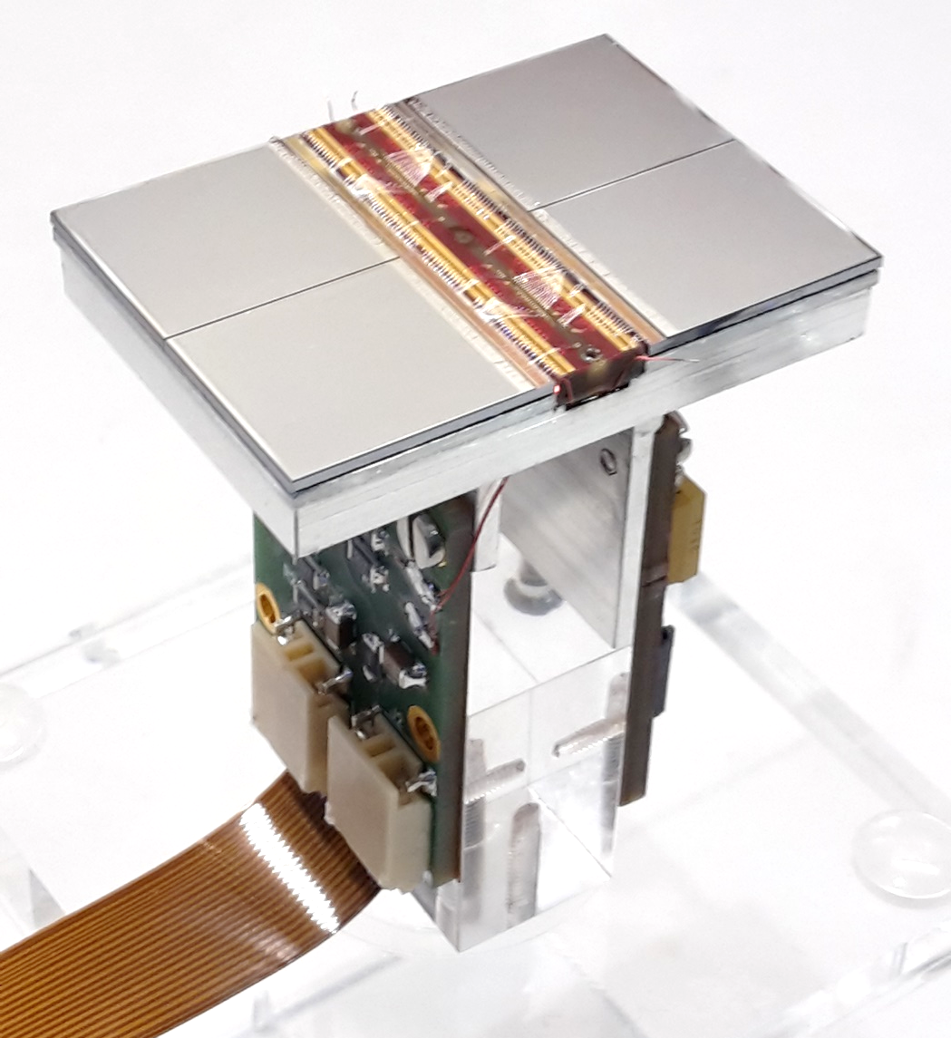
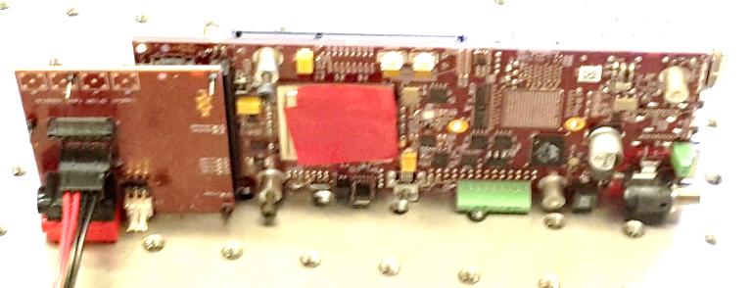
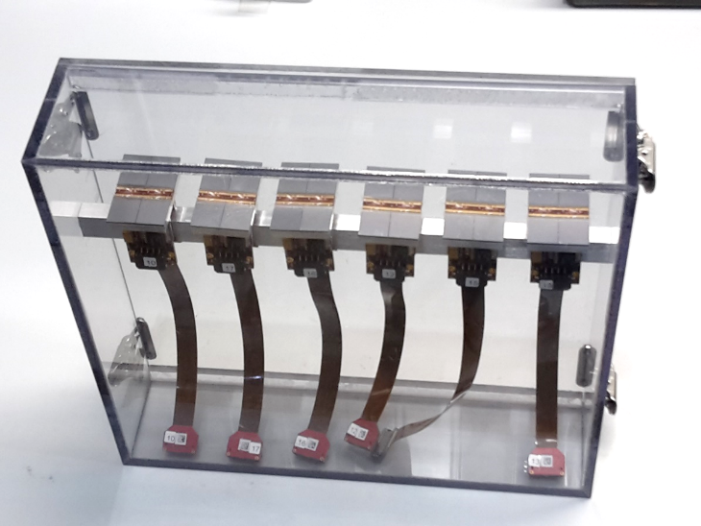
Assembled QUAD
COld CArrier
(COCA)
QUAD has a sensitive area of 68.9%
DAQ by SPIDR
  Optical link
QUADs being produced in series
(14 QUADs)
Guard electrode omitted
Commercialization under study
Contact us if you are interested

Slide 10

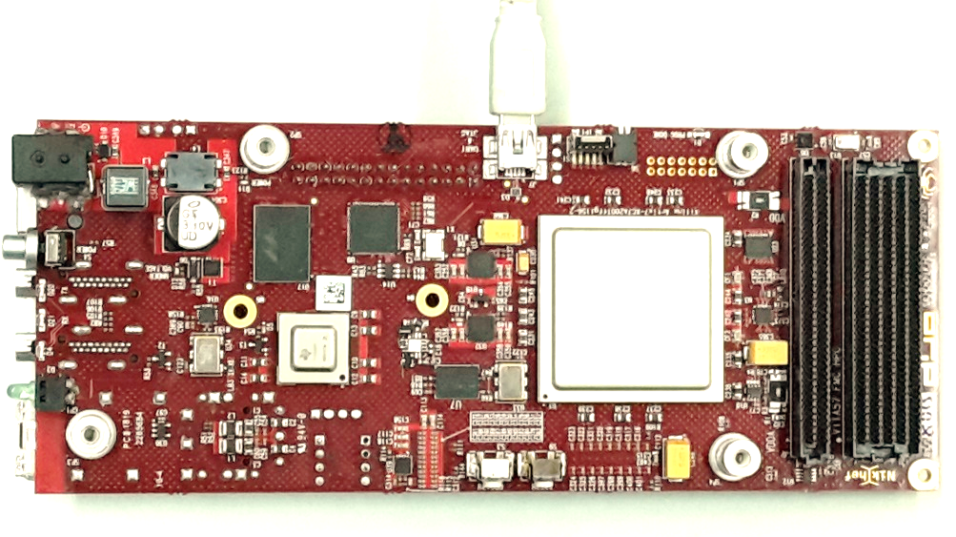
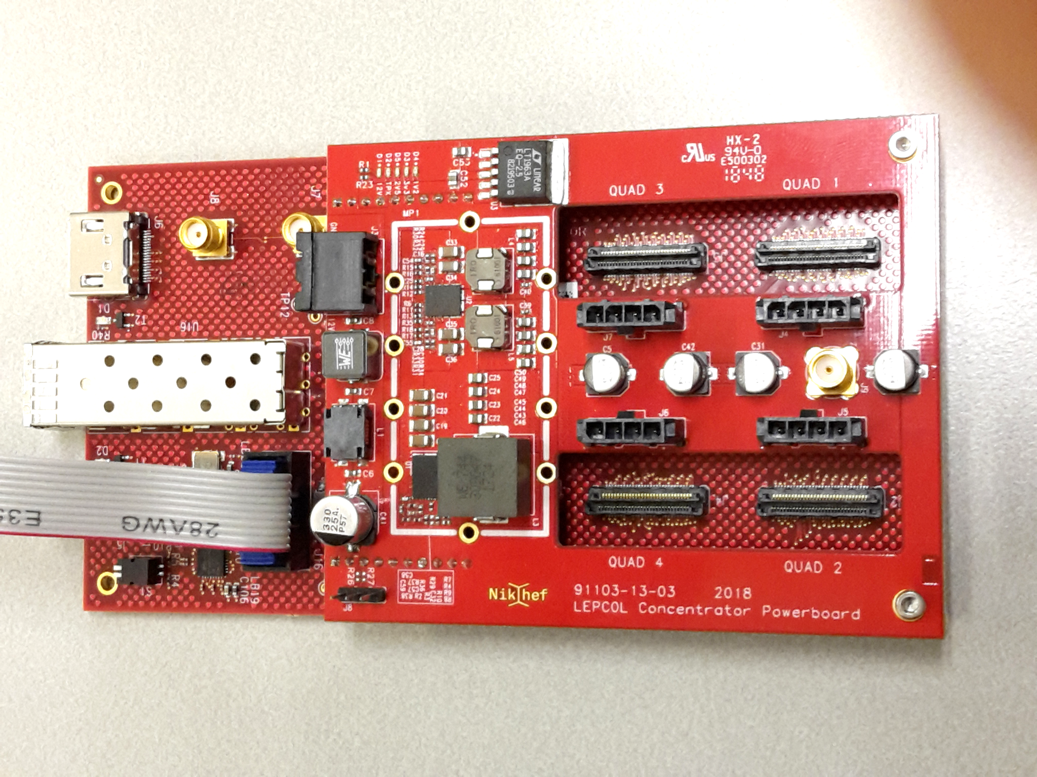
DAQ
Concentrator
SPIDR board

Slide 11
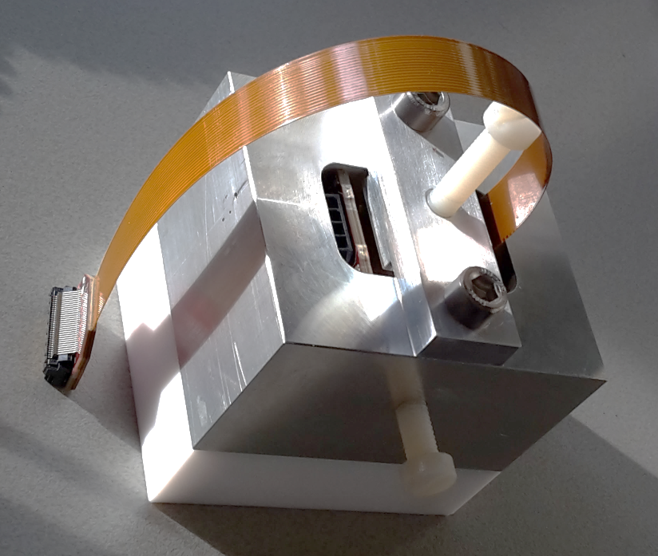
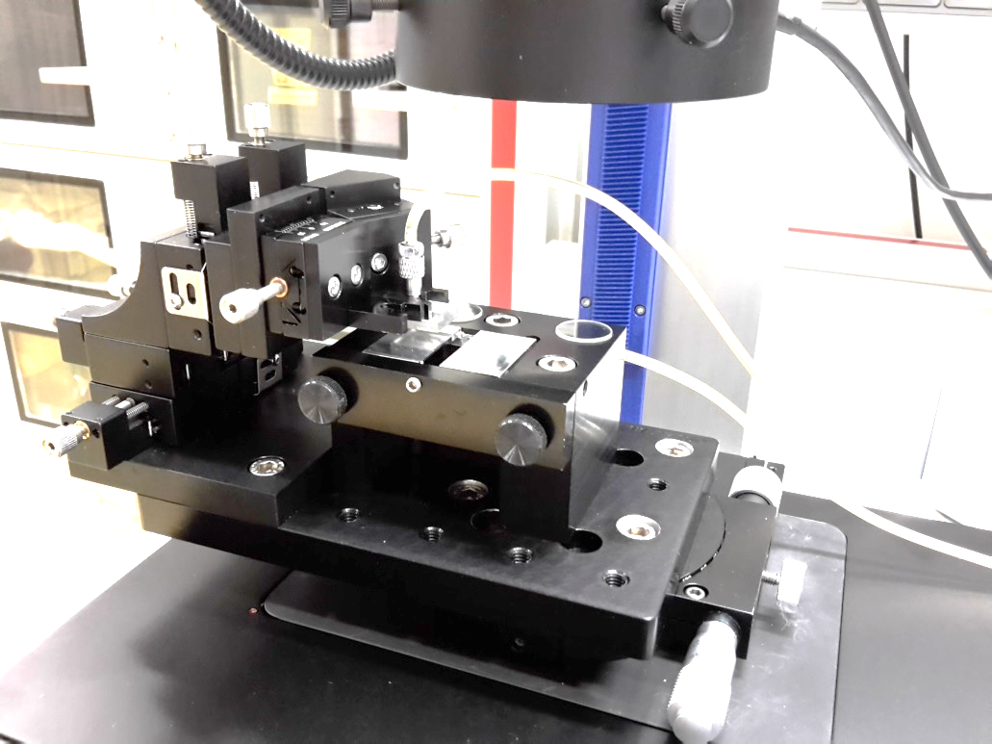
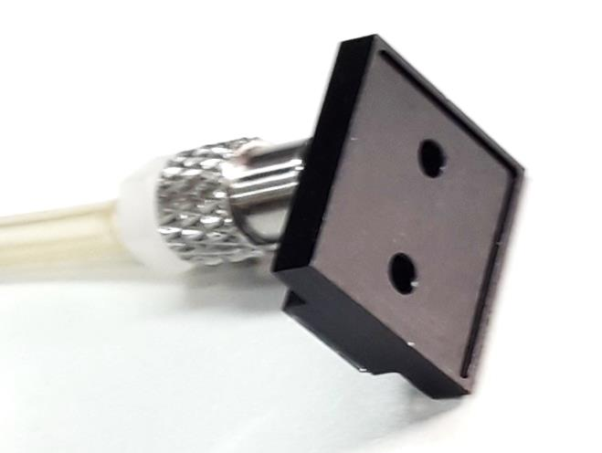
QUAD’s tooling
Gluing tool
Based on small production quatities (up to ~ 50)
Chip alignment jig
Pickup tool for chip
with InGrid

Slide 12
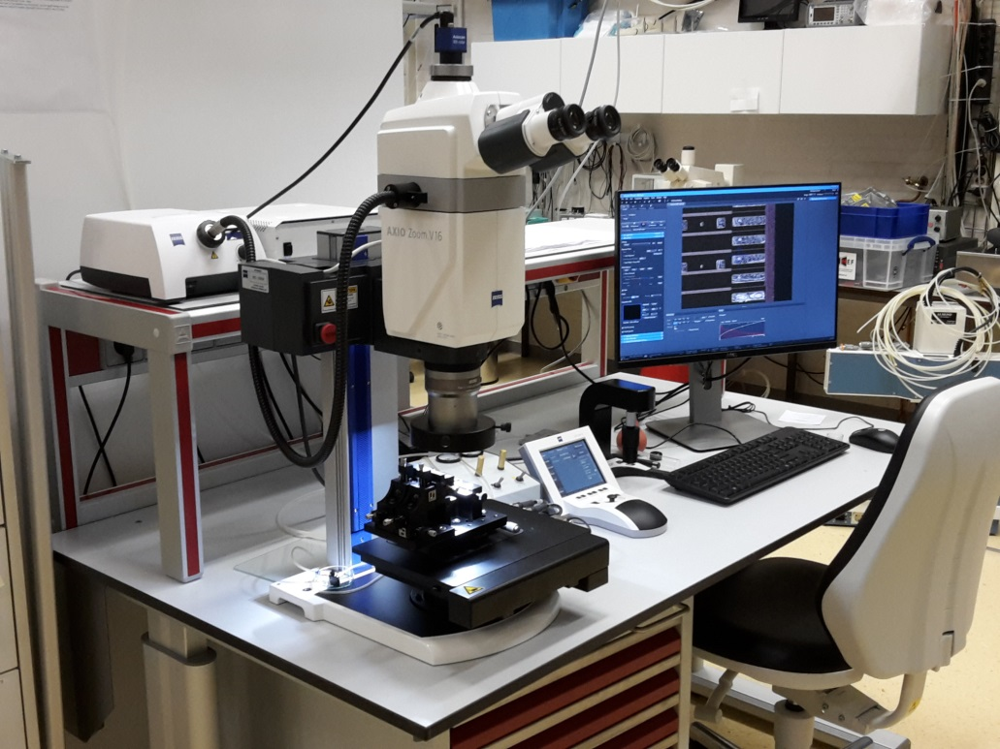
Chip aligment
Semi automatic under LabVIEW
Referring the precise edges of the COCA to the bonding pads
Aimed accuracy 20 µm in X,Y and Z

Slide 13
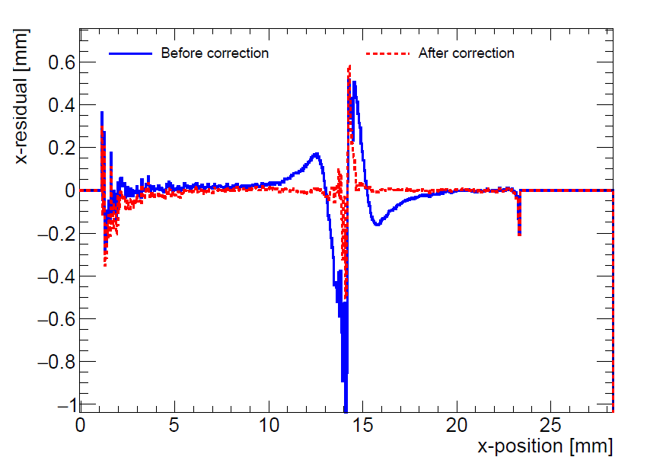
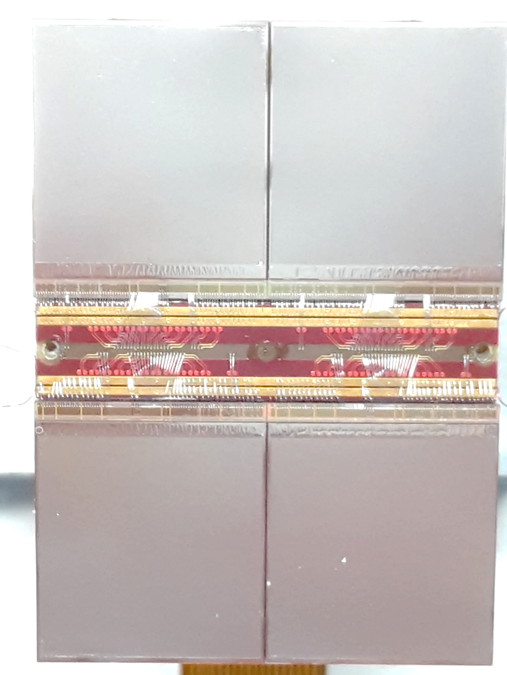
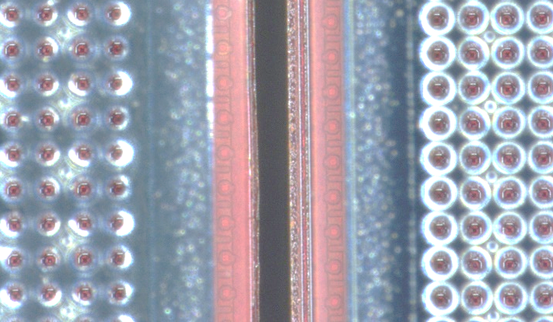
QUAD edge deformations
Last testbeam => small deformations due to
  Dead zone between chips
  Grounded region between chips
May be corrected by fitted correction function or adding proper guard electrode
Grounded region
Preliminary

Slide 14
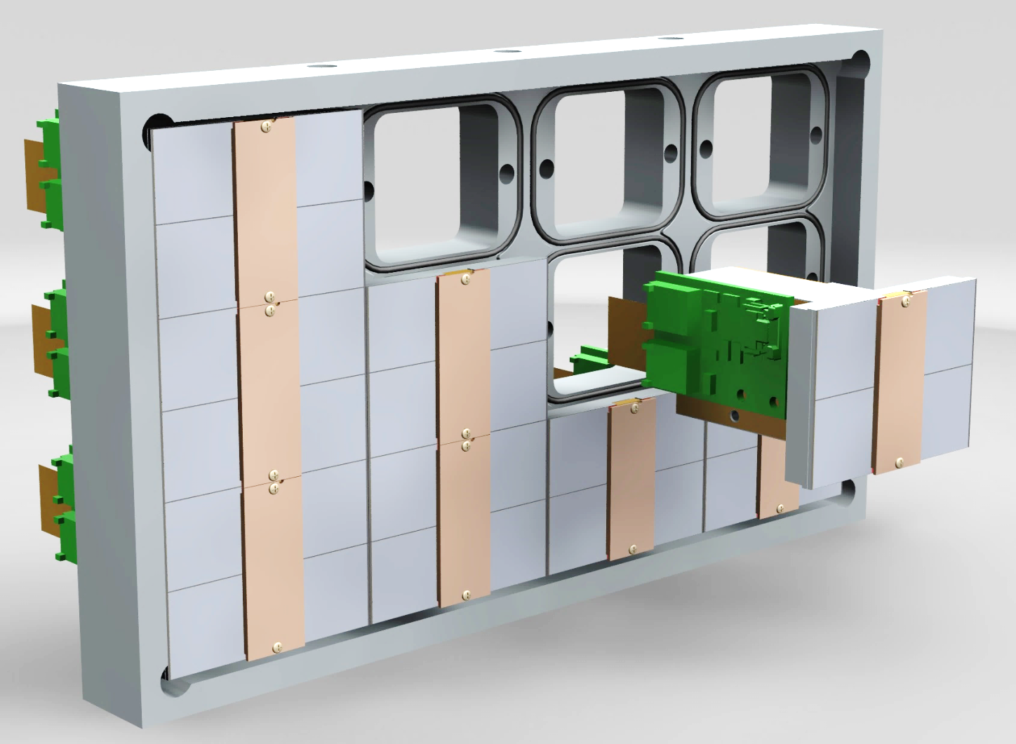
QUAD as a building block
Building blocks of 39.6 x 28.38 mm
Unlimited surface may be covered
Plug in QUADs into a cooled gastight mounting plate
Push them from two sides to a mechanical reference
Concentrator board to connect 4 QUADs to a single SPIDR board in progress
Cooling channels
Sensitive area 68.9%

Slide 15
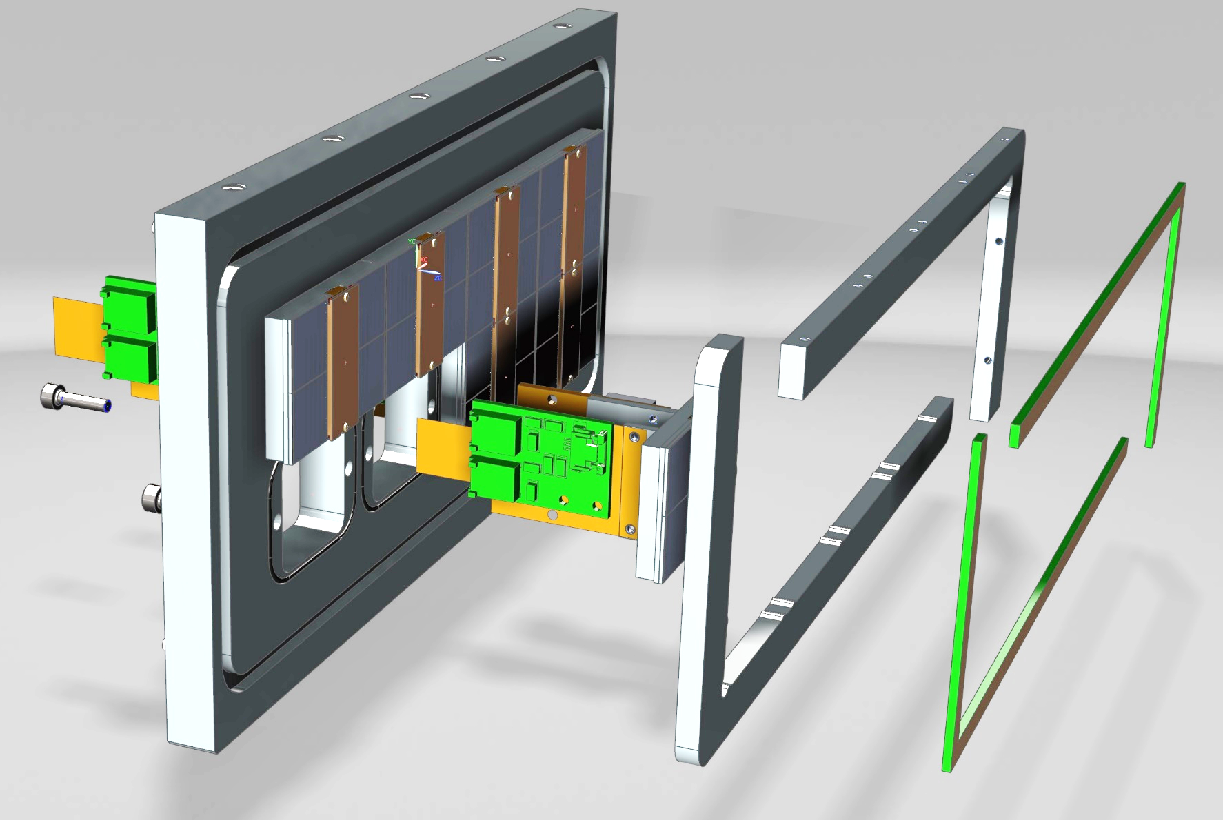
Testbox for 2 x 4 QUADs
Being assembled

Slide 16
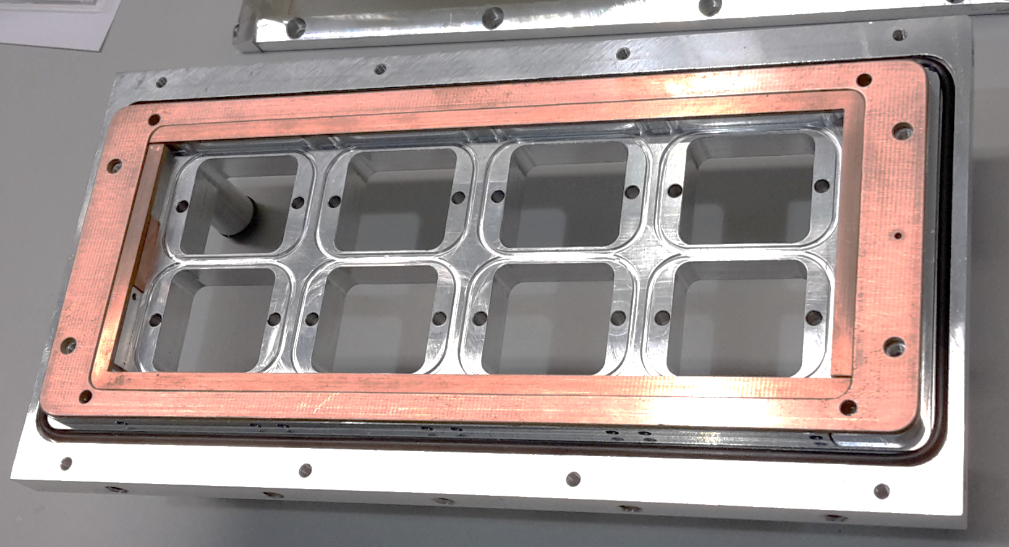
Guard structure around the QUADs

Slide 17
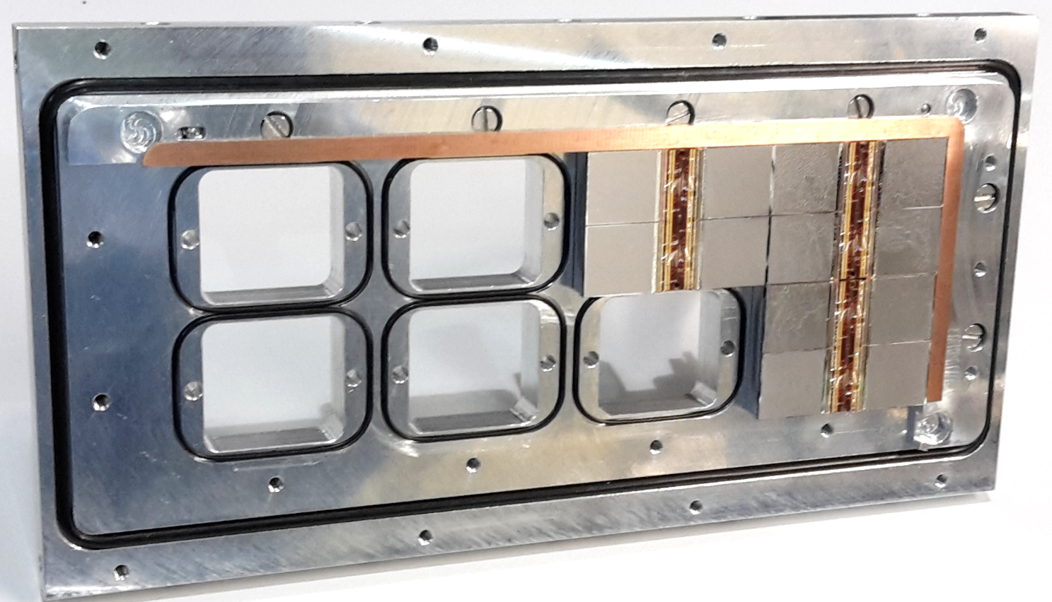
Mounting plate for 8 QUADs being assembled
Guard electrodes not yet installed
Thermal grease (outside gas volume)

Slide 18
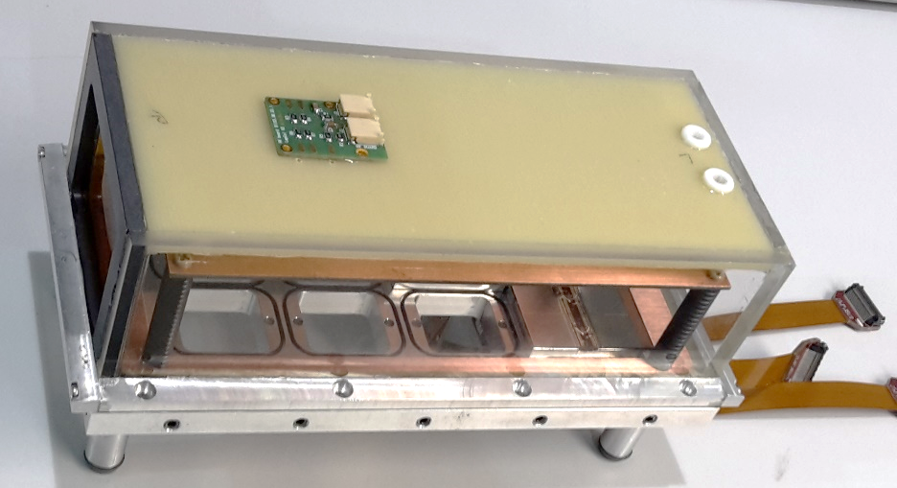
Testbox in assembly
Glass cover for UV laser measurements

Slide 19

Conclusions
Since 2017 three TimePix3 wafers were successfully equipped with an InGrid
  Last two (low yield) wafers carried 88 electrically usable chips
  Only a few were rejected because of grid problems
The QUAD we present as a building block to populate an ILCTPC module
A beam test showed the need for a narrow guard electrode structure covering the gap between the chips
Presently the QUAD can be produced in small quantities
  One QUAD per two days can be achieved
  Improvement of the HV wiring is needed, requires minor design modifications
  A production of 14 QUAD modules is close to finish
A testbox carrying 2 x 4 QUADs is being assembled
  UV laser tests: focused and parallel beam (ionization in the gas)
  Testbeam (Bonn)

Slide 20
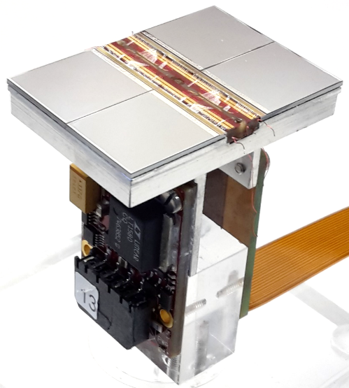
Thank you for your attention
This work is done by the effort of:
Yevgen Bilevych, Klaus Desch, Jean-Paul Fransen, Harry van der Graaf, Markus Gruber, Fred Hartjes, Bas van der Heijden, Kevin Heijhof, Charles Ietswaard, Dimitri John, Jochen Kaminski, Peter Kluit, Naomi van der Kolk, Auke Korporaal, Cornelis Ligtenberg, Oscar van Petten, Gerhard Raven, Joop Rövekamp, Lucian Scharenberg, Tobias Schiffer, Sebastian Schmidt and Jan Timmermans
Nikhef
and
Physikalisches Institut Universität Bonn

Slide 21
BACKUP

