Slide 1

HIGGS FACTORIES

Slide 2

THREE YEARS ALREADY

Slide 3
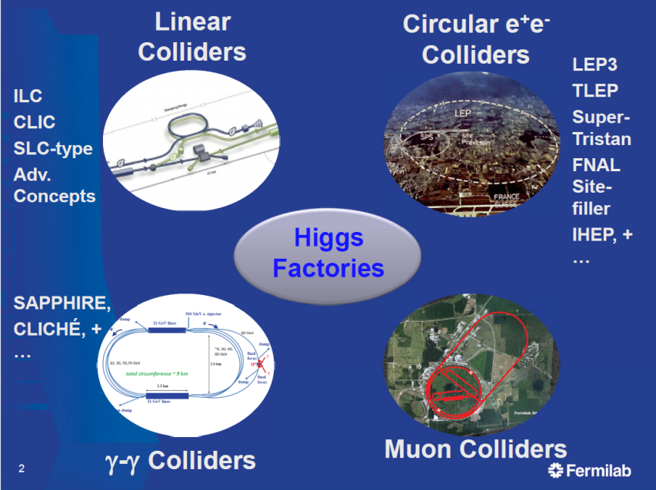
HF2012 Workshop, Fermilab Nov 2012
CEPC
FCC-ee

Slide 4
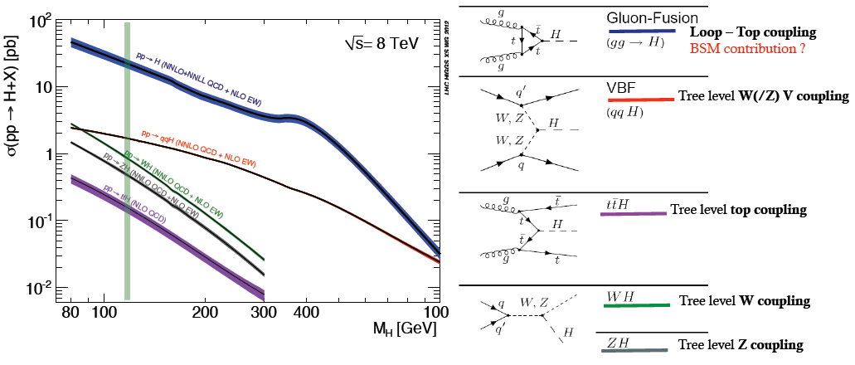
THE LHC is a Higgs Factory
The LHC is a Higgs Factory !
several Million Higgs already produced – more than most Higgs factory projects.
15 Higgs bosons / minute – and more to come (gain factor 3 going to 13 TeV)
Difficulties: several production mechanisms to disentangle and
significant systematics in the production cross-sections σ_{prod} .
Challenge will be to reduce systematics by measuring related processes.
σ_{i→f} ^{observed} ∝ σ_{prod} (g_{Hi} )²(g_{Hf})² extract couplings to anything you can see or produce from
Γ_{H} if i=f as in WZ with H→ ZZ → absolute normalization

Slide 5
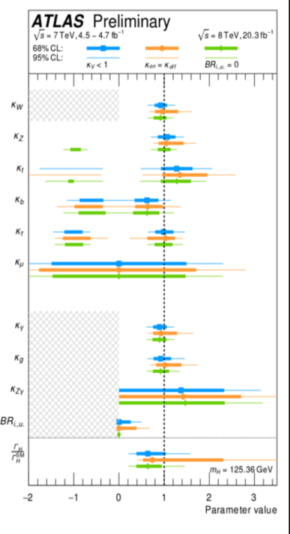
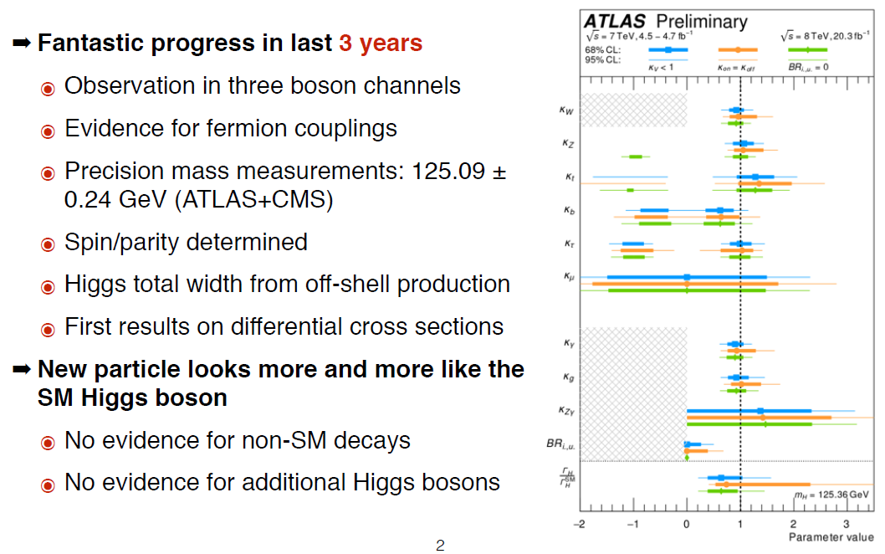
THE LHC is a Higgs Factory

Slide 6
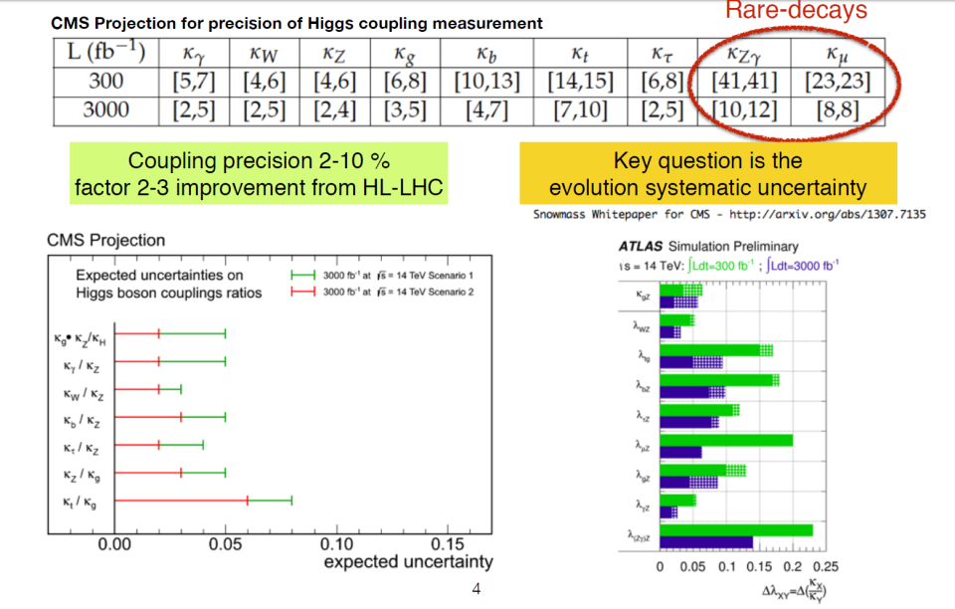
THE LHC(13) and HL-LHC as Higgs Factory
Results from 13 TeV run will be very instructive from this point of view!

Slide 7
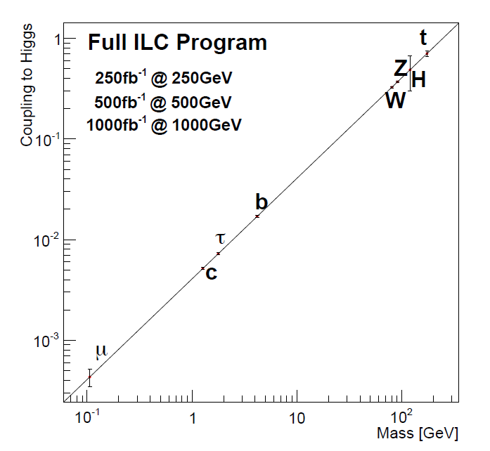
t
Full HL-LHC
H
Z
W
b
τ
μ

Slide 8

naive views...

Slide 9
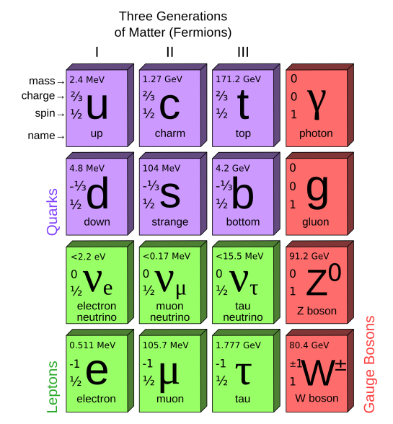
THE STANDARD MODEL CONSTRUCTION
2012
125.6 GeV
0
0
Higgs boson
H
<0.3 eV
<0.3 eV
<0.3 eV
1
2
3
1897

Slide 10
What now?
Question 1: is the H(125) The Higgs boson?
-- do/will we know well enough from LHC?
-- how precisely do we need to know before we are convinced?
Question 2: is the SM closed? or is there something else in sight?
-- known unknown facts need answer:
neutrino masses, (Dirac, and/or Majorana, sterile and right handed, CPV, MH..)
non baryonic dark matter,
Accelerated expansion of the Universe
Matter-antimatter Asymmetry
-- can the Higgs be used as search tool for new physics that answer these questions?
-- precision measurements sensitive to the existence of new particles through loops?
-- prepare highest possible reach
-- how precisely do we need to know before we are convinced?
Question 3: which Higgs factories ?
-- HL-LHC
-- (V)HE-LHC
-- mu+mu-
-- gamma-gamma
-- e+e- : linear (ILC or CLIC?) or circular (TLEP)
A: As precisely as we possibly can

Slide 11
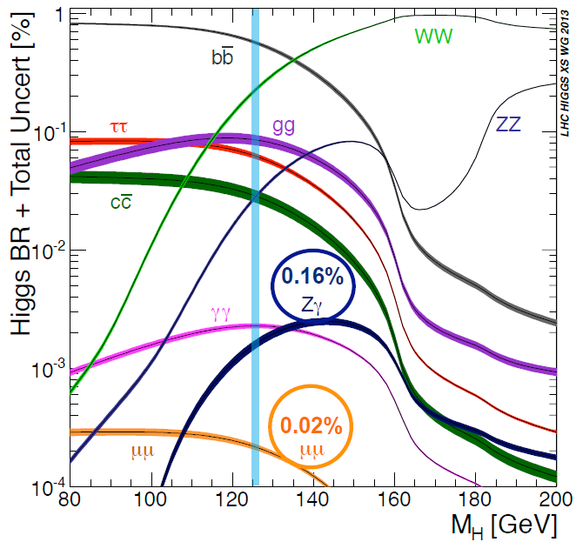
a 125 GeV SM scalar is
-- a new object!
-- quite narrow
Γ_{H} = (4.2 MeV)
-- decays into bb (57%)
-- and many other things!
What would we learn
from these measurements?
ee : 10⁻⁸

Slide 12
Recommendations concerning Higgs Factories
European Strategy:
There is a strong scientific case for an electron-positron collider, complementary to the LHC, that can study the properties of the Higgs boson and other particles with unprecedented precision and whose energy can be upgraded.
(up to which energy?)
US P5 Report
An e+e- collider can provide the next outstanding opportunity [after LHC/HL-LHC]
to investigate the properties of the Higgs in detail. [...] the physics case is extremely strong.
LINEAR or CIRCULAR?
At the time of the definition of these strategies, ILC was proposed by Japanese physicists to their governments and welcoming statements were added. Situation has been reviewed in Japan since. Likely to wait for results from LHC13. Issues of physics, manpower, cost, spinoffs, have been raised.

Slide 13
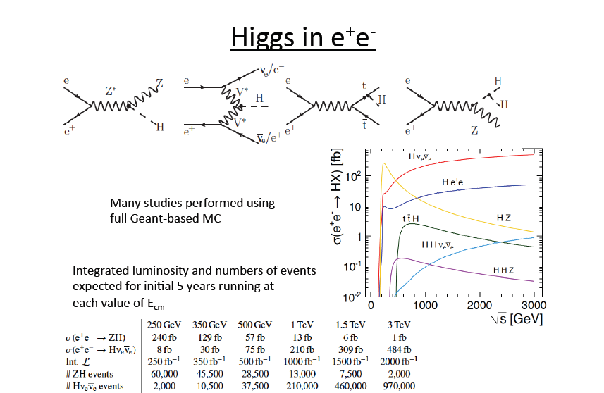
⬅ baseline ILC/CLIC

Slide 14
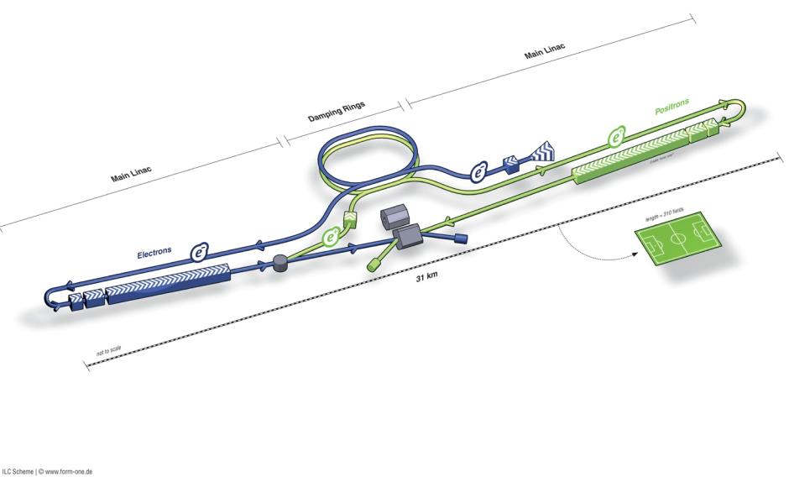
ILC in a Nutshell
Polarised electron source
Damping Rings
Ring to Main Linac (RTML)
(inc. bunch compressors)
e+ Main Linac
Beam Delivery System (BDS) & physics detectors
Polarised positron
source
Beam dump
e- Main Linac
not too scale

Slide 15
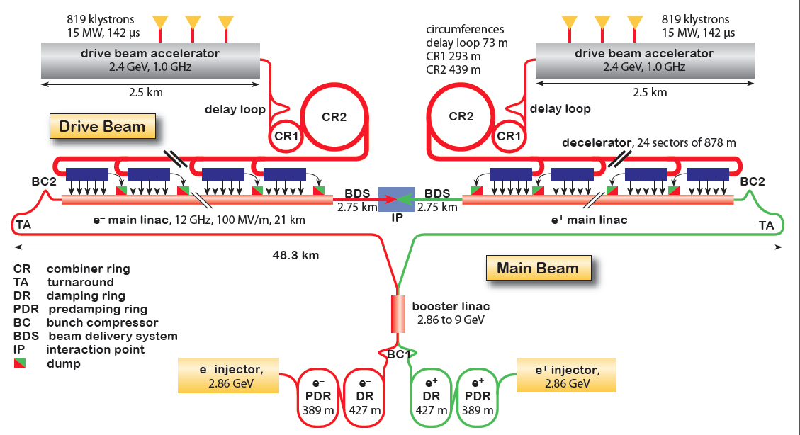
CLIC Layout at 3 TeV
Goal: Lepton energy frontier
Drive Beam Generation Complex
Drive beam time structure - initial
Drive beam time structure - final
240 ns
240 ns
5.8 μs
140 μs train length - 24 × 24 sub-pulses
4.2 A - 2.4 GeV – 60 cm between bunches
Main Beam Generation Complex
24 pulses – 101 A – 2.5 cm between bunches

Slide 16
LEP3, CEPC and TLEP/FCC-ee
Circular e+e- colliders designed to study the Higgs boson
but also Z,W (top) factories
AB, F. Zimmermann
Dec. 13 2011

Slide 17
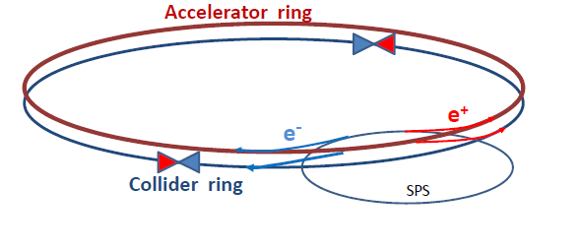
Original motivation (end 2011): now that m_H and m_top are known,
explore EW region with a high precision, affordable, high luminosity machine
➔ Discovery of New Physics in rare phenomena or precision measurements
ILC studies → need increase over LEP 2 (average) luminosity by a factor 1000
How can one do that without exploding the power bill?
Answer is in the B-factory design: a low vertical emittance ring with
higher intrinsic luminosity, and small β*_{y} (1mm vs 5cm at LEP)
Electrons and positrons have a much higher chance of interacting
➔ much shorter lifetime (few minutes)
➔ top up continuously with booster ==> increase operation efficiency
Increase SR beam power to 50MW/beam
50
5
4
1000
at ZH threshold
in LEP/LHC tunnel
X 4 in FCC tunnel
X 4 interaction points
EXCITING!

Slide 18

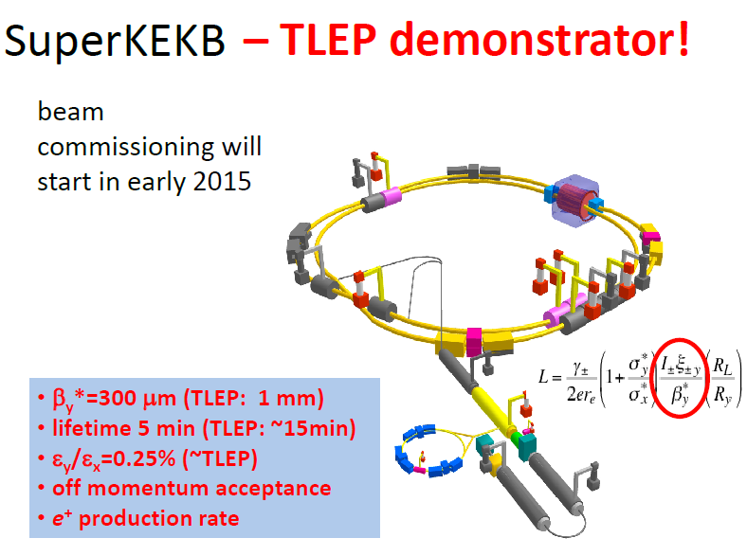
2016

Slide 19
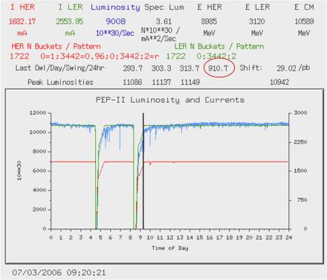
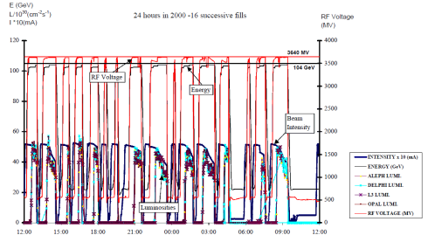
Toping up ensures constant current, settings, etc...
and greater reproducibility of system
LEP2 in 2000 (12th year!):
fastest possible turnaround but
average luminosity ~ 0.2 peak luminosity
B factory in 2006 with toping up
average luminosity ≈ peak luminosity

Slide 20
The Higgs at a e+e- Collider has been studied for many years (Tesla, ILC, CLIC)
At a given Ecm and Luminosity, the physics has marginally
to do with the fact that the collider is linear or circular
--specifics:
-- e- polarization is easy at the source in LC, (not critical for Higgs)
-- EM backgrounds from beam disruption at LC
-- knowledge and definition of beam energy at CC
-- one IP (LC) vs several IPs (CC)
-- Dependence of Luminosity on Center-of-mass energy →
-- detectors are likely to be very similar

Slide 21
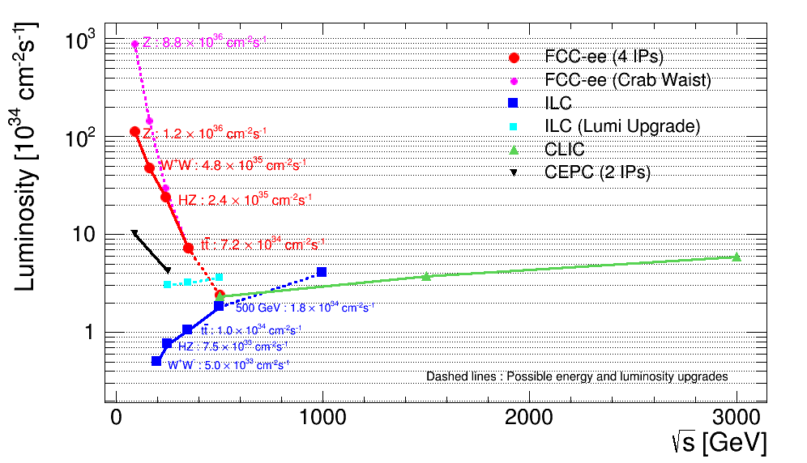
Overlap in Higgs/top region, but differences and complementarities
between linear and circular machines:
Circ: High luminosity, experimental environment (up to 4 IP), E_{CM} calibration
Linear: higher energy reach, longitudinal beam polarization

Slide 22
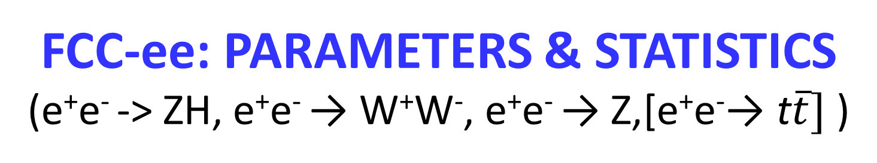
FCC-ee: PARAMETERS & STATISTICS
(e⁺e⁻ -> ZH, e⁺e⁻ → W⁺W⁻, e⁺e⁻ → Z,[e⁺e⁻→ t$\overline{t}]$ )
 | TLEP-4 IP, per IP | statistics
circumference | 80 km
max beam energy | 175 GeV
no. of IPs | 4
Luminosity/IP at 350 GeV c.m. | 1.3x10³⁴ cm⁻²s⁻¹ | 10⁶‾tt pairs
Luminosity/IP at 240 GeV c.m. | 6.0x10³⁴ cm⁻²s⁻¹ | 2 10⁶ ZH evts
Luminosity/IP at 160 GeV c.m. | 1.6x10³⁵ cm⁻²s⁻¹ | 10⁸ WW pairs
Luminosity/IP at 90 GeV c.m. | 2. 10^{35/36} cm⁻²s⁻¹ | 10^{12/13} Z decays
at the Z pole repeat the LEP physics programme in a few minutes…

Slide 23
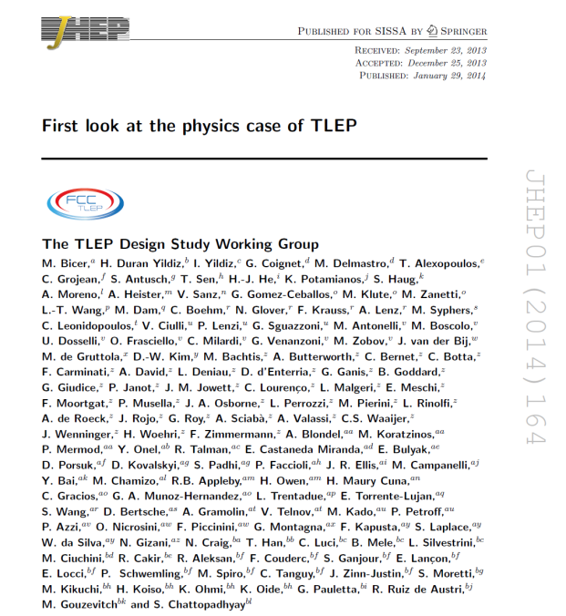
PUBLISHED

Slide 24
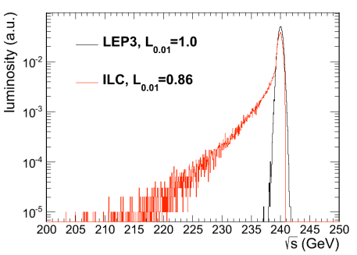
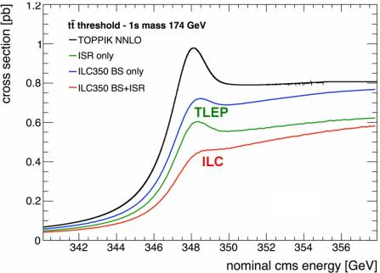
BEAMSTRAHLUNG
Luminosity E spectrum
Effect on top threshold
➔
Beamstrahlung @TLEP is benign: particles are either lost or recycled on a synchrotron oscillation
➔ some increase of energy spread
but no change of average energy
Little EM background in the experiment.

Slide 25
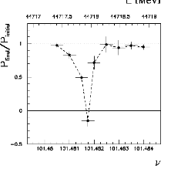
Beam polarization and E-calibration @ TLEP
Precise meast of E_{beam} by resonant depolarization
~100 keV each time the meast is made
At LEP transverse polarization was achieved routinely at Z peak.
instrumental in 10⁻³ measurement of the Z width in 1993
led to prediction of top quark mass (179+- 20 GeV) in March 1994
Polarization in collisions was observed (40% at BBTS = 0.04)
At LEP beam energy spread destroyed polarization above 60 GeV
σ_{E} ∝ E²/√ρ ➔ At TLEP transverse polarization up to at least 80 GeV
to go to higher energies requires spin rotators and siberian snake
TLEP: use ‘single’ bunches to measure the beam energy continuously
no interpolation errors due to tides, ground motion or trains etc…
<< 100 keV beam energy calibration around Z peak and W pair threshold.
Δm_{Z} ~0.1 MeV, ΔΓ_{Z} ~0.1 MeV, Δm_{W} ~ 0.5 MeV

Slide 26
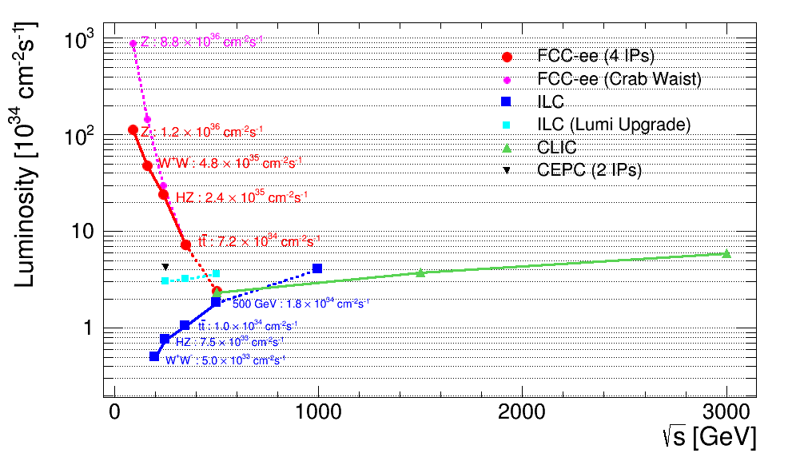
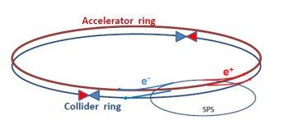
First look at the physics case of TLEP, arXiv:1308.6176v3 scoped the precision measurements:
-- Model independent Higgs couplings and invisible width
-- Z mass (0.1 MeV), W mass (0.5 MeV) top mass (~10 MeV), sin²_{W}^{eff} , R_{b ,} N_{ν} etc...
➔ powerful exploration of new physics with EW couplings up to very high masses
➔ importance of luminosity and E_{beam} calibration by beam depolarization up to W pair
So far: simulations with CMS detector (Higgs) -- or «just» paper studies.
Snapshot of novelties appeared in recent workshops
Higher luminosity prospects at W, Z with crab-waist
➔ sensitivity to right handed (sterile) neutrinos
➔ s-channel e+e- → H(125.2) production almost possible ( ➔ monochromators?)
➔ rare Higgs Z W and top decays, FCNCs etc...
➔ discovery potential for very small couplings
➔ precision event generators (Jadach et al)
http://cern.ch/FCC-ee

Slide 27
Higgs production mechanism
“higgstrahlung” process close to threshold
Production xsection has a maximum at near threshold ~200 fb
10³⁴/cm²/s ➔ 20’000 HZ events per year.
e⁻
H
Z – tagging
by missing mass
Z*
e⁺
Z
For a Higgs of 125GeV, a centre of mass energy of 240GeV is sufficient
➔ kinematical constraint near threshold for high precision in mass, width, selection purity

Slide 28
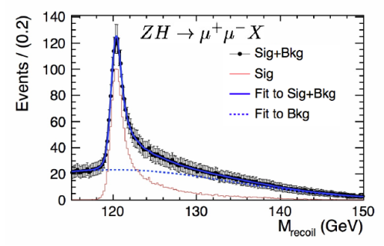
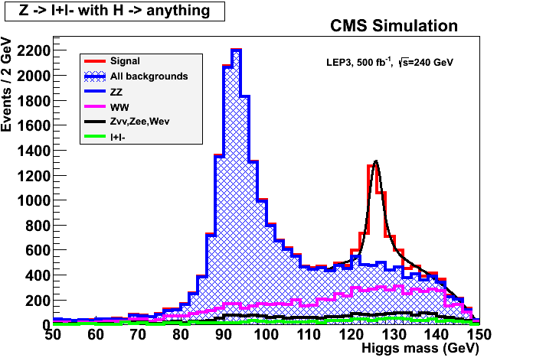
ILC
Z – tagging
by missing mass
total rate ∝ g_{HZZ}²
ZZZ final state ∝ g_{HZZ}⁴/ Γ_{H}
➔ measure total width Γ_{H}
empty recoil = invisible width
‘funny recoil’ = exotic Higgs decay
easy control below theshold
e⁻
H
Z*
e⁺
Z

Slide 29
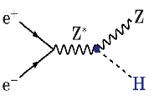
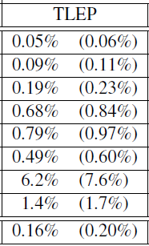
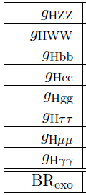

Higgs factory
(constrained fit
including ‘exotic’)
4 IPs
(2 IPs)
2 10⁶ ZH events in 5 years
«A tagged Higgs beam».
sensitive to new physics in loops
incl. invisible = (dark matter?)
A big challenge, but unique:
Higgs s-channel production at √s = m_{H}
10⁴ events per year.
Very difficult because huge background
and beam energy spread ~ 10 x Γ_{H}
limits or signal? monochromators?
Aleksan, D’Enterria, Woijcik
➔ total width
HHH (best at FCC-hh)
Htt (best at FCC-hh)
<1%
28%
13%
from HZ thresh
from tt thresh

Slide 30
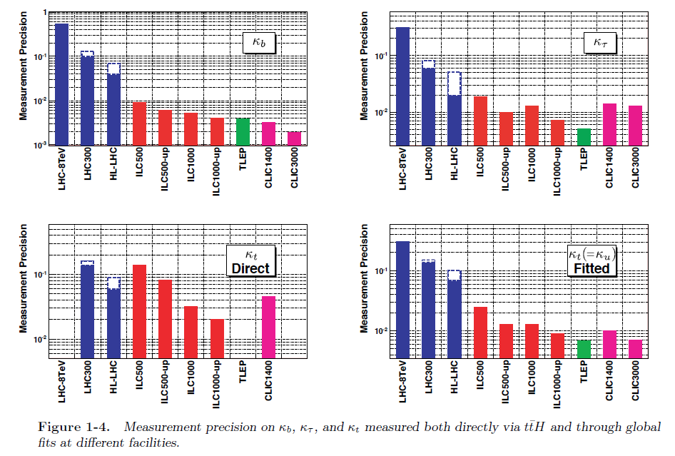

Slide 31
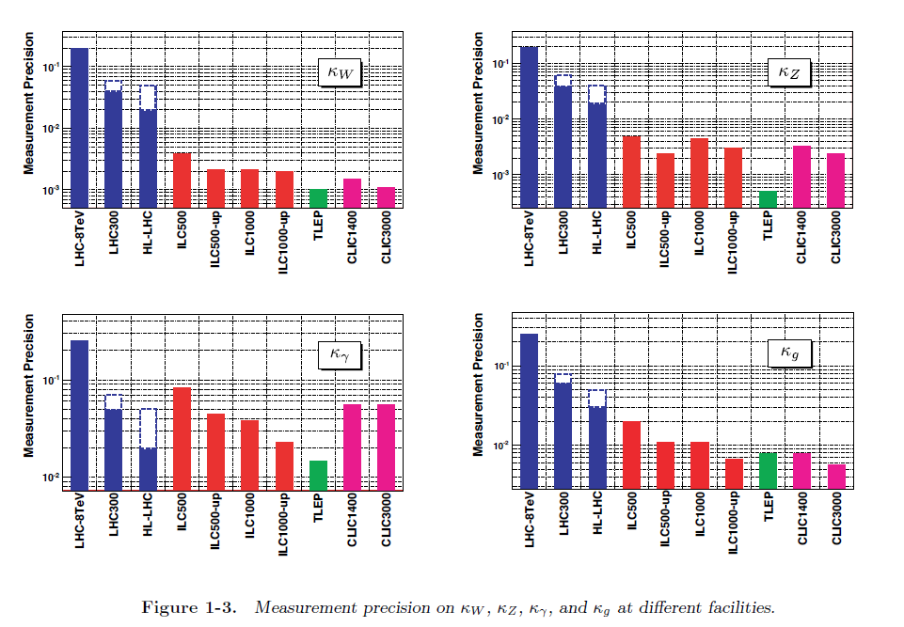

Slide 32
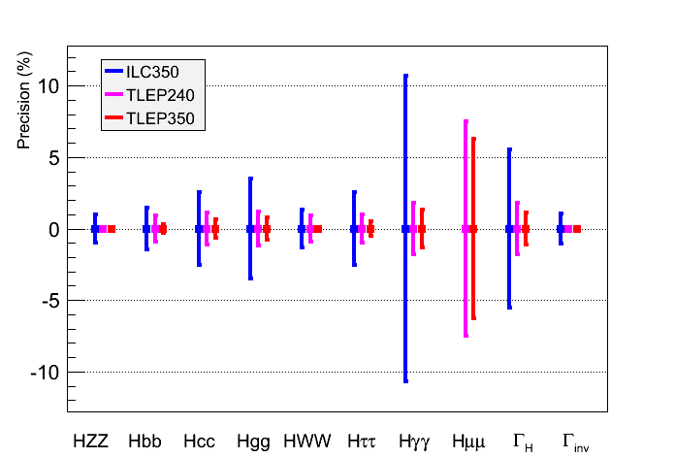
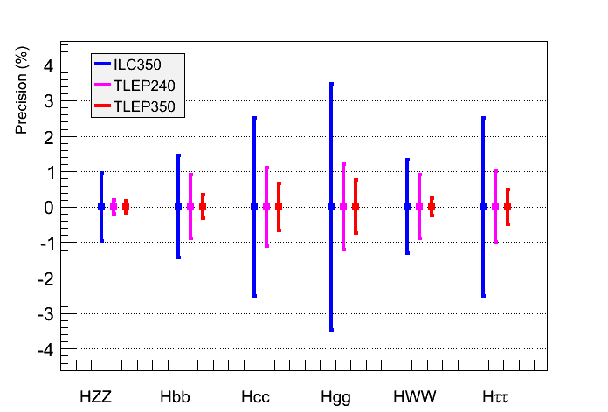
Performance Comparison
Same conclusion when Γ_{H} is a free parameter in the fit
    TLEP : sub-percent precision, BSM Physics sensitivity beyond several TeV
  Expected precision on the total width
μ⁺μ⁻ | ILC350 | ILC1000 | TLEP240 | TLEP350
5% | 5% | 3% | 2% | 1%

Slide 33
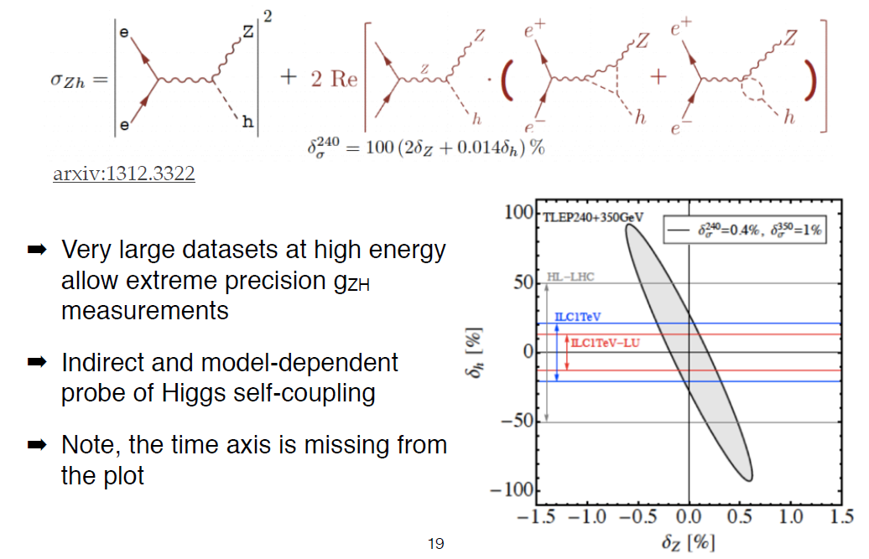
very accurate precision on threshold cross-section sensitive to loop corrections

Slide 34
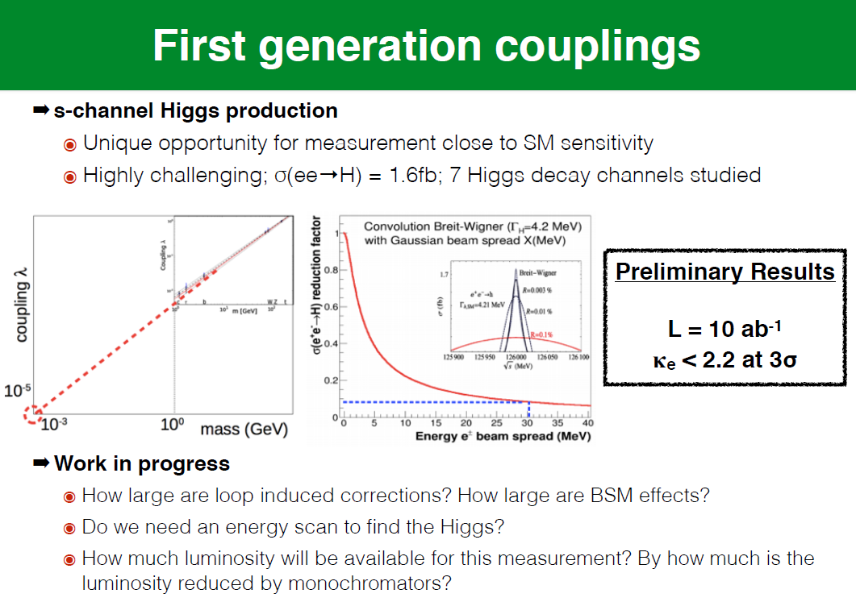

Slide 35
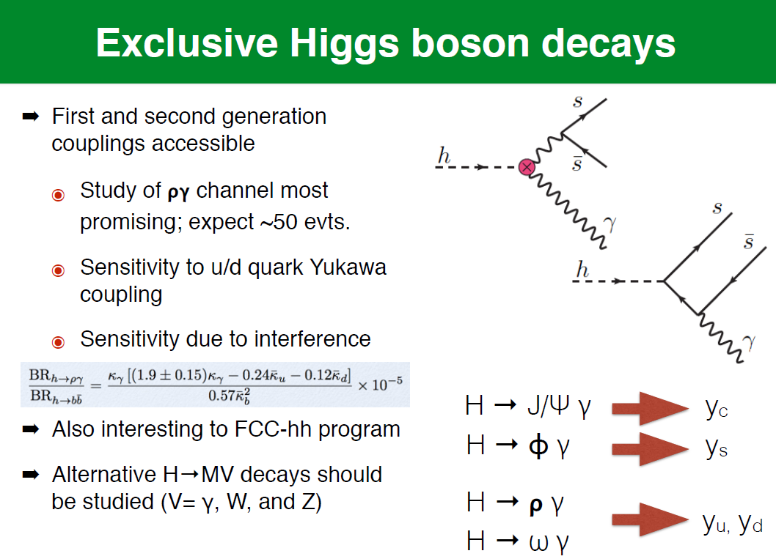

Slide 36
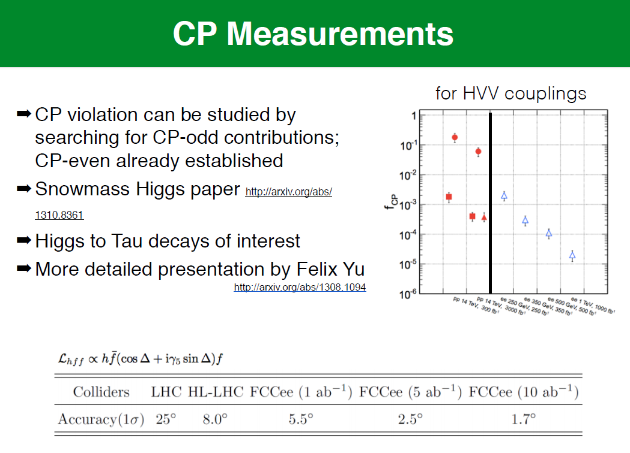

Slide 37
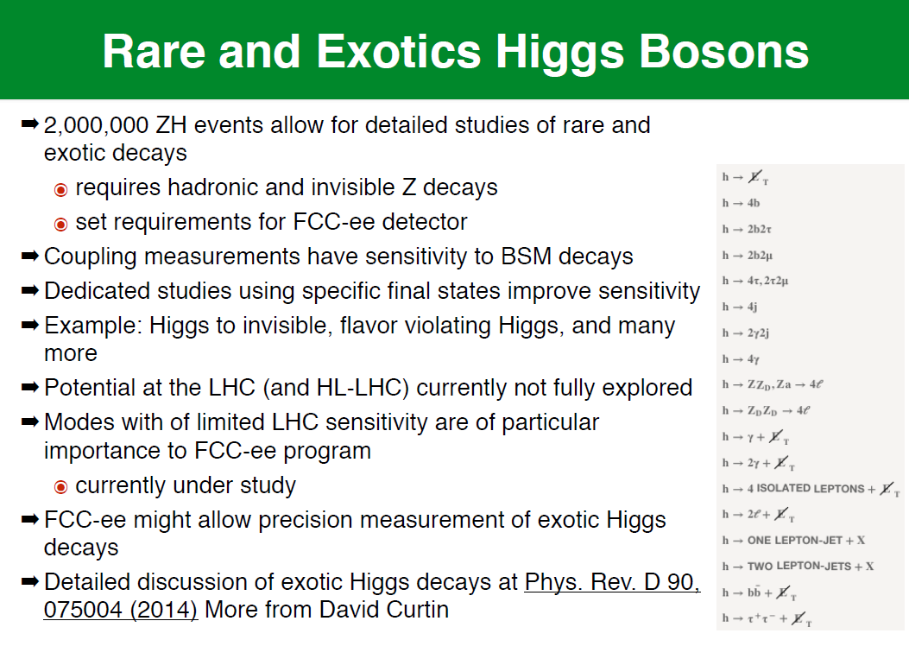

Slide 38
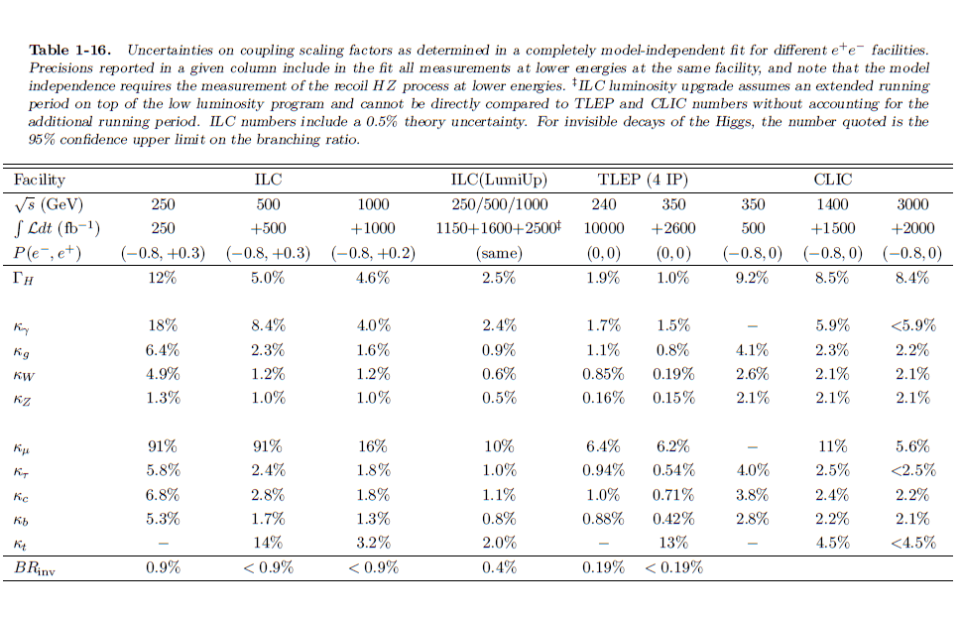
the
10B$ ILC

Slide 39
possible long-term strategy
TLEP (80-100 km,
e⁺e⁻, up to
~350 GeV c.m.)
LEP
PSB
PS (0.6 km)
LHC (26.7 km)
HL-LHC
HE-LHC?
(33 TeV c.m.)
SPS (6.9 km)
VHE-LHC
(pp, up to
100 TeV c.m.)
“same” detectors!?
& e± (120 GeV)–p (7, 16 & 50 TeV) collisions ([(V)HE-]TLHeC)
≥60 years of e⁺e⁻, pp, ep/A physics at highest energies

Slide 40
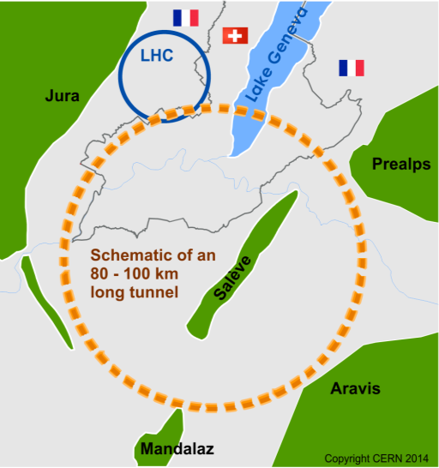
Future Circular Collider Study - SCOPE
CDR and cost review for the next ESU (2018)
Forming an international collaboration to study:
pp-collider (FCC-hh) → defining infrastructure requirements
e⁺e⁻ collider (FCC-ee) as potential intermediate step ECM=90-400 GeV
p-e (FCC-he) option
80-100 km infrastructure in Geneva area
~16 T ⇒ 100 TeV pp in 100 km
~20 T ⇒ 100 TeV pp in 80 km

Slide 41
FCC-hh parameters – starting point
Energy 100 TeV c.m.
Dipole field ~ 16 T (Nb₃Sn), [20 T option HTS]
Circumference ~ 100 km
#IPs 2 main (tune shift) + 2
Luminosity/IP_{main} 5 10³⁴ [2.5x10³⁵] cm⁻²s⁻¹
Stored beam energy 8.2 GJ/beam
Synchrotron radiation 26 W/m/aperture (filling fact. ~78% in arc)
Long. emit damping time 0.5 h
Bunch spacing 25 ns [5 ns option]
Bunch population (25 ns) 1x10¹¹ p
Transverse emittance 2.2 micron normalized
#bunches 10500
Beam-beam tune shift 0.01 (total)
β* 1.1 m (HL-LHC: 0.15 m)
already available from SPS for 25 ns
Ongoing discussion : should we go to 10³⁶cm⁻²s⁻¹ ?

Slide 42
parameter | LHC | HL-LHC | FCC-hh
c.m. energy [TeV] | 14 |  | 100
dipole magnet field [T] | 8.33 |  | 16 (20)
circumference [km] | 36.7 |  | 100 (83)
luminosity [10³⁴ cm⁻²s⁻¹] | 1 | 5 | 5 [→20?]
bunch spacing [ns] | 25 |  | 25 {5}
events / bunch crossing | 27 | 135 | 170 {34}
bunch population [10¹¹] | 1.15 | 2.2 | 1 {0.2}
norm. transverse emitt. [μm] | 3.75 | 2.5 | 2.2 {0.44}
IP beta-function [m] | 0.55 | 0.15 | 1.1
IP beam size [μm] | 16.7 | 7.1 | 6.8 {3}
synchrotron rad. [W/m/aperture] | 0.17 | 0.33 | 28 (44)
critical energy [keV] | 0.044 |  | 4.3 (5.5)
total syn.rad. power [MW] | 0.0072 | 0.0146 | 4.8 (5.8)
longitudinal damping time [h] | 12.9 |  | 0.54 (0.32)
FCC-hh baseline parameters defined in EDMS No. 1342402, FCC-ACC-SPC-0001
- preliminary -
Cms energy
Luminosity

Slide 43


FCC-hh: some design challenges
  Stored beam energy: 8 GJ/beam (0.4 GJ LHC) = 16 GJ total
  ➔ equivalent to an Airbus A380 (560 t) at full speed (850 km/h)
  Collimation, beam loss control, radiation effects: very important
  Injection/dumping/beam transfer: very critical operations
  Magnet/machine protection: to be considered from early phase

Slide 44
“….an ambitious post-LHC accelerator project at CERN”
Parameters - choices for initial machine relatively conservative
- a few more aggressive choices where cost savings balance the risks
--> establishing a credible baseline
- potential for evolution in performance
- as design process incl R & D proceeds
- as planned machine upgrade
important parameters for detectors baseline 2014 considered (2015)
Energy 100 TeV
Lumi 5 x 10³⁴ (p-p) up to 2.5 x 10³⁵ (p-p)
3 x 10²⁷ (Pb-Pb)
Bunch spacing 25ns 5 ns
Pile-up 170 34 - 340
Bunch-length 8 cm increased
% circumference filled 80 %
L * 46m 38m
β* 0.8m 0.3m
transverse beam size at ip 6.8mm 3mm
optimum run time 12 hrs

Slide 45
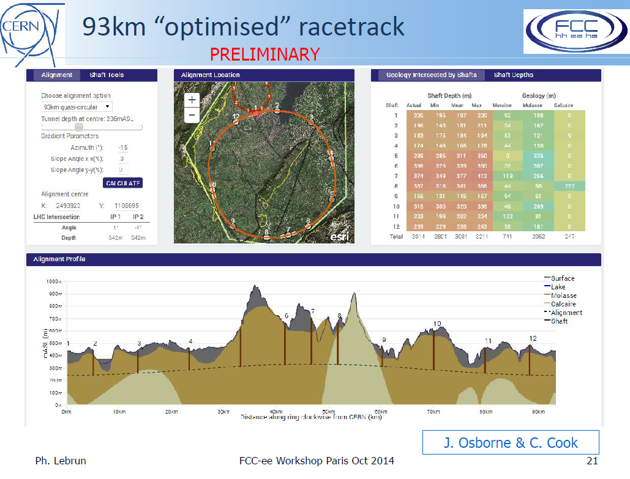

Slide 46
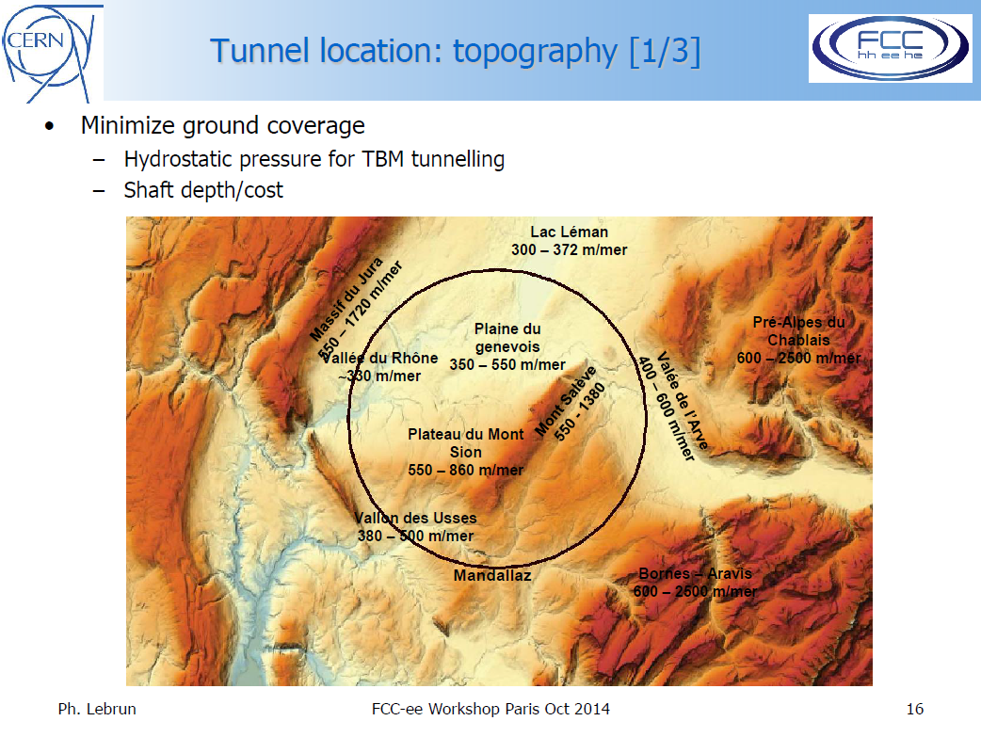

Slide 47
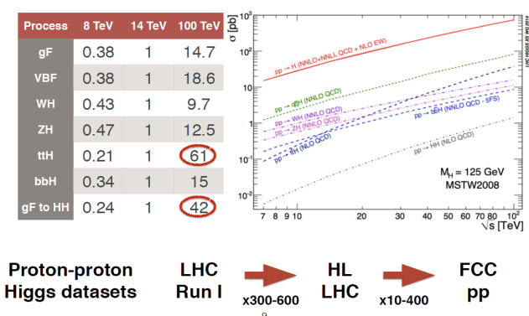
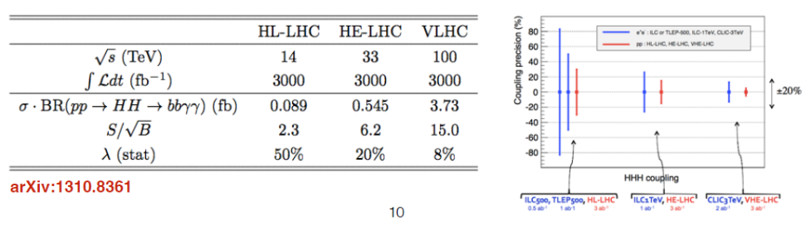
HIGGS AT FCC-pp

Slide 48
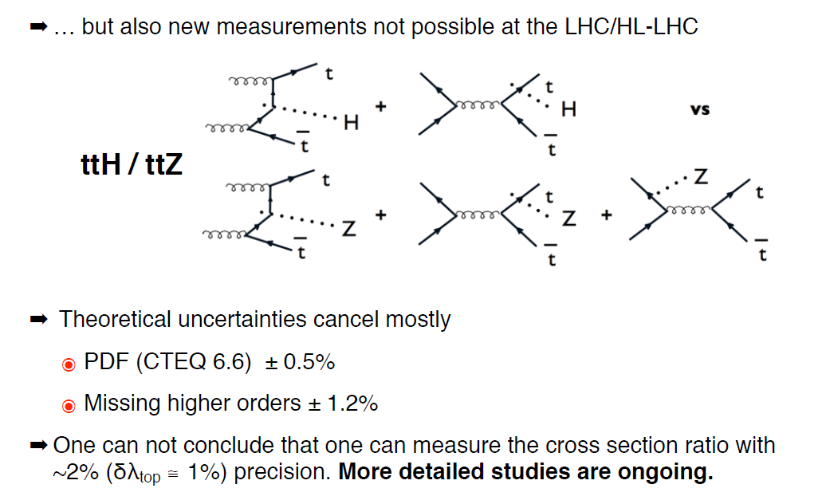

Slide 49
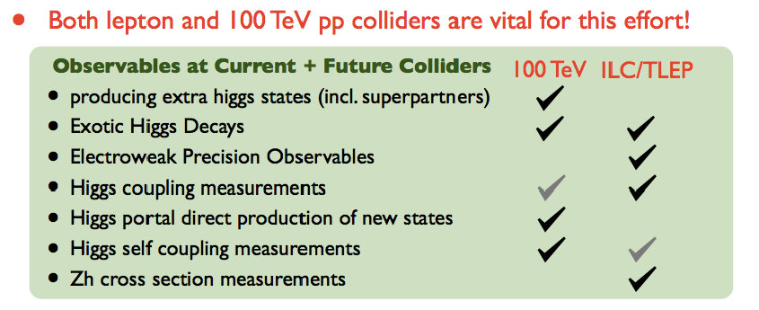
Table from D. Curtin FCC workshop, Washington, 23-27 March 2015)
Higgs invisible decays
Right handed Neutrinos
etc.. etc..

Slide 50
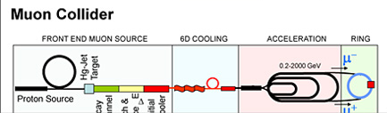

Slide 51
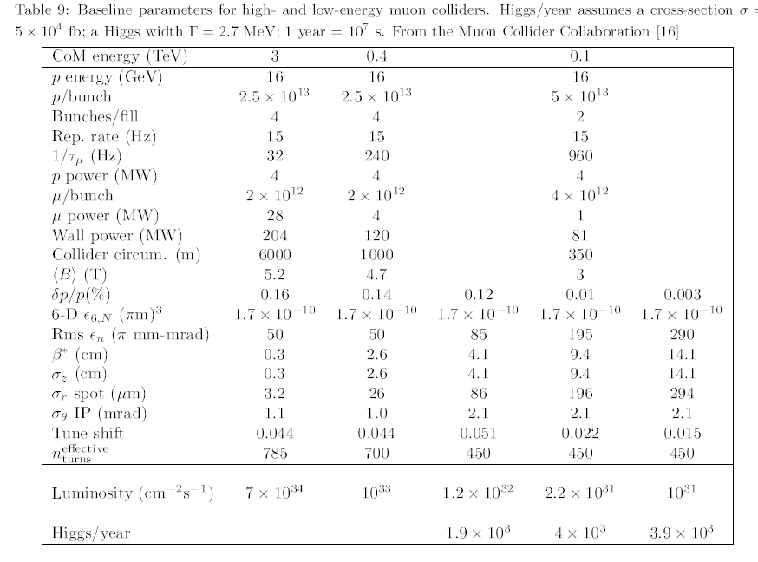
The numbers then (1999)

Slide 52
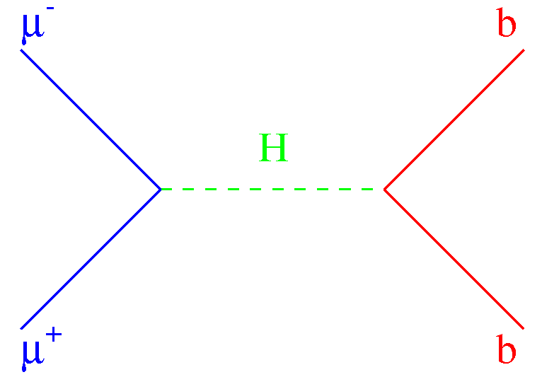
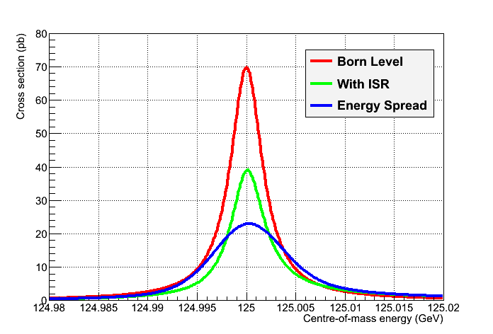
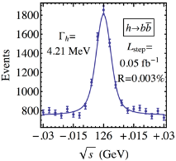

μ⁺μ⁻ Collider vs e⁺e⁻ Collider ?
A μ⁺μ⁻ collider can do things that an e⁺e⁻ collider cannot do
  Direct coupling to H expected to be larger by a factor m_{μ}/m_{e}
    ,jh [σ_{peak} = 70 pb at tree level]
  Beam energy spread δE/E may be reduced to 3×10⁻⁵
    6D Cooling, no beamstrahlung, ~no bremsstrahlung
    For δE/E = 0.003% (δE ~ 3.6 MeV, Γ_{H} ~ 4 MeV)
      Corresponding luminosity ~ 10³¹ cm⁻²s⁻¹
        Expect 2300 Higgs events in 100 pb⁻¹/ year
  Polarization, beam energy and energy spectrum
    Can be measured with an exquisite precision
      From the electrons of the muon decays
  Then measure the lineshape of the Higgs at √s ~ m_{H}
    Five-point scan, 50 + 100 + 200 + 100 + 50 pb⁻¹
      Precision from H→bb and WW :
[16,17]
, W, …
σ (pb)
_{, W, …}
√s
σ(m_{H}), TLEP
m_{H} | σ_{Peak} | Γ_{H}
0.1 MeV | 0.6 pb | 0.2 MeV
10⁻⁶ | 2.5% | 5%

Slide 53

Muon collider is the best way to reach lepton ccoliisions above 3 TeV ECM. MUCH R&D remain in cooling!
Muon collider is a very pretty Higgs factory but not necessarily the one we need for H(125)
-- if it is a single particle we will know more from the e+e- collider with ZH tag
muon collider can do this but high luminosity is necessary.
-- except ig the Higgs boson is constituted of several nearby peaks.
-- such a situation can occur in MSSM for H,A doublet with different CP parities
in which case only the muon collider can isolate the two peaks.
-- neutrino factory is the ultinmate neutrino oscillation tool and a ‘baby neutrino factory’ nustorm is
a necessary step to ensure the measurements of cross-sections needed for the long baseline search of CP violation

Slide 54



MICE
Neutrino Factory
MICE is one of the critical R&D experiments
towards neutrino factories and muon colliders
With the growing importance of neutrino physics
+ the possibility of a light Higgs (115-130 GeV)
physics could be turning this way very fast!
Cooling and more generally the initial chain
capture, buncher, phase rotation and cooling
rely on complex beam dynamics and technology,
such as
High gradient (~>12 MV/m) RF cavities embedded
in strong (>2T) solenoidal magnetic field
MANY CHALLENGES!
MUON COOLING ➔ HIGH INTENSITY NEUTRINO FACTORY
HIGH LUMINOSITY MUON COLLIDER

Slide 55



COOLING -- Principle is straightforward…
Longitudinal:
Transverse:
Similar to radiation damping in an electron storage ring: muon momentum is reduced in all directions by going through liquid hydrogen absorbers,
and restored longitudinally by acceleration in RF cavities. Thus transverse emittance is reduced progressively.
Because of a) the production of muons by pion decay and b) the short muon lifetime,
ionization cooling is only practical solution to produce high brilliance muon beams
Emittance exchange involves ionization
varying in space which cancels the dispersion of energies in the beam.
This can be used to reduce the energy
spread and is of particular interest for
μ⁺ μ⁻ → H (125)
since the Higgs is very narrow (~5MeV)
Practical realization is not!
MICE cooling channel (4D cooling)
6D candidate cooling lattices

Slide 56

MICE the Muon Ionization Cooling Experiment
Measure input particle
x,x’,y,y’, t, t’=E/Pz
➔ input emittance ε^{in}
Measure output particle
x,x’,y,y’, t, t’=E/Pz
➔ output emittance ε^{out}
COOLING CHANNEL
Particle by particle measurement, then accumulate few 10⁵ muons
→ Δ[ (ε^{in}- ε^{out})/ε^{in} ] = 10⁻³

Slide 57

















MICE Collaboration across the planet
Coupling Coils 1&2
Focus coils
MICE is now completely engineered !
Spectrometer
solenoid 2
Spectrometer
solenoid 1
Beam PID
TOF 0, TOF 1
Cherenkovs
RF cavities
RF power
Downstream
particle ID:
TOF 2, KL
EMR
Variable
Diffuser
Liquid Hydrogen absorbers 1,2,3
Incoming muon beam
Trackers 1 & 2

Slide 58






MICE STEPS
COMPLETED
Both for funding and science reasons
MICE is executed in Steps …. Originally we had 6 Steps
We will probably only have 3 steps
step I, step IV, and the final step (P5)
2015
STEP V and VI will not take place
STEP VI
2017

Slide 59


Completed and published!
Main results:
-- It all works!
-- TOF resolution s: 50 ps and 1cm
-- ~100 muons per second
Beam commissionning
y (mm) vs x (mm)
x′ (mrad) vs x (mm)
y′ (mrad) vs y (mm)
Data
-- and first measts of emittance with the TOFs
MC

Slide 60

STEP IV EXPERIMENTS (2013)
No absorber
Alignment
Optics studies
Solid absorber(s)
LiH
Liq H₂ absorber
(full/empty)
Multiple scattering
Energy loss
➔ Cooling

Slide 61
There is a very strong motivation to study the Higgs boson thoroughly
-- first time we see an elementary scalar!
The FCC-ee+FCC-hh combination is ‘invincible’
most precise and most complete.
CERN has launched a study of this ‘ambitious post-LHC project’ , the FCC
Join us!
Muon storage rings remain very specific and quite unique for neutrino studies and
precise high energy colliders.
Much R&D remains to be done
MICE at RAL is the concrete R&D that is taking place.
Although it has been delayed significantly since the beginning of the effort in 2001, it is now about to take thecrucial muon cooling data in 2015.
The final ‘sustainable cooling’ will be tested in 2017.

