Slide 1

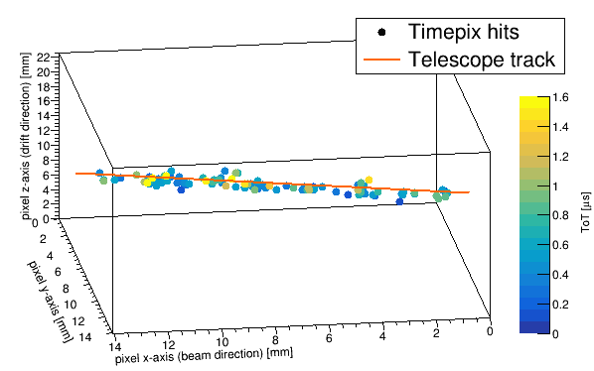


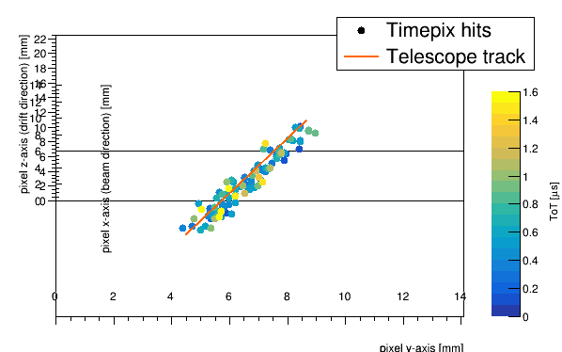
Performance of a GridPix TPC readout based on the Timepix3 chip
Cornelis Ligtenberg, Y. Bilevych, K. Desch, H. van der Graaf, M. Gruber, F. Hartjes, K. Heijhoff,
J. Kaminski, N. van der Kolk, P.M. Kluit, G. Raven, L. Scharenberg, T. Schiffer, S. Schmidt, J. Timmermans
24 October 2018, International Workshop on Future Linear Colliders, LCWS2018

Slide 2
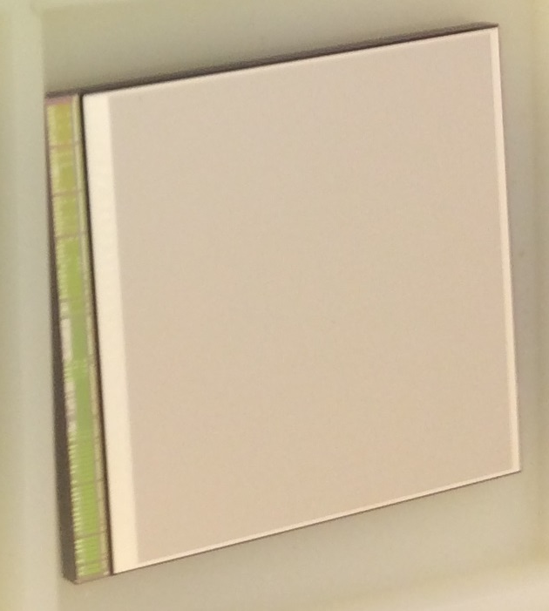
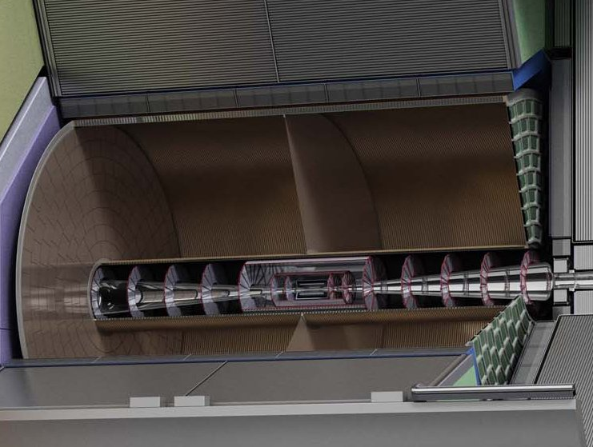
Introduction and outline
The goal is to develop a pixel-based readout for the ILD TPC at ILC
Outline:
Test beam results from a single chip detector
Development of quad module to cover large areas
Expected performance of the ILD TPC from simulations
ILC TDR 2013

Slide 3
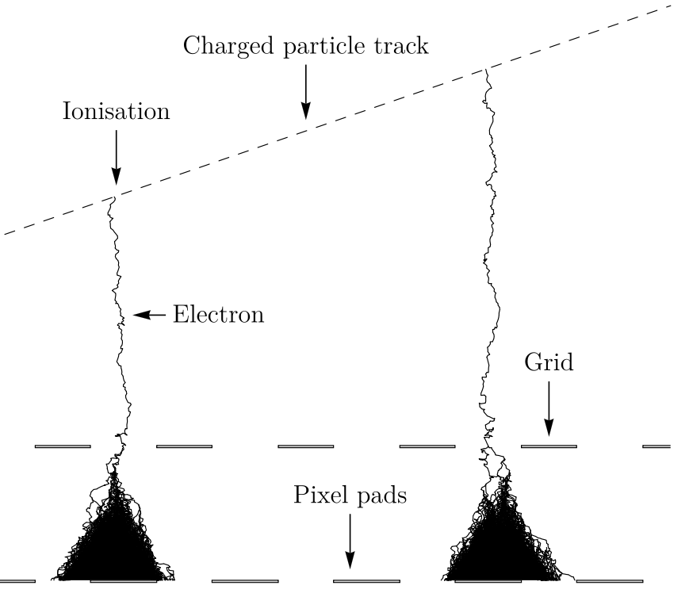
GridPix technology
GridPix is a type of micro-pattern gaseous detector
The GridPix consists of a Timepix3 with an aligned Aluminium amplification grid added by photolithographic postprocessing techniques
Single ionization electrons are detected with high efficiency:
  The maximum possible information from a track is acquired
The chip has been made spark proof using a 4 µm thick Silicon rich Nitride protection layer
35 µm
50 µm
55 µm

Slide 4
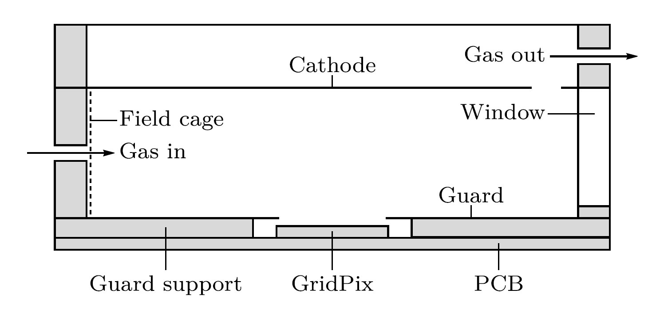
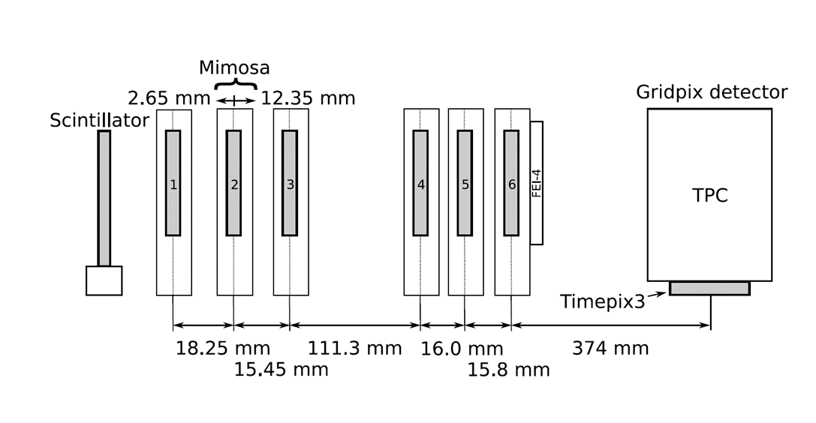
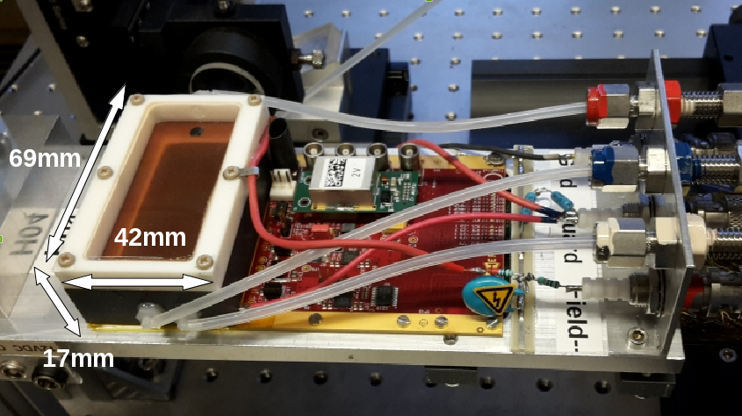

Detector setup at Bonn test beam (2017)
A Timepix3 based Gridpix with SPIDR readout
  Simultaneous data-driven detection of time and time over threshold (charge) allows for timewalk corrections
  Higher rates and more precise (1.56 ns time resolution) compared to its predecessor Timepix1
Detector with guard and field shaper
2.5 GeV electrons
@Bonn
See also paper on this testbeam: https://doi.org/10.1016/j.nima.2018.08.012

Slide 5
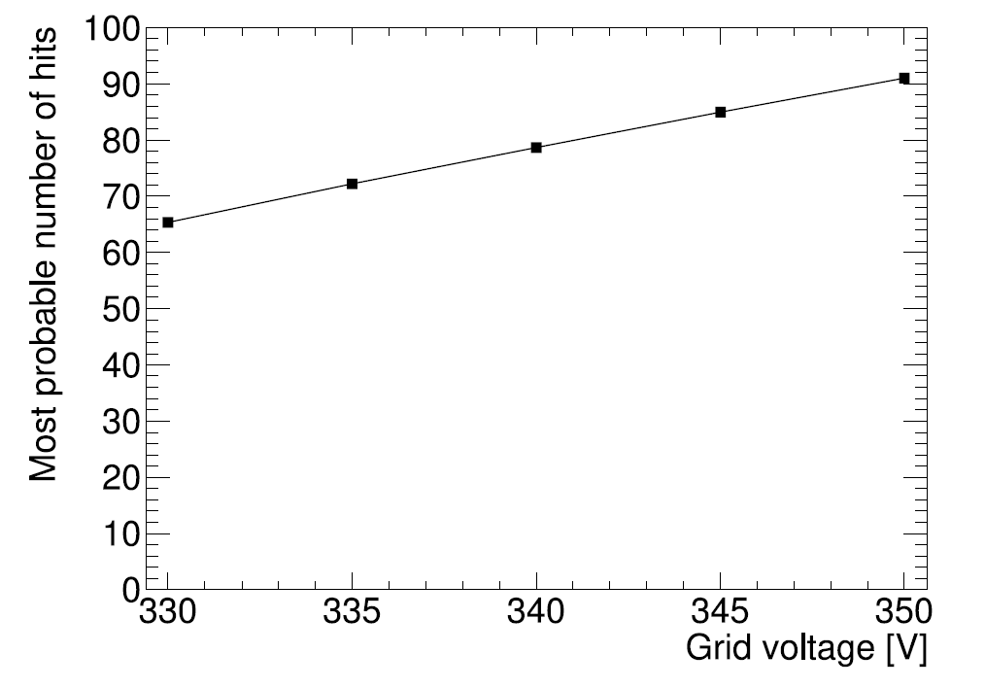
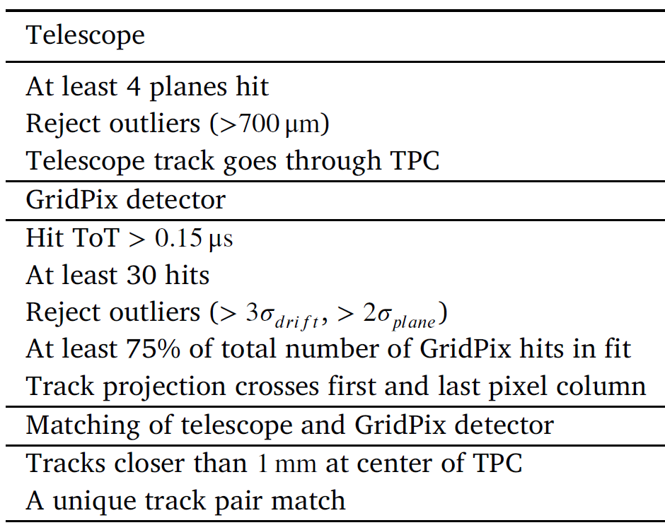
Run parameters and selection
Use run with the highest single electron efficiency (close to 1)
Use basic selection cuts to find clean tracks (69% efficiency)
Drift velocity for T2K gas from Magboltz was 78.9 µm/ns (consistent with data)
Run 347
Duration | 60 min.
Triggers | 4 733 381
V_{grid} | 350 V
E_{drift} | 280 V/cm
Rotation | 17 degr. 0 degr.
Threshold | 800 e

Slide 6
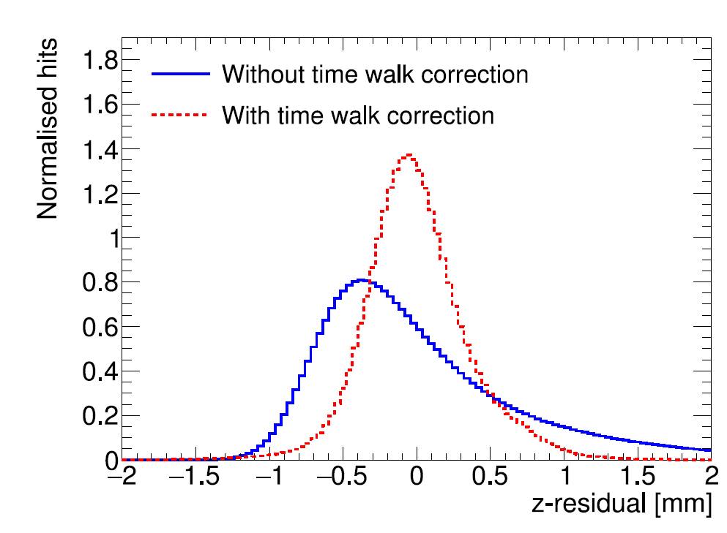
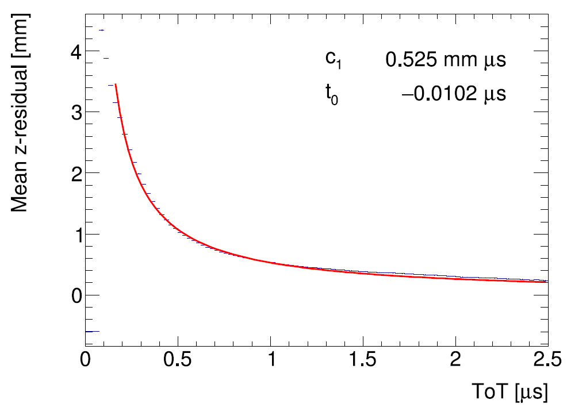
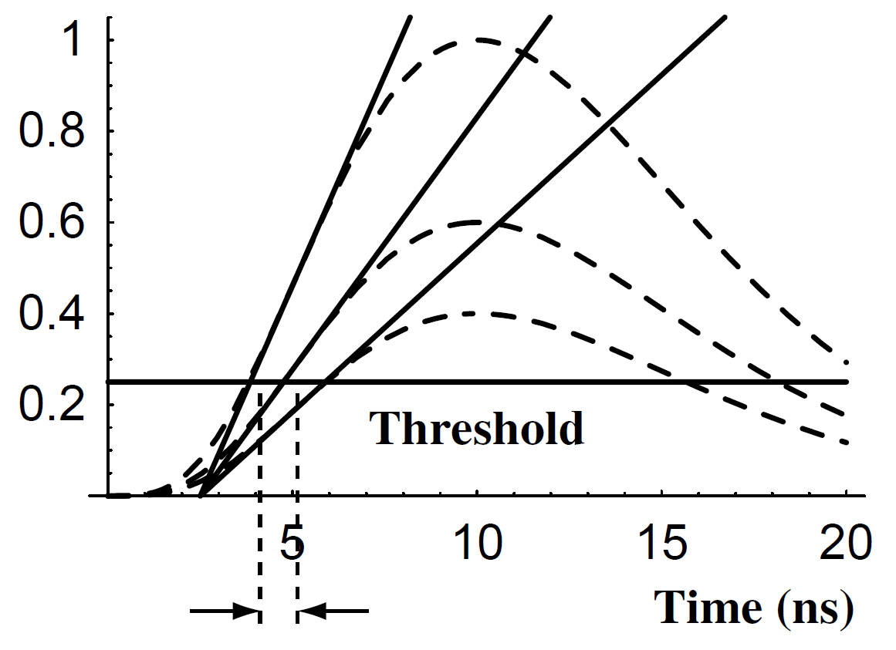
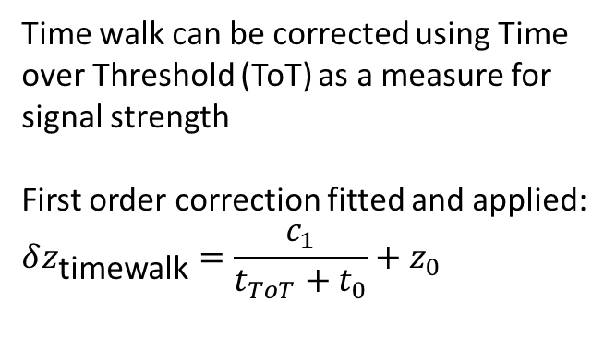
Time walk correction
Blum, Particle detection 2008
Time walk error: time of arrival depends on signal amplitude
Time walk can be corrected using Time over Threshold (ToT) as a measure for signal strength
First order correction fitted and applied:
$$δz_{\text{timewalk}}=\frac{c_{1}}{t_{ToT}+t_{0}}+z_{0}$$
Residual distribution improved
Higher order corrections were also tried but did not yield further improvements

Slide 7
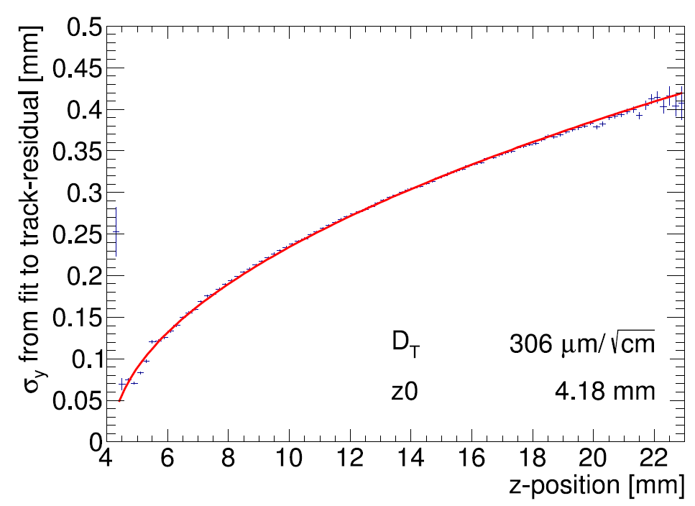
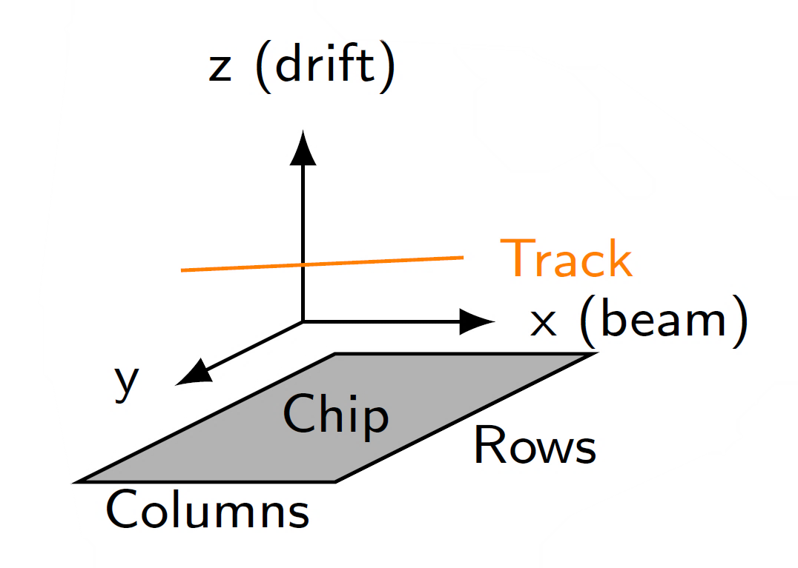
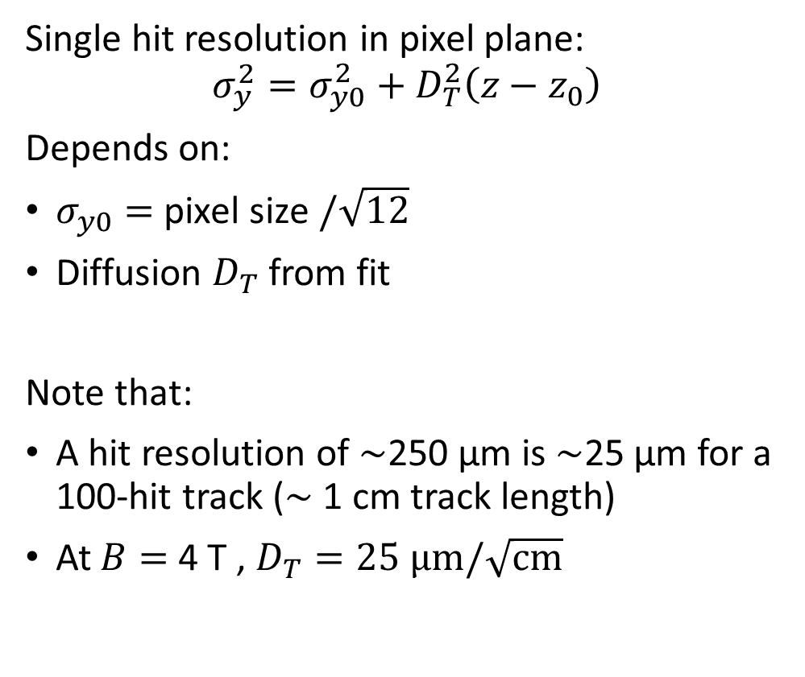
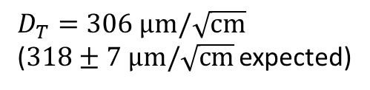

Single hit resolution in pixel plane
Single hit resolution in pixel plane:
$$σ_{y}^{2}=σ_{y0}^{2}+D_{T}^{2}\left(z−z_{0}\right)$$
Depends on:
$σ_{y0}=$ pixel size $/\sqrt{12}$
Diffusion $D_{T}$ from fit
Note that:
A hit resolution of $\sim$250 µm is $\sim$25 µm for a 100-hit track ($\sim$ 1 cm track length)
At $B=$ 4 T , $D_{T}=25 \text{μm}/\sqrt{\text{cm}}$
B$=0$ T
$D_{T}=306 \text{μm}/\sqrt{\text{cm}}$
($318±7 \text{μm}/\sqrt{\text{cm}}$ expected)

Slide 8
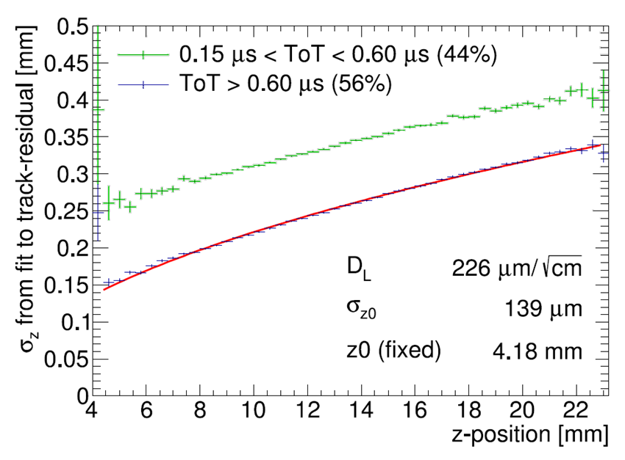
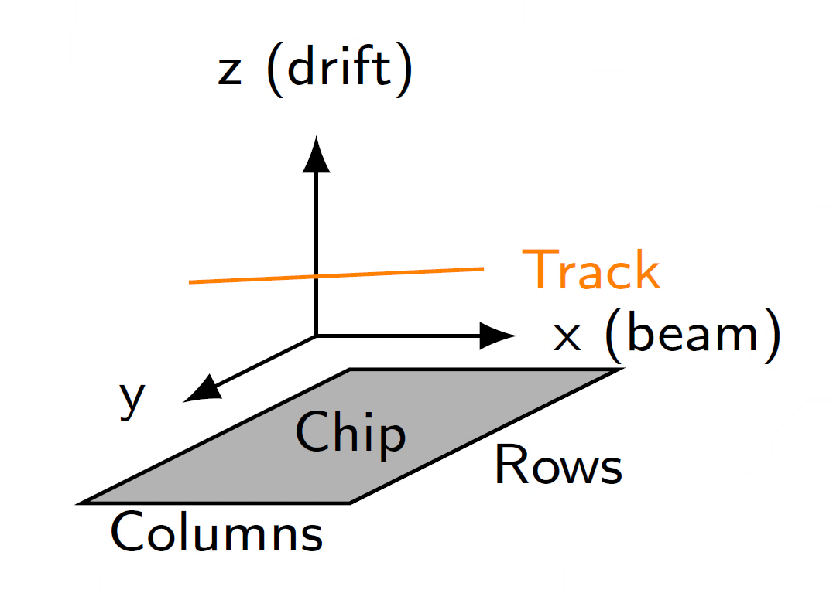
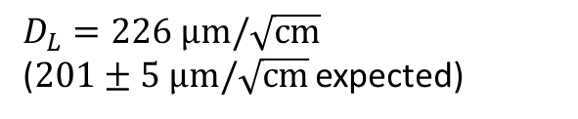
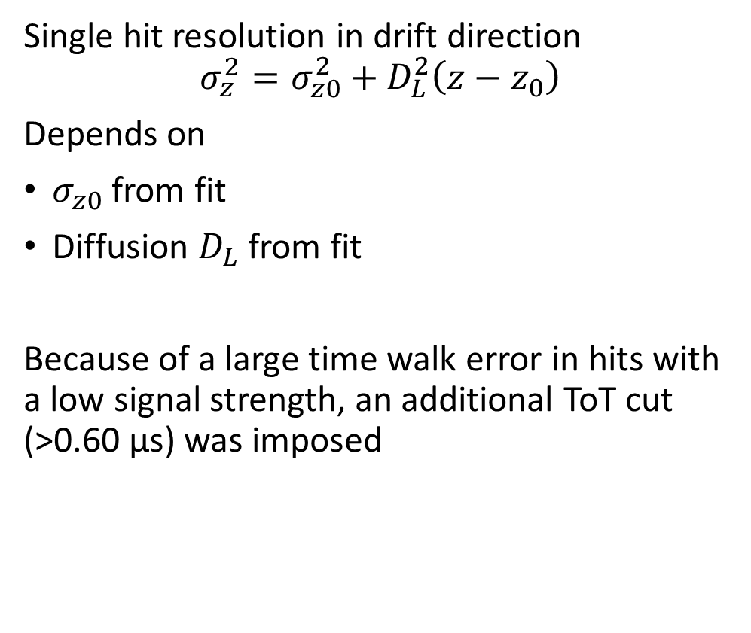

Single hit resolution in drift direction
Single hit resolution in drift direction
$$σ_{z}^{2}=σ_{z0}^{2}+D_{L}^{2}\left(z−z_{0}\right)$$
Depends on
$σ_{z0}$ from fit
Diffusion $D_{L}$ from fit
Because of a large time walk error in hits with a low signal strength, an additional ToT cut (>0.60 µs) was imposed
B$=0$ T
$D_{L}=226 \text{μm}/\sqrt{\text{cm}}$
($201±5 \text{μm}/\sqrt{\text{cm}}$ expected)

Slide 9
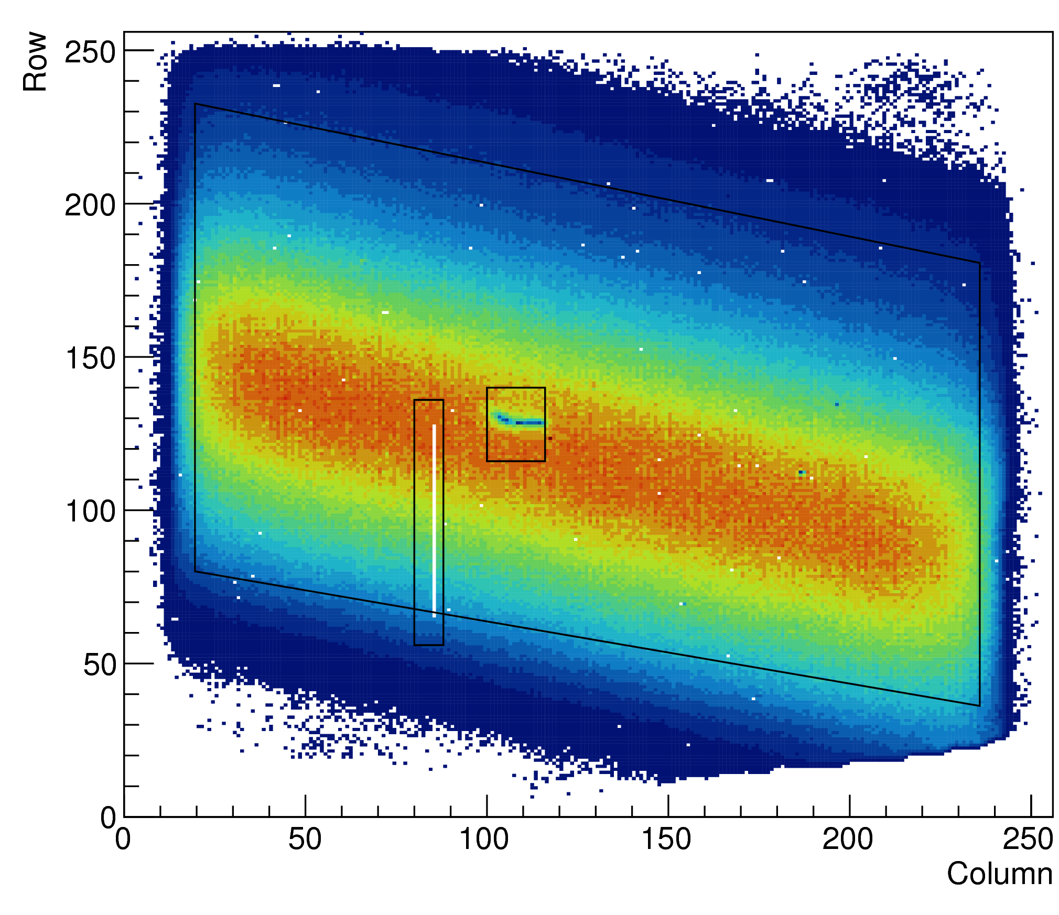
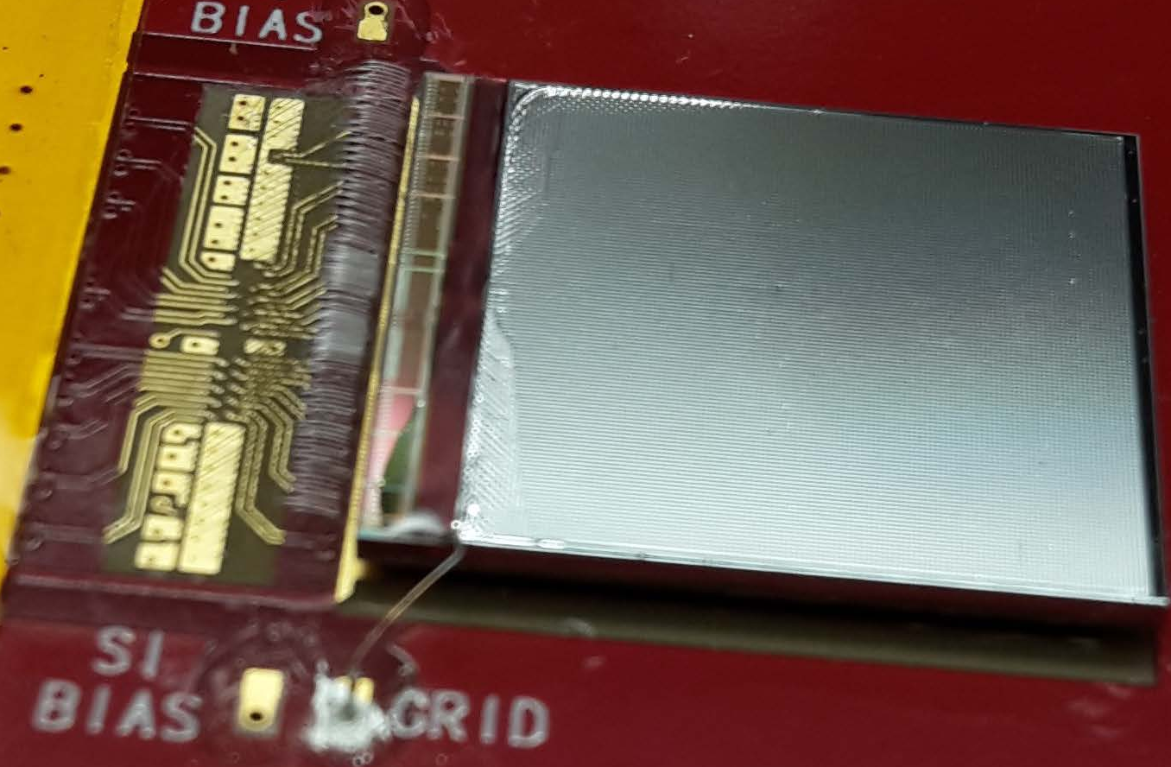
Map of Timepix3 hits
Successfully measured a large number of hits
The chip and grid have some small defects
beam
Wrinkle in grid
Broken column

Slide 10
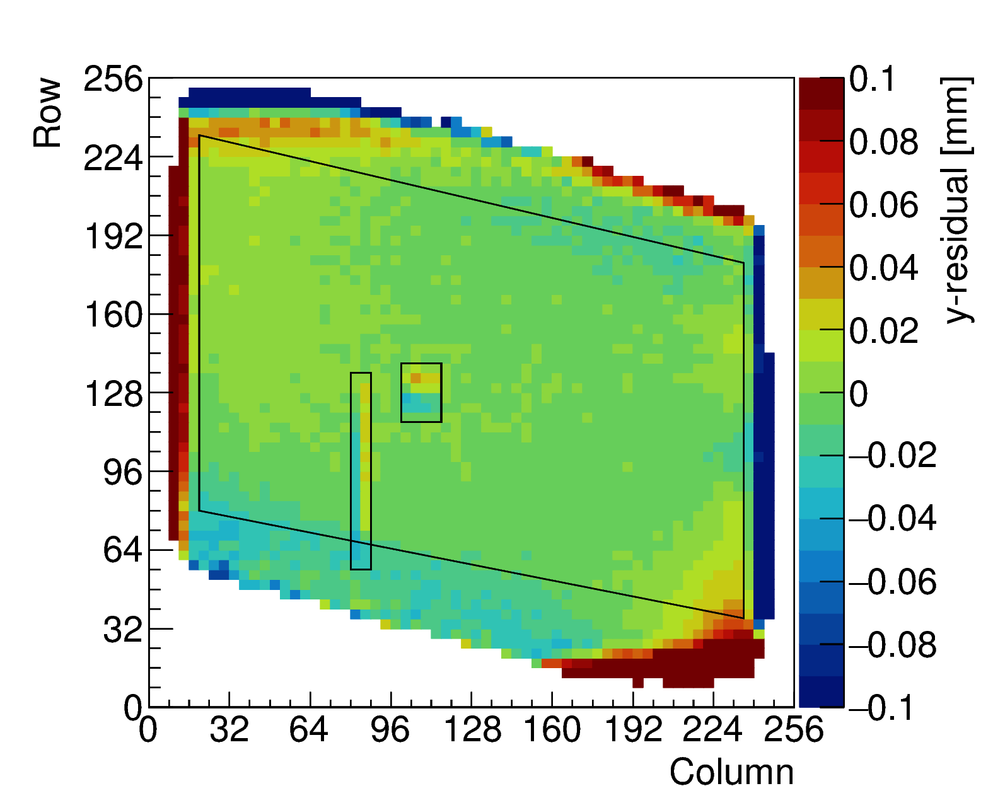
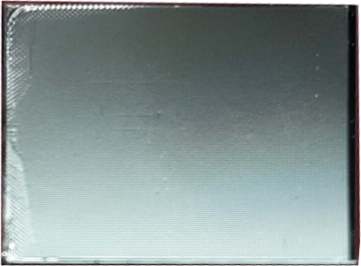
Mean residuals from test beam
For applications in a large TPC, systematic deviations must be well under control
Each bin displays mean of residuals from 4 × 4 pixels
1 mm from the edges distortions are below 30 µm
Mean residual above 100 µm
residuals are below 30 µm
Too small number of hits in first and last 8 columns (at edge)
Mean residual above 100 µm for columns 8-16, 240-248
From column 16-240, residuals are below 30 µm
Bottom right is damaged
Top left has distortions of 60 µm
distortions of 60 µm
damaged
damaged
Not enough hits

Slide 11
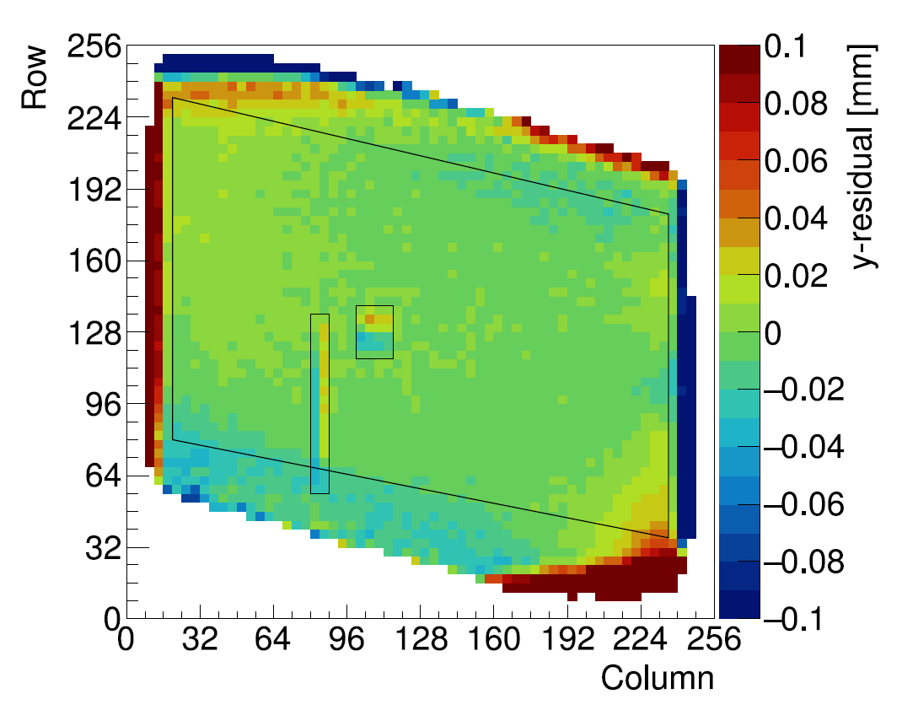
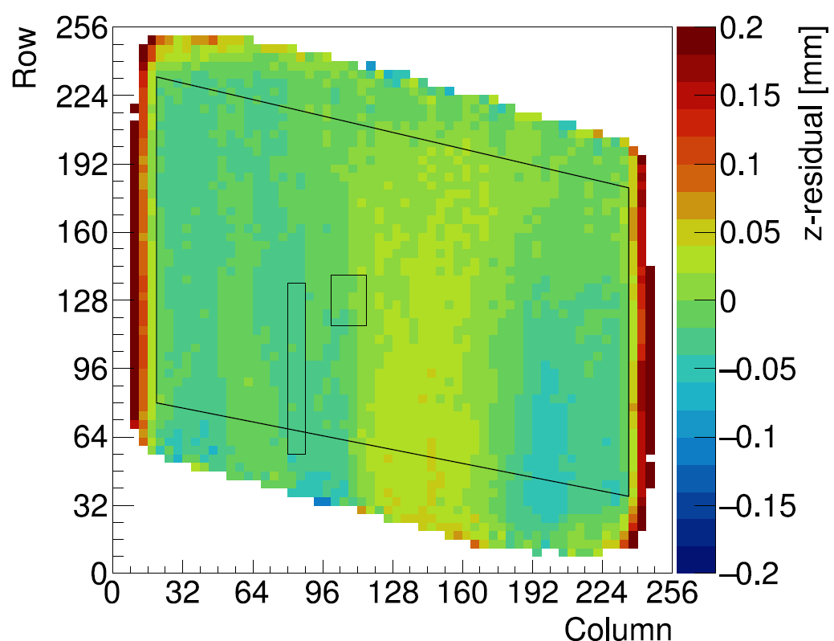
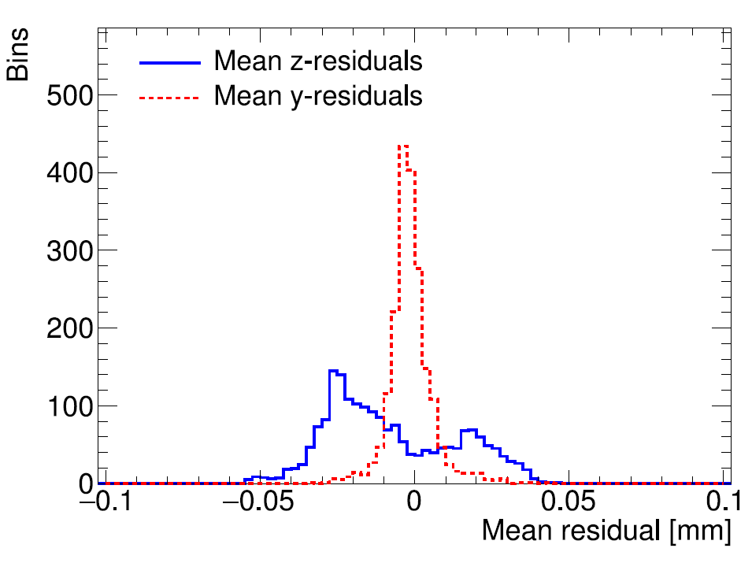

Deformations in pixel plane and drift direction
Each bin displays mean of residuals from 4×4 pixels at expected position
The RMS of the mean residuals is 7 µm in the pixel plane, and 21 µm (0.3 ns) in the drift direction $⇒$ Overall grid quality is very good

Slide 12
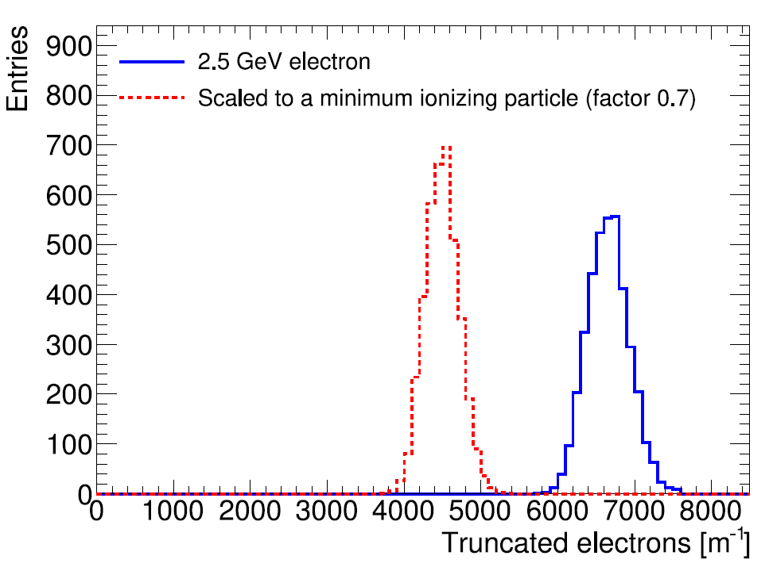
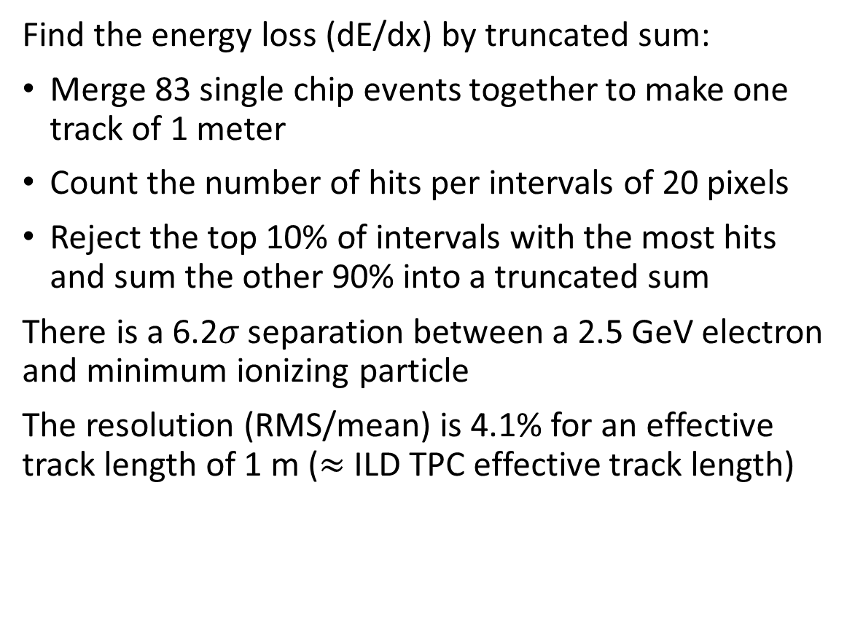
Particle identification by dE/dx
Find the energy loss (dE/dx) by truncated sum:
Merge 83 single chip events together to make one track of 1 meter
Count the number of hits per intervals of 20 pixels
Reject the top 10% of intervals with the most hits and sum the other 90% into a truncated sum
There is a 6.2𝜎 separation between a 2.5 GeV electron and minimum ionizing particle
The resolution (RMS/mean) is 4.1% for an effective track length of 1 m ($≈$ ILD TPC effective track length)
Electron: 0.7
Scale electron track to MIP
MIP: 1.0
0.7)

Slide 13
Energy loss resolution by cluster counting
With the pixel granularity ionization clusters can be partially resolved
This gives the possibility to improve the dE/dx resolution by cluster counting
Various algorithms were tried
Weighted mean distance between hits is a good measure of dE/dx
Use (actual/Poisson)-fluctuation as weights
2.7% resolution or 9.2 𝜎 separation between MIP and
2.5 GeV electron

Slide 14
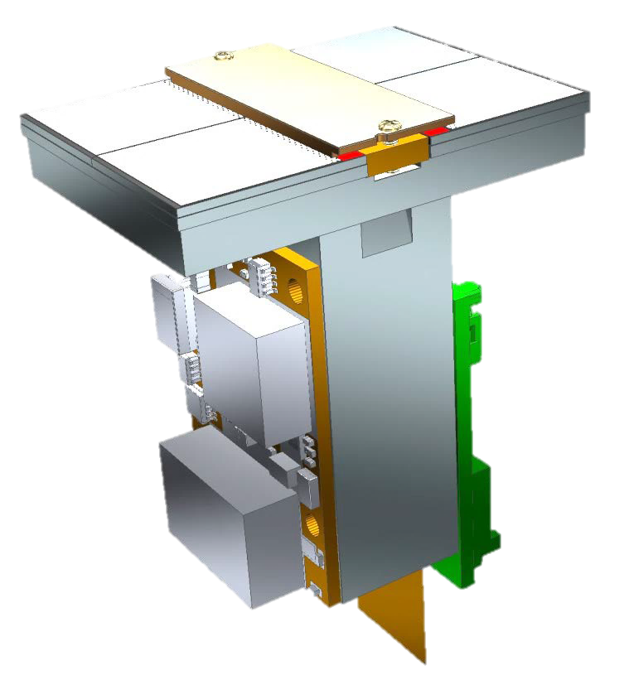
Quad module development
Developed a 4-chip module with all services under the active area
Active area overage is 70% (Through-silicon via technology might increase this)
Can be used as a building block to cover arbitrarily large TPC areas
Wirebond
PCB
Cooling channels
Guard
Cold carrier plate
LV-
regulation
Stump
Flex
Quad
Quad base plate
Quad without guard
Test Box

Slide 15
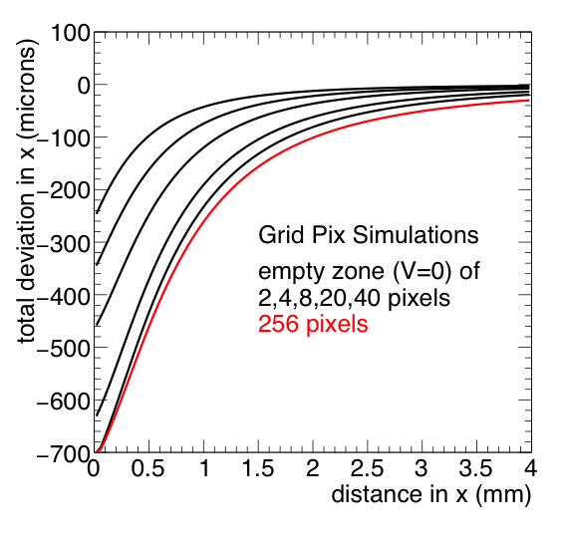
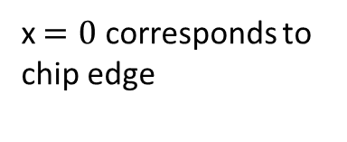
Chip placement requirements in Quad design
To design a precise module with multiple chips, the electric field behavior at edges is studied with simulations
Hit deviations are calculated for different distances between chip edges
For the top curve with 2 pixels (110 μm) distance, deviations < 20 µm are found > 1 mm from the edge
Larger distances must be bridged with a guard structure
The Quad module is designed for these stringent requirements on chip placement:
  chip-chip distance < 100 µm
  guard height precise at 20 µm level
chip
chip
x$=0$ corresponds to chip edge

Slide 16
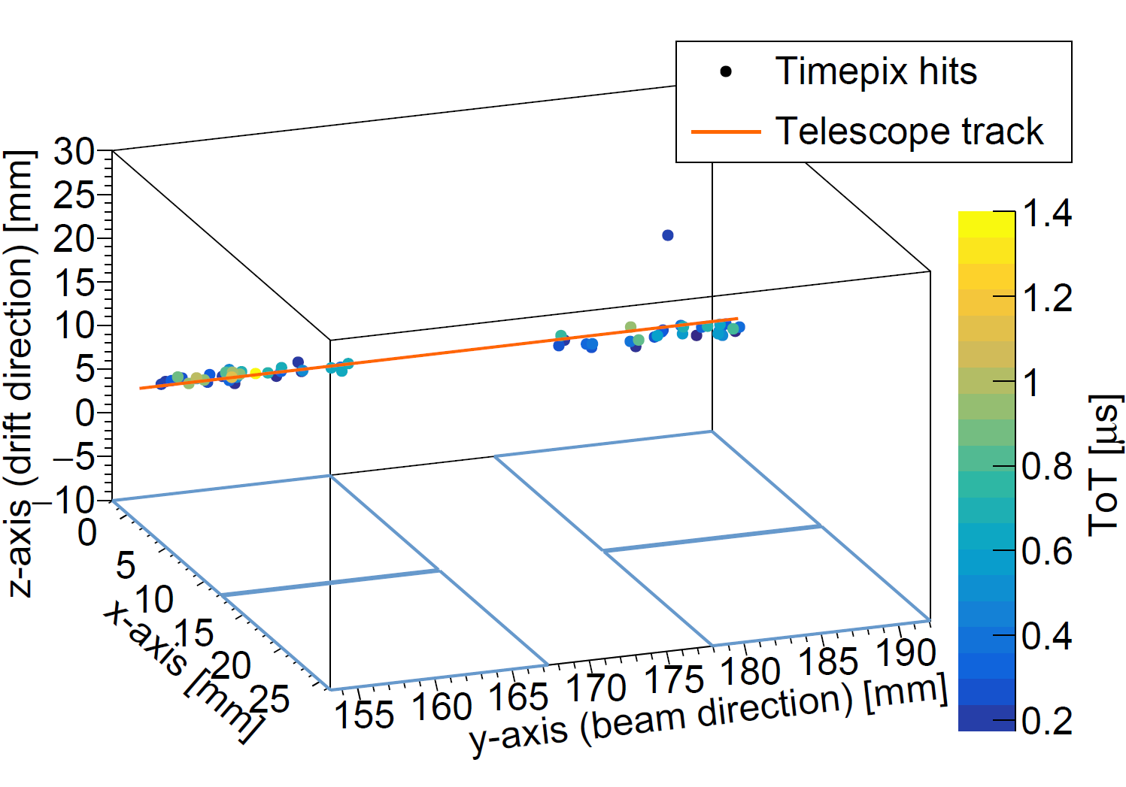
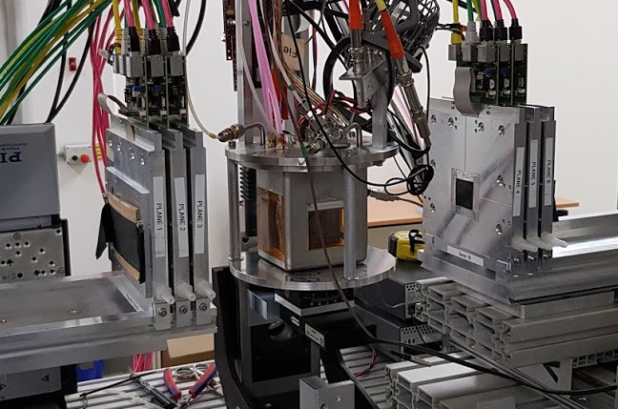
Quad tested with electron beam at Bonn (2018)
Also tested in another testbeam with 2.5 GeV electrons at the ELSA Facility in Bonn on 4-5 October 2018
Analysis just started…
Preliminary
Improved Quad setup in test beam at Bonn

Slide 17
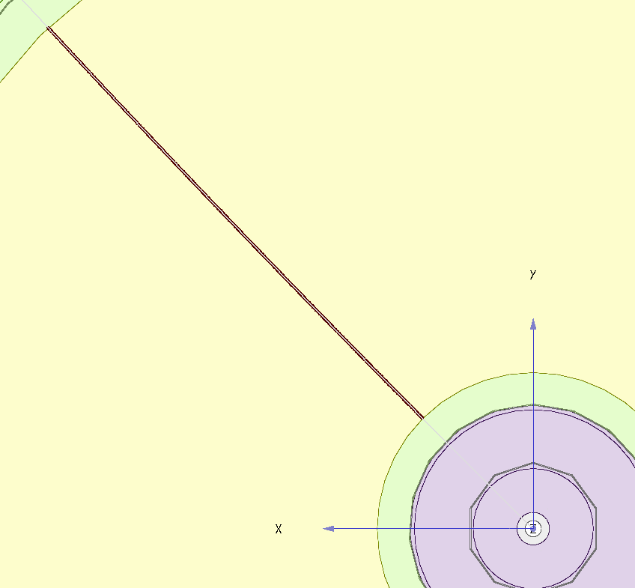
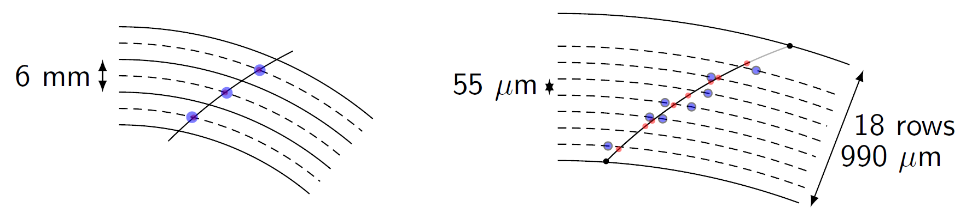
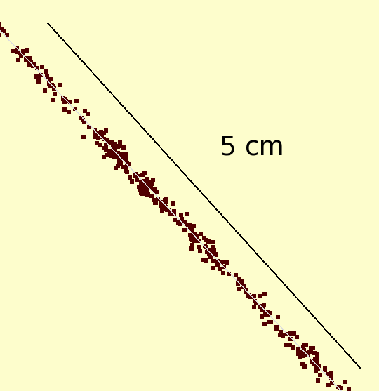
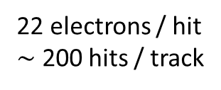

Simulation of ILD TPC with pixel readout
To study the performance of a large pixelised TPC, the pixel readout was implemented in the full ILD DD4HEP (Geant4) simulation
Changed the existing TPC pad readout to a pixel readout
Adapted Kalman filter track reconstruction to pixels
50 GeV muon track with pixel readout
Pads
Pixels
22 electrons / hit
$∼$ 200 hits / track
1 electron / hit
$\sim$ 10 000 hits / track
See also LCTPC-WP meeting 11-05-17, (The problem with pulls is solved)

Slide 18
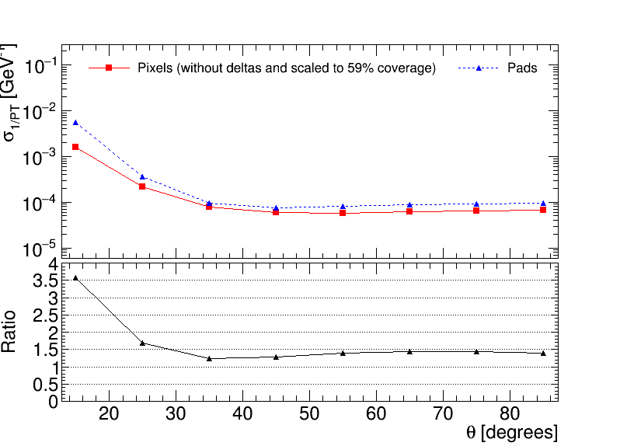



Performance of a GridPix TPC at ILC
From full simulation, momentum resolution can be determined
Momentum resolution is $\tilde{>}$ 20% better (scaled from 100% coverage)
Momentum resolution of the TPC for a 50 GeV muon
Realistic tiling with quad module
$∼$DELPHI all trackers barrel
$∼$ATLAS inner detector barrel
Coverage 59%

Slide 19
Conclusions
A GridPix based on the Timepix3 chip was reliably operated in a test beam setup
The resolution is primarily limited by diffusion
Systematic uncertainties are low: < 10 µm in the pixel plane
Energy loss resolution (dE/dx) by truncated sum is 4.1 % per meter
A Quad module is built and data from a test beam is now under investigation
Simulations show an improvement in momentum resolution of a pixel TPC readout over a pad readout

Slide 20
Backup

Slide 21
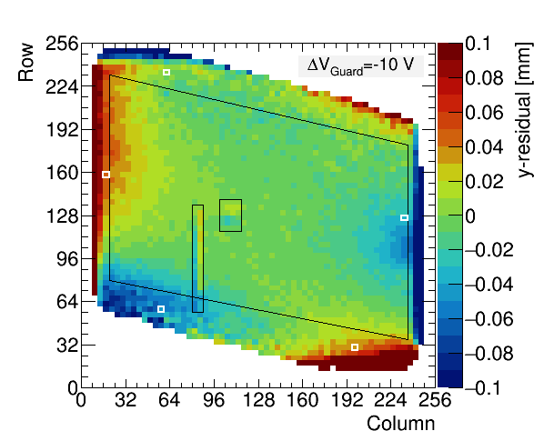
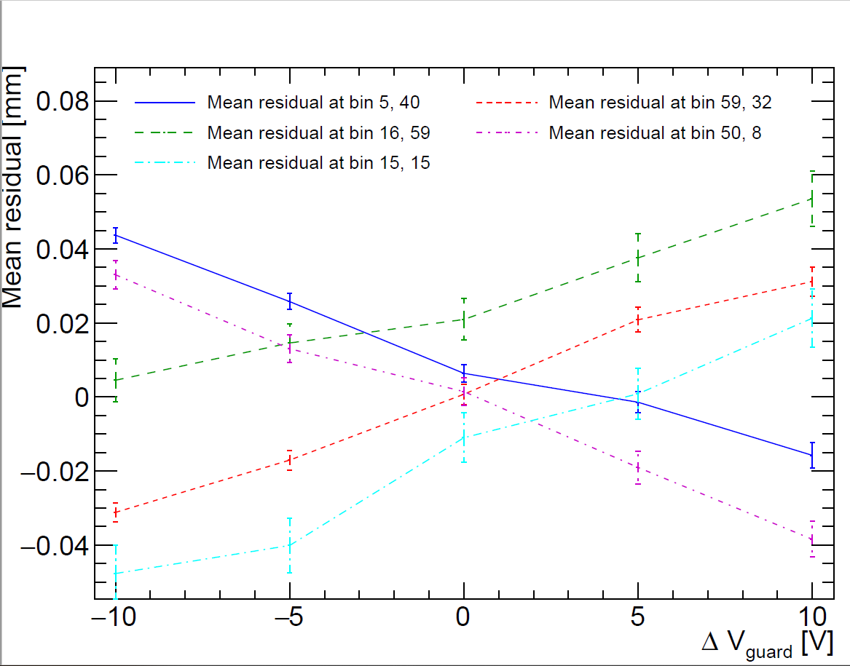
Distortions at the edges due to variation of guard voltage
In the deformation plot, the attraction of hits to the guard is visible near the edges
The Projection of selected bins 1-3.5 mm from the edge, shows that deformations are below +-50 µm for +- 10 V
This image is a GIF with 2s/frame
Mistuned Guard voltage

Slide 22
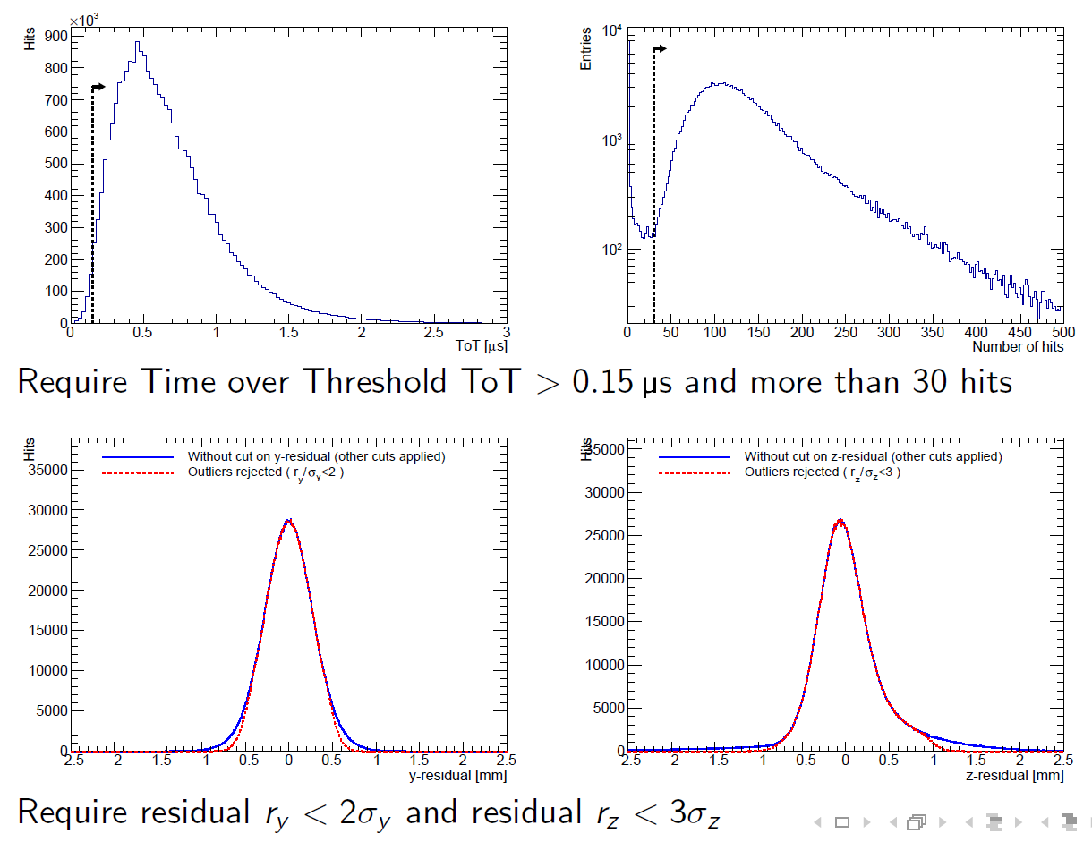
Outlier rejection

Slide 23
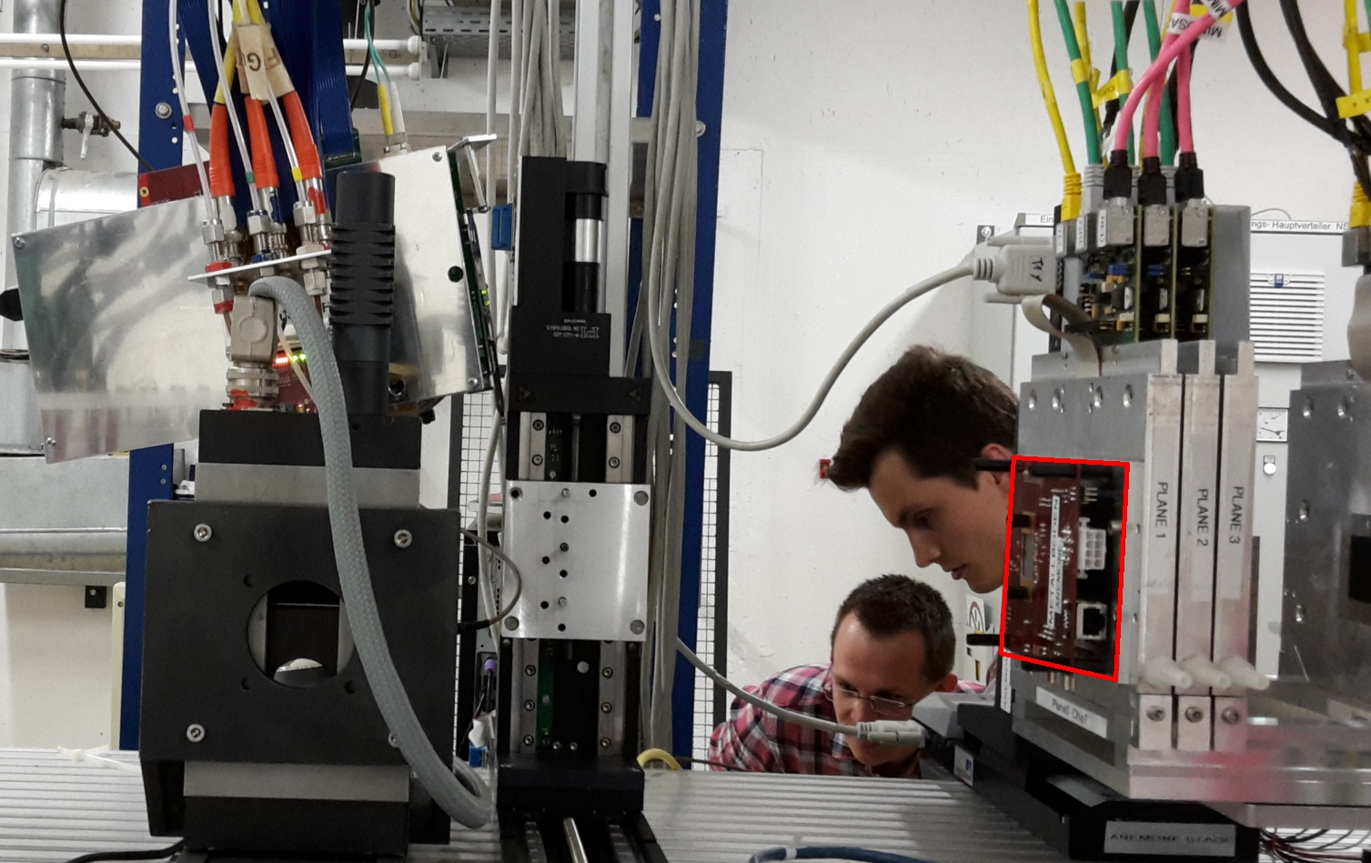
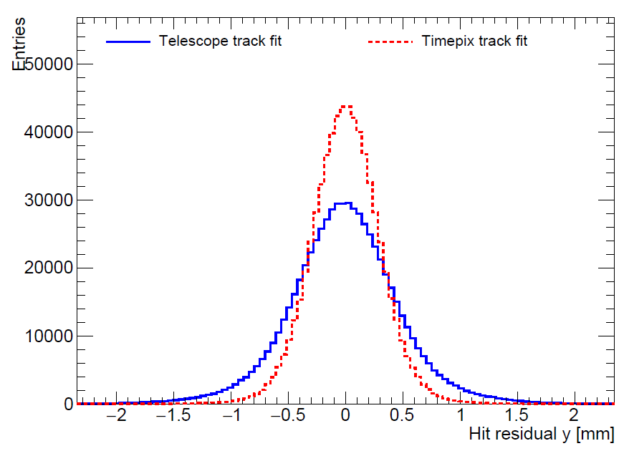

Scatter at last telescope plane (2017)
Telescope setup was not optimal in 2017: detector was not between planes
Multiple scattering of $\sim$0.7 mrad at last telescope plane
Only a reliable intercept with 10 µm error from the telescope
TPC
Telescope
Scatter caused broadening of residual distribution

