Slide 1
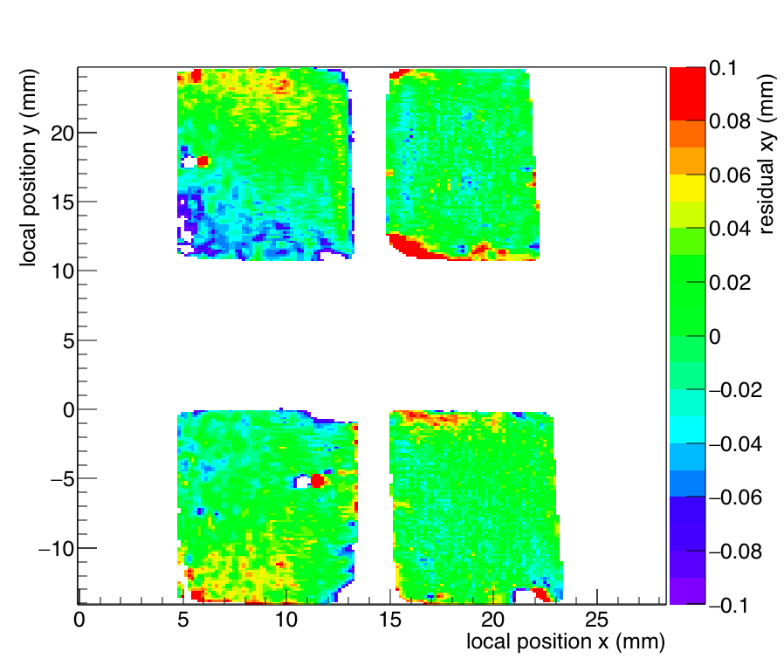
2013
Lepton Collider meeting 3 December

