Slide 1



QUAD development
A TPC building block
Yevgen Bilevych, Klaus Desch, Harry van der Graaf, Markus Gruber, Fred Hartjes, Bas van der Heijden, Kevin Heijhof, Jochen Kaminski, Peter Kluit, Auke Korporaal, Cornelis Ligtenberg, Oscar van Petten, Gerhard Raven, Lucian Scharenberg, Tobias Schiffer, Sebastian Schmidt and Jan Timmermans
Nikhef
and
Physikalisches Institut Universität Bonn
9th Symposium on Large TPCs for Low-energy Rare Event Detection. Diderot University, December 12 - 14, 2018

Slide 2
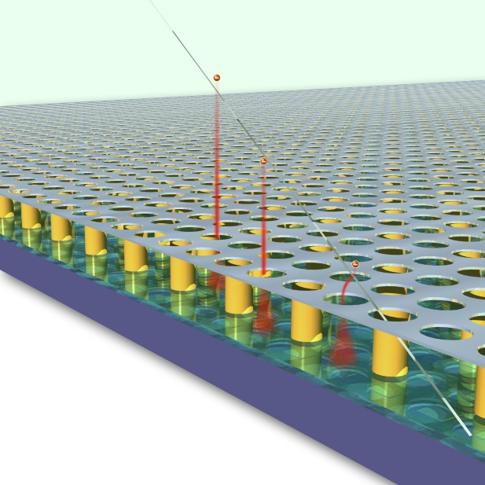
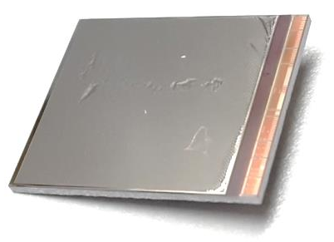
GridPix technology
Pixel chip with integrated Micromegas
=> InGrid
Very small pixel size
  55 µm
=> Mostly detecting individual electrons
GridPix chip
55 µm

Slide 3
GridPix: detecting individual electrons
Uses the complete information of the ionization profile
The best resolution that can be obtained from a gaseous detector
  dE/dx by single electron counting
Fine granularity enables rejecting background tracks and deltas in offline analysis
Measured track in test beam

Slide 4
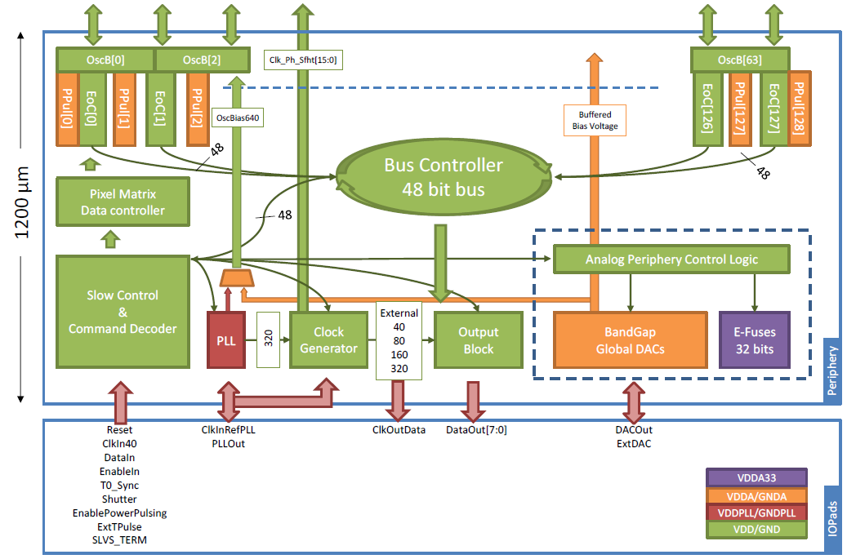
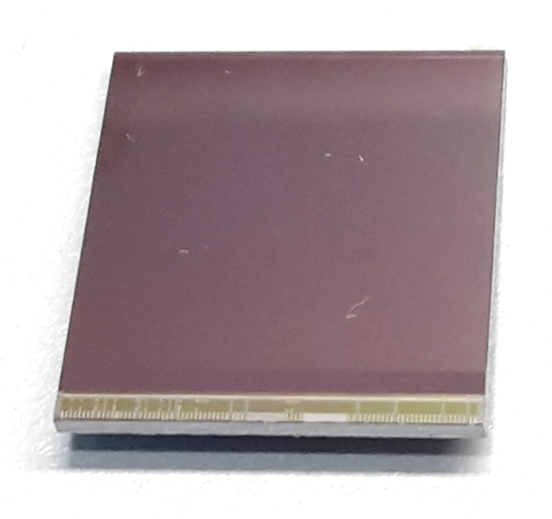
Pixel chip: TimePix3
256 x 256 pixels
55 x 55 µm pitch
=> 14.1 x 14.1 mm sensitive area
TDC with 600 MHz clock (1.7 ns)
Presently used in the data driven mode
  Each hit consists of a pixel address and time stamp of arrival time (TtA)
  Time over threshold (ToT) is added to register the signal amplitude
  => compensation of time walk
  Trigger added as additional time stamp
  (Running in triggered mode is possible)
High power consumption
  ~ 1 A @ 2 V (2W), depending on hit rate
  => good cooling is important

Slide 5
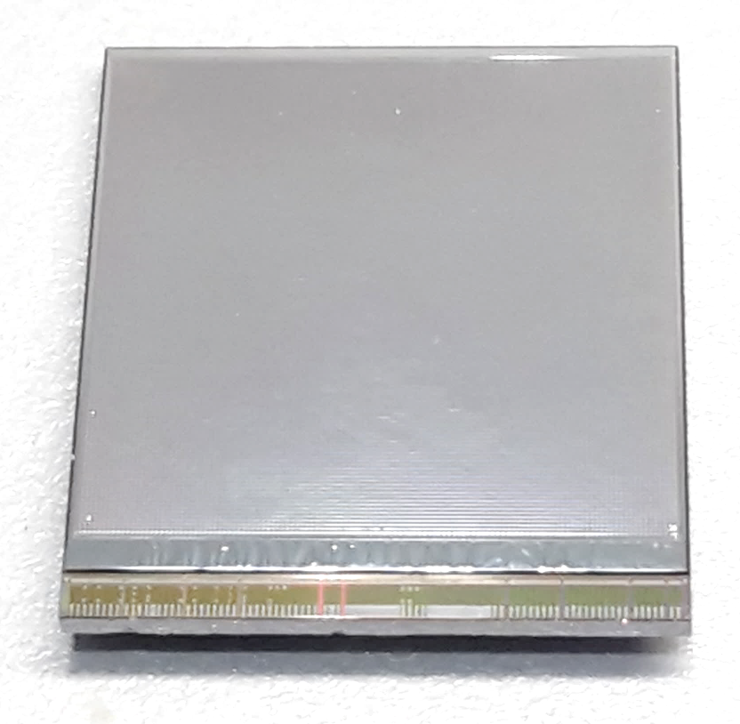
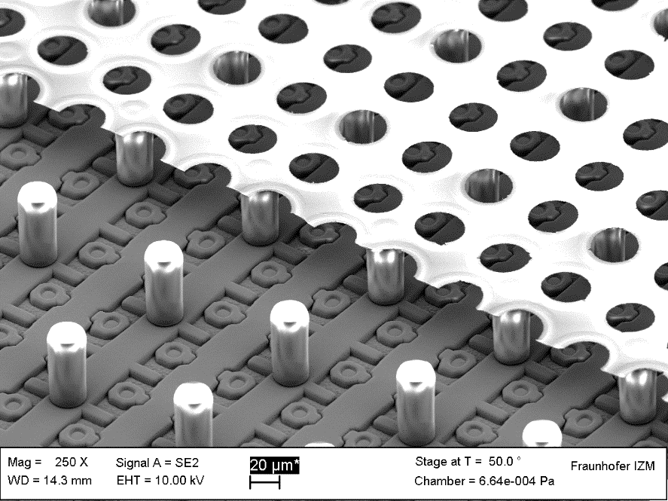
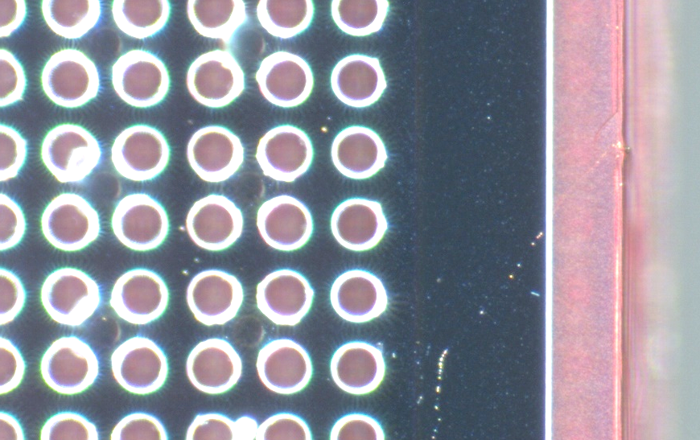
TimePix3 equipped with InGrid
Wafer postprocessing at IZM
Aluminium grid (1 µm thick)
35 µm wide holes, 55 µm pitch
Supported by SU8 pillars 50 µm high
Grid surrounded by SU8 dyke (150 µm wide solid strip) for mechanical and HV stability
dyke
50 µm
Cut view

Slide 6
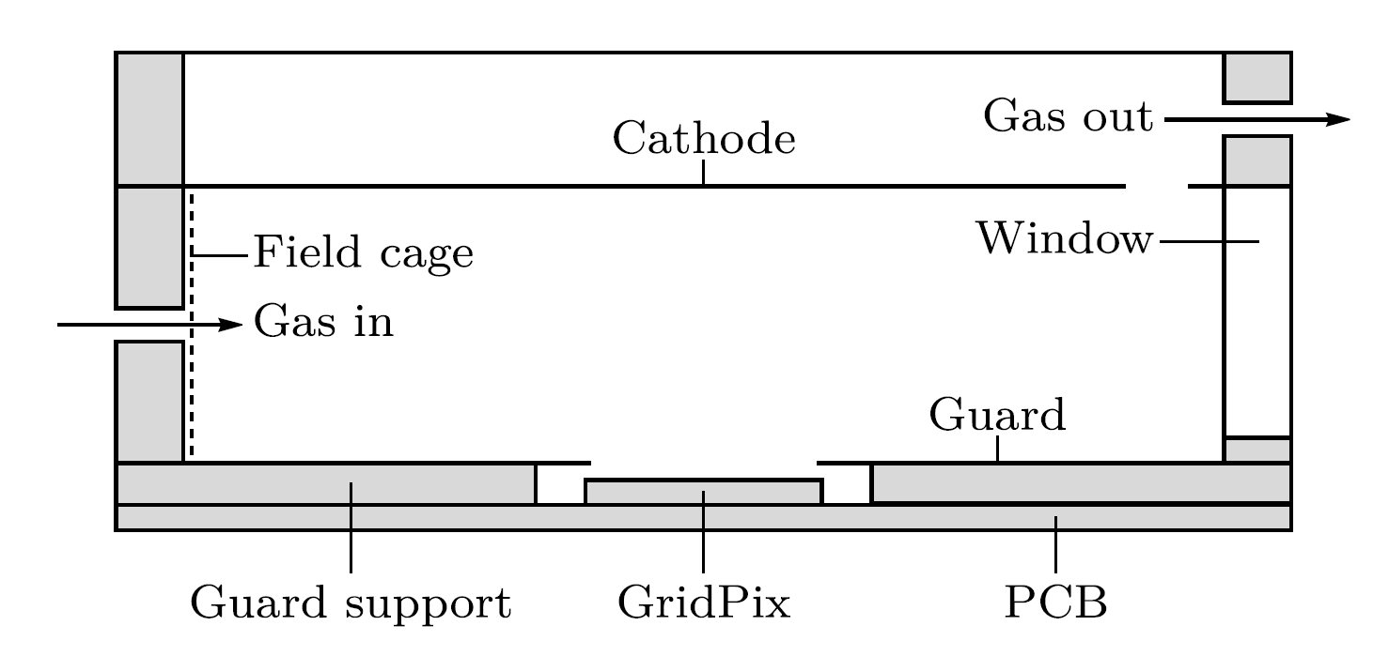
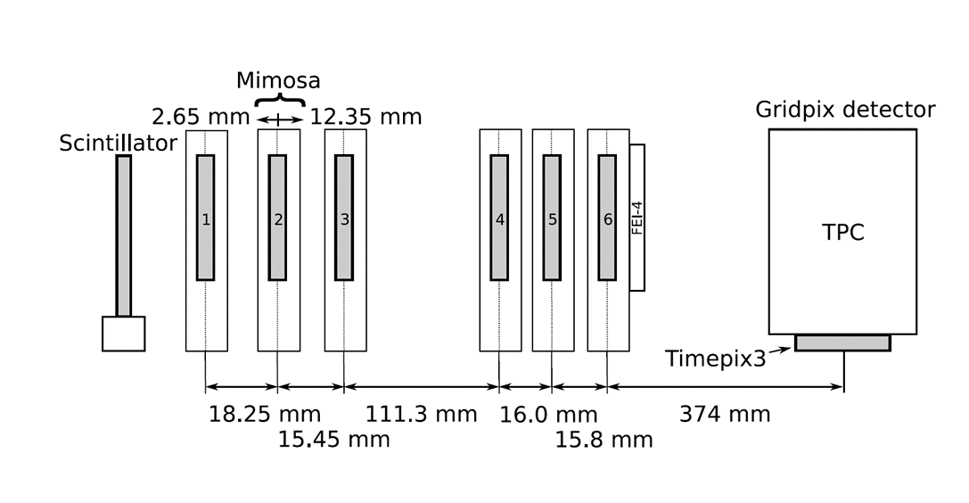


Single chip test at Bonn (June 2017)
ELSA: 2.5 GeV electrons
Tracks referenced by Mimosa telescope
Detector with guard and field shaper
@Bonn
Published paper on 2017 testbeam: https://doi.org/10.1016/j.nima.2018.08.012

Slide 7
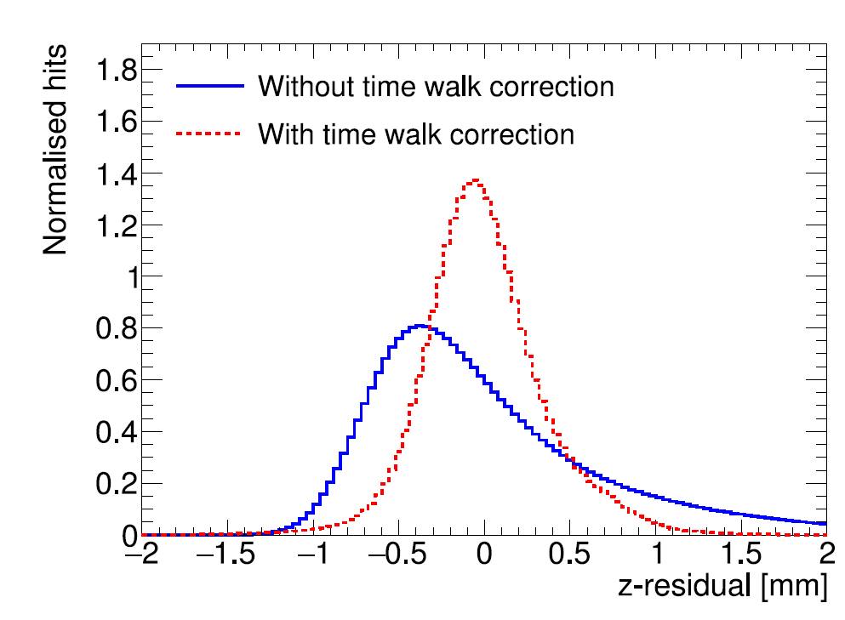
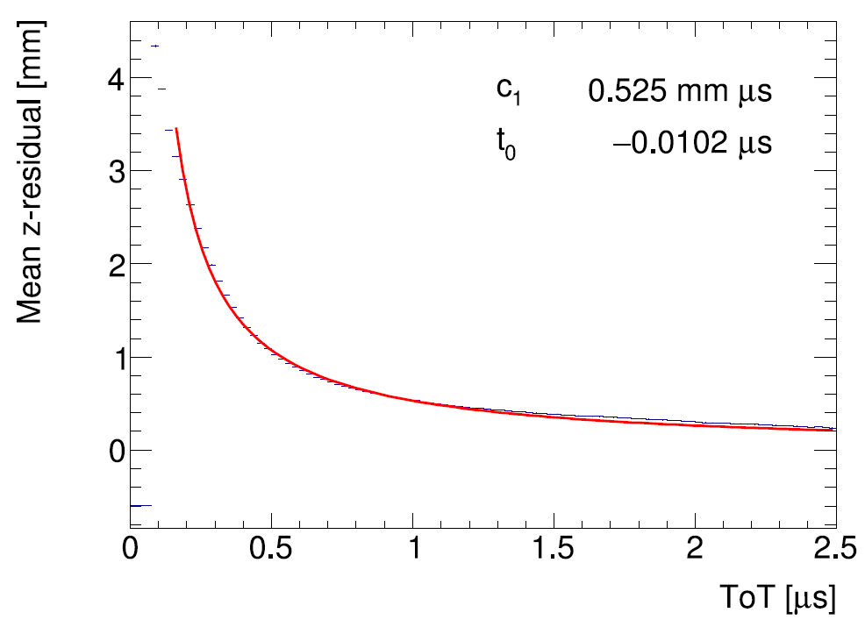
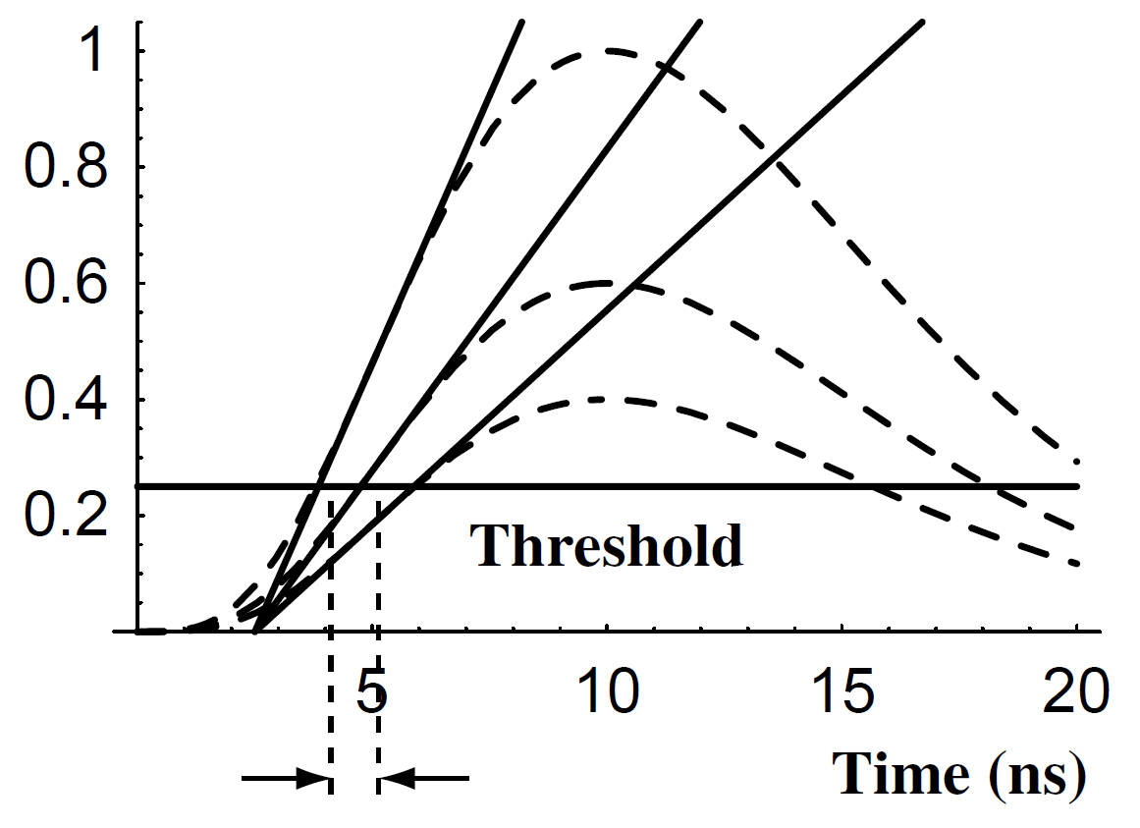
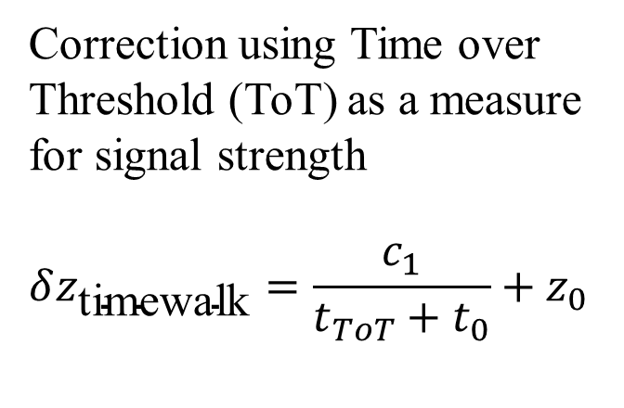
TimePix3 time walk correction
Time walk error: time of arrival depends on signal amplitude
Correction using Time over Threshold (ToT) as a measure for signal strength
$$δz_{\text{timewalk}}=\frac{c_{1}}{t_{ToT}+t_{0}}+z_{0}$$
Residual distribution improved
Higher order corrections did not yield further improvements
(Blum, Particle detection 2008)

Slide 8
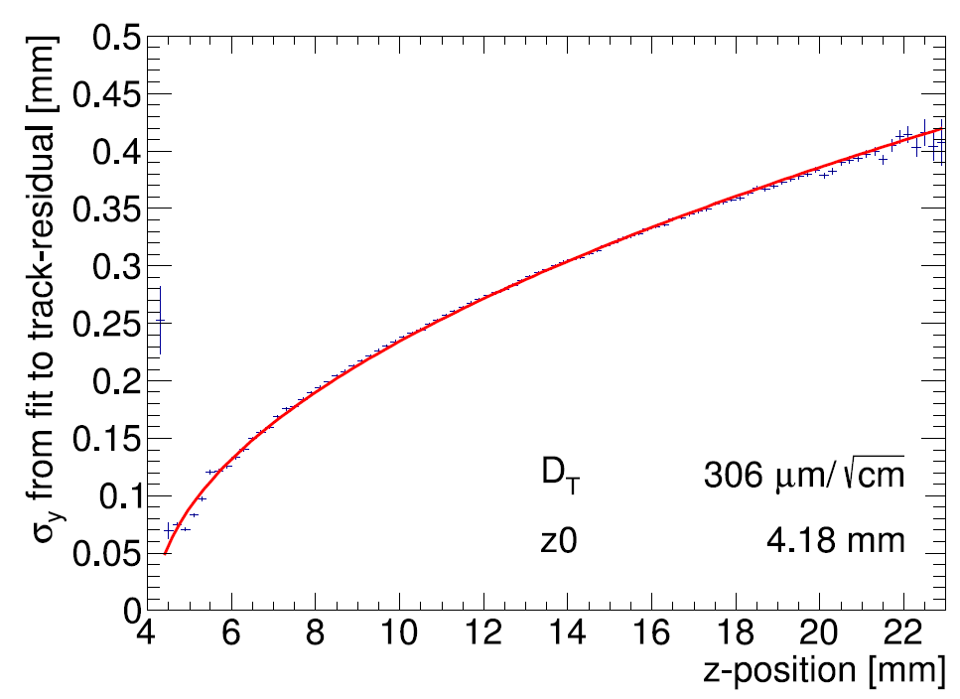
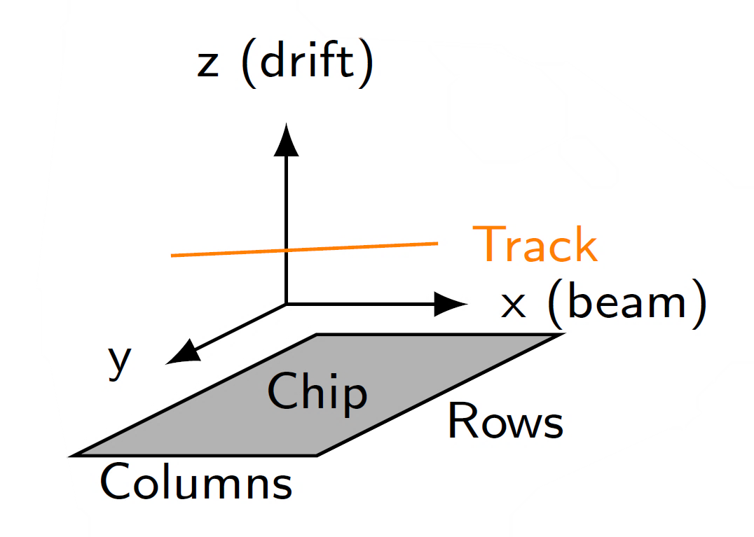
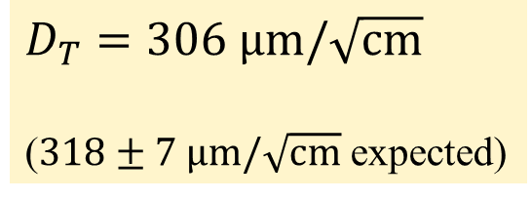
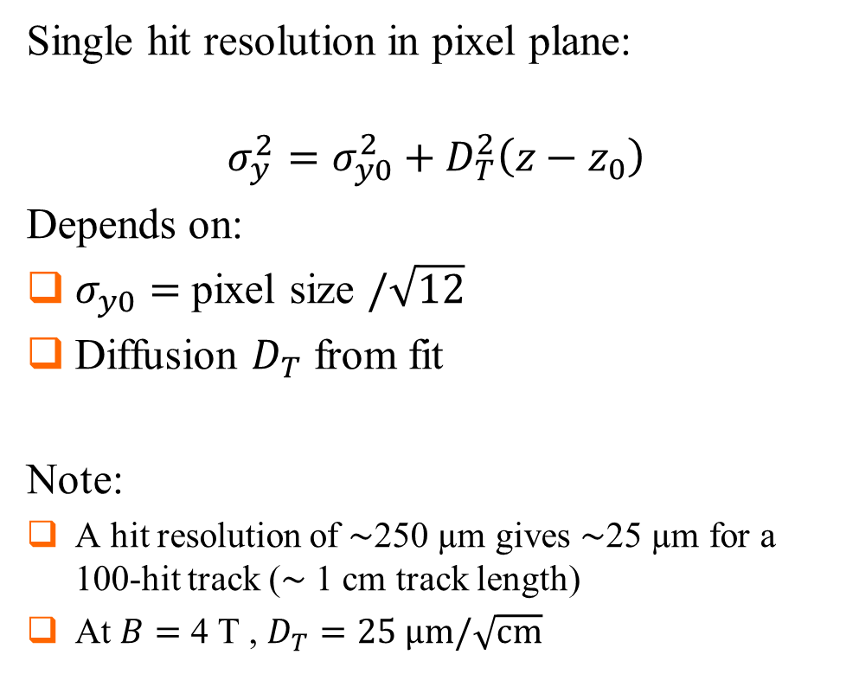
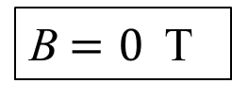
Single hit resolution in transverse direction
Single hit resolution in pixel plane:
$$σ_{y}^{2}=σ_{y0}^{2}+D_{T}^{2}\left(z−z_{0}\right)$$
Depends on:
$σ_{y0}=$ pixel size $/\sqrt{12}$
Diffusion $D_{T}$ from fit
Note:
A hit resolution of $\sim$250 µm gives $\sim$25 µm for a 100-hit track ($\sim$ 1 cm track length)
At $B=$ 4 T , $D_{T}=25 \text{μm}/\sqrt{\text{cm}}$
B$=0$ T
$D_{T}=306 \text{μm}/\sqrt{\text{cm}}$
($318±7 \text{μm}/\sqrt{\text{cm}}$ expected)

Slide 9
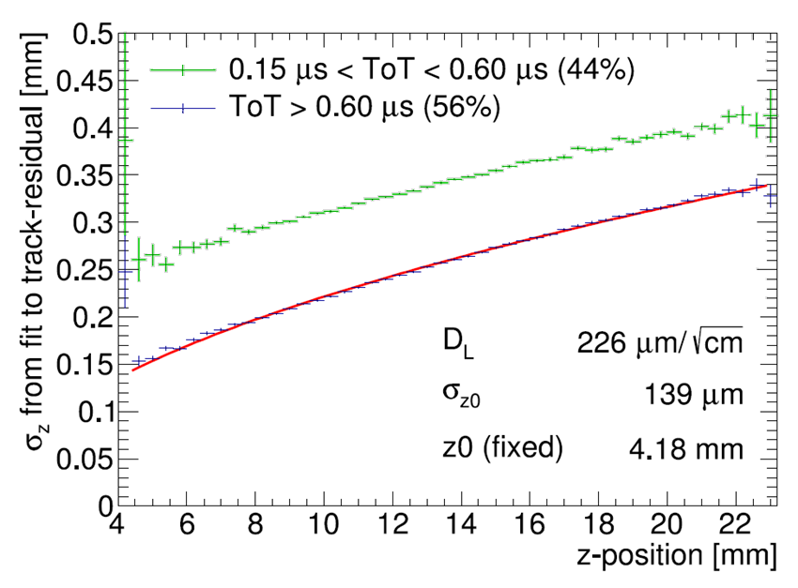
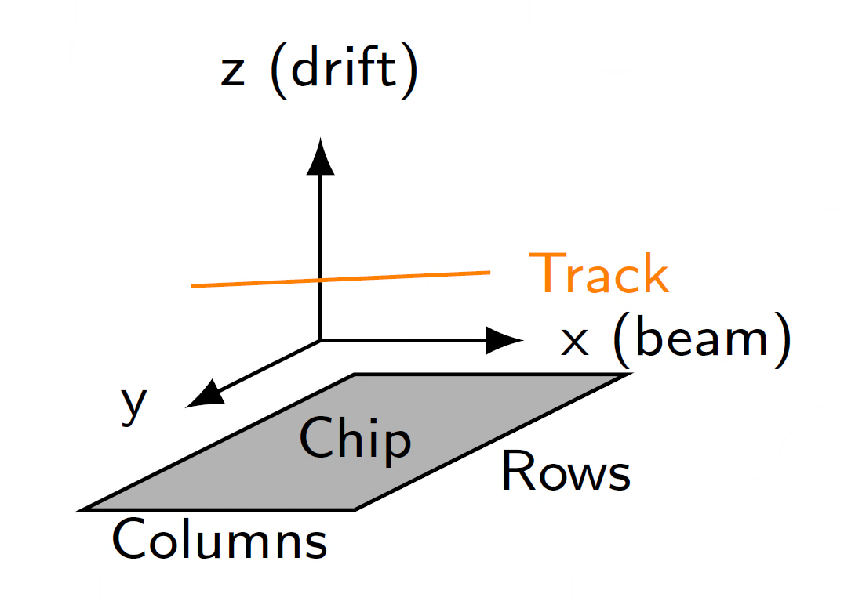
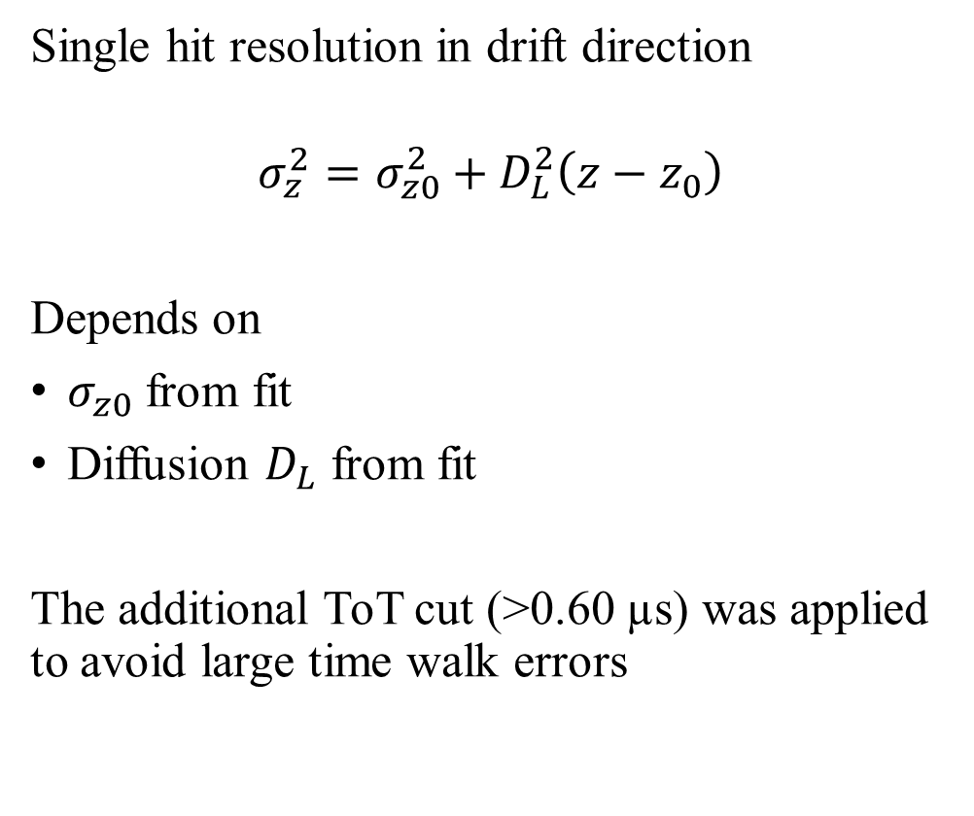
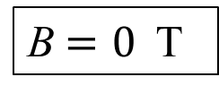
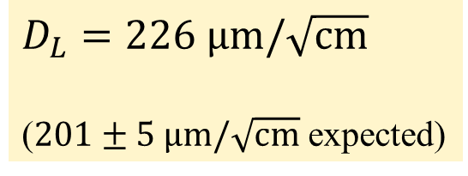
Single hit resolution in longitudinal direction
Single hit resolution in drift direction
$$σ_{z}^{2}=σ_{z0}^{2}+D_{L}^{2}\left(z−z_{0}\right)$$
Depends on
$σ_{z0}$ from fit
Diffusion $D_{L}$ from fit
The additional ToT cut (>0.60 µs) was applied to avoid large time walk errors
B$=0$ T
$D_{L}=226 \text{μm}/\sqrt{\text{cm}}$
($201±5 \text{μm}/\sqrt{\text{cm}}$ expected)

Slide 10
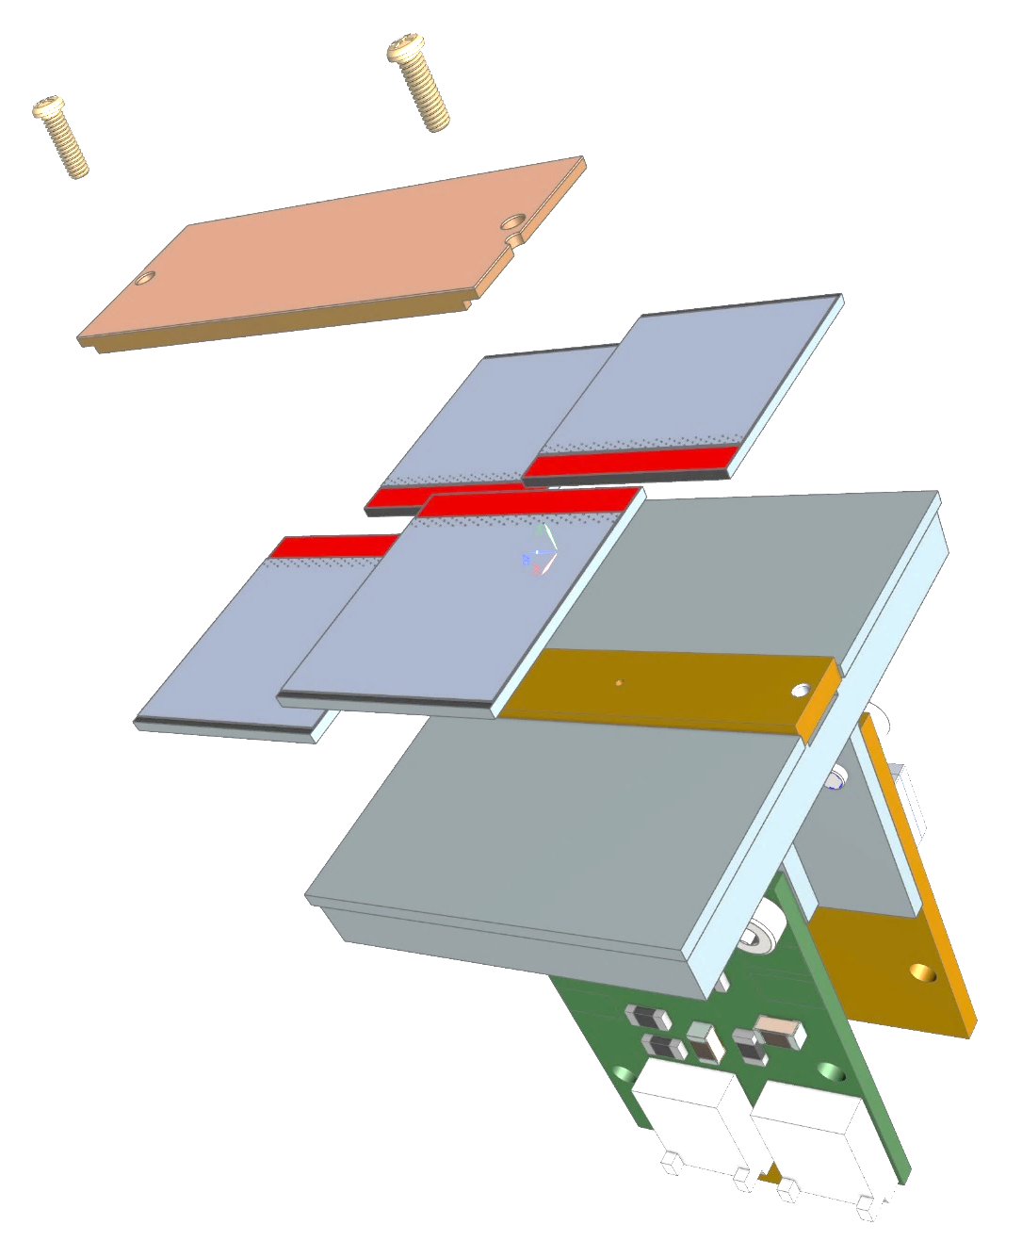
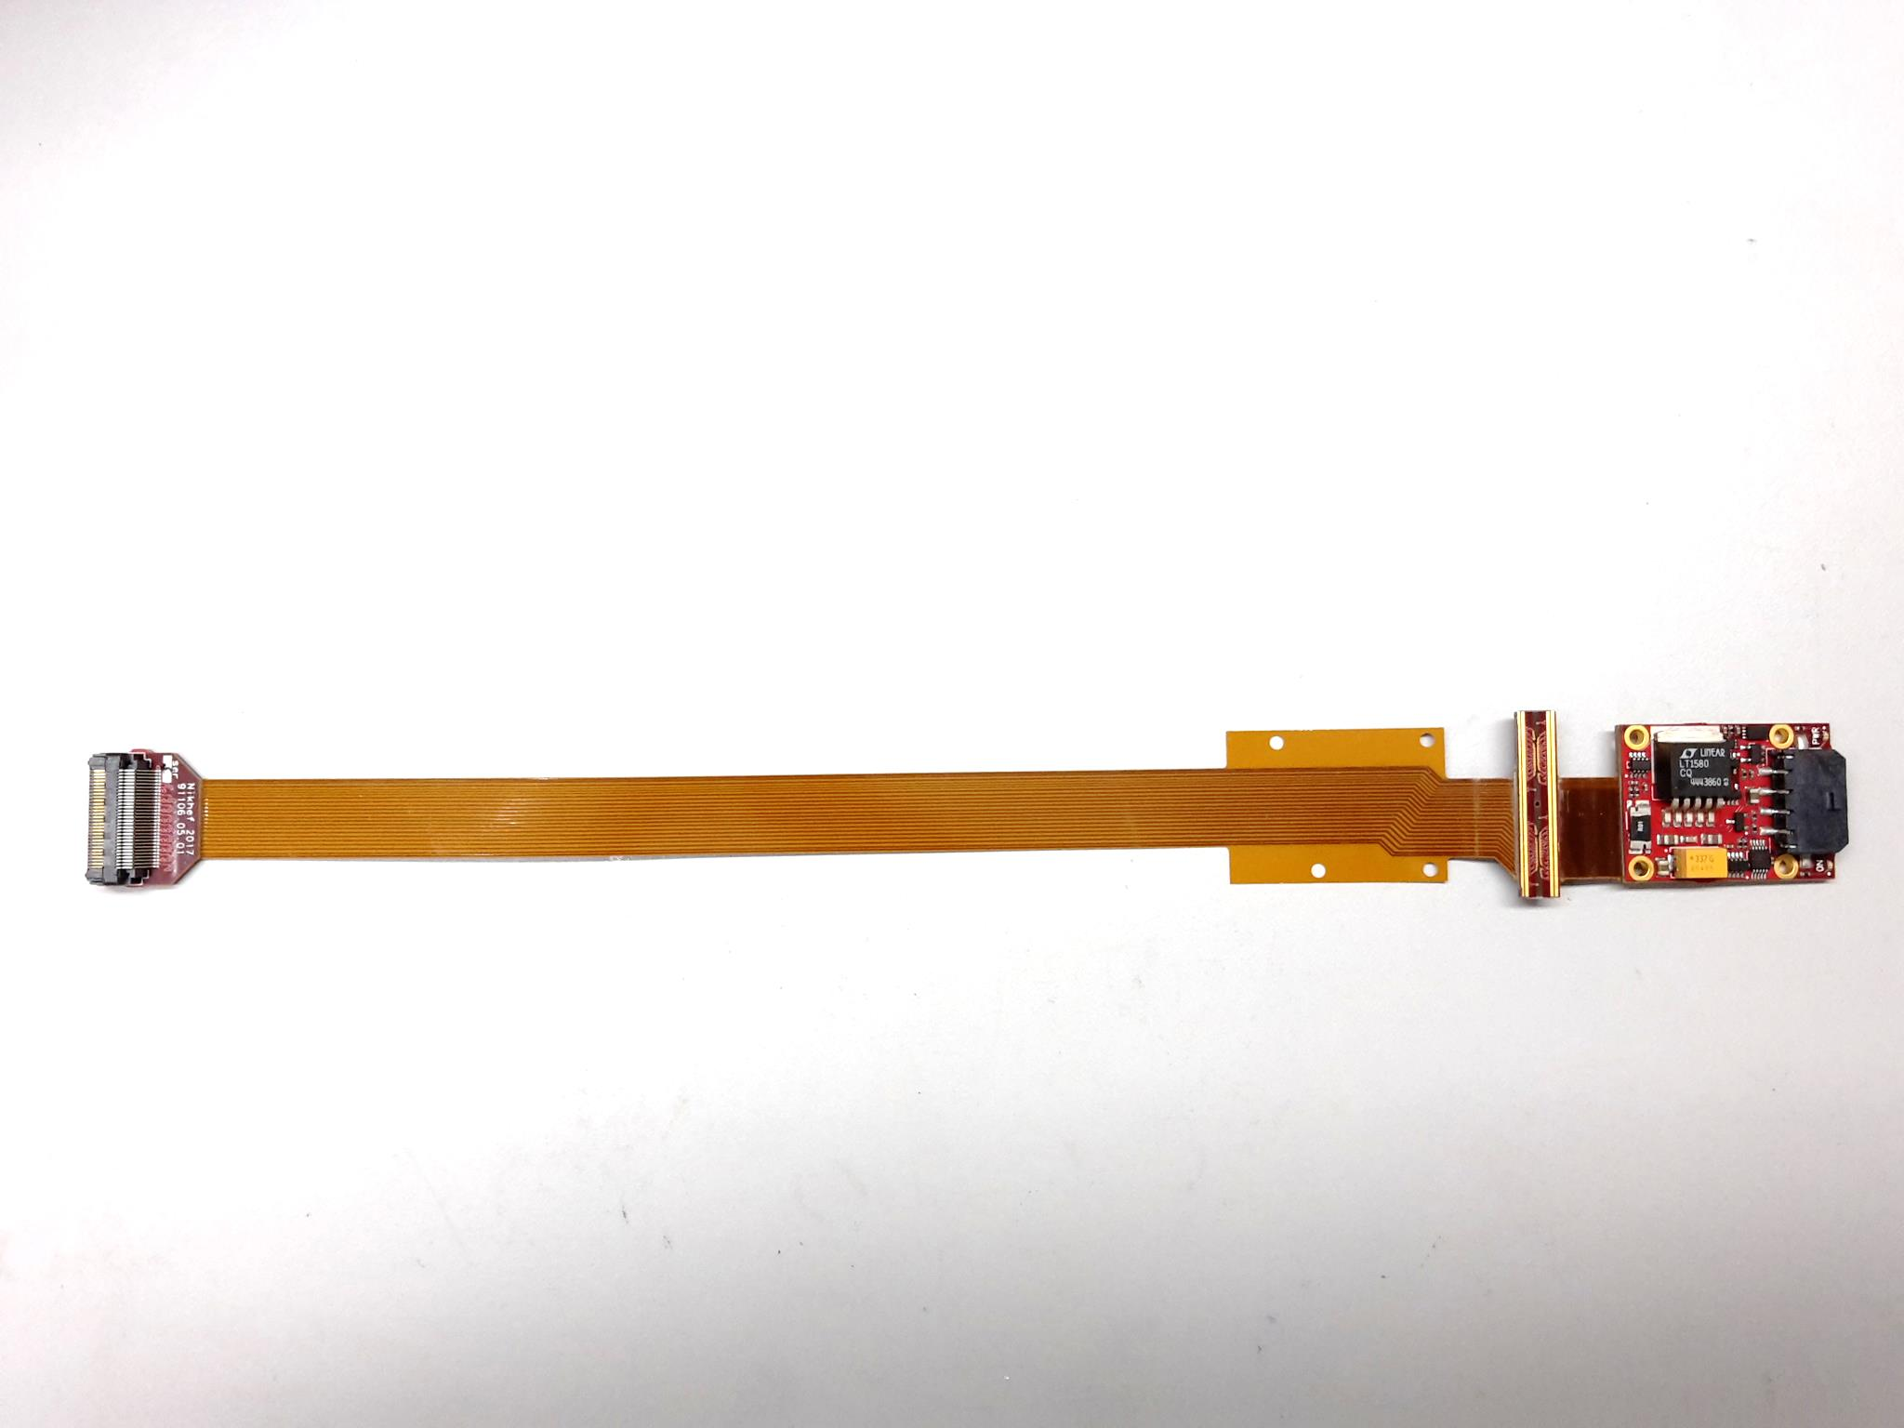
Covering large detection areas: QUAD
Four-TimePix3 detector
All services (signal IO, LV power are located under the detection surface
The area for connections was squeezed to the minimum
Detection surface can be extended by adding other QUADs at all 4 sides
  => no limit on detection area
Guard
TPX3
TPX3
TPX3
TPX3
COld
CArrier
LV PS

Slide 11
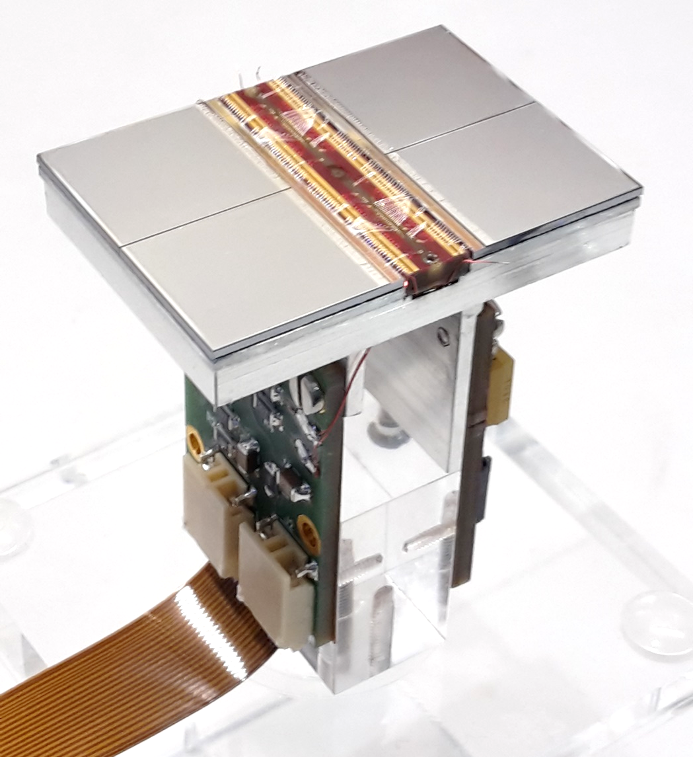
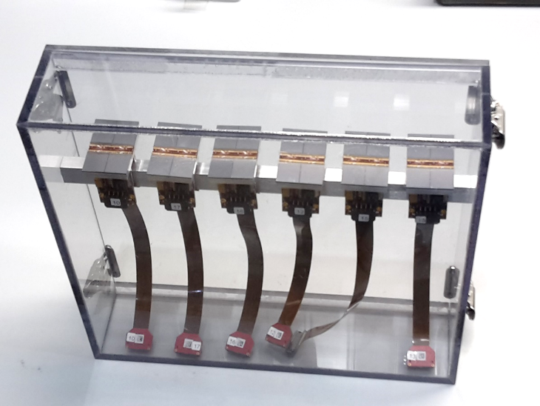
Assembled QUAD
QUAD has an sensitive area of 68.9%
COCA dimensions 39.6 x 28.38 mm
COld CArrier
(COCA)
QUADs being produced in series
(14 QUADs)
Guard electrode omitted
Commercialization under study

Slide 12
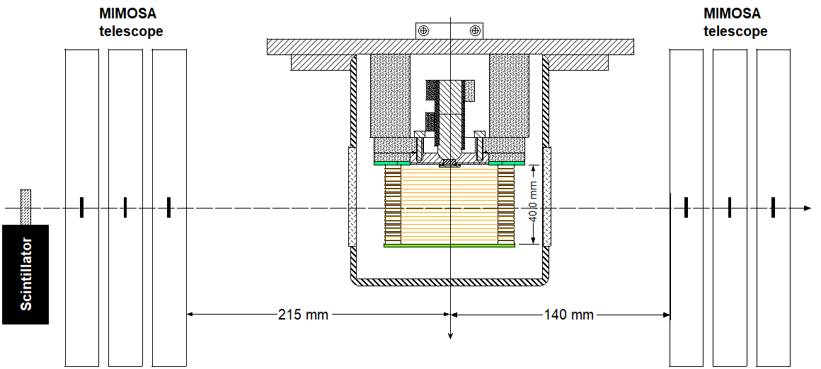
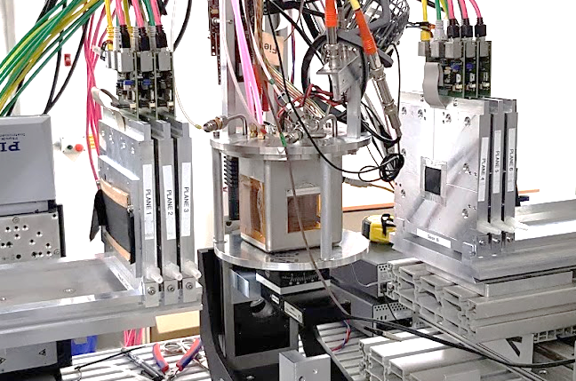
Single QUAD test in Bonn (October 2018)
ELSA: 2.5 GeV electrons
Tracks referenced by Mimosa telescope
QUAD sandwiched between Mimosa halves
  Largely improved track definition
Only preliminary results, analysis in progress
QUAD
@Bonn
Field cage

Slide 13
Hit cleaning parameters

Slide 14
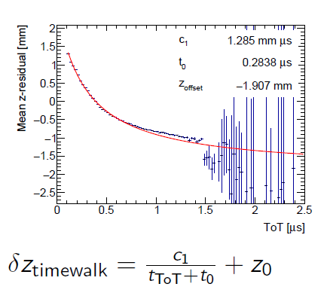
QUAD time walk results
Preliminary
Correction works well

Slide 15
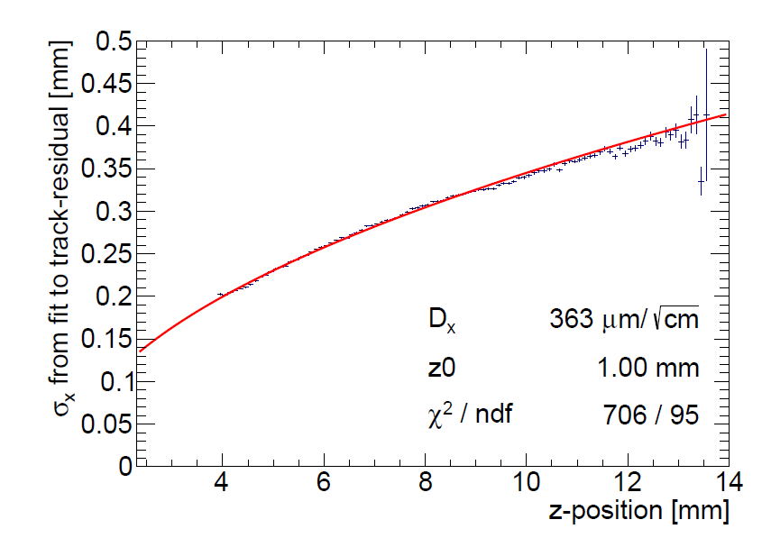
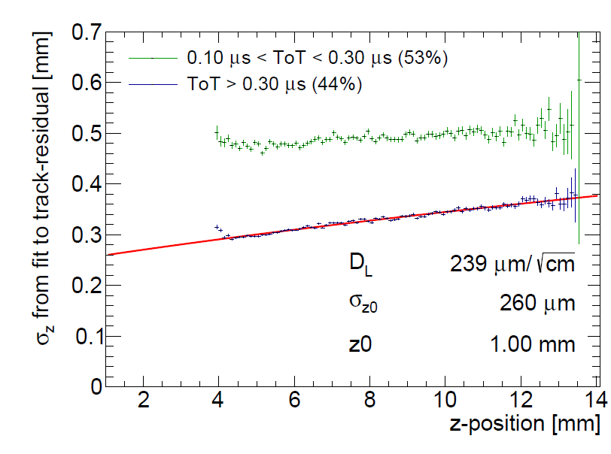




QUAD diffusion measurements
Preliminary
$Transverse$
$Longitudinal$
$D_{T}=363 \text{μm}/\sqrt{\text{cm}}$
$D_{L}=239 \text{μm}/\sqrt{\text{cm}}$

Slide 16
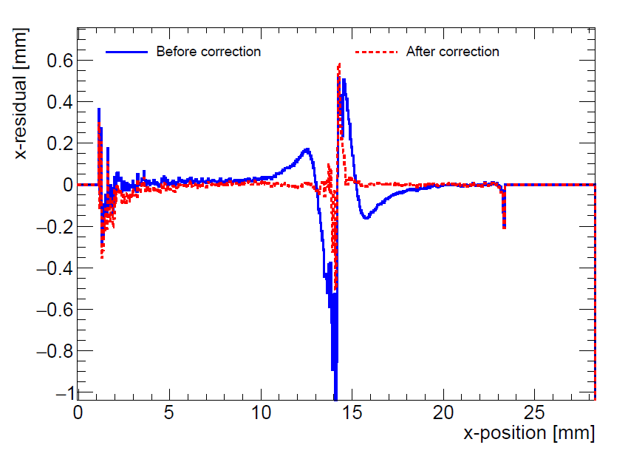
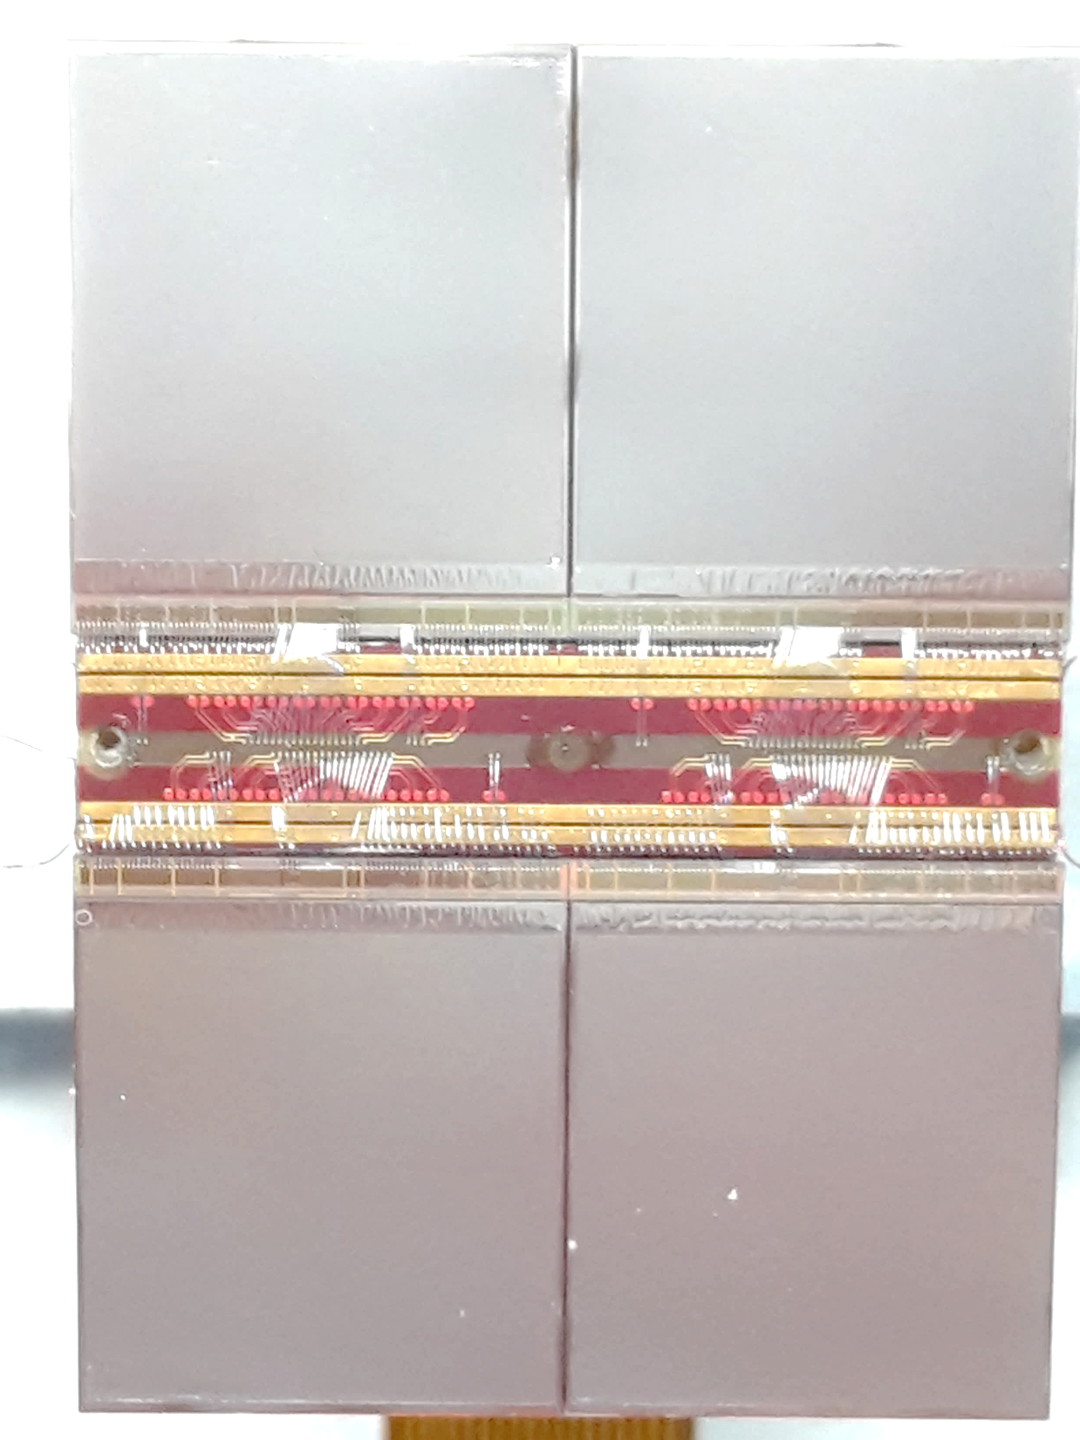
QUAD edge deformations
Deformations due to
  Dead zone between chips
  Grounded strip between chips
May be corrected by proper guard electrode
Preliminary

Slide 17
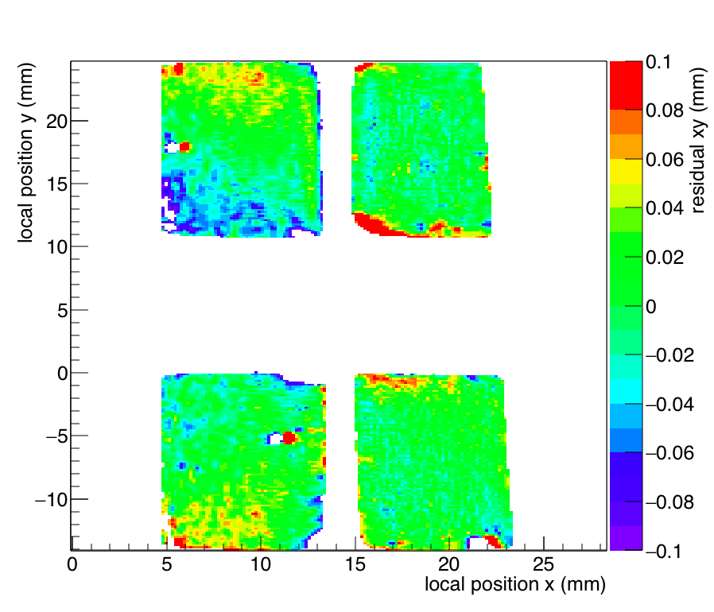
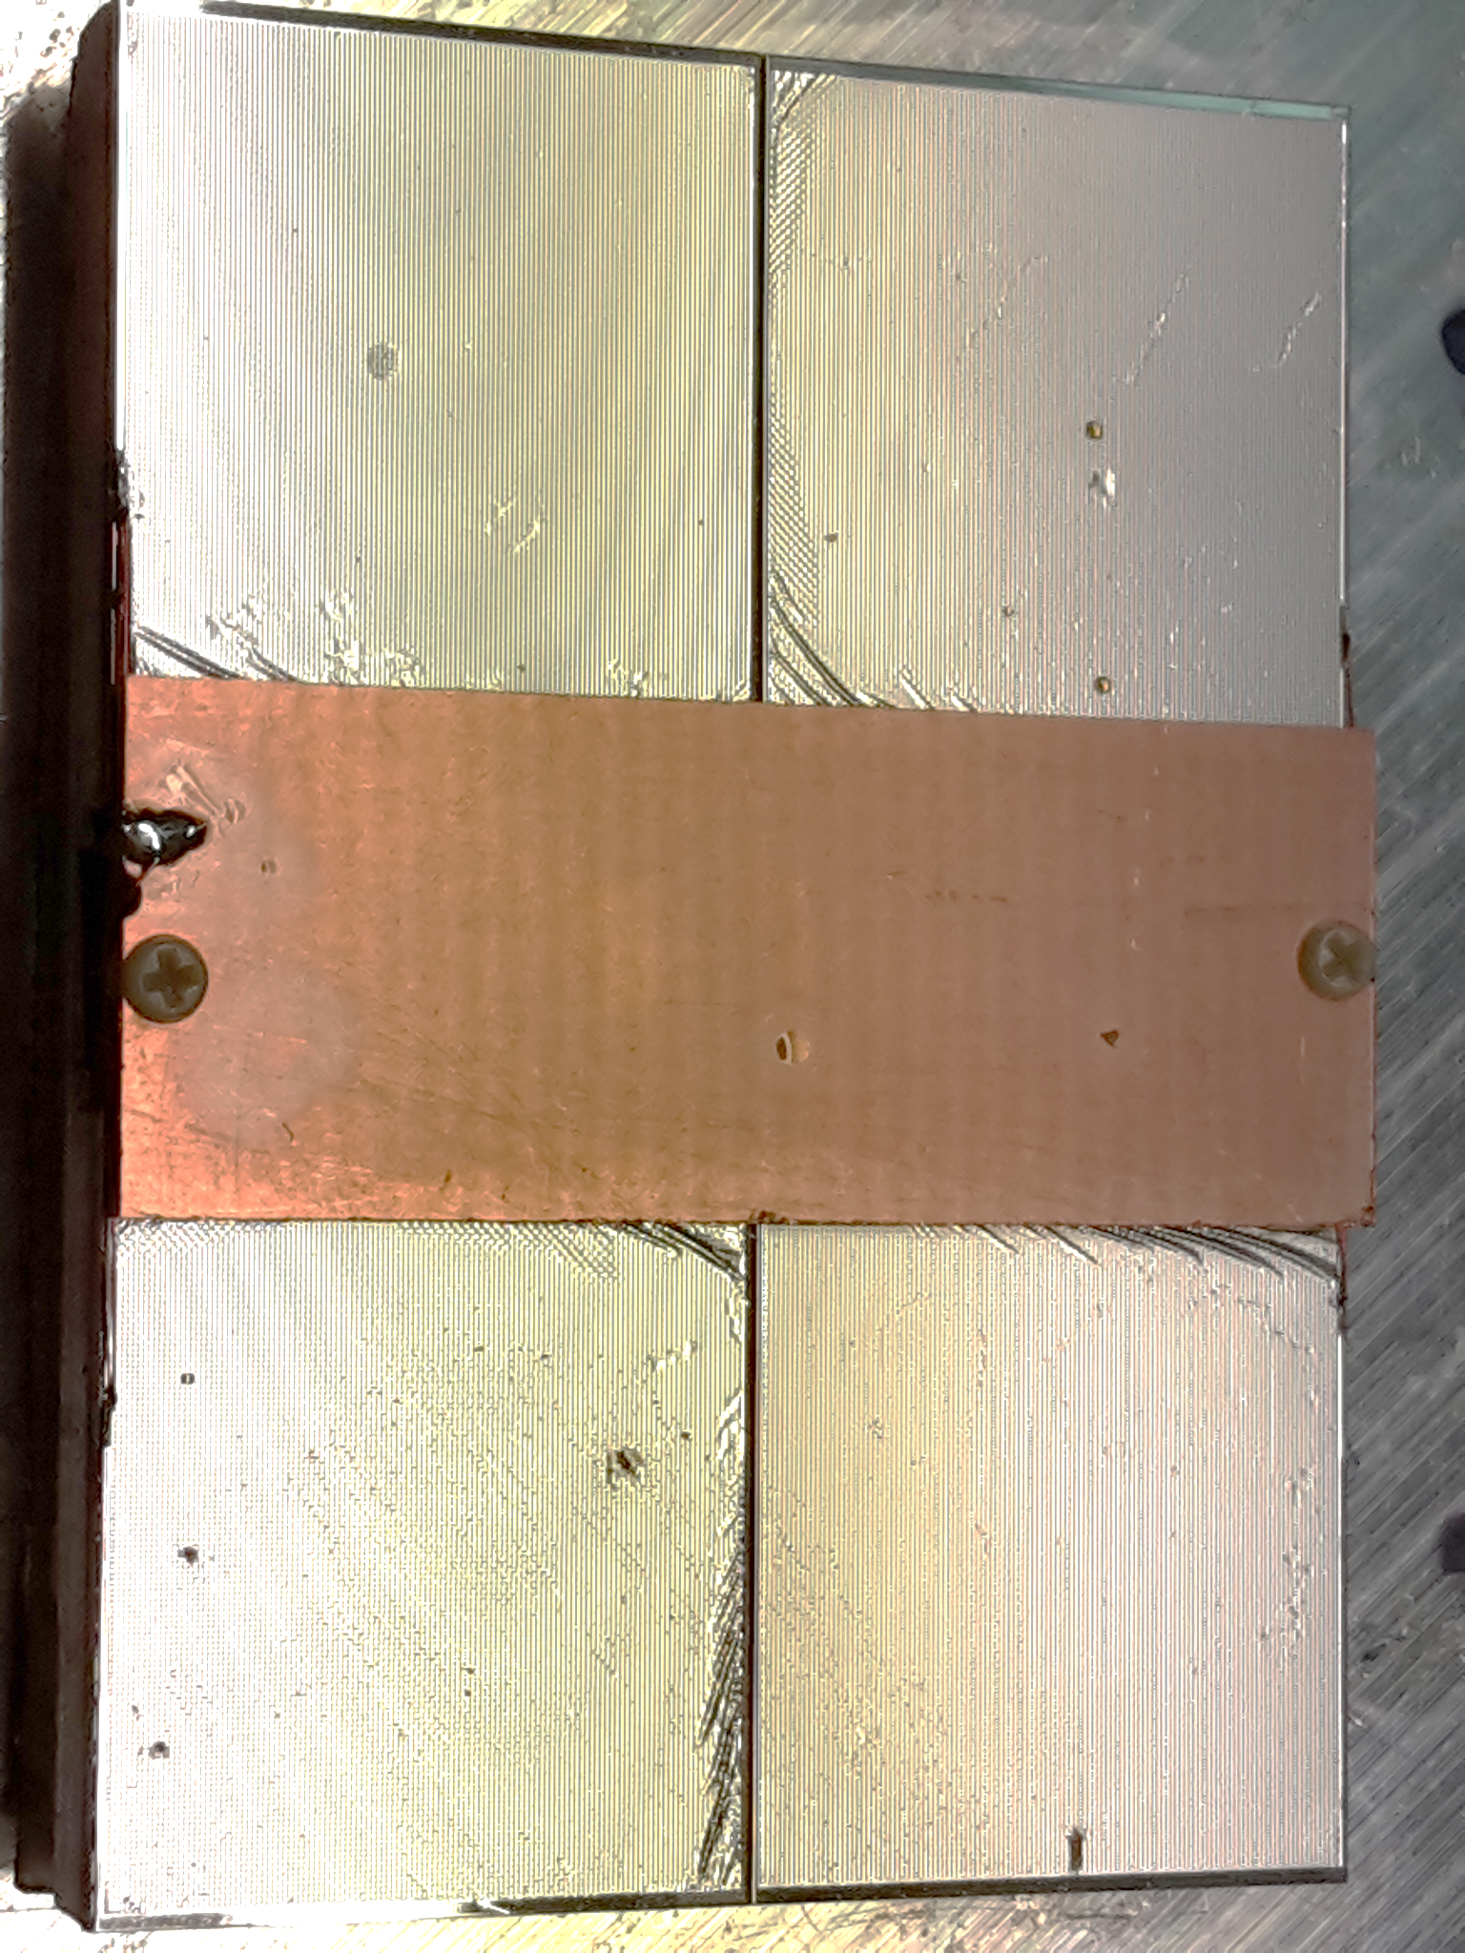
QUAD residuals in precision plane
Preliminary
2013
After applying edge corrections
The cut off at left and right side are due to the telescope acceptance and beam coverage
Lepton Collider meeting 3 December
Outside telescope acceptance
guard
Outside telescope acceptance
Residuals well below 100 µm

Slide 18
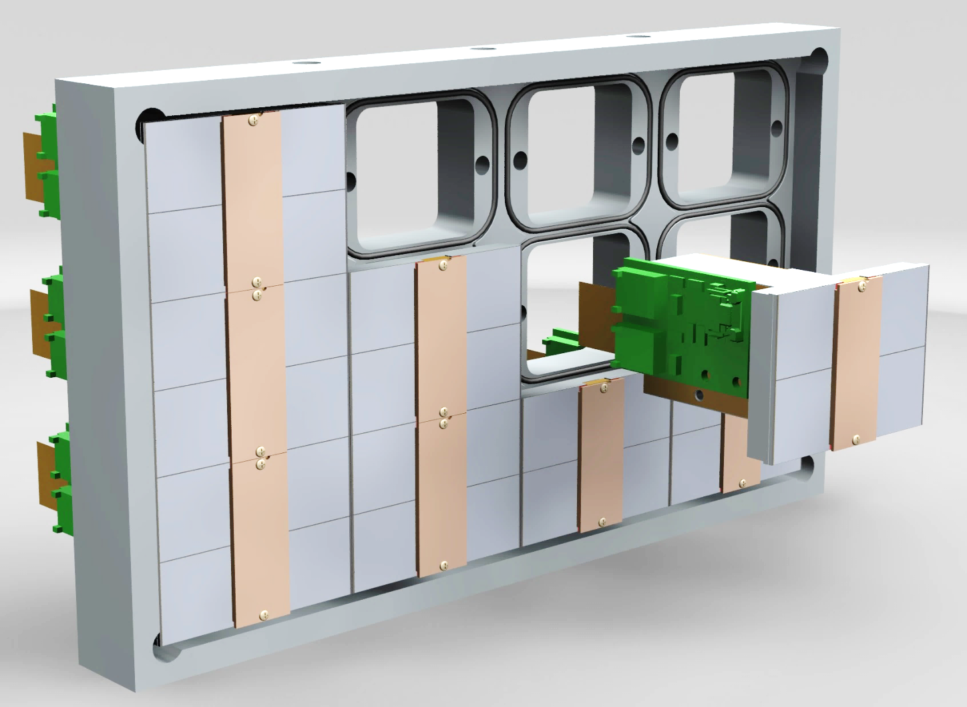
QUAD as a building block
Cooling channels
Building blocks of 39.6 x 28.38 mm
Unlimited surface may be covered
Plug in QUADs into a cooled base plate
Push them from two sides to a mechanical reference
Sensitive area 68.9%

Slide 19
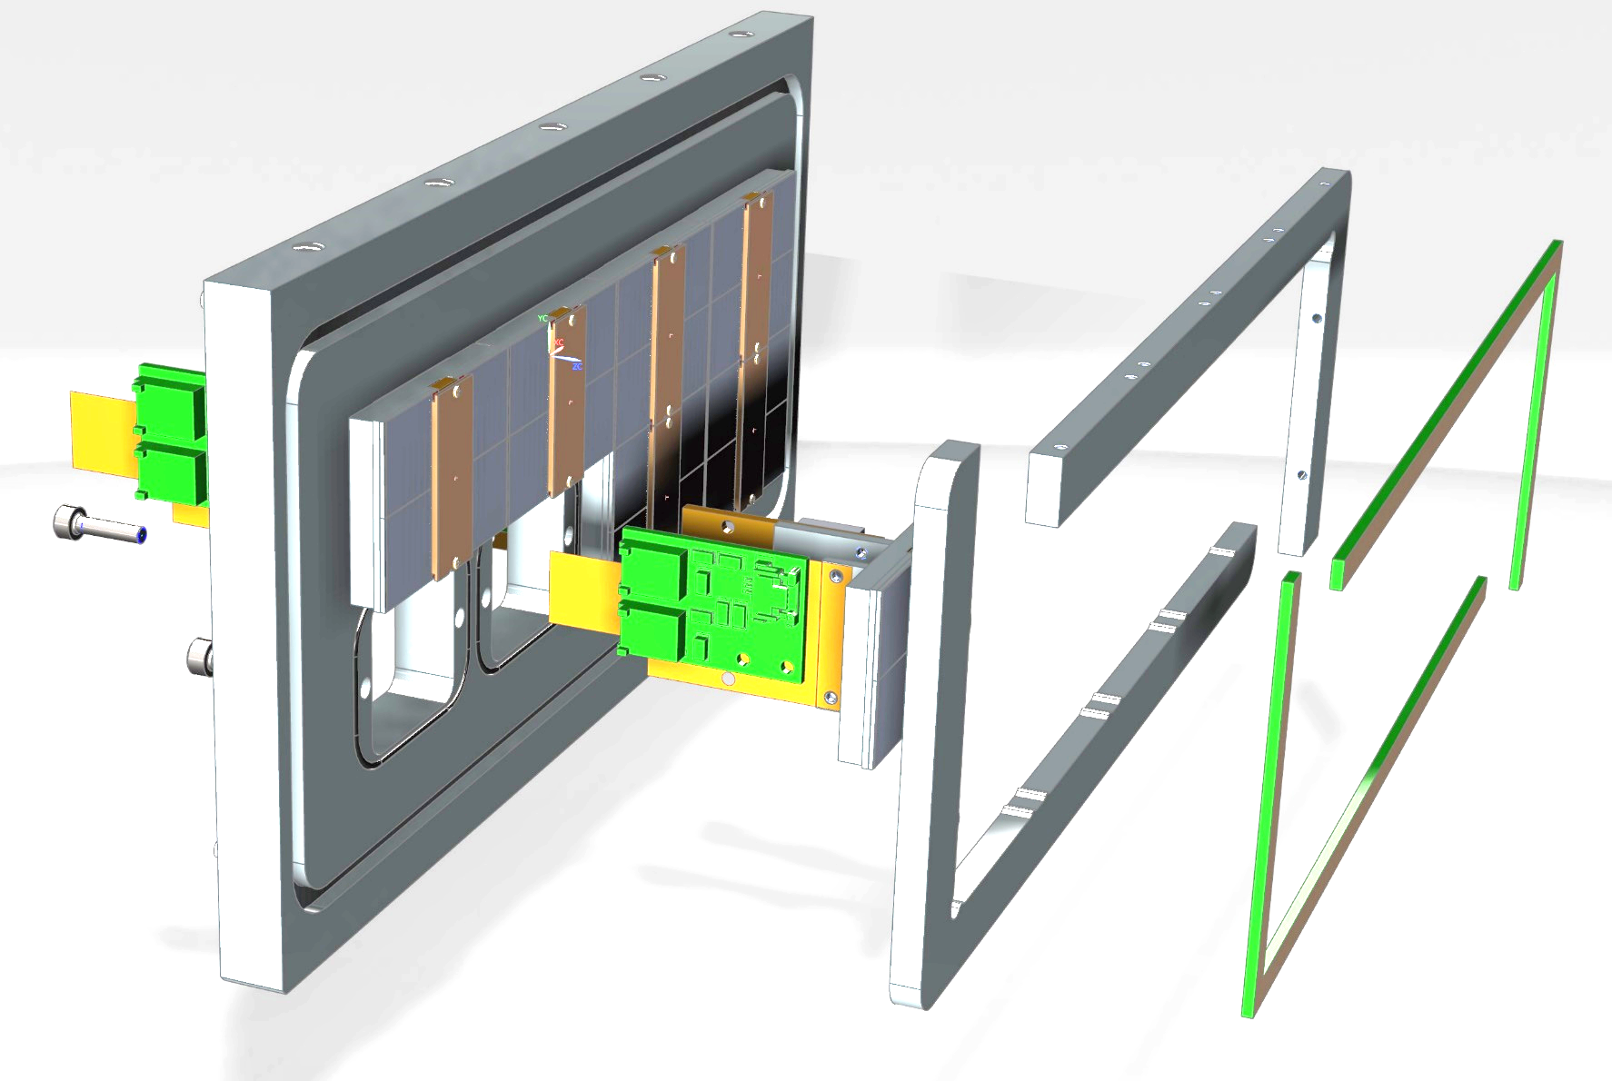
Testbox for 8 QUADs in assembly
Guard electrode
Guard electrode

Slide 20
Conclusions
Since 2017 three TimePix3 wafers were successfully processed with an InGrid
A GridPix detector from this production was reliably operated in a test beam experiment in 2017
  The resolution is primarily limited by diffusion
  Systematic uncertainties are low: < 10 µm in the pixel plane***
  Energy loss resolution (dE/dx) by truncated sum is 4.1 % per meter***
Simulations show an improvement in momentum resolution of a pixel TPC readout over a pad readout****
  Data from a recent single QUAD test beam experiment is under investigation*
A production of 14 QUAD modules is almost finished
A testbeam assembly of 8 QUADs is being assembled
At the QUAD significant edge deformations in the boundary between two chips are observed
  We study solutions with guard electrodes to avoid them
QUAD commercialization being discussed
* Report about the 2018 bem test in relation to the ILC and the ILD TPC to be found in:
"Performance of a GridPix TPC readout based on
the Timepix3 chip", C. Ligtenberg et al.,
Proceeedings of the International Workshop on Future Linear Colliders (LCWS2018), Arlington, Texas, 22-26 October 2018. C18-10-22

Slide 21
BACKUP

Slide 22
Maximizing active area
Using TimePix3 chip
Wirebond board squeezed to smallest width possible => 3 mm
Inactive zone (wirebond pads + electronics) => 2 mm
=> we have to reserve a 5 mm wide zone for connection + chip electronics
Sensitive area
2 mm
3 mm

Slide 23
New QUAD all hits

Slide 24
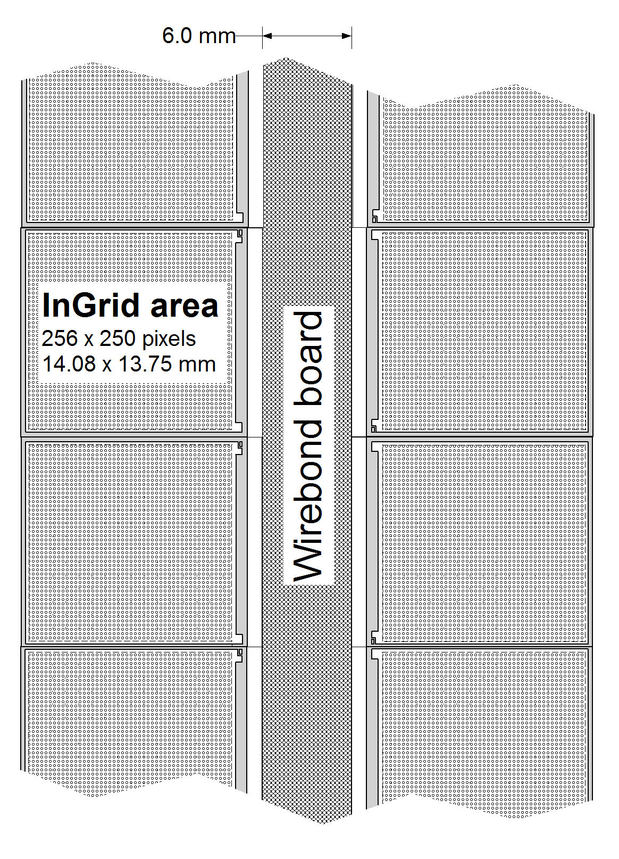
Getting the optimal detector size
10 mm
1 x 2 chips
  Not sufficient space (14 mm) for a LV stabilisation, chip control lines and a data RO
2 x 2 chips (QUAD)
  All fits
≥ 3 x 2 chips
  Less flexible, lower yield, more handling risk, harder reworking

Slide 25
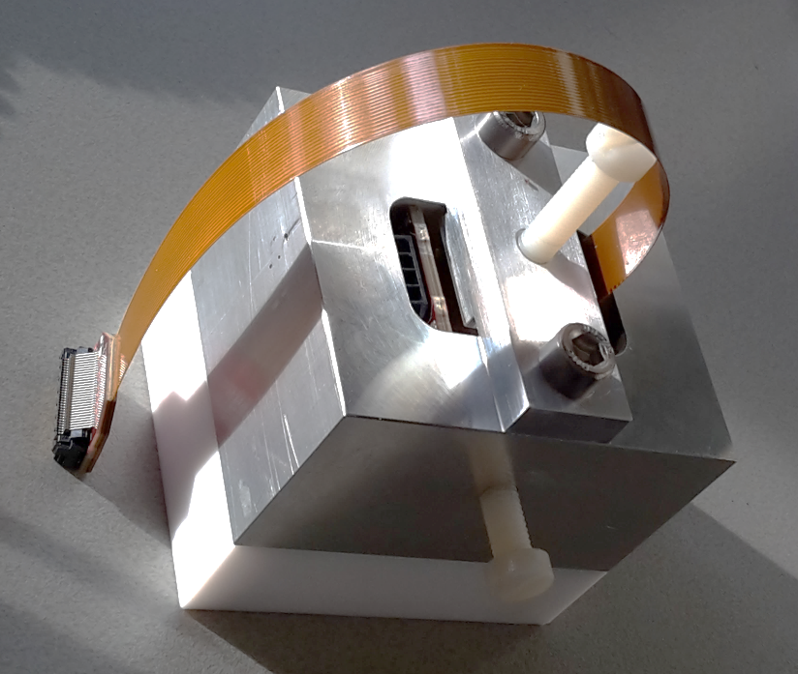
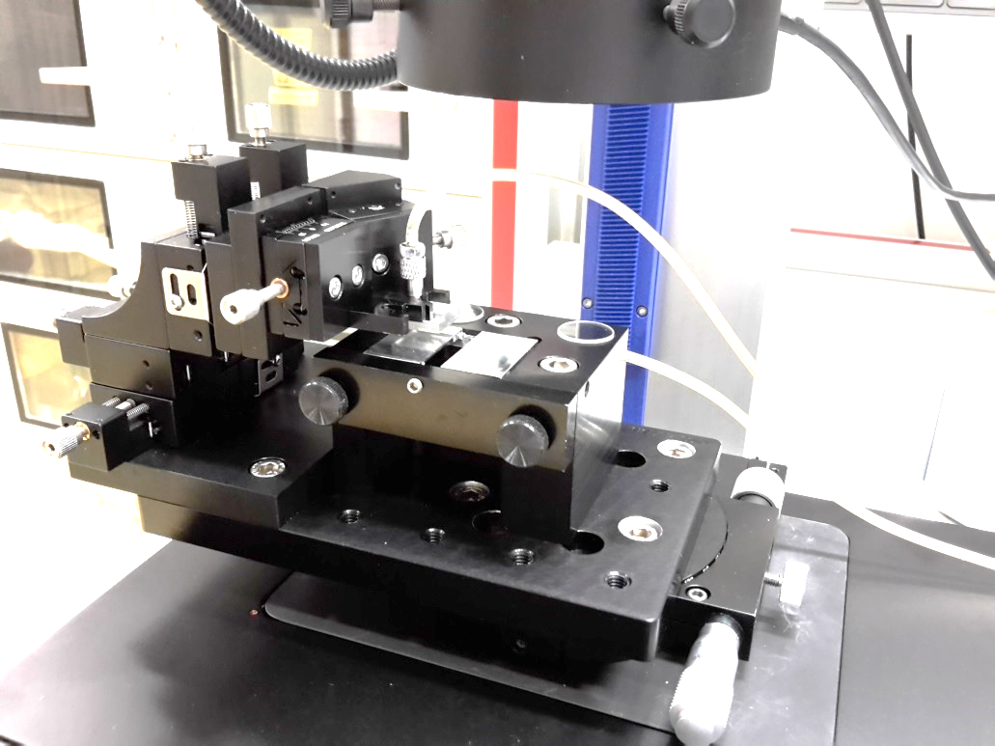
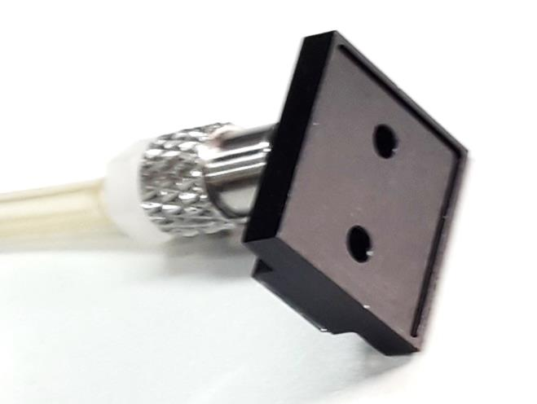
QUAD’s tooling
Assembly tool
Chip alignment jig
Pickup tool for chip
with InGrid

Slide 26
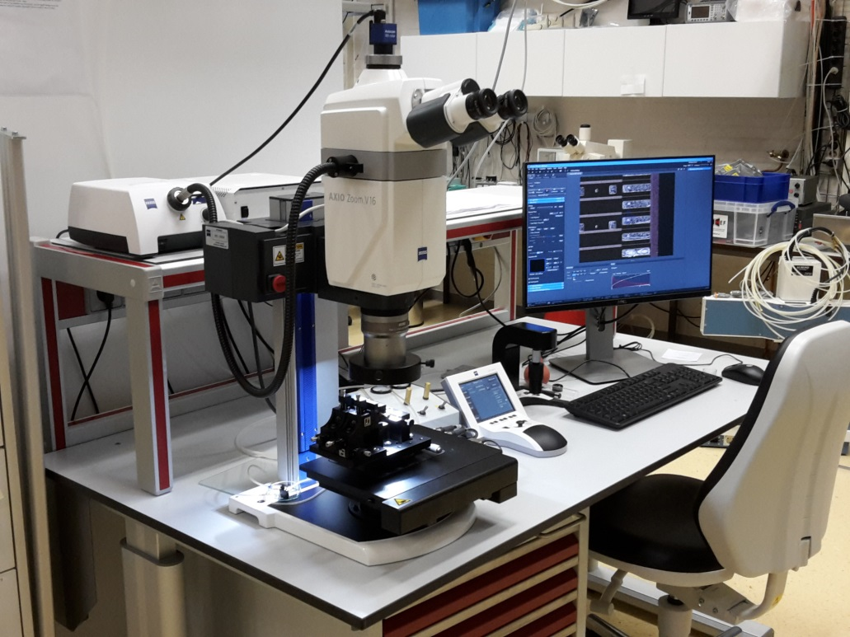
Chip aligment
Semi automatic under LabVIEW
Referring the bonding pads of the chips to the precise edges of the COCA
Aimed accuracy 20 µm in X,Y and Z

Slide 27
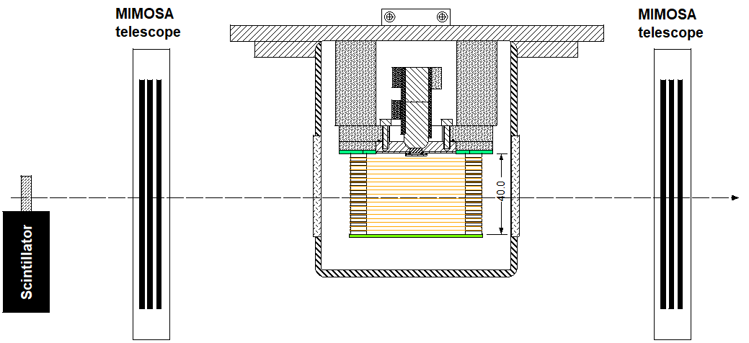
Testbeam setup
*** afstanden geschat ****
QUAD
180 mm
115 mm
Field cage

Slide 28
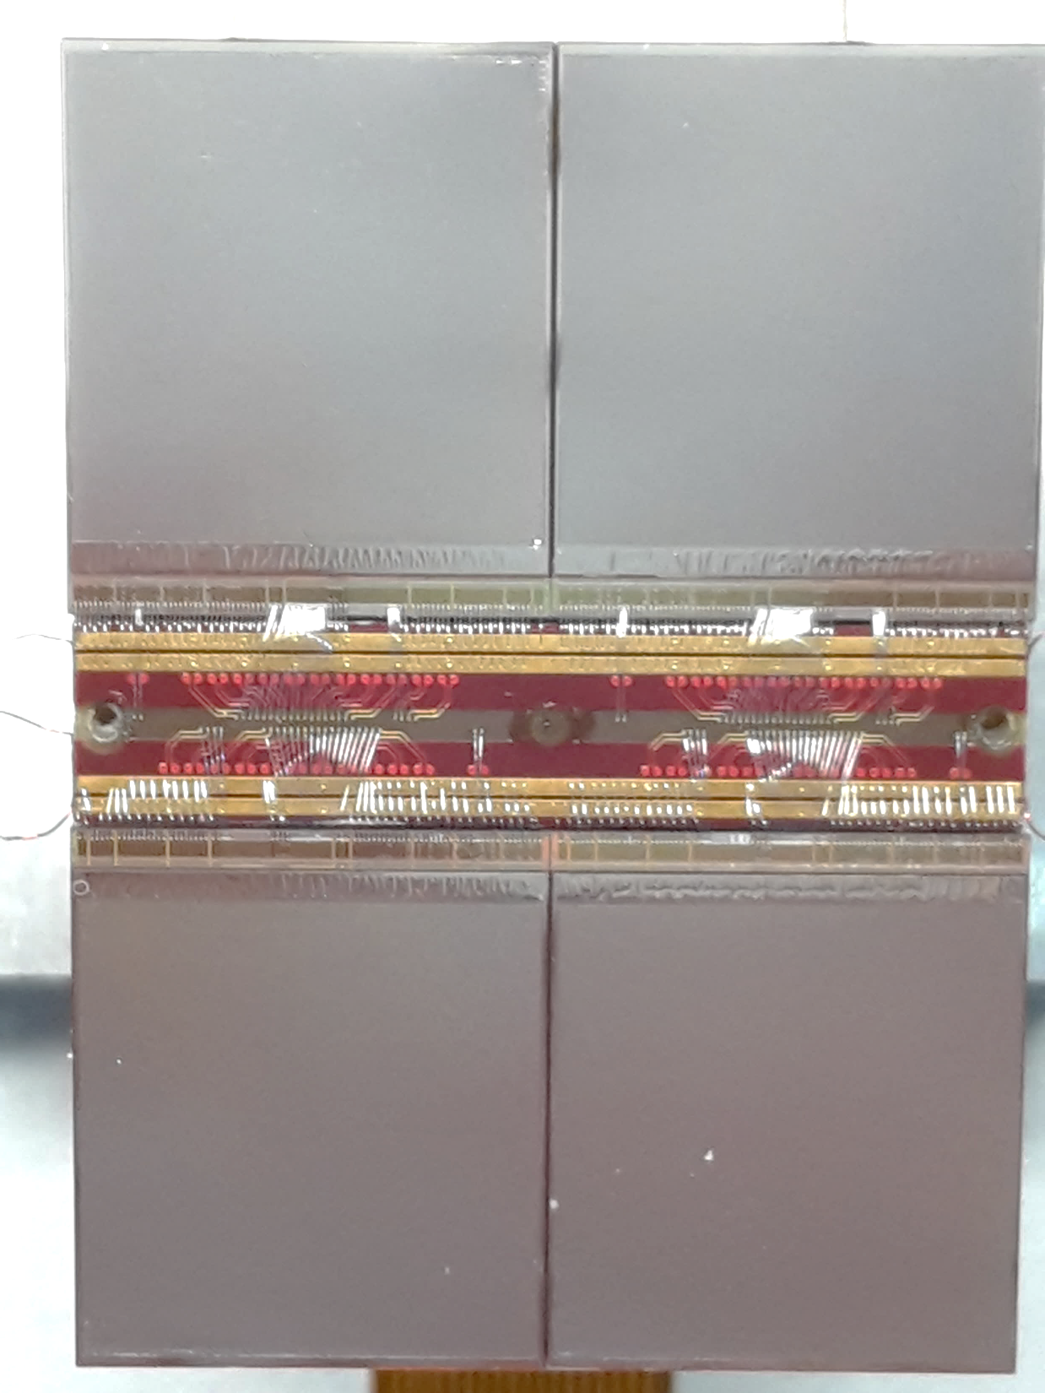
QUAD’s active area
Each chip has 256 x 250 active pixels of 55 x 55 µm
  4 columns of pixels used for dykes
  => 4 x 193.6 = 774.4 mm2 in a QUAD
QUAD’s outer dimensions
  39.60 x 28.38 = 1123.8 mm2
=> QUAD has an active area of 68.9%
By using a possible future through via option, the active area can be increased to 86.4%

Slide 29
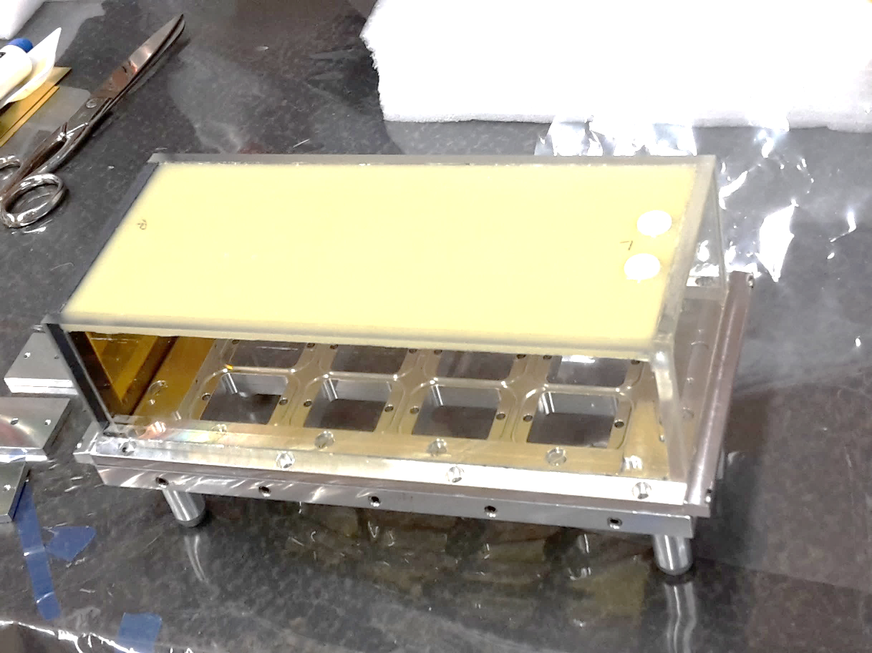
Testbox for 8 QUADs
Being assembled
**** moet nog ander plaatje voor komen***

Slide 30

QUADs being produced in series
Presently a series of 14 QUADs is being produced

Slide 31
New QUAD
Min 70 hits on chip 1&4 or 2&3

Slide 32
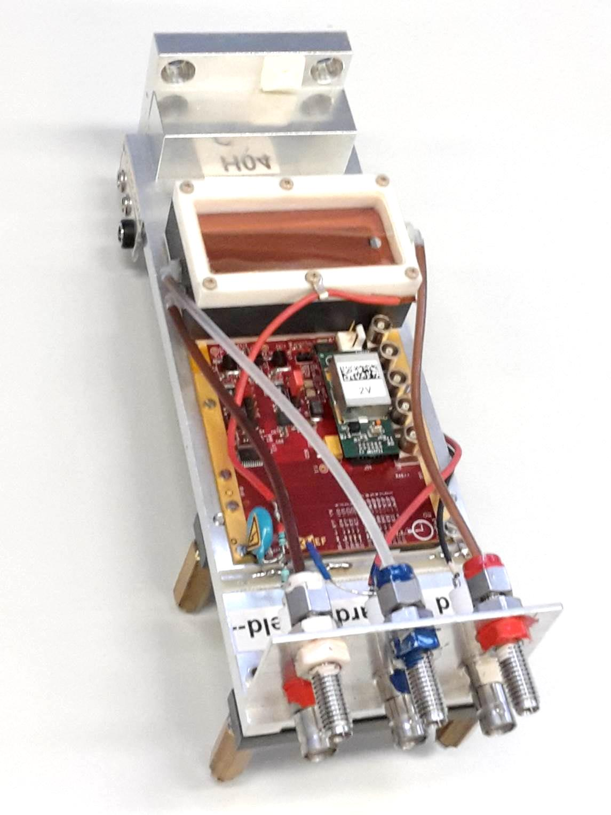
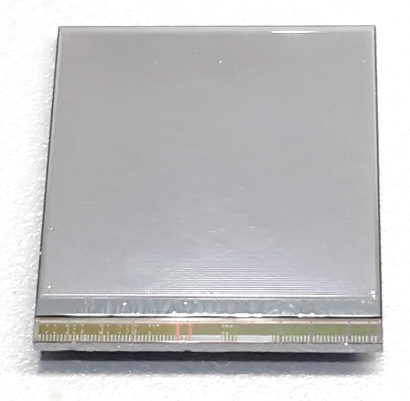
Single chip detector
Very small active area coverage
  1.2% (whole structure)
  2.4% (PCB)
14 mm
14 mm

