Slide 1
Satisfying the Ever Growing Appetite of HEP for HTC
Miron Livny
John P. Morgridge Professor of Computer Science
Center for High Throughput Computing
University of Wisconsin-Madison

Slide 2
Higher luminosity and more complex events drive the LHC appetite for HTC capacity

Slide 3
Exascale (and commercial clouds) is a “phenotype” of the research computing eco-system that is the result of the “expression” of changes in the “genetic code” of funding for HEP computing
Computing constrains Science
Less control (ownership) of the computing environment

Slide 4
“Recommendation 2.2. NSF should (a) … and (b) broaden the accessibility and utility of these large-scale platforms by allocating high-throughput as well as high-performance workflows to them.”

Slide 5
“… many fields today rely on high-throughput computing for discovery.”
“Many fields increasingly rely on high-throughput computing”

Slide 7
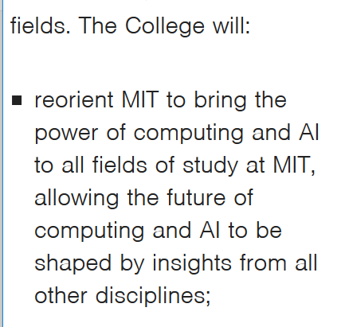

Slide 8
The UW-Madison Center for High Throughput Computing (CHTC) was established in 2006 to bring the power of Distributed High Throughput Computing (HTC) to all fields of study, allowing the future of Distributed HTC to be shaped by insight from other disciplines

Slide 10
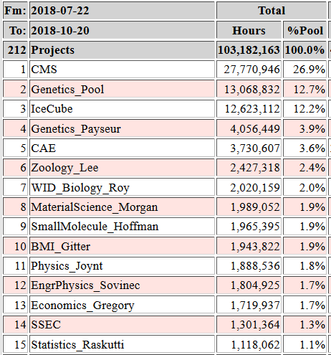
Top 15 projects from latest 90-days report from the CHTC

Slide 11
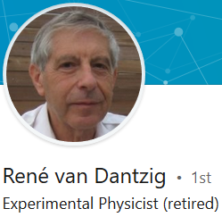
My partnership with HEP computing started in 1990 with an email from
after reading a paper we published in 1988. He basically said “we need what you did and rather than re-doing it ourselves let us collaborate and build on your software!”

Slide 12
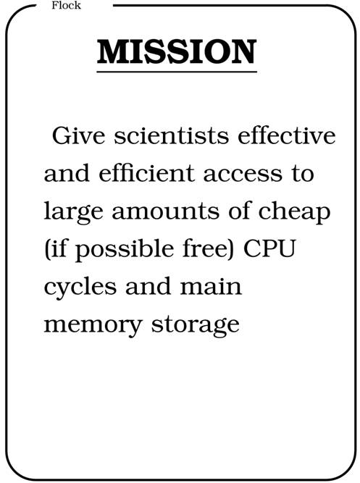
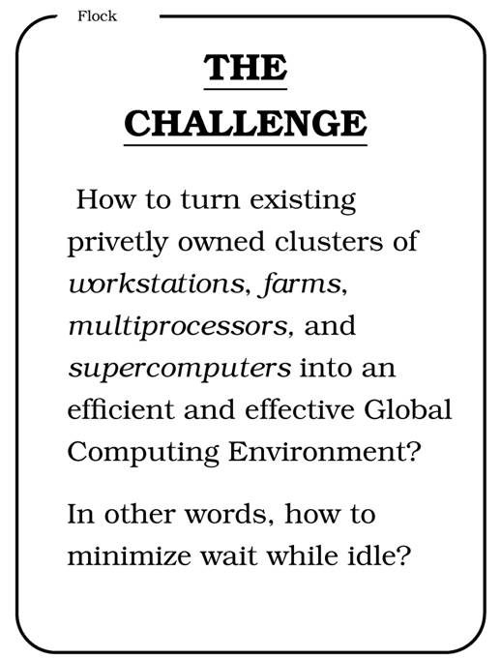
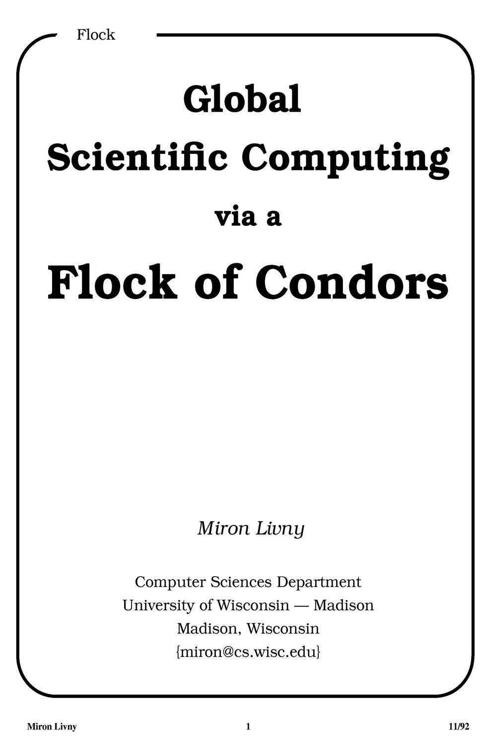
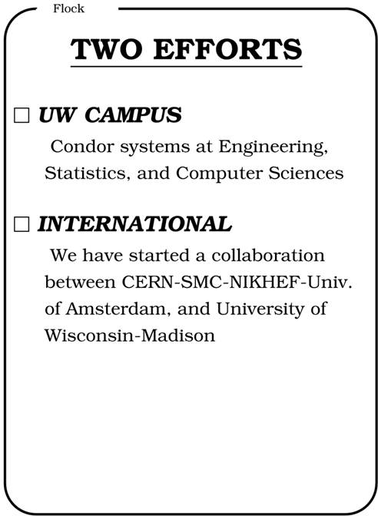
CERN 92

Slide 13
1994 Worldwide Flock of Condors
Delft
Amsterdam
30
200
10
3
3
3
3
Madison
Warsaw
10
10
Geneva
Dubna/Berlin
D. H. J Epema, Miron Livny, R. van Dantzig, X. Evers, and Jim Pruyne, "A Worldwide
Flock of Condors : Load Sharing among Workstation Clusters" Journal on Future
Generations of Computer Systems, Volume 12, 1996

Slide 14
Claims for “benefits” provided by Distributed Processing Systems
P.H. Enslow, “What is a Distributed Data Processing System?” Computer, January 1978
High Availability and Reliability
High System Performance
Ease of Modular and Incremental Growth
Automatic Load and Resource Sharing
Good Response to Temporary Overloads
Easy Expansion in Capacity and/or Function

Slide 15
Definitional Criteria for a Distributed Processing System
P.H. Enslow and T. G. Saponas “”Distributed and Decentralized Control in Fully Distributed Processing Systems” Technical Report, 1981
Multiplicity of resources
Component interconnection
Unity of control
System transparency
Component autonomy

Slide 16
Unity of Control
All the component of the system should be unified in their desire to achieve a common goal. This goal will determine the rules according to which each of these elements will be controlled.

Slide 17
Component autonomy
The components of the system, both the logical and physical, should be autonomous and are thus afforded the ability to refuse a request of service made by another element. However, in order to achieve the system’s goals they have to interact in a cooperative manner and thus adhere to a common set of policies. These policies should be carried out by the control schemes of each element.

Slide 18
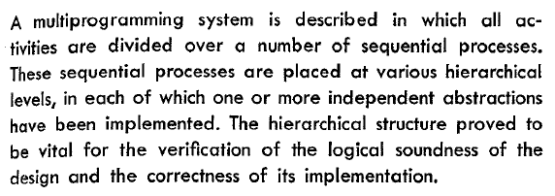

Slide 19
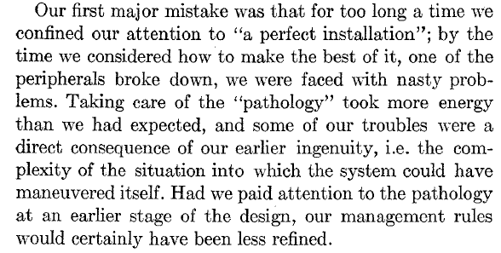
On the second page of the paper …

Slide 21
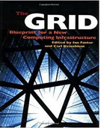
Mechanisms hold the key
The Grid: Blueprint for a New Computing Infrastructure
Edited by Ian Foster and Carl Kesselman
July 1998, 701 pages.

Slide 22
Resource Sharing, Resource Scavenging and the problem of Load Balancing in Distributed Systems

Slide 23
The value of Job Control Languages (JCL)
The power of preemptive- resume mechanisms
Data shipping vs. function shipping
Protection across job lines
Expressing, implementing, debugging, monitoring and understanding policies

Slide 24
It is all about Storage Management, stupid! (Allocate B bytes for T time units)
Miron Livny
John P. Morgridge Professor of Computer Science
Director Center for High Throughput Computing
University of Wisconsin Madison
We do not have tools to manage storage allocations
We do not have tools to schedule storage allocations
We do not have protocols to request allocation of storage
We do not have means to deal with “sorry no storage available now”
We do not know how to manage, use and reclaim opportunistic storage
We do not know how to budget for storage space
We do not know how to schedule access to storage devices

Slide 25
On The Fly Capacity Planning

Slide 27
Expanding our GPU capacity
UW
grid
condor_annex
Cooley

Slide 28
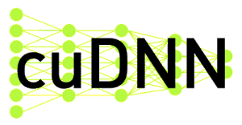
Software dependencies
Chemical screening software
System
libraries
NVIDIA driver XXX.YY

Slide 30
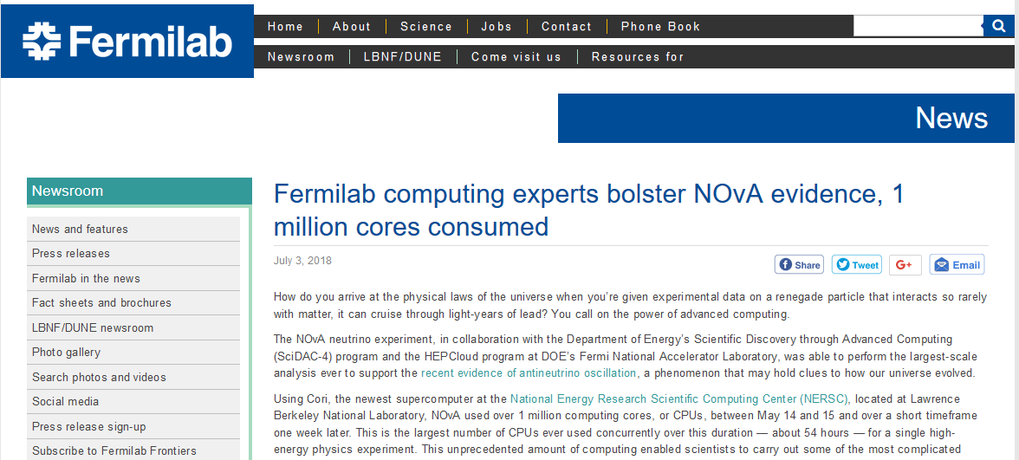

Slide 31
Phython Notebooks, the return of the interactive workload

Slide 32
How to bring HTC to Jupyter Notebooks*?
Researchers want to “live” in a notebook
Interactive nature of the notebook vs. the batch nature of HTC
Shared everything notebook environment vs. shared nothing approach of (distributed) HTC
Is the Python MAP function the right abstraction for bags of HTC tasks?
* NOT the same as a Python binding

Slide 33
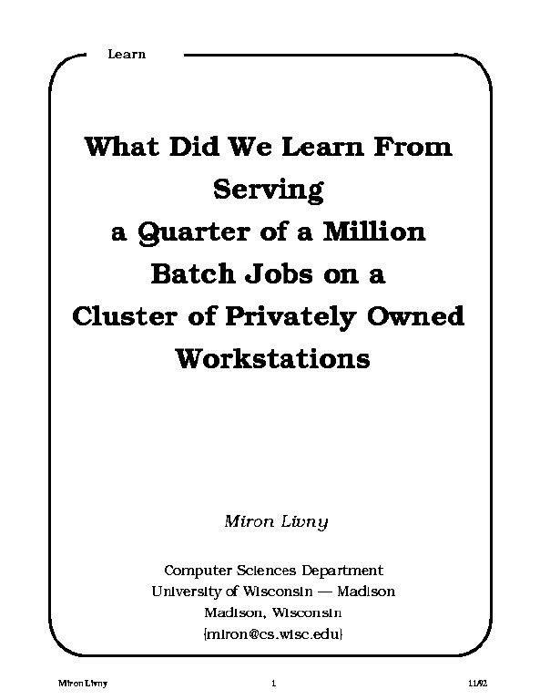
1992

Slide 34
Submit locally (queue and manage your jobs/tasks locally; leverage your local resources) and run globally (acquire any resource that is capable and willing to run your job/task)

Slide 35
Job owner identity is local
Owner identity should never “travel” with the job to execution site. Namely trust should be established at the level of service providers.
Owner attributes are local
Name spaces are local
File names are locally defined. They can be part of a distributed federation.
Resource acquisition is local
Submission site (local) is responsible for the acquisition of all resources – local and remote.

Slide 36
“external” forces moved us away from this “pure” local centric view of the distributed computing environment.
With the help of capabilities (short lived tokens) and reassignment of responsibilities we are committed to regain full local control.
Handeling users with money (real or funny) to acquire commuting resources helps us move (push) in this positive direction.

Slide 37
Master-Worker Applications

Slide 38
Clean separation between resource allocation (deployment of workers) and work delegation (assignment of tasks)
Management and deployment of workers is (typically) external to the application
Assumes on-the-fly deployment of workers (DevOps) and remote access to data
Built in fault recovery
Built in elasticity
Master can follow a scheduling policy when selecting work for execution

Slide 39
And what if the Worker is a (little) Master?

Slide 40
Addresses connectivity challenges between workers and (top) Master
Helps with storage allocation and data placement management
Supports scale out of Master duties
Promotes group of jobs/tasks into higher level structures

Slide 41
Some HTC applications may have job interdependencies that form (complex and/or very large) workflows
Directed Acyclic Graphs (DAGs) effectively capture job interdependencies
Workflows are restartable and recoverable
Workflows can be recursive

Slide 42
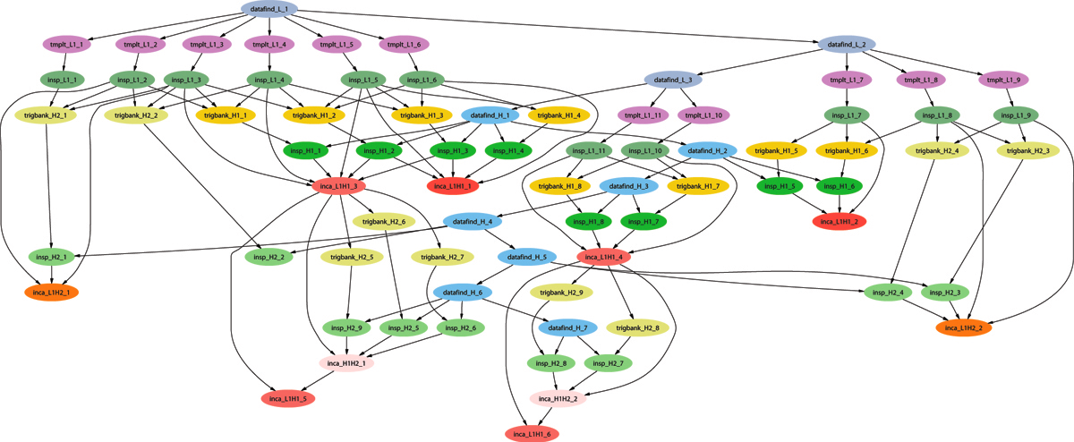
Example of a LIGO Inspiral DAG (Workflow)

Slide 43
The advantages and challenges of “remote I/O” in a distributed environment
Instrumentation/configuration of worker nodes to support remote access to data/storage
Management of I/O capacity of shared data servers
How to use/leverage data placement and data caching?

Slide 44
In 1996 I introduced the distinction between High Performance Computing (HPC) and High Throughput Computing (HTC) in a seminar at the NASA Goddard Flight Center in and a month later at the European Laboratory for Particle Physics (CERN). In June of 1997 HPCWire published an interview on High Throughput Computing.

Slide 45
Obstacles to HTC
Ownership Distribution
Size and Uncertainties
Technology Evolution
Physical Distribution
(Sociology)
(Robustness)
(Portability)
(Technology)
1997

Slide 46
High Throughput Computing requires automation as it is a 24-7-365 activity that involves large numbers of jobs and computing resources
FLOPY ≠ (60*60*24*7*52)*FLOPS
100K Hours*1 Job ≠ 1 H*100K J

