Slide 1

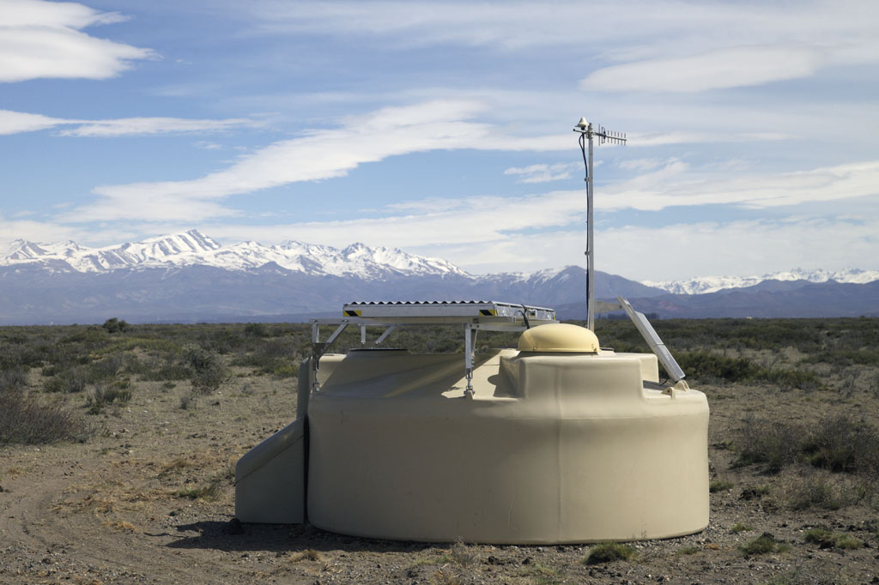

Ultra-high-energy cosmic rays introduction & status
Sijbrand de Jong
Nikhef Jamboree 2018 (SdJ)

Slide 2
Nikhef Cosmic Ray Crew:
Staff: Jörg Hörandel, Sijbrand de Jong, Heino Falcke, Cristina Galea (2019, RU)
Charles Timmermans (Nikhef), Olaf Scholten (RuG)
Ad van den Berg (RuG, until summer 2018) Jacco Vink (UvA, from 2018)
Postdoc: Arjen van Vliet (NWO-ENW, until summer 2018)
PhD students: Fabrizia Canfora, Giuseppe de Mauro, Mart Pothast (Nikhef),
Alexander Aab (RU), Bjarni Pont (NWO-Top)
Engineers: Auke Korporaal, Hans Verkooijen (Nikhef),
Arno Engels, Peter Dolron, Rene Habraken, Roel Jordans,
Daniel Szalas, Gerben Wulterkens (RU)
Technicians: Lesley Room, Eithel Delle/Sirous Alai Nasab (Nikhef)

Slide 3
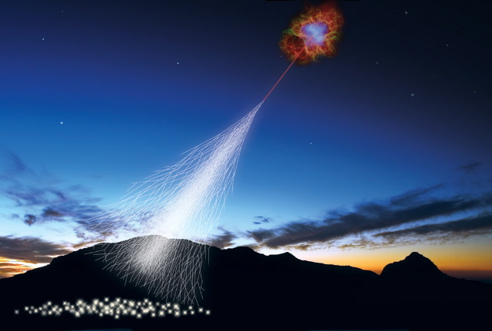
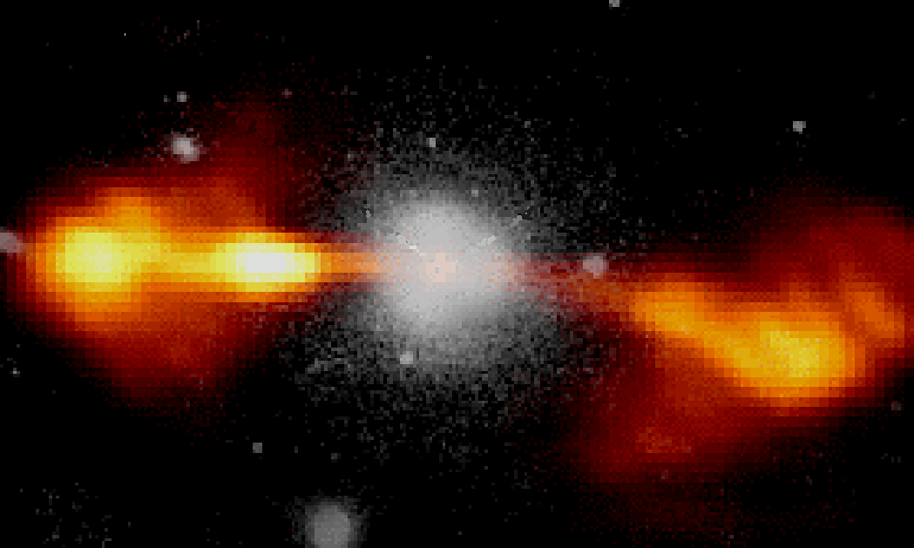
Ultra-High-Energy Cosmic Rays
Particle interactions
at the highest energy
ever seen
Origin of highest-energy
particles in the Universe
?
?
Particle type is the key !
We developed the detector !

Slide 4
Cosmic Rays in the Universe
10²⁰ eV
Proton
10²⁰ eV
Iron

Slide 5
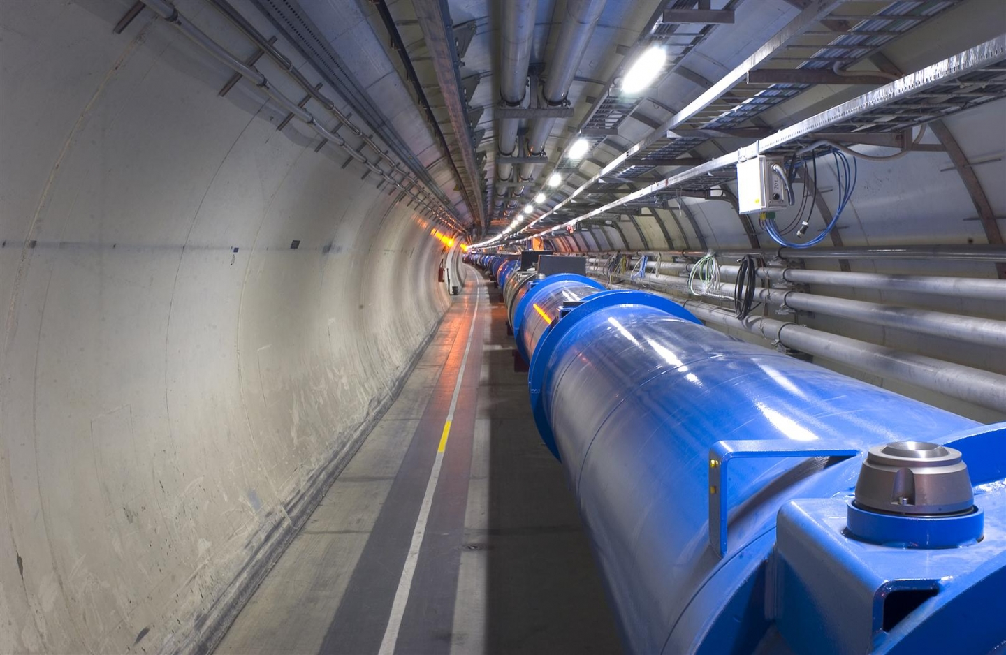
Particle interactions at 60x the LHC energy
Need to know the “beam” particle
Far
Future
Circular
Collider

Slide 6
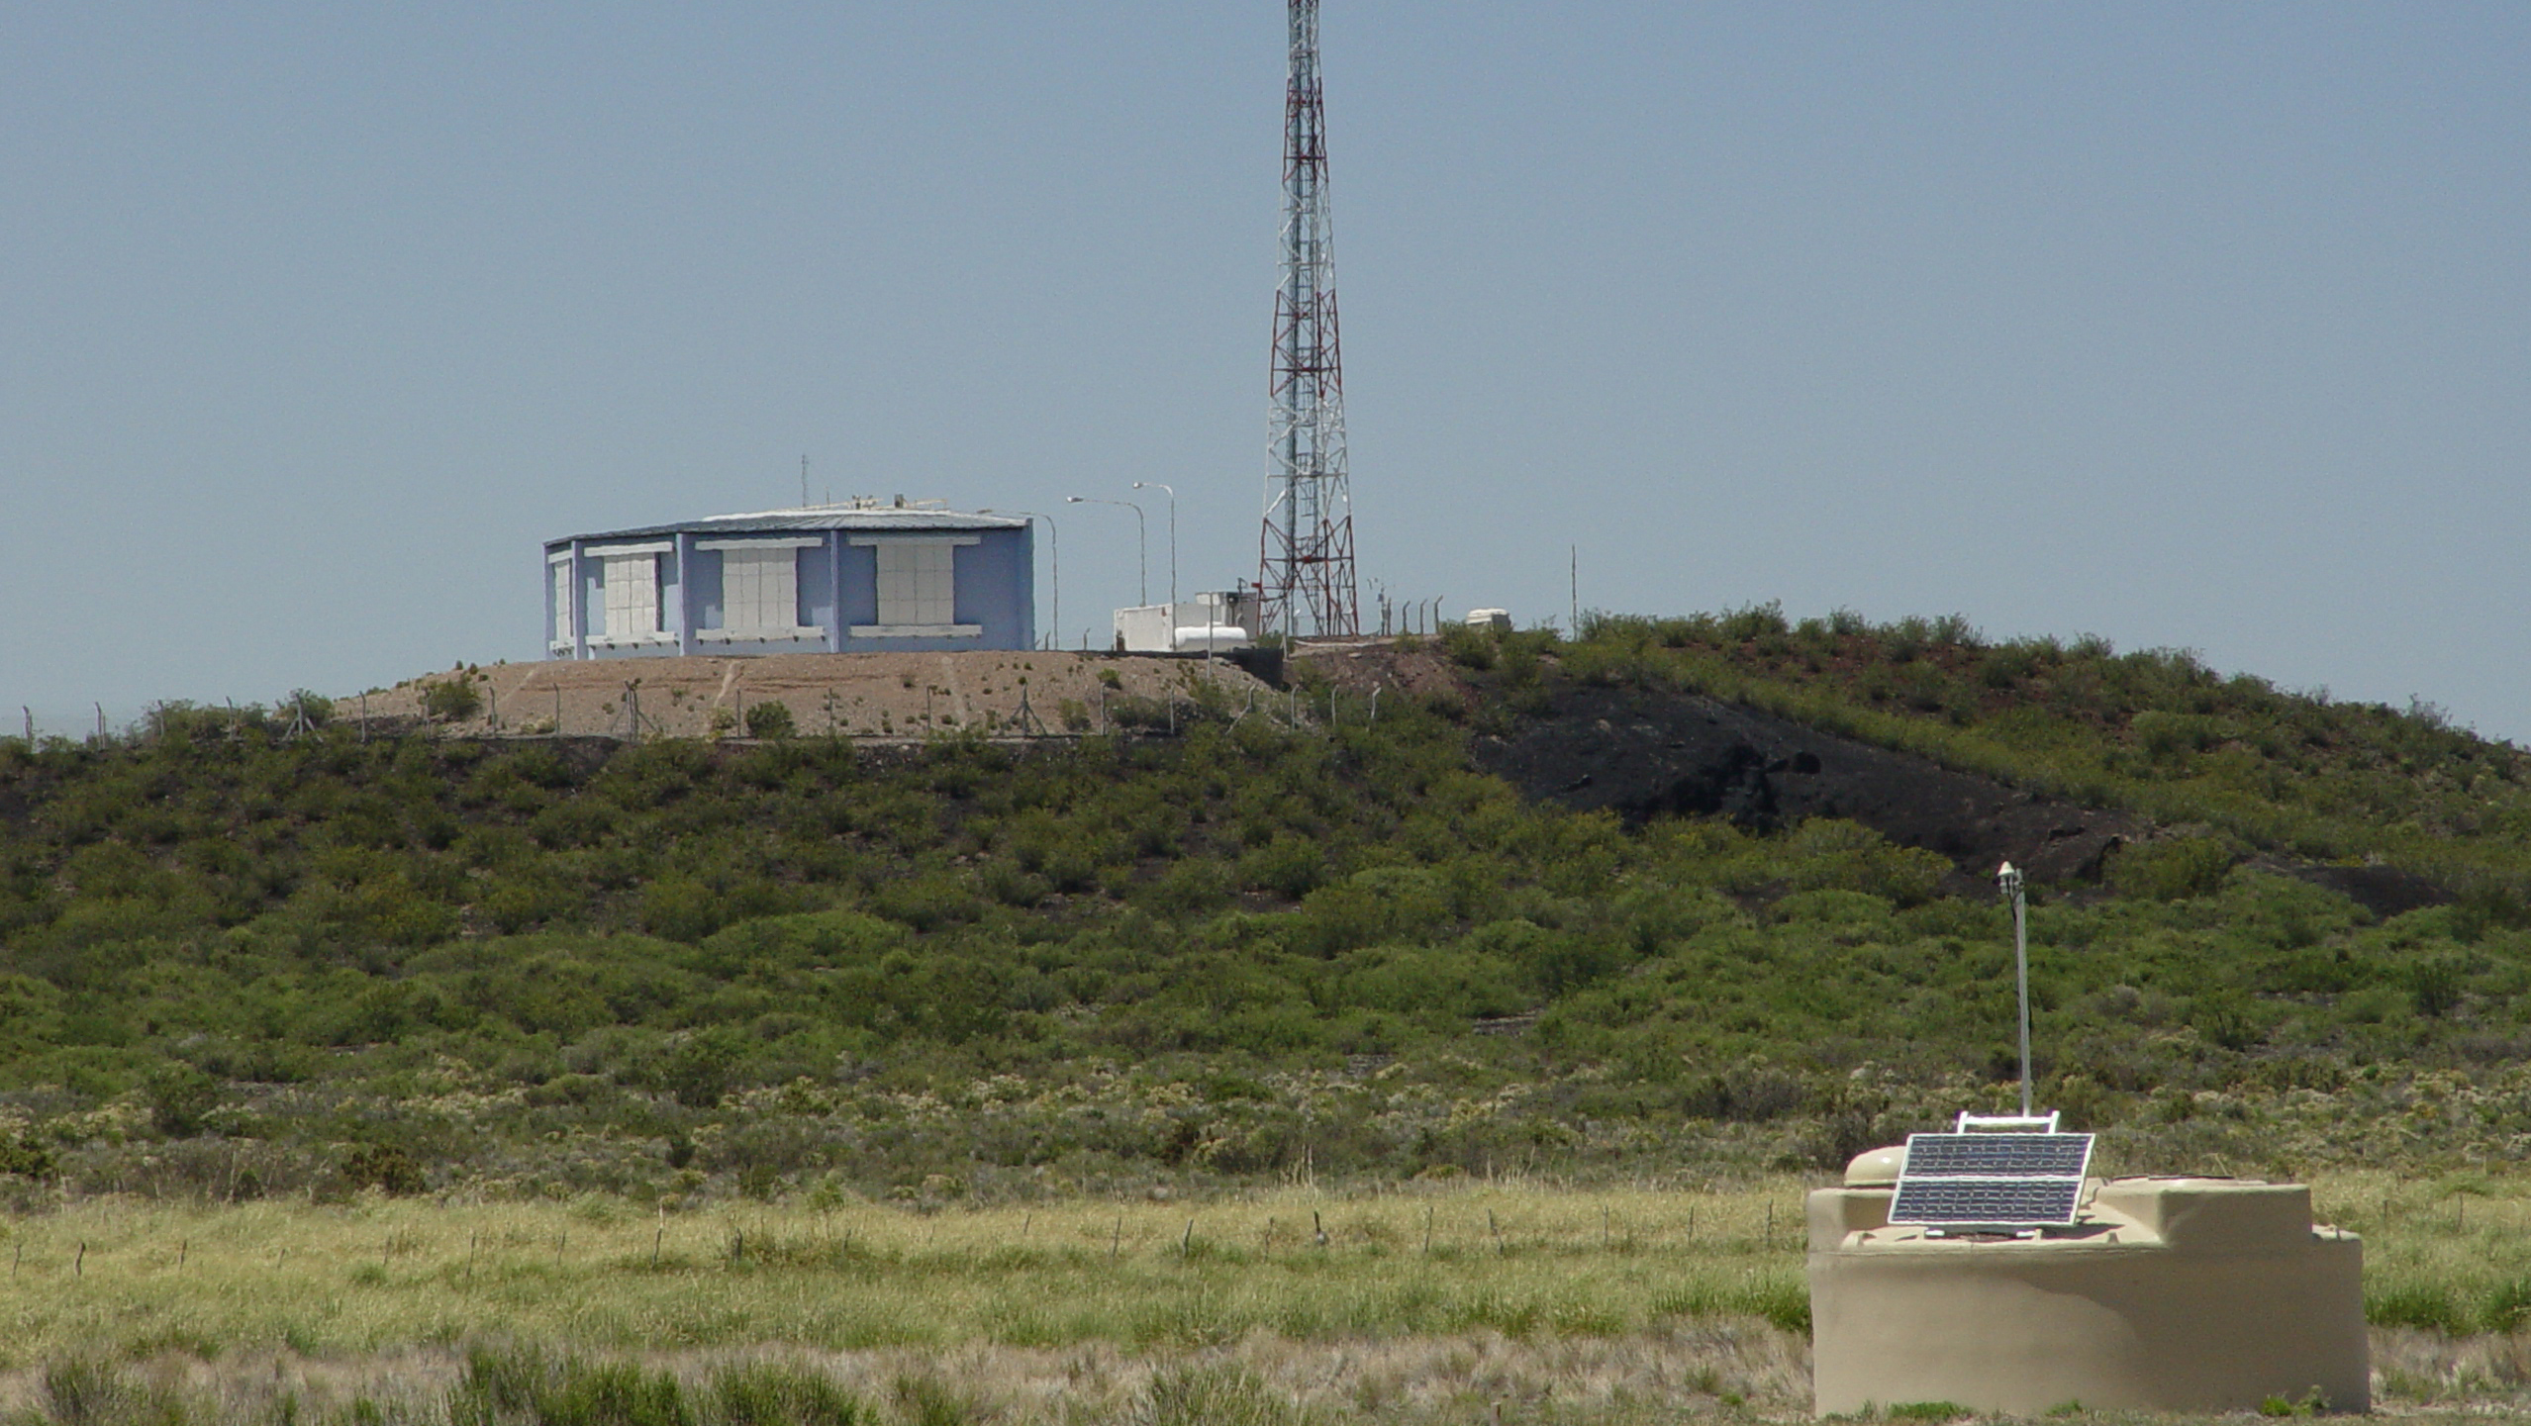
The Pierre Auger Observatory

Slide 7

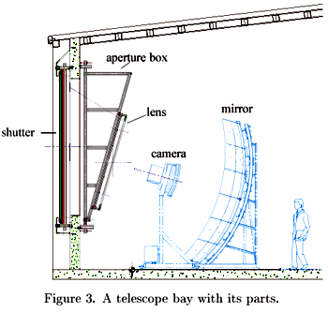
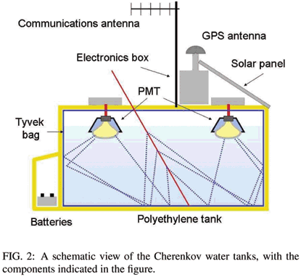
Pierre Auger Observatory
Cosmic Ray
X_{max}
State-of-the-art: FD
Energy, direction & particle type
X_{max} using fluorescence light σ(X_{max}) = 20 g/cm²
fluorescence
light
mirror
camera
# particles
50x60 km = Dutch province
Only in dark nights
10% duty cycle
SD measures only
tail of shower
Energy & direction
100% duty cycle

Slide 8
New Detector Concept
Cosmic Ray
X_{max}
State-of-the-art: FD
Energy, direction & particle type
X_{max} using fluorescence light σ(X_{max}) = 20 g/cm²
New: RADIO
Energy, direction &
particle type
complementary to SD
100% duty cycle
particle type
radio
fluorescence
light
mirror
camera
# particles
radio
Only in dark nights
10% duty cycle
10% duty cycle
SD measures only
tail of shower
Energy & direction
100% duty cycle

Slide 9
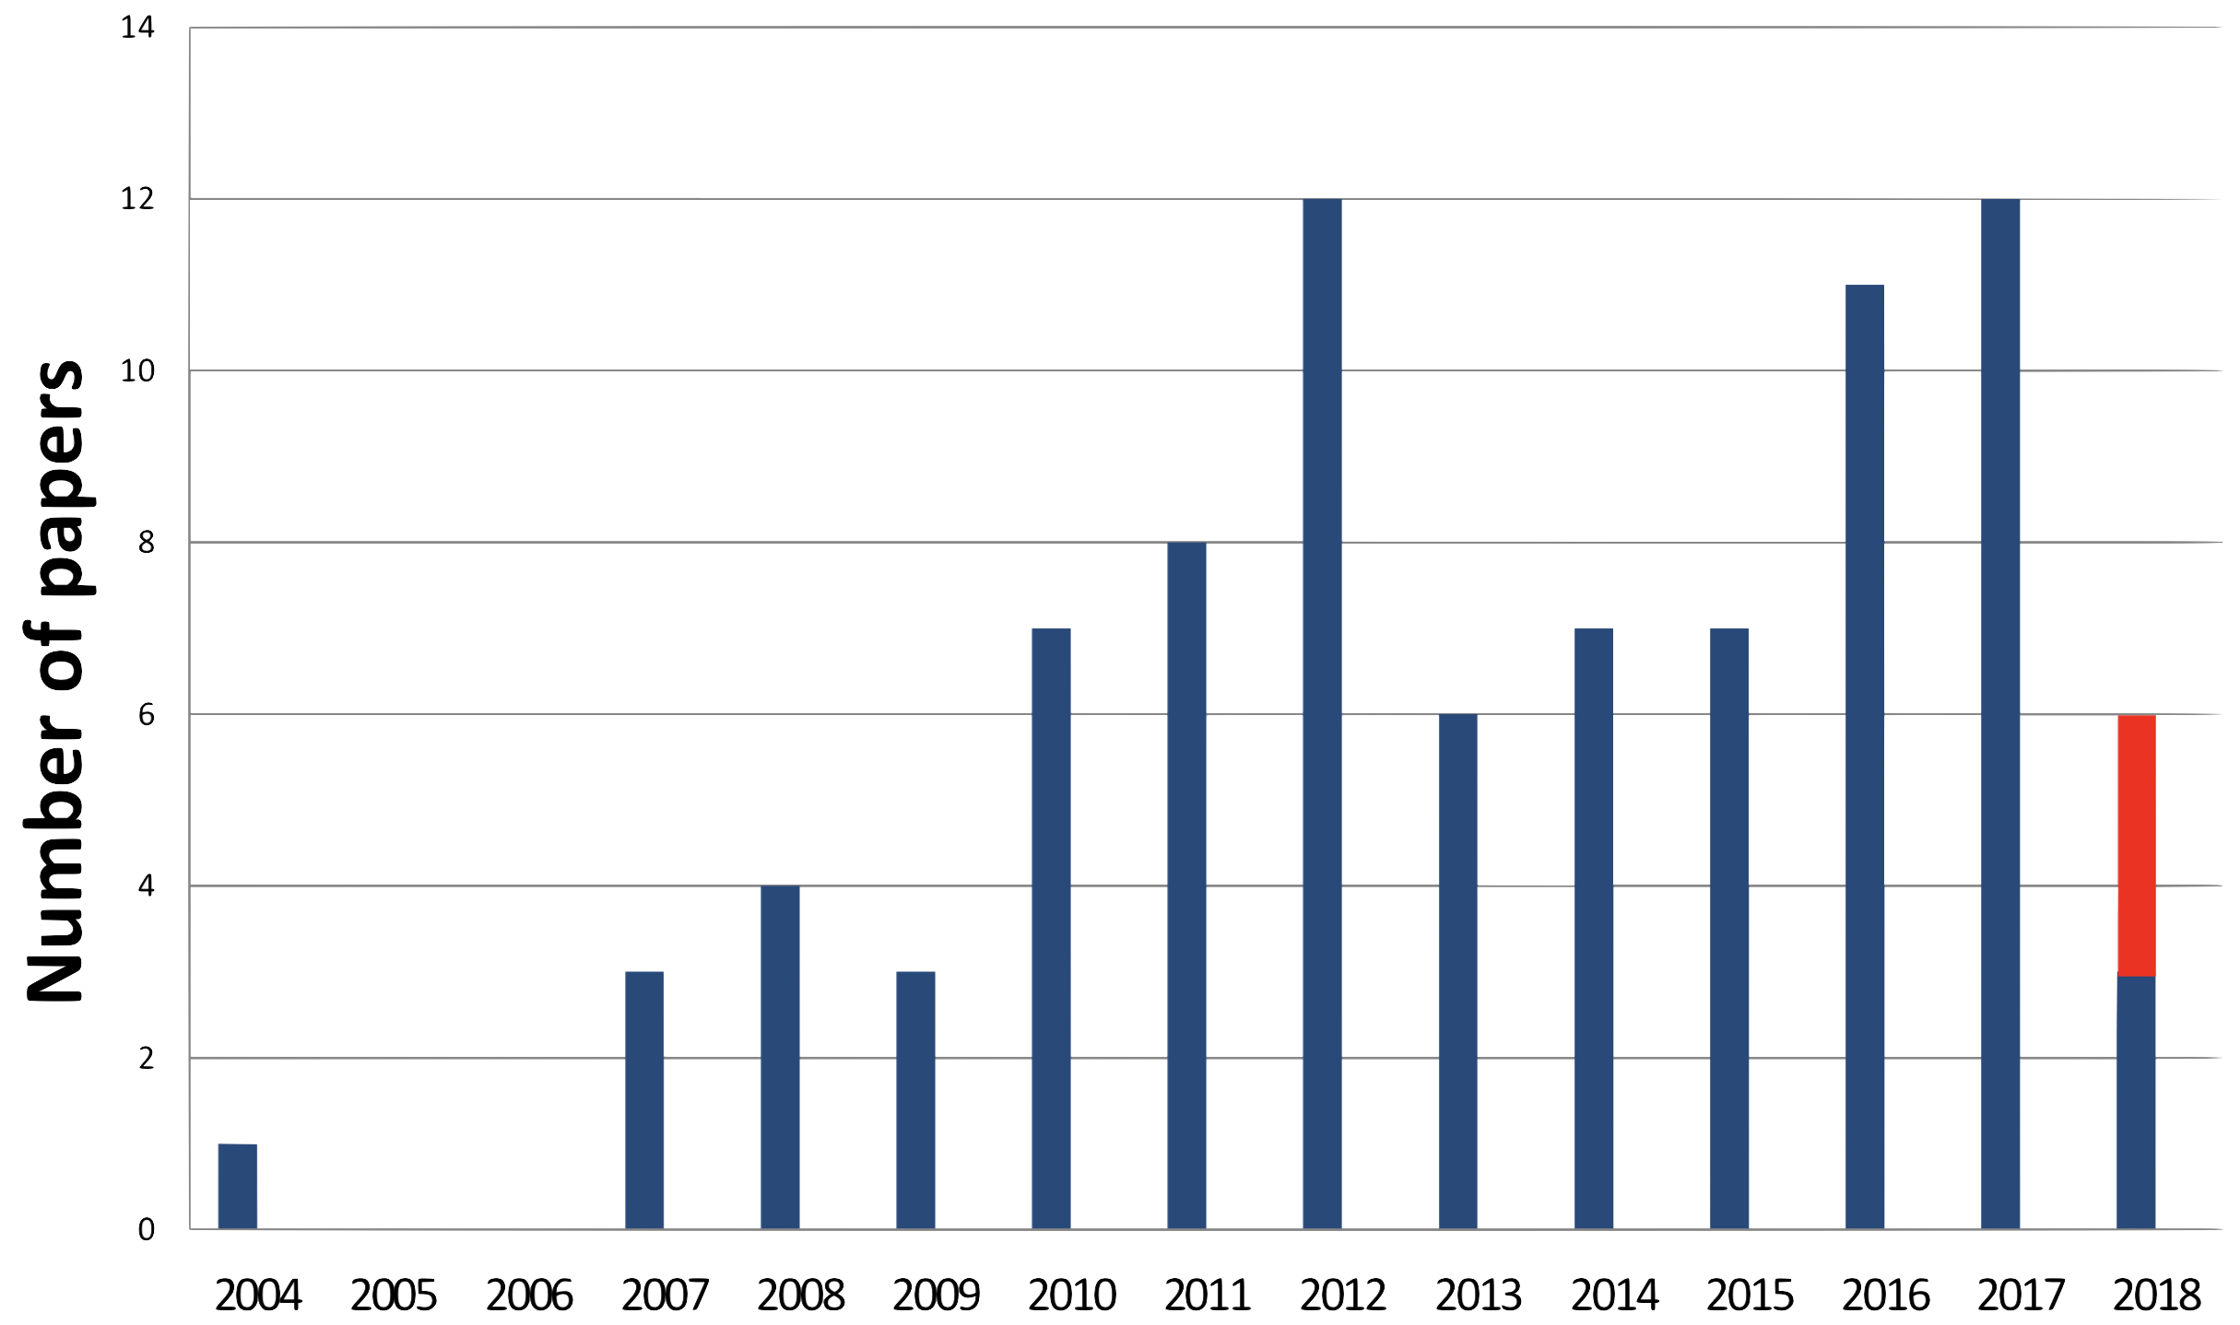
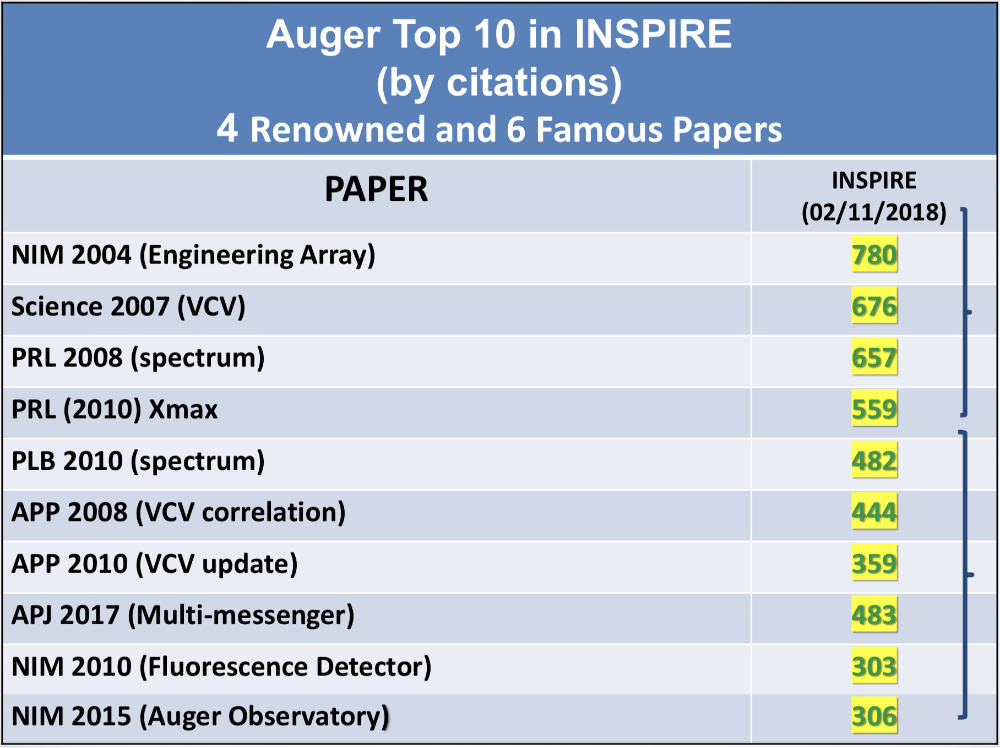
Recent Pierre Auger Observatory Results
+22 Conference Proceedings

Slide 10
Recent Pierre Auger Observatory Results
Auger concentrates on high-level analysis and interpretation:
Large-scale cosmic-ray anisotropies above 4 EeV measured by the Pierre Auger Observatory
Observation of inclined EeV air showers with the radio detector of the Pierre Auger Observatory (see Jörg’s talk)
An Indication of Anisotropy in Arrival Directions of Ultra-high-energy Cosmic Rays through Comparison to the Flux Pattern of Extragalactic Gamma-Ray Sources
Nikhef analyses:
SSD time trace analysis (Giuseppe, Alexander, Mart, Charles);
AERA analysis (see Fabrizia’s talk + Bjarni, Charles, Jörg, Sijbrand)

Slide 11
Global picture of recent Auger results
Two scenarios
Maximum acceleration Cosmic Horizon
Upgrade
Upgrade
N
p
N
p
He
Fe
Fe
He

Slide 12
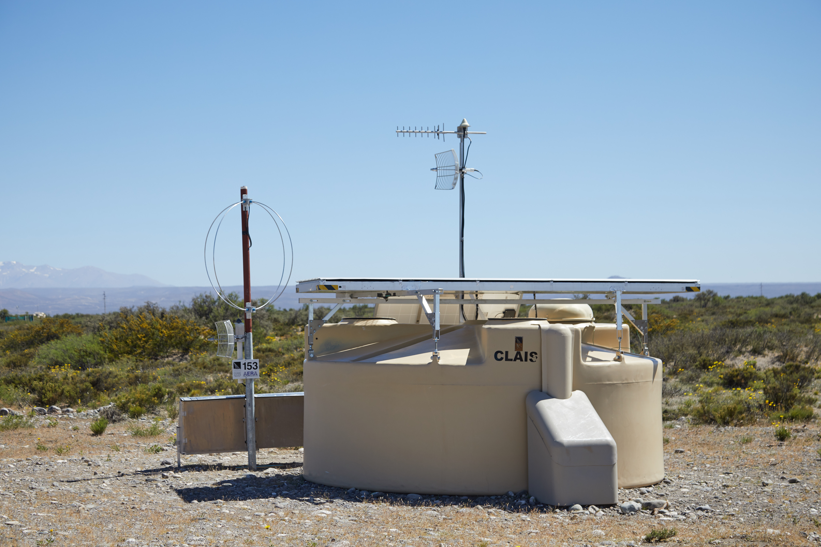

Measure particle type at highest energies
combination gives
e and μ separately
total # e
e + μ in
shower tail
total # e
See talk by Jörg Hörandel
μ in
shower
tail
a e + b μ
in shower tail

Slide 13
SSD: Scintillator Surface Detector
Major Nikhef design input: A. Korporaal is lead designer
1300 modules to be produced in:
Karlsruhe, Lecce, Cracow, Aachen, Grenoble, Nijmegen
Looking for funding for 400 more modules
135 modules (10%) in NL in period 1/1/2018 – 30/6/2019
1300 mounting frames produced in NL Industry (MCB)
1st container transport from NL to Malargüe on 20/9/2018
2nd container transport from NL to Malargüe on 14/1/2019
3rd and final transport planned end May 2019

Slide 14
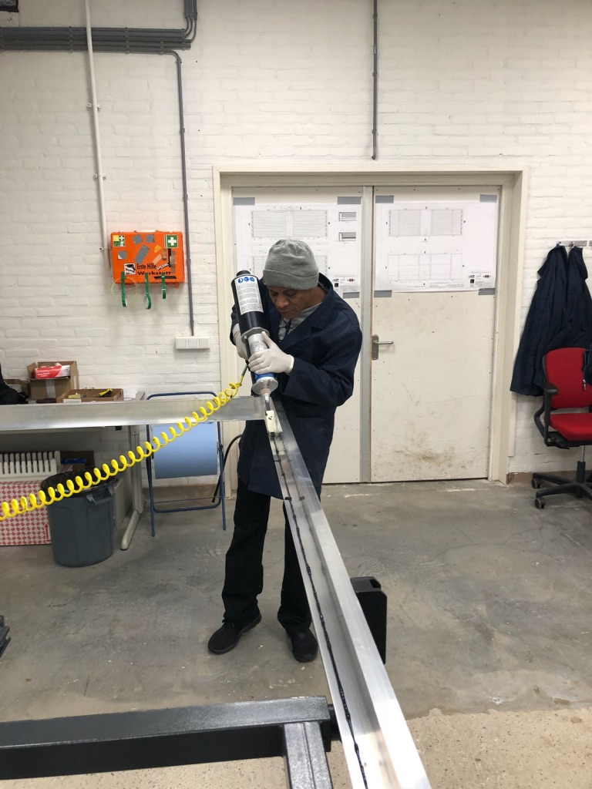
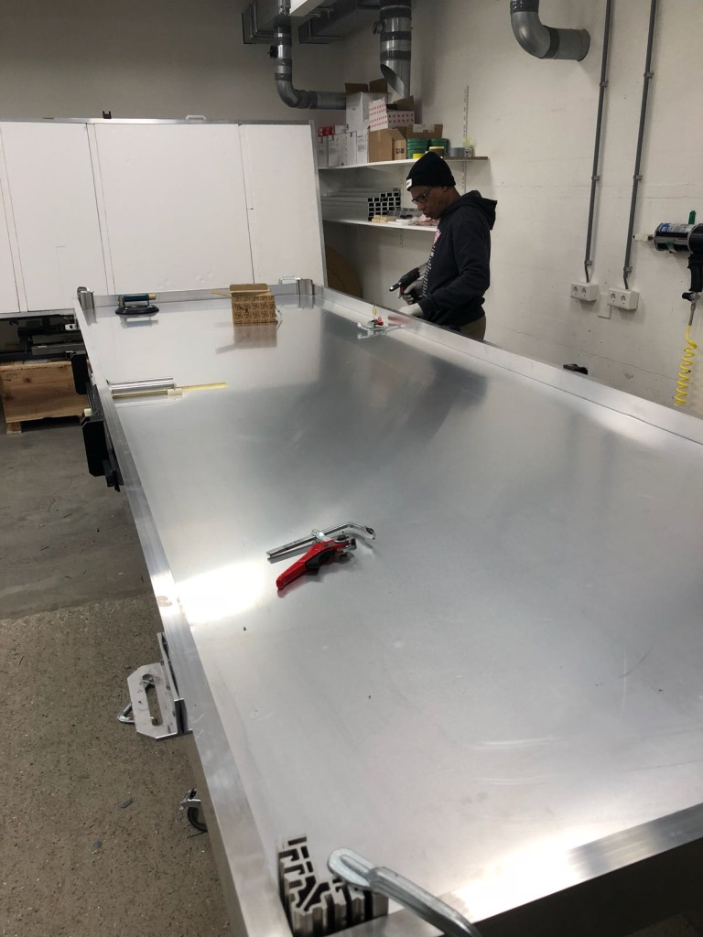
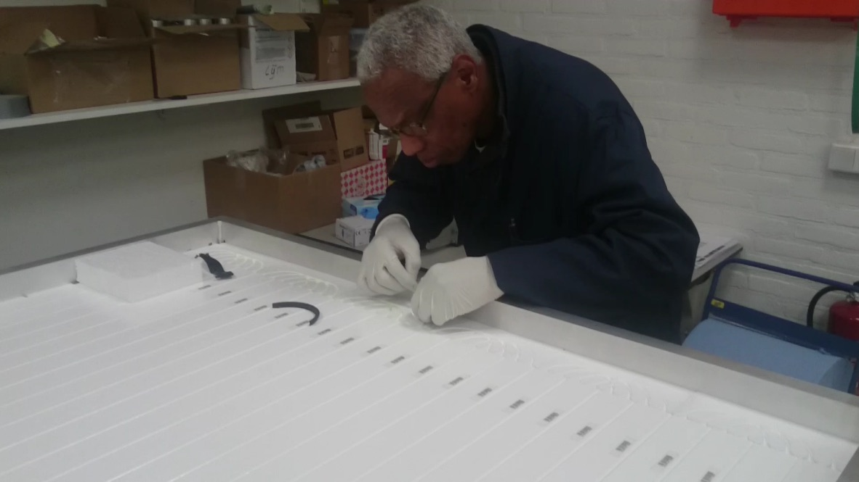
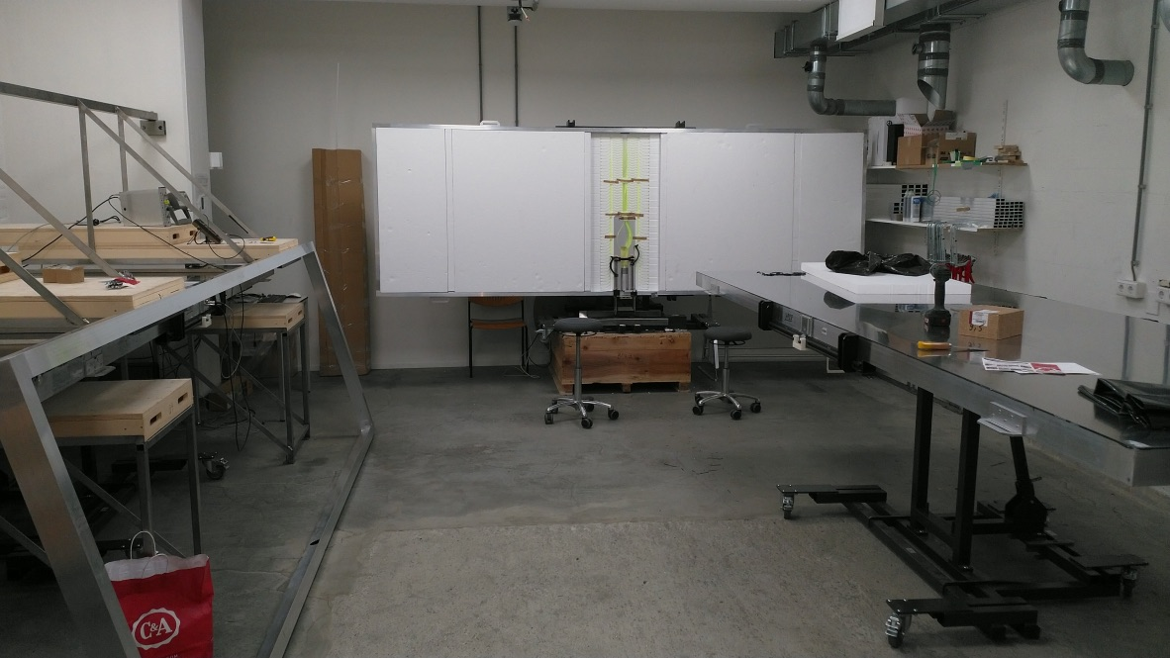
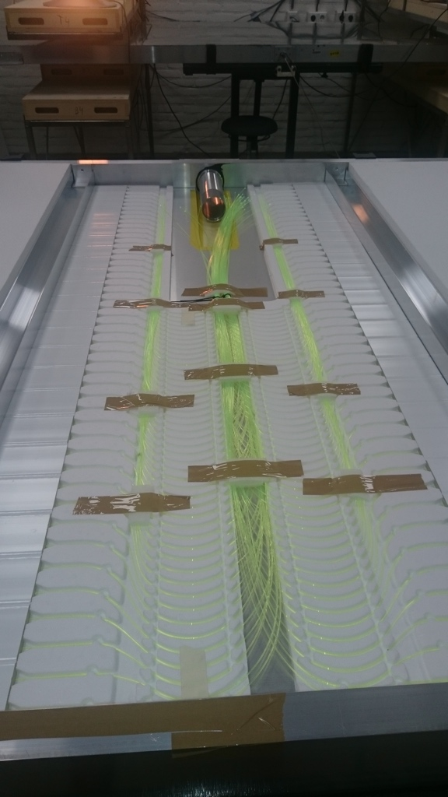
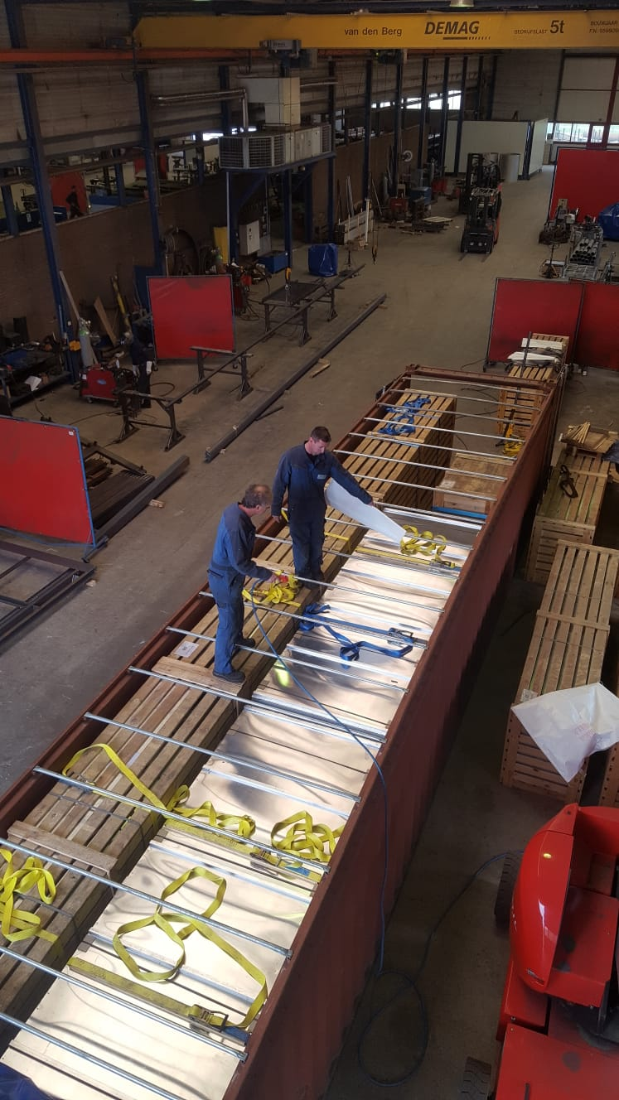
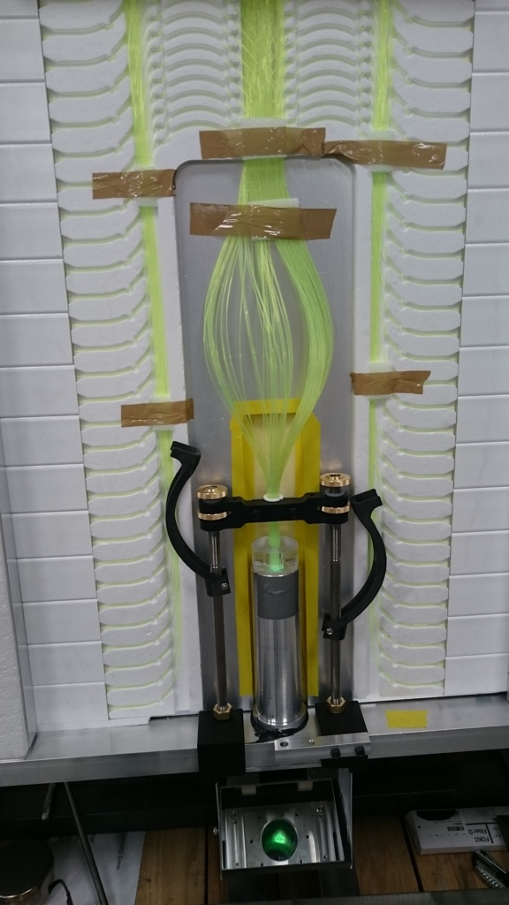
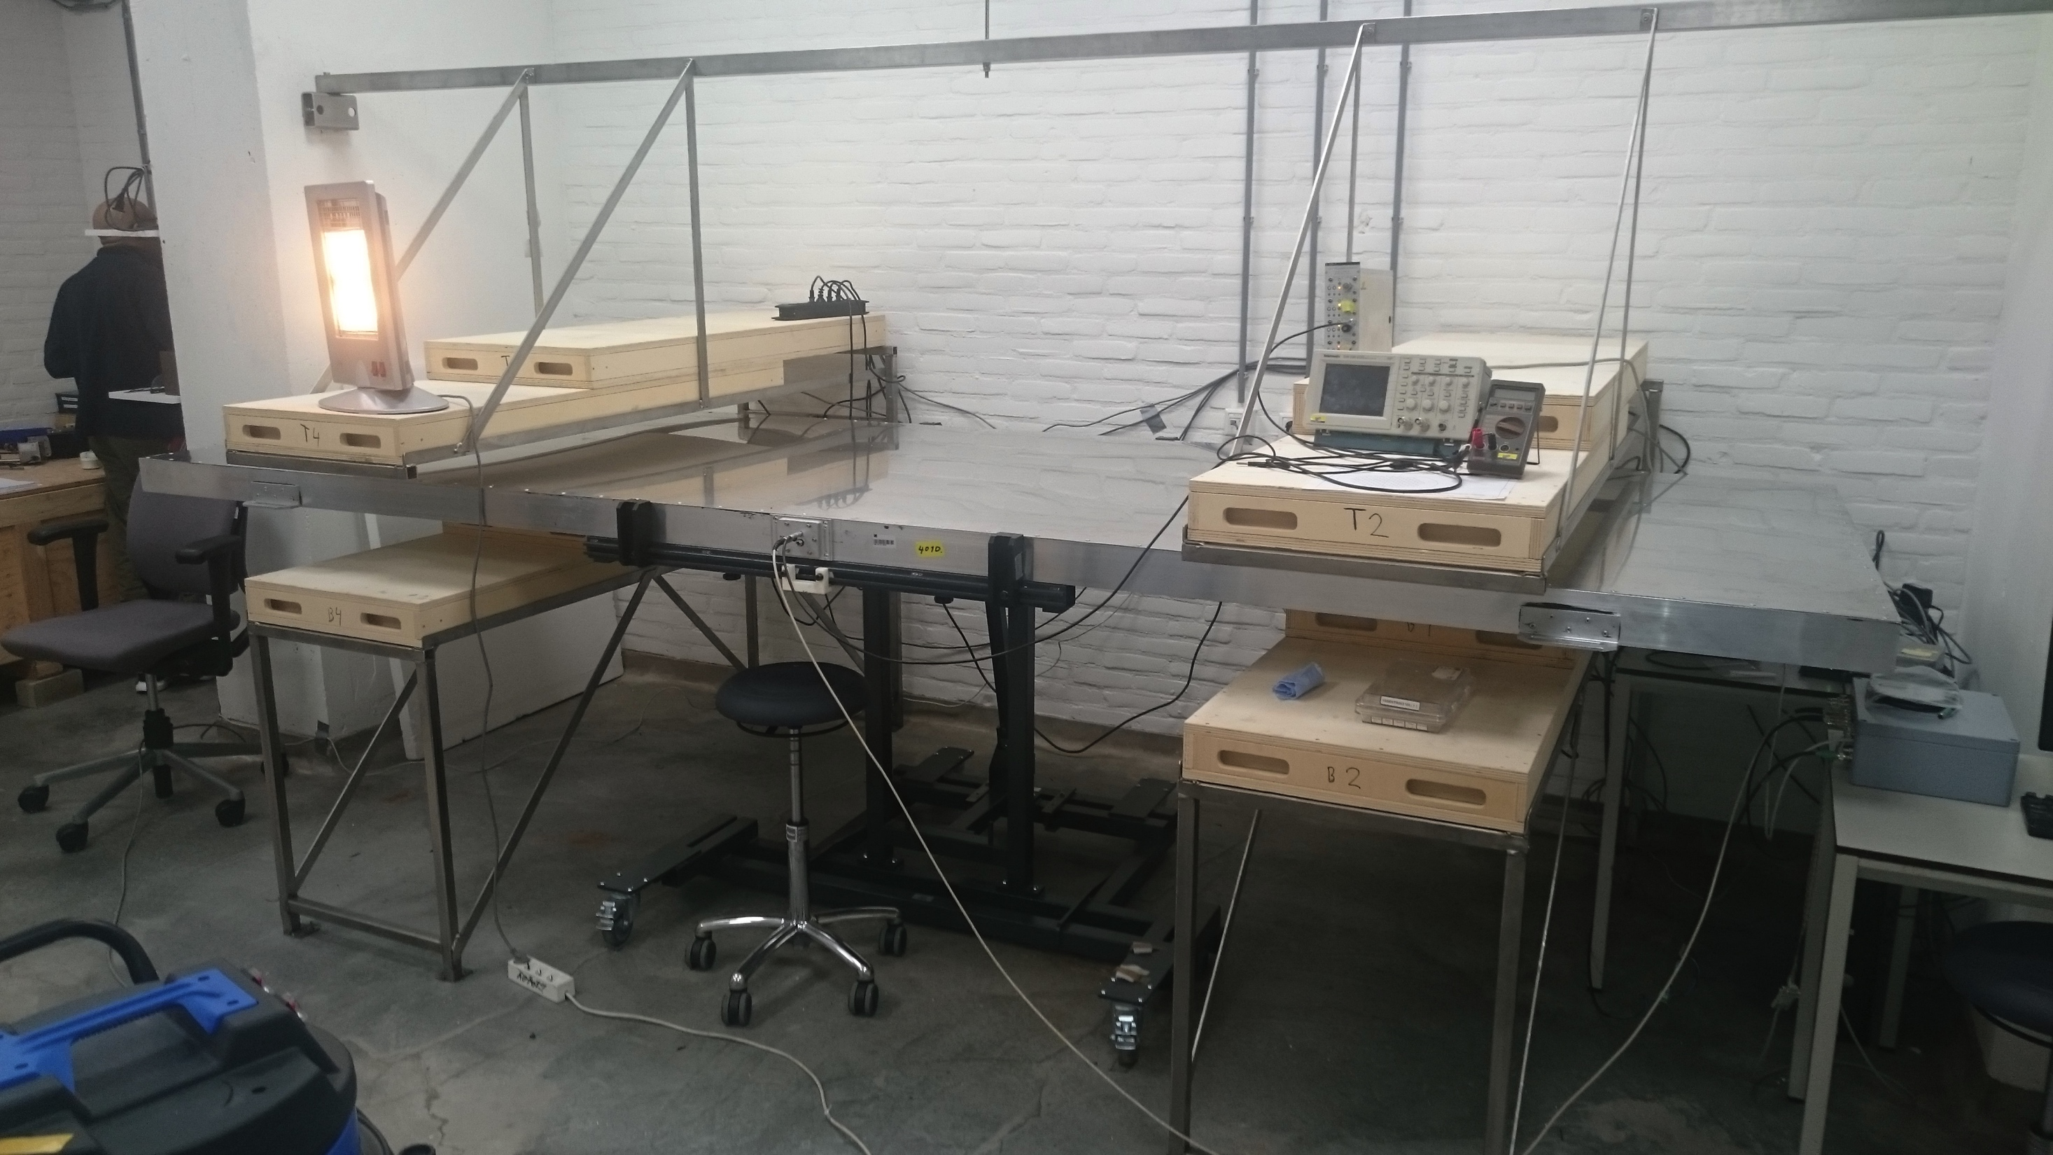
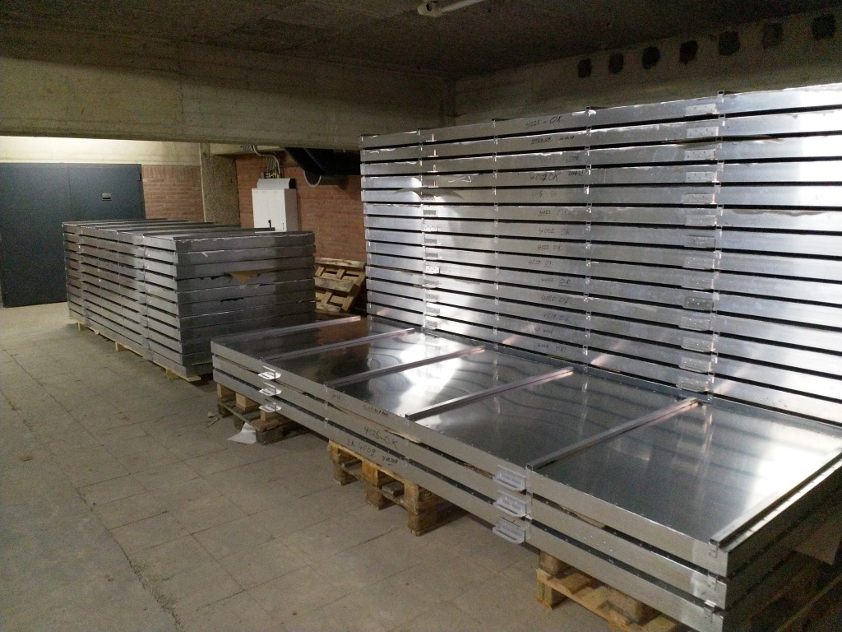
Scintillator Surface Detector

Slide 15
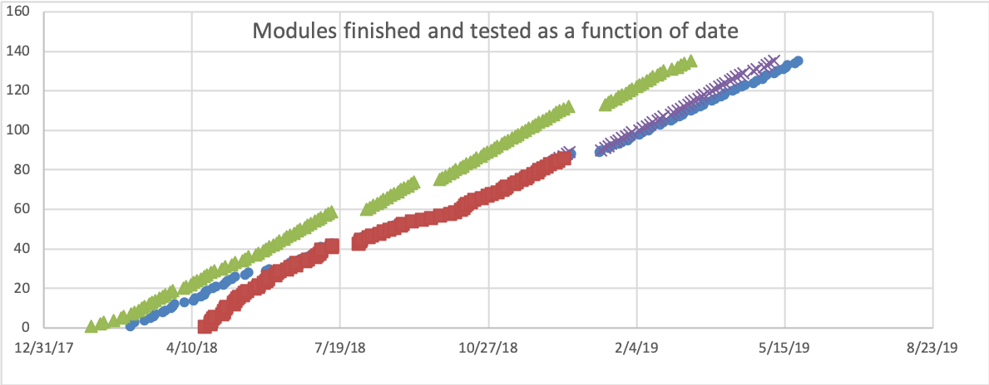
SSD Production in Nikhef/Nijmegen
Optimistic
Original plan
Pessimistic
prognosis
Eithel -> Sirous
Production finished by
end May 2019
Christmas
break
Re-testing Period
Realized production
87/135 modules done
Production Set-up
Summer
holidays

Slide 16
SSD deployment at Auger

Slide 17
Further future: UHE Neutrino radio detection
Neutrino
interaction
Tau decay
Radio frequency signal
Cosmic
neutrino
Air shower
Detection antennas
Giant Radio Array Neutrino Detector: GRAND

Slide 18
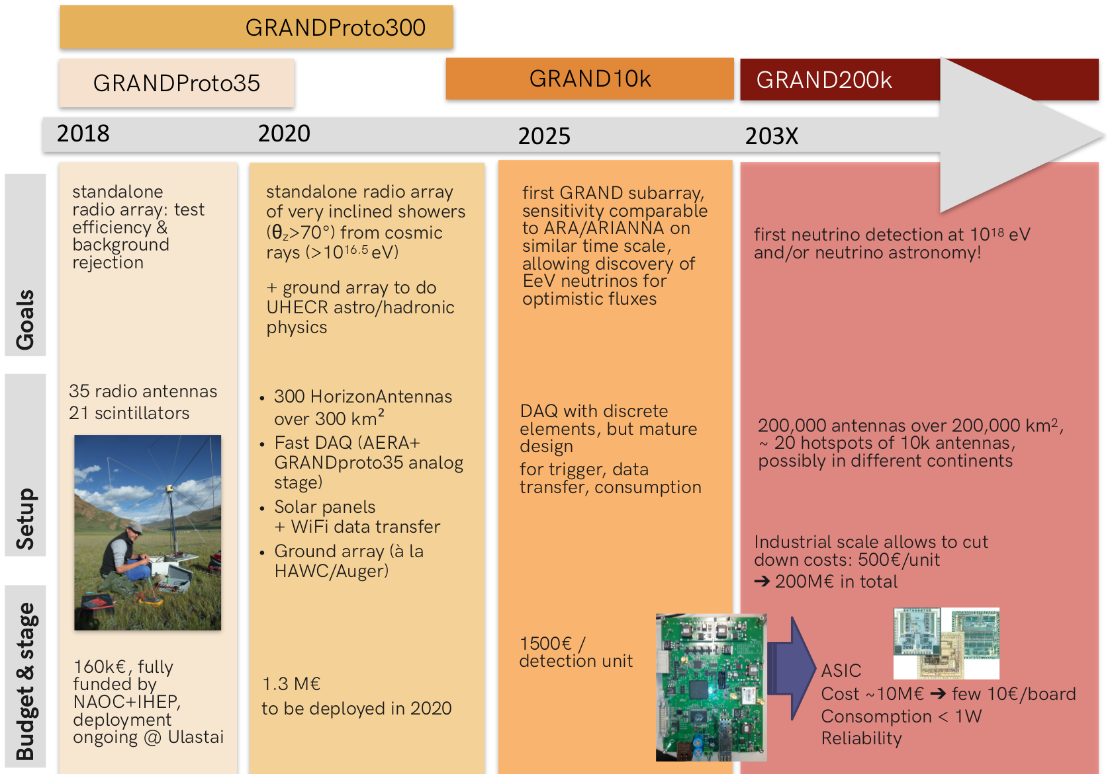
GRAND Road Map

Slide 19
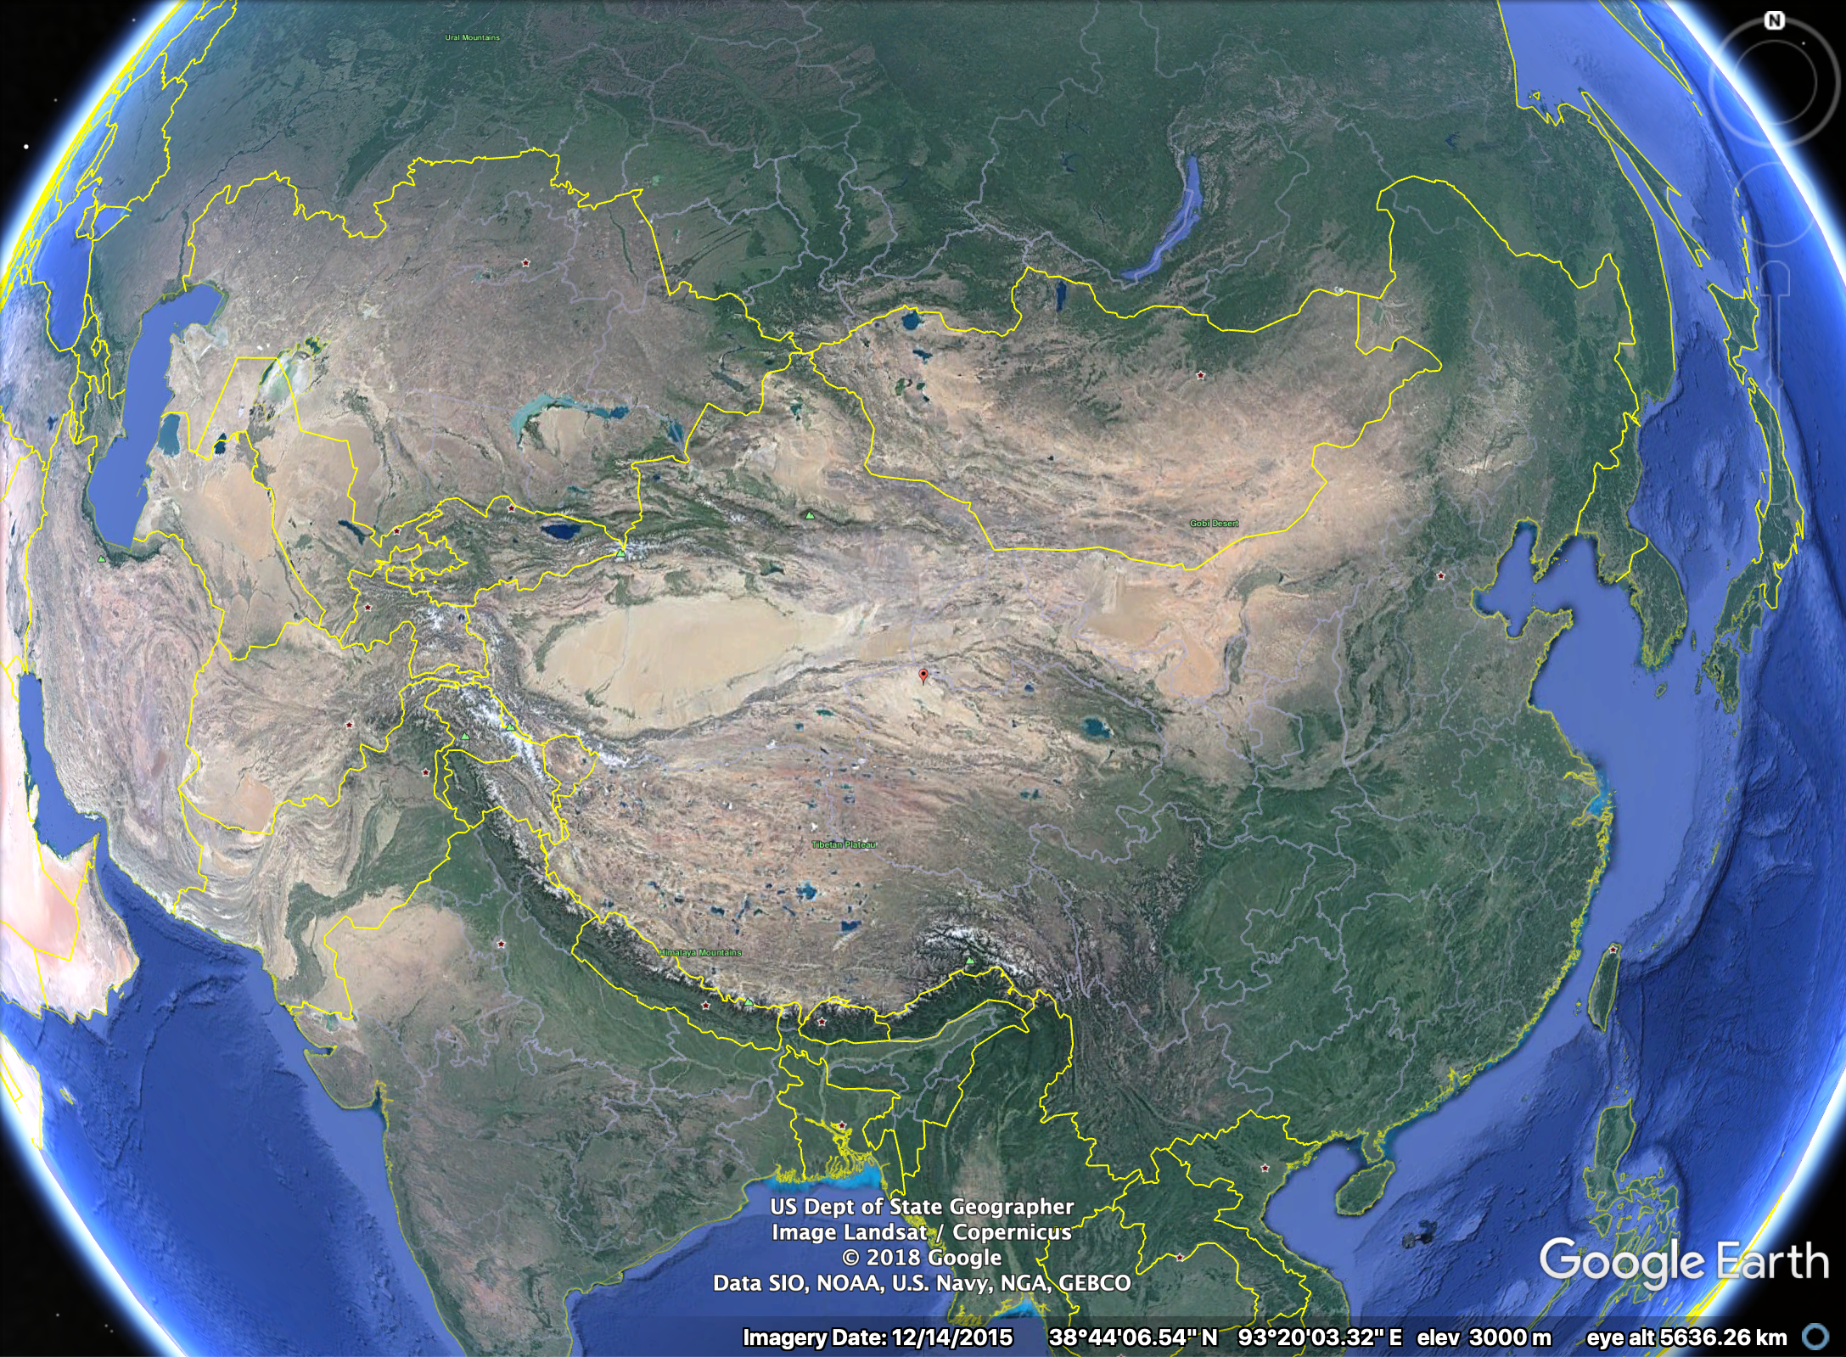
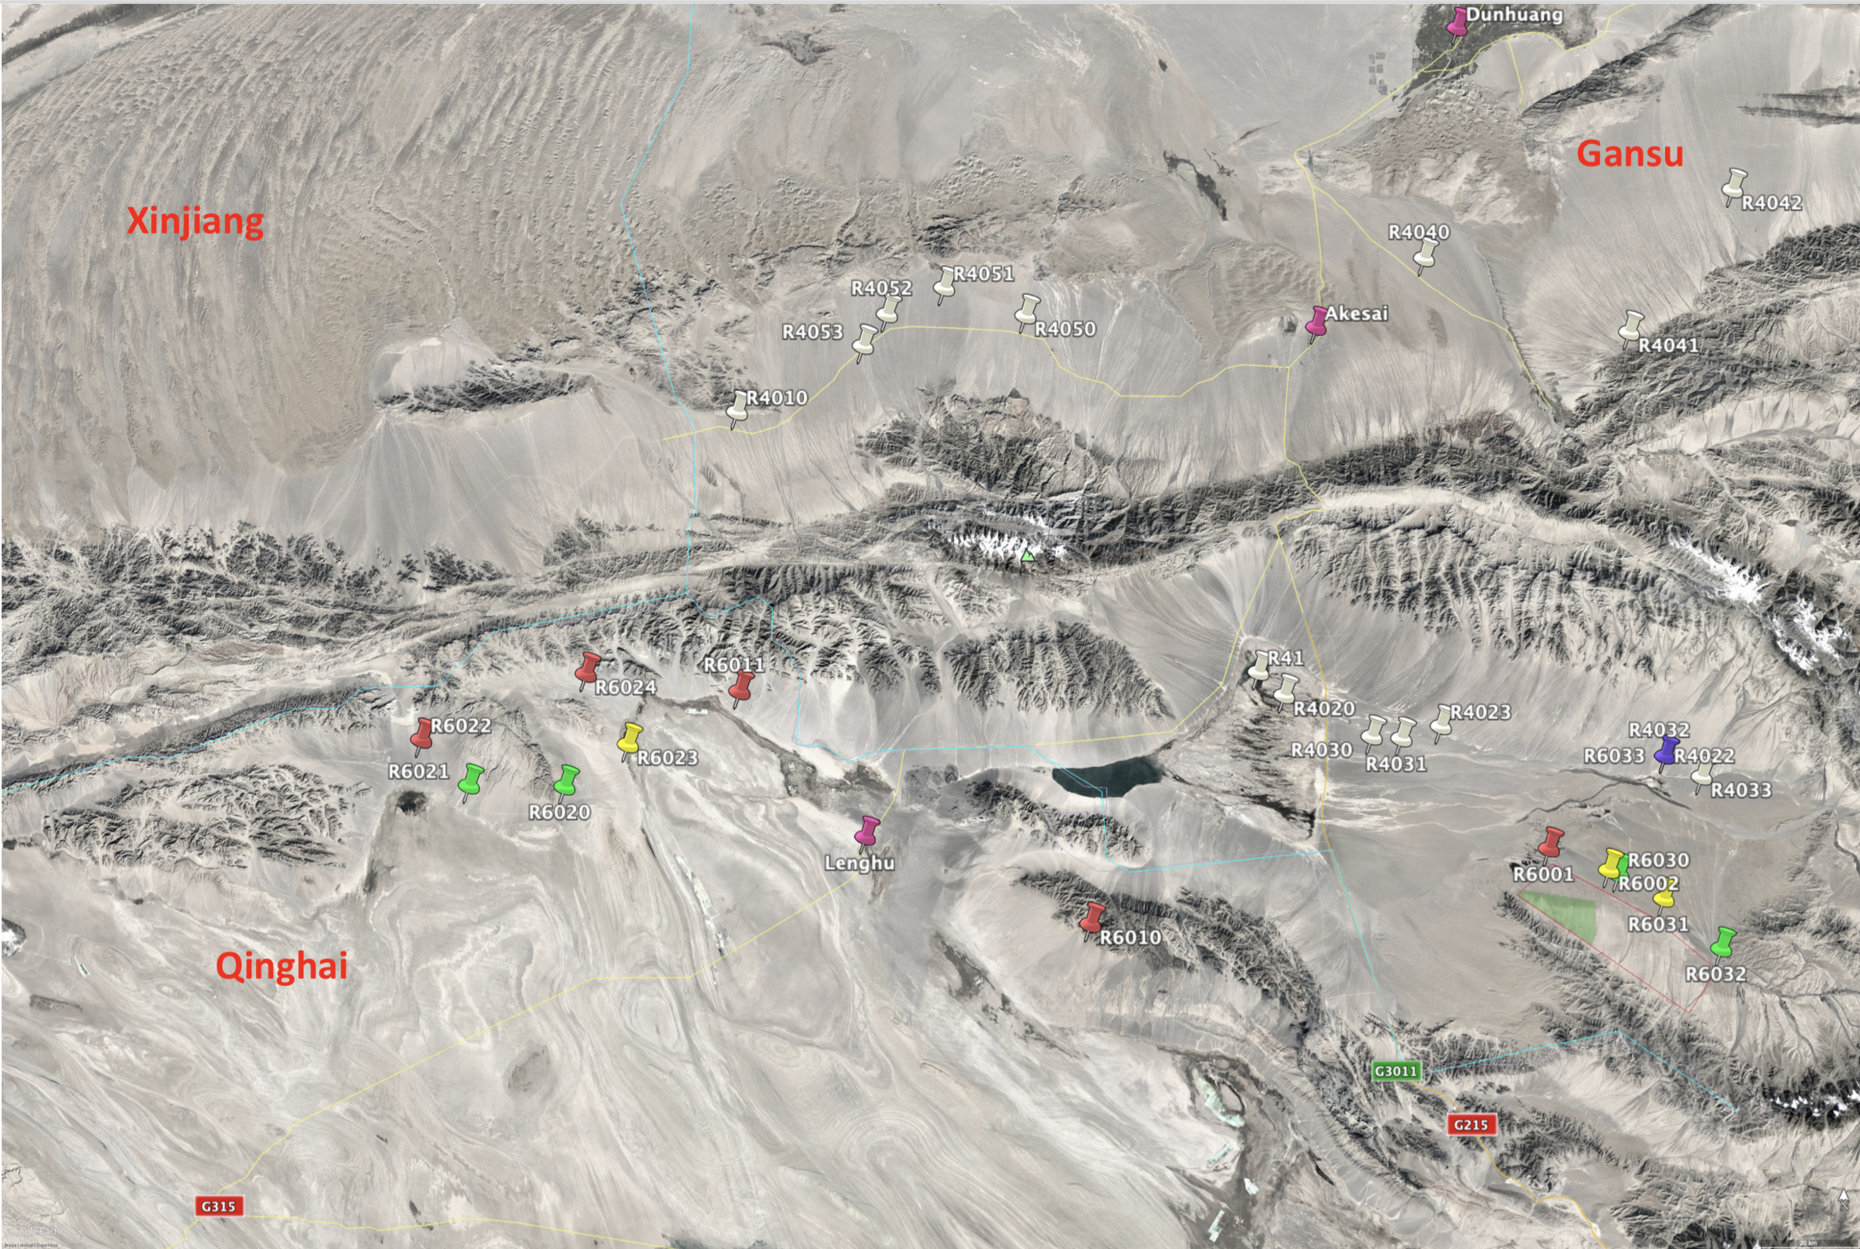
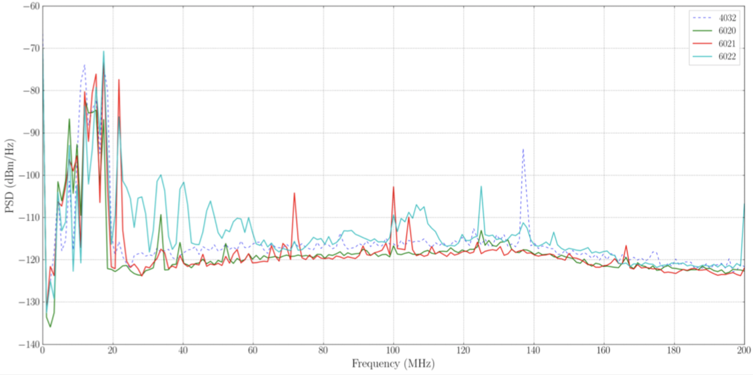
GRAND Proto300 Site Selection
Noise level [dBm/Hz]
40
100
180
Frequency [MHz]

Slide 20
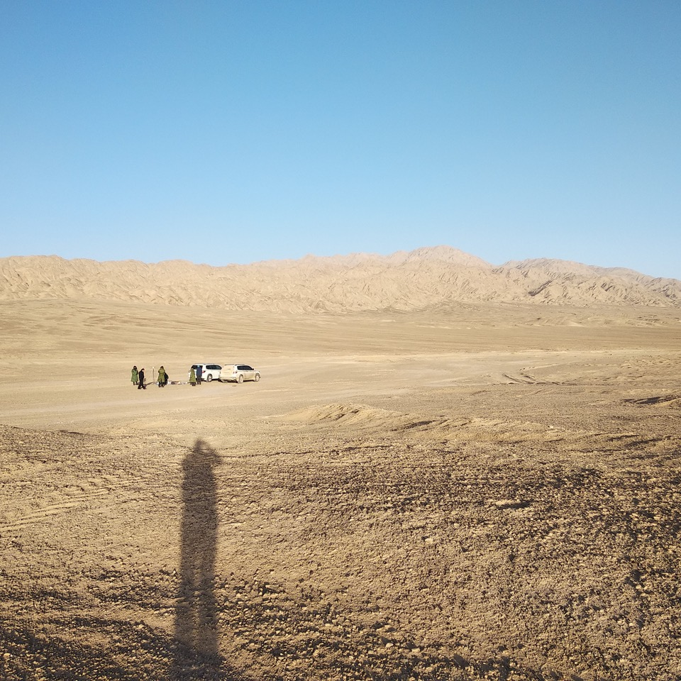
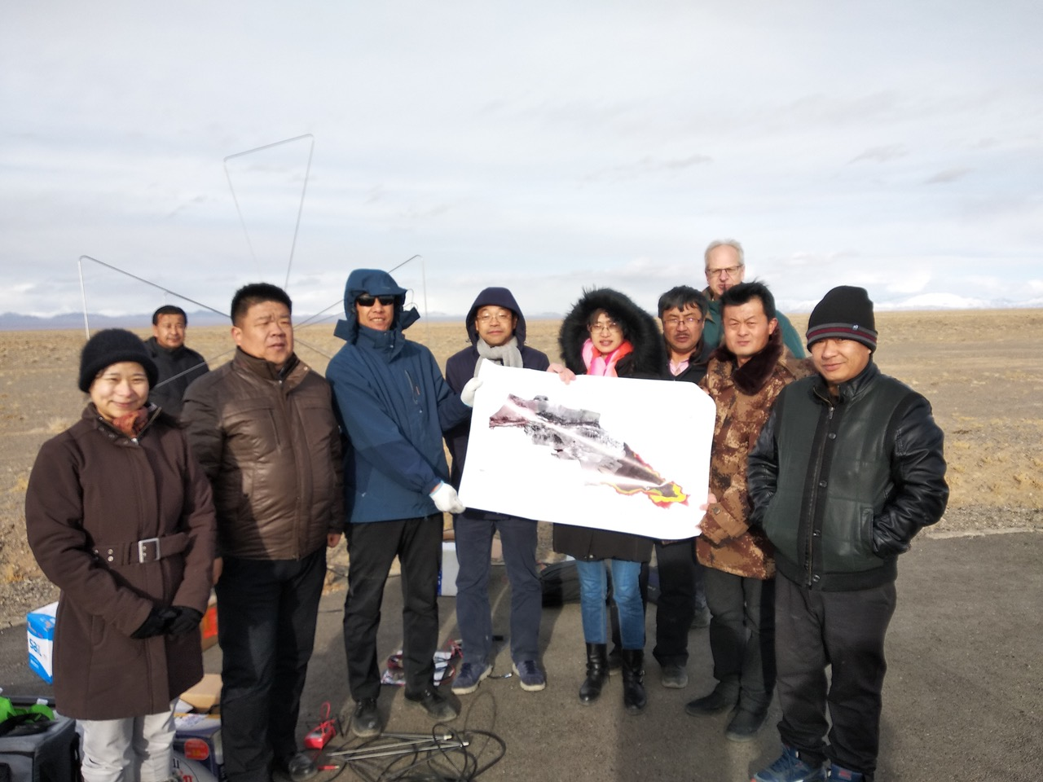
GRAND Proto300 Site Selection
Notes:
Man on the moon project ?

Slide 21
State of Nikhef Cosmic Ray Physics
Ongoing Auger analyses:
    Surface Detector composition analysis promising
    Radio Detector composition analysis well advanced
Major partner in AugerPrime upgrade:
    Significant contribution in SSD upgrade
    Dominant contribution in Radio Detector upgrade
    In excellent position to reap upgrade harvest,
just need people to do it: NWO-ENW-Groot proposal
Founding partner in GRAND:
    First steps in realization taken
  June 2019 Auger Analysis meeting in Nijmegen

Slide 22
Next Speakers
Jörg Hörandel: Auger Radio Upgrade
Fabrizia Canfora: Composition using Radio Detection

Slide 23
Backup Slides

Slide 24
Leadership & Awards
Leadership
Auger task leaders:
AERA: J. Hörandel
Outreach: C. Timmermans
Full RD initiative: J. Hörandel,
C. Timmermans & S. de Jong
GRAND:
Project manager: C. Timmermans
CERN:
President of Council: S. de Jong
Awards
NWO Spinoza Award: 2011 – H. Falcke
ERC Synergy Grant: 2013 – H. Falcke
Elected to KNAW: 2013 – H. Falcke
Elected to Academia Europaea:
2013 – H. Falcke
2016 – S. de Jong
Knight Order of the Netherlands Lion:
2015 – S. de Jong
2016 – H. Falcke

