Slide 1
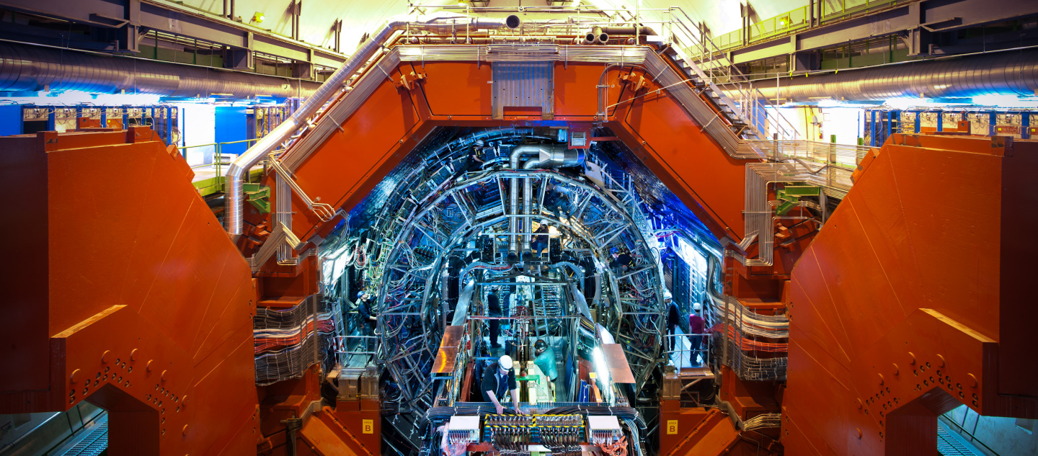


“Go” slide
ALICE UPGRADE
Goran Simatović
for the Dutch ALICE team
Nikhef Jamboree 2018

Slide 2
Current ITS has successfully finished its mission!

Slide 3
Inner Tracking System
SPD: Silicon Pixel Detector for the two inner layers
SDD: Silicon Drift Detector for the two central layers
SSD: Silicon double-sided Strip Detector for the two outer layers
primary vertex reconstruction, momentum and angular resolution of tracks from outer detectors
secondary vertex reconstruction with high resolution
tracking and PID of low pT particles, also in stand-alone

Slide 4

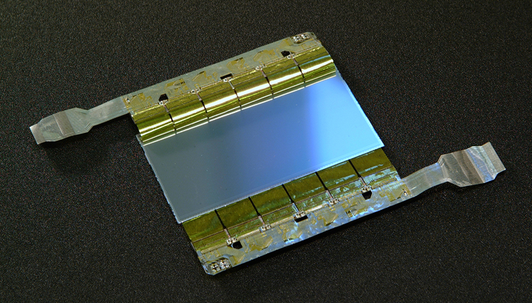
Silicon Strip Detector
Strip: pitch (rφ): 95 μm ; length (z): 40 mm
Leak-less water cooling system + air dryer system
Dutch contributions:
  Read-out unit (UU/IGF)
  ASICs for power regulation and signal buffering (ET)
  Ladder assembly (Nikhef)
  Barrel assembly (UU)
Significant role in TPC-ITS track matching
Complementary role in participle identification

Slide 5
Thank you to the whole Dutch SSD crew for making this happen !

Slide 6
What are the new plans ?

Slide 7
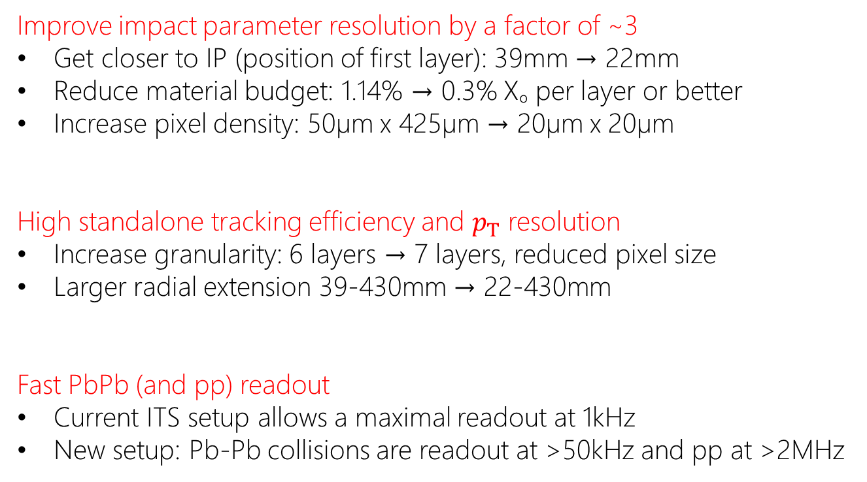
ITS Design Goals
Improve impact parameter resolution by a factor of ~3
Get closer to IP (position of first layer): 39mm → 22mm
Reduce material budget: 1.14% $\text{→}$ 0.3% Xₒ per layer or better
Increase pixel density: 50µm x 425µm $\text{→}$ 20µm x 20µm
High standalone tracking efficiency and $p_{T}$ resolution
Increase granularity: 6 layers $\text{→}$ 7 layers, reduced pixel size
Larger radial extension 39-430mm $\text{→}$ 22-430mm
Fast PbPb (and pp) readout
Current ITS setup allows a maximal readout at 1kHz
New setup: Pb-Pb collisions are readout at >50kHz and pp at >2MHz

Slide 8
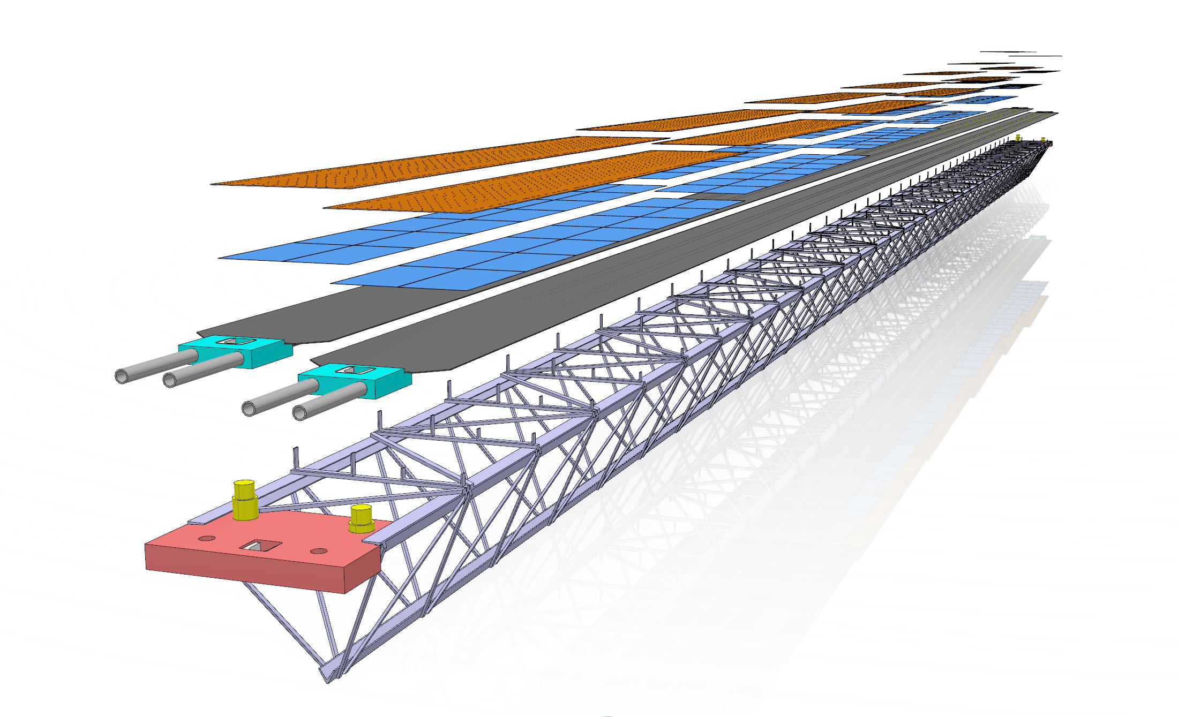
Production @Nikhef / schedule
Nikhef will produce 25% of the OB staves
OB assembly started in March 2018
commissioning starts July 2019 (300 days estimate)
production in ongoing at 5 assembly sites
Expected production rate – 0.5 staves/week
Nikhef has produced 9 staves so far
First two staves delivered to CERN
  Tested and OK

Slide 9
What does it take to make an ITS stave?

Slide 10
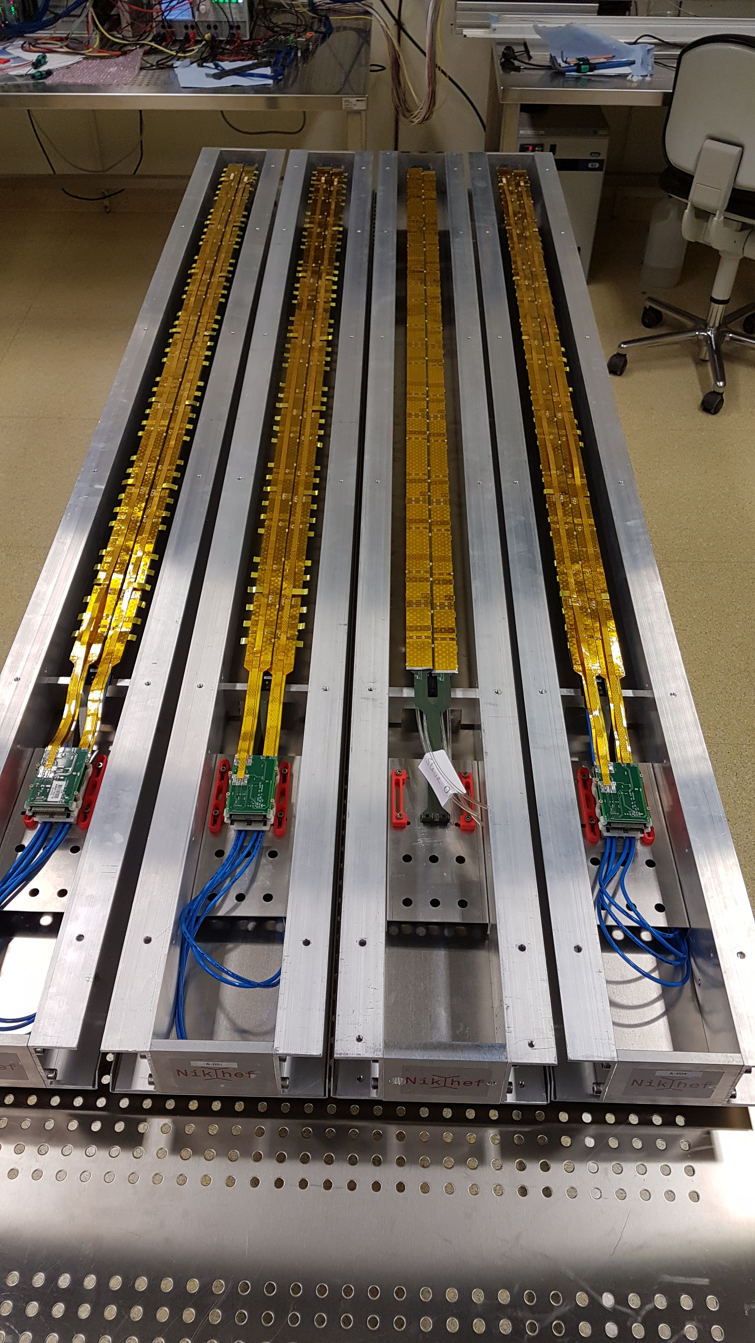
Acceptance testing (QA)
  Powering
  FIFO
  Memory tests
  Threshold, Noise, …
HIC preparation and testing
  10um precision cutting
  Post-cut testing
Half-Stave assembly
  Gluing/soldering
  Testing
Stave assembly
  alignment/gluing
  Testing
Packaging and Shipment
Large student involvement
Nikhef contributed significantly to the assembly tooling
Readout board testing also performed at Nikhef
Nikhef can keep the desired production rate

Slide 11
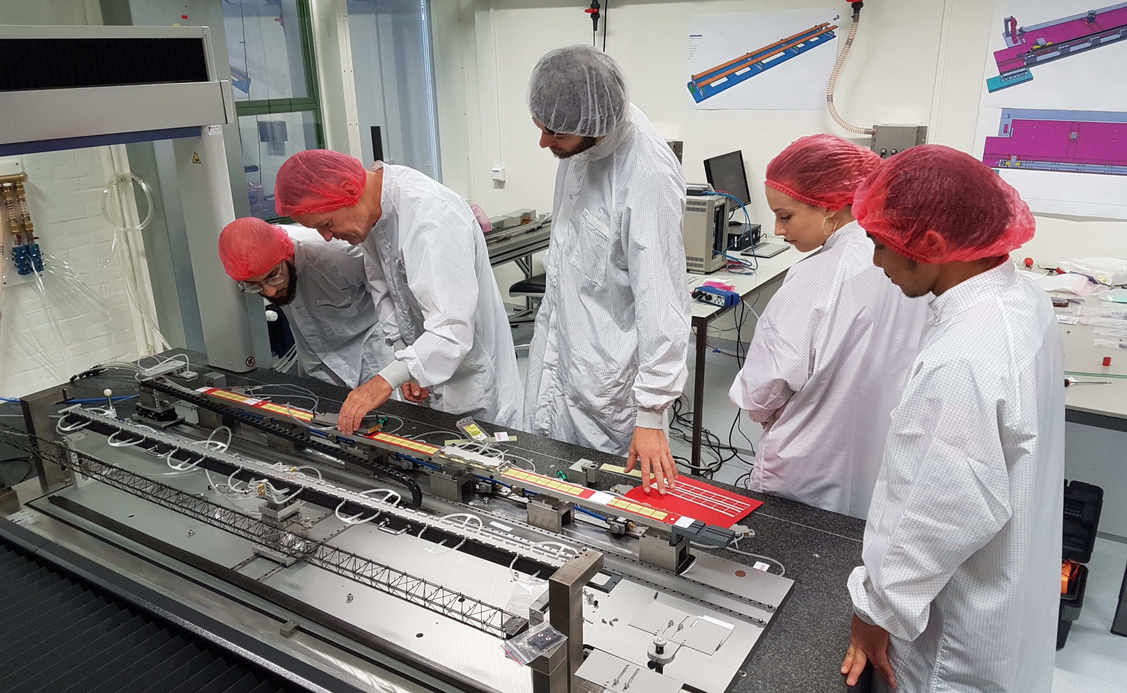
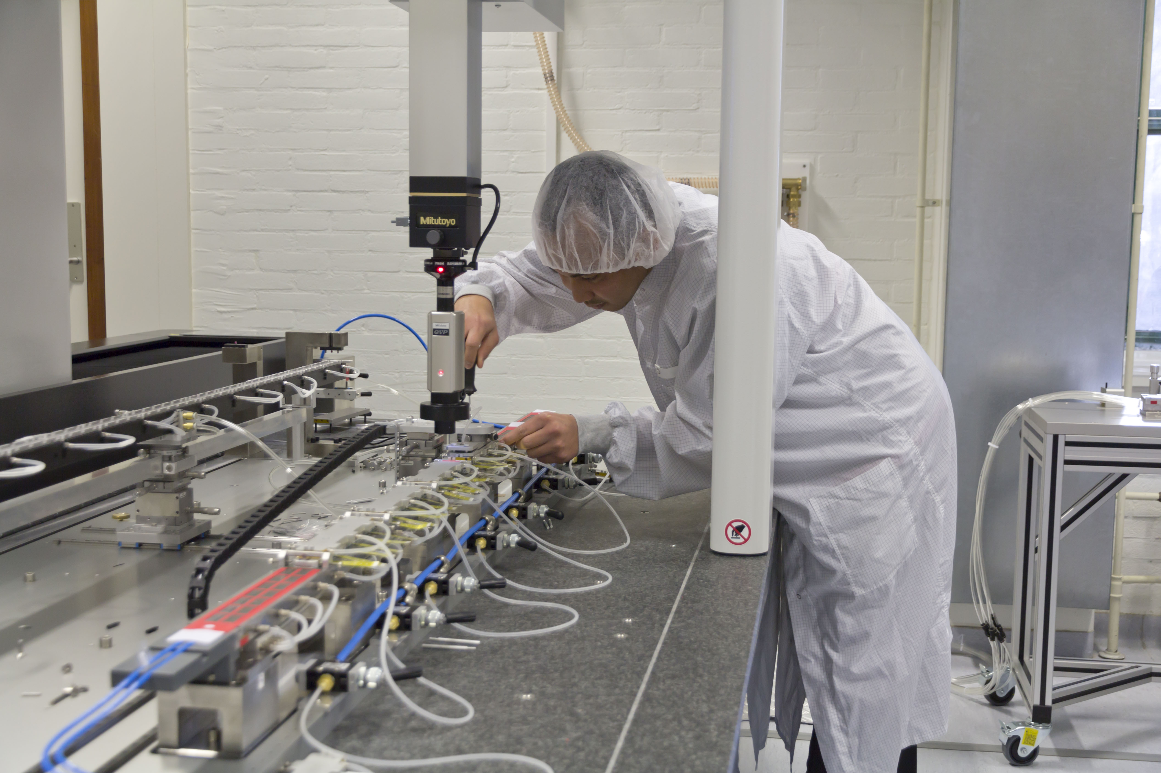
Half/Stave assembly
  10µm precision alignment
  powering system soldered after initial assembly
Student involvement
  three PhD students involved with the ITS upgrade via Service Tasks
  all procedures demonstrated and documented (online manuals)
  student work is independent and needs little supervision

Slide 12
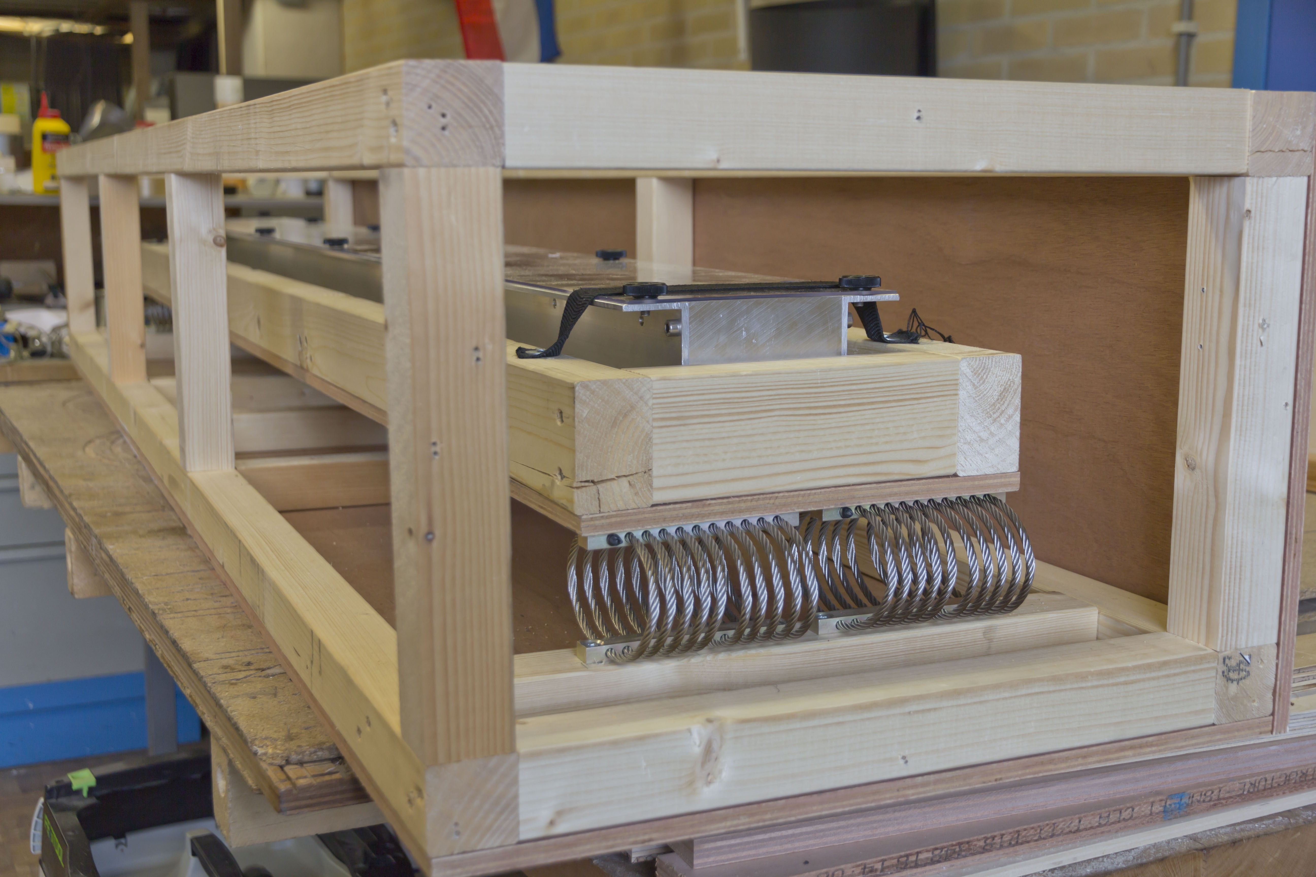
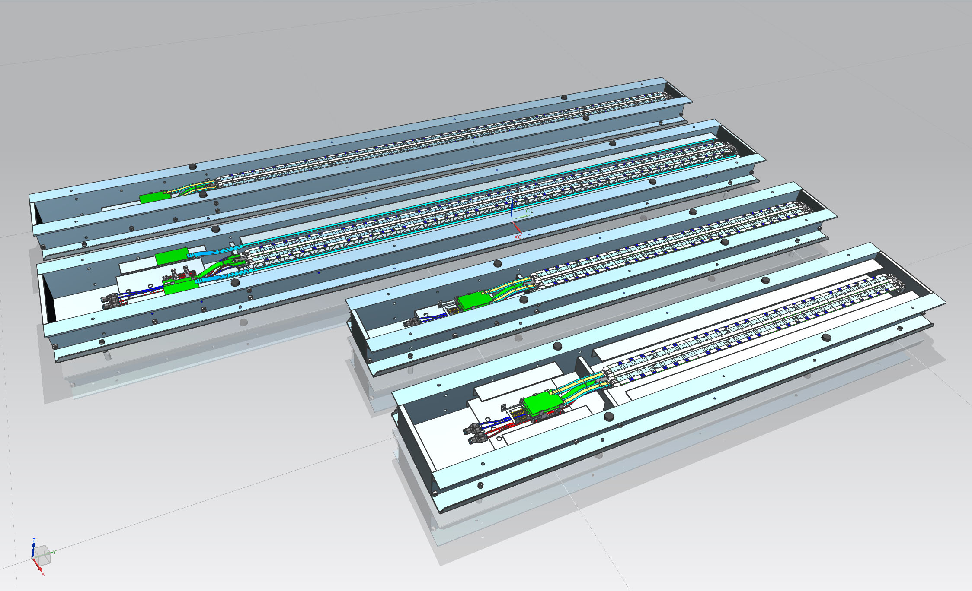
Stave Storage and Transport
  Boxes, springs, bags, and other tooling needed for stave storage and transport designed and selected by Nikhef
Inner aluminum box cradled and suspended with springs inside the wooden transport crates
vibration and acceleration levels regulated
aluminum bags used to control humidity levels
each shipment has data loggers (next slides)

Slide 13
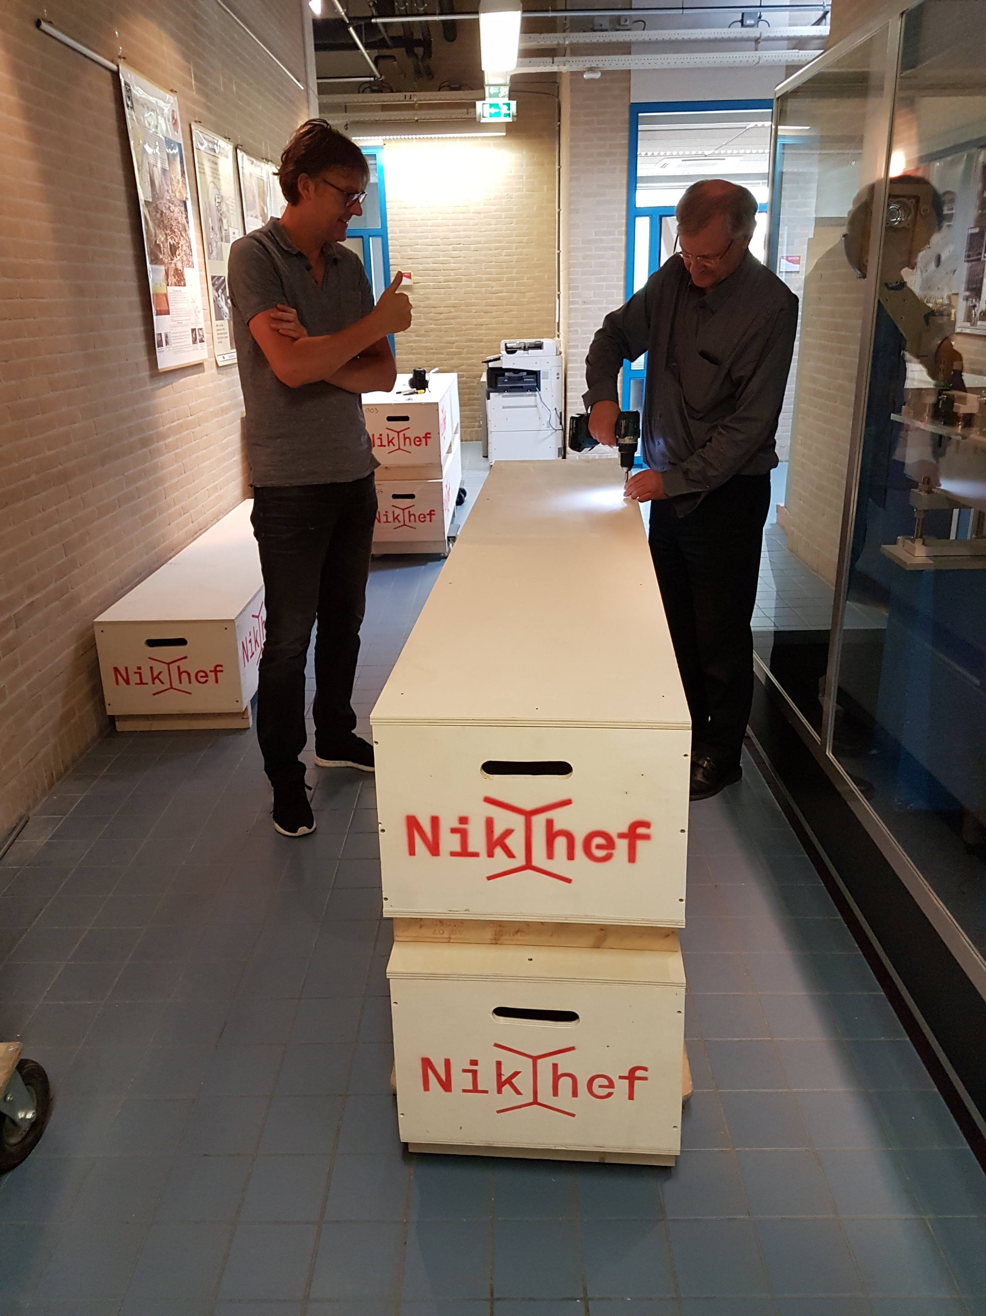
“Go” slide
Students can’t have all the fun!

Slide 14
Electronics

Slide 15
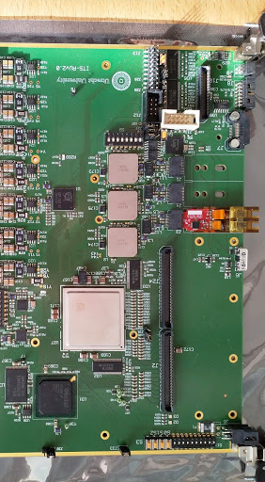
Read-out unit
Connects the front-end chips to the DAQ
Connects the power supplies to the DCS
Designed by Utrecht+Amsterdam
  Marcel Rossewij
  Jan-David Schipper
Firmware made by Berkeley+CERN
Pre-series boards now under test
  Using Nikhef climate chamber
  Functionality is ok!

Slide 16
How far along are we?

Slide 17
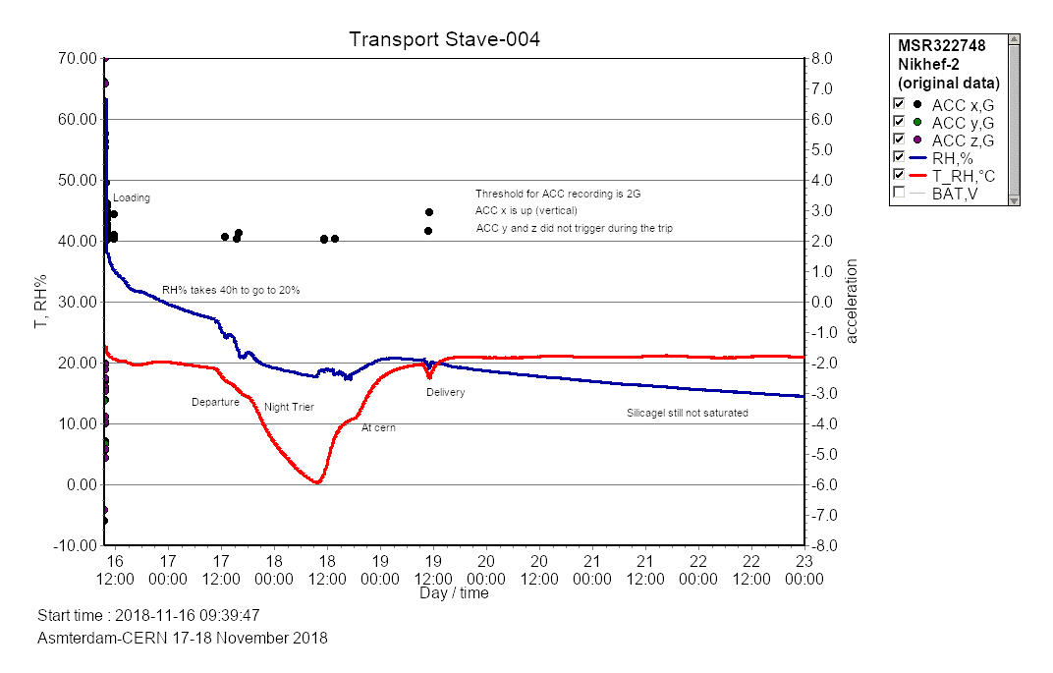
“Go” slide
First transport successful!
Thanks to Roman (LHCb) for generously offering to take our staves to CERN aswell!
Data logger measures relative humidity, 3D acceleration, temperature
Transportation via Nikhef van seems to be a viable method of transportation to CERN

Slide 18
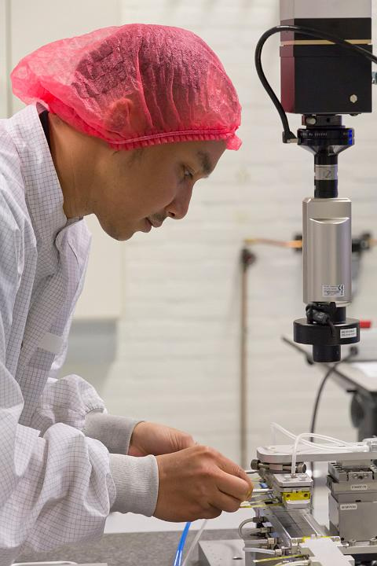
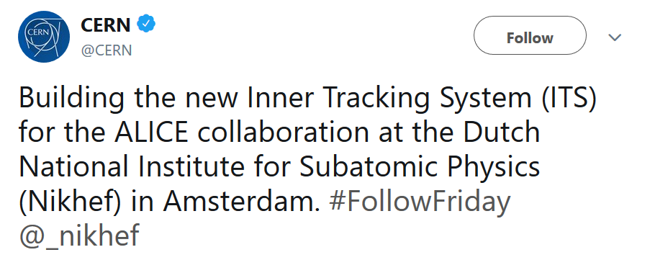

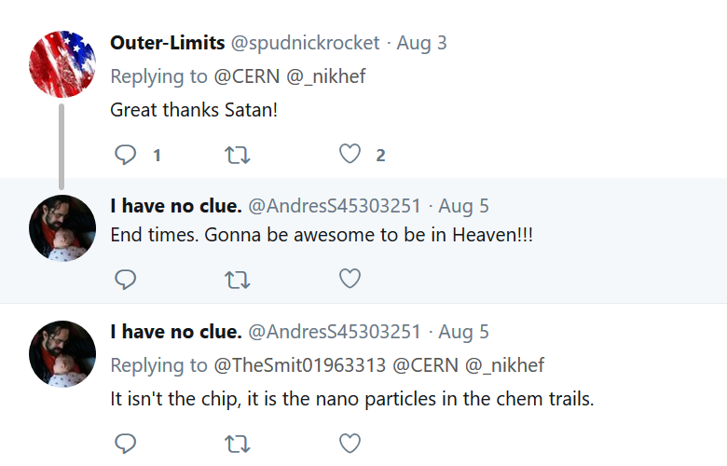
our very own Syaefudin Jaelani (aka J) was featured on the CERN #FollowFriday campaign.
the photo was used by the Nikhef PR department for the Nikhef website and social media channels (Facebook, Twitter ..)
by Marco Kraan

Slide 19
ALICE ITS upgrade in the Netherlands
major contributions to the overall project
wide spread efforts in both hardware and software
Strong involvement of students (master/PhD)
Active international collaboration and visibility (Torino, Frascati, Bari, Liverpool, Daresbury, Berkeley, ... )
Dutch ALICE team is strongly involved in physics with future ITS
  Thermalization, heavy quark in-medium energy loss
  Anisotropic flow, quarkonium dissociation

Slide 20
“Go” slide
Inner Tracking System Upgrade Team
Marco Kraan, Gerrit Brouwer, Jean-Paul Fransen, Martijn van Overbeek,
René de Boer, Sheifudin Jaelani, Zhanna Khabanova, Lennart van Doremalen, Marcel Rossewij, Jan-David Schipper
Many thanks to our staff and students !!

Slide 21
Back up

Slide 22
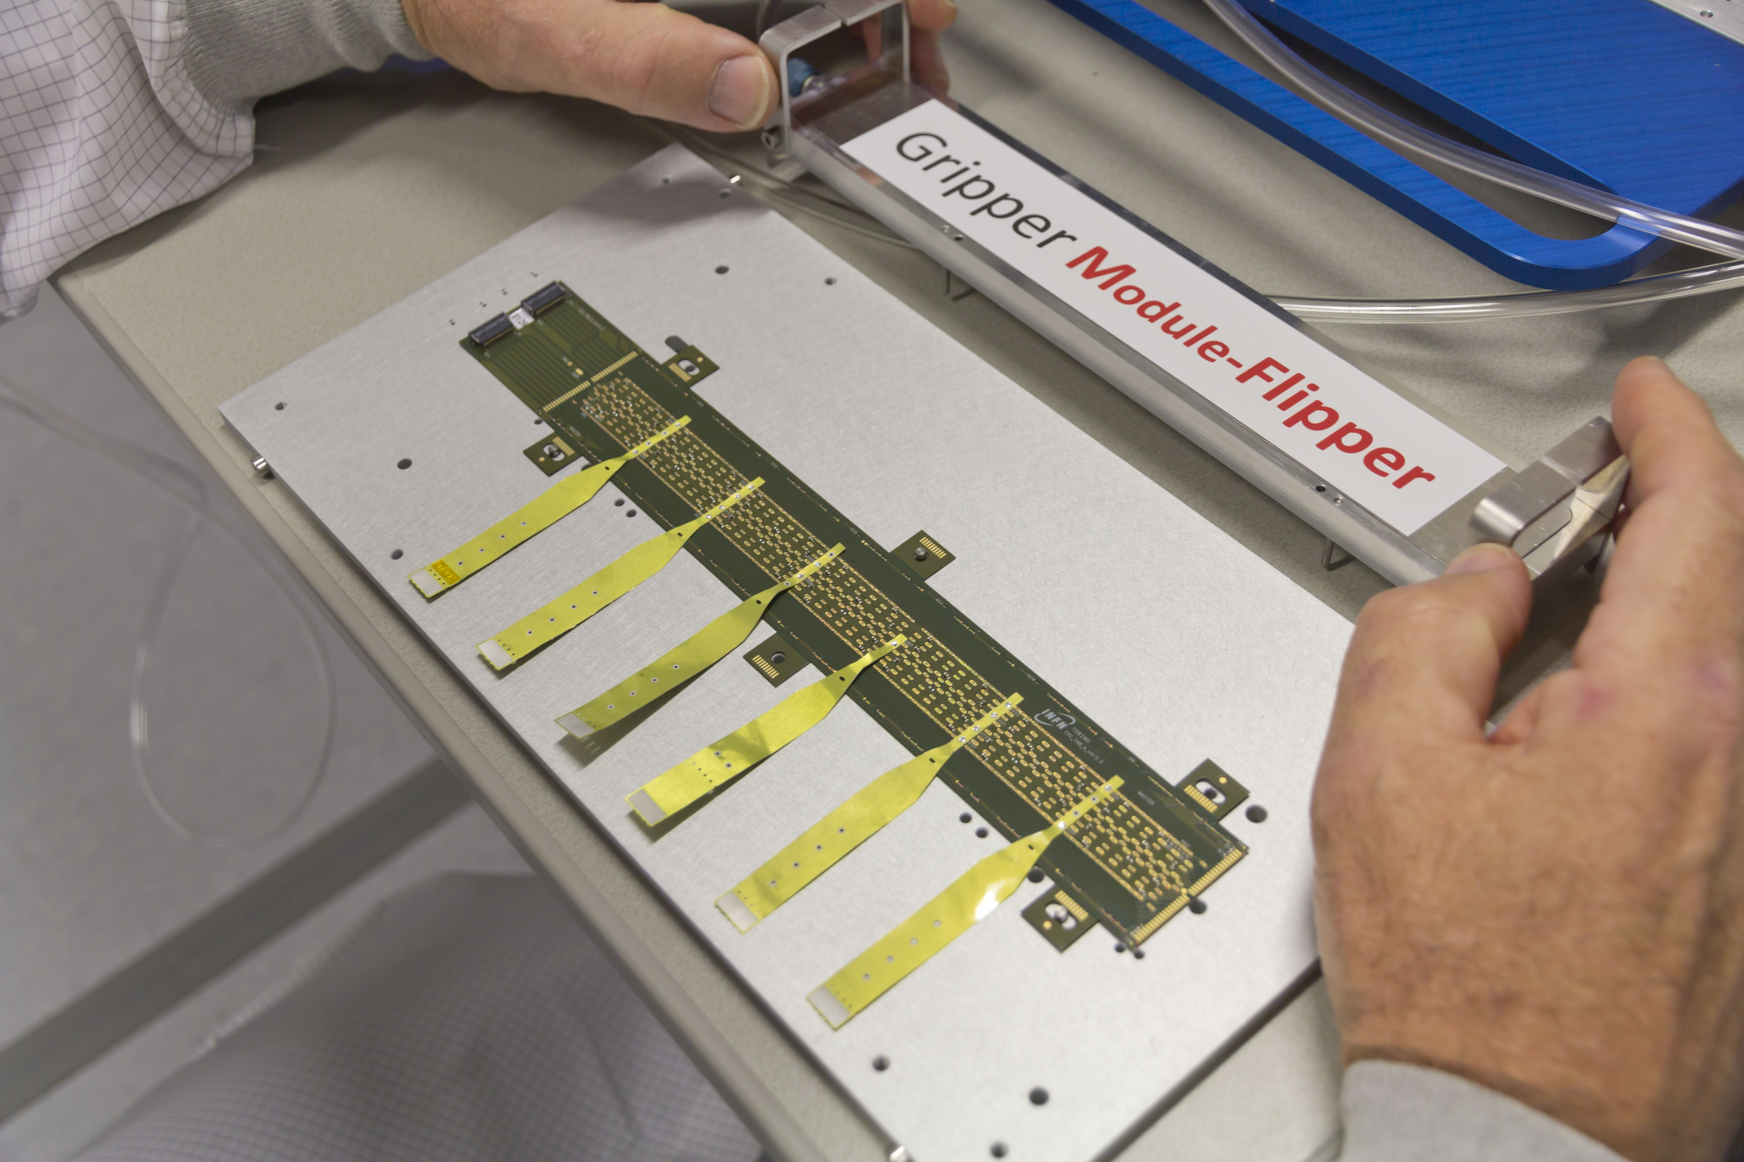
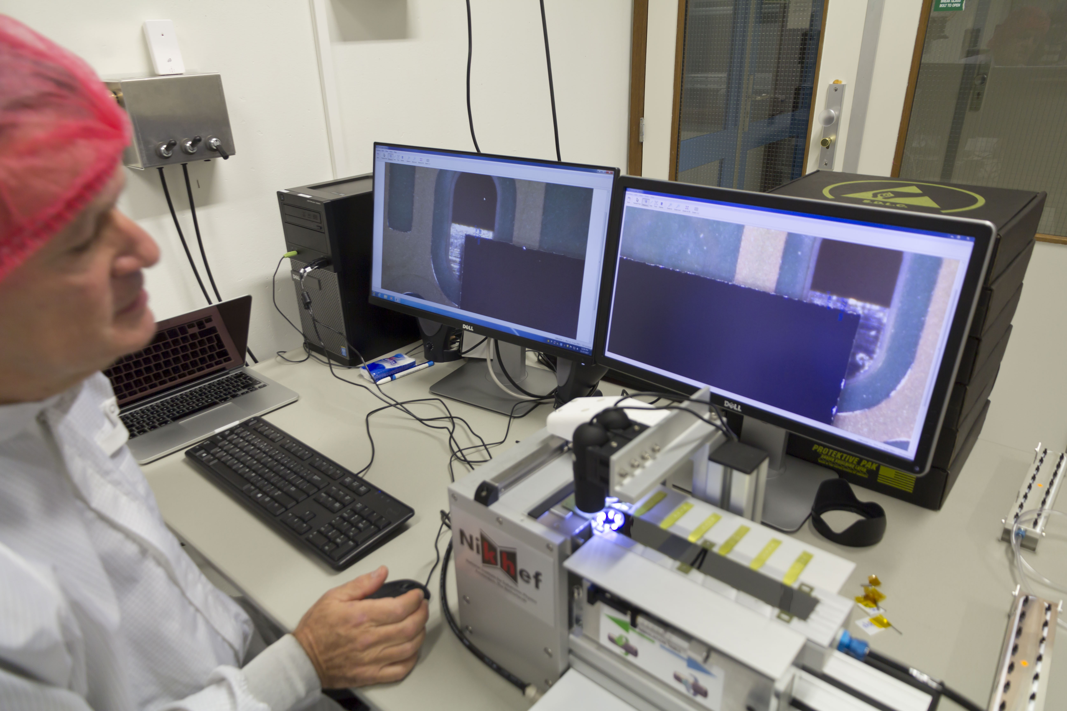
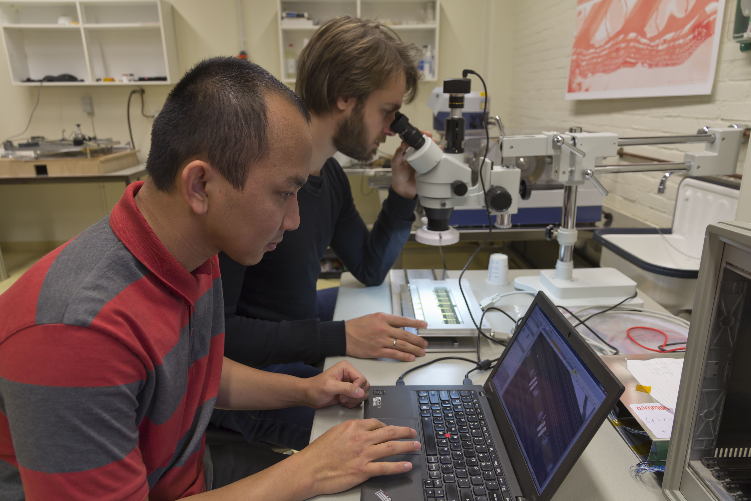
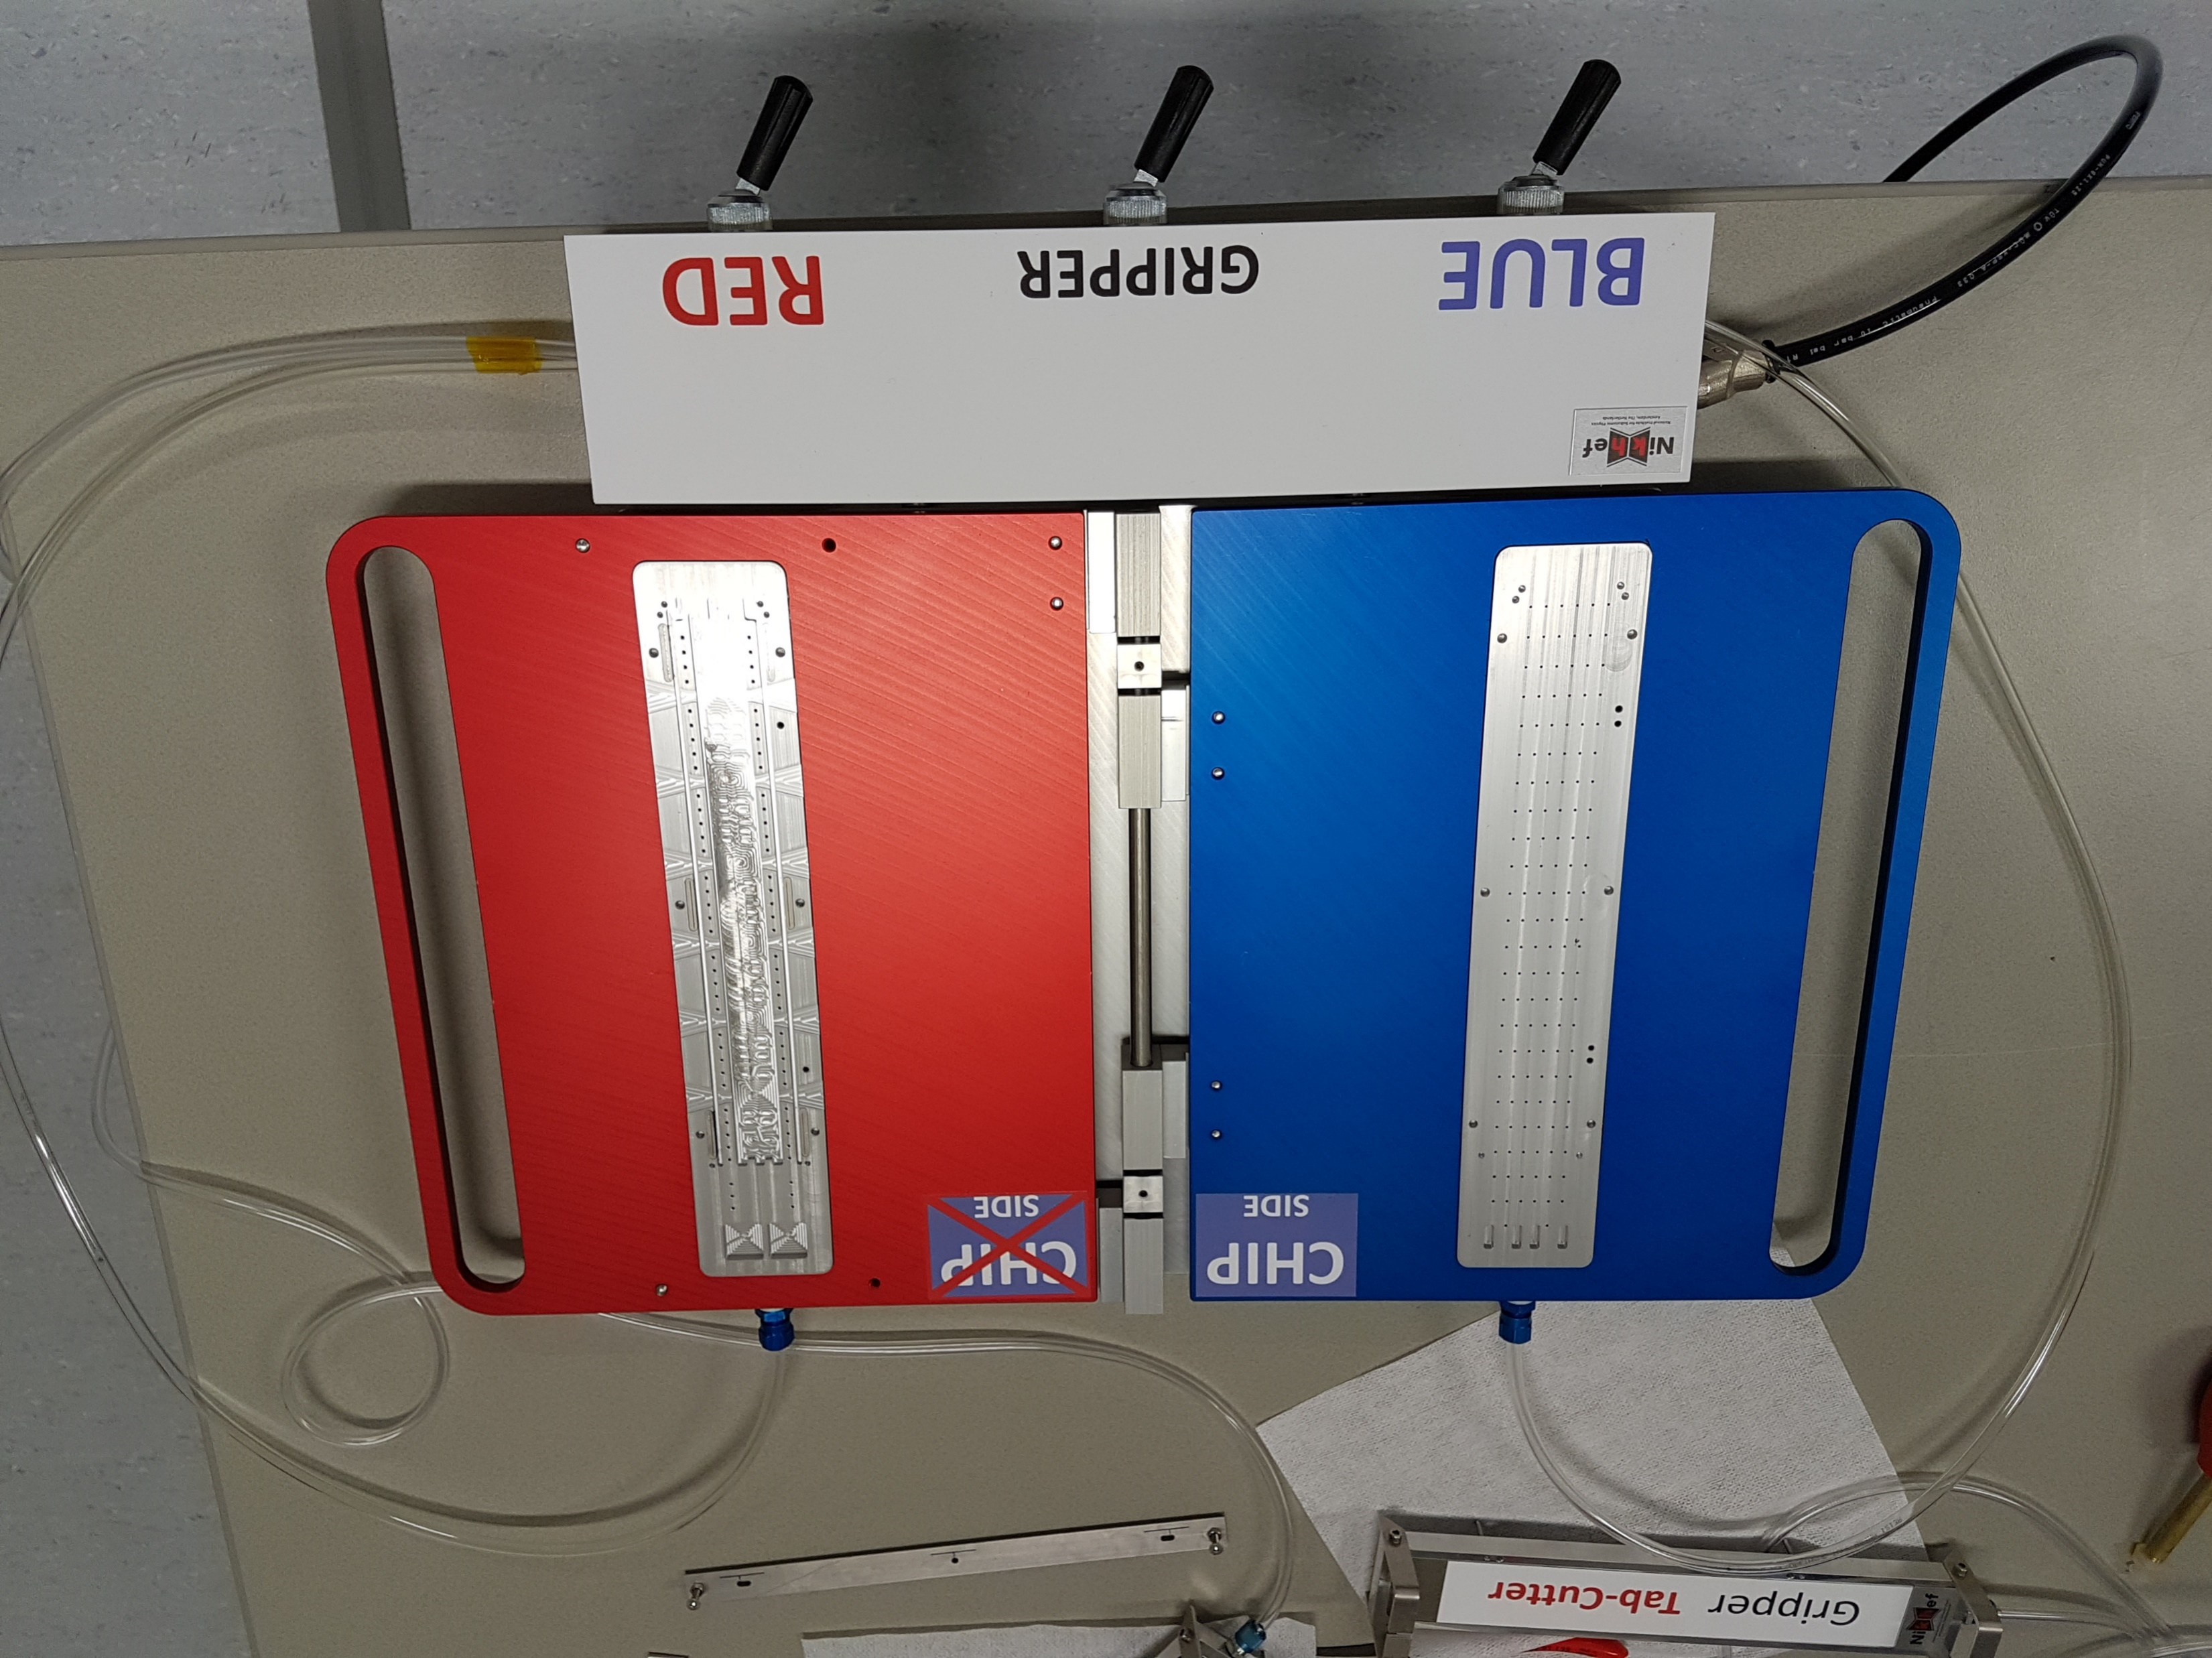
Hybrid Integrated Circuit (HIC)
  Classified by quality and type
  Tests before and after handling assure quality is kept
HIC preparation and testing
  powering, FIFO, memory, noise, threshold ..
  15µm precision cutting
HIC Flipper / Cutter
  Designed, tested and distributed by Nikhef
  Software for cut line definition with twin microscopes also provided by Nikhef
  Spares in storage (no site requested)

