Slide 1
A Buffer gas source for cold molecular beams
Kevin Esajas, Yanning Yin, Rutger Hof, Leo Huisman

Slide 2
Why?
Minimizes molecular beam velocity
Optimizes molecular flux
Nicholas R. Hutzler, Hsin-I Lu, and John M. Doyle
Chemical Reviews 2012 112 (9), 4803-4827

Slide 3
The big picture

Slide 4
Principles buffer gas cooling
Cooling of molecules through collisions with cold buffer gas

Slide 5
Principles buffer gas cooling
Beam properties determined by:
Cell geometry
Production of molecules
Buffer gas properties
Buffer gas flow regime

Slide 6
Principles buffer gas cooling
Interesting molecular beam properties
Flux
Velocity
Temperature
Position and velocity spread

Slide 7
Principles Molecules production
Production by Laser ablation
Salt
Metal

Slide 8
Principles Molecules detection
Laser Induced Fluorescence
Fluorescent light from molecules detected by PMT
Absorption spectroscopy
Using photodiode

Slide 9
setup
25 Kelvin
4 Kelvin

Slide 10
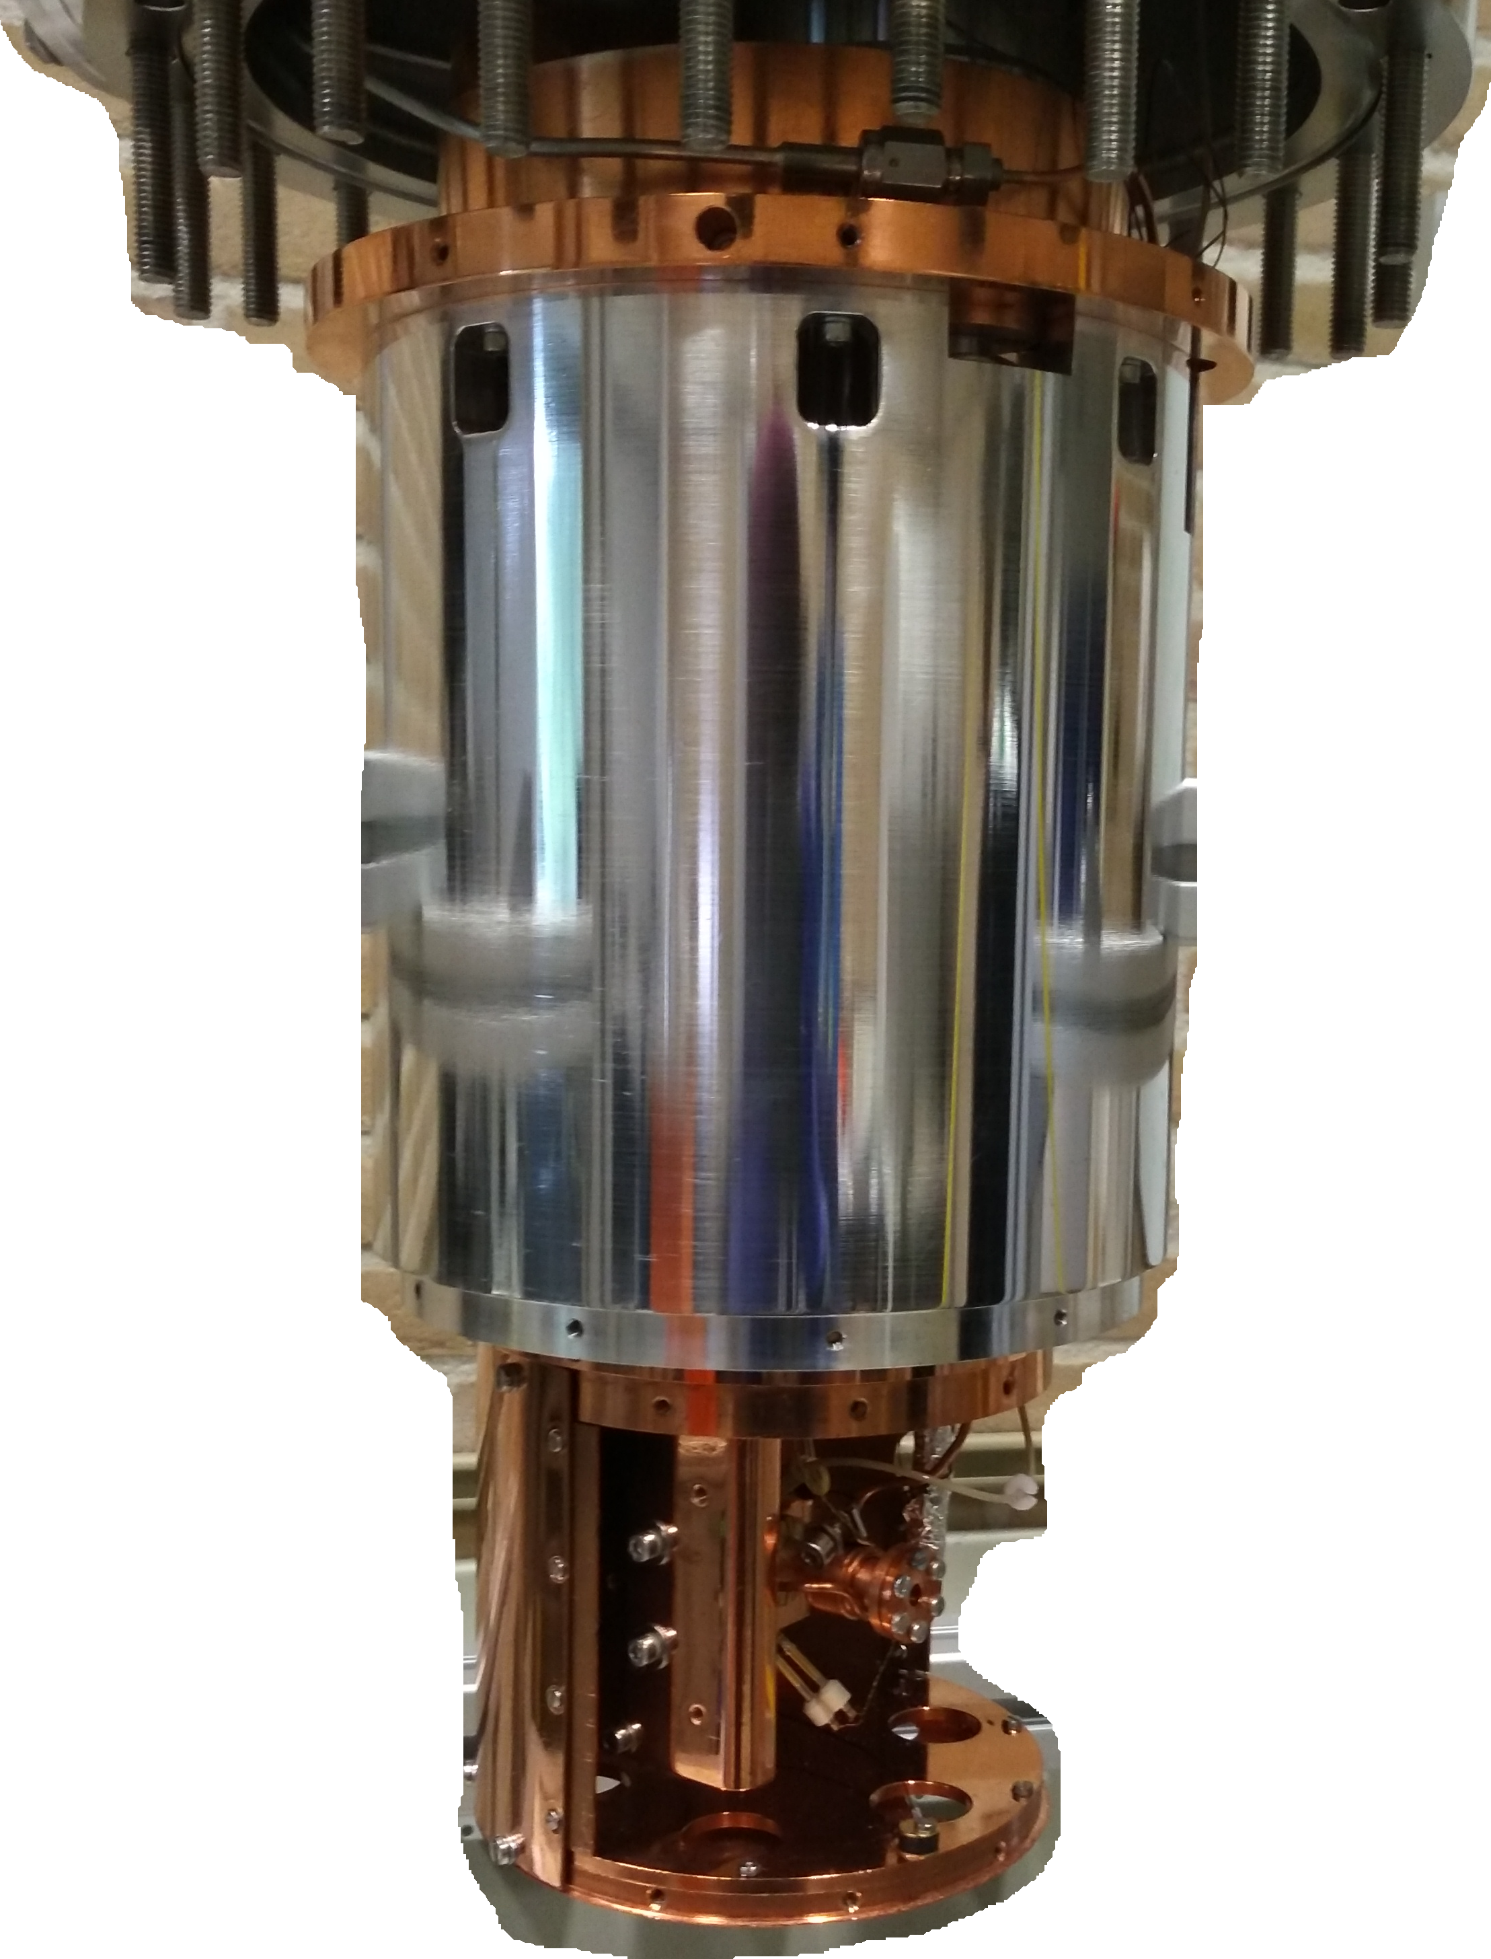
Setup
Cryocooler
PMT
Fluorescence Laser
Absorption Laser
Cell
Heat shields

Slide 11
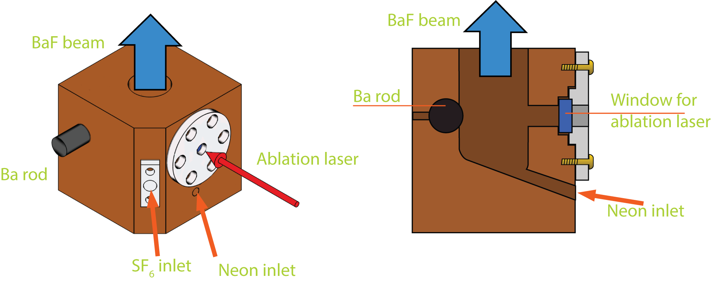
Setup
Cell design in collaboration with Stefan Truppe and Mike Tarbutt,
Imperial College London

Slide 12
Results Molecules detection
Laser Induced Fluorescence of SrF at low buffer gas flow rates: 9 sccm

Slide 13
Results Absorption and fluorescence
Light absorption and induced fluorescence at high buffer gas flow rates: >18 sccm

Slide 14
Results Velocity profile

Slide 15
Results
Photon counts per ablation shot

Slide 16
Conclusion
We have a working buffer gas source
Optimization in progress
Ready to produce cold BaF molecules for the next stage in the eEDM experiment

Slide 17
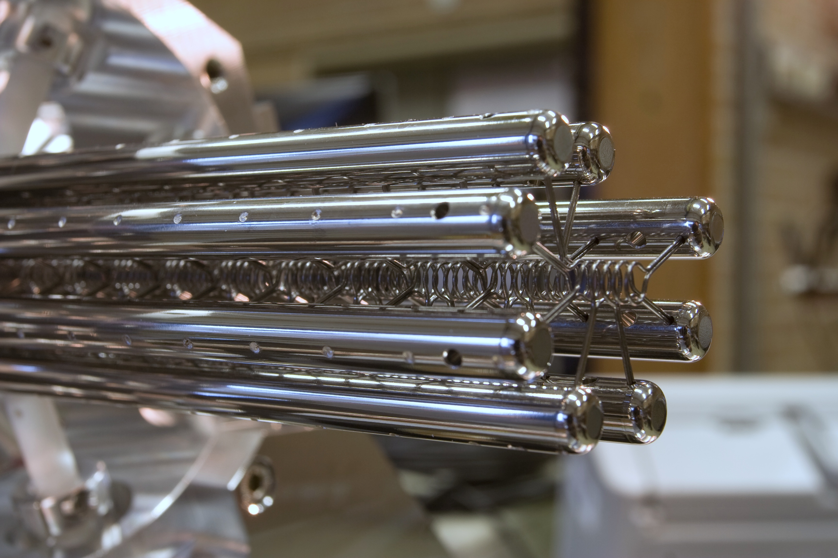
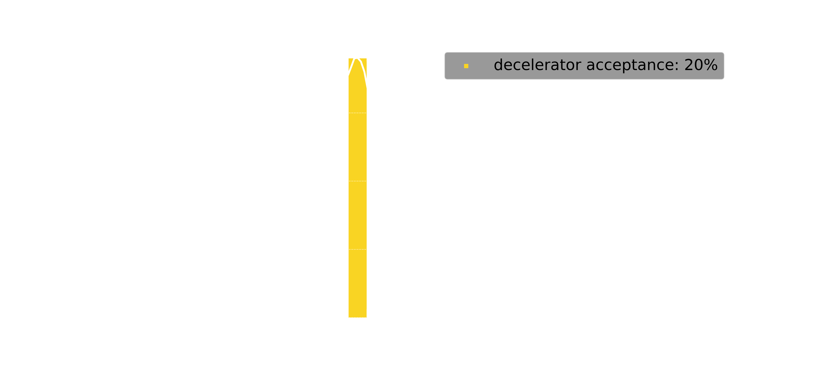
Outlook
Couple buffer gas source to traveling wave Stark decelerator

Slide 18
Thank you

Slide 19
Questions?

