Slide 1
Theory contribution to the eEDM measurement in BaF
A. Borschevsky

Slide 2
Theoretical investigations
Understanding how the electronic structure is affected by the phenomena
Identification of atomic/molecular candidates with enhanced sensitivity
Supplying the necessary parameters for the interpretation of the experiments
Calculations of the practical parameters needed for the experiment (spectra, lifetimes of levels, etc.)

Slide 3
Theoretical investigations
Understanding how the electronic structure is affected by the phenomena
Identification of atomic/molecular candidates with enhanced sensitivity
Supplying the necessary parameters for the interpretation of the experiments
Calculations of the practical parameters needed for the experiment (spectra, lifetimes of levels, etc.)

Slide 4
Which brings us to the computational methods…
Relativity
Dirac-Coulomb-Breit
+higher corrections
Dirac-Breit
Dirac-Coulomb
Electron
correlation
ZORA,
X2C
CCSD(T)
RECP
CCSD
Full-CI
Douglas-Kroll
MRCI+MBPT
MRCI
Nonrelativistic Domain
Breit-Pauli
CISD
DFT
MBPT2
HF
Basis sets
STO-3G
6-31G*
cc-pvdz
cc-pvqz
CBS
3-21G
cc-pvtz
CBS
methods

Slide 5
Relativistic Hamiltonian
Relativity
Dirac-Coulomb-Breit
+higher corrections
Dirac-Breit
Dirac-Coulomb
Electron
correlation
ZORA,
X2C
CCSD(T)
RECP
CCSD
Full-CI
Douglas-Kroll
MRCI+MBPT
MRCI
Nonrelativistic Domain
Breit-Pauli
CISD
DFT
MBPT2
HF
Basis sets
STO-3G
6-31G*
cc-pvdz
cc-pvqz
CBS
3-21G
cc-pvtz
CBS
methods

Slide 6
Relativistic coupled cluster
Relativity
Dirac-Coulomb-Breit
+higher corrections
Dirac-Breit
Dirac-Coulomb
Electron
correlation
ZORA,
X2C
CCSD(T)
RECP
CCSD
Full-CI
Douglas-Kroll
MRCI+MBPT
MRCI
Nonrelativistic Domain
Breit-Pauli
CISD
DFT
MBPT2
HF
Basis sets
STO-3G
6-31G*
cc-pvdz
cc-pvqz
CBS
3-21G
cc-pvtz
CBS
methods

Slide 7
Relativistic coupled cluster
Relativity
Dirac-Coulomb-Breit
+higher corrections
Dirac-Breit
Dirac-Coulomb
Electron
correlation
ZORA,
X2C
CCSD(T)
RECP
CCSD
Full-CI
Douglas-Kroll
MRCI+MBPT
MRCI
Nonrelativistic Domain
Breit-Pauli
CISD
DFT
MBPT2
HF
Basis sets
STO-3G
6-31G*
cc-pvdz
cc-pvqz
CBS
3-21G
cc-pvtz
CBS
methods

Slide 8
Relativistic coupled cluster
State of the art highly accurate computational approach
Relativity
Dirac-Coulomb-Breit
+higher corrections
Dirac-Breit
Dirac-Coulomb
Electron
correlation
ZORA,
X2C
CCSD(T)
RECP
CCSD
Full-CI
Douglas-Kroll
MRCI+MBPT
MRCI
Nonrelativistic Domain
Breit-Pauli
CISD
DFT
MBPT2
HF
Basis sets
STO-3G
6-31G*
cc-pvdz
cc-pvqz
CBS
3-21G
cc-pvtz
CBS
methods

Slide 9
Applications to BaF
Spectroscopic properties
E_{eff} and W_{s}
Hyperfine structure

Slide 10
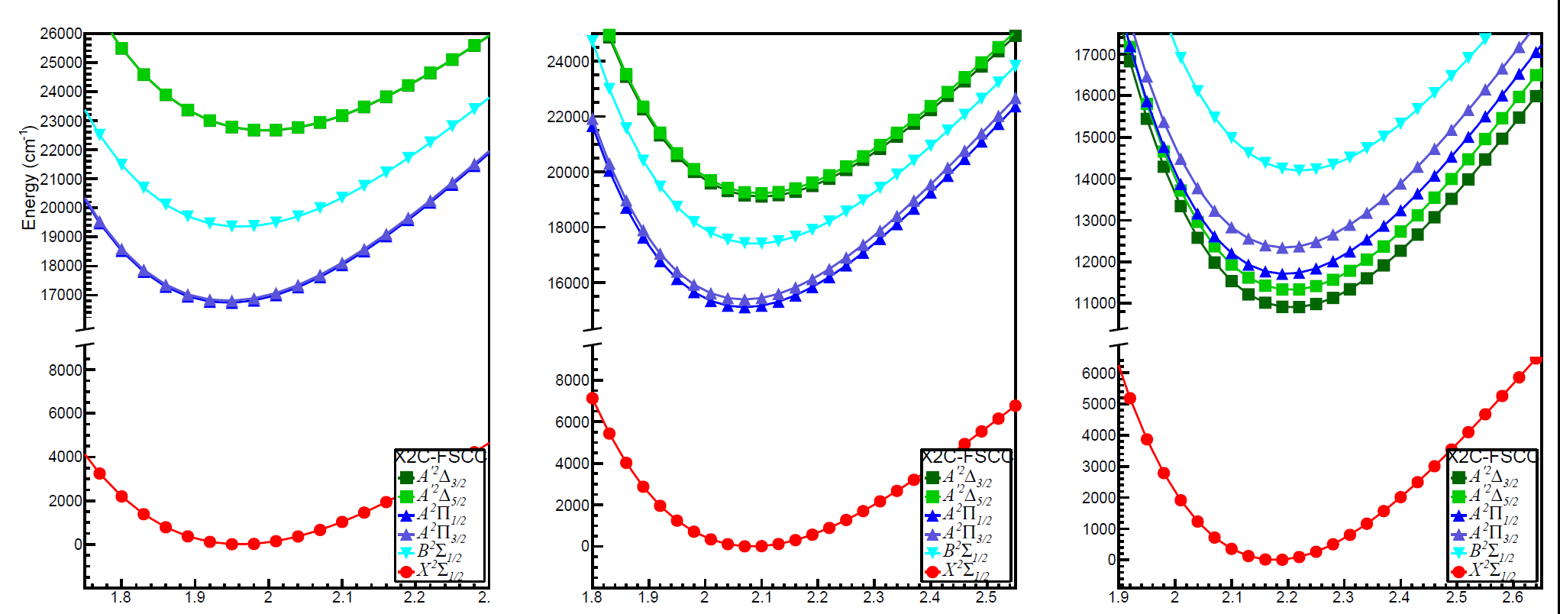
Molecular properties of BaF
Laser cooling is an important component of the experiment: identify optimal cooling scheme
Needed: potential energy curves, spectroscopic constants, Franck-Condon factors (FCFs), transition dipole moments, etc.
Relativistic CC calculations for BaF and lighter homologues (CaF and SrF)
CaF
SrF
BaF

Slide 11
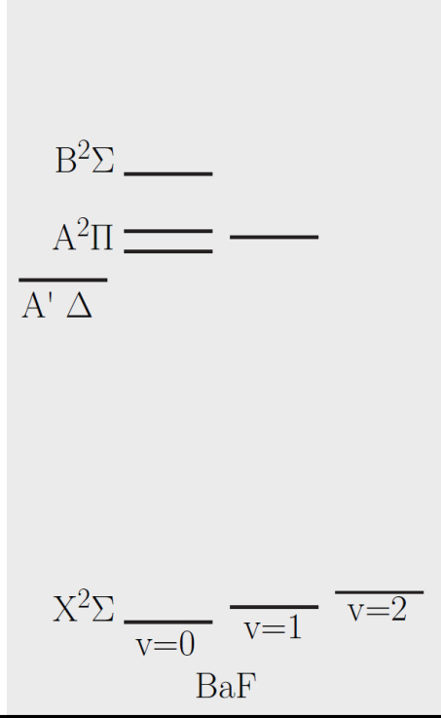
Cooling scheme
Two possible cooling schemes:
X ²Σ_{1/2}→ B ²Σ_{1/2} (CaF)
X ²Σ_{1/2} → A ²Π_{1/2} (CaF and SrF)
Use calculated FCFs (measure of overlap of vibrational wavefunctions) to determine the appropriate scheme
Diagonal FCFs→ efficient cooling

Slide 12
Cooling scheme
Two possible cooling schemes:
X ²Σ_{1/2}→ B ²Σ_{1/2} (CaF)
X ²Σ_{1/2} → A ²Π_{1/2} (CaF and SrF)
Use calculated FCFs (measure of overlap of vibrational wavefunctions) to determine the appropriate scheme
Diagonal FCFs→ efficient cooling

Slide 13
Cooling scheme
X ²Σ_{1/2}→ B ²Σ_{1/2}?

Slide 14
Cooling scheme
X ²Σ_{1/2}→ B ²Σ_{1/2}?
So no.

Slide 15
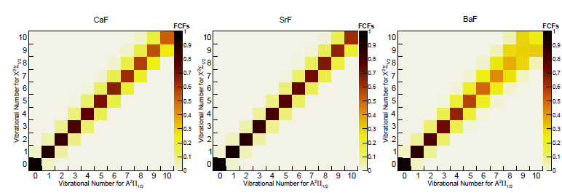
Cooling scheme
X ²Σ_{1/2} → A ²Π_{1/2}?

Slide 16
Cooling scheme
X ²Σ_{1/2} → A ²Π_{1/2}?
Yes!

Slide 17
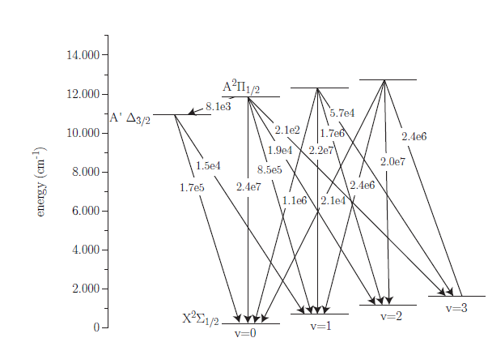
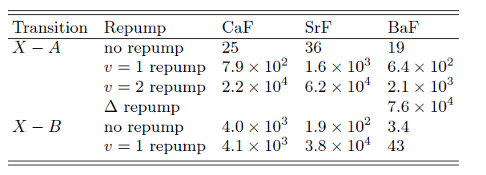
Cooling scheme

Slide 18
E_{eff} and W_{s} in BaF
In paramagnetic systems two main contributions to P,T-violating effect: the eEDM (d_{e}) and the S-PS nucleon-electron interaction (C_{S})
We need to know E_{eff} and W_{s} to interpret the experiment
M. Jung, JHEP 2013, 168 (2013)

Slide 19
Calculations
Relativistic coupled cluster (finite field)
New implementation needed
Extensive tests of computational parameters to set an uncertainty on the result

Slide 20
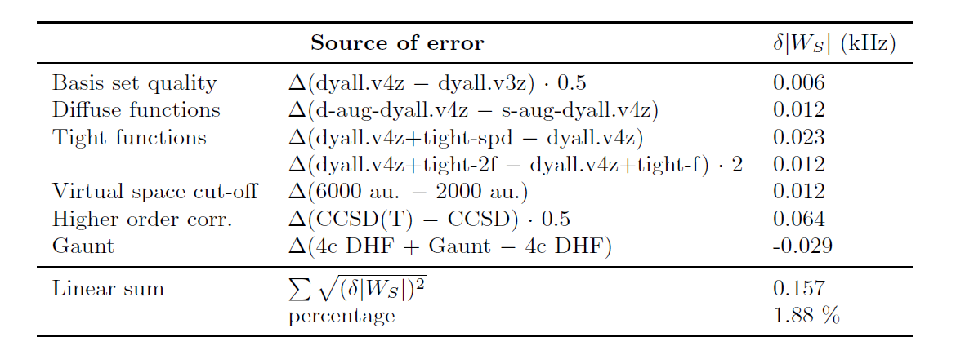
Calculations
Uncertainty evaluation for W_{s}:

Slide 21
Results
Method | E_{eff} (GV/cm) | Ref.
CCSD(T)+Gaunt | 6.33±0.14 | Present
RECP+SCF+EO | 7.5 | Kozlov et al., PRA 56 R3326 (1997)
4c-RASCI | 7.28 | Nayak and Chaudhuri, J. Phys. B 39 1231 (2006)
4c-CISD | 4.32 | Fukuda et al., PRA 93, 012518 (2016)
GKS ZORA | 6.0 | Gaul and Berger, JCP 86, 014109 (2017)
CCSD(T) | 6.46 | Abe et al., PRA 97 032515 (2018)
CCSD | 6.6 | Sunaga et al., PRA 98, 042511 (2018)
Method | W_{s} (KHz) | Ref.
CCSD(T)+Gaunt | 8.30±0.16 | Present
RECP+SCF+EO | 5.9 | Kozlov et al., PRA 56 R3326 (1997)
4c-RASCI | 9.7 | Nayak et al., PRA 75 022510 (2007)
MBPT | 8.4 | Nayak and Chaudhuri, PRA 78, 012506 (2008)
CCSD | 8.4 | Sunaga et al., PRA 98, 042511 (2018)

Slide 22
Magnetic hyperfine constant
Can be used to test our expected accuracy
Method | A|| (MHz) | Ref.
CCSD(T)+Gaunt | 2355 | Present
Exp. | 2376(12) | Chem. Phys. 71, 389 (1982)

Slide 23
Conclusions
Calculations of spectroscopic properties of BaF for efficient cooling scheme
New implementations carried out for calculation of E_{eff}, W_{s}, and A||
Method of choice: relativistic coupled cluster, the most powerful and accurate method for treatment of small heavy systems
Results can be improved systematically; we are able to set uncertainties on the predicted values

Slide 24
Yongliang Hao: properties, Pi Haase E_{eff}, A||, Diewertje Doeglas: W_{s}

Slide 25
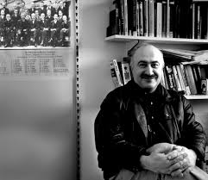
Ephraim Eliav
Miroslav Ilias
Lukas Pasteka
Miroslav Ilias

Slide 26
Thank you for your attention!
Ephraim Eliav
Miroslav Ilias
Lukas Pasteka
Miroslav Ilias

Slide 27
Ephraim Eliav
Miroslav Ilias
Peter Schwerdtfeger
Victor Flambaum
Miroslav Ilias

Slide 28
Relativistic coupled cluster
Extremely powerful and accurate method for electron correlation
Exponential wave operator:
S is the excitation operator:
CC energy equations:

Slide 29
Relativistic coupled cluster
CCSD(T) - single reference coupled cluster
Closed shell systems/systems with one dominant configuration (good example: BaF, X ²Σ)
FSCCSD – multireference Fock space coupled cluster
Open shell systems, excited states, bond dissociation
(good example: ThO, ³Δ₁)
Use the most suitable method, or both in complementary manner.

Slide 30
Finite Field Approach
Obtaining expectation values/matrix elements within CC problematic (some implementations available/ongoing)
Alternative: use finite field approach
Established method: dipole moments, polarizabilities, effective field gradients...
Basic idea:
H=H⁽⁰⁾+λH′
Expectation value is obtained from the derivative of the energy with respect to λ

Slide 31
Finite Field Approach
Example: effective electric field, E_{eff}

Slide 32
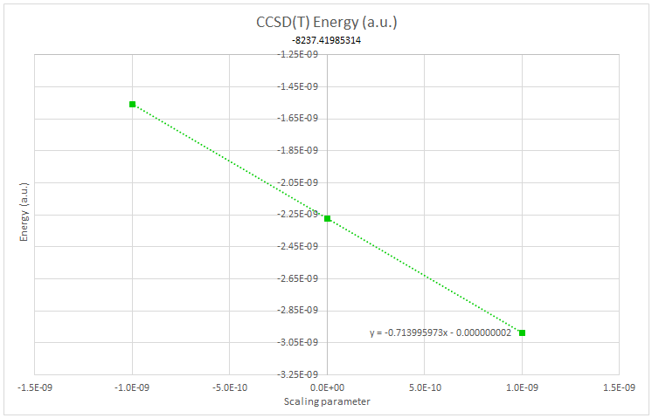
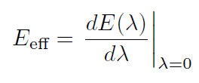
Finite Field Approach
Example: effective electric field, E_{eff}
Abe et al., PRA 97, 032515 (2018)

Slide 33
Finite Field Approach
Properties:
E_{eff}
Scalar-pseudoscalar interaction coefficient W_{s}
NAM interaction coefficient W_{A}
Magnetic hyperfine coupling constants
...
Developers version of the DIRAC program
CCSD(T), FSCC, DHF, MP2
Systematic investigation of effect of computational parameters and uncertainty evaluation

Slide 34
W_{A} coefficient in BaF
Nuclear anapole moment is the dominant NSD-PV effect in heavy systems
Planned measurement in BaF*
W_{A} coefficient can be used to extract anapole from measurements
E. Altuntas et al., PRL 120, 142501 (2018)

Slide 35
W_{A} coefficient in BaF
Computational parameters:
Basis set
Correlation: method (DHF/DFT/MP2/CCSD(T)/FSCC)
Correlation (CC): higher excitations
Correlation (CC): number of correlated electrons and virtual orbitals
Treatment of relativity (Gaunt term)

Slide 36
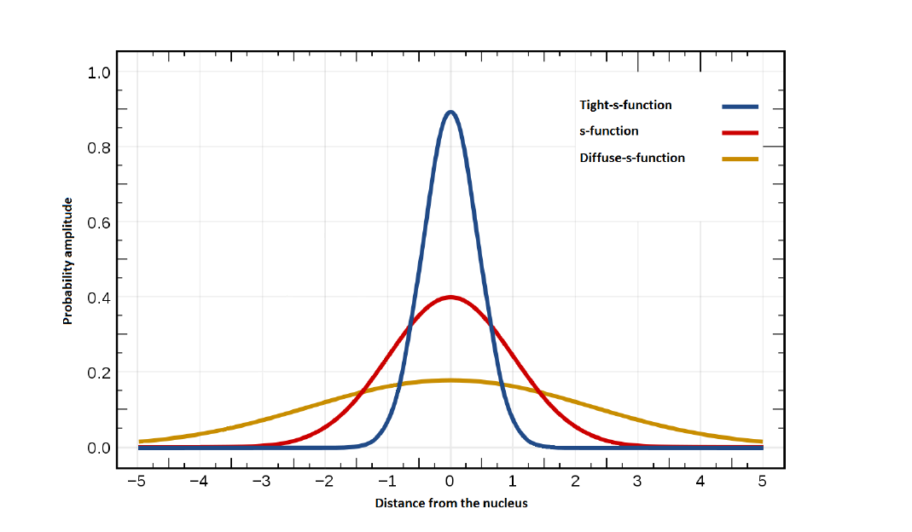
Basis set effects
We use relativistic basis sets of Dyall*
Manually augment with diffuse and tight functions
K. G. Dyall, JPCA 113, 12638 (2009), Theor. Chem. Acc. 135, 128 (2016)
D. Doeglas, Master Thesis

Slide 37
Basis set effects
Basis set quality:
Diffuse functions:
Tight functions:
 | v2z | v3z | v4z
N. functions | Ba: 25s19p13d F: 10s6p1d | Ba: 31s24p16d3f F: 14s8p2d1f | Ba: 35s30p19d4f3g F: 18s10p3d2f1g
W_{A} (Hz) | 129.22 | 141.42 | 141.84
 | v4z | s-aug-v4z (Ba) | s-aug-v4z (F)
W_{A} (Hz) | 141.84 | 141.76 | 141.05
 | v4z | v4z+ts | v4z+tp | v4z+td | v4z+tf | v4z+tg
W_{A} (Hz) | 141.84 | 141.89 | 141.97 | 141.82 | 143.02 | 142.31

Slide 38
Correlation space
E
.
.
.

Slide 39
Correlation space
E
30 a.u.
-20 a.u.
.
.
.

Slide 40
Correlation space
E
Virtual space cutoff | 30 a.u. | 500 a.u.
W_{A} (Hz) | 144.4 | 148.4
30 a.u.
 | Standard corr. space | all e, 500 a.u.
W_{A} (Hz) | 143.0 | 148.4
-20 a.u.
Correlated electrons | -20 a.u. cutoff | all electrons
W_{A} (Hz) | 143.5 | 148.4
.
.
.

Slide 41
Correlation treatment and final result
Method | W_{A} (Hz)
DHF | 112.3
DFT(CAMB3LYP) | 112.9
MP2 | 138.3
CCSD | 150.7
CCSD(T) | 148.4
FSCC | 148.8
Source of error | |ΔW_{A}| (Hz)
Basis set | 0.5
Virtual space cut-off | 1.0
Higher excitations | 1.5
Full Breit; QED | 0.7
Numerical | 0.5
Total | 2
Gaunt contribution: -0.7 Hz (on DHF level)
W_{A}(CCSD(T)+Gaunt)=147.7±2 Hz

Slide 42
Recommended value
Method | W_{A} (Hz) | Ref.
CCSD(T)+Gaunt | 147.7±2 | Present
RECP+SCF+EO | 181 | Kozlov et al., PRA 56 R3326 (1997)
Semiempirical | 164 | DeMille et al., PRL 100, 023003 (2008)
4c-RASCI | 160 | Nayak and Das, PRA 79, 060502 (2009)
Scaled ZORA-HF | 190 | Isaev & Berger, PRA 86, 062515 (2012)
DHF/DFT+CP | 146 | Borschevsky et al., PRA 88, 022125 (2013)

Slide 43
Conclusions
High accuracy relativistic

Slide 44
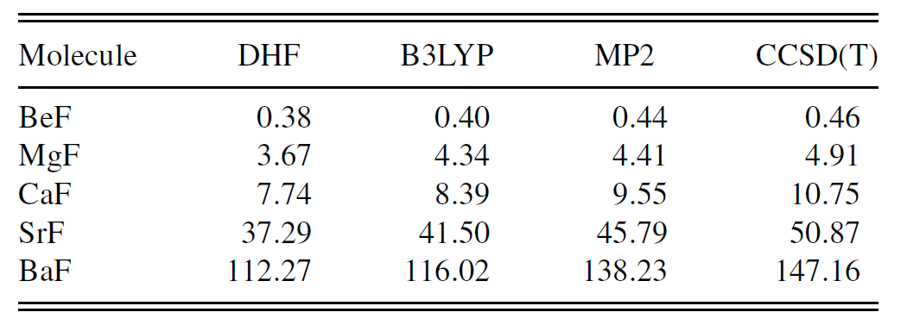
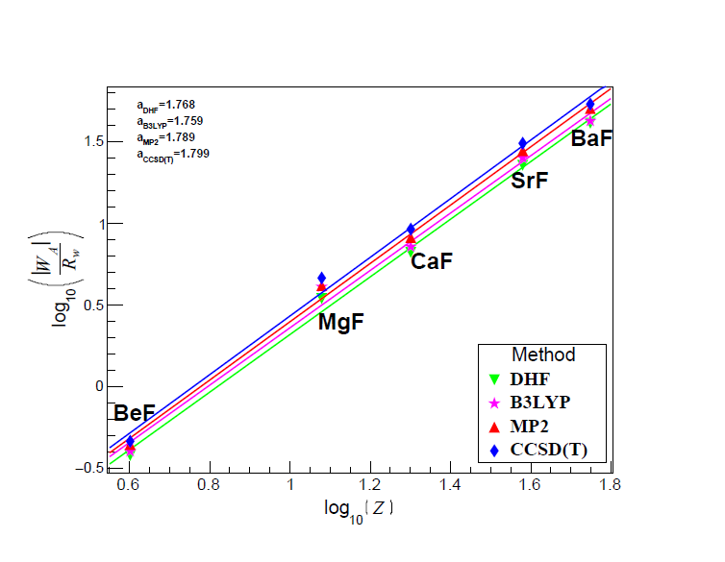
Trends in the group
W_{A} is expected to scale as Z²R_{W}
Flambaum et al., Phys. Lett. B 146, 367 (1984)

Slide 45
Trends in the group
W_{A} is expected to scale as Z²R_{W}

Slide 46
E_{Eff} and W_{s} in BaF

Slide 47
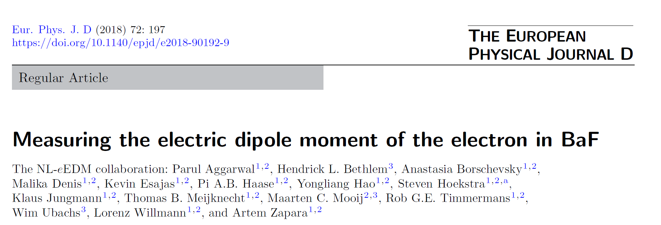
E_{Eff} and W_{s} in BaF

Slide 48
E_{Eff} and W_{s} in BaF
In paramagnetic systems two main contributions to the EDM are the eEDM (d_{e}) and the S-PS electron-nucleon interaction (C_{S})
Associated interaction coefficient:

Slide 49
Computational scheme
Extensive tests were carried out
Final computational scheme:
E_{eff}: Dyall’s v4z basis set+ tight f function
All electrons correlated, virtual cut-off: 2000 a.u.
CCSD(T)+Gaunt
W_{s}: Dyall’s s-aug-v4z basis set+ tight f function
All electrons correlated, virtual cut-off: 2000 a.u.
CCSD(T)+Gaunt

Slide 50
Results
Method | E_{eff} (GV/cm) | Ref.
CCSD(T)+Gaunt | 6.33±0.14 | Present
RECP+SCF+EO | 7.5 | Kozlov et al., PRA 56 R3326 (1997)
4c-RASCI | 7.28 | Nayak and Chaudhuri, J. Phys. B 39 1231 (2006)
4c-CISD | 4.32 | Fukuda et al., PRA 93, 012518 (2016)
GKS ZORA | 6.0 | Gaul and Berger, JCP 86, 014109 (2017)
CCSD(T) | 6.46 | Abe et al., PRA 97 032515 (2018)
CCSD | 6.6 | Sunaga et al., PRA 98, 042511 (2018)

Slide 51
Results
Method | W_{s} (KHz) | Ref.
CCSD(T)+Gaunt | 8.30±0.16 | Present
RECP+SCF+EO | 5.9 | Kozlov et al., PRA 56 R3326 (1997)
4c-RASCI | 9.7 | Nayak et al., PRA 75 022510 (2007)
MBPT | 8.4 | Nayak and Chaudhuri, PRA 78, 012506 (2008)
CCSD | 8.4 | Sunaga et al., PRA 98, 042511 (2018)

Slide 52
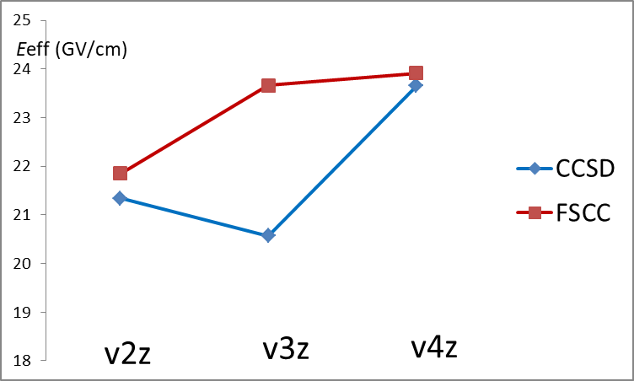
E_{eff} in YbF: multireference character
Ground state ²Σ (f¹⁴ s¹), but has a low-lying excited state (f¹³ s²)
Miltireference character; (T) are unstable. Use CCSD?
E_{eff} (GV/cm) | CCSD | FSCC
v2z | 21.34 | 21.85
v3z | 20.57 | 23.66
v4z | 23.65 | 23.91
Here, FSCC is better suited.

Slide 53
Magnetic hyperfine coupling constants
Getting an accuracy estimate
Useful in experiments
New implementation, first test case: Cs
Use FSCC to treat excited states
Large basis sets (t-aug-ae4z)

