Slide 1
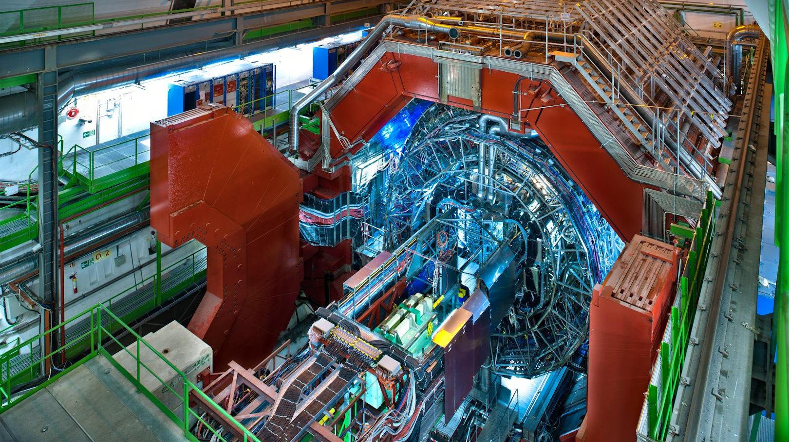

Heavy-Ion Physics : ALICE
Mike Sas, on behalf of the ALICE group
Jamboree Dec 2018

Slide 2
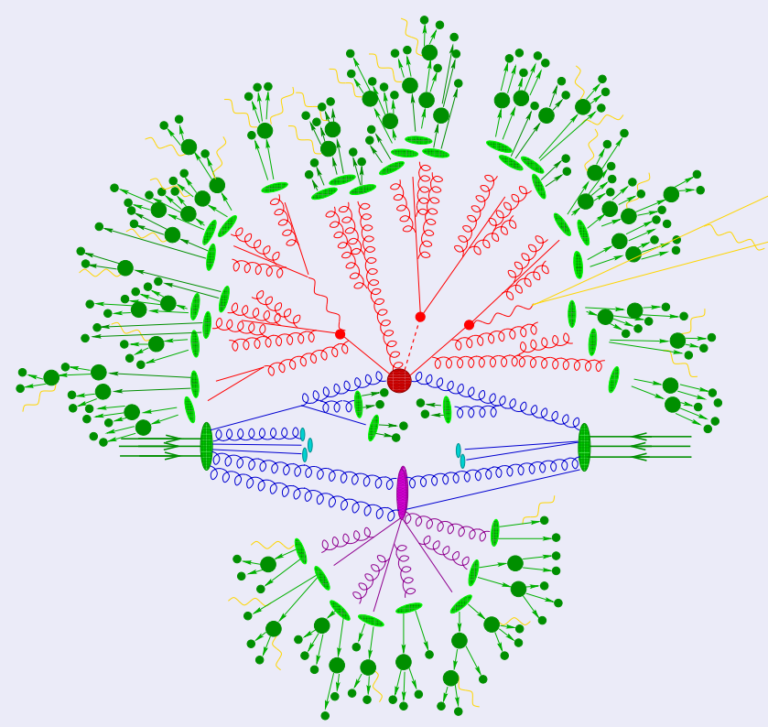
The situation in
proton-proton collisions
Hard interaction
Parton shower
Multiple parton interactions
Hadronisation
Hadron decays

Slide 3
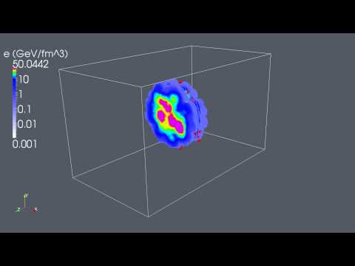
Heavy-ion collisions
All of the proton-proton stuff…and...
Many collisions superimposed
Energy density / temperature high enough for a phase transition to occur
Creation of hot strongly interacting matter →”QGP”
The game: Measure the properties of the QGP, by disentangling and understanding the mechanisms

Slide 4
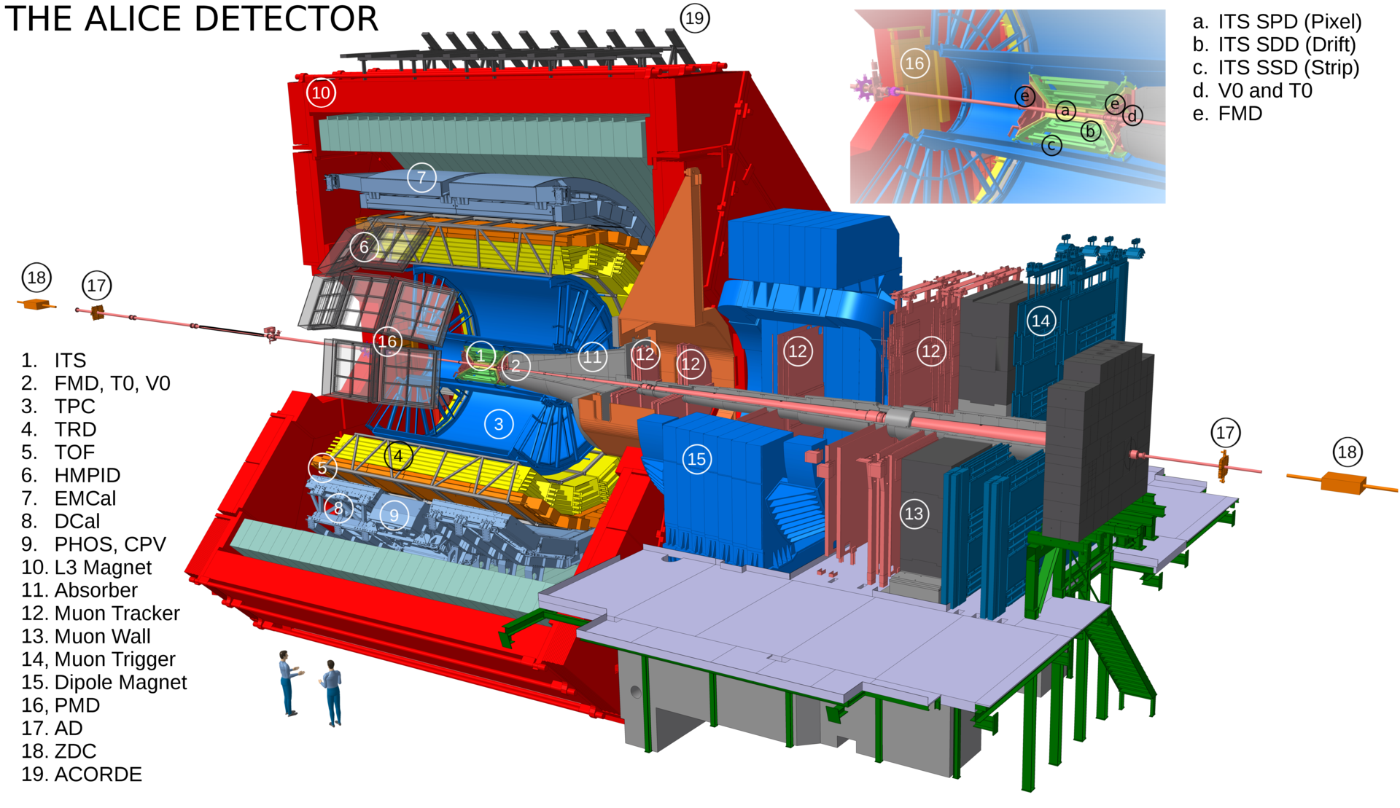

Slide 5

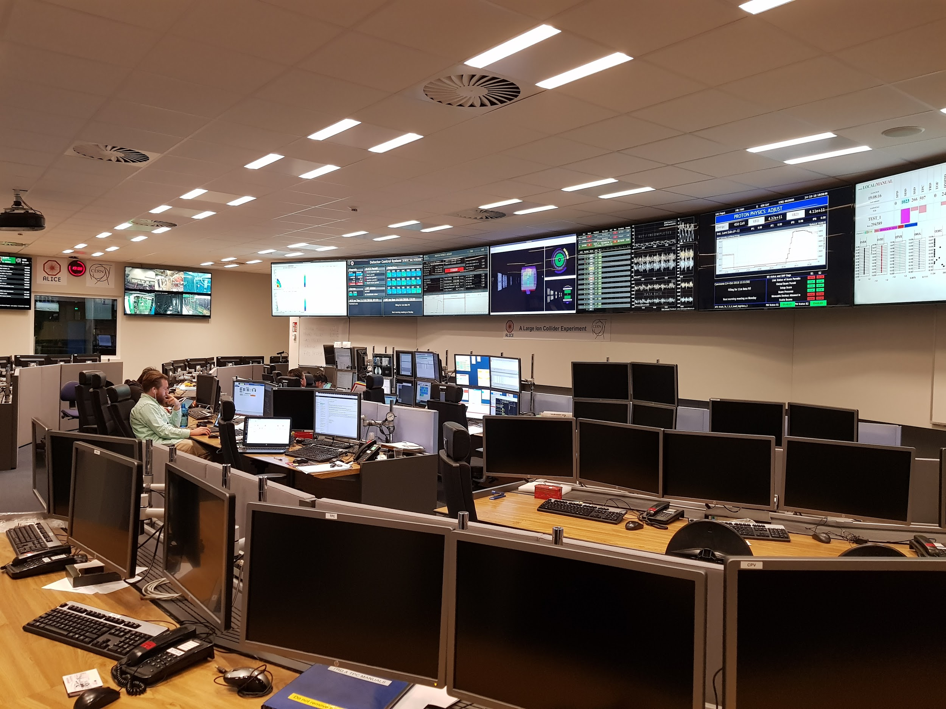
ALICE data taking

Slide 6
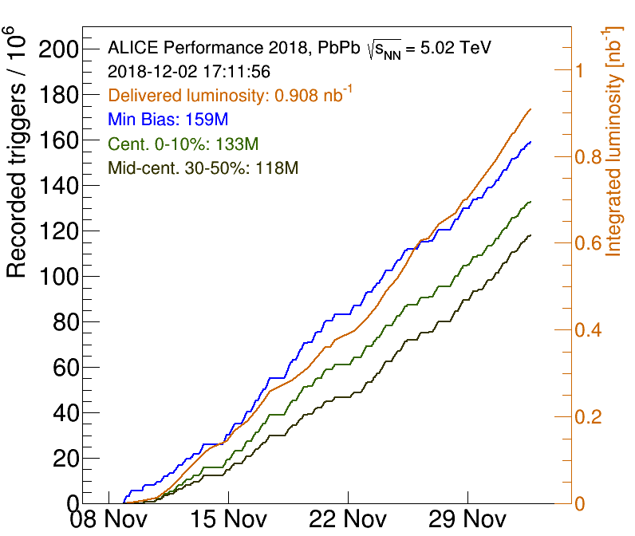
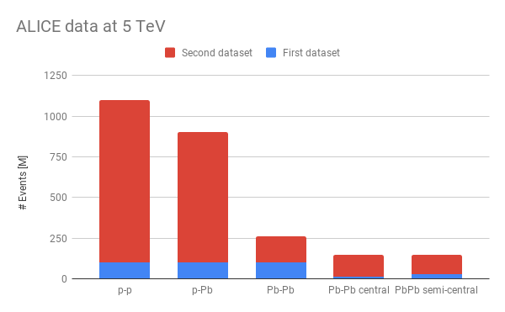
ALICE data taking

Slide 7
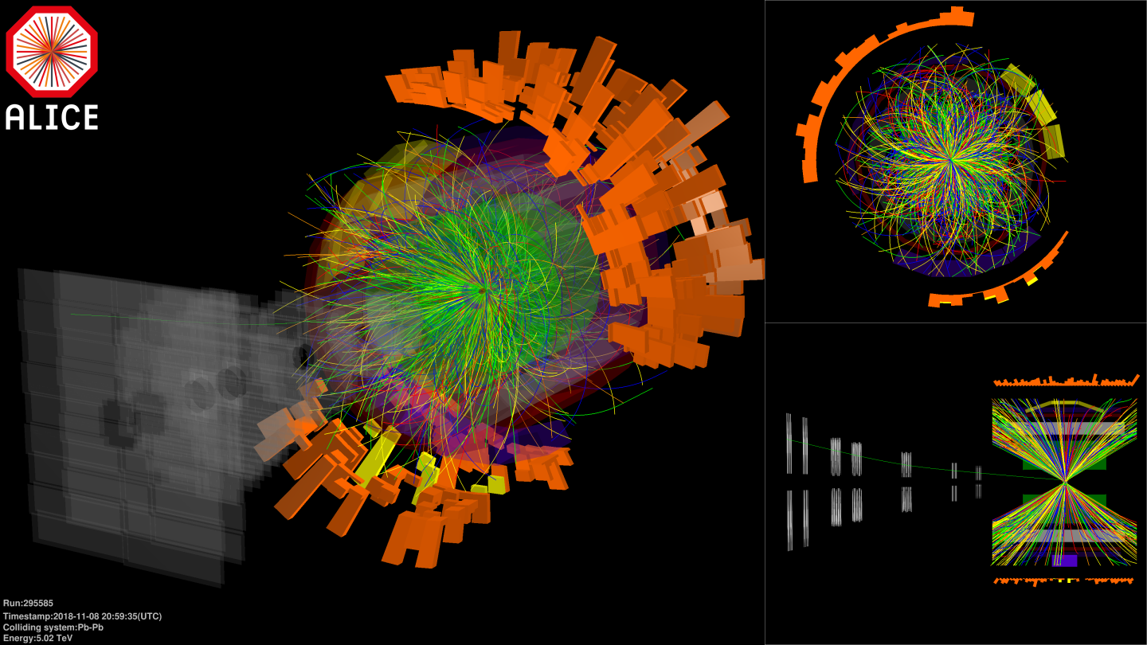

Slide 8

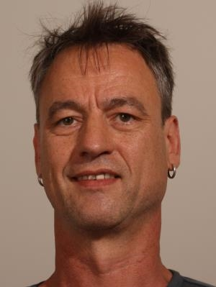
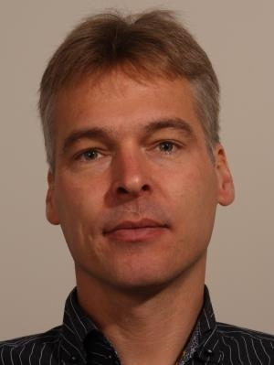

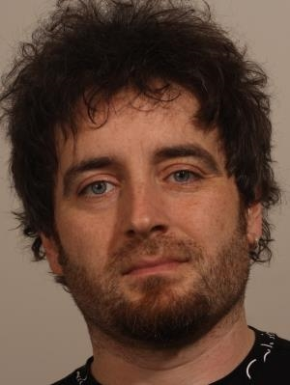
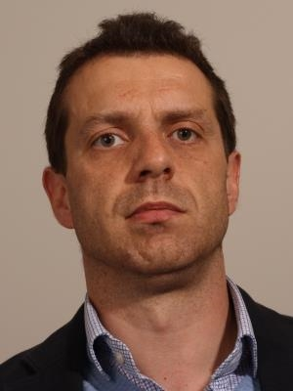
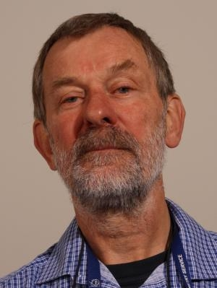
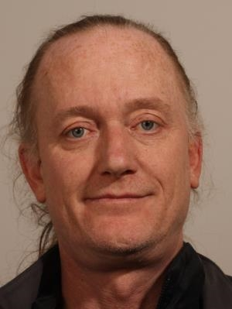

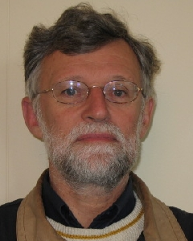
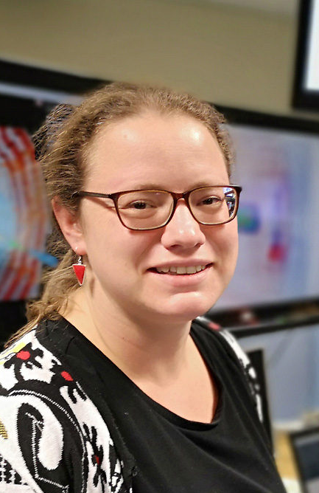

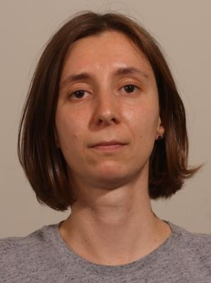
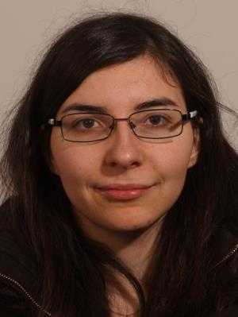
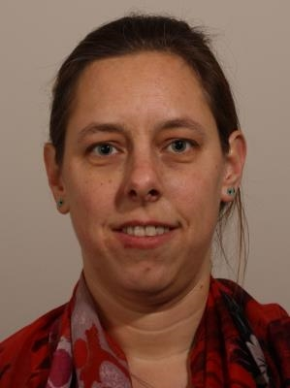
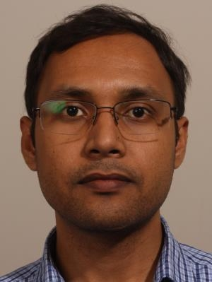
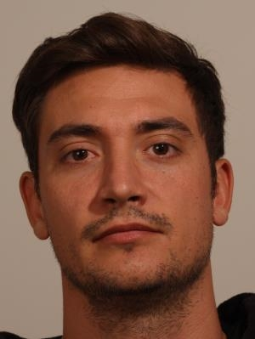
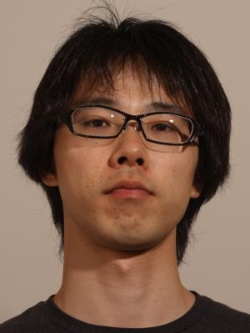
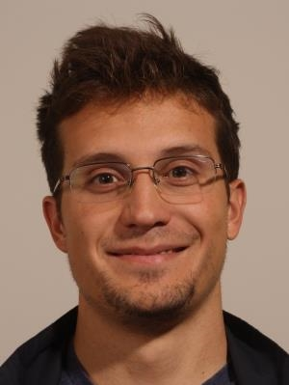
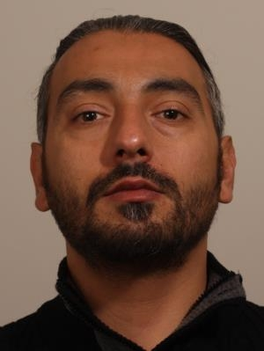
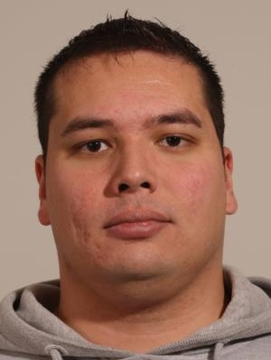


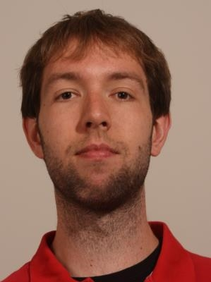
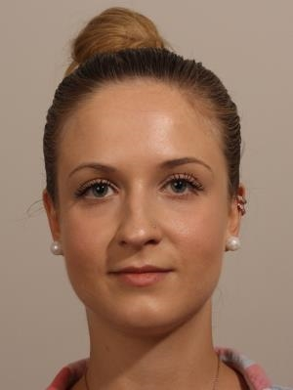
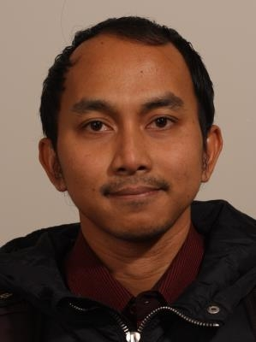
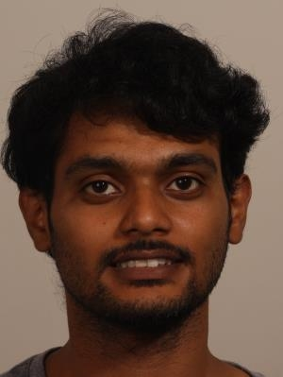

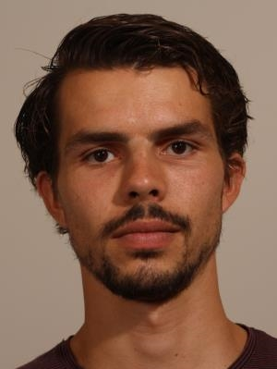

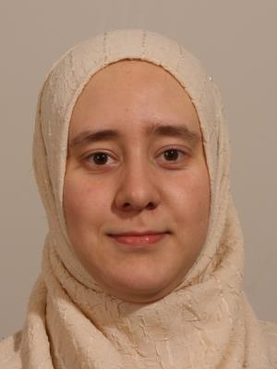
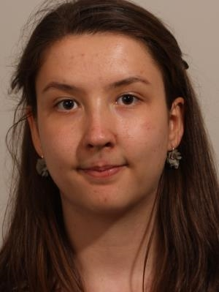

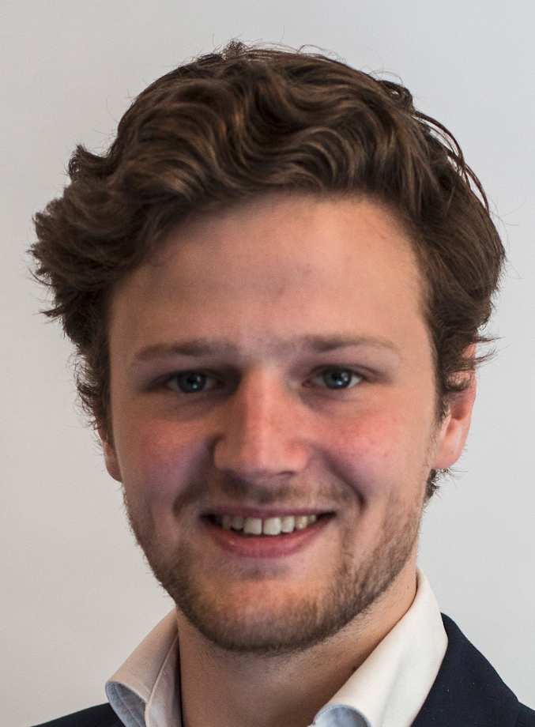
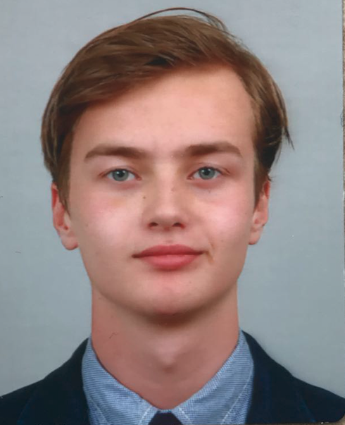

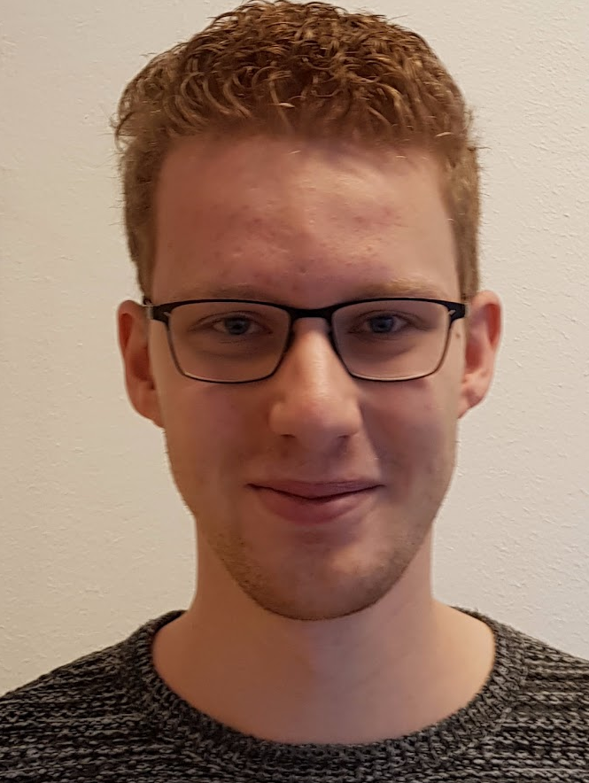
Our group
Staff
Post-doc
Westerdijk Fellowship
PhD
Kees
Jerom
Rene
Loek
Fedor
Master
Bachelor

Slide 9
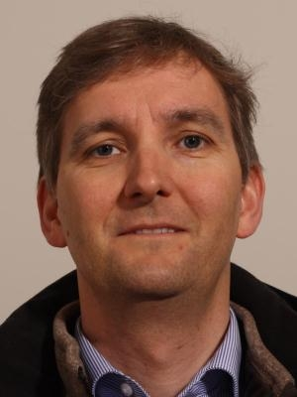
In memoriam

Slide 10
Our roles in the ALICE collaboration
Marco: Physics coordinator
Alessandro: Heavy Flavour working group convener
Barbara: HF Correlation and Jets analysis group coordinator
Davide: Correlations analysis group coordinator
Paul: ITS-upgrade coordinator
Panos: Conference committee member
Mike: Junior representative (finished this year)
Contribution to the “Yellow report”; a document about the future of our field.
Our presence is very significant and notable in ALICE and the whole Heavy-ion physics community!

Slide 11
Conferences & Prizes
Talks at all major conferences: ICHEP, Quark Matter, Hard Probes,...
Best experimental talk: Best poster:
Barbara Mike
Jacopo Cum laude!
“Rotating planes, fluctuating shapes”

Slide 12
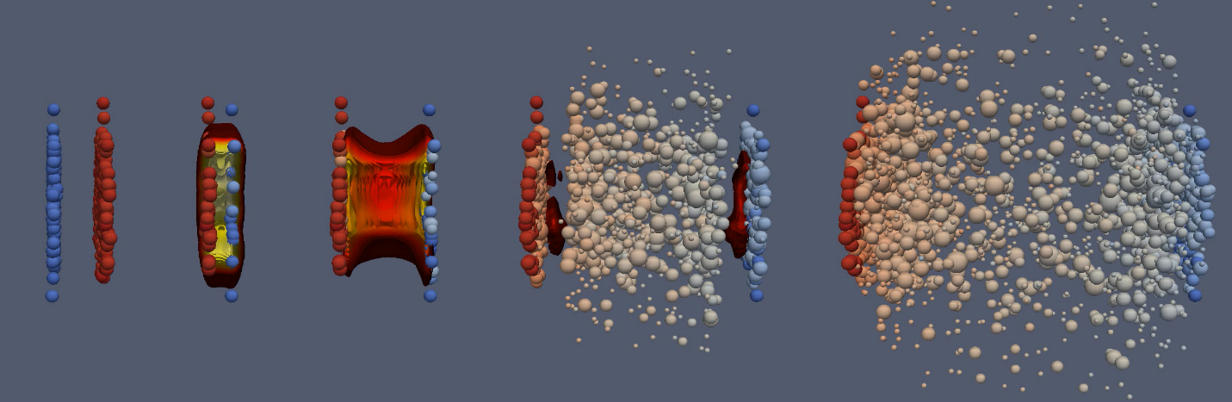
Our core business
Heavy flavour - Jets - Photons - Correlations

Slide 13
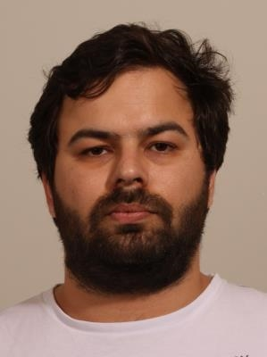
Papers & preliminaries - Heavy Flavour
Paper “Azimuthal anisotropy of heavy-flavour decay electrons in p-Pb collisions at 5.02 TeV”
https://arxiv.org/abs/1805.04367
Paper “Measurement of D0, D+, D∗+ and D+s production in Pb-Pb collisions at 5.02 TeV”
https://arxiv.org/abs/1804.09083
“D-meson cross section in pp at 5.02 TeV”
https://alice-figure.web.cern.ch/node/12780
“D* RpPb with reference measured at 5TeV”
https://alice-figure.web.cern.ch/node/13438
“Cross section, RpPb and RAA for D0-tagged jets at 5.02 TeV”
https://alice-figure.web.cern.ch/node/14622
https://alice-figure.web.cern.ch/node/14615

Slide 14
Papers & preliminaries - Jets
Papers & preliminaries - Photons
Paper “Medium modification of the shape of small-radius jets in central Pb-Pb collisions at 2.76 TeV”
https://arxiv.org/abs/1807.06854
Paper “Neutral pion and η meson production in p-Pb collisions at 5.02 TeV”
https://arxiv.org/abs/1801.07051
Paper “Direct photon elliptic flow in Pb-Pb collisions at 2.76 TeV”
https://arxiv.org/abs/1805.04403
“Neutral meson measurements in pPb collisions at 5.02 TeV as function of multiplicity”
http://alice-figure.web.cern.ch/node/14495

Slide 15
Papers & preliminaries - Correlations
Paper “Energy dependence and fluctuations of anisotropic flow in Pb–Pb collisions at 5.02 and 2.76 TeV”
https://arxiv.org/abs/1804.02944
Paper “Constraining the magnitude of the Chiral Magnetic Effect with Event Shape Engineering in Pb-Pb collisions at 2.76 TeV”
https://arxiv.org/abs/1709.04723
“Charge-dependent directed flow of D0 meson in Pb-Pb collisions at 5.02 TeV”
https://alice-figure.web.cern.ch/node/14441
“Chiral magnetic effect in run 2 data”
https://alice-figure.web.cern.ch/node/13598
“Transverse sphericity dependent pion femtoscopy in pp @ 7 TeV”
https://alice-figure.web.cern.ch/node/7334
“Charged particles and Identified balance functions measurements with Run2 data”
https://alice-figure.web.cern.ch/node/13995

Slide 16
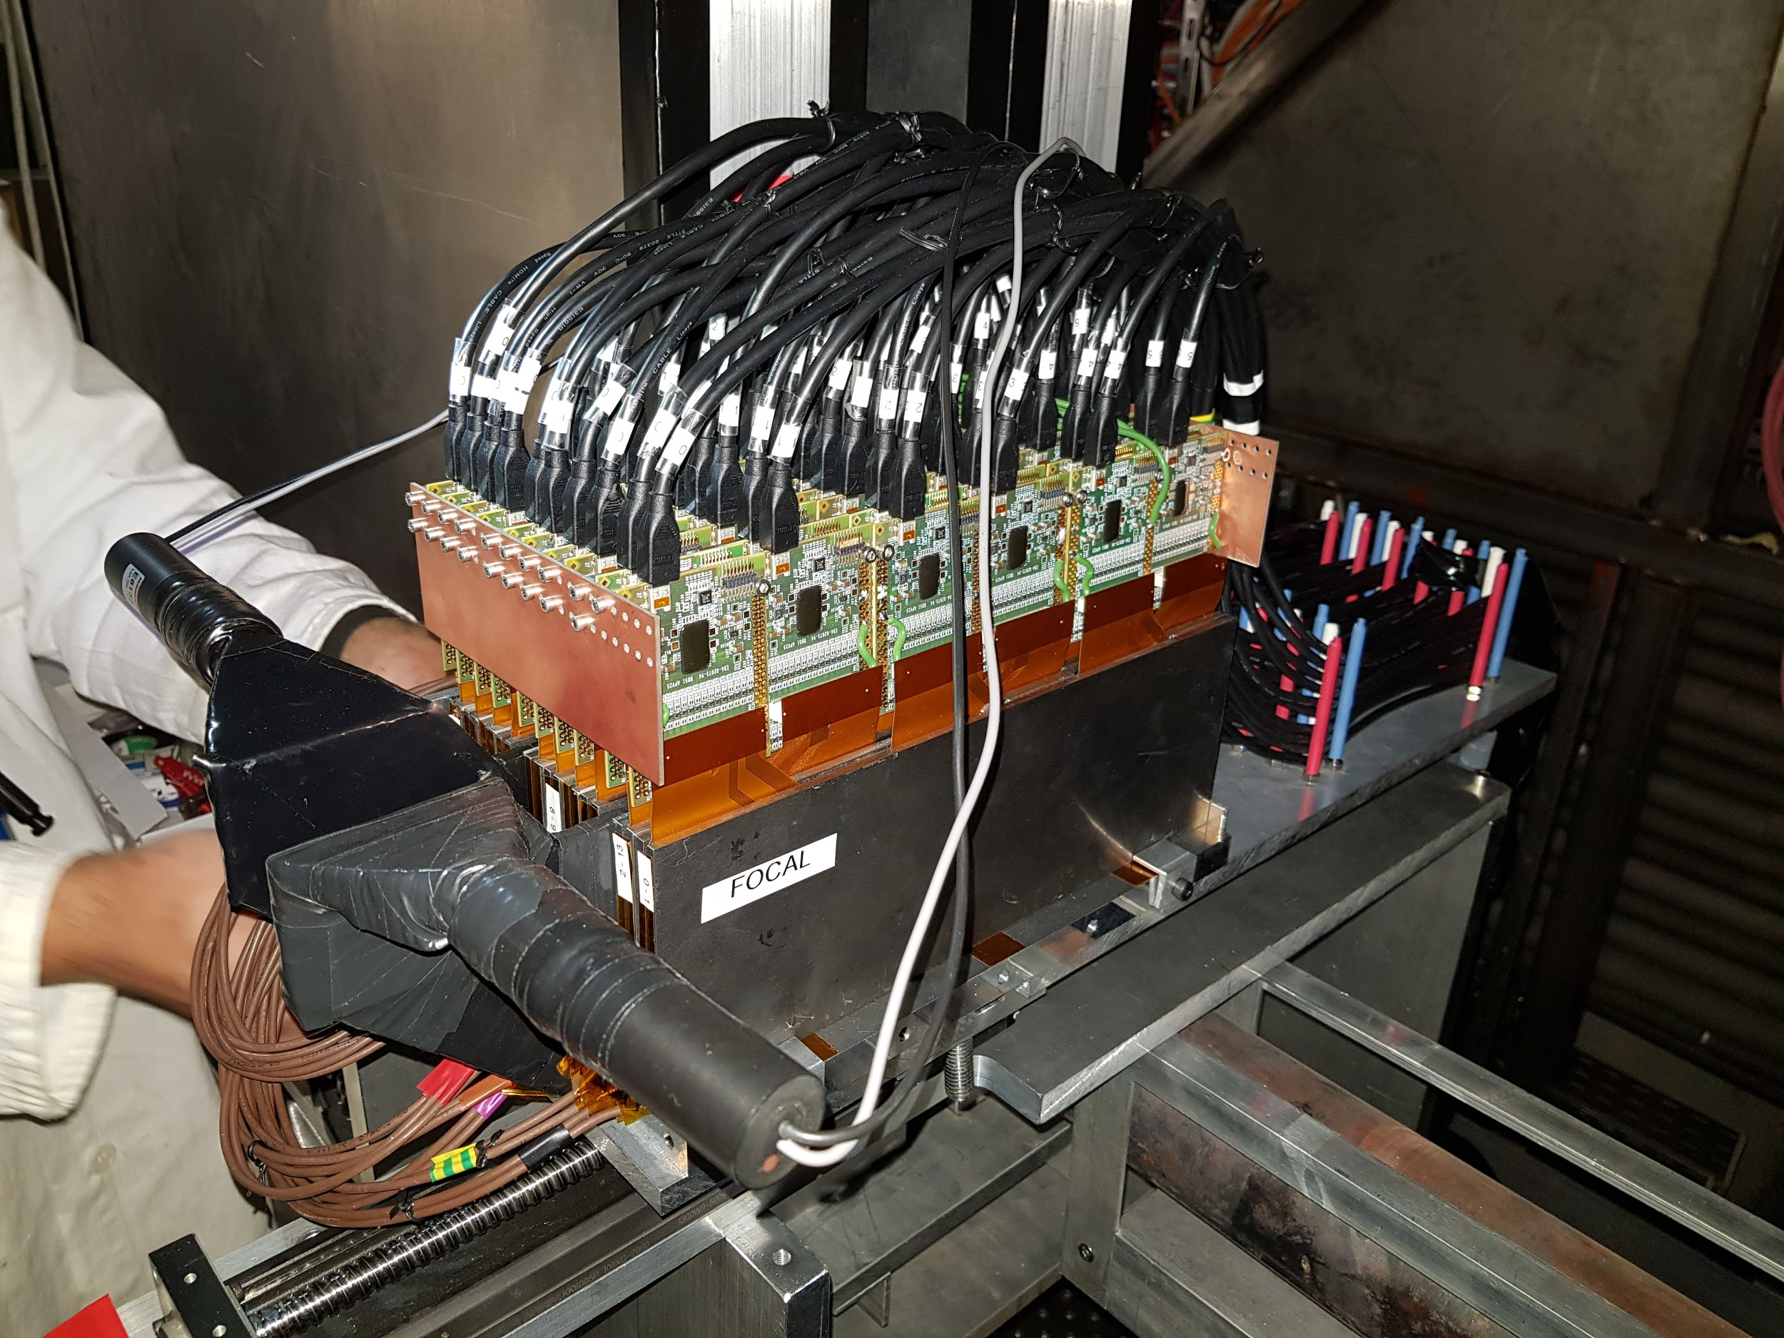
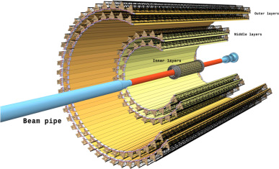
FoCal & ITS upgrade
Paper “The FoCal prototype“
https://arxiv.org/abs/1708.05164 FoCal prototype test at point 2
ITS upgrade
Paper “Hadronic Energy Resolution of a Combined
High Granularity Scintillator Calorimeter System”
https://arxiv.org/abs/1809.03909

Slide 17
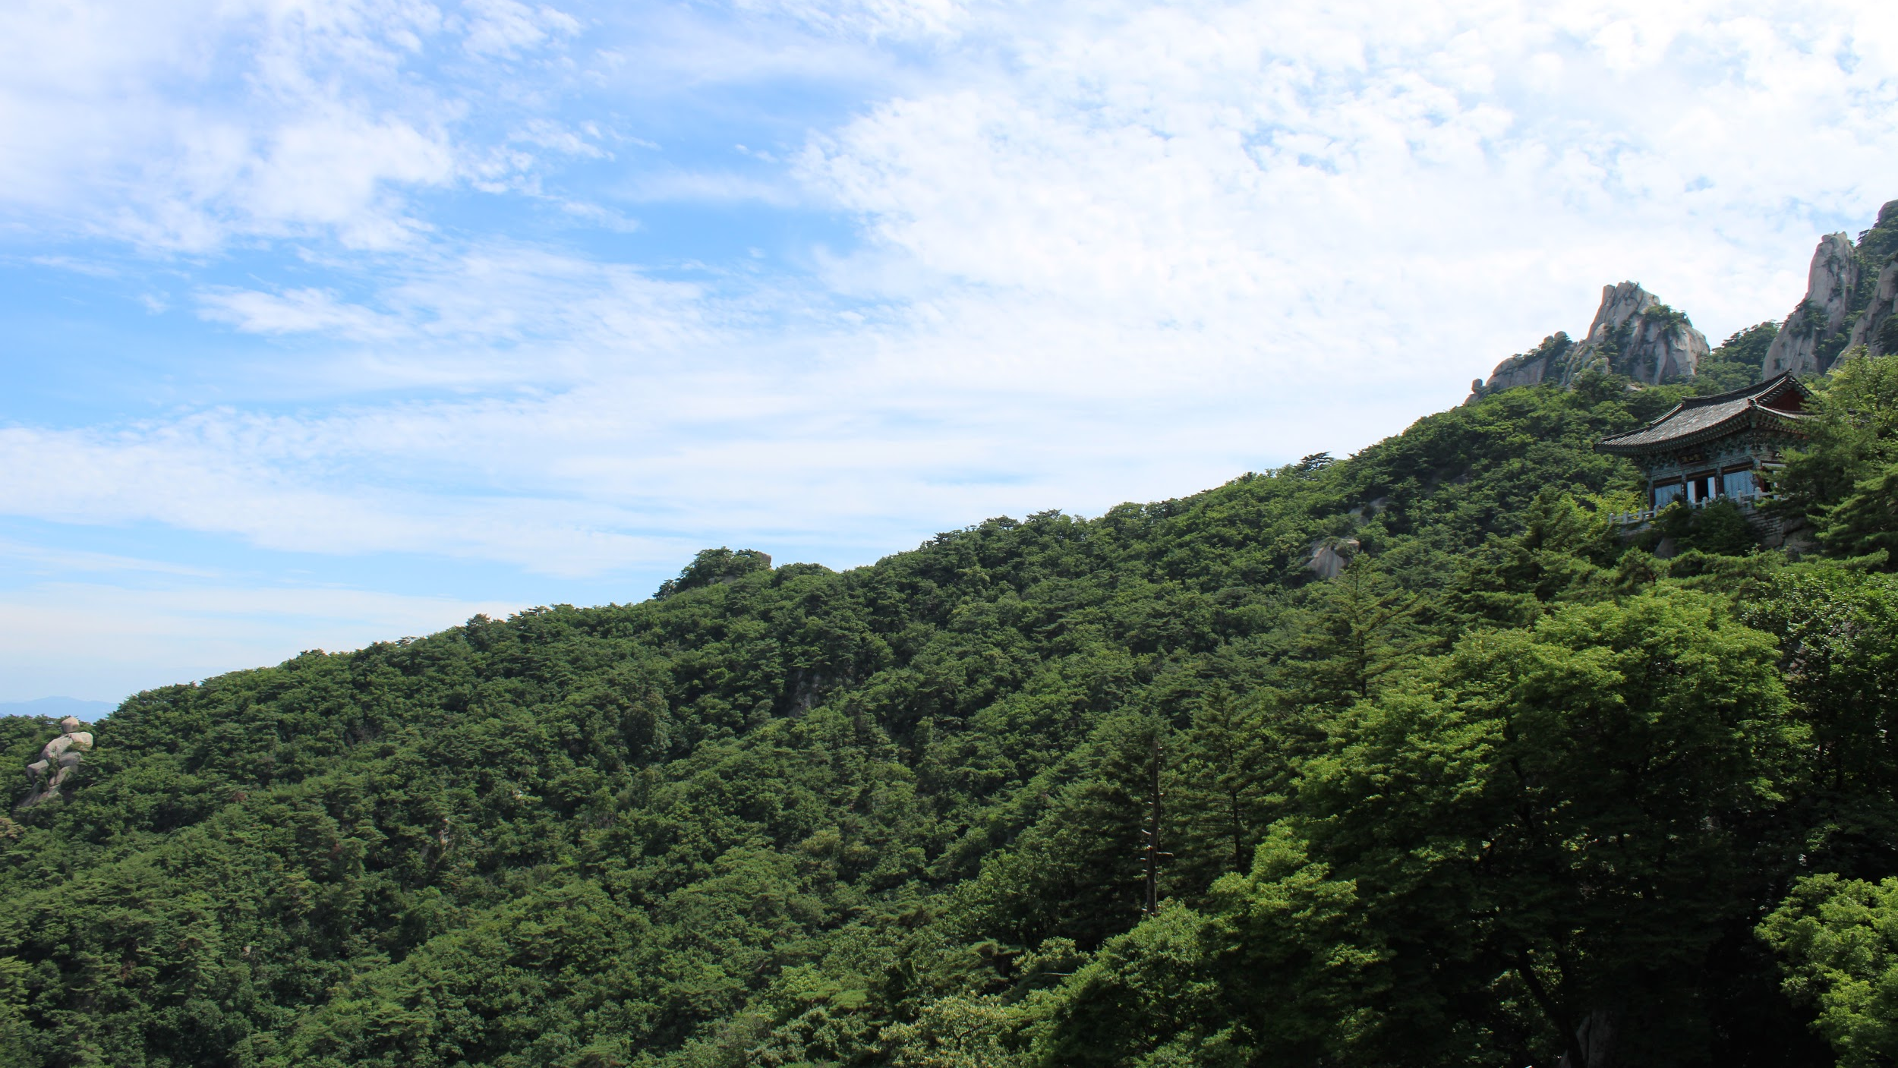
Next talks
Physics - Davide
ITS upgrade - Goran
FoCal - Naomi

Slide 18
Backup

Slide 19
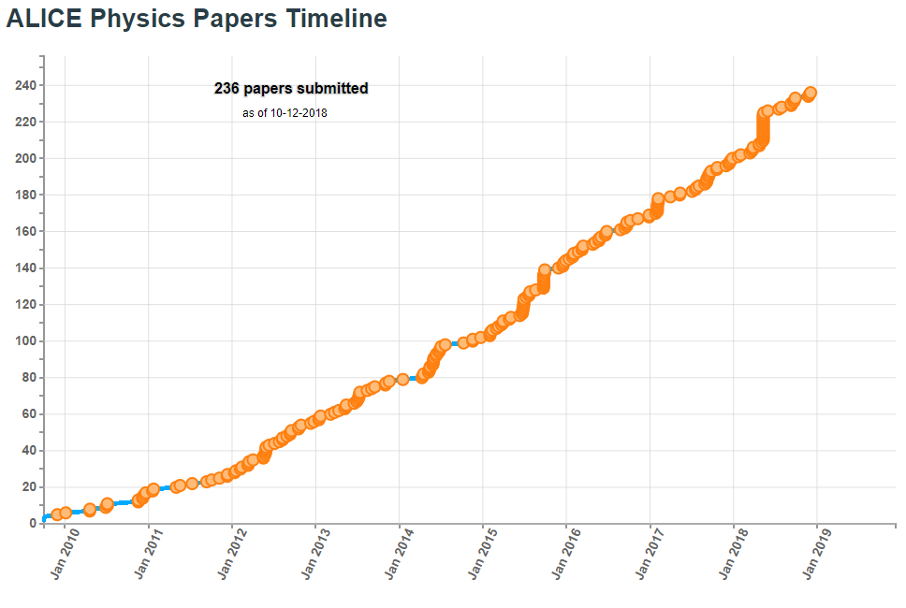
Total ALICE papers

