Slide 1
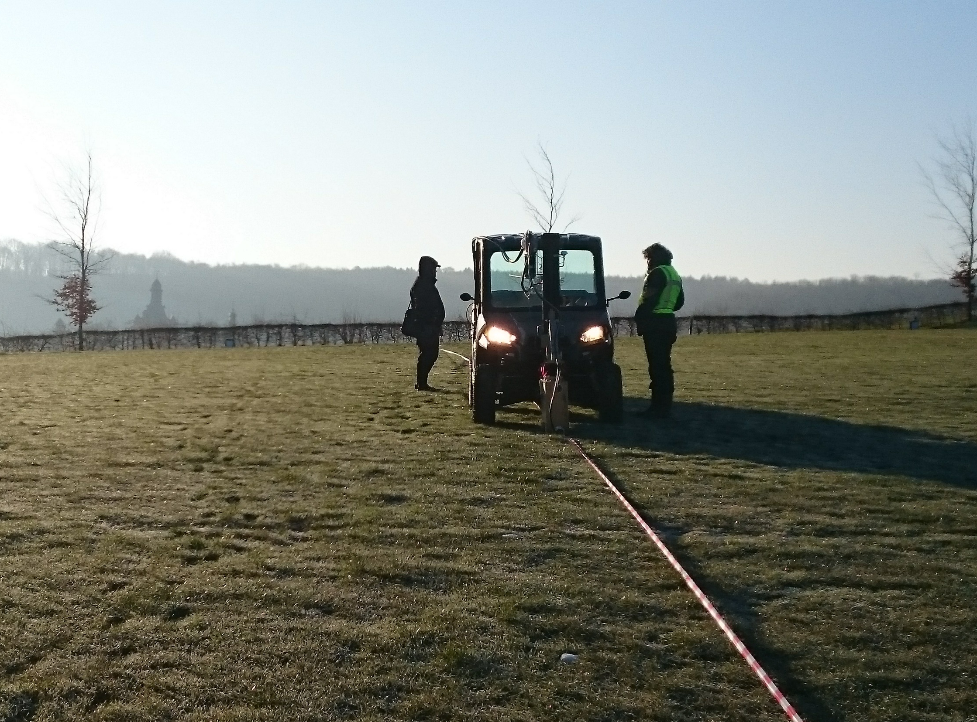
Seismic Campaigns and
ET-pathfinder
Henk Jan Bulten, Nikhef Jamboree Dec 17/18, 2018

Slide 2
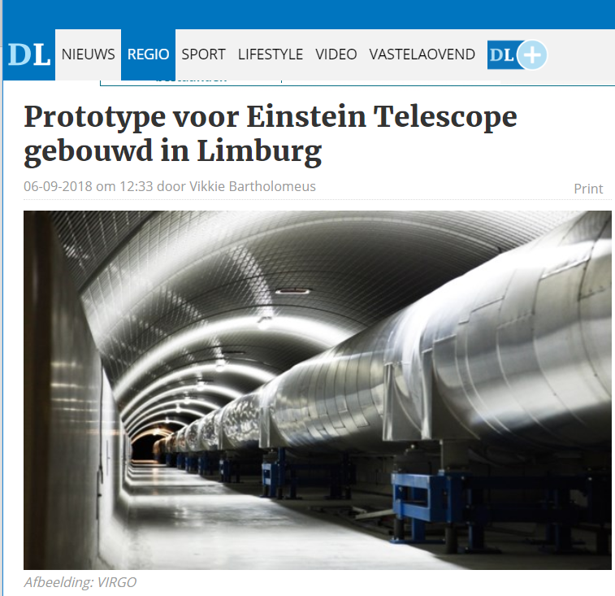
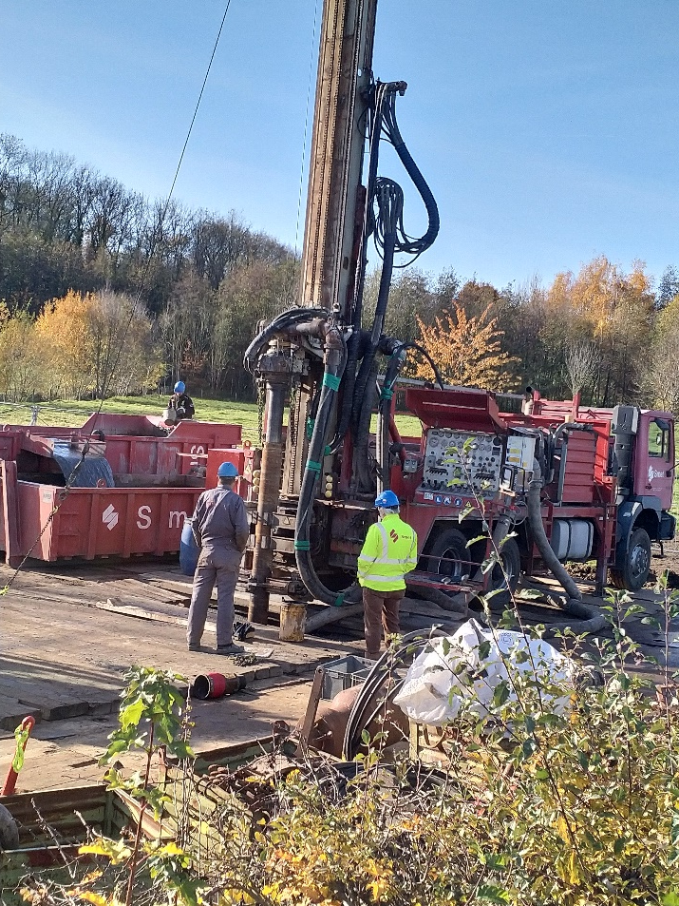
Seismic Campaigns & ET Pathfinder
Nikhef members from R&D, ET, MT, gravitational waves
Seismic Campaigns:
Ph. D: Soumen Koley (geophysics), Maria Bader (Newtonian Noise), Vincent van Beveren (wireless networking), Laura van der Schaaf, Boris Boom
Staff Frank Linde, Niels van Bakel, Alessandro Bertollini, Martin van Beuzekom, Jo van den Brand, Henk Jan Bulten, Martin Doets, Eric Hennes, Marco Kraan, Gideon Koekkoek, Paul Kuyer, Matteo Tacca, Bas Swinkels, Jan Visser

Slide 3
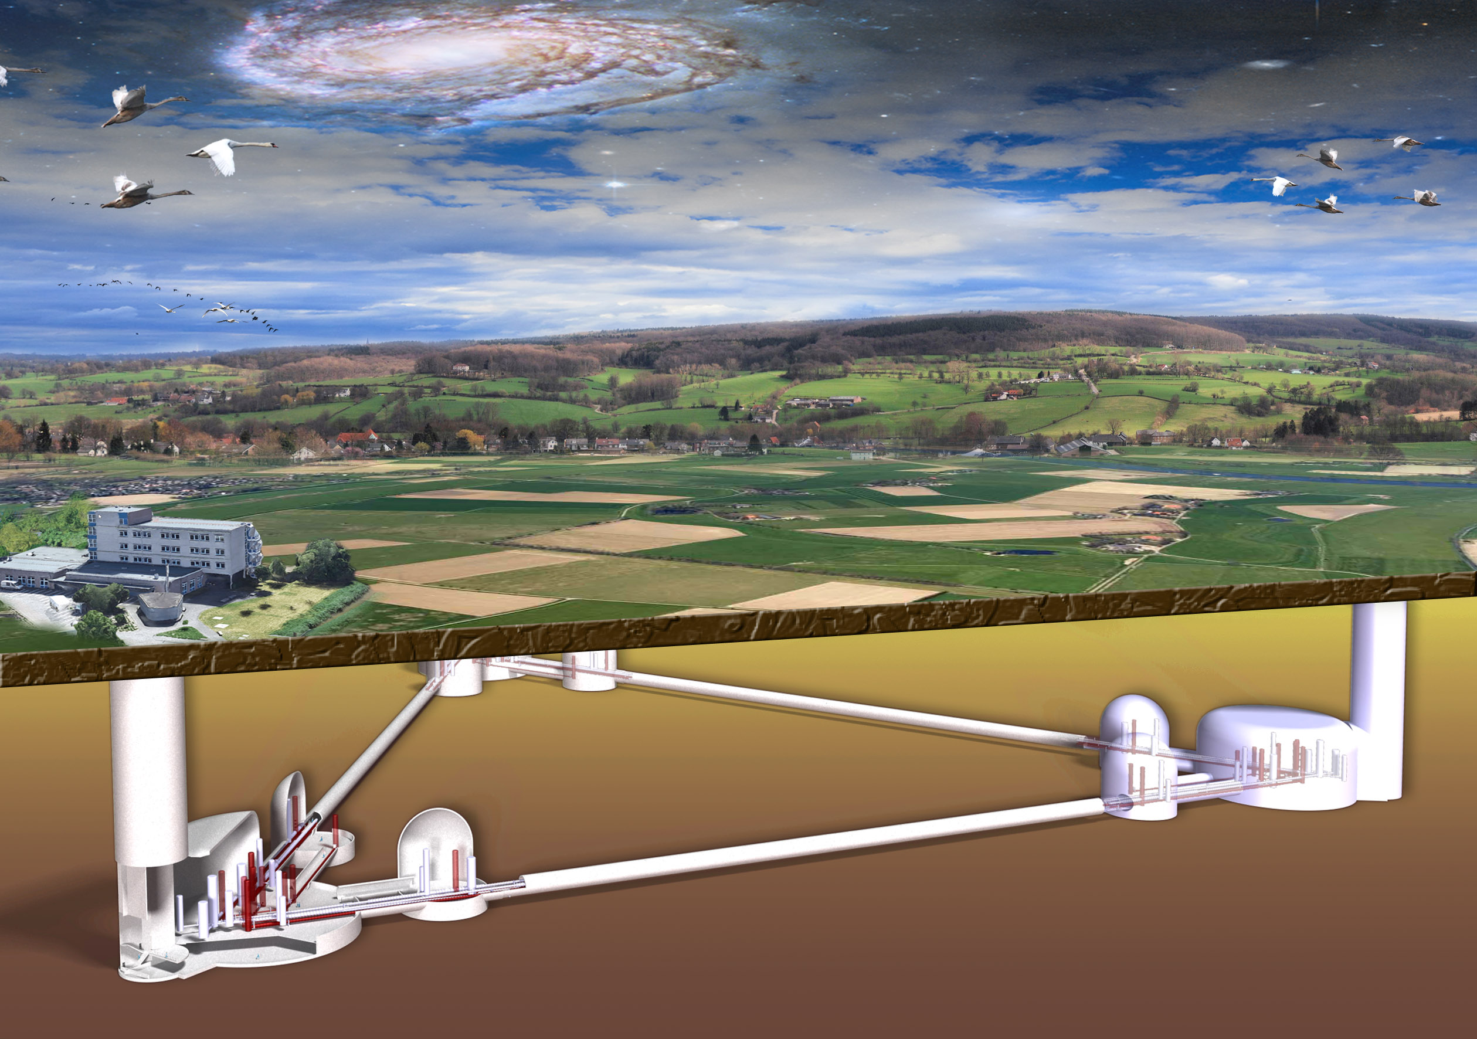
Einstein telescope, next generation detector
Detector with higher sensitivity and starting at lower frequencies
- underground to reduce seismic noise
- longer arms (higher sensitivity) and more power in cavities (lower quantum noise)
- Cryogenic Silicon mirrors (lower thermal noise)
- 3 interferometers (measure all GW-polarizations)

Slide 4
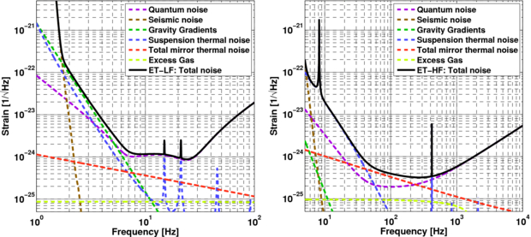
Einstein telescope sensitivity limits
Thermal noise limits the sensitivity in mid-frequency range, Newtonian Noise at low frequencies
Radiation pressure
Shot noise
Thermal noise dominant 10-200 Hz.
Low frequencies:
Quantum noise: heavy mirrors, 18 kW beam power, squeezing. Seismic noise: underground. Thermal noise: cryogenic.
High-frequencies:
shot noise limited. Room temperature, 3 MW beam power in arms.

Slide 5
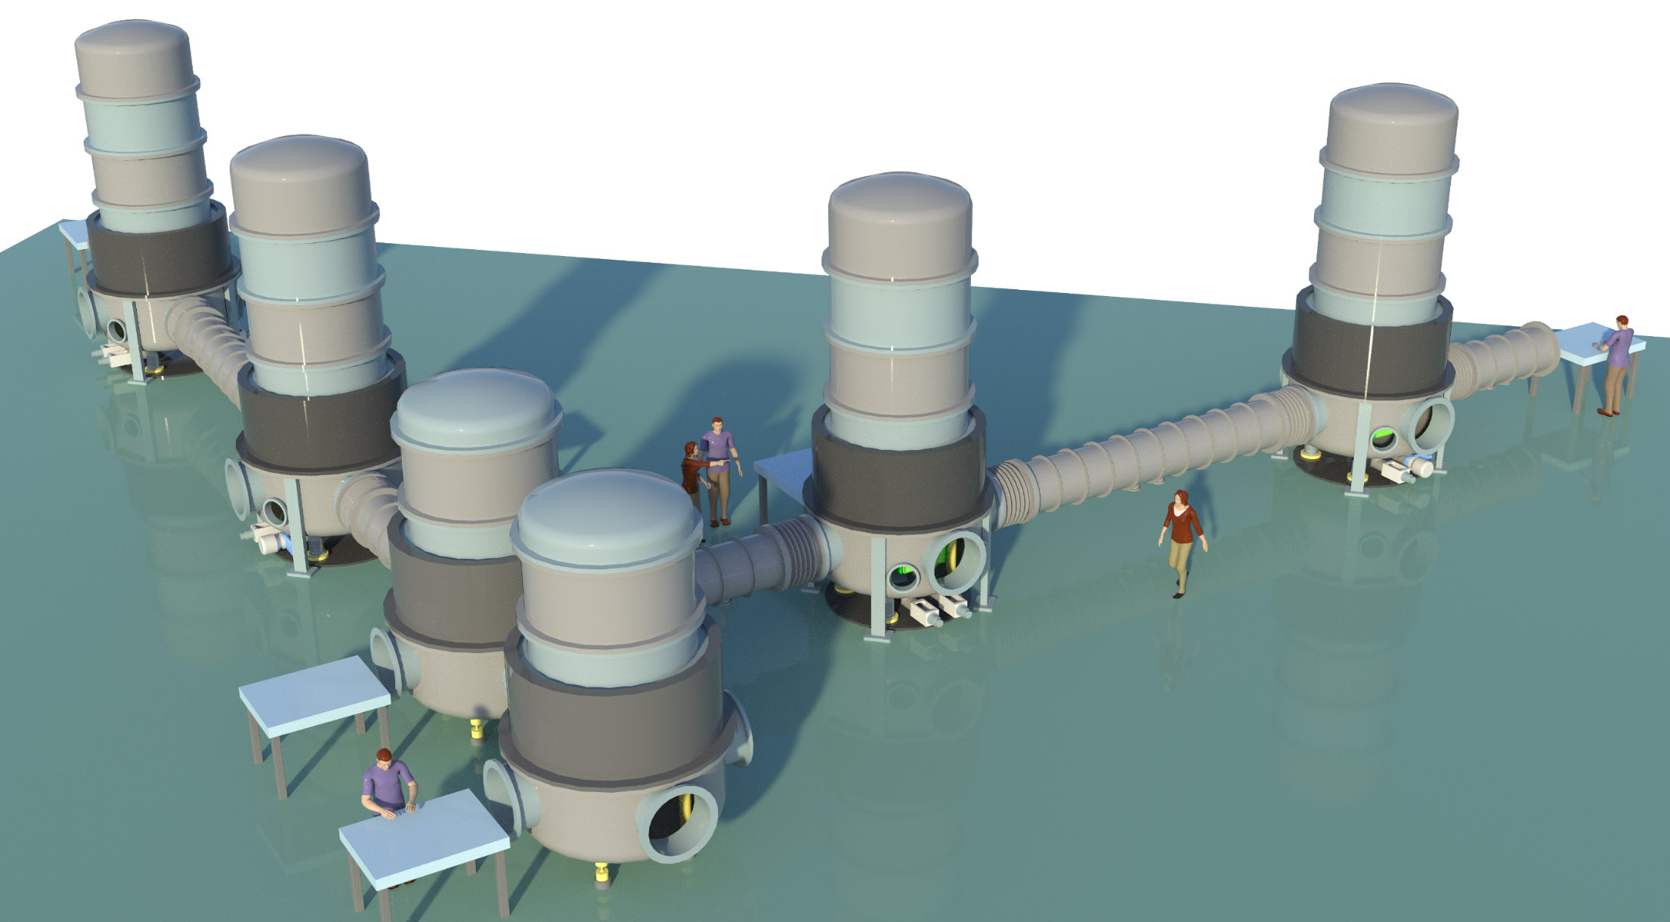
ET pathfinder
14.5 M€ acquired in Sept, 2018 for research facility in Maastricht to develop cryogenic interferometry
Research Questions:
production and test of mono-crystalline Silicon mirrors, coatings and suspensions,
operation at cryogenic temperatures, optical strategies
Small-scale test interferometer, ~ 20 m arm length, in UHV with cryogenic arms. Currently under design.
Notes:
Newton: acceleration connects ot density fluctuation
We connect density fluctuation to seismic displacement
For NN integrate over the seismic displacements near the test mass -> requires a model of the seismic field near the test mass.

Slide 6
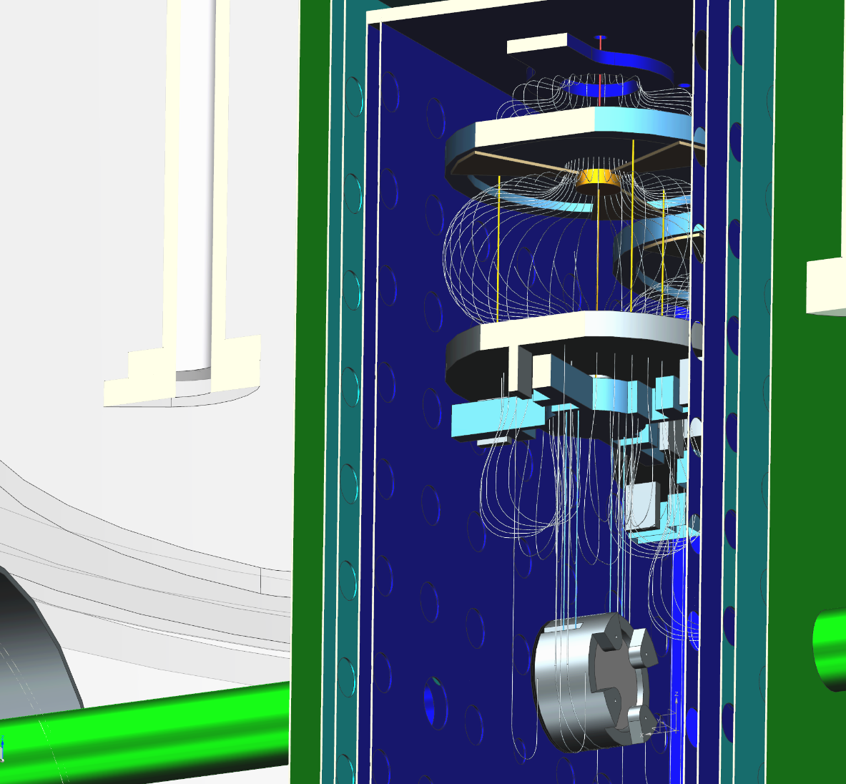
ET pathfinder
10-K shield
80-K shield
Vibration-free cooling needed
Floating shield
4.2k cooling
Mirror surface should be moving less than 10⁻¹⁸ m/sqrt(Hz)
Cryogenic temperature shields need to be double-walled with holes for vacuum conductance
Inner shield must be vibrationally isolated for scattered light contribution.
Shield contains 6 optical viewports to room temperature surrounding
Mirror, marionette, reaction masses need to be cooled to 10K, GAS filters needed at 300K.
Filter with flat copper beryllium blades
Recoil mass
Marionette
Recoil mass
Vibration-free cooling: we study sorption cooling (collaboration with cryogenics material group ter Brake,
Univ. Twente). Need flexible feed-through of cold (25 K) helium through vacuum tower to cool ring and inner shield.

Slide 7
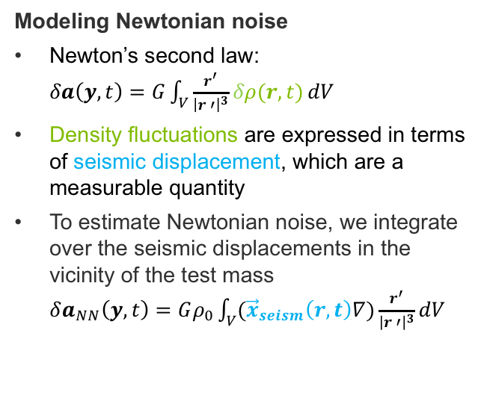
Newtonian Noise
M. Bader
For the Newtonian noise model, a seismic model of the surface and underground displacements is required
Newtonian noise
Direct coupling between seismic wave field and interferometer test mass.
Modeling Newtonian noise
Newton’s second law:
$δa\left(y,t\right)=G\int_{V}{\frac{r^{′}}{{\left|r ′\right|}^{3}}δρ(r,t)}dV$
Density fluctuations are expressed in terms of seismic displacement, which are a measurable quantity
To estimate Newtonian noise, we integrate over the seismic displacements in the vicinity of the test mass
$δa_{NN}\left(y, t\right)=Gρ_{0}\int_{V}{({\vec{x}}_{seism}\left(r, t\right)∇)\frac{r^{′}}{{\left|r ′\right|}^{3}}dV}$
For a Newtonian noise estimate, we need a model of the seismic displacement field in the vicinity of the test mass
Reference:
M. Beker, Low-frequency sensitivity of next generation gravitational wave detectors
G. Cella, Improving the senitivity of future GW observatories in the 1-10 Hz band
Notes:
Newton: acceleration connects ot density fluctuation
We connect density fluctuation to seismic displacement
For NN integrate over the seismic displacements near the test mass -> requires a model of the seismic field near the test mass.

Slide 8
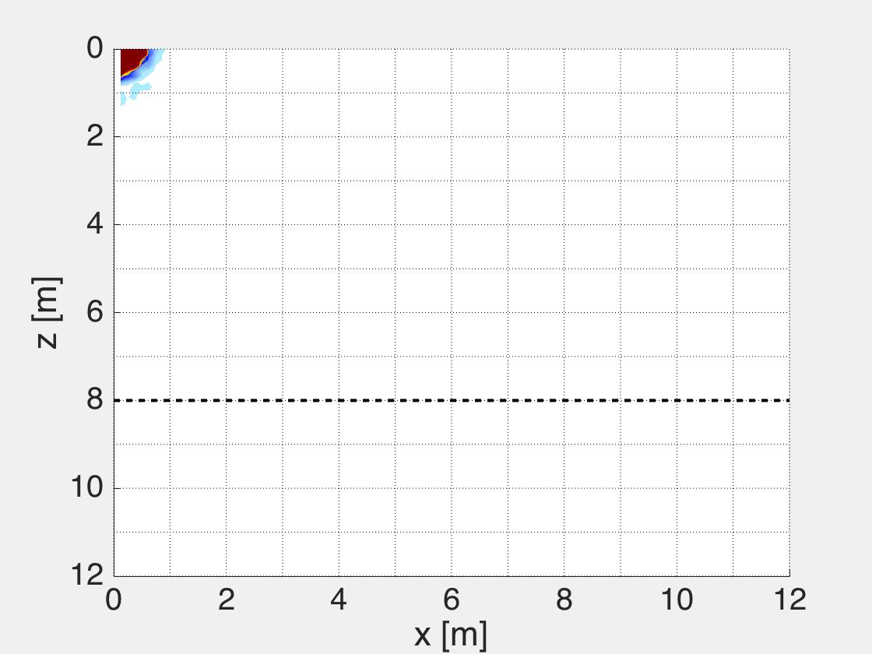

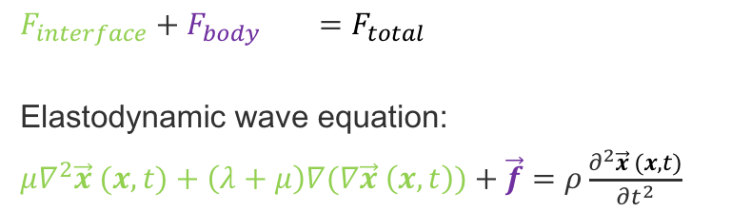
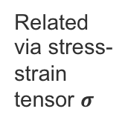


How to model seismic fields
M. Bader
The seismic displacement field is modeled from a full solution of the elastodynamic wave equation of a horizontally layered medium with realistic geology of the detector site
$F_{interface}+F_{body} =F_{total}$
Elastodynamic wave equation:
$μ∇^{2}\vec{x} (x, t)+\left(λ+μ\right)∇(∇\vec{x} \left(x, t\right))+\vec{f}=ρ\frac{∂^{2}\vec{x} (x, t)}{∂t^{2}}$
Traction $\vec{T}$
Related via stress-strain tensor $σ$
dV
Body force $ρ\vec{b}$
Displacement$\vec{ x}$
Current standard Newtonian noise calculations
Analytic solution in a homogenous half space
Constant P-waves
New: PDE solver in Matlab
Horizontally layered medium with known layer, velocity and density model of the detector site → knowledge of local geology required
Seismic displacement as dynamic soil response
Full solution of the wave equation
Matlab ElastoDynamic toolbox, KU Leuven
Reference:
Mattias Schevenels, The Impact Of Uncertain Dynamic Soil Characteristics On The Prediction Of Ground Vibrations
M. Schevenels, G. Degrande, and S. Francois. EDT: An ElastoDynamics Toolbox for MATLAB.
Notes:
Seismic wave propagation is described by the elastodynamic wave equation. Displacements are the solution to this wave equation
This solution is not trivial: we use PDE solver and get full solution in layered medium
This requires knowledge of local geology

Slide 9

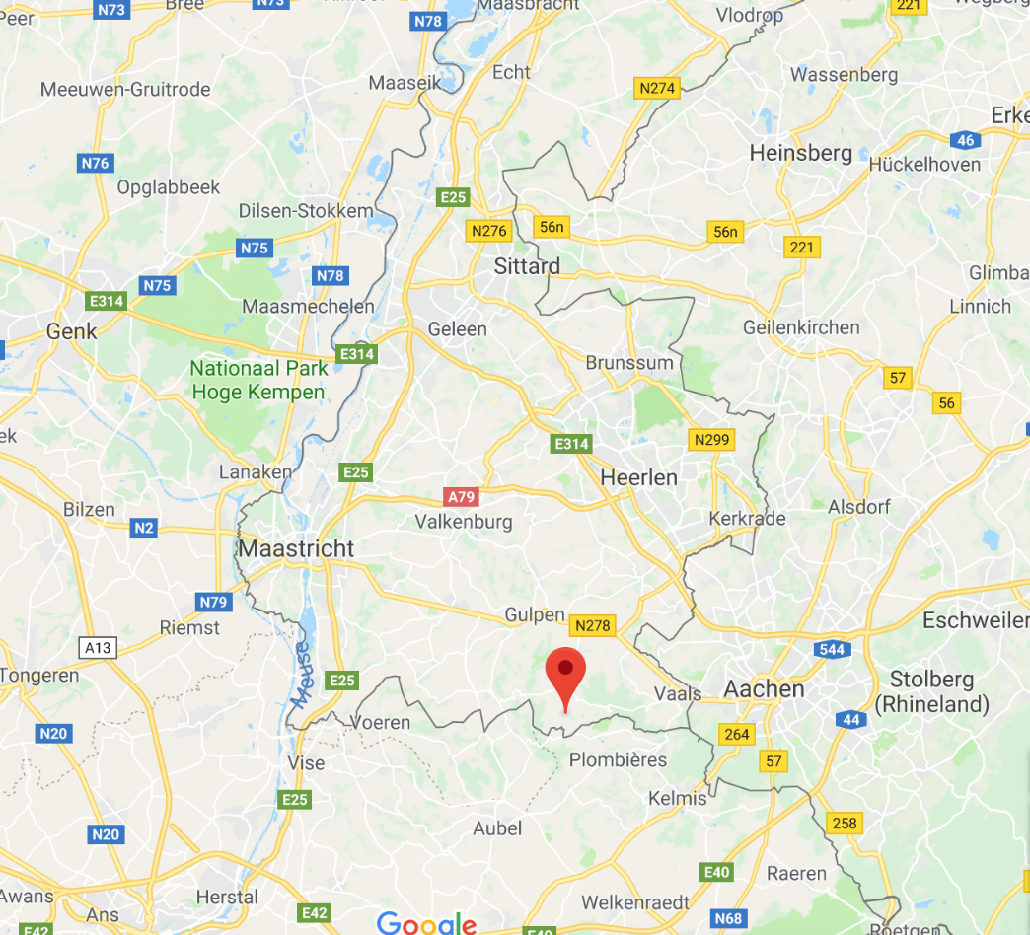
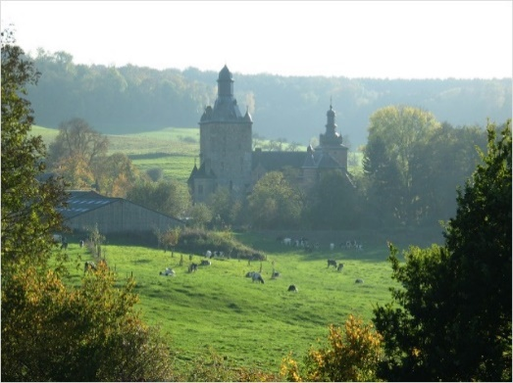
Seismic Studies in Terziet (Dutch-Belgian Border)
Various seismic studies have been conducted at the location of the NL-B-G ET candidate site
Terziet
Completed studies
First borehole study
Two passive seismic array studies
One active seismic array study
Surface PSD measurements
In progress
Second borehole study with three axial sensor installation at 300 m depth. Seismic imaging while drilling.
NL
D
Locations with underground PSD measurements at 10 m and 60 m
20 km
BE
Notes:
20km located from maastricht

Slide 10
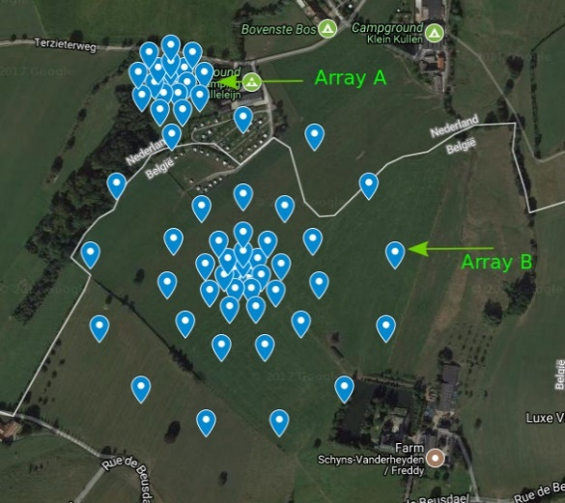
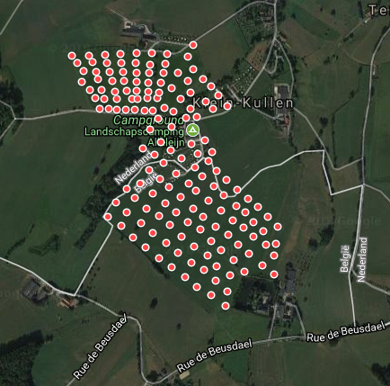
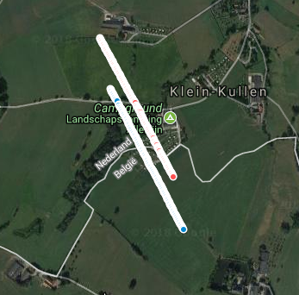
Seismic array studies
Passive and active seismic studies have been conducted at the ET candidate site to get information about the subsurface geology
The studies
Passive 1
  Nov 2017, 75 sensors
  Arrays sensitivity: ~1 – 8 Hz
  One array on each side of the fault line
Passive 2:
  Dec 2017, up to 200 sensors
  Larger sensor array allow for better wave array sampling
Active
  Feb 2018, up to 200 sensors
  Active seismic source
Passive 1
Passive 2
Fault line
Fault line
Active
Goal
Study the fault line and its evolution underground
Main seismic noise sources and dispersion curve with beamforming analysis
Horizontally layered subsurface model (P- and S-wave speed, densities, Q-factors) with inversion analysis
Can be used to simulate local seismic field
Fault line

Slide 11
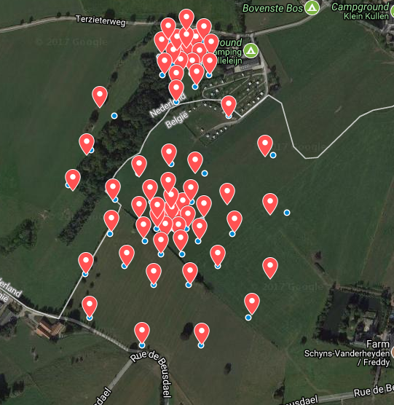
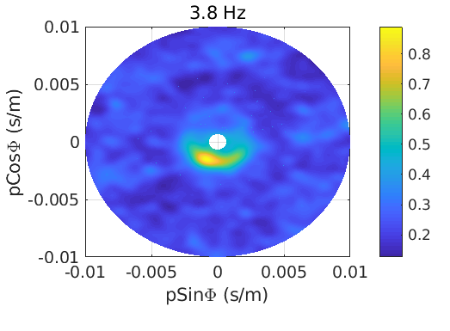
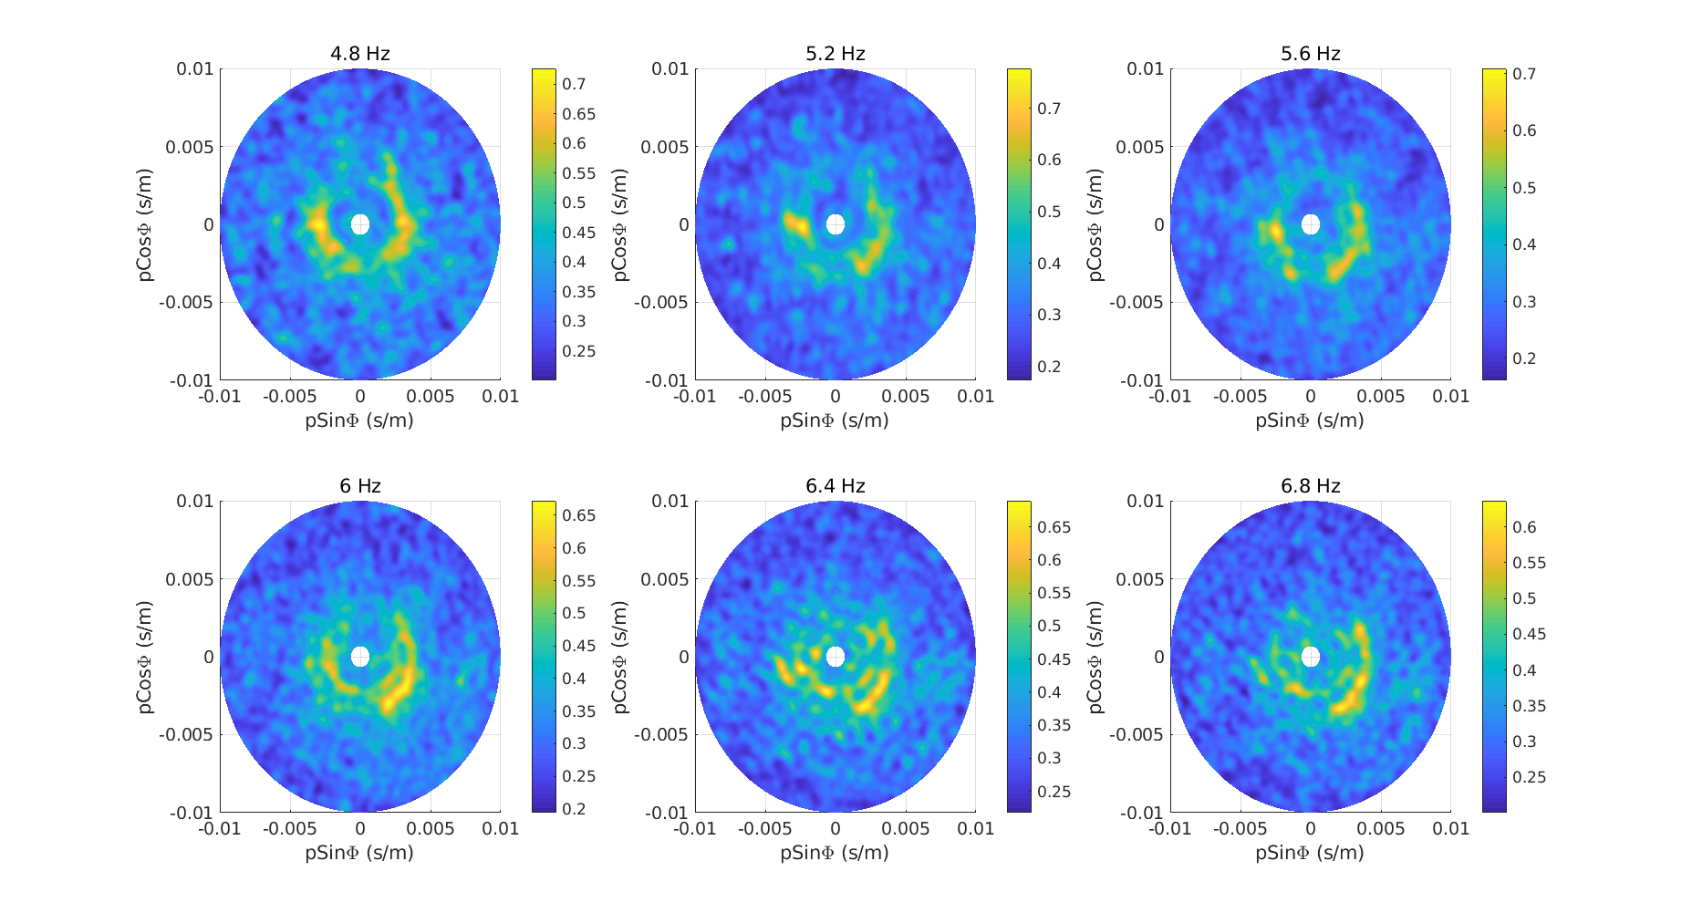
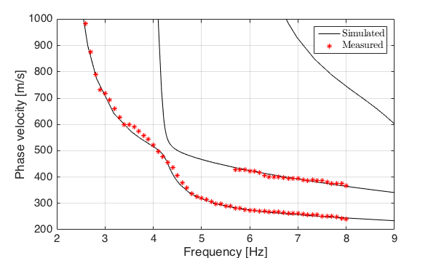
Results from the seismic array: beamforming
Beamforming and seismic inversion allow to determine main the noise sources and local dispersion curve, as well as a model of the underground geology
Phase velocity
0
Beamforming
Main noise sources well defined at low frequencies
Frequency dependent phase velocity
Measured first overtone of phase velocity
N
∞
E
W
S
Dispersion curve
Surface information
First overtone
Fundamental mode
Notes:
higher order modes can be understood as the constructive interference of transmitted and reflected waves in the layered medium

Slide 12
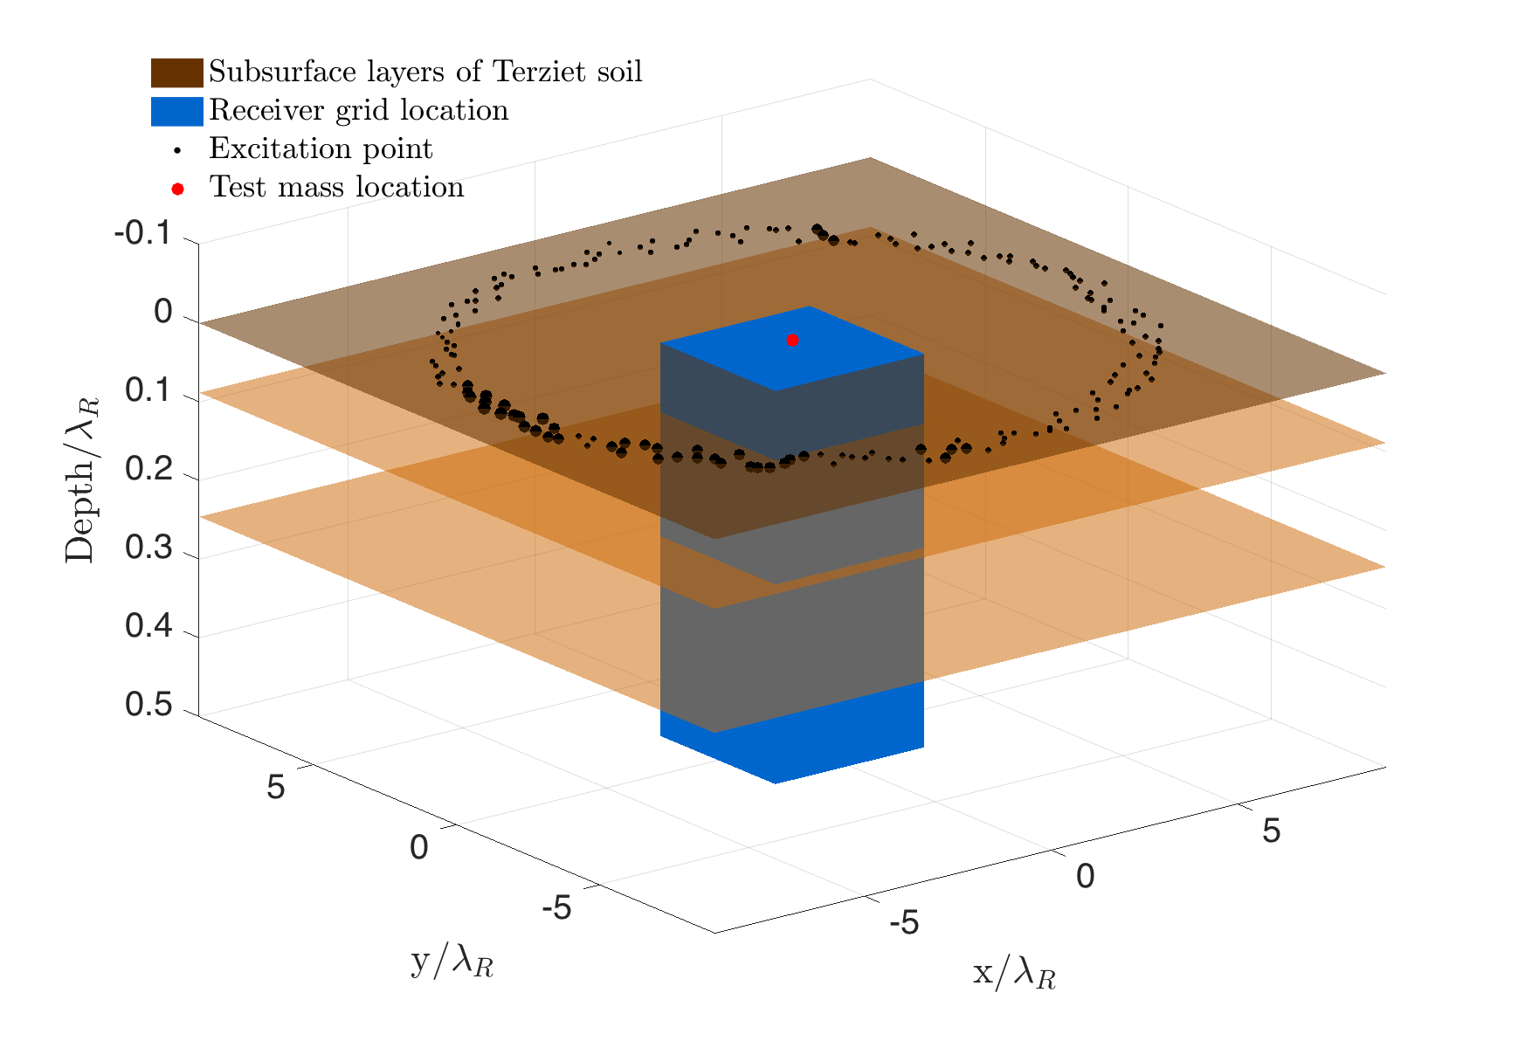
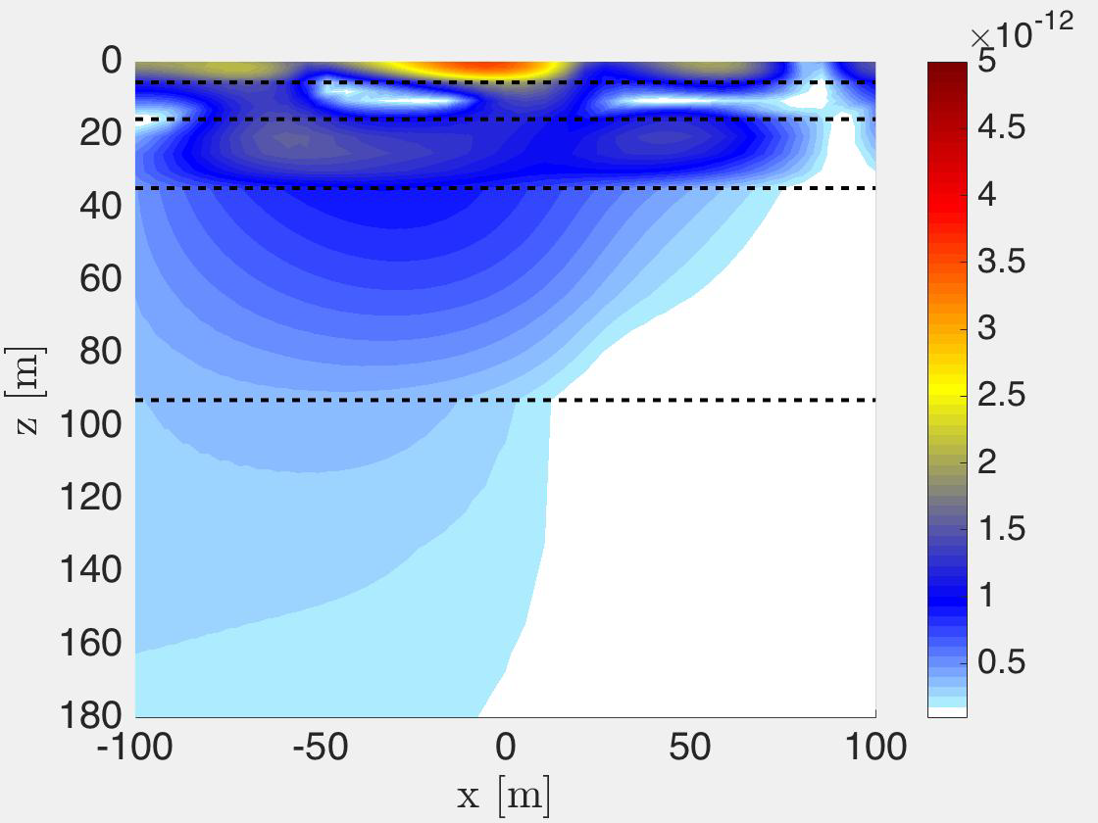
Seismic field modeling
The inputs for the seismic model are the layered subsurface model from the inversion analysis, locations of the main noise sources and the PSD measured on site
Ingredients from the measurement
Subsurface horizontally layered geology model (layers, velocities, densities)
Vertical and horizontal sources
Relative source strength: Measured beam power
Absolute source strength: Reproduce measured surface PSD
Results from modeled ambient field
Amplitudes are confined to the soft surface layers of 30m thickness
At depths where Newtonian noise is relevant (> 100 m), the seismic amplitudes from the dominant Rayleigh waves will have mostly attenuated
N
E
Re(displacement) [a.u.]
@ 5 Hz
Timedomain video/plot
Soft soil
Rock
Amplitude [au]
@ 5 Hz

Slide 13
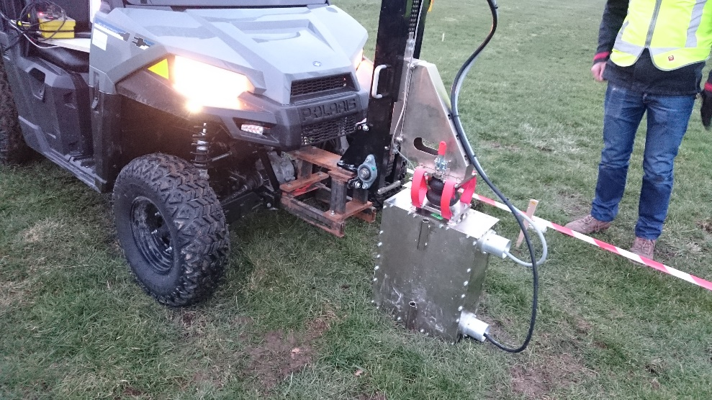
Active survey
Goal: better imaging velocity as a function of depth and of the fault at the drillhole
Electronic Light Vibroseis (Rossingh, Seismic Mechatronics, Shell)
Light system, linear electronic drive.
collaboration with Shell and Rossingh
Max ground force 1100 N, sweep from 7 Hz to 100 Hz in 30 seconds.
One of the first tests of this system.
Sensors every 3 m. Shots every 6 m.

Slide 14
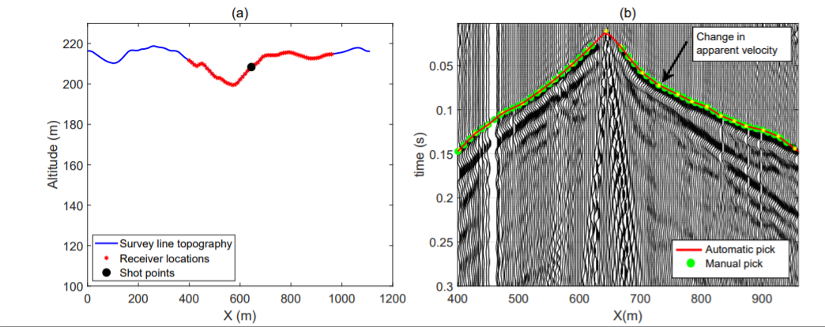
Active survey
Shot record
Ground roll
refractions
Shots are done every 6 m along the blue line. Sensors are located every 3 m (red points). One shot gatherer is shown; on the horizontal axis the position of the sensor, and on the vertical axis the correlation as a function of lag (the delay between the signal in the sensor and the actuation of the shot).
The ground roll Rayleigh waves have the highest amplitude but travel slowest (steepest slope).
The direct p-wave gives the first arrival time. Change of slope in the arrival times can be due to changes in the thickness of the layer of the soft soil. Multiple refractions can be detected from the first hard layer.

Slide 15
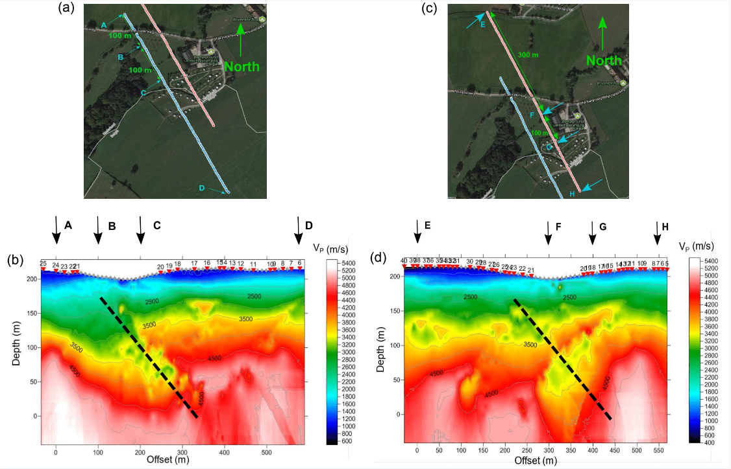
Active survey
sub-surface velocity with Delta-V model using the first arrival times.

Slide 16
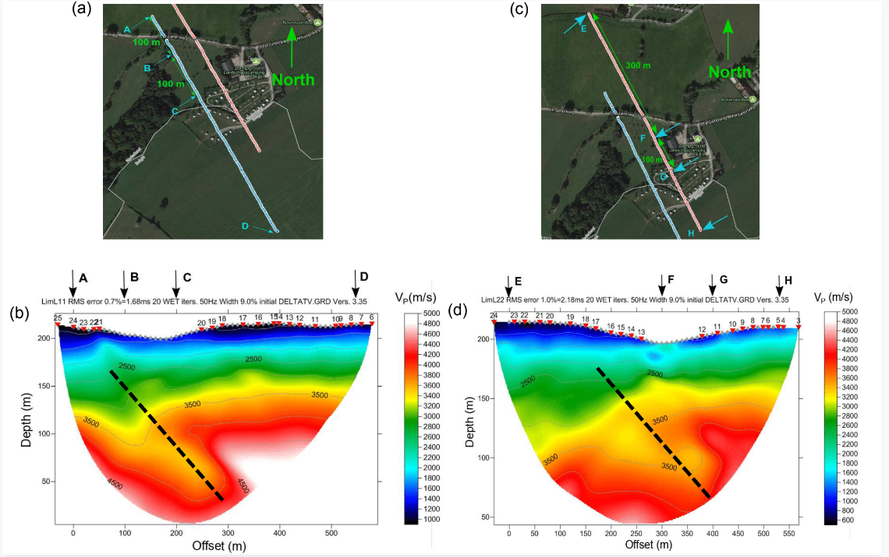
Active survey
sub-surface velocity eikonal approach: use the Fresnel zone of the wave instead of single rays.

Slide 17
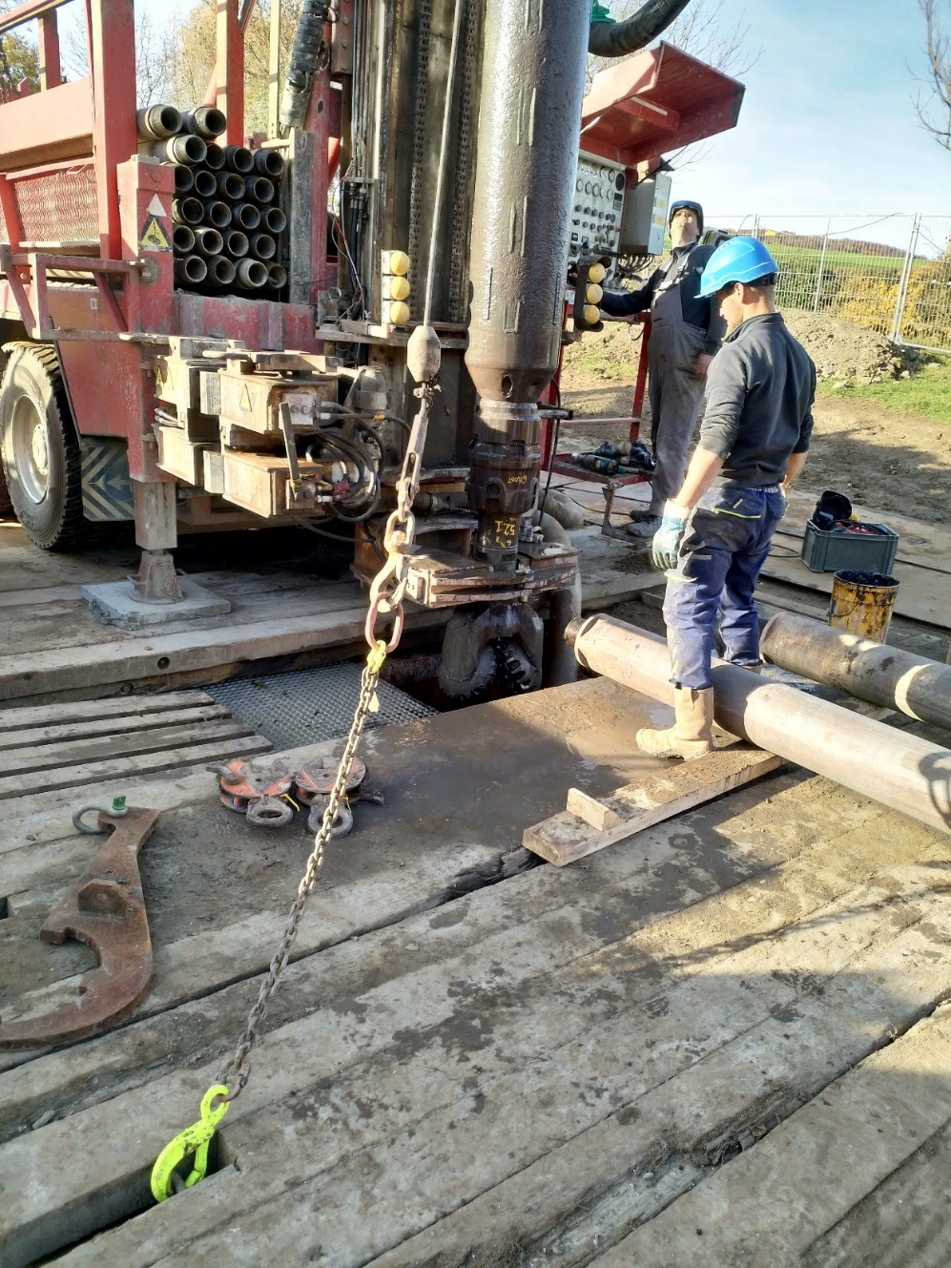
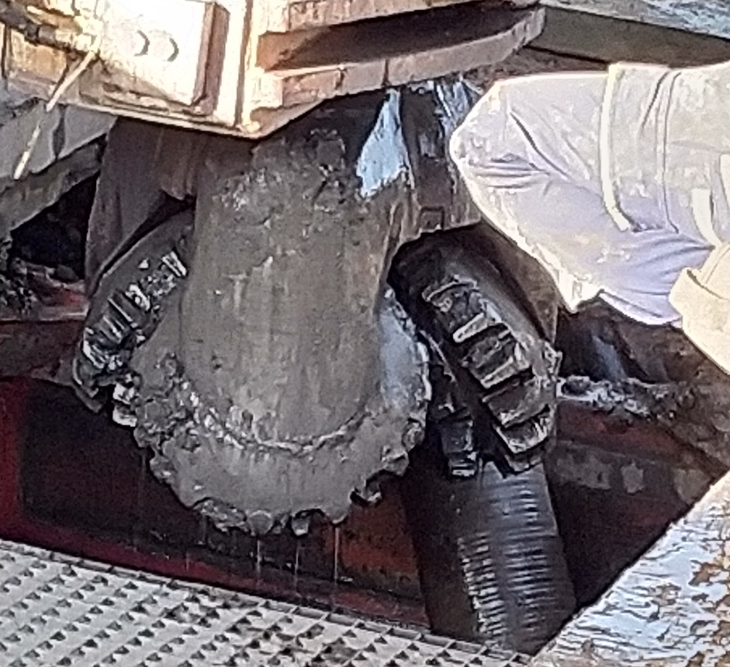
Drill hole Terziet
Measurements of seismic PSD at 300 m deep can be used to confirm Limburg as suitable candidate site
Drilling in progress (currently 95 m deep)
Steel pipes are installed as housing (different diameters). Bottom will be sealed with concrete.
Sensors and power will be installed in Jan/Feb 2019.

Slide 18
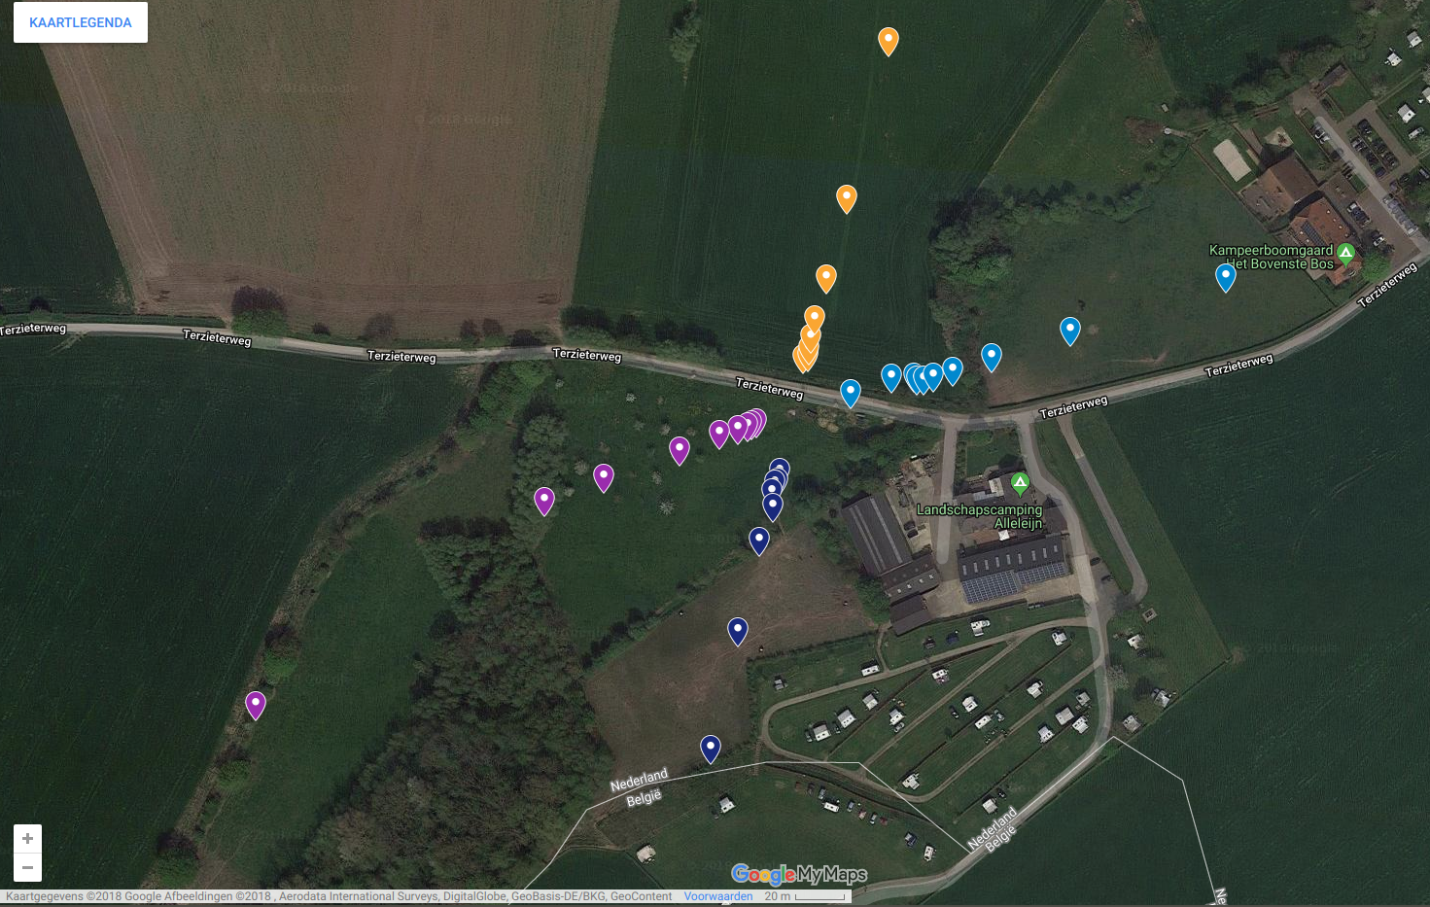
Drill hole Terziet
Measurements in progress; unique opportunity to inject seismic noise at different depths
39 sensors at octave distances (2,4,8,…256 m), 8 sensors far-field (~ 1km)
During drilling, position of drill bit and exerted torque is measured; cross-correlation will give unique map of elastodynamic soil parameters.

Slide 19
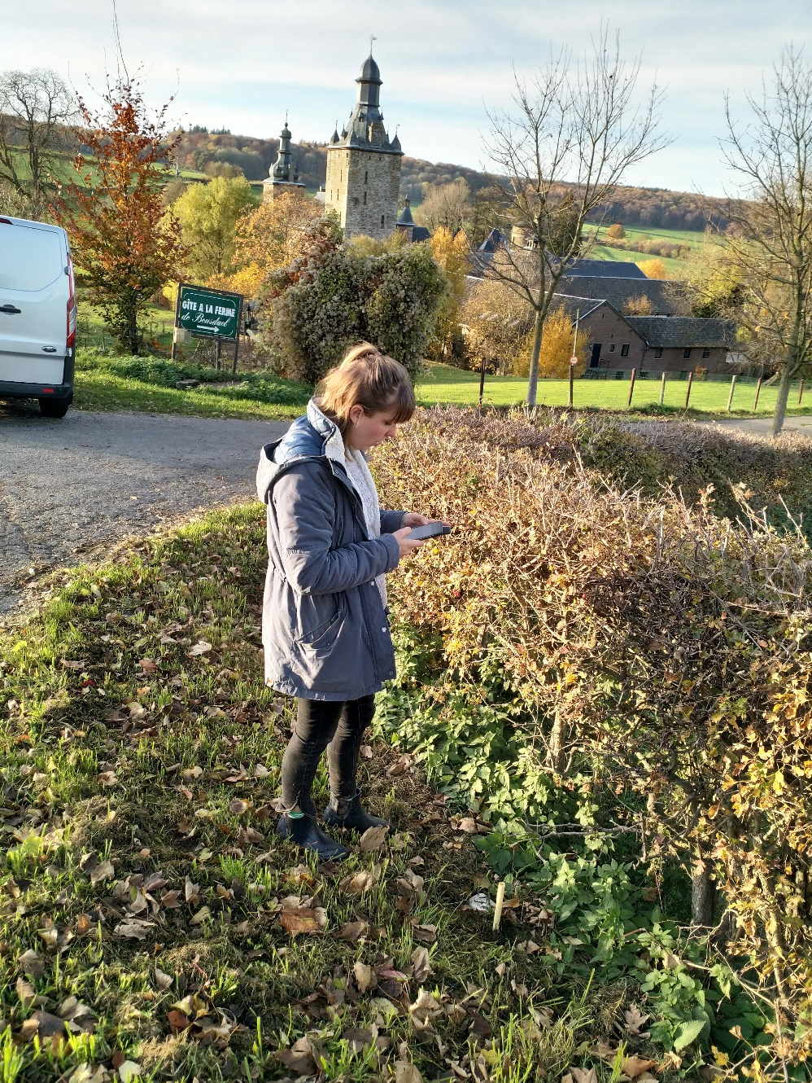
Summary
Looking back at a very successful year!
ET pathfinder funding secured
host site University of Maastricht
collaboration built with many partners from industry and science, Nikhef playing a lead role
design under rapid progress
Finished active and passive seismic campaigns
good sub-surface model and local noise sources
lots of interest from Dutch and Belgian geophysicists and also from industry
Started drilling bore-hole
Currently at 95 m depth (Dec 14), lots of water to be pumped out
will give seismic activity at 300 m deep
unique opportunity to calibrate Newtonian-Noise subtraction technique!

Slide 20
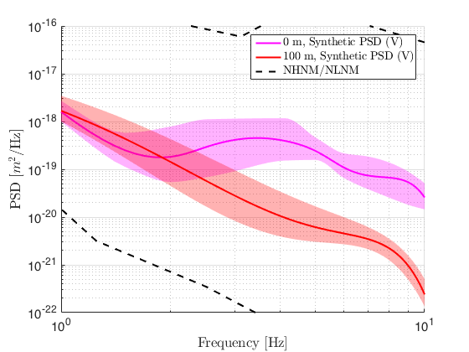
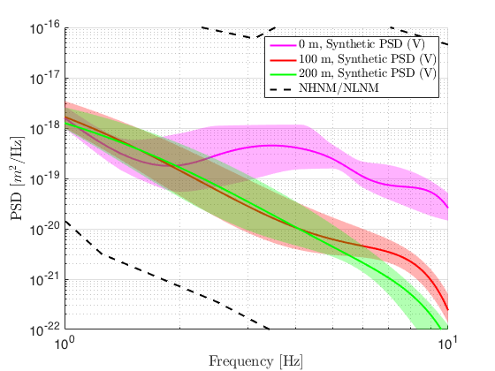
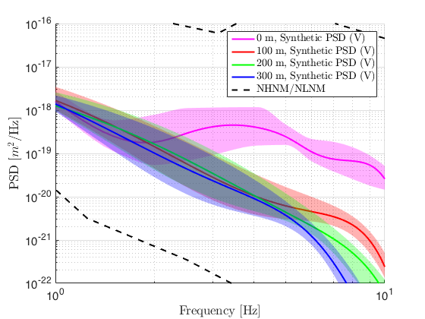
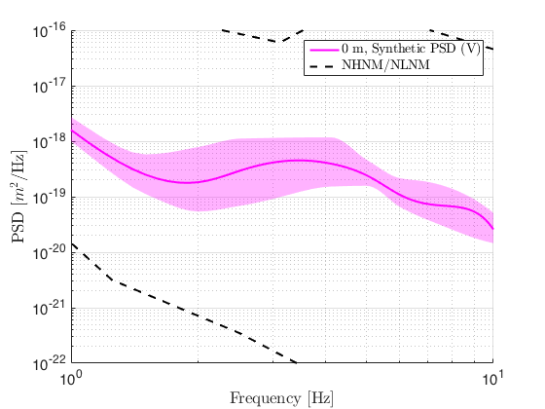
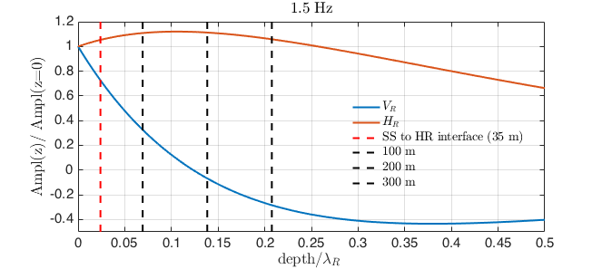
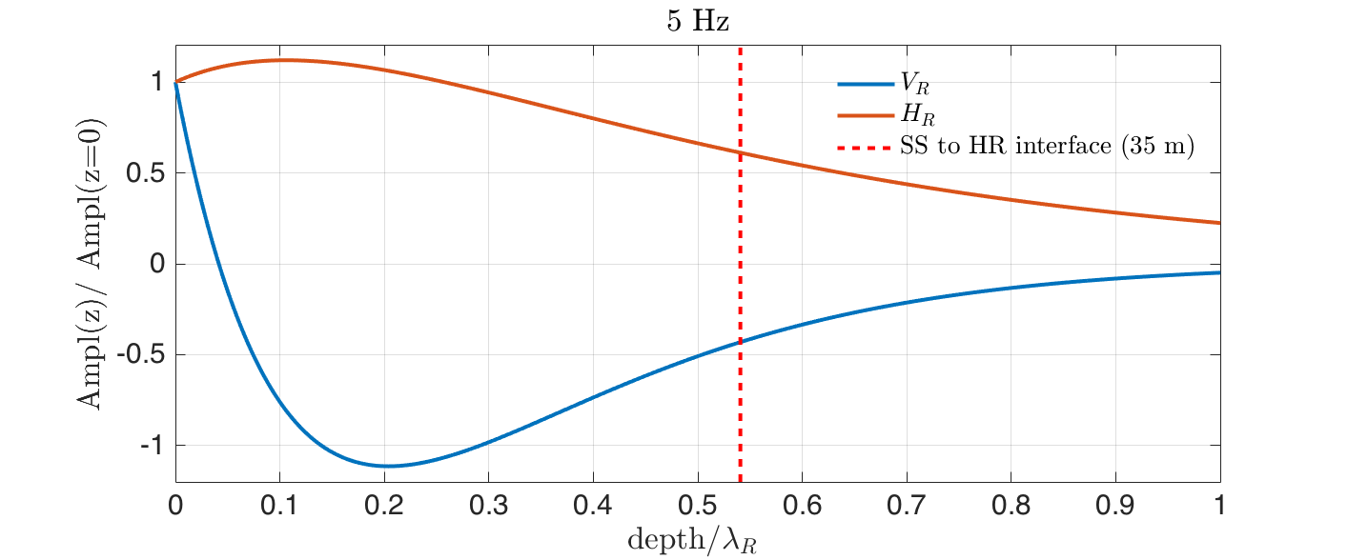
Underground PSDs from simulated data
The simulations suggest a strong reduction of seismic amplitudes underground. This will be confirmed with a borehole study at the end of 2018
Underground PSD from synthetic data
Below 2 Hz: Large Rayleigh wave amplitudes (>> 300m) lead to little attenuation factor underground
Above 2 Hz: Attenuation of about one order of magnitude (in power) already at depth of 100 m with respect to surface
This will be confirmed by borehole study to 300m depth (in progress), with installation of 3-axial permanent seismic sensor underground
P R E L I M I N A R Y

Slide 21
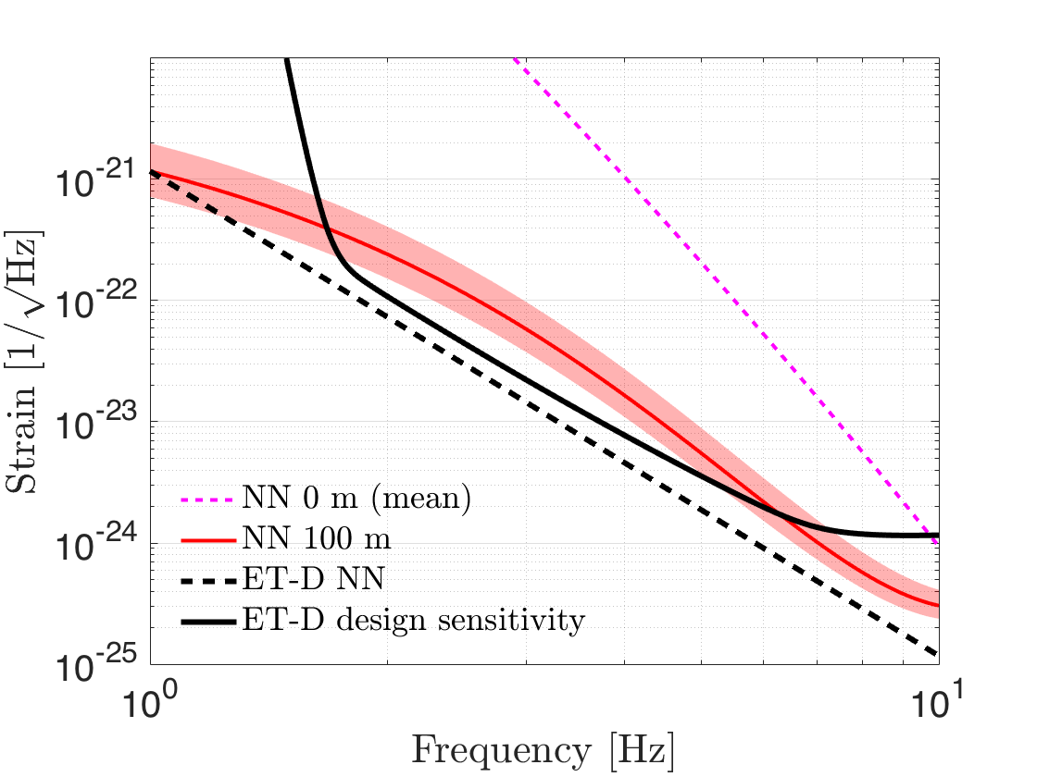
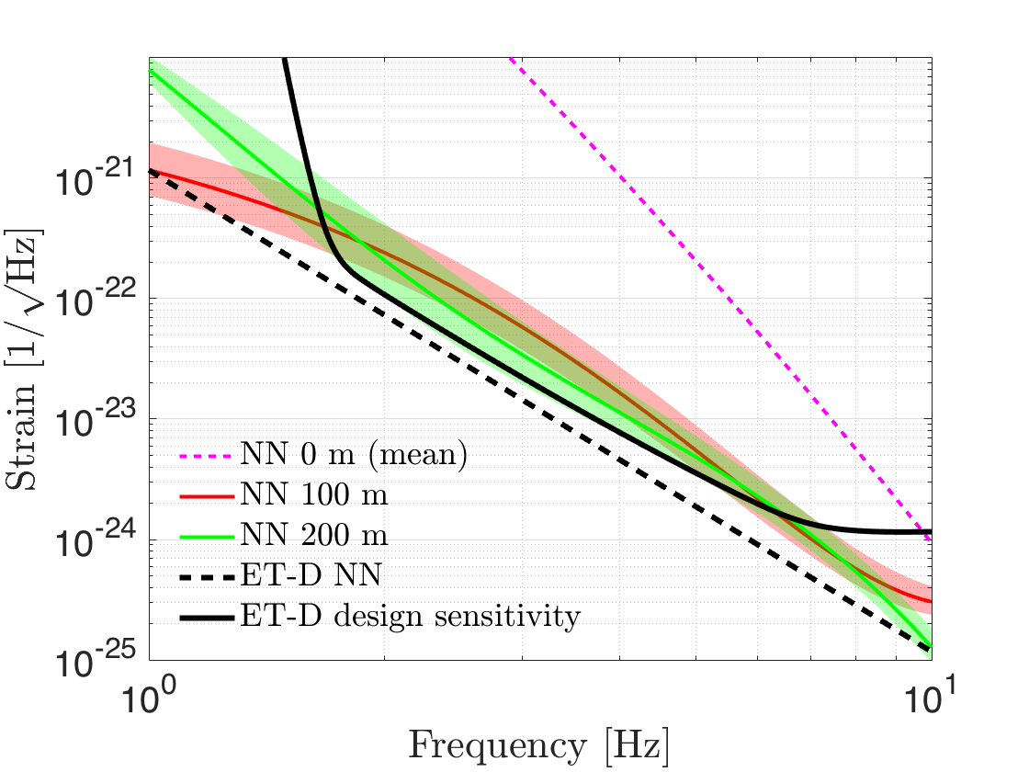
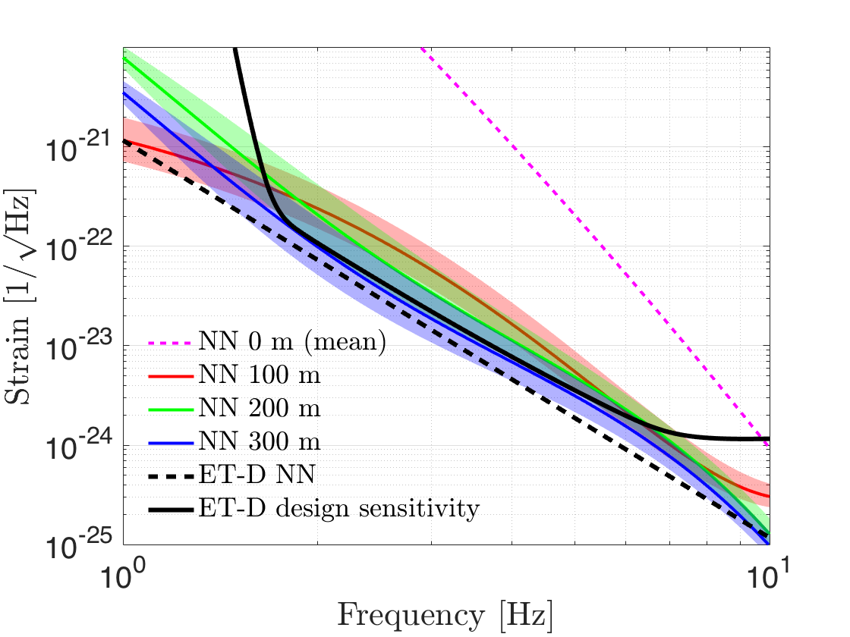
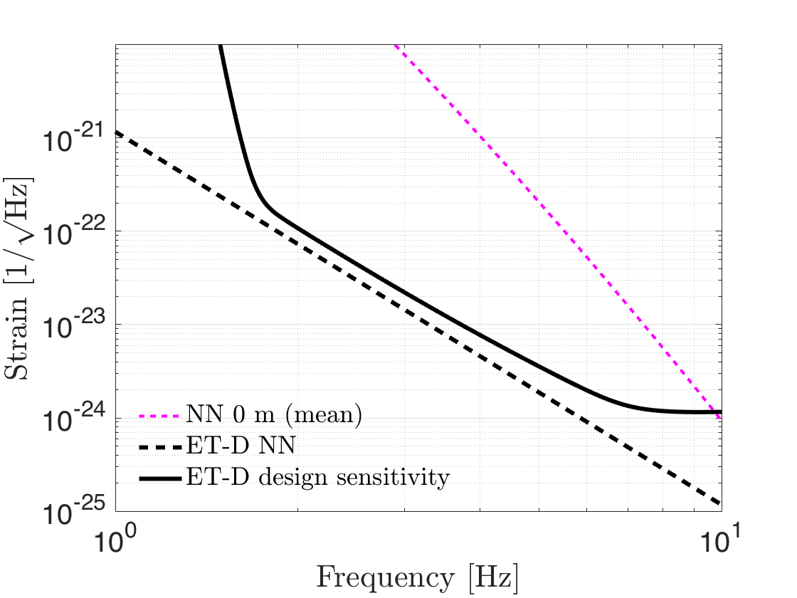
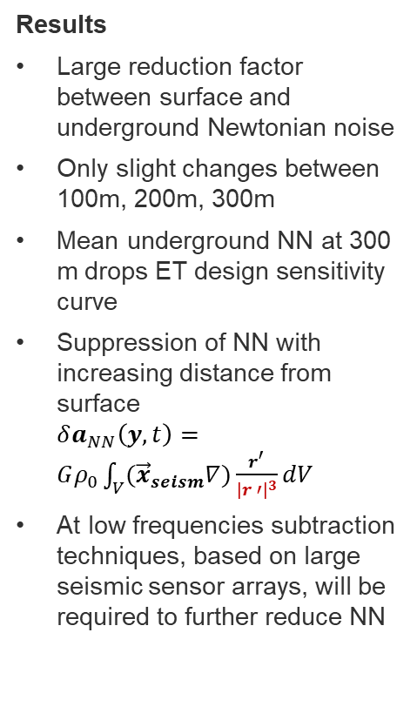
Newtonian noise at the ET candidate site
Newtonian noise underground is strongly suppressed with respect to surface Newtonian noise
Results
Large reduction factor between surface and underground Newtonian noise
Only slight changes between 100m, 200m, 300m
Mean underground NN at 300 m drops ET design sensitivity curve
Suppression of NN with increasing distance from surface
$δa_{NN}\left(y, t\right)=Gρ_{0}\int_{V}{({\vec{x}}_{seism}∇)\frac{r^{′}}{{\left|r ′\right|}^{3}}dV}$
At low frequencies subtraction techniques, based on large seismic sensor arrays, will be required to further reduce NN
P R E L I M I N A R Y
Notes:
Message
Suppression of at least 1 order of magnitude when going underground
@ 100 m: Above 3 Hz the expected mean NN at the site is already at the level of the design sensitivity curve
The NN level strongly depends on the surface PSD, to ensure larger suppression we need to go further underground
Calculation of NN further below are work in progress
Consistent at 100m

