Slide 1
Faster, smaller, more and better
Developments in the field of pixel detectors
Martin Fransen,
Detector R&D

Slide 2
Faster, smaller, more and better
On behalf of:
Martin van Beuzekom
Harry vd Graaf
Navrit Bal
Kevin Heijhoff
Robbert Geertsema
Peter Bosch
Marjolein Heidotting
Hella Snoek
Daniel Hynds
Kazu Akiba
ET:
Bas vd Heijden
Peter Jansweijer
Guido Visser
Henk Peek
Frans Schreuder
Vladimir Gromov
Arseniy Vitkovskiy
Charles Ietswaard
CT:
Vincent v Beveren
Henk Boterenbrood
ASI:
Kiavash Matin
Bram Bouwens
Developments in the field of pixel detectors

Slide 3
Pixel detectors
ASIC pixel matrix to read out:
Segmented ‘vacuum’ (Membrane)
Segmented gas (Gridpix)
Segmented liquid (XENON?)
Segmented solids (Si, GaAs, …)
Applications: Tracking, (X-ray) imaging

Slide 4
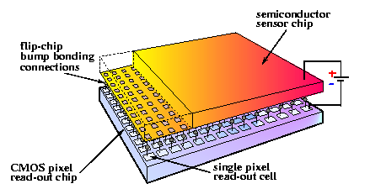
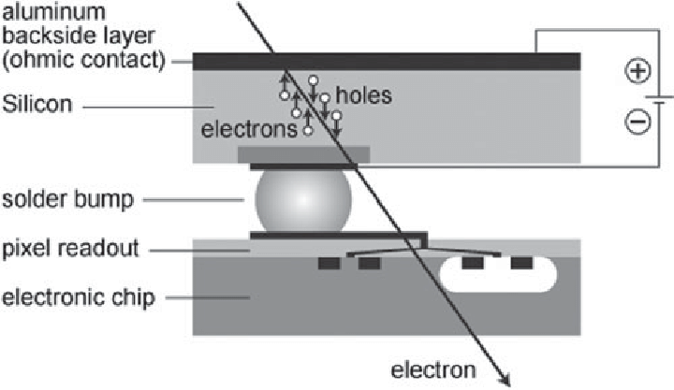
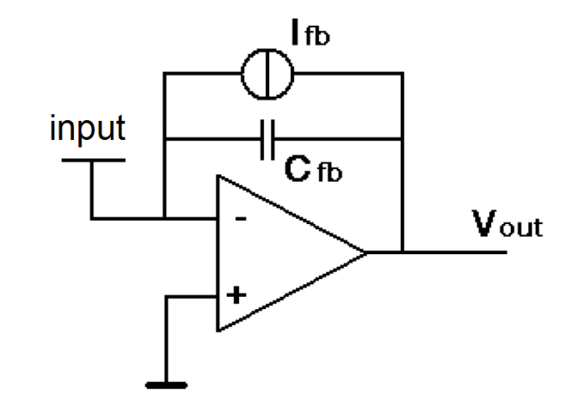
Timepix and medipix chips
Timepix:
Single hits
Time information
Data driven
Medipix:
Hit counting
Frame based
Pixels measure charge
Signal processing
And digitizing
Data out
Vout
Pixel input stage
Detection threshold
Time

Slide 5
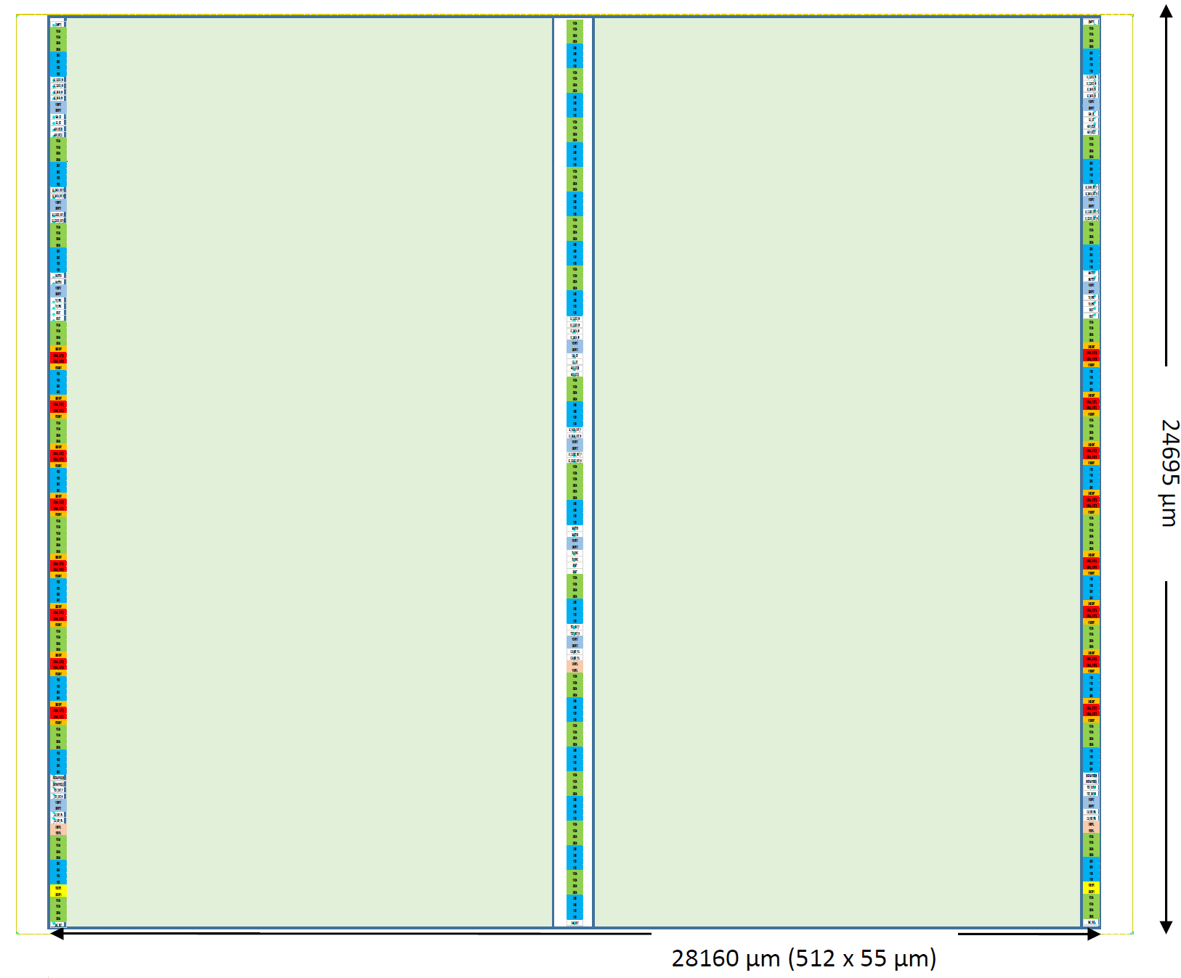
New generation: Timepix4
Area: 512x448 pixels
Timepix4 by CERN and Nikhef:
Large(st) chip (28 mm x 25 mm)
About 230 kpix, was 65 kpix
0.2 ns time bin, was 1.6 ns
Four side ‘tile-able’, was 3 sided
350 Mhits/cm²/s, was 40 Mhits
….
….
160 Gbps data out
Expected mid 2019
Guess who are going to build the readout system.
Pixel electronics matrix
Chip connections
(through the silicon)

Slide 6
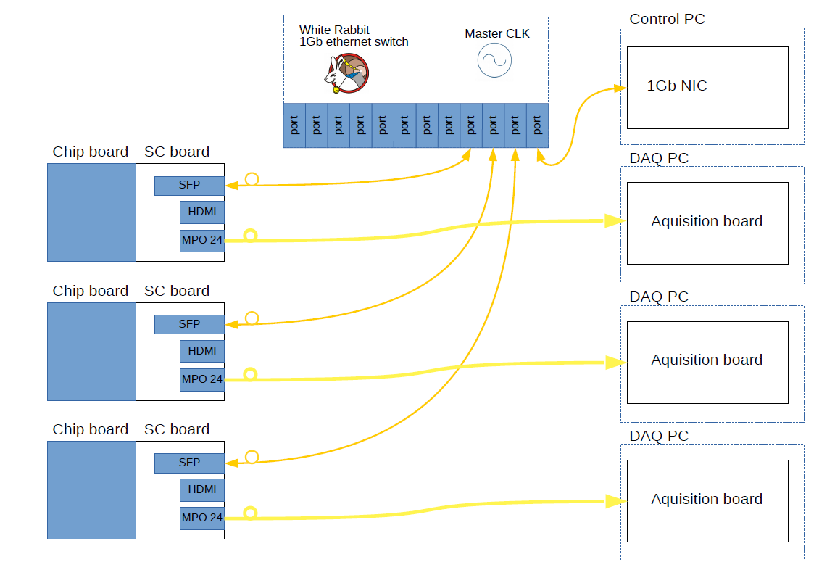
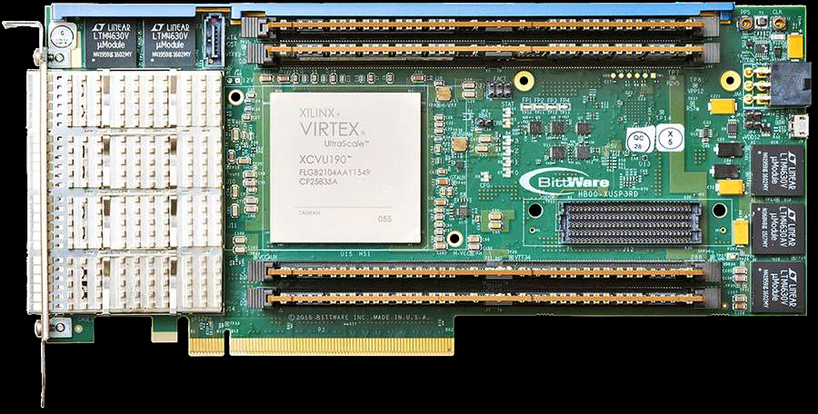
Timepix4 readout system (Nikhef)
Control PC (the ‘chief’)
Master of Timepix4 readout system
Control board (the ‘brain’):
Controls up to 8 TPX4 chips
‘slow’ readout of one TPX4 @ 10 Gb/s
Timing (the ‘conductor’):
Improved white rabbit, <100 ps timing and sync.
DAQ (the ‘brawn’):
Big boys FPGA + workstation. >1TB/min/chip

Slide 7
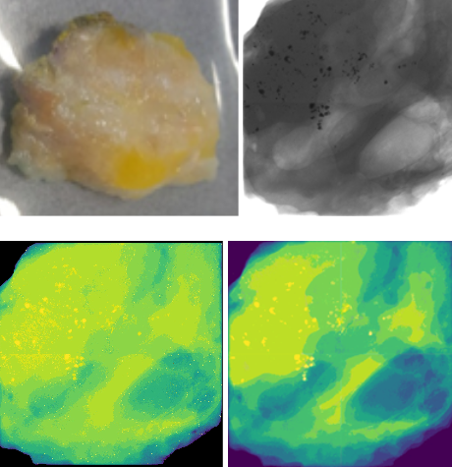
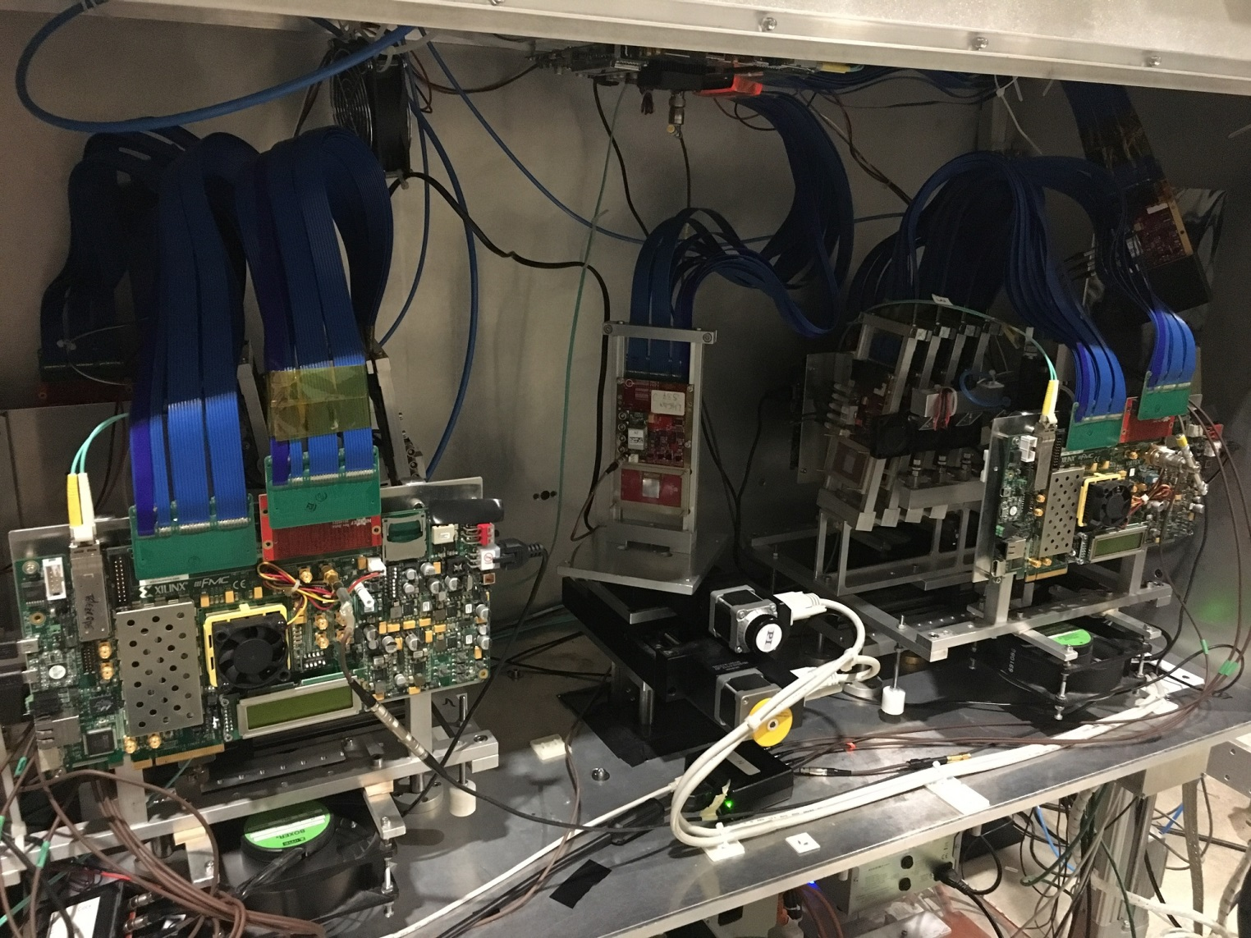
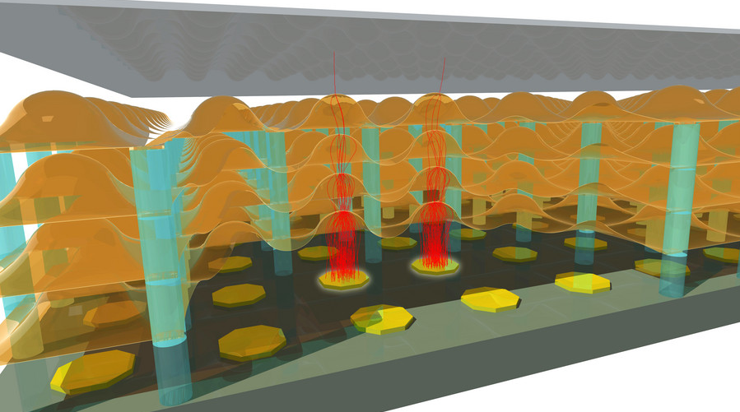
what we do with the (old) pixel chips
Spectral X-ray imaging
Spectral CT
‘dark field’ imaging
‘Visible’ photon counting
New photocathode
New charge amplifier
Fast & precise timing
Timepix3 timing performance
3D silicon

Slide 8
Spectral X-ray imaging
5 - 35 keV full spectrum
X-ray tubes emit a broad spectrum
16-20 keV Band
Density gradient?
Nope!

Slide 9
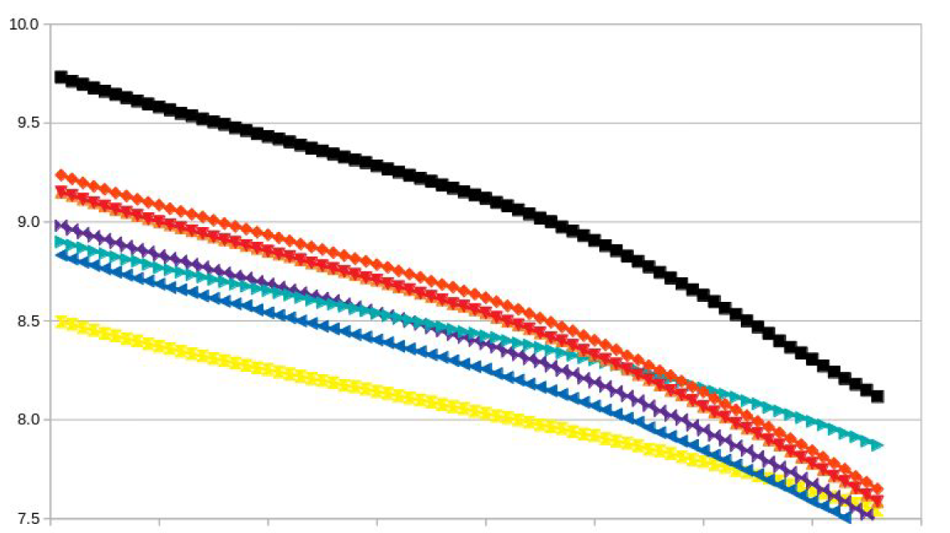
Spectral CT tumour recognition
Real tumour
Conventional X-ray
Joint project proposal:
Institutes:
NKI (Dutch cancer institute)
Nikhef
CWI (our neighbours)
Industry:
ASI (Nikhef spin-off)
XRE (Ghent univ. spin-off)
X-ray absorption of different parts in sample
Conventional+spectral
FleX-ray
collaboration
Absorption arb. units
Prevent ‘excessive’ surgery!
X-ray photon energy

Slide 10
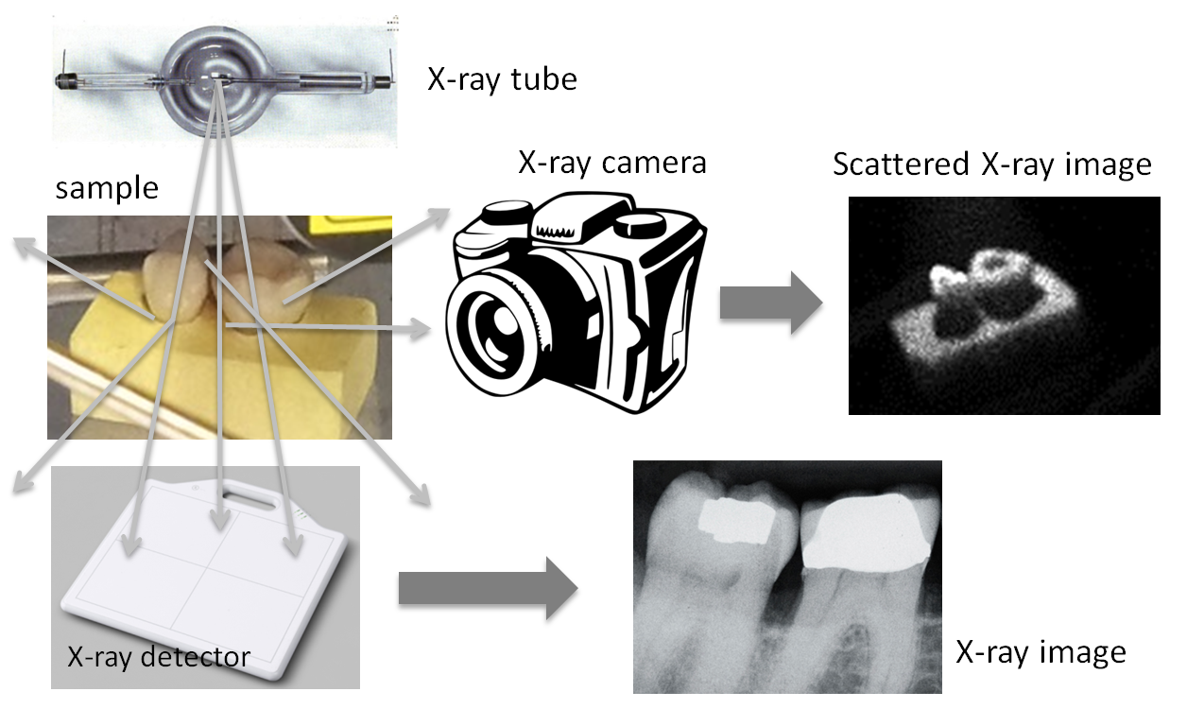
X-ray ‘dark field’ imaging
Scattered X-rays for imaging
Coded aperture
Grazing incidence optics
‘Improve’ on the pin-hole concept
Combine information of:
X-ray absorption
(Compton) scattering
Fluorescence
More information and/or less dose
ATTRACT project proposal (Nikhef & Cosine)
Inspired by
astrophysics

Slide 11
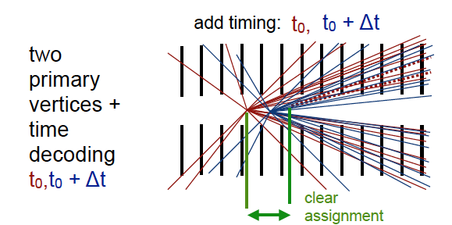
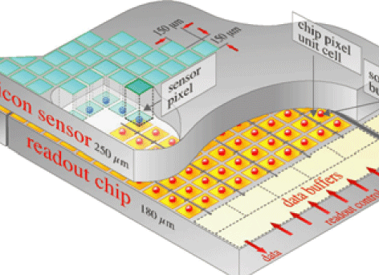
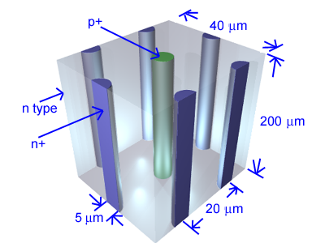
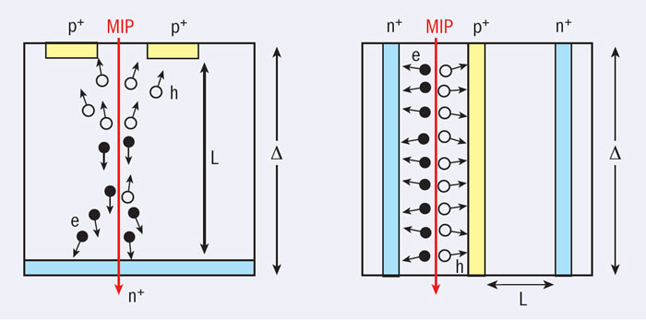
Fast timing
Next generation high luminosity experiments
High spatial and time resolution
Fast(er) ASICs:
Timepix3, VeloPix
Timepix4
Faster sensor:
Thin, Low Gain Avalanche Detector (LGAD), 3D
Membrane
2D sensor
3D sensor

Slide 12
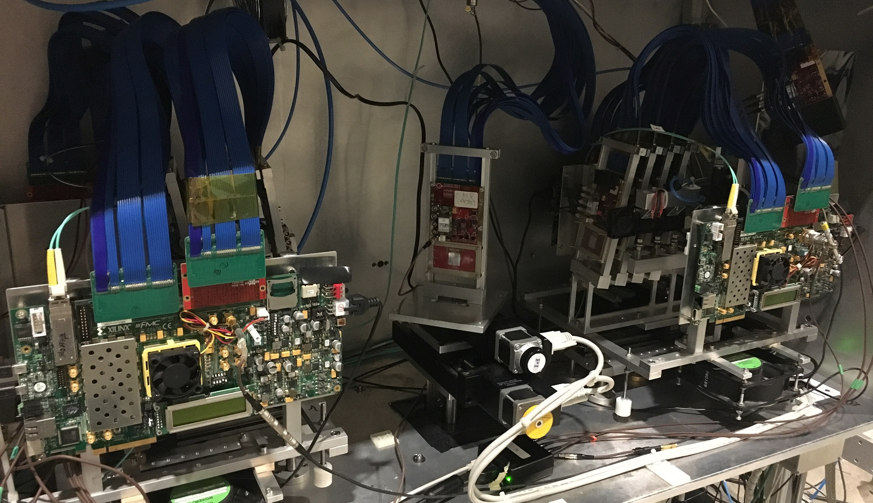
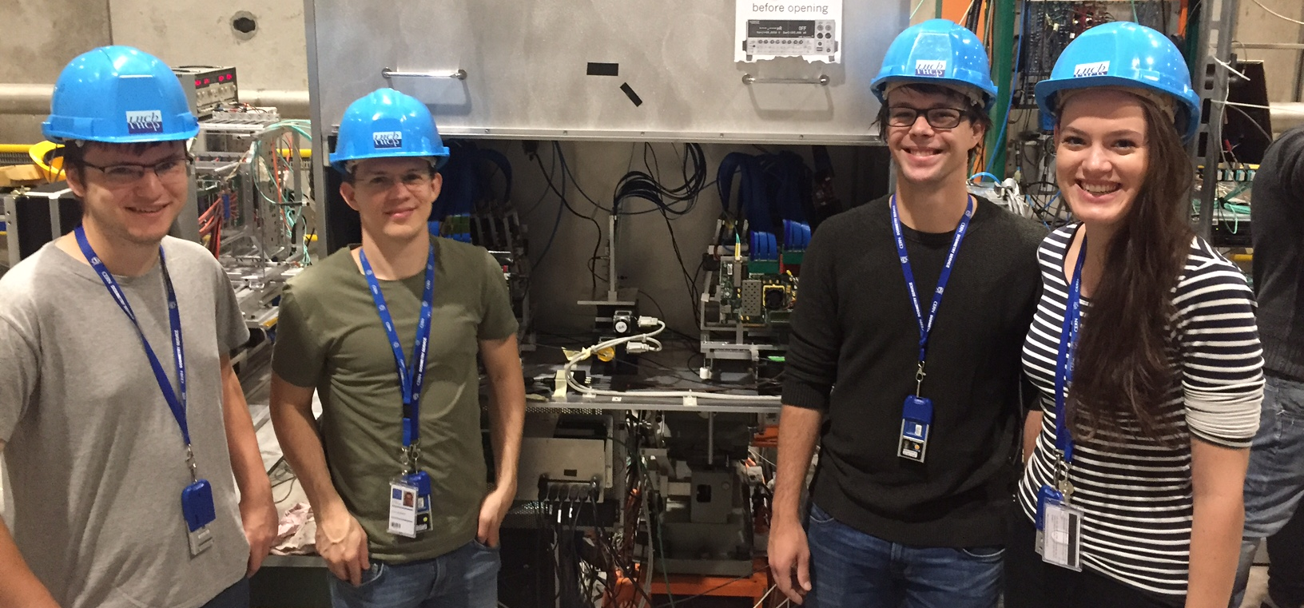
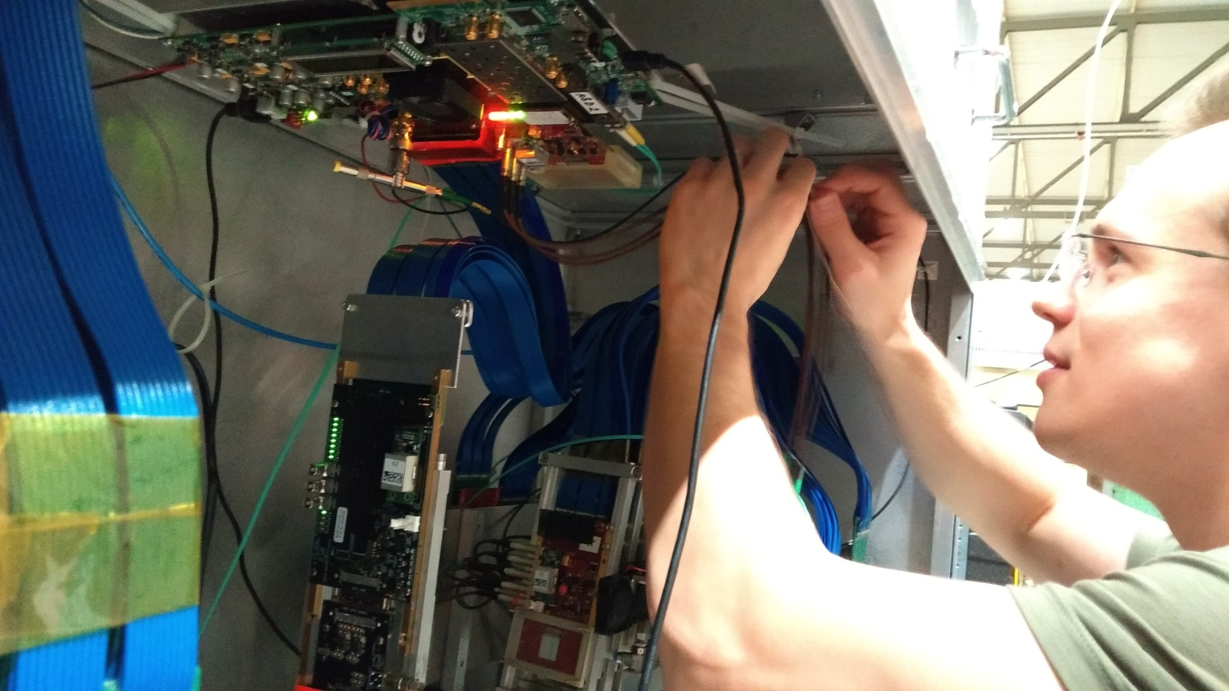
Timepix3 tests @ CERN beam line
Using Timepix3 telescope, test:
3D silicon
Thin silicon (50 μm)
Pixel to pixel timing variations

Slide 13
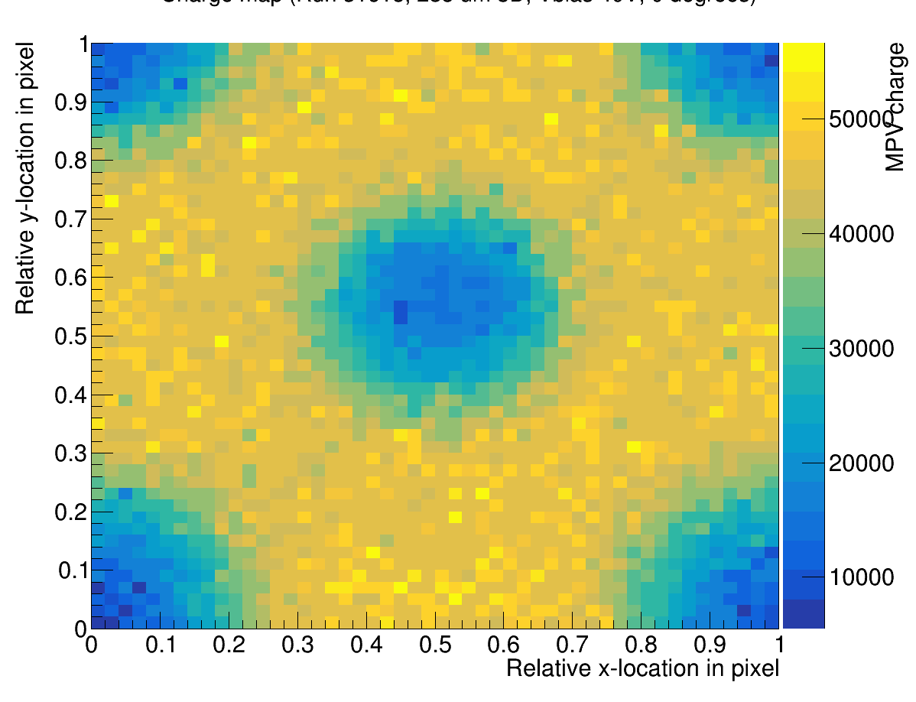
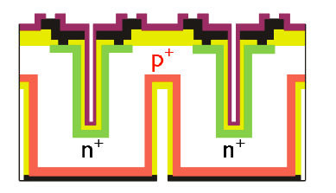
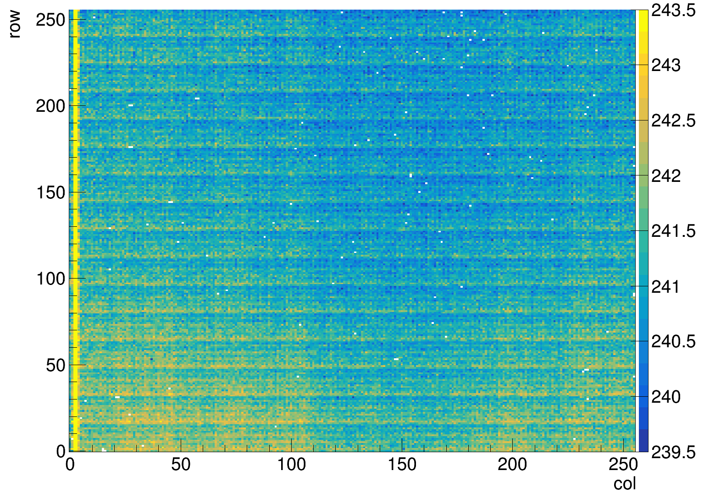
Timepix3 tests @ CERN beam line
55 μm pixel, top view
timing variation across Timepix3
min-max = 3 ns ( >> resolution)
-> correction essential
structure due to routing (crosstalk)
power distribution
Charge versus position in 3D sensor
much lower charge in pillars
Less charge -> worse timing
14 mm
Much interest for TPX3 systems:
ASACUSA (anti proton experiment)
Univ of Liverpool (proton therapy)
LHCb
Lepcol
…….
3D sensor side view

Slide 14
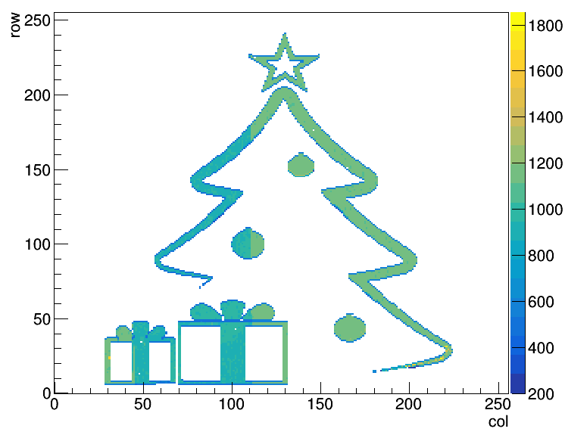
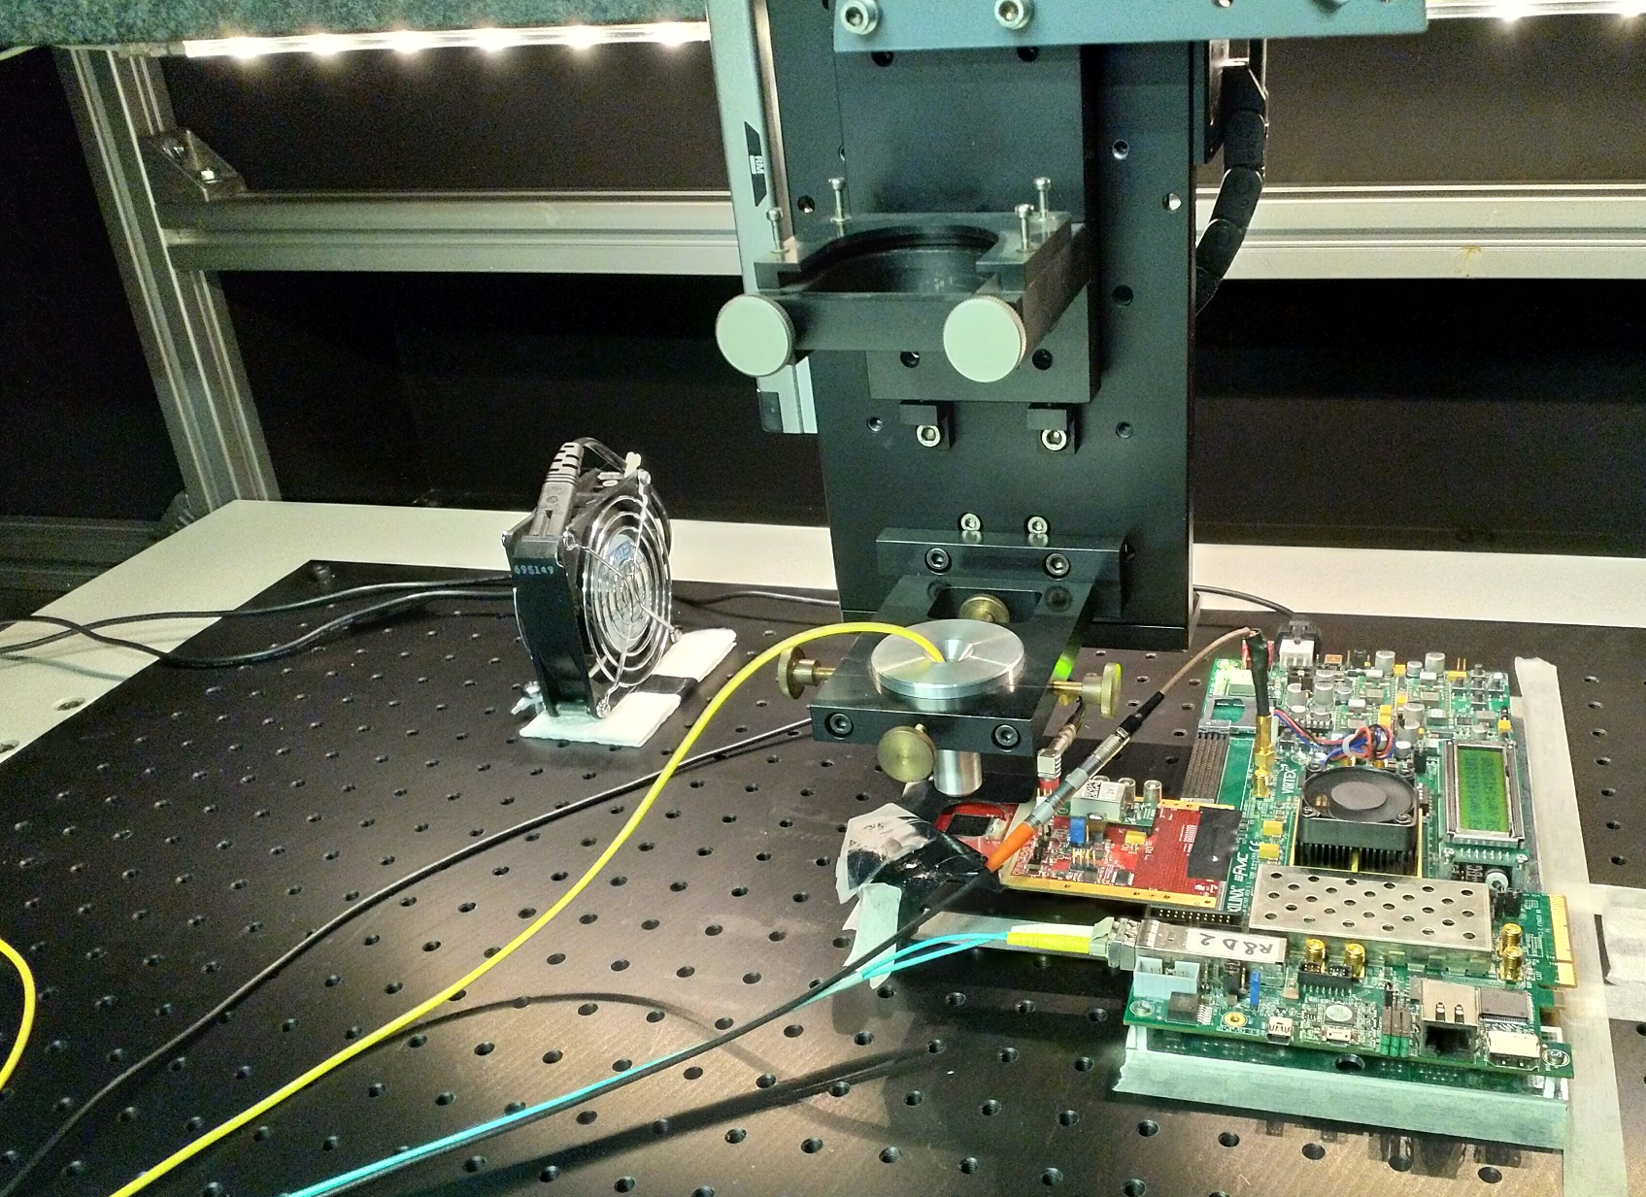
Laser set-up at Nikhef
Laser to systematically cross check beam data
Submicron positioning in X, Y and Z
Currently limited by laser min. pulse length and spot size
(considering to upgrade the laser)
Counts

Slide 15
Questions?

