Slide 1
Collaborative analysis at a global scale with SWAN: Jupyter-as-a-service
M. Lamanna (CERN IT) for the SWAN team
https://cern.ch/swan
Amsterdam Oct 29th, 2018
“Generic Components of the eScience Infrastructure Ecosystem” workshop
Notes:
Honor and pleasure to be here

Slide 2
The Work Behind These Slides
I am here on behalf of the SWAN team, spanning two CERN Departments: Experimental Physics and Information Technology
The team: E. Tejedor, D. Castro, P. Mato, E. Bocchi, J. Moscicki, P. Kothuri, D. Piparo, M. L.
I’d like to thank Diogo Castro, Danilo Piparo and Enric Tejedor for contributing so much to this talk.

Slide 3
Introduction

Slide 4
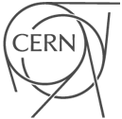

Slide 5
Write and archive:
What?
up to 12 PB/month
When?
LHC running
April - December
Read:
What?
several of 10 GB/s
When?
well… always

Slide 6
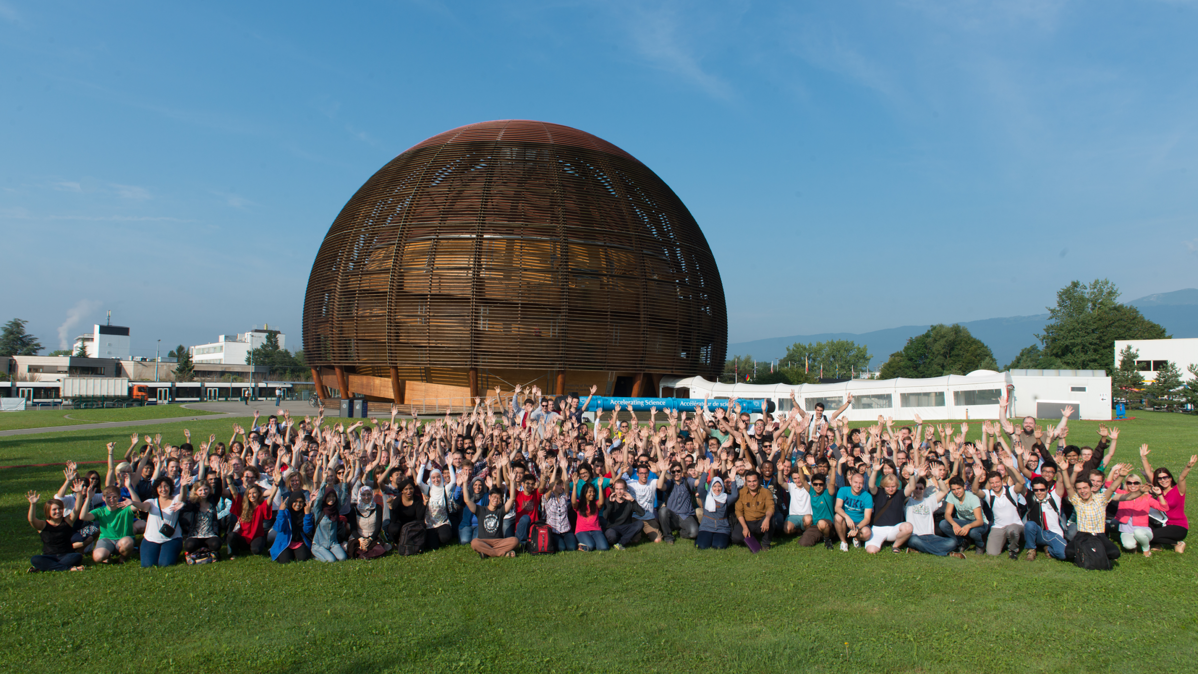
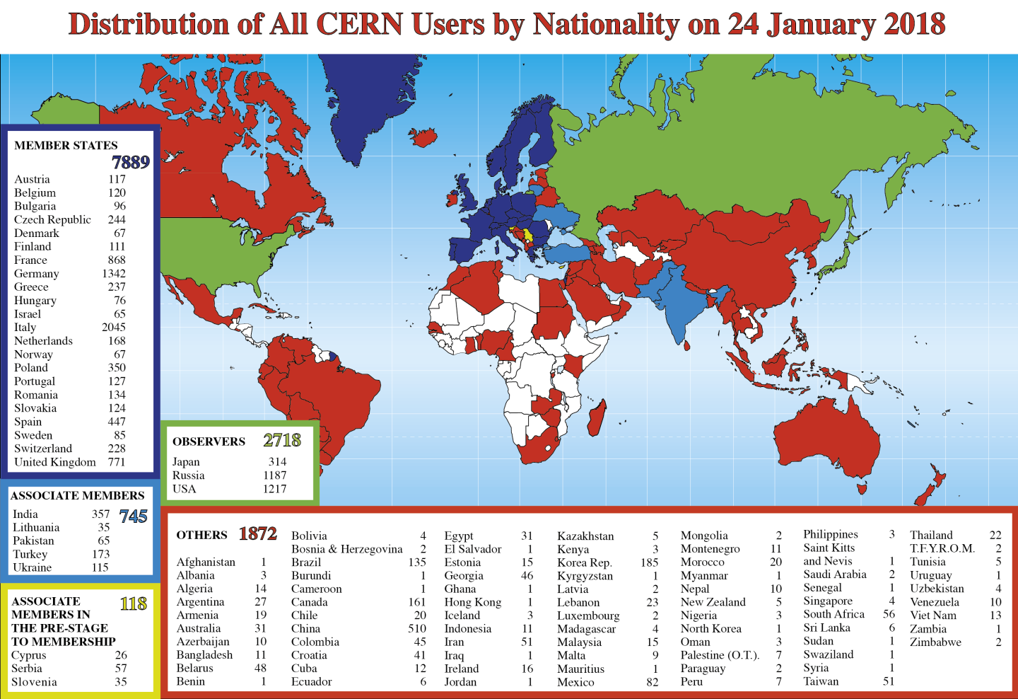
~17.5k people in total
N.B.: “everyone” is a data scientist
‹#›

Slide 7
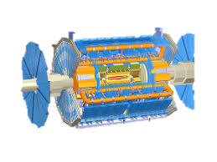
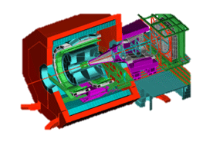
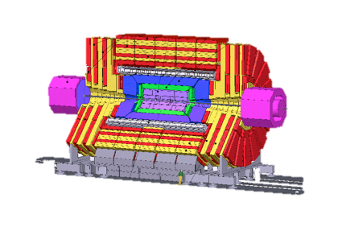
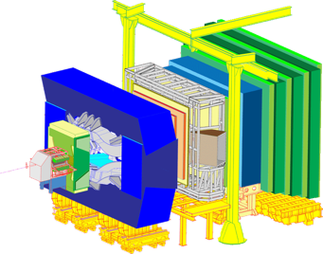
The steps towards data analysis
Data collection
Data analysis
ALICE
Event filtering
ATLAS
Results
Event selection, stat. treatment…
CMS
LHCb
Raw data
Offline processing
Analysis formats
Reconstruction
Rec
Processing, skimming
~ 300 PB

Slide 8
Service for Web based Analysis
Data collection
Data analysis
ALICE
Event filtering
ATLAS
Results
Event selection, stat. treatment…
CMS
LHCb
Raw data
Offline processing
Analysis formats
Reconstruction
Rec
Processing, skimming

Slide 9
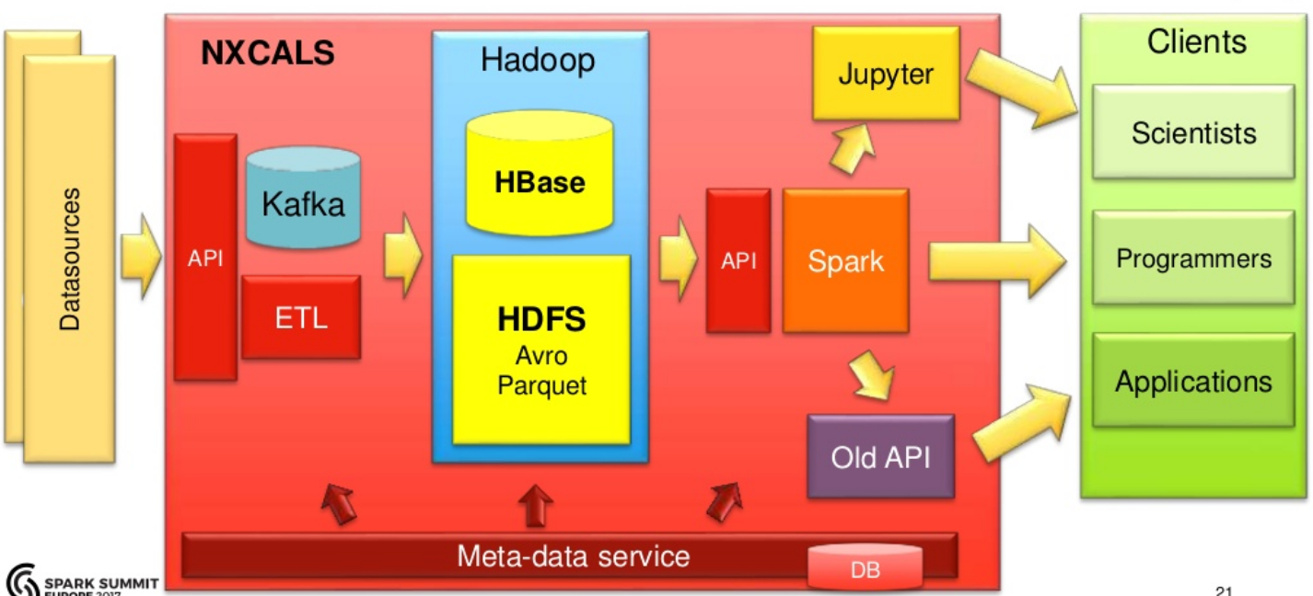
Not Only HEP Analysis: LHC Controls Data

Slide 10
Service for Web based ANalysis: SWAN

Slide 11
ROOT
The physics Data Analysis Framework
Created at CERN
Our Lingua Franca (from data structures to analysis objects to presentation style)
Used for data analysis, I/O, ML, advanced graphics…
Integrated with Jupyter notebooks
First C++ kernel based on ROOT C++
The origin story of SWAN
http://root.cern

Slide 12
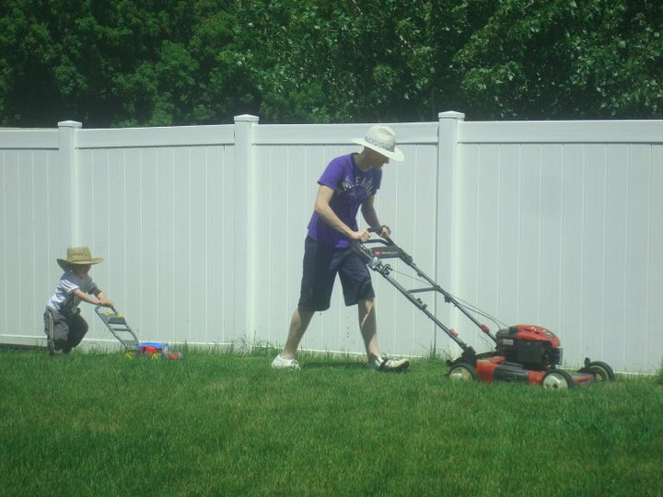
Use cases
How do I do this?
Get an example from my colleague (instead reading the manual)
Share my activity
I cannot understand why it does not work... (code)
I cannot understand why my data look like this ... (histo)
ROOT + …
Juggling between languages
Juggling between platforms
…
Not only in our community (HEP)
Example from the SWITCH IT research day 2018
https://www.switch.ch/engines/events/researchday2018
Example from JRC (Copernicus Earth Satellite images)
http://www.bigdatafromspace2017.org/

Slide 13
Biology
Not small any longer
1 PB/year
Data sizes exploding due to research progress and instrumentation advance
They need: Matlab and R and C++ and ...
Dr. Maciej Dobrzynski, Institute for Cell Biology, University of Bern

Slide 14
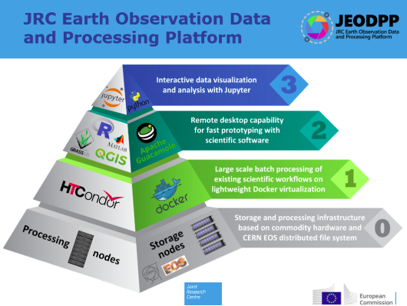
Earth Observations
P. Soille and A. Burger from EU Joint Research Programme

Slide 15
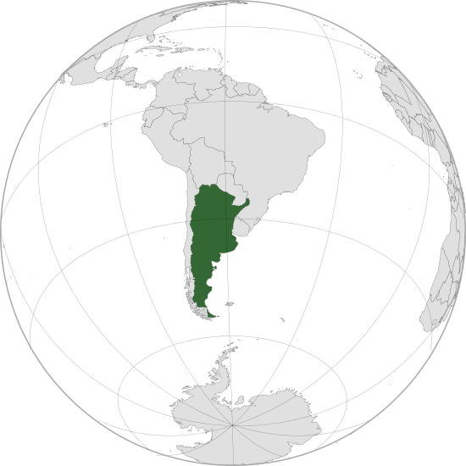
Web-based Analysis as a solution
Analysis only with a web browser
Blur boundaries between web and local applications
Available everywhere and at anytime
Providing access also to Jupyter notebooks
Easy to use (but powerful)
No local installation and configuration needed
Create easily shareable scientific results: plots, data, code
Storage is crucial: mass & synchronized
Integration with CERN resources
Access software, user/experiments data, mass processing power
Synergy among analysis ecosystems : ROOT, R, Python, ...
https://en.wikipedia.org/wiki/Argentina
Notes:
Service that provides access to on demand notebooks

Slide 16
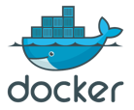
Integrating services
Infrastructure
Software
Storage
Notes:
We had to make choices
Two pillars you don’t know

Slide 17
Open Source Technologies
Notes:
We had to make choices
Two pillars you don’t know

Slide 18
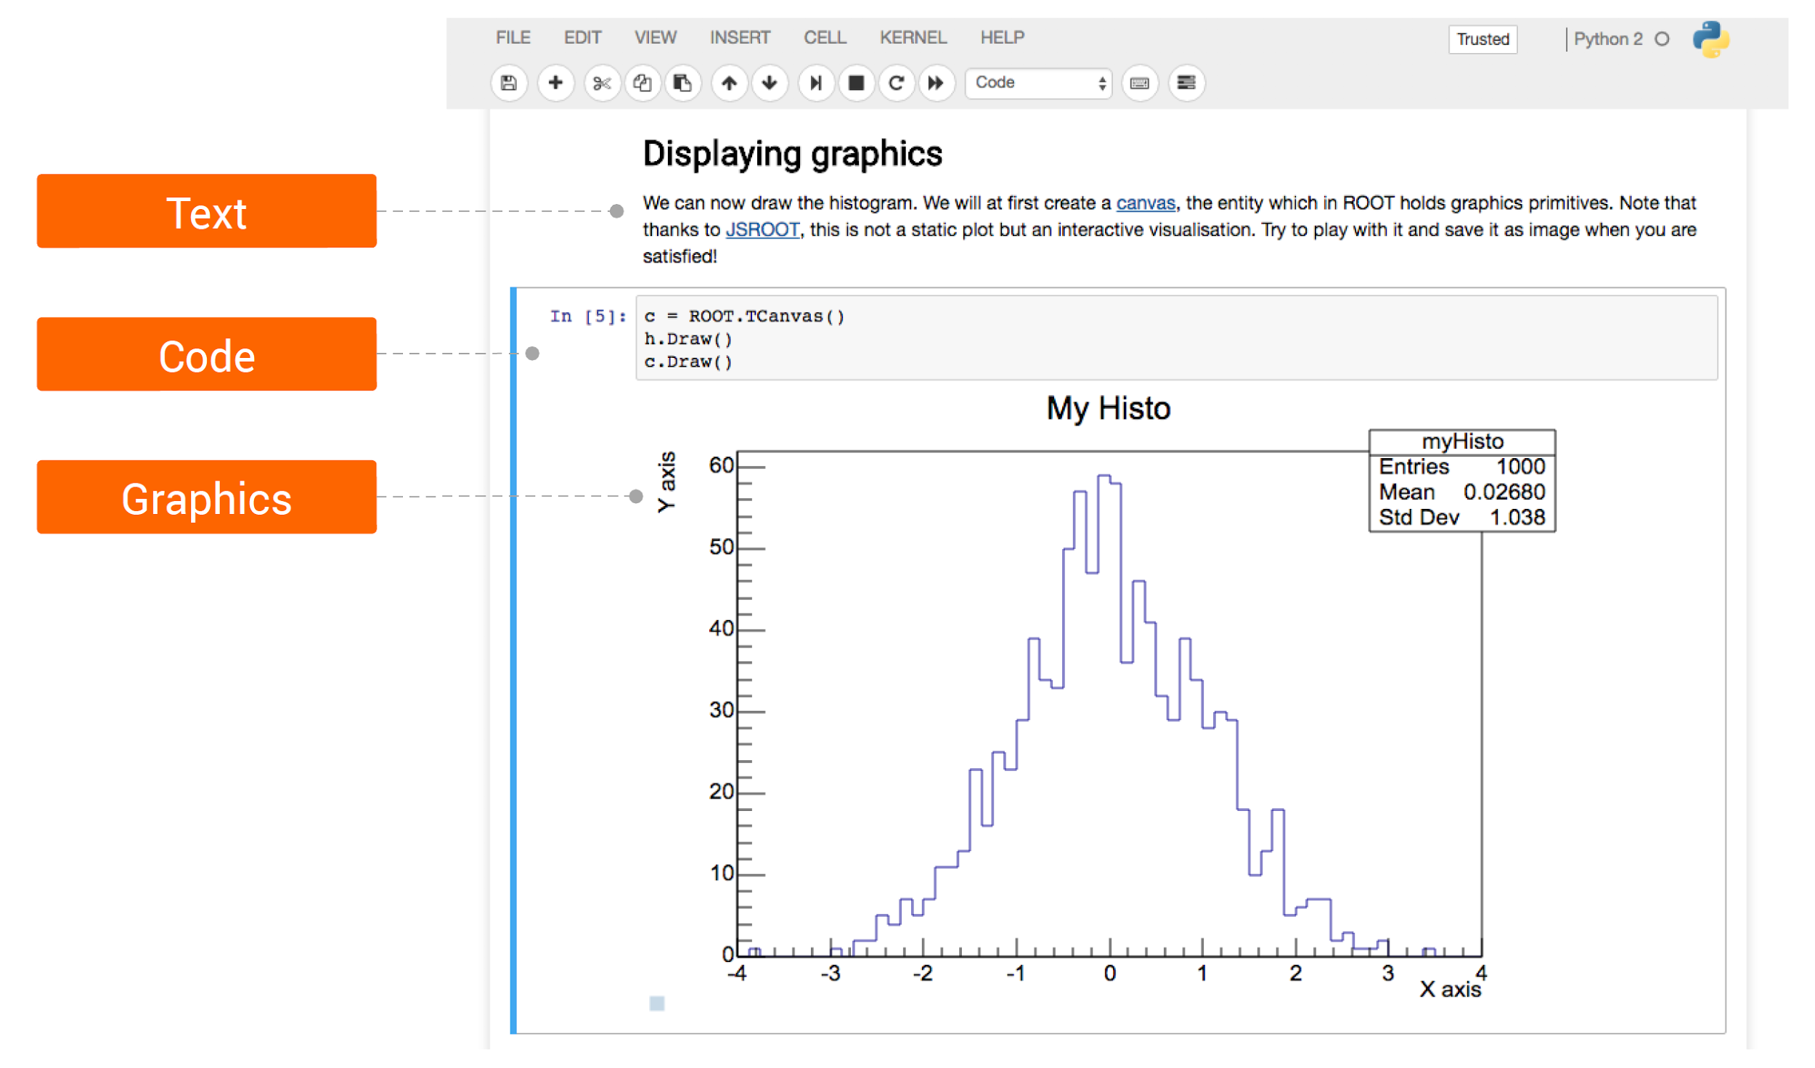
Jupyter Notebooks
Notes:
We had to make choices
Two pillars you don’t know

Slide 19
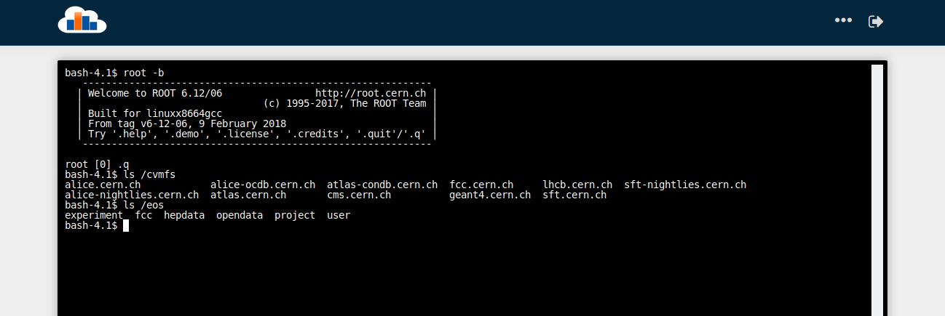
Does it Have a Terminal?
Experiment’s data at your fingertips!
Notes:
We had to make choices
Two pillars you don’t know

Slide 20
Storage
Uses EOS disk storage system
All experiment data potentially available
CERNBox is SWAN's home directory
Storage for your notebooks and data
Sync&Share
Files synced across devices and the Cloud
Collaborative analysis

Slide 21
Software
Software distributed through CVMFS
“LCG Releases” - pack a series of compatible packages
Single Docker image, many software stacks
Reduced Docker Image size
Lazy fetching of software
Possibility to install libraries in user cloud storage
Good way to use custom/not mainstream packages
Configurable environment
Multiple “kernels” (“links” between Jupyter and a language) available
Python 2 or 3, ROOT C++, R, Octave
User Software
Jupyter modules
LCG Release
CERN Software

Slide 22
Architecture
Single Sign On
Web portal
Container Scheduler
User 1
User 2
...
User n
CERN Resources
CVMFS
(Software)
EOS/CERNBox
(Data/User files)

Slide 23
Leveraging the power of Jupyter
Service for Web based Analysis
Notes:
Jupyter on top

Slide 24
Extensions, extensions everywhere
Notifications
Gallery
Contents
Help
Notebook Viewer
Share
Intro
Spark Connector
Spark Monitor
New user interface
...
JupyterHub
CERN Resources

Slide 25
New User Interface

Slide 26
New User Interface

Slide 27
Collaborative Analysis
Service for Web based Analysis

Slide 28
Sharing made easy
Sharing from inside SWAN interface
Integration with CERNBox
Users can share “Projects”
Special kind of folder that contains notebooks and other files, like input data
Self contained

Slide 29
The Share tab
Users can list which projects...
they have shared
others have shared with them

Slide 30
Inspecting a Project
Users can inspect shared project contents
Browsing of the files
Static rendering of notebooks
Useful to decide whether to accept or not the shared project

Slide 31
Accepting a Shared Project
If accepted, project is cloned to the receiver's CERNBox
The receiver will work on his own copy
Concurrent editing not (yet?) supported by Jupyter
Safer to clone

Slide 32
Access to Computing Resources
Spark integration

Slide 33
Motivation
Beams department at CERN built and operates the LHC
Data: monitoring LHC accelerator hardware devices
Analysis of logs
Different from physics data of the experiments
With increase in data, they adopted Spark
Spark: a modern cluster management system allowing distributed and interactive data analysis
But it was missing a unified platform for analytics visualization

Slide 34
Integration with Spark
Connection to CERN Spark Clusters
Same environment across platforms
User data - EOS
Software - CVMFS
Graphical Jupyter extensions developed
Spark Connector
Spark Monitor
User Notebook
Spark Cluster
Spark Master
Spark Worker
Python task
Python task
Python task

Slide 35
Spark Connector

Slide 36
Spark Monitor
Allows to monitor Spark jobs from within the notebook
Interactive display appears automatically in the output of the cell
Multiple views
Progress bars for jobs and stages
Task timeline
Resource utilization

Slide 37
Access to Computing Resources
Batch jobs

Slide 38
Connecting More Resources
Ongoing effort: submit batch jobs from the notebook
Monitoring display
Jobs tab

Slide 39
Education, Outreach
Notes:
Another thing I’d like to talk is education
It’s part of our mission

Slide 40
Notebooks for Teaching
SWAN and notebooks are very useful for teaching
Teachers prepare exercises in the form of notebooks
Students complete and run the exercises
Used frequently as support for:
CERN Summer student courses: ~150 students, data analysis with ROOT
CERN School of Computing exercises: ~70 students, parallelism
CERN ATLAS PhD student courses: ~50 students, declarative data analysis
Machine learning tutorials at CERN
Notes:
Last 3 months summer students

Slide 41
Science Box: SWAN on Premises
UP2University European Project
Bridge the gap between secondary schools, higher education and the research domain
Partner universities (OU, UROMA, NTUA, …), pilot schools
http://up2university.eu
SWAN used by students to learn physics and other sciences
Let them use the very same tools & services used by scientists at CERN
Integrating Jupyter in teaching environment
Complete SWAN package, with CERNBox, EOS and CVMFS

Slide 42
SWAN Users

Slide 43
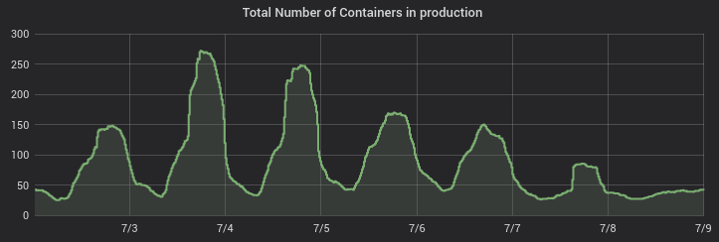
Stats
~200 user sessions a day on average
Users doubled this year with new SWAN interface
Spark cluster connection: 15 – 20 % of users
SWAN as entry point for accessing computational resources
Courses
Notes:
The clusters have been available for few months
Its important to keep interactivity hence the graphical tools for monitoring

Slide 44
User community
Example notebooks at cern.ch/swan
SWAN development is guided by our user community
New features (libs, kernels, ...) are requested by users from their real usage needs
Gallery of examples
Made in collaboration with our users
Almost 50 notebooks in 7 categories
Access with only a click

Slide 45
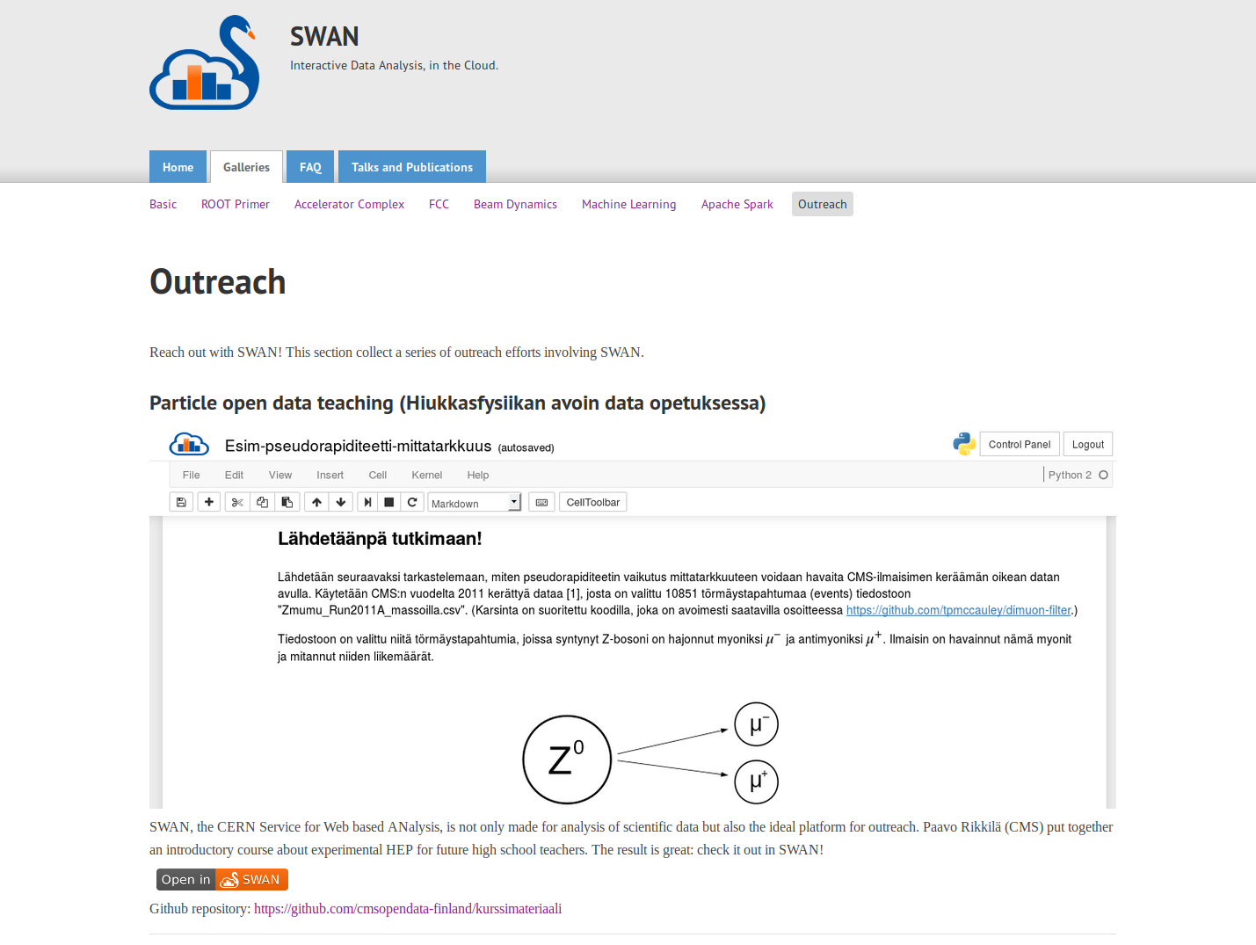
Education, Too
Example notebooks at cern.ch/swan
Finnish High School program

Slide 46
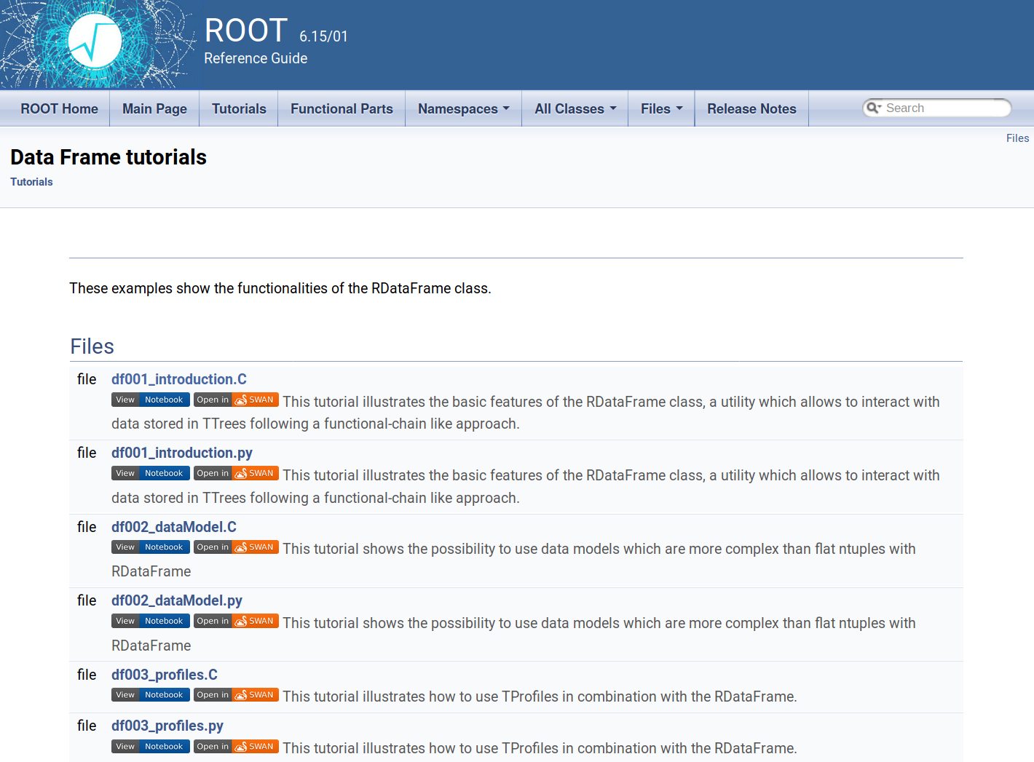
Integrate Software Packages
Example notebooks at root.cern

Slide 47
Looking ahead

Slide 48
Future work/challenges
Move to Jupyterlab
Porting the current extensions
ROOT is already migrating its graphics to JavaScript only
Ultimate blur between local/cloud resources and apps
New architecture made to scale
Based on Kubernetes, leveraging CERN Container Service
Exploitation of GPUs
ML found its place in HEP
Speed up computation of GPU-ready libraries (e.g. TensorFlow)
Moving beyond LHC
New challenges from HL-LHC
Even small dataset will not fit inside users laptops: need R&D - Analysis Facilities?

Slide 49
Where to find us

Slide 50
Where to find us
Contacts
swan-talk@cern.ch
http://cern.ch/swan
Repository
https://github.com/swan-cern/
Science Box: SWAN distribution deployable on premises
https://cern.ch/sciencebox
Includes all SWAN components: CERNBox/EOS, CVMFS, JupyterHub
Deployable through Kubernetes or docker-compose

Slide 51
Conclusions

Slide 52
Conclusion
We successfully integrated CERN computing services with Jupyter
Increase value of existing services’ portfolio (storage, batch, auth)
Successfully boosting productivity of scientists
Jupyter became a new entry-point to our computing resources and data
Successful model for teaching activities
Tutorials for software, data analysis, ML, Spark…
European project focused on higher education
Blending desktop and web application can help reach more users
Can Jupyterlab help?
TAKE PART?

Slide 53
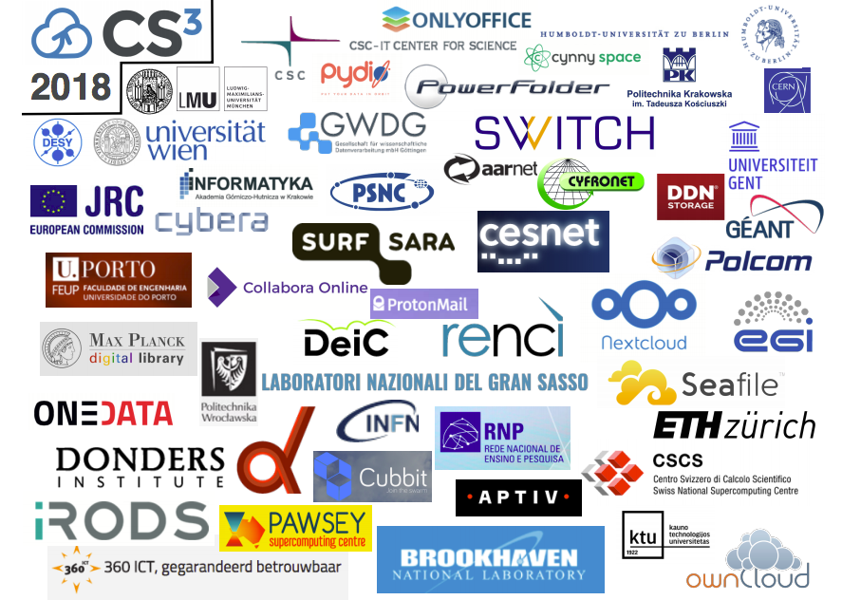
TAKE PART!
Visit cs3.infn.it
Registration OPEN!
Abstract submission OPEN!

